Slide 1
行動平台開發實作(Android)
開發團隊: 1102105301 詹邵暐
1102105326溫偉程
1102105336張譯安
指導老師:
陳健文 (Bob Chen)老師

Slide 2
軟體名稱: 吃不飽的蛇
軟體玩法:
將蘋果一一吃盡，每吃得一個蘋果可增加遊戲分數1分，但是撞到牆壁或是本身結束遊戲。 說明：此遊戲可進行螢幕觸控來控制蛇的移動方向

Slide 3
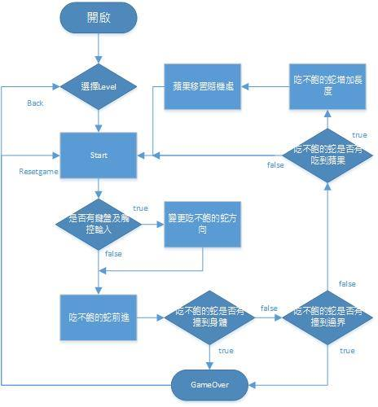
流程圖

Slide 4
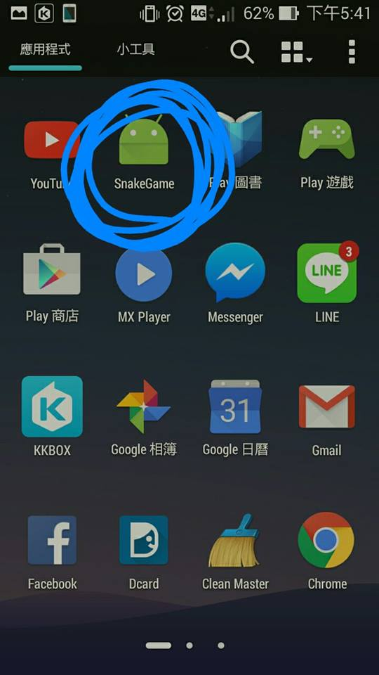
App 操作流程
1.下載APK到手機
2.點開SnakeGame進入遊戲

Slide 5
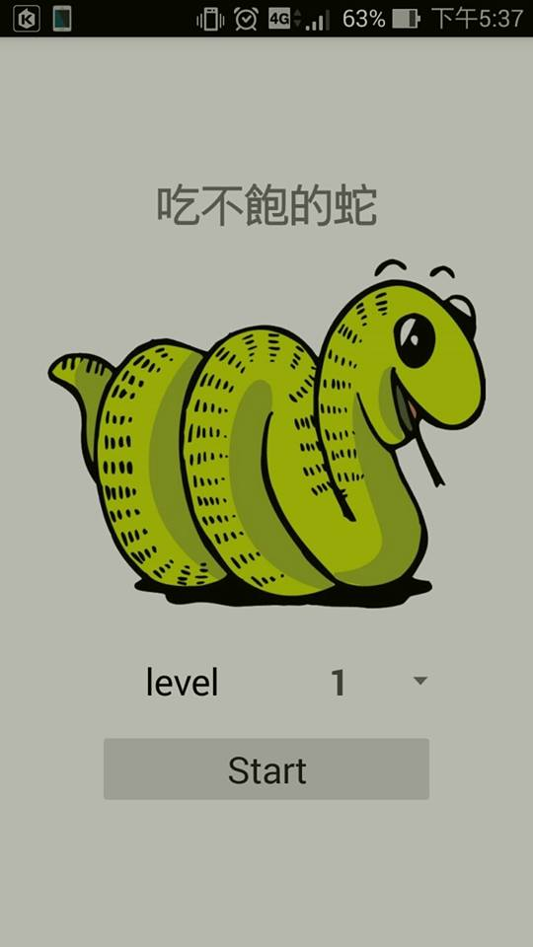
此為程式的主頁面
//MainActivity
startButton.setOnClickListener(new Button.OnClickListener() { @Override public void onClick(View v) { Intent i = new Intent(MainActivity.this, SnakeActivity.class); i.putExtra("level", list[spinner.getSelectedItemPosition()]); //i.putExtra("best", bestint startActivity(i); } });
//SnakeActivity
setContentView(R.layout.activity_game);//膨脹GUI
spinner.setOnItemSelectedListener(new AdapterView.OnItemSelectedListener() { @Override public void onItemSelected(AdapterView<?> arg0, View arg1, int position, long arg3) { Toast.makeText(mContext, "level " + list[position], Toast.LENGTH_SHORT).show(); } @Override public void onNothingSelected(AdapterView<?> arg0) { // TODO Auto-generated method stub } });

Slide 6
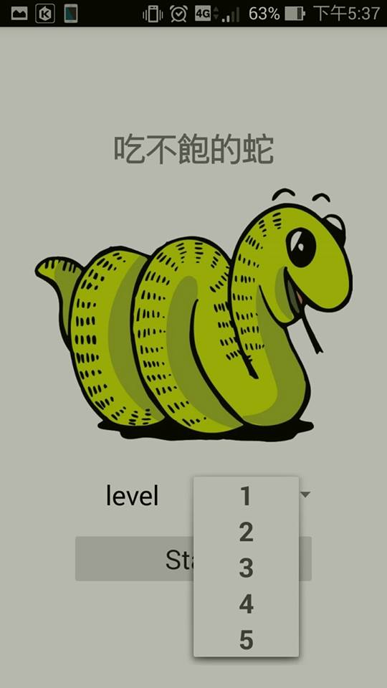
點選LEVEL來調控等級速度
if (mContext instanceof SnakeActivity) { switch (((SnakeActivity) mContext).level) { case "2": speed = 200; snakelevel = 200; break; case "3": speed = 150; snakelevel = 150; break; case "4": speed = 100; snakelevel = 100; break; case "5": speed = 50; snakelevel = 50; break; default: speed = 250; snakelevel = 250; } }
private void init(Context context) { activity = (Activity) context; myGestureListener = new MyGestureListener(context); mContext = context; getHolder().addCallback(this); Resources res = getResources(); bestint = Memory.getInt(mContext, "BEST", 0); apple = BitmapFactory.decodeResource(res, R.drawable.apple); int width = apple.getWidth(); int height = apple.getHeight(); int newWidth = SIDE_LENGTH; int newHeight = SIDE_LENGTH; float scaleWidth = ((float) newWidth) / width; float scaleHeight = ((float) newHeight) / height; Matrix matrix = new Matrix(); matrix.postScale(scaleWidth, scaleHeight); newbm = Bitmap.createBitmap(apple, 0, 0, width, height, matrix, true); applePaint = new Paint(); snakePaint = new Paint(); xPaint = new Paint(); targets = new Point(); targetsPaint = new Paint(); backgroundPaint = new Paint(); textPaint = new Paint();
if (mContext instanceof SnakeActivity) { switch (((SnakeActivity) mContext).level) { case "2": speed = 200; snakelevel = 200; break; case "3": speed = 150; snakelevel = 150; break; case "4": speed = 100; snakelevel = 100; break; case "5": speed = 50; snakelevel = 50; break; default: speed = 250; snakelevel = 250; } }

Slide 7
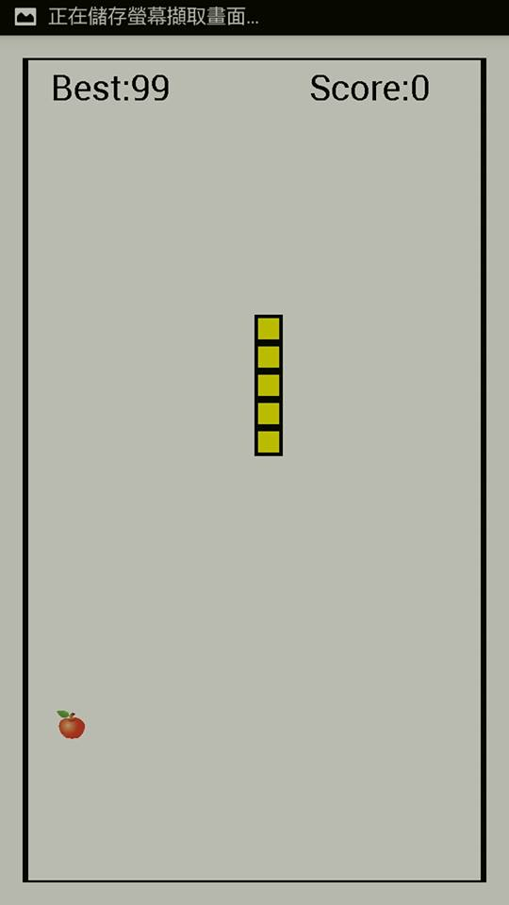
點選START進入遊戲
@Override
//設定一些初始值 protected void onSizeChanged(int w, int h, int oldw, int oldh) { super.onSizeChanged(w, h, oldw, oldh); //存取設定螢幕長寬 screenWidth = w; screenHeight = h; width_count = w / SIDE_LENGTH; height_count = h / SIDE_LENGTH; backgroundPaint.setColor(Color.WHITE); snakePaint.setColor(Color.BLACK); xPaint.setColor(Color.YELLOW); targetsPaint.setColor(Color.RED); textPaint.setTextSize(50); //補償左右不均 width_offset = (screenWidth - width_count * SIDE_LENGTH) / 2; height_offset = (screenHeight - height_count * SIDE_LENGTH) / 2; if (width_offset != 0 || height_offset != 0) newGame(); RelativeLayout.LayoutParams lp = (RelativeLayout.LayoutParams) getLayoutParams(); lp.setMargins((int) width_offset, (int) height_offset, (int) width_offset, (int) height_offset); setLayoutParams(lp); }
//重設所有畫面上的元件並啟動一個新遊戲
public void newGame() { time = 0; score = 0; timeLeft = 20; speed = snakelevel; //shotsFired = 0; totalElapsedTime = 0.0; nowdirection = snakeUp; snakeover = false; targets = new Point(new Random().nextInt(width_count) * SIDE_LENGTH, new Random().nextInt(height_count) * SIDE_LENGTH); startx = (width_count) / 2 * SIDE_LENGTH;//中間 starty = (height_count) / 2 * SIDE_LENGTH;//中間 arrayList.clear();
//產生蛇的身體 arrayList.add(new Point(startx, starty)); arrayList.add(new Point(startx, starty + SIDE_LENGTH)); arrayList.add(new Point(startx, starty + 2 * SIDE_LENGTH)); arrayList.add(new Point(startx, starty + 3 * SIDE_LENGTH)); arrayList.add(new Point(startx, starty + 4 * SIDE_LENGTH)); if (gameOver) { gameOver = false;//遊戲尚未結束 cannonThread = new CannonThread(getHolder());//建立執行續 cannonThread.start();//啟動遊戲迴圈執行續 } }

Slide 8
private class CannonThread extends Thread { private final SurfaceHolder surfaceHolder; private boolean threadIsRunning = true; public CannonThread(SurfaceHolder holder) { surfaceHolder = holder; setName("CannonThread"); } //變更執行狀態 public void setRunning(boolean running) { threadIsRunning = running; } @Override //控制遊戲迴圈 public void run() { Canvas canvas = null; //繪圖 long previousFrameTime = System.currentTimeMillis(); while (threadIsRunning) { try { //從執行緒中取得Cavans以進行繪圖 canvas = surfaceHolder.lockCanvas(); synchronized (surfaceHolder) { long currentTime = System.currentTimeMillis(); double elapsedTimeMS = currentTime - previousFrameTime; totalElapsedTime += elapsedTimeMS / 1000.0; updatePositions(elapsedTimeMS); if (!snakeover) { drawGameElements(canvas); } previousFrameTime = currentTime; } } finally { //在CannonView 中顯示畫布內容 並讓執行續能夠使用Canvans if (canvas != null) surfaceHolder.unlockCanvasAndPost(canvas); } } } }
//繪製遊戲
public void drawGameElements(Canvas canvas) { if (canvas == null) return; //清除背景 canvas.drawRect(0, 0, screenWidth, screenHeight, backgroundPaint); //繪製目標 for (Point point : arrayList) { canvas.drawRect(point.x, point.y, point.x + SIDE_LENGTH, point.y + SIDE_LENGTH, snakePaint); canvas.drawRect(point.x + 5, point.y + 5, point.x + SIDE_LENGTH - 5, point.y + SIDE_LENGTH - 5, xPaint); } //繪製蘋果物件 canvas.drawBitmap(newbm, targets.x, targets.y, applePaint); canvas.drawText(getResources().getString(R.string.score, score), screenWidth - 250, 60, textPaint); canvas.drawText(getResources().getString(R.string.best, bestint), 40, 60, textPaint); }

Slide 9
private void updatePositions(double elapsedTimeMS) { double interval = elapsedTimeMS / 1000.0; //轉換成秒 timeLeft -= interval; //是否碰到邊界 if (screenWidth - arrayList.get(0).x < SIDE_LENGTH || screenHeight - arrayList.get(0).y < SIDE_LENGTH || arrayList.get(0).x < 0 || arrayList.get(0).y < 0) { snakeover = true; } if ((Math.abs(timeLeft - time) * 1000 > speed || time == 0) && !snakeover) { time = timeLeft; //前進 for (int i = arrayList.size() - 1; i > 0; i--) { arrayList.set(i, arrayList.get(i - 1)); } if (nowdirection == 0) { arrayList.set(0, new Point(arrayList.get(0).x, arrayList.get(0).y - SIDE_LENGTH)); } else if (nowdirection == 1) { arrayList.set(0, new Point(arrayList.get(0).x, arrayList.get(0).y + SIDE_LENGTH)); } else if (nowdirection == 2) { arrayList.set(0, new Point(arrayList.get(0).x - SIDE_LENGTH, arrayList.get(0).y)); } else if (nowdirection == 3) { arrayList.set(0, new Point(arrayList.get(0).x + SIDE_LENGTH, arrayList.get(0).y)); }
if (snakeover) { timeLeft = 0.0; gameOver = true; cannonThread.setRunning(false); showGameOverDialog(R.string.lose); }

Slide 10
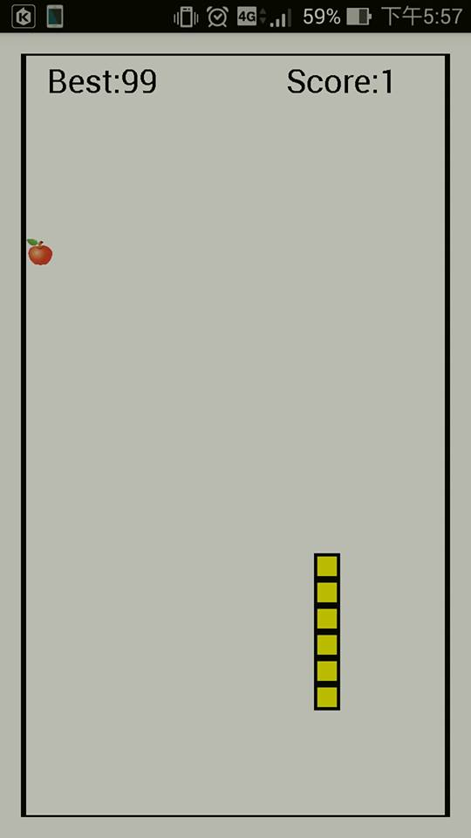
若吃到蘋果則Score:+1
if (arrayList.contains(targets)) {//吃到蘋果 arrayList.add(arrayList.get(arrayList.size() - 1));//尾巴變長 for (int i = arrayList.size() - 2; i > 0; i--) { arrayList.set(i, arrayList.get(i - 1)); } //方向 if (nowdirection == 0) { arrayList.set(0, new Point(arrayList.get(1).x, arrayList.get(1).y - SIDE_LENGTH)); } else if (nowdirection == 1) { arrayList.set(0, new Point(arrayList.get(1).x, arrayList.get(1).y + SIDE_LENGTH)); } else if (nowdirection == 2) { arrayList.set(0, new Point(arrayList.get(1).x - SIDE_LENGTH, arrayList.get(1).y)); } else if (nowdirection == 3) { arrayList.set(0, new Point(arrayList.get(1).x + SIDE_LENGTH, arrayList.get(1).y)); } //蘋果RANDOM targets = new Point(new Random().nextInt(width_count) * SIDE_LENGTH, new Random().nextInt(height_count) * SIDE_LENGTH); score++; speed = speed - 20; if (score > bestint) { bestint = score; } } }

Slide 11
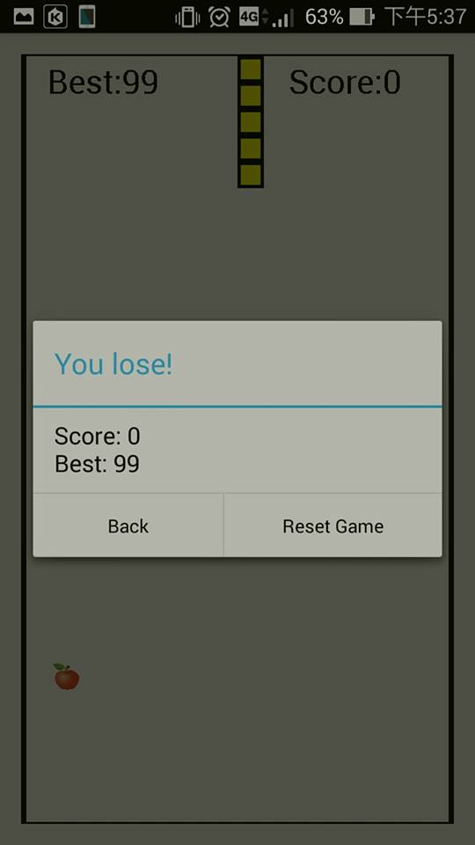
showGameOverDialog
builder.setTitle(getResources().getString(messageId)); builder.setMessage(getResources().getString( R.string.results_format, score, bestint)); Memory.setInt(mContext, "BEST", bestint); builder.setNegativeButton(R.string.back, new DialogInterface.OnClickListener() { @Override public void onClick(DialogInterface dialog, int which) { if (mContext instanceof SnakeActivity) ((SnakeActivity) mContext).onBackPressed(); } }
builder.setPositiveButton(R.string.reset_game, new DialogInterface.OnClickListener() { @Override public void onClick(DialogInterface dialog, int which) { dialogIsDisplayed = false; newGame(); } } ); return builder.create();

Slide 12
public boolean onFling(MotionEvent e1, MotionEvent e2, float velocityX, float velocityY) { float x1 = e1.getX(); float y1 = e1.getY(); float x2 = e2.getX(); float y2 = e2.getY(); Direction direction = getDirection(x1, y1, x2, y2); if (direction == Direction.left) { if (nowdirection != snakeRight) nowdirection = snakeLeft; } else if (direction == Direction.right) { if (nowdirection != snakeLeft) nowdirection = snakeRight; } else if (direction == Direction.up) { if (nowdirection != snakeDown) nowdirection = snakeUp; } else if (direction == Direction.down) { if (nowdirection != snakeUp) nowdirection = snakeDown; } return super.onFling(e1, e2, velocityX, velocityY); }
public static Direction get(double angle) { if (inRange(angle, 45, 135)) { return Direction.up; } else if (inRange(angle, 0, 45) || inRange(angle, 315, 360)) { return Direction.right; } else if (inRange(angle, 225, 315)) { return Direction.down; } else { return Direction.left; } }
public double getAngle(float x1, float y1, float x2, float y2) { double rad = Math.atan2(y1 - y2, x2 - x1) + Math.PI; return (rad * 180 / Math.PI + 180) % 360; }

Slide 13
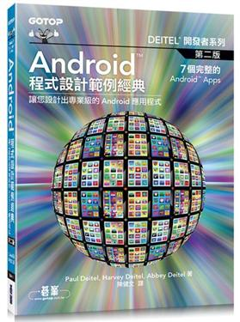
參考資料: Android 程式設計範例經典(Pual Deitel,Harvey Deitel,Abbey Detel著 ) 陳健文 譯

Slide 14
App 的限制
請勿長時間持續玩這遊戲，盡量避免30分鐘以上，以保持視力 ， 30分鐘請休息15分鐘後再繼續
別太快刪除遊戲，給作者一點尊重
評分者分數不得打低於90分

Slide 15
謝謝大家

