Slide 1

Uber Fare Prediction
Supervised Machine Learning
Vasiliki, Oscar, Jordi, Theresa Ironhack - Unit ML
June 2024

Slide 2

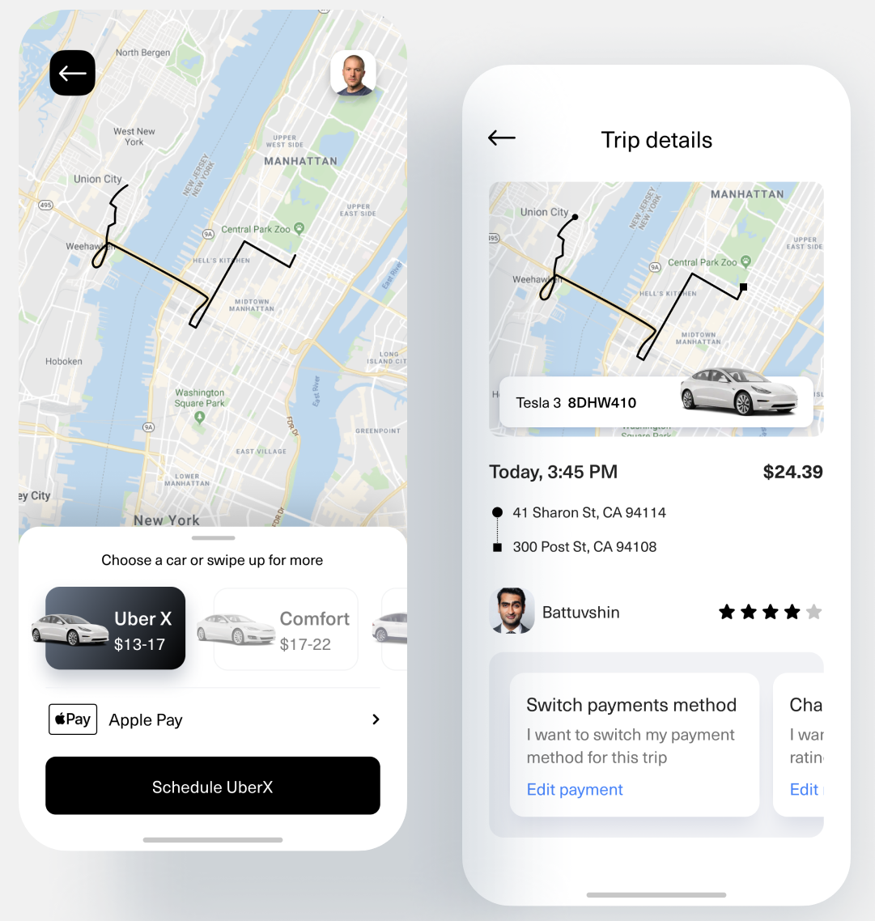
Importance and Applications of Uber Fare Prediction Analysis
For Uber and Ride-Sharing Companies:
Dynamic Pricing Optimization: Balances demand and supply.
Operational Efficiency: Optimizes fleet management and reduces wait times.
Customer Satisfaction: Enhances experience with accurate fare estimates.

Slide 3
Importance and Applications of Uber Fare Prediction Analysis
For Uber and Ride-Sharing Companies:
Dynamic Pricing Optimization: Balances demand and supply.
Operational Efficiency: Optimizes fleet management and reduces wait times.
Customer Satisfaction: Enhances experience with accurate fare estimates.
For Drivers:
Earnings Estimation: Helps plan work schedules and routes.
Route Optimization: Maximizes earnings by understanding fare structures and demand patterns

Slide 4
Importance and Applications of Uber Fare Prediction Analysis
For Uber and Ride-Sharing Companies:
Dynamic Pricing Optimization: Balances demand and supply.
Operational Efficiency: Optimizes fleet management and reduces wait times.
Customer Satisfaction: Enhances experience with accurate fare estimates.
For Drivers:
Earnings Estimation: Helps plan work schedules and routes.
Route Optimization: Maximizes earnings by understanding fare structures and demand patterns
For Customers:
Fare Estimation: Enables informed decisions and budgeting.
Cost Savings: Plan rides during off-peak hours to save money.

Slide 5
Importance and Applications of Uber Fare Prediction Analysis
For Uber and Ride-Sharing Companies:
Dynamic Pricing Optimization: Balances demand and supply.
Operational Efficiency: Optimizes fleet management and reduces wait times.
Customer Satisfaction: Enhances experience with accurate fare estimates.
For Drivers:
Earnings Estimation: Helps plan work schedules and routes.
Route Optimization: Maximizes earnings by understanding fare structures and demand patterns
For Customers:
Fare Estimation: Enables informed decisions and budgeting.
Cost Savings: Plan rides during off-peak hours to save money.
Applications
Pricing Strategies | Demand Forecasting | Personalized Marketing | Operational Efficiency | Enhanced Customer Experience

Slide 6
Data Collection - Processing - Explanatory Analysis
Uber Fare Dataset: 2009-2015, New York City, ~200K entries (source: Kaggle)
Fare | Date | Time | PickUp Coordinates | DropOff Coordinates | # Passengers

Slide 7
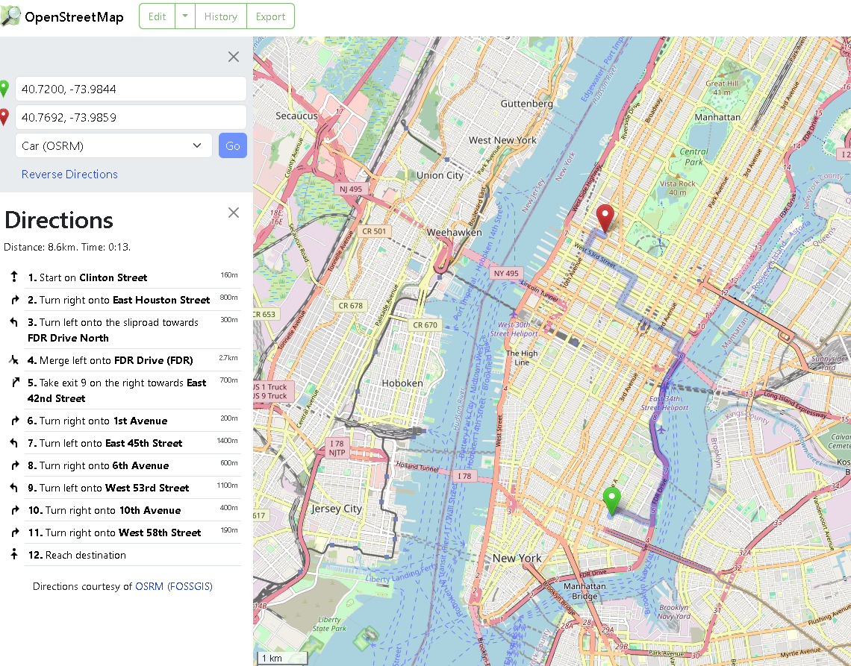
Data Collection - Processing - Explanatory Analysis
Uber Fare Dataset: 2009-2015, New York City, ~200K entries (source: Kaggle)
Fare | Date | Time | PickUp Coordinates | DropOff Coordinates | # Passengers
Driving Distance
OSRM API - connected to OpenStreetMap
- Due to big amount of rides we used the API by setting up our own OSRM Server locally
OSRM Backend → Download OSM Data → → Prepare the Data → Activate Local Host → → Create Requests → Get Responses → → Retrieve Driving Distance

Slide 8
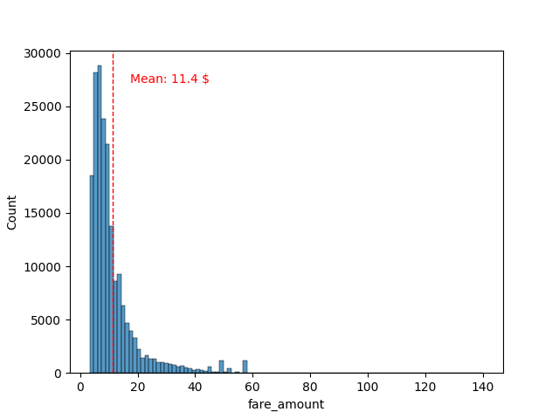
Data Collection - Processing - Explanatory Analysis
Uber Fare Dataset: 2009-2015, New York City, ~200K entries (source: Kaggle)
Fare | Date | Time | PickUp Coordinates | DropOff Coordinates | # Passengers
Driving Distance
But what is the relation between Fare -Time and -Distance ?

Slide 9
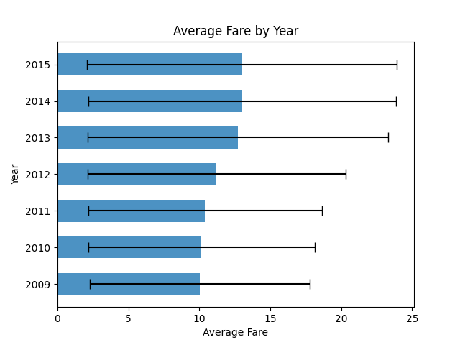
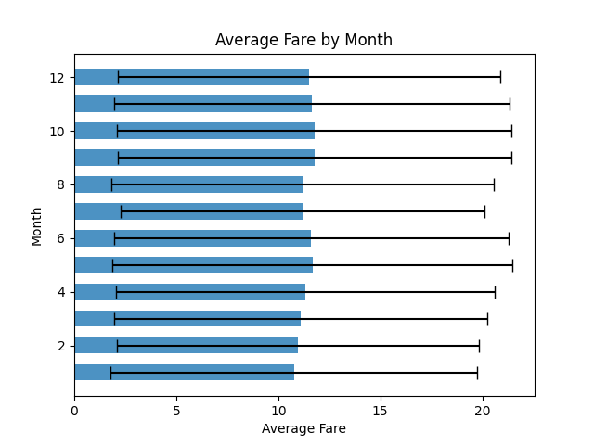
Data Collection - Processing - Statistical Analysis
Generate Features from Date and Time: Year | Month | DayOfWeek | TimeOfDay
ANOVA results:
P-value = 0.0
ANOVA results:
P-value << 5%
Statistically significant differences across the years 2009-2015
Statistically significant differences across the months of the year

Slide 10
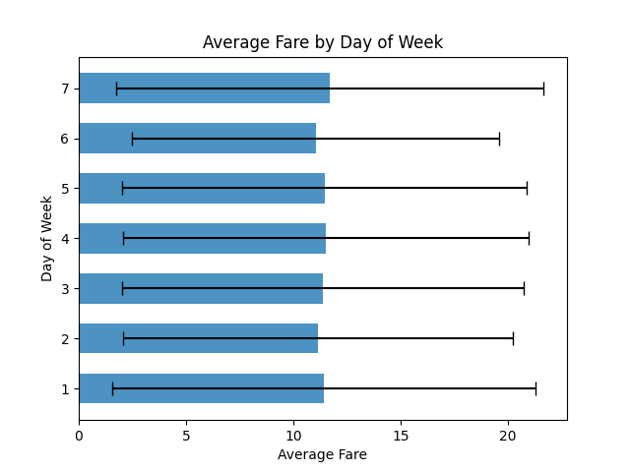
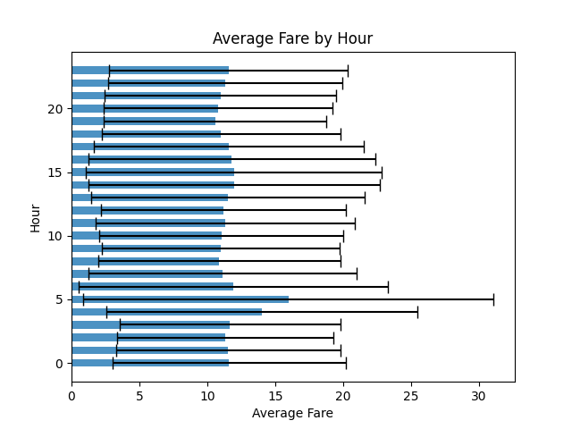
Data Collection - Processing - Statistical Analysis
Generate Features from Date and Time: Year | Month | DayOfWeek | TimeOfDay
ANOVA results:
P-value << 5%
ANOVA results:
P-value <<< 5%
Statistically significant differences across days of the week
Statistically significant differences across time of the day

Slide 11
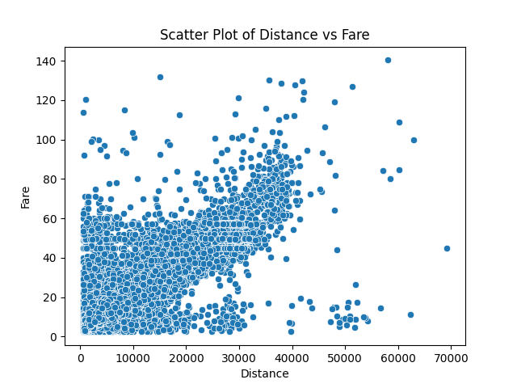
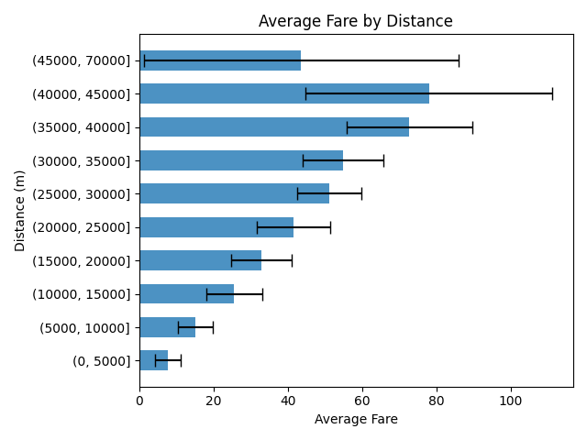
Data Collection - Processing - Statistical Analysis
Distance Feature
As expected, the distance is linearly correlated with the fare.
The outliers were included because it is not clear whether tips or discounts were included in the dataset.
As expected, the distance is linearly correlated with the fare. We observed patterns that are not captured above.

Slide 12
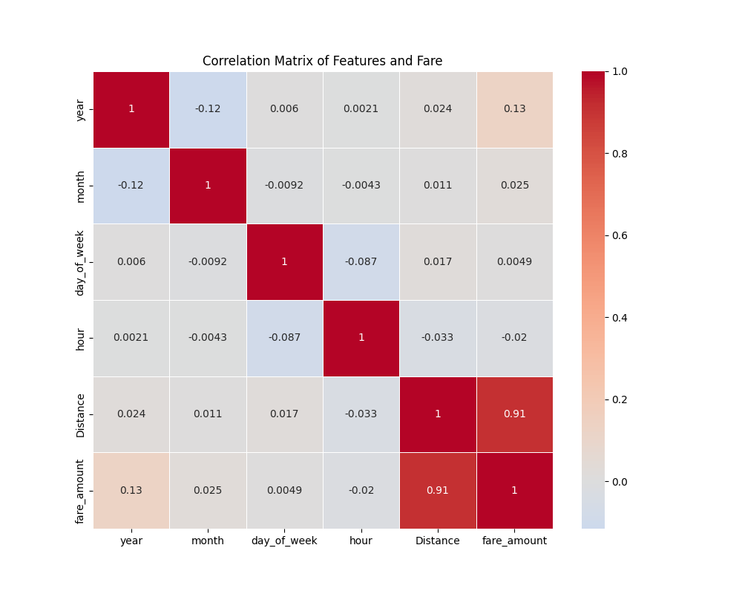
Feature internal dependencies
Correlation Coefficients between Fare and Features

Slide 13
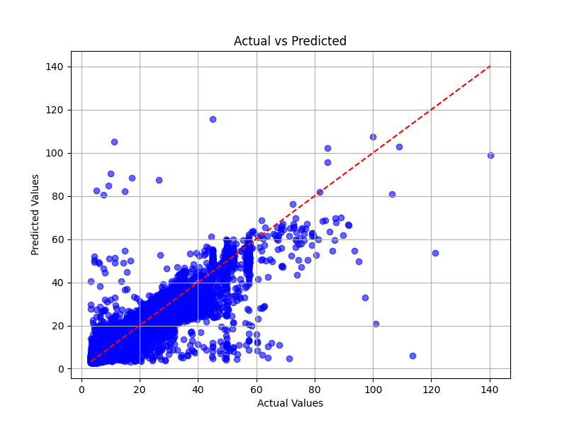
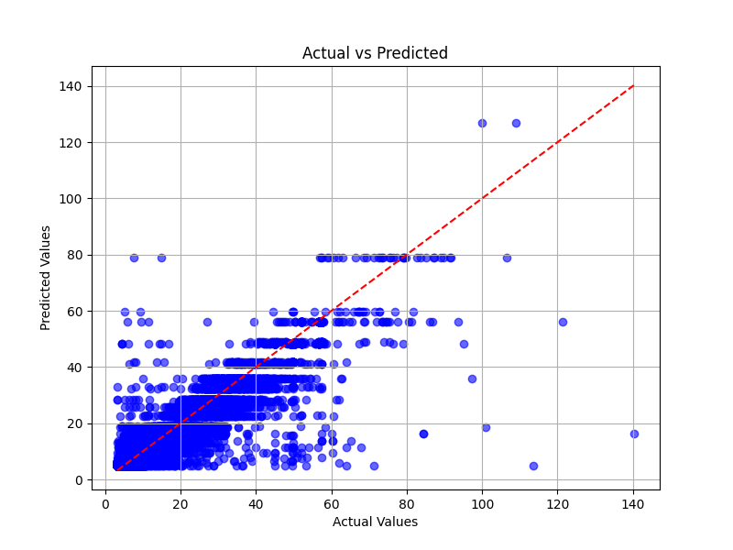
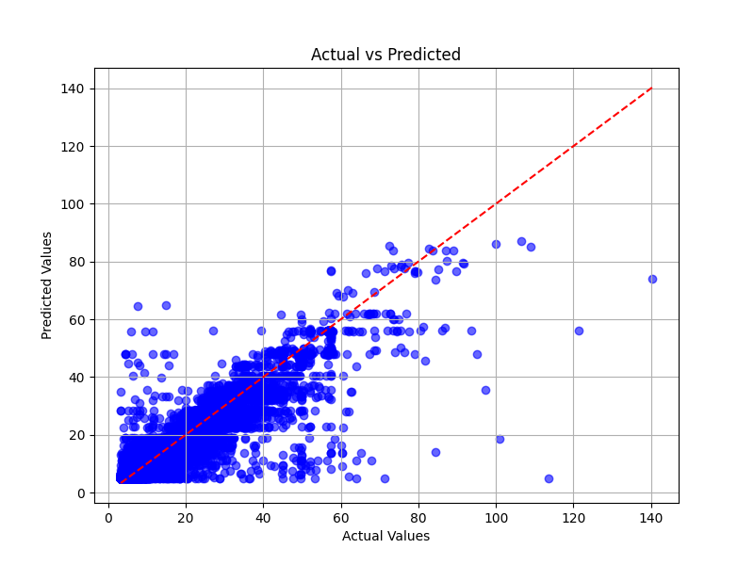
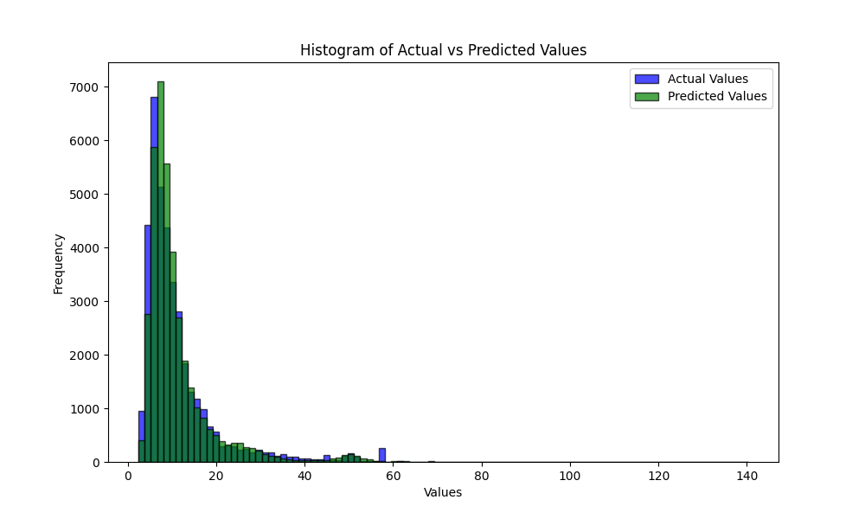
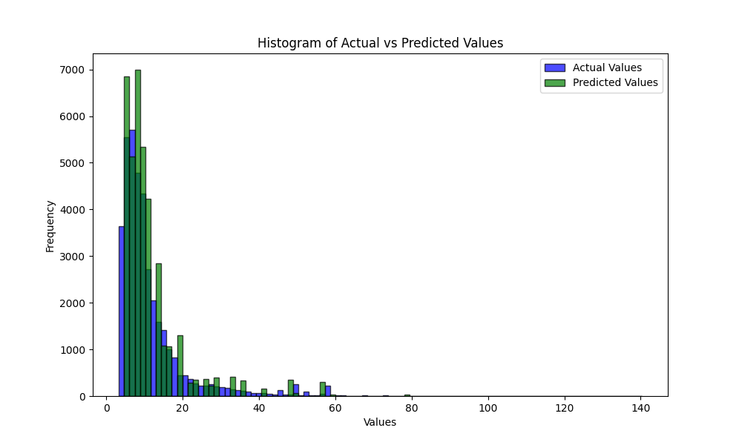
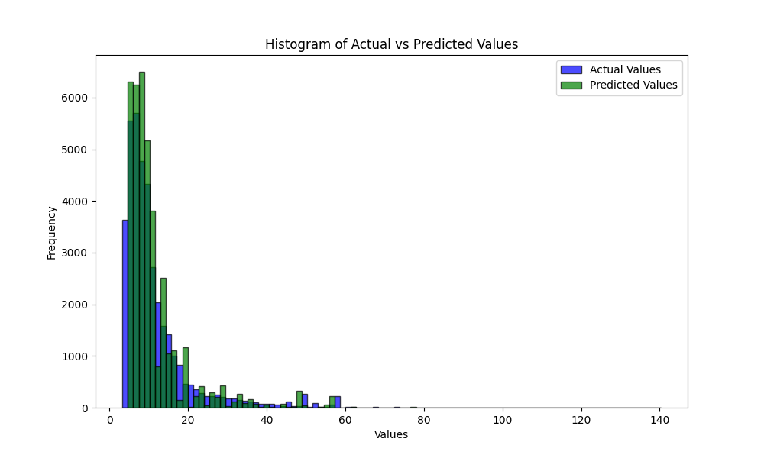
Fare Prediction: Regression Techniques
Linear - R2 score: 83.7%
Decision Tree - R2 score: 84.7%
Random Tree - R2 score: 85.6%

Slide 14
Fare Prediction: Regression Techniques
Linear - R2 score: 83.7%
Decision Tree - R2 score: 84.7%
Ensemble Models
Random Tree - R2 score: 85.6%

Slide 15
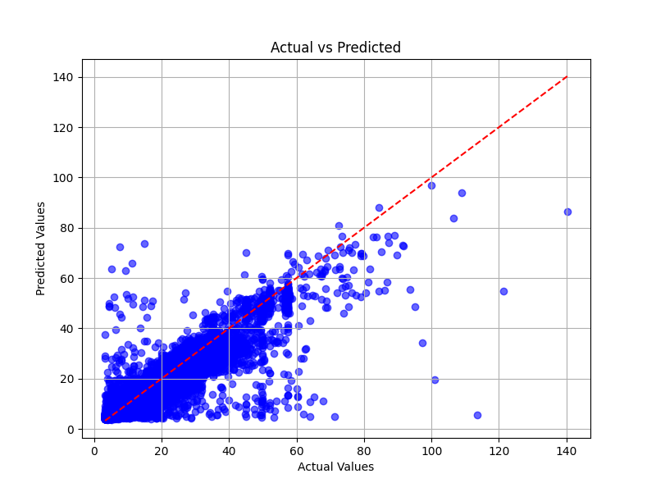
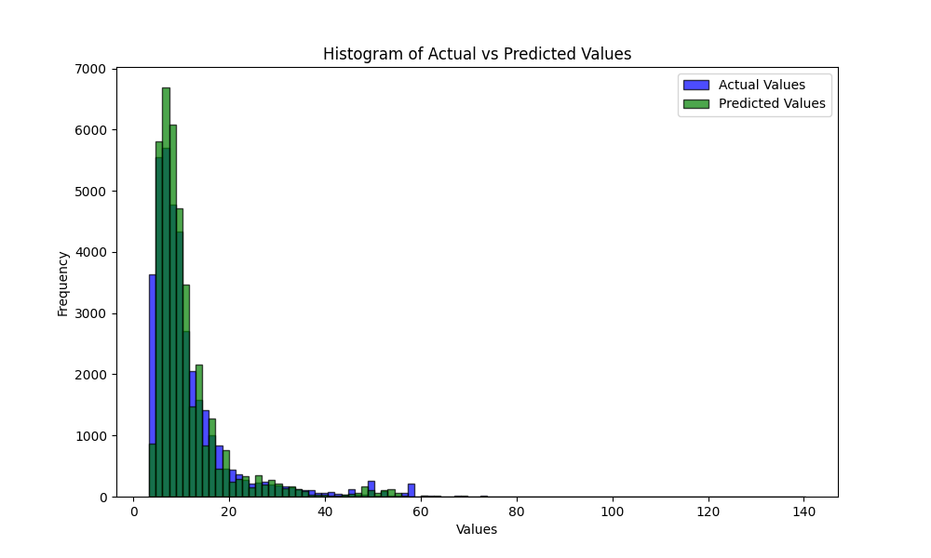
Fare Prediction: Regression Techniques - Ensembled Model
Linear - R2 score: 83.7%
Linear*0.5 & RF*0.5 - R2 score: 85.5%
Random Tree - R2 score: 85.6%

Slide 16
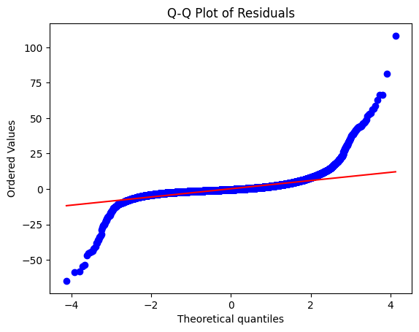
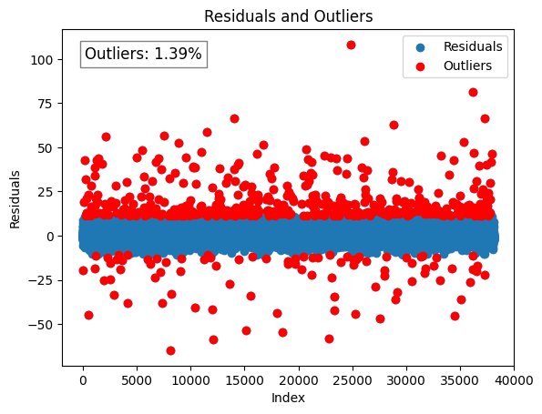
Fare Prediction: Regression Techniques - Ensembled Model - Assessment
Residuals
Linear*0.5 & RF*0.5 - R2 score: 85.5%
Residuals not randomly distributed
~1.4% large residuals (>3-sigma)

Slide 17
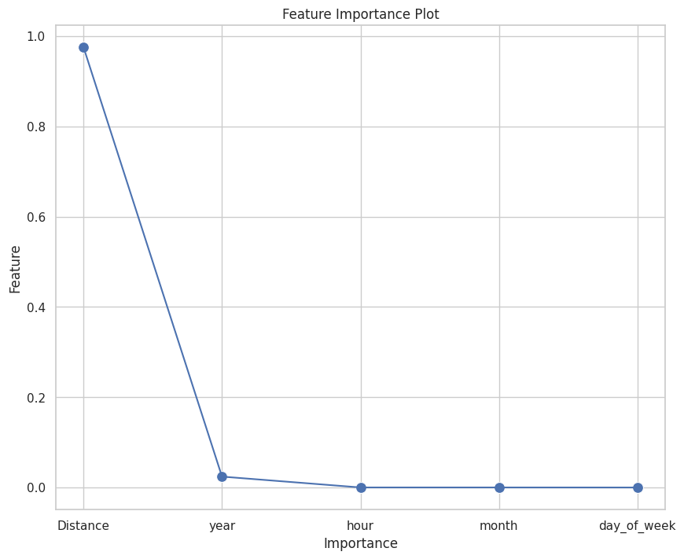
Fare Prediction: Regression Techniques - Ensembled Model - Assessment
Residuals
Linear*0.5 & RF*0.5 - R2 score: 85.5%
Model fails to capture all the patterns in the data
- Re-assessment of model or/and data patterns / imbalances
- Model for short- & long- distance rides separately
- Linear regression works quite well due to high correlation with distance
Residuals not randomly distributed
~1.4% large residuals (>3-sigma)

Slide 18
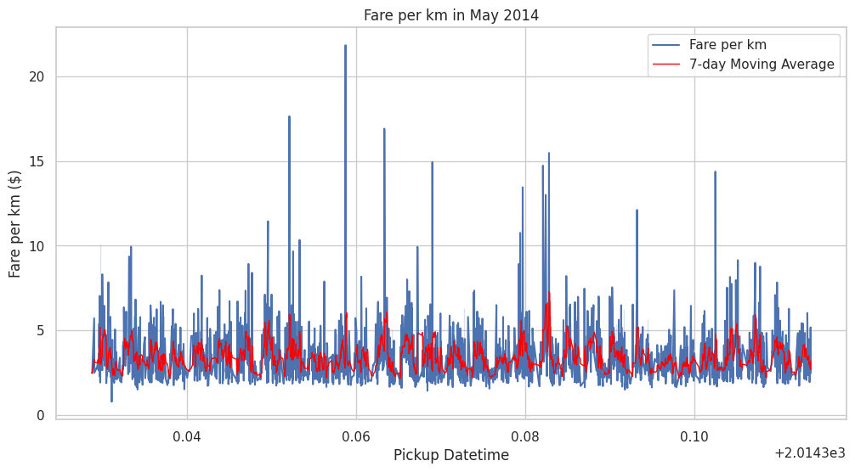
Fare Prediction: Regression Techniques - Ensembled Model - Assessment
Residuals
Linear*0.5 & RF*0.5 - R2 score: 85.5%
Model fails to capture all the patterns in the data
- Re-assessment of model or/and data patterns / imbalances
- Model for short- & long- distance rides separately
- Linear regression works quite well due to high correlation with distance
Residuals not randomly distributed
Fare/km model unsuccessful
Appropriate models to take into account the temporal patterns in data e.g. Kalman filtering forecast

Slide 19
Thank you
Uber Fare Prediction
Vasiliki, Oscar, Jordi, Theresa Ironhack - Unit ML
June 2024

