Slide 1
BAC Calculator

Slide 2

Hello!
INSERT
IMAGE
HERE
I am Christopher Odden
I am here to tell you about my wonderful idea.

Slide 3
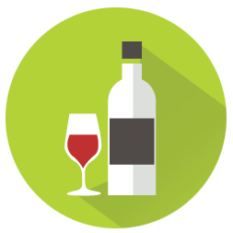
BAC Calculator
Never risk driving drunk again!

Slide 4
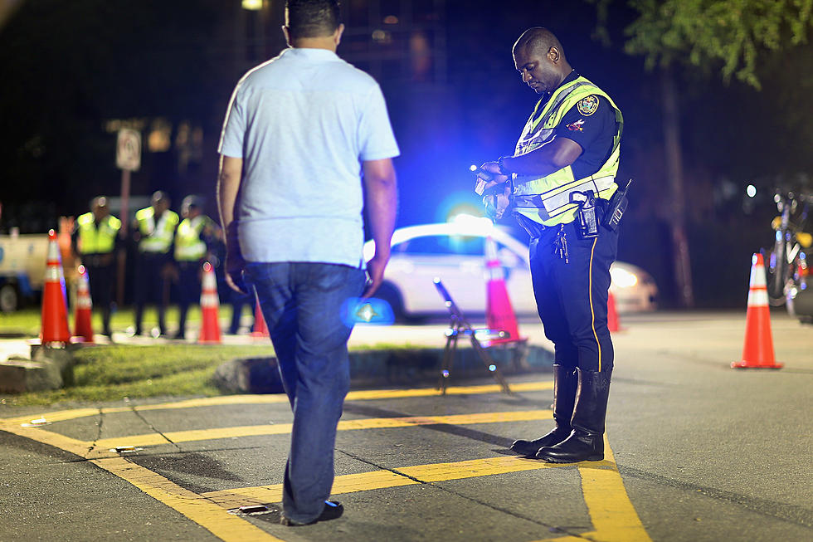
Help Prevent Drunk Driving
Driving intoxicated is a risk to yourself and everyone else on the road. Don’t be that guy!

Slide 5
Mobile App Purpose
This app will approximate blood alcohol content based on these factors
Gender
Body Weight
Type of Beverage Consumed
Number of Beverages Consumed
Elapsed Time

Slide 6
Mobile App Goal
This app aims to help people make better decisions when drinking
Don’t drink and drive
What is your current BAC
Learn to equate number of drinks with specific BAC
How long until I am under the limit?
How long until I am back to 0.00%?

Slide 7
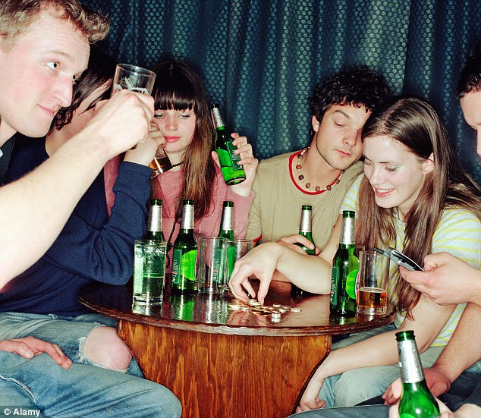
The target audience is mainly college aged drinkers
Anyone that drinks
Males and Females
Any level of drinking
People that don’t want to get in trouble with the law
Drunk people
Eagles

Slide 8
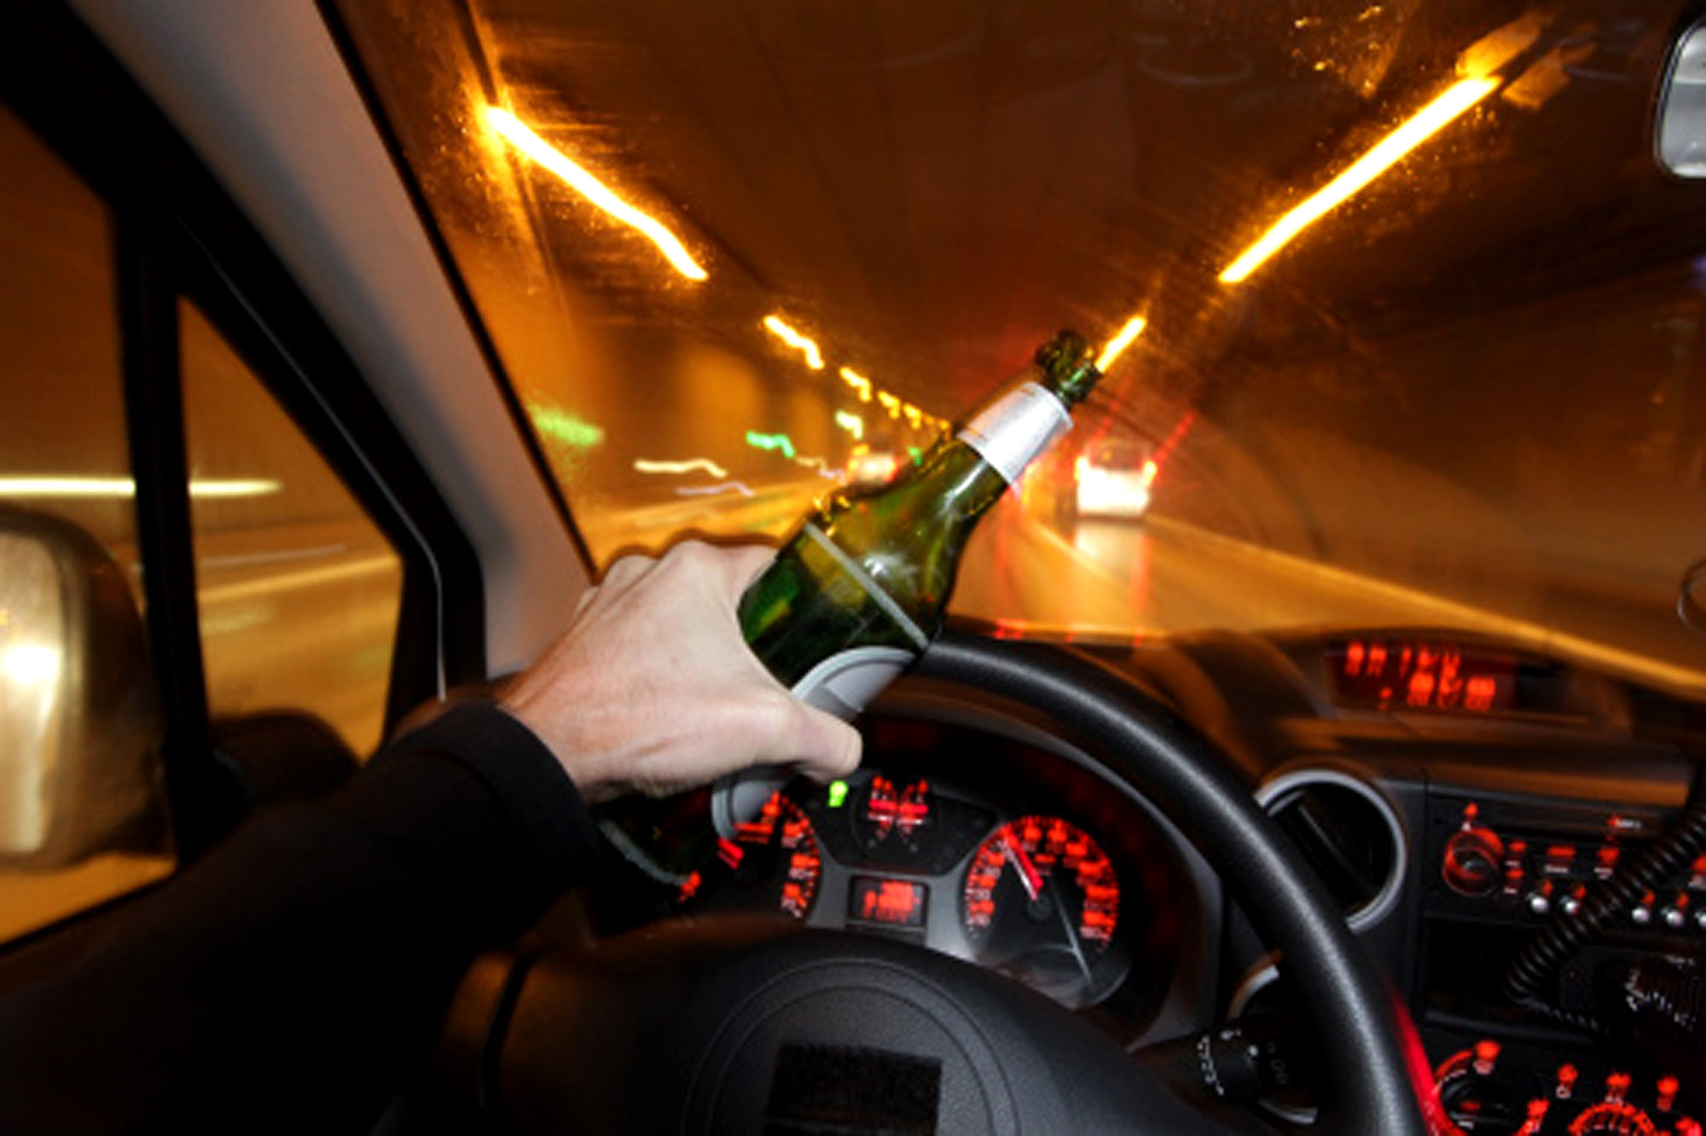

Slide 9
Mobile App Features
Choose Gender
A drop down menu to choose one of the two genders. We do not yet know the effects of alcohol on trans people.
Enter Weight
Enter your weight in pounds
Type of Drink
We offer a large dropdown menu of many different types of alcoholic beverages to choose from. From malt liquor to a manhattan.

Slide 10
Mobile App Features
Number of Drinks
Enter any number of drinks. No limits!
Elapsed Time
Enter the total time since you first began drinking
BAC
We will give you an approximate current BAC
BAC Over Time
We also offer you accurate estimates of how long you will have to wait until your BAC reaches the limits of 0.08%, 0.04%, and 0.00%

Slide 11
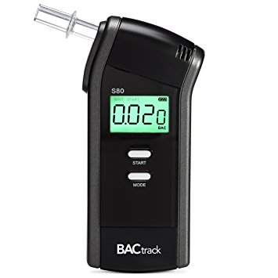
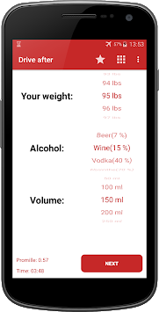
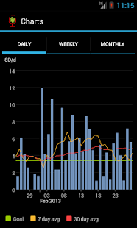
Competition Mapping
Breathalyzer
Actual breathalyzers give a more accurate measure of BAC, but they often don’t have additional features
Drive After
This is a less advanced BAC calculator that is not user friendly and bombards users with advertisements and paid add-ons.
AlcoDroid
This is a very advanced BAC calculator app that even features a graph and saves user statistics over time

Slide 12
Risks/Weaknesses
Cost
This app will be free, and I do not currently have plans of adding advertisements or in-app purchases. If I can find a way to make this better than Drive After, I will put it in the Google Play store.
Experience
I currently do not have much experience coding in Android Studio, and I feel the quality of this app will suffer due to it. Also, I am far more interested in learning the concepts of the MEAN stack because it is cutting edge, and I see it as a more marketable skill.

Slide 13
Development process
concept
(1-2 weeks)
aesthetics
(1.5 weeks)
code behind
(1.5 weeks)

Slide 14
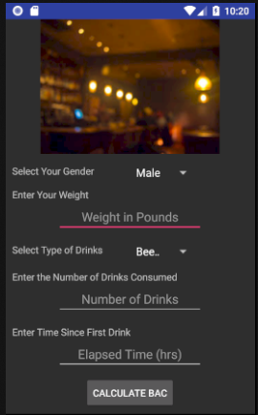
Android project
Place wireframe/mock-up here
This is the screen that captures the user’s input

Slide 15
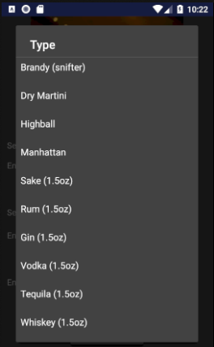
Android project
Place wireframe/mock-up here
These are some of the drink types available to choose from

Slide 16
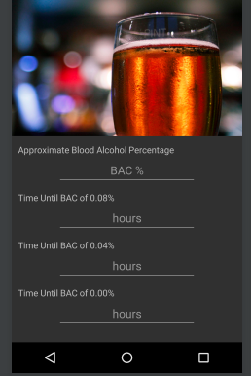
Android project
Place wireframe/mock-up here
Final screen that displays user’s BAC and the amount of time needed to become sober

Slide 17
Thanks!
Any Questions ?
You can find me at
chrodd9604@students.ecpi.edu

