Slide 1

Rappi Business Case:
Business Intelligence / Business Analyst, Lead
Octavio Alberto García Morán

Slide 2





We just launched the credit card to market. As you might be aware, everyone was extremely busy planning and developing the product, but no one thought of coming up nor monitoring the key performance indicators of the business.
1.
First question:
1.1 What would be the key performance indicators you would come up as the most important to monitor a credit card business?
Answer:
The first thing that must be clear before designing the KPIs is the objective of the company, the needs it has and the stage¹ in which the business is. Also, it is important to remember that this is an iterative process that involves feedback from different areas, so the KPI must be clear enough so that the other stakeholders can help improve it.
KPIs proposed:
Response rate
New cardholders rate
Rejection rate
Measure the effectiveness of the MKT campaign.
Measure the effectiveness of the integration of users as new cardholders.
Measure the rate of users that are rejected and can´t be new cardholders.
$$= \frac{\# of users that started validation process}{\# of total users who received the notification}$$
$$= \frac{\# of users that approved validation process}{\# of users that started validation process}$$
$$= \frac{\# of users that failed validation process}{\# of users that started validation process}$$
These three indicators will help us identify important trends to make changes in the following strategies to attract a greater number of users who end up with a credit card. As a next step, I would recommend exploring the group of people who fail to pass the verification process, since this universe has the necessary information to be able to make the product more flexible and thus attract more new customers.
1.In this case, it is mentioned that the product is in a launch stage, and these will be the first KPIs designed for the credit card, additionally the database is considered, since it contains identifiers for the people who responded to the MKT campaign.

Slide 3


We just launched the credit card to market. As you might be aware, everyone was extremely busy planning and developing the product, but no one thought of coming up nor monitoring the key performance indicators of the business.
1.
First question:
1.2 How often would you suggest such indicators must be monitored?
Answer:
Trying to measure them on a weekly basis can be very expensive, and the information that can be obtained is minimal.
Measured monthly
New Strategies
Measuring the KPIs monthly allows the implementation of new strategies to avoid deviations or allows the modification of existing ones with a lower cost than waiting for a semi-annual or annual indicator.

Slide 4




Dealing with diverse stakeholders is difficult. Where one might interpret a concept in a way, another one might differ from such interpretation. Let’s take for example the concept ‘dormant’: some stakeholders might interpret the dormant customer as one that has not done any transactions in 6 months, where another one might say it takes only 4 months to reach this state
2.
Second question:
2.1 Propose a problem resolution strategy with the stakeholders. How would you deal with this issue?
Answer:
The strategy that I would implement is the next one:
Search external regulation
Search internal regulation
Stakeholder conciliation
Search in the current external regulations (government regulatory documents), to find a definition for the concept "Dormant" or "inactive account".
If Point 1 can´t find a definition, the next step would be to review the current internal regulations of the company, hoping that there is a formal definition for the concept.
Finally, if steps 1 and 2 do not have results, I would conciliate with the stakeholders to adopt a formal definition of the concept, allowing to receive feedback from all parties and generating a consensus for the subsequent use of the concept.
Both will allow to establish a formal definition of the concept.
No disputes with the stakeholders.
2.2 I would present the results of the two searches to support the definitions found (if applicable) and / or the documents of the meetings with the agreements made for the use of the concept, with the validation of the stakeholders.
Answer:
Results of the two searches to support the definitions found (if applicable) and / or the documents of the meetings with the agreements made for the use of the concept, with the validation of the stakeholders

Slide 5





3.
Third question:
3.1 What should we do to centralize the data in order to display it in charts for KPI monitoring?
Answer:
First, to centralize the information, it is necessary to identify the components with which our KPIs will be built; Once identified, it is necessary to know what the sources of information are necessary to build the indicators, it may be that it is not necessary (at first) to access all the databases and we only use information from some databases. With the components and sources identified, very precise information extractions can be made, and these could be established as a recurring process in a fixed storage location. This will allow the creation of the necessary connections with the custom-built database to generate the necessary graphs automatically and with the least possible processing to optimize resources.
3.2 What would you propose the data governance strategy should be?
Answer:
I would structure the data governance strategy in 5 main pillars:
01
02
03
04
05
Data Principles
Data Quality
Metadata
Data Access
Data Life Cycle

Slide 6
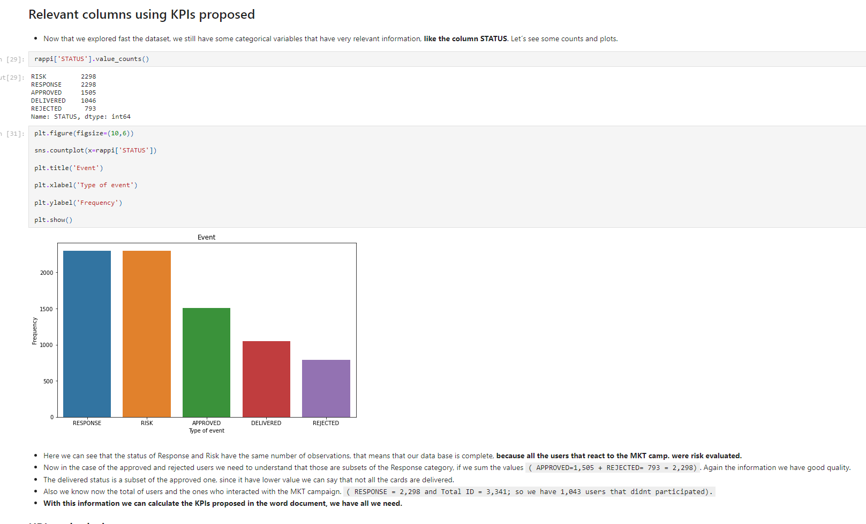
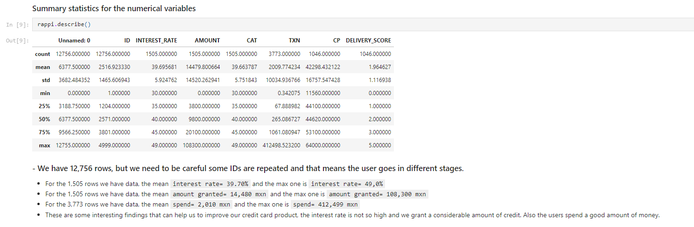
4.
Fourth question:
4.1 YOUR TASK IS TO exploit the information contained in the aforementioned file as you find fit. 4.2 Display and plot the information you consider to be the most relevant for a Credit card business. You could consider the following departments: Operations, Growth (Marketing), Finance, Customer Service, and Product. 4.3 Use your imagination to best describe the data with charts and tables. Select those key performance indicators you consider that drive the business. Present recommendations on those indicators that, to the best of your knowledge, might be low or could be boosted. 4.4 Think outside the box. If you feel that, extra information might be needed to support your arguments, include it in the folder: Power Point presentations, word documents, etc… 4.5 Uploading your results to a git repo is desired but not mandatory.
Answer:
4.1 to 4.4 are in the .html, python document, the presentation, and this word document.
4.5 link : https://github.com/ogmoran13/RappiBC_Octavio

