Slide 1
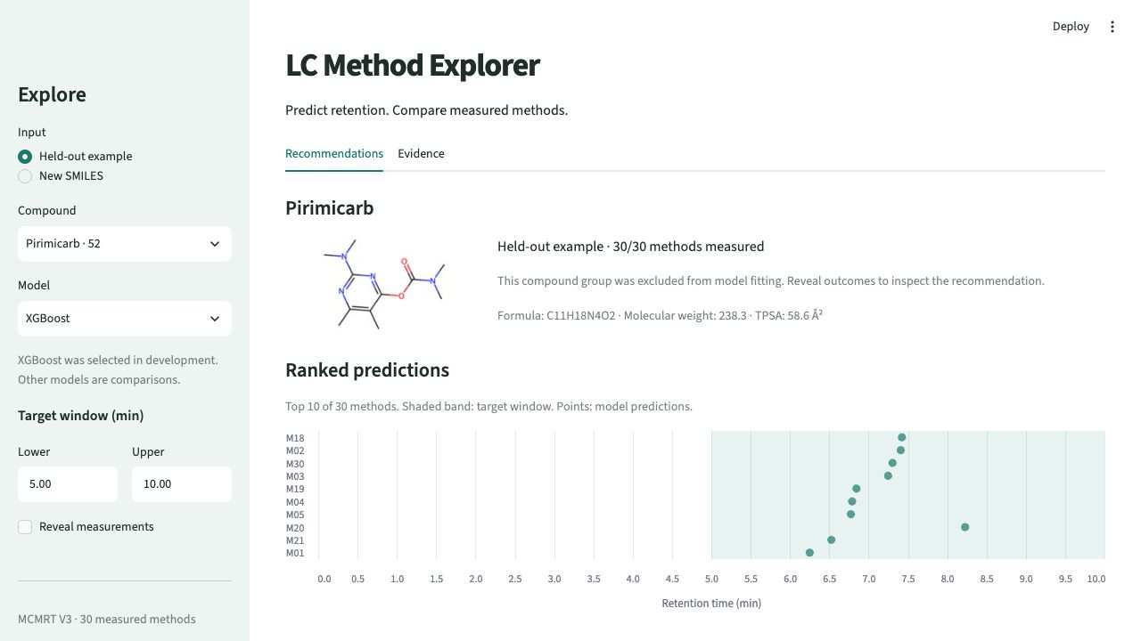
LC Method
Explorer
A local LC method-ranking prototype
Which supported method places a molecule inside a target retention window?
Research prototype using public measurements. Local training and inference. September 2026.
Notes:
Suggested delivery: 20 seconds.
This project asks whether molecular structure and recorded LC conditions can predict retention time for a compound absent from training, then rank the 30 supported methods for a requested window. It uses public measurements. It does not claim that I collected these laboratory data or validated separation quality. This independent implementation was developed in September 2026 with coding-assistant support.
Optional demo: choose Pirimicarb, XGBoost, and 5–10 minutes. M18 predicts 7.42 minutes. Reveal the measured value of 6.82 minutes, then open the Evidence tab. This example illustrates interaction, not population performance.
Sources: demo/app.py; reports/figures/demo_recommendations.png; reports/MODEL_CARD.md. Screenshot captured from the actual local app on September 24, 2026. Dataset DOI: https://doi.org/10.57760/sciencedb.15823

Slide 2
MCMRT V3 covers the required condition axes
10,073
343
30
measured retention times
source compounds
recorded methods
Condition | Observed coverage
Column products | 6 within the RP C18 family
Mobile-phase pairs | 6 A/B pairs
Time / %B schedules | 15 distinct schedules
Column temperature | 30, 40, 45 °C
Total run duration | 10–100 minutes
330 of 343
compounds have measurements
under every method.
217 missing pairs stay
unobserved.
Source: MCMRT V3, DOI 10.57760/sciencedb.15823. Coverage is not a full factorial design.
Notes:
Suggested delivery: 25 seconds.
I checked all 30 source workbooks against publisher MD5 checksums and recorded SHA256 hashes. The 10,073 positive numeric observations span columns, solvents and gradients, satisfying the planned condition-coverage requirement within these 30 methods. This is not universal chromatography coverage or a controlled factorial design.
330 compounds appear in all 30 methods. Five appear in 25 methods and eight in six, leaving 217 missing pairs out of 10,290 possible. Missing RT is not zero and is not evidence of failed retention.
RDKit parses all 343 supplied structures. Conservative parent/tautomer grouping gives 341 groups. Ten secondary InChIKey differences remain documented. Source structures are preserved.
Sources: reports/DATA_AUDIT.md; reports/preparation.json; data/source/mcmrt_manifest.json. Dataset: https://doi.org/10.57760/sciencedb.15823. Publisher record: https://www.scidb.cn/en/detail?dataSetId=7b1a8766e1e947e1884707f6a1016e4f. The dataset record specifies CC0; the article license is separate.

Slide 3
Compound groups define the evaluation
Keep each compound group together across all methods.
Partition | Compounds / groups | Observations | Purpose
Development | 273 / 272 | 8,026 | Five grouped folds
Final holdout | 70 / 69 | 2,047 | One final evaluation
Inputs available before measurement
Selection stays inside development
21 molecular descriptors plus column, solvent, temperature and gradient features.
Three configurations per tree family. Select by MAE, freeze the choice, then evaluate the holdout.
Target: unseen compound groups under familiar methods. Grouping is not scaffold separation.
Notes:
Suggested delivery: 25 seconds.
A random row split would let the same compound occur in training and testing under different methods. I instead keep compound groups intact across methods. Grouping normalizes parent/charge, isotope, stereo and tautomer variants for splitting only. It does not imply identical chemistry or actual solution charge. Molecular descriptors retain the supplied structures.
Development contains 273 source compounds in 272 groups, with 8,026 observations. Five grouped folds compare the median baseline with three Random Forest and three XGBoost configurations. Feature encoding is fitted within each training fold. The 70-compound, 69-group holdout contains 2,047 observations. Saved model artifacts are fitted on development compounds only.
The feature schema has 21 molecular descriptors and 62 method fields before categorical encoding. Measured retention factor and RSD are excluded because a new unmeasured compound would not supply them. MAE is mean absolute error in minutes.
The holdout is now evaluated. Further experiments must not describe it as untouched or tune against it.
Sources: reports/EVALUATION_PROTOCOL.md; config/experiment.json; data/splits/compounds.csv; data/splits/protocol.json; data/processed/feature_schema.json; reports/BASELINE.md.

Slide 4
Lower timing error, modest ranking gain
Retention-time MAE (minutes)
XGBoost remains the default
It won development validation.
Random Forest did better
on the final holdout.
172 vs 169
target-window hits in 268 cases
XGBoost versus a fixed rule
Three additional hits. Statistical
significance is not established.
Ranking: 67 complete-panel compounds × 4 prespecified windows. XGBoost 64.2%, fixed rule 63.1%.
Notes:
Suggested delivery: 30 seconds.
Development MAE is 4.8531 minutes for the median baseline, 1.9437 for RF and 1.9034 for XGBoost. That selection preceded the final holdout. Holdout MAE is 4.8423, 1.8909 and 2.1599 minutes respectively. I kept the development-selected XGBoost default and reported the RF reversal instead of selecting using the test result.
For recommendations, the model ranks the known methods by predicted distance outside the requested window, then distance to its center, run duration and method ID. It never uses measured truth to rank. The prespecified windows are 2–5, 5–10, 10–20 and 20–40 minutes.
67 holdout compounds have complete panels, giving 268 compound/window cases. Three incomplete compounds stay in RT metrics but are excluded from ranking metrics. XGBoost has 172 top-1 hits, the fixed rule 169, RF 175 and median-prediction ranking 146. The fixed rule learns method order from development data and uses the same ordering for every new compound for a given window. The XGBoost advantage is modest and varies by window. No significance claim or measured lab-time saving follows.
At least one measured method meets the window in 199 of 268 cases. 172/199 = 86.4% is a conditional feasible-case rate, not overall success. Overall is 64.2%.
If asked about uncertainty: the paired compound-group bootstrap 95% interval for XGBoost MAE improvement over the median baseline is 1.94–3.49 minutes. It conditions on fixed models and is not an individual prediction interval.
Sources: reports/MODEL_RESULTS.md; reports/experiments/mcmrt-v3-compound-v1/selection.json; reports/experiments/mcmrt-v3-compound-v1/holdout/metrics.json. Native chart values come from those JSON records, rounded to two decimal places for display.

Slide 5
Limits and next experiments
Observed failure
Evidence still needed
14 negative XGBoost predictions
New methods and laboratories
Use independent data to test transfer.
The app flags raw values and retains them in the reported evaluation.
Mixture separation quality
Measure resolution, peak shape and sensitivity in the laboratory.
A future experiment can test positive outputs and calibrated uncertainty.
No claim of laboratory deployment or time savings. The evaluated holdout cannot guide further tuning.
Notes:
Suggested delivery: 20 seconds.
The 14 negative XGBoost predictions occur among 2,047 holdout observations, ranging from about -1.52 to -0.008 minutes. They are physically invalid. The app preserves and flags them, and the scores include them. Clipping or filtering after seeing holdout outcomes would change the evaluated policy. Future experiments could prespecify a positive-target transformation, invalid-candidate policy and calibrated intervals.
The dataset supports known-method prediction for held-out compound groups within one source. It does not establish new-method, new-laboratory or scaffold extrapolation. A window hit alone does not establish mixture separation, peak shape or sensitivity. The illustrative timing windows are not scientist-approved requirements.
Local feasibility: development comparison took 49.4 seconds and final refitting/evaluation 5.9 seconds on an M2 Pro with 16 GB RAM, excluding imports/setup. The interface uses frozen local artifacts without retraining. These are measured timings for this experiment, not general hardware benchmarks.
Prioritize independent validation and a stronger decision objective before expanding the interface. An independent-machine end-to-end reproduction has not yet been performed.
Sources: reports/MODEL_RESULTS.md; reports/MODEL_CARD.md; reports/experiments/mcmrt-v3-compound-v1/holdout/metrics.json.

