Slide 1
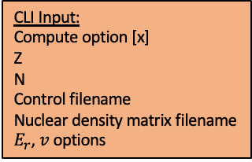
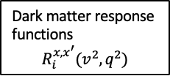
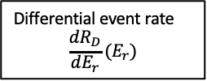

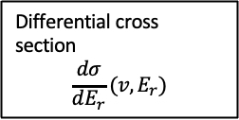


CLI Input:
Compute option [x]
Z
N
Control filename
Nuclear density matrix filename
$E_{r}$, $v$ options
Control file (.control):
EFT coefficients
List of optional parameters
Density matrix file (.dres)
Wigner functions
EFT coefficients $c_{i}^{x}$
CHG functions
Dark matter response
functions
$$R_{i}^{x,x^{′}}(v^{2},q^{2})$$
Nuclear form factors
$$W_{i}^{x,x^{′}}(E_{r})$$
[6] Nuclear form factor
Transition probability
$$T(v,E_{r})$$
[3] Transition probability velocity curve
Differential cross section
$$\frac{dσ}{dE_{r}}(v,E_{r})$$
[2] Differential cross section velocity curve
Quadrature routines
Differential event rate
$$\frac{dR_{D}}{dE_{r}}(E_{r})$$
[1] Differential event rate spectra

