Slide 1
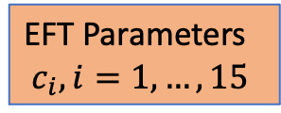
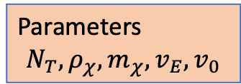
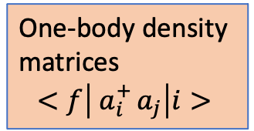

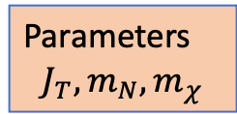
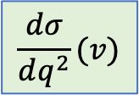
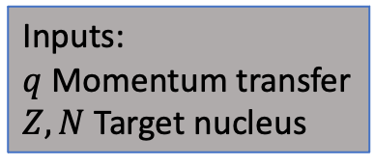
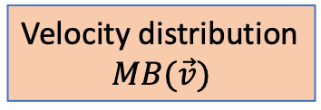
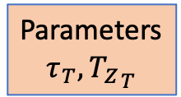
One-body density
matrices
$$<f\left| a_{i}^{+ }a_{j}\right|i>$$
Operator matrix
elements
Parameters
$$τ_{T}, {T_{Z}}_{T}$$
Velocity distribution
$$MB(\vec{v})$$
Nuclear response
functions (8)
Inputs:
$q$ Momentum transfer
$Z, N$ Target nucleus
Transition probability/
Galilean-invariant
amplitude
$$\frac{dσ}{dq^{2}}(v)$$
$$∫d^{3}v$$
Event Rate
Control file
Dark matter response
functions (8)
Parameters
$$N_{T},ρ_{χ}, m_{χ}, v_{E}, v_{0}$$
Parameters
$$J_{T}, m_{N}, m_{χ}$$
EFT Parameters
$$c_{i}, i=1, …,15$$

Slide 2
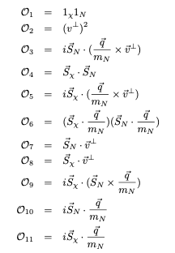
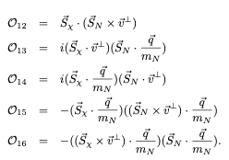


Slide 3
