Slide 1





Methane Phenotypes in Cattle
Oscar Gonzalez-Recio and Coralia Manzanilla-Pech
Zaragoza, February 25th, 2025

Slide 2
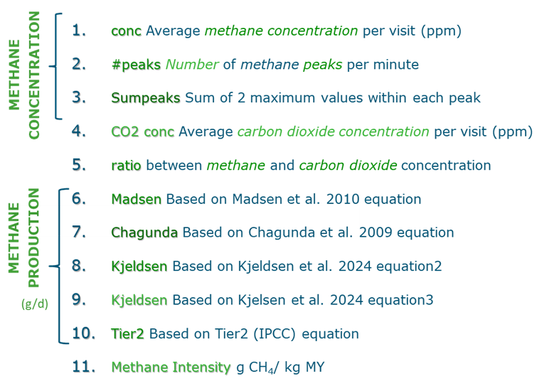


Methane phenotypes
2

Slide 3
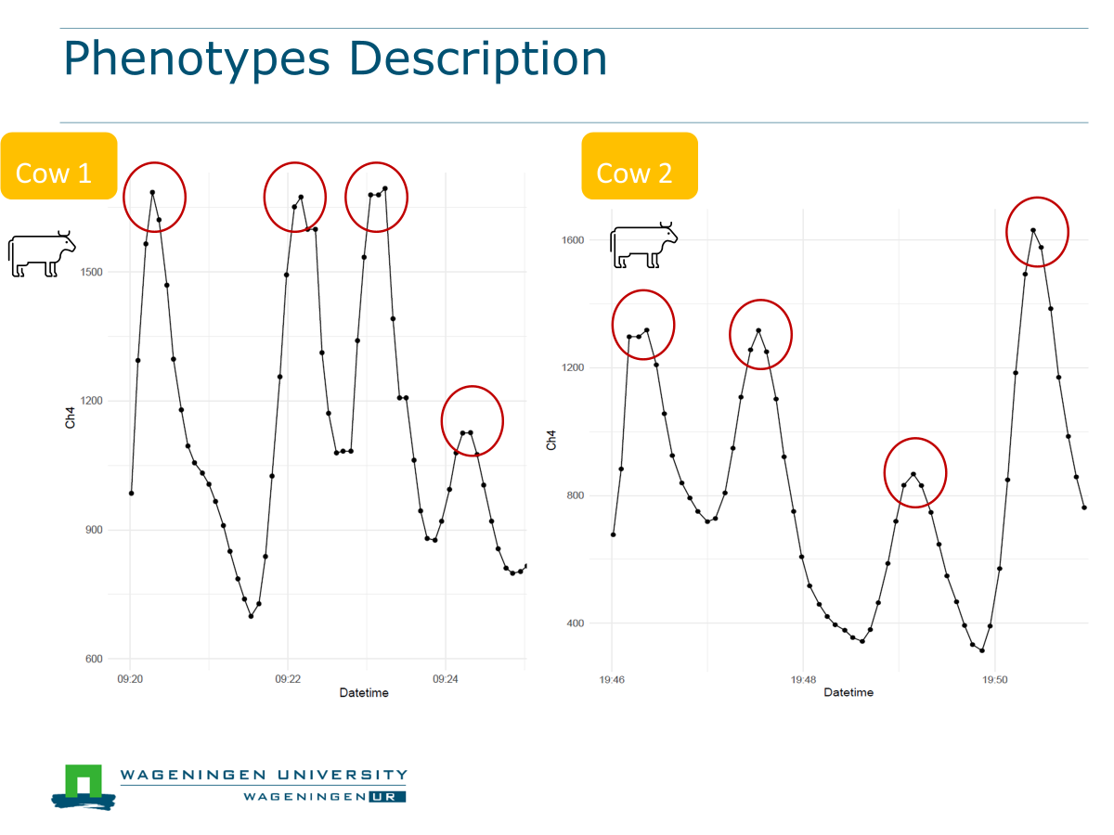
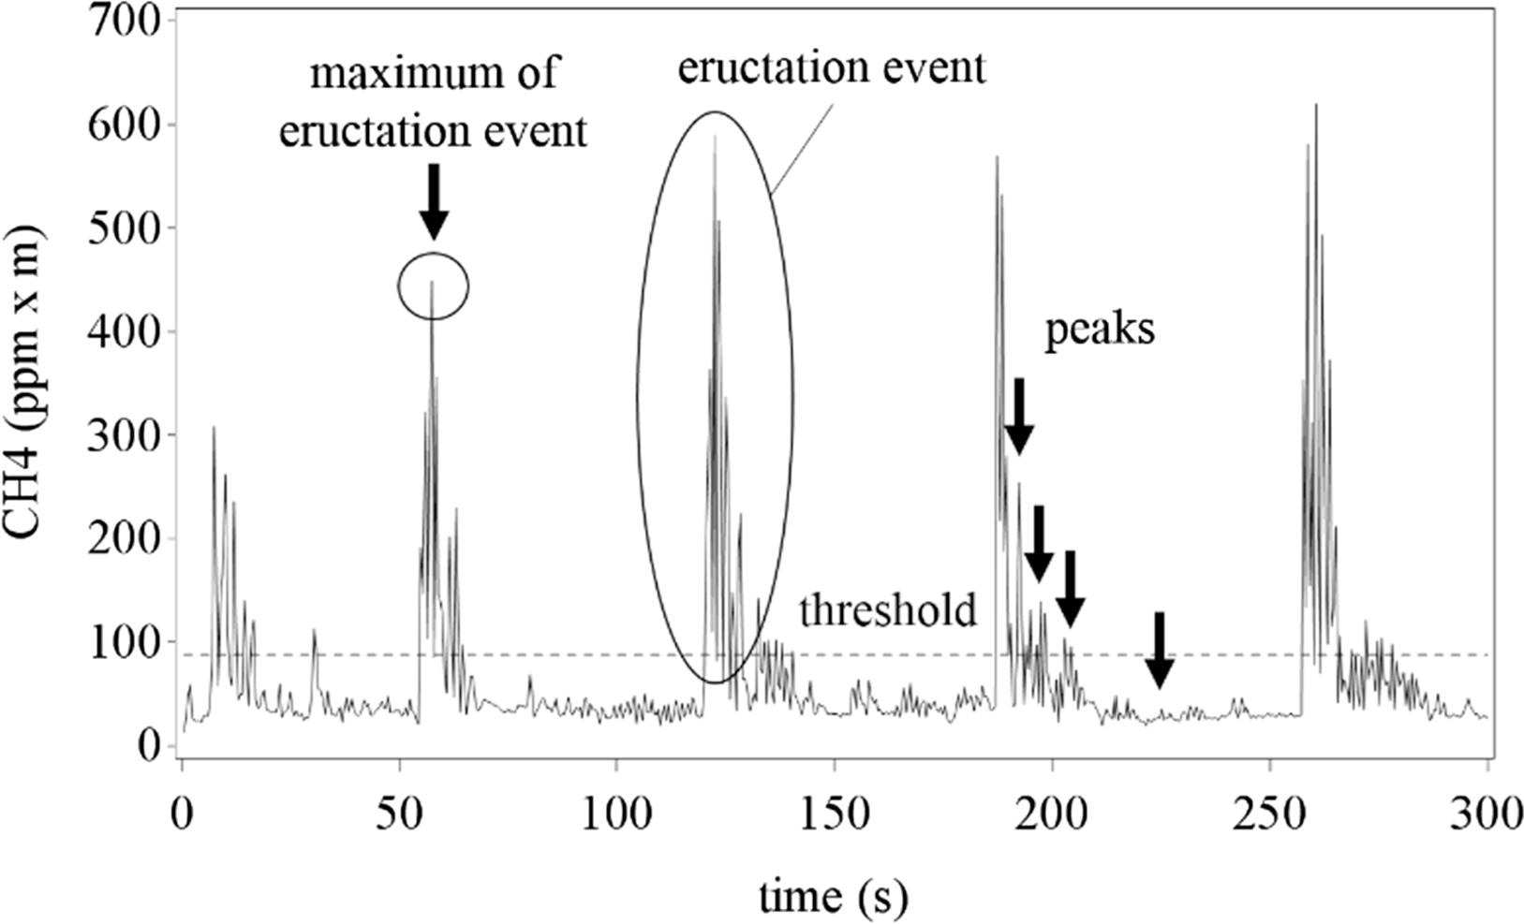
Methane concentration phenotypes
Sorg, et al. 2018
3

Slide 4
Methane phenotypes
Methane concentration (MeC)
CH₄ ppm
MeC
Methane production (MeP)
g/d
MeC
4

Slide 5


From Methane Concentration to Methane Production
Chagunda
Madsen
Tier2
Kjeldsen
Others
CH₄ ppm
formulas
CH₄ g/d
MeC
MeP
5
Notes:
If you know the [CH₄]:[CO₂] ratio → and if you calculate the CO₂ production
calculate amount of CH₄
4th report from working group on climatization of animal houses: Used to determine ventilation in barns, and not to be used on individual animals
HPU: heat producing units

Slide 6
Formulas that predict CO₂
* CH₄ g/d= ratio x predicted CO₂
Madsen et al. (2010) equation
CO₂ g/d= 180 × 24 × (5.6 MBW + 22 ECM + 1.6*10-5 * num days in gestation)
Kjeldsen et al. (2024) equation 1
CO2 (g/d) = ß0 + (ß1 × DMI) + (ß2 × MBW) + (ß3 × Diet CP) + breed + (bDMI, breed × DMI) + (ßDMI, parity × DMI) + (MBW, breed × MBW)
Kjeldsen et al. (2024) equation 2
CO₂ g/d = ß0 + (ß1 × ECM) + (ß2 × MBW) + (ß3 × Milk CF) + (ß4 × DIM) + breed + (ßDIM, Diet CF × DIM × Diet CF) + (ßECM, DIM × ECM × DIM) + (ßECM, MBW × ECM × MBW) + (ßMilkCF, MBW × Milk CF × MBW) + (ßMBW, breed × MBW) + (ßDIM, breed × DIM) + (ßMBW, parity × MBW)
Kjeldsen et al. (2024) equation 3
CO₂ g/d = ß0 + (ß1 × ECM) + (ß2 × DIM) + breed + parity + (ßbreed, parity) + (ßDIM, Diet CF × DIM × DietCF) + (ßECM, DIM × ECM × DIM) + (ßDIM, breed × DIM) + (ßMilkCF, parity × Milk CF)
6

Slide 7
Other Formulas
Chagunda et al. (2009) equation
CH₄ g/d = 0.000576 x M_{TV} x TV_{r}
M_{TV} = CH₄ conc x TV_{r}
Tier2 et al. (2019) equation from IPCC
NEm = CF * MBW NE₁ = Milk * (1.47 + 0.4 * Kg Fat)
REM = 1.123 – (0.004092) * DE + 0.00001126 * (DE² - 25.4/DE)
GE = (1000*(Nem+Nea+NE₁+Nep)/REM/ DE /100
CH₄ g/d= GE * 0.065 / 55.65
Do not use CH₄ conc
7

Slide 8
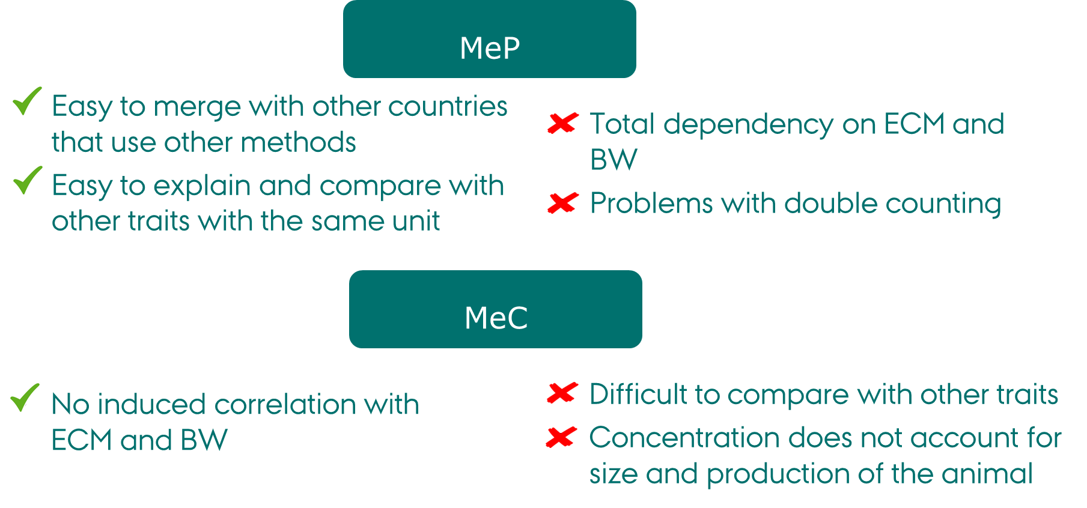
8

Slide 9
Other Methane Phenotypes
Regression on MBW and DMI and fixed effects
Regression on MBW and ECM and fixed effects
Regression on MBW, DMI and ECM and fixed effects
RMeP
RESIDUAL
RMeC
Methane intensity (MeI)
g CH₄ / kg ECM
RATIO
Methane yield (MeY)
g CH4 / kg DMI
g CH4 / kg BW
9

Slide 10
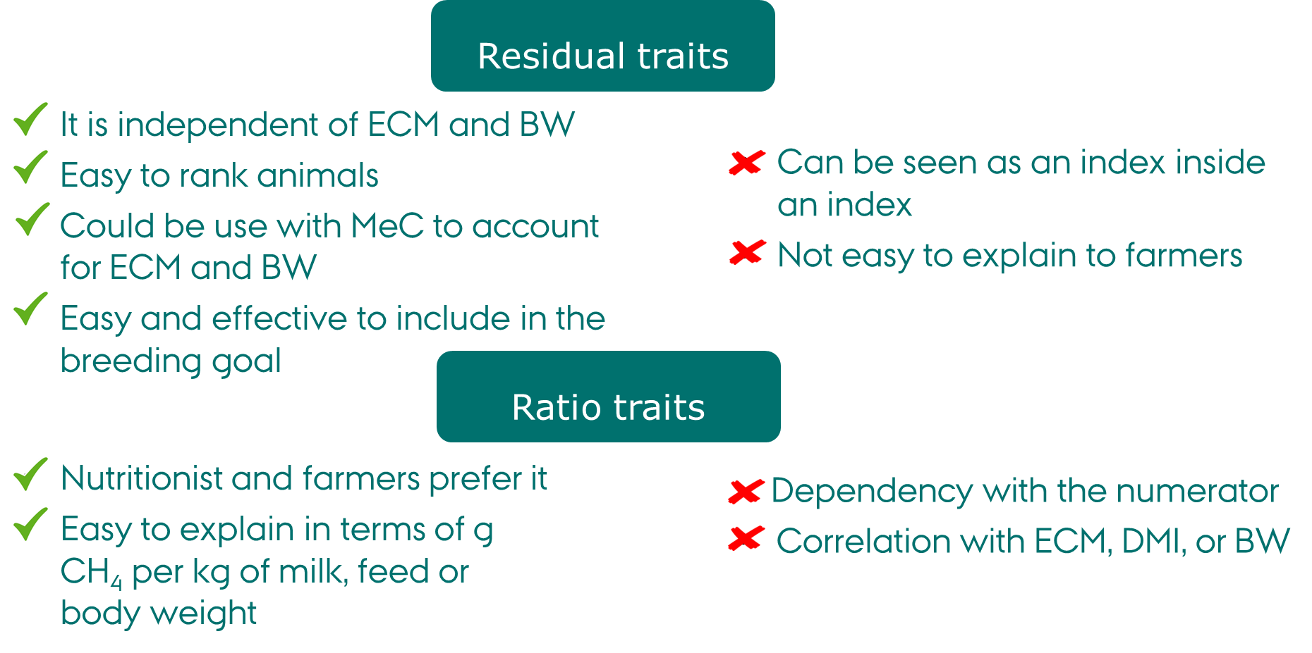
10

Slide 11
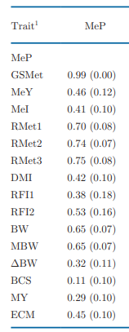
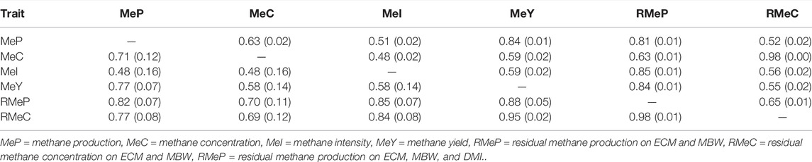
Genetic correlations among traits
Manzanilla-Pech, et al. 2021, 2022
11

Slide 12
Calculation of baseline and merging data with milk recording
n

Slide 13

Editing steps after alignment
Example (2 months/600 cows)
Background
Creating event
Discard first 20-60 sec
Measuring or estimating
Per animal and visit
Accounting for the time the gas takes to travel through the tube
17.6 millions CH₄/sec/cow
Final CH4 conc
phenotype
24,723 weekly individual CH₄ records
Discard records with less 300 sec
Keeping homogeneous visits
Keep between 60-300 sec
Head cow in the AMS
Create mean per visit per animal per day
Delete outliers

Slide 14
Calculation of baseline and merging data with milk recording: Netherlands example
n

Slide 15
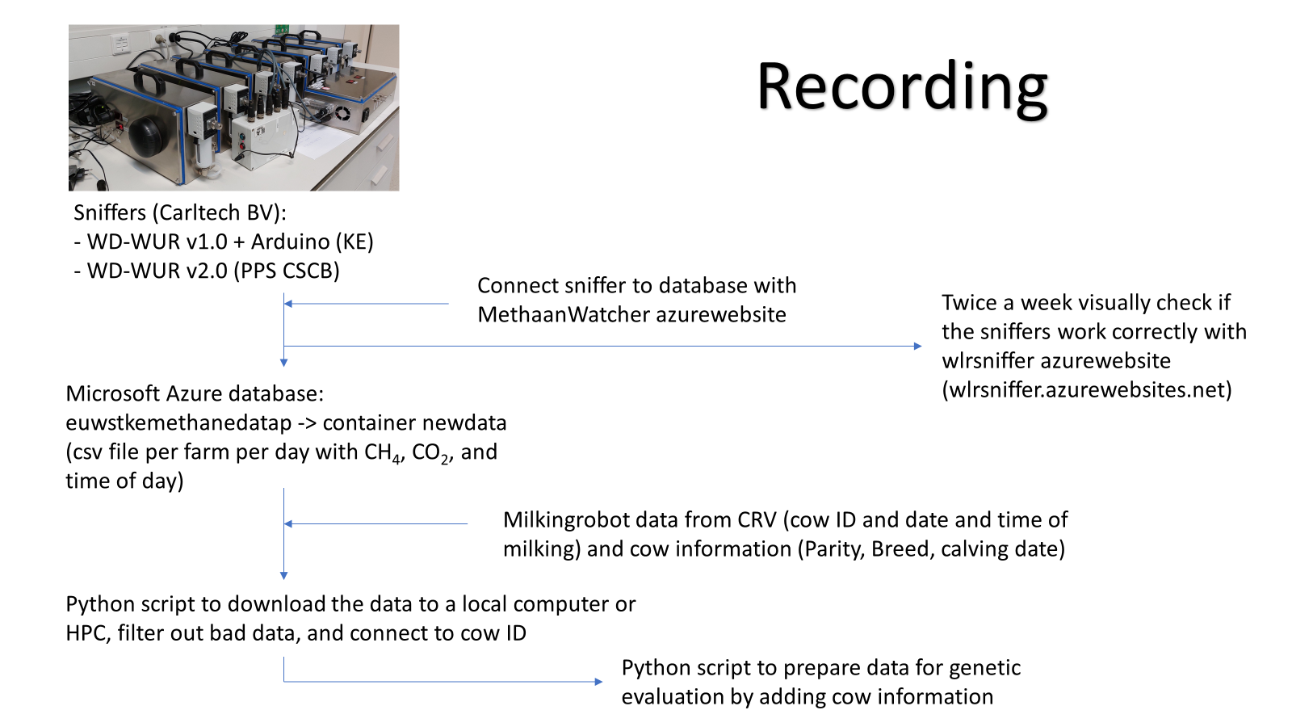
Downloading data from Azure database
n

Slide 16
Data processing 1
Pipeline_part1.sh, runs scripts:
Python Script number | Function
1 | Makes a subfile of the AMS data per farm, to increase computational efficiency
2 | Make a list of all the farms that are in the Azure database with sniffer data, to download them one by one for each farm
3 | Processes the .csv files in the Azure database one by one, and calls functions from Raw_sniffer_CSCB.py to filter the data, and from Align_AMS_sniffer_CSCB.py to align the filtered data to the AMS data

Slide 17
Data processing 2
Pipeline_part2.sh, runs scripts:
Script number | Function
4 | Calculates the mean emissions per milking robot visit, including some filtering criteria of which records to include in a visit
5 | This script combines the methane data with data on other cow traits for genetic analyses. Based on the animals in the combined dataset the pedigree is then pruned

Slide 18
Data processing 3
Run_diu.sh, runs scripts:
Script name | Function
2309_asreml_diu_cor_CSCB.R | Runs ASReml to precorrect visit means for diurnal variation, before averaging to daily means. The model includes a random genetic and permanent environmental effect
Data processing 4
Pipeline_part3.sh, runs scripts:
Script name | Function
2308_DataGenAnalyses_part2_CSCB.py | Add the diurnal corrected trait from the ASReml output, and summarize traits as weekly means

Slide 19
Calculation of baseline and merging data with milk recording: Denmark example
n

Slide 20
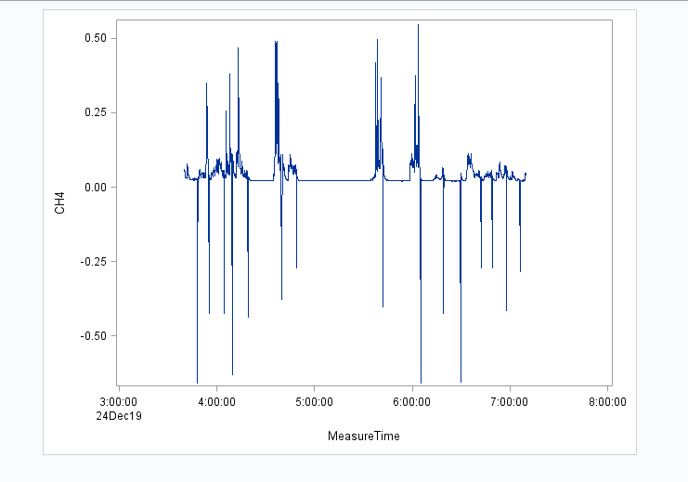
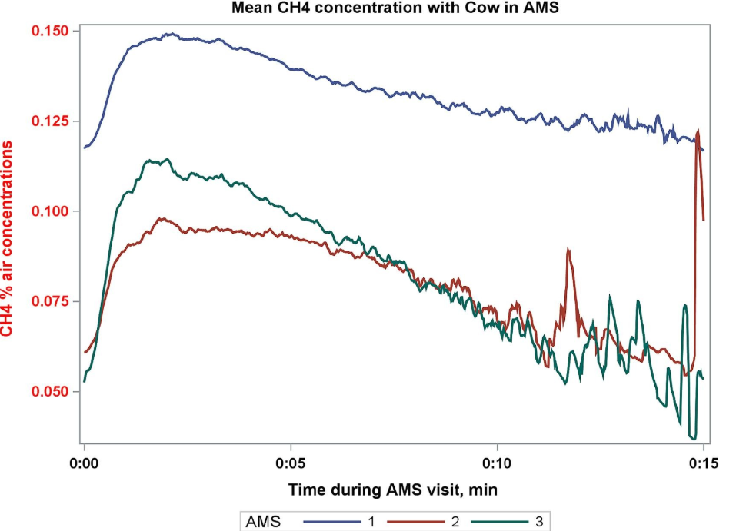
Aligning the data and setting a background
Aligning sniffer and AMS data
Several approaches to align data
Double tag reading
Identify cleaning time of AMS
n

Slide 21
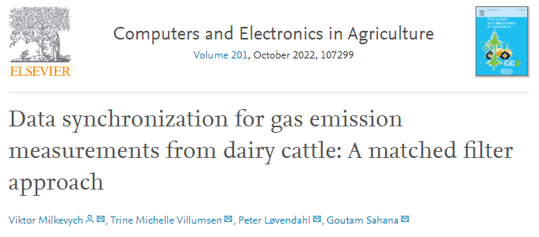
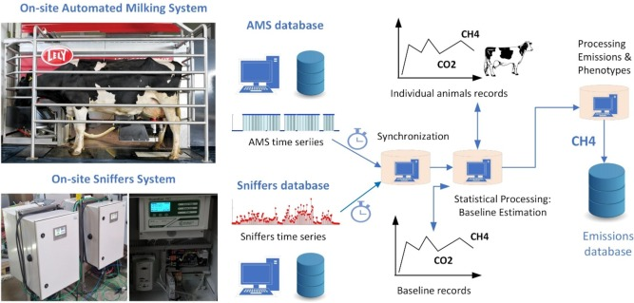
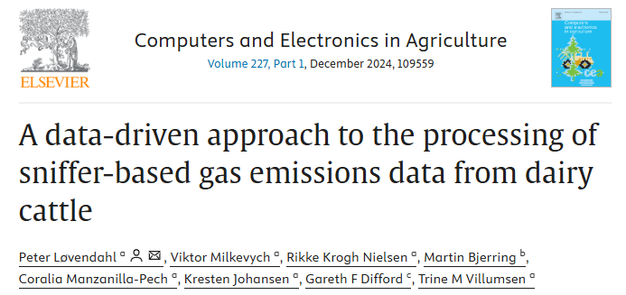
Aligning the data (Developed software)

Slide 22
n

