Slide 1

.NET 9.0 Migration
Future-Proof Your Legacy Application with a Seamless .NET 9.0 Migration
Notes:
I will talk about today .NET 9 migration. There are many levels from easy to difficult. It depends what condition legacy app is in. Also depends on developers, architecture, company culture and users too.
First I will assess the situation,
Do we actually need to modernize it
Or could some refactoring just save the legacy code base at least for a certain time.
If we will do it, would it be financially a good decision for us?
If we throw a stone, it should be worth that all the birds we scrared off.
There could be many approach to the problem but this video series is explains how I approach the problem and how I do it.

Slide 2
We seek answers
Why?
When?
How?
Notes:
I will try to answer our 3 main questions.
1. Why should we migrate?
2. When should we migrate?
3. How would I do it?

Slide 3
Why?
Migrating to .NET 9.0 ensures better performance, enhanced security, and long-term support. It also allows your application to take advantage of modern cloud architectures, faster execution times, and reduced technical debt.
NET 9.0 introduces Profile-Guided Optimizations (PGO), improved garbage collection, and faster execution. I optimize performance bottlenecks, refactor outdated code, and enhance database queries to make your application significantly faster.
The migration process is designed to be smooth and structured. I use a phased approach to identify and replace deprecated components while maintaining your business logic.
Notes:
----- All are by the book words hah? Nice tailored words. But we need to see real life situation and examples, don’t we right?

Slide 4
Let's assess the situation
Best Case:
We have for example a .NET 8.0, 7.0 or 6.0 application written in C# and we have some performance, scalability or security issues.
Solution could be just a config change: <TargetFramework>net9.0</TargetFramework>
Migrating to .NET 9.0 ensures better performance, enhanced security, and long-term support. It also allows your application to take advantage of modern cloud architectures, faster execution times, and reduced technical debt.
Worst Case:
There is an existing application that written in very old frameworks and older version of the languages. Even worst, the source code could be lost, not maintained since a long long time. No body wants to develop any more on that code base, the developers are already retired or resigned. Maybe there are some resources can be found more expensive than market conditions.
More struggle,
there are serious number of customers and users depending on the deployed version
they are complaining about necessity of new features, performance issues and bugs.
Notes:
Before getting into this at least you need to have a problem with your product.
If you don’t have any problem. There is no need to upgrade your application. If it works don’t touch it.
If we have problems let’s assess what they are and be aware of them.
----
The things can’t be always black and white. There could be also intermediatory states between worst and best cases. But if you are in a situation at least convergent a little bit to the worst case, your hands are tight. You definatelly need to move a modernized version of your application. Your customers are depending on it.
It could be an MFC++, Visual Basic, Windows Forms, ASP.NET 2.0, 16bit C application, a java application older than Java SE 6

Slide 5

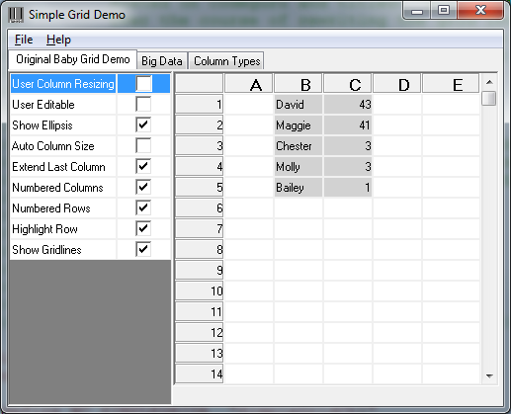
Worst Case
It could be an MFC++ application.
No Crossplatform depending on Windows OS.
Installation required, it is an assembly. Hard to maintain as a SaaS applicaiton.
Tight Coupling of UI and Business Logic, Monolithic CView/CDocument classes, Macros instead of interfaces
Extensive Use of Preprocessor Macros
Manual Resource Management, Raw pointers everywhere, GDI leak bugs
Poor Testability and Dependency Isolation
Threading and Concurrency Pitfalls
Build and Dependency Complexity

Slide 6
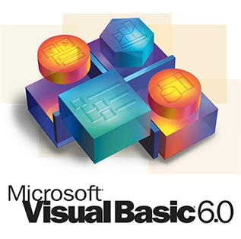
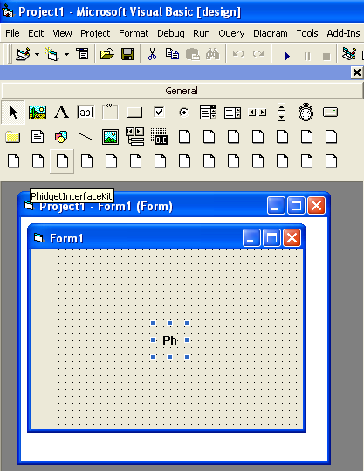
Worst Case
It could be a Visual Basic Application
Weak Type Safety and Late Binding
“On Error Resume Next”–Driven Error Handling
Monolithic Forms and Code‑Behind
Module‑Based Global State
Poor OO Abstractions (Especially in VB6)
COM/Interop and Binary Compatibility Woes
Lack of Unit Testing and CI Integration
Resource Management and Memory Leaks
UI Scaling, Localization & Accessibility Gaps

Slide 7
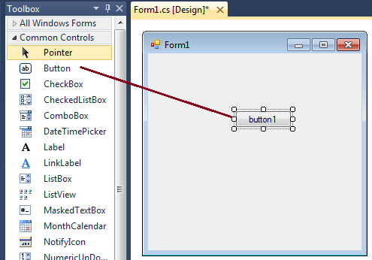
Worst Case
It could be a Windows Forms Application
UI and Business Logic Tightly Coupled
Designer‑Generated Code Fragility
Event‑Driven “Spaghetti” Code
Poor Testability
Layout and Scaling Shortcomings
Data‑Binding Misuses
Threading and Concurrency Pitfalls
Resource Management Leaks
Localization and Accessibility Gaps
Designer and Build Performance

Slide 8
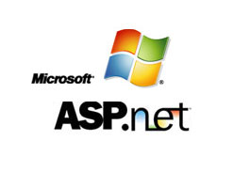
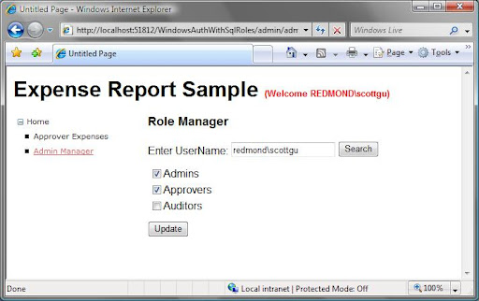
Worst Case
It could be a ASP.NET 2.0 Application
ViewState Bloat and Lifecycle Confusion
Tight Coupling of UI and Business Logic
Excessive Use of Server Controls and PostBacks
State Management Misuse
Data Access Anti‑patterns
Lack of Dependency Injection and Testability
Configuration and Deployment Fragility
Performance and Memory Leaks
Security Pitfalls
Caching Misconfiguration

Slide 9

Worst Case
It could be a java application older than Java SE 6
Boilerplate‑Heavy Resource Management
Antiquated Concurrency Practices
Outdated Collections and Utilities
Legacy Date/Time APIs
XML‑Heavy Configuration and Wiring
Build and Dependency Sprawl
Primitive or Missing Testing Infrastructure
Ad‑Hoc Logging and Diagnostics
Runtime and Deployment Fragility

Slide 10
When?
If you are in a situation similar that I mentioned.
Struggling with an outdated .NET application that limits performance, scalability, and security?
Customers are waiting for new release within new features and solutions to the existing bugs inside.
The financialy maintain cost exceeds the modernization costs.
IT IS TIME TO MOVE ON TO .NET9 NOW.

Slide 11
How?
With 20+ years of experience in .NET technologies, I provide a comprehensive migration service that ensures minimal disruption, optimized performance, and long-term maintainability.
✅ Seamless Backend & Frontend Modernization
✅ Security & Performance Enhancements with Profiler Tuning
✅ Zero-Downtime Deployment with CI/CD Best Practices
✅ Cloud Migration & Scalability (Azure/AWS)
✅ End-to-End Support & Developer Training
Unlike generic migration services, I take a strategic, step-by-step approach to ensure:

Slide 12
Let’s make an example
In the Upcomming Video:
Source code is lost. There was no disaster recovery solution or backup exists.
Developers are retired or resigned, but assume I know all the user stories.
My task will be create a POC version in .NET9 in 2 days.
We have only the database backup from a customer
Schema does not change from customer to customer.
I will start a .NET 9 Migration example.
I will assume there is an application deployed as an B2B application to several high paying customers.

Slide 13
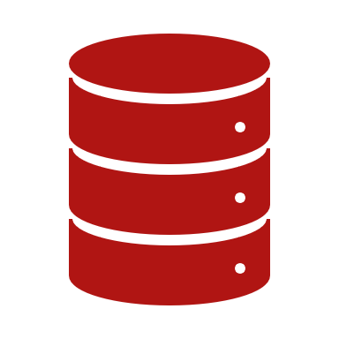
1st Day : Backend
Web API
Services with Domain Models
Providers with Database Entities
Entity Framework scraffolding the Database
MS-SQL Database server.
Notes:
First day I will create a backend a restfull web api with C# and .NET9. I will use clean architecture.
Domain driven model design.
Database first approach.
I will use SOLID princibles, design patterns and best practices as much as I can and I know.

Slide 14
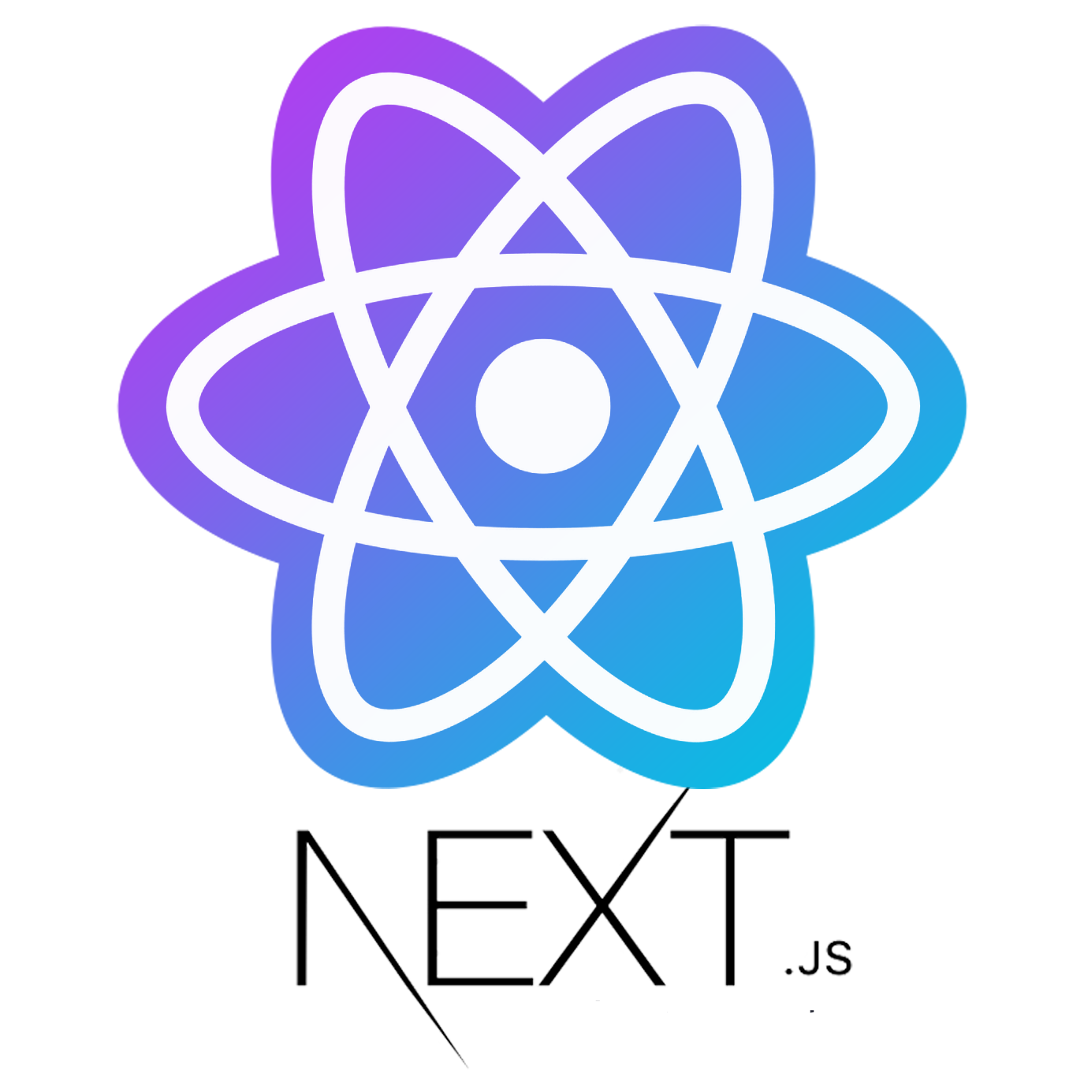
2nd Day : Frontend
Next JS
React
Notes:
Second day I will create a REACT Next.JS User Interface that consumes the backend service that I have created in the first day. I choose react because when the time comes I will explain more about this choice.
But I can tell this example Database and user stories shows us this application highly B2B SaaS application full of datagrids and CRUD functionalities.
This type of User Experience can be represented with Next.JS and React.
Or else I would of course prefer Vanilla JS or others depending on the job description.
But today with this example the UI will be a NextJS.

Slide 15
Good Luck
Don’t forget to SUBSCRIBE the channel.
Don’t forget to LIKE this video.
Notes:
Good Luck for me about this task. I hope I could manage it. Don’t forget SUBSCRIBE the channel and like this video if you actually liked it.

Slide 16





DAY 1
Build WEB API with .NET 9
Notes:
Lets continue with our .net 9 migration example. Now, we come to how to build a .NET 9 web api over a restored database from an existing application. Lets remind us what we are left from the first video.

Slide 17
DAY 1: Web API
An exıstıng applıcatıon
Source code ıs lost
Customers depending on ıt and stıll payıng for ıt
Customers waıtıng for new release because new features required
There are bugs needs to be solved.
UEX ıssues
Developers are retıred or resıgned.
Notes:
This was an existing application and it is still in use in production with many high paying customers. Customers are stuck with this version with lots of UEX and UI issues and there are lots of bugs and there are also functional bugs and bussiness logic issues. Can’t be fixed because not just the source code is lost also the developers are resigned or retired. This is our first day and we will migrate the existing database. So this will be a DB First Approach in this nature. Lets examine the existing database first in Dbeaver.

Slide 18
DAY 2
Build WEB API with .NET 9
Notes:
Lets continue with our .net 9 migration example. Lets remind ourself what we are left from DAY1, we had implemented a .NET WEB API Service Back then and now we need to implement a User Interface that consumes the API. This will be a NEXT JS react application.

Slide 19
DAY 2
Notes:
Lets continue with our .net 9 migration example. Lets remind ourself what we are left from DAY1, we had implemented a .NET WEB API Service Back then and now we need to implement a User Interface that consumes the API. This will be a NEXT JS react application.

Slide 20
DAY 3
pagination
Notes:
Now we came to day 3. If you didn’t watch previous videos please go backwards in the playlist if you want.
What we have done since today could be more clear than.
But if we try to summarize. Previously in .NET Migration. We had implemented the backend first day and the day after we implemented a react next js user interface application. Now we are facing an issue some pages especially orders screen loading hunders of rows and trying to render a html table with 800 rows to be exact. This is meaningles in point of User Experience and a burgain on server side both application and database. Please think about concurent users. You will get what I ment. Paginating this kind of long listing pages are helpful for better user experience and performance of the app. This is a way amoung much others to create more convinient applications. Lets do it! I start with the backend first. SERVER SIDE PAGINATION.

Slide 21
DAY 4
PAGINATION AT USER INTERFACE
Notes:
Previously on .NET Migration. We saw a performance bottle neck around loading some entities like orders.
Rendering it to the html table was useless and create an unnecesary load at the server. We decided go for pagination for those types of entities like.
Previous day we completed the backend implementation and lets move to the frontend and consume what we have implemented back then.

Slide 22
DAY 5
Response Caching

Slide 23
DAY 6
MCP SERVER
Notes:
Today we will talk about how to integrate an AI Agent to our modernized .net 9 CRM product. Our topics are: - Build a MCP Server that consumes the backend API. - Build a MCP Client and a Chat Client and serve it as a REST API.
- Develop a chat page inside react interface.

Slide 24
Northwind MCP Architecture
DB
OPENAI MODELS
MCP SERVER
TOOLS
RESOURCES
PROMPTS
AGENT REST API
AGENTS
REST API CRUD FUNCTIONS
MCP CLIENT
REACT UI
Notes:
This is overall MCP architecture that I will follow.
Let’s divide into pieces and one by one we talk about our strategy.

Slide 25
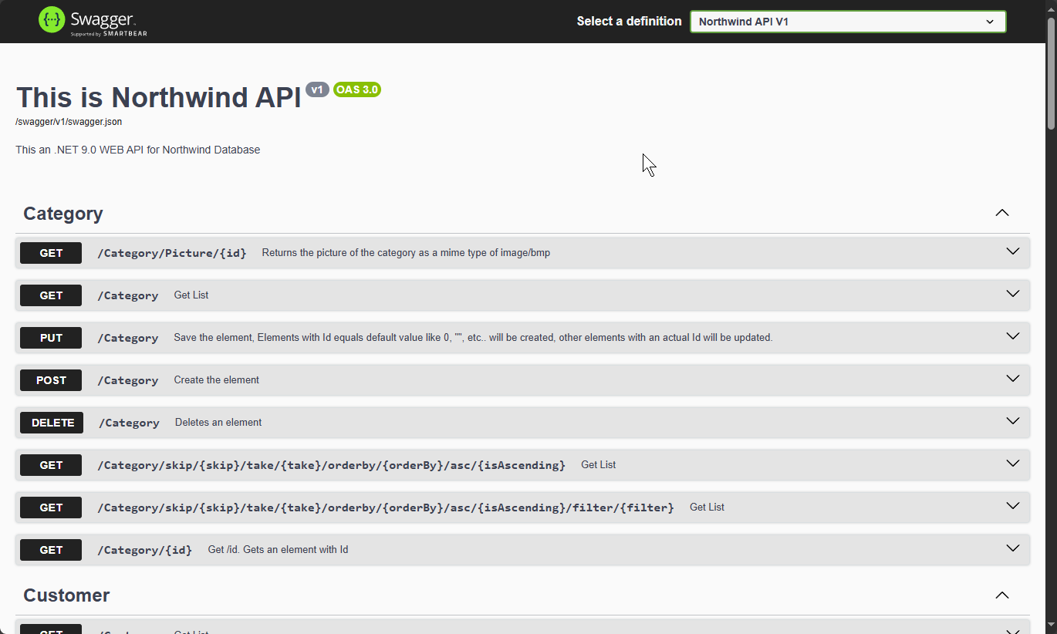
Northwind MCP Architecture
DB
REST API CRUD FUNCTIONS
REACT UI
Notes:
Let’s remember. Right now, in the end of 5th day we already completed the REST API

Slide 26
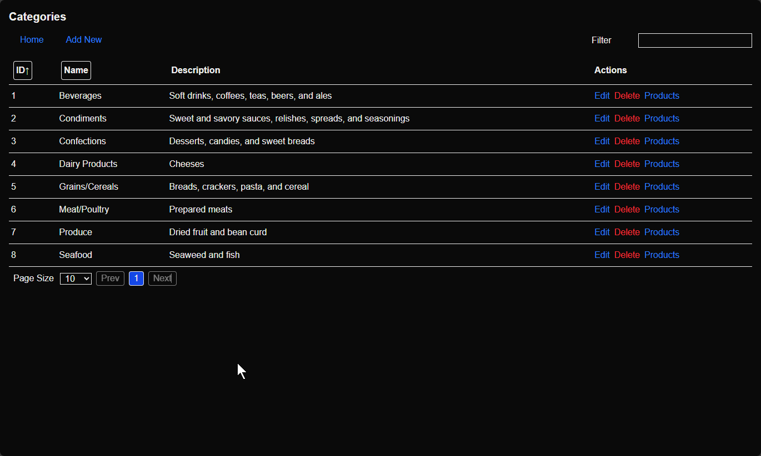
Northwind MCP Architecture
DB
REST API CRUD FUNCTIONS
REACT UI
Notes:
and the REACT UI that consumes that REST API.
Even with .NET 9 Backend modernization combined with modern Next.JS REACT UI the User interaction capability is limited.
Think about it; With this User Interface we have the capability for create, read, update and delete actions easily and fast, but what we can’t get all the information's when necessary. Yes, there is a search capability, order by column functionality, but there is still something missing. For example, this Categories listing and editing screens doesn’t have the capability show the most top categories according to product count? Or categories that have most or less ordered. Those are sounding like some reports, maybe those can be developed as reporting section. In upcoming sections I will talk about how affordable, cheap and efficient to develop a MCP server and client instead of reporting server along with reporting clients.

Slide 27
Northwind MCP Architecture
DB
MCP SERVER
TOOLS
RESOURCES
PROMPTS
REST API CRUD FUNCTIONS
REACT UI
Notes:
We will build MCP server and tools, resources and prompts inside it. Those will be a wrapper to REST API functions.
Why building here tools over REST API instead of directly using an SQL MCP Server directly connected to the Database?
1. First, security purposes, we don’t want to share all the database structure, information and data with agents.
2. Second, The CRUD REST API is the API that we are using for the User Interface, so the toolset for the users has been already be decided at that point. AI Agent is here no more than a power user for this application here.
3. Third, Logging and Metrics are already defined in the REST API Backend.
4. Last but not least, the performance of course. All the rate limiters, Froud layers, countermeasures, database separation strategies are defined at the REST API Gateway.
All of those and more reasons building the mcp server over on top of rest api gateway is a elegant choice.

Slide 28
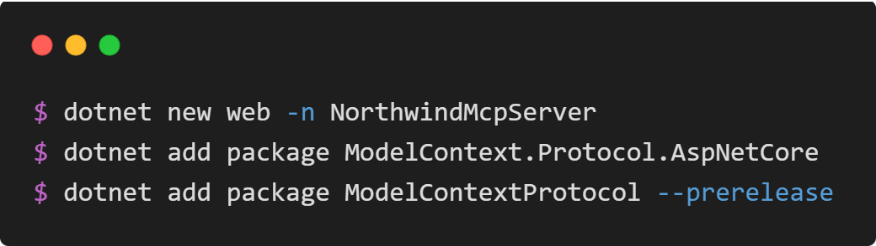
MCP Server
Notes:
Let’s create a web project inside /src folder. This will be our MCP server.
Add model context protocol nuget packages to the project.

Slide 29
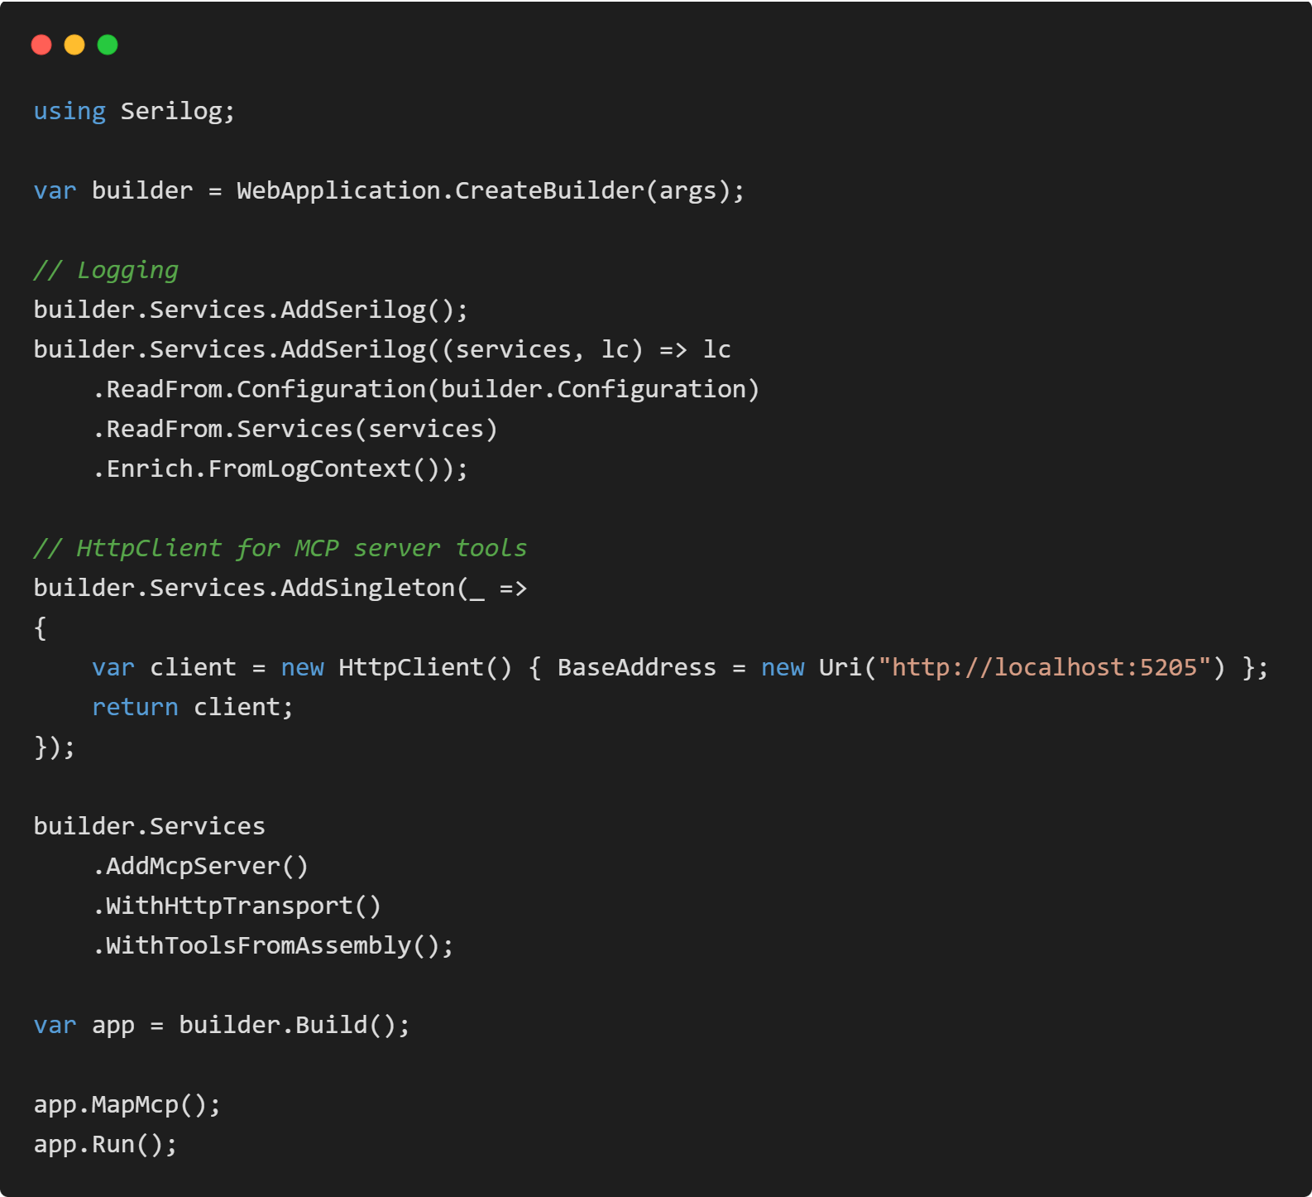
MCP Server Program.cs
Notes:
Let’s edit the program.cs for the MCP Server Web Project.
-------------------------------------------------------------------
Add some logging same as the backend API has. Same drill.
Then after add a Singleton generic HttpClient that has the CRUD Backend API Url as base address. This HttpClient will be used to send and retrieve data between Backend API and MCP server.
Finally, we can add a MCP server with http transport.
Map the MCP Tools and run the app.

Slide 30
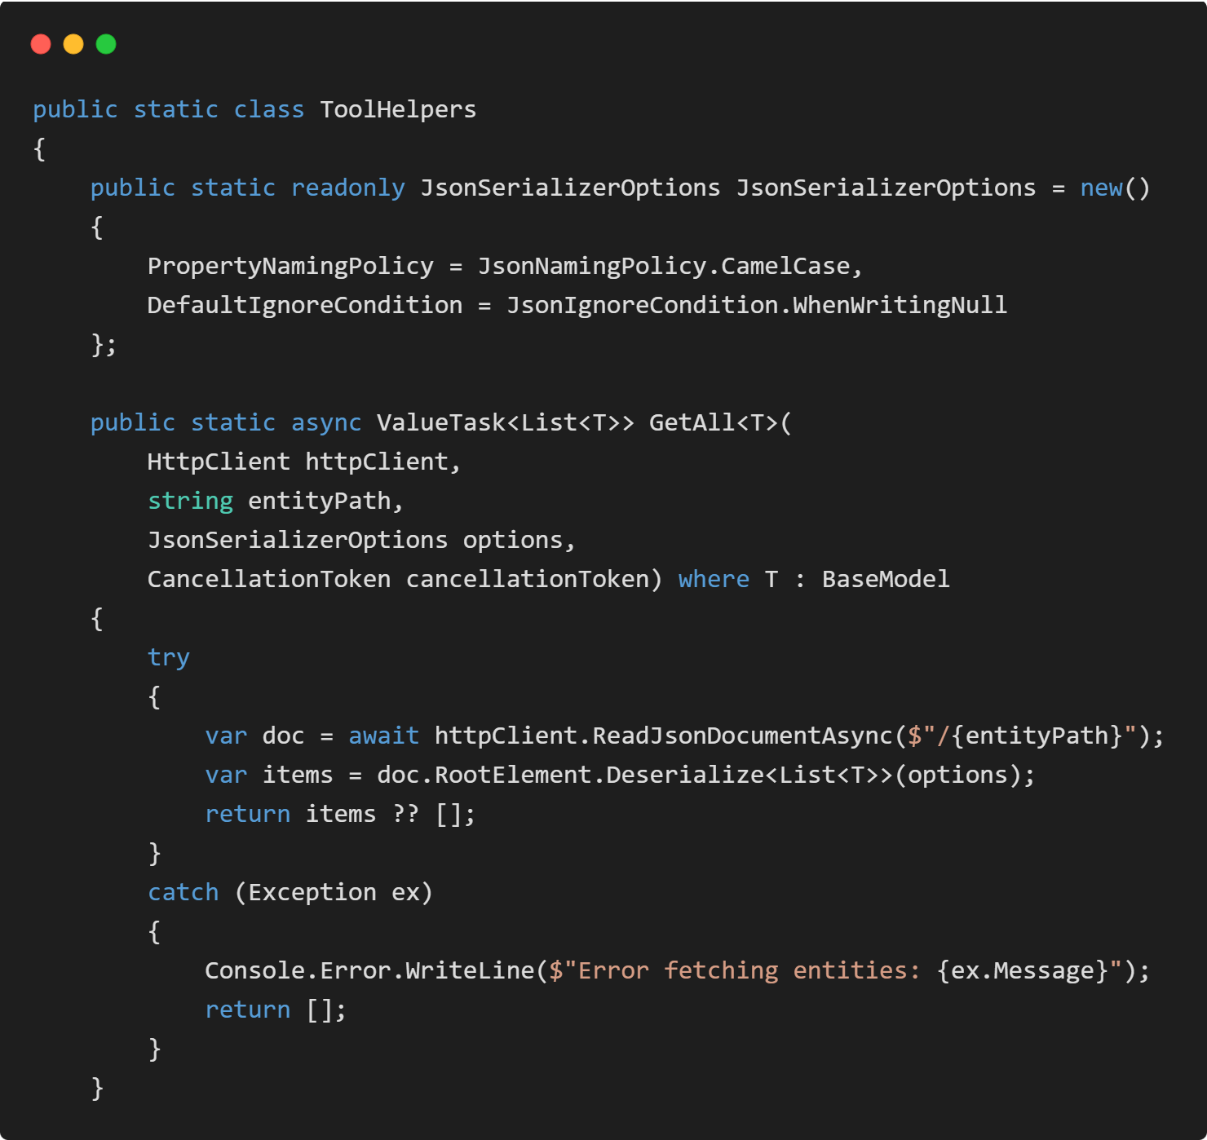
MCP Server Tool Helpers
Notes:
Here I try to wrap around my Gateway API with MCP Tools. Here as you can see, I am trying to abstract the implementation as much as I could.
For example, the GetAll method of T mean to be used for generic types of my entities open from API like Categories, Customers, Suppliers, Orders, Products. Basically, we call the GET method with http client. We use the relative URL of the entity at the API. API will return the elements in json format and here it will be parsed.

Slide 31
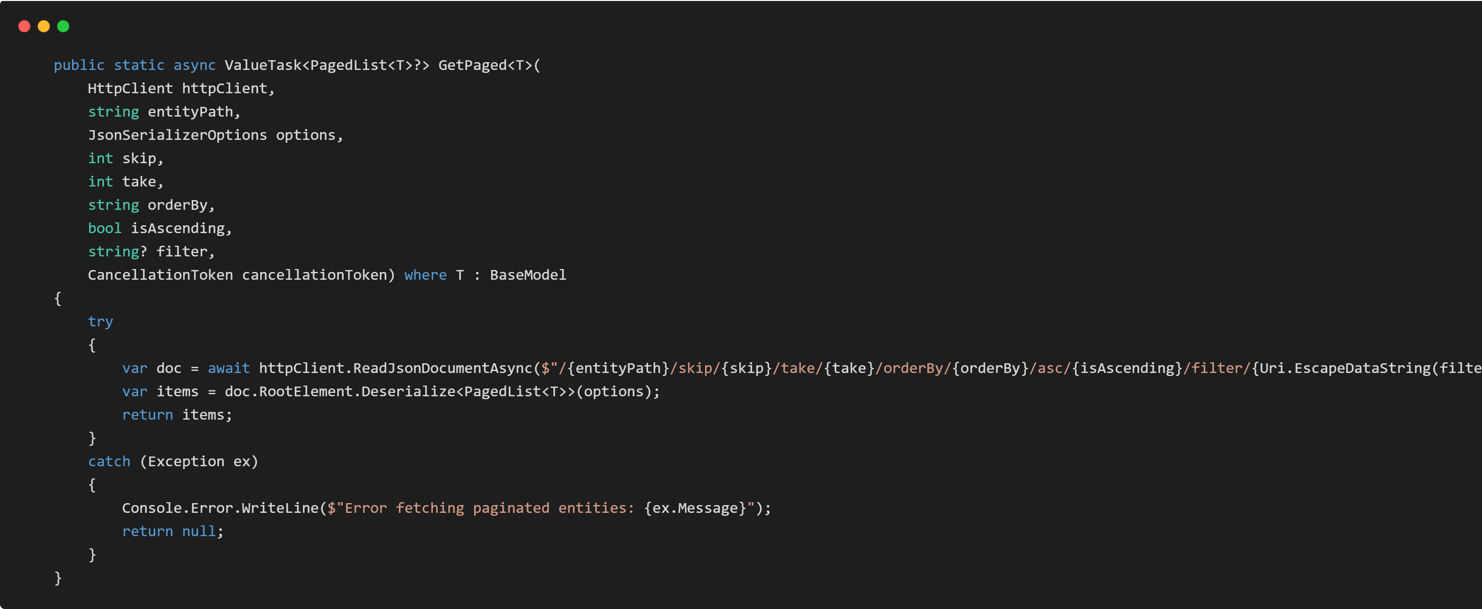
MCP Server Tool Helpers
Notes:
Same way we could also implement the GetPaged method. The URL pattern is known and again with HttpClient we call the get method, collect the json response, parse it and return the same type. Here we are returning Paged List of T. T is generic, but PagedList is our creation as we remember from the DAY 1 API.

Slide 32
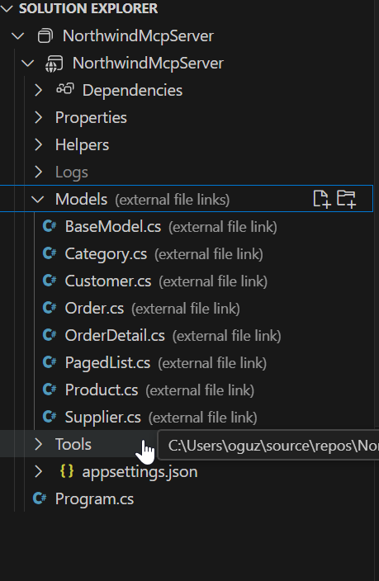
DTO Model files - POCO Classes
Notes:
The Paged List and all other dto model files must be linked to the MCP Server. This way MCP server also know the types of the Gateway API.

Slide 33
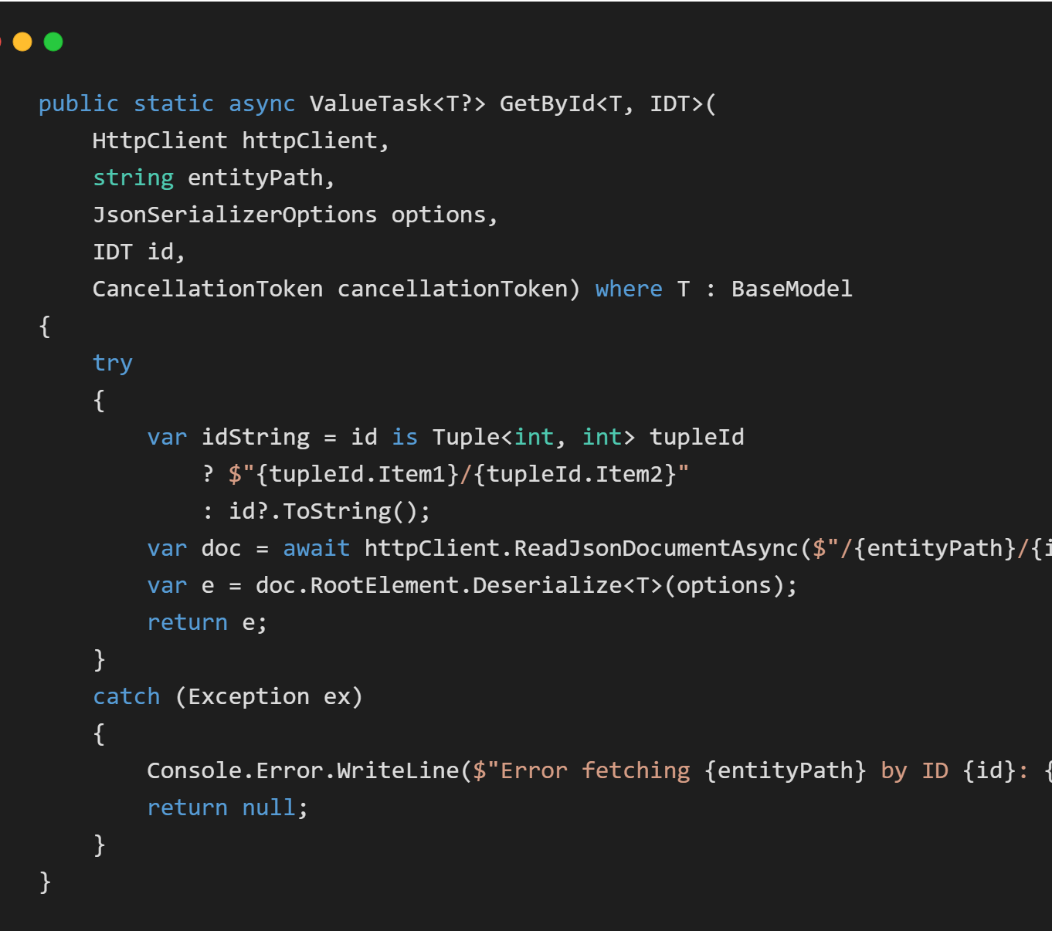
MCP Server Tool Helpers
Notes:
Let's go back to Generic tool helpers.
Same way we can implement the get method of the single entity with an ID. Here also as you can see the IDT is the generic type of the entity key. This way we can handle the integer, string, combined keys from generic methods.

Slide 34
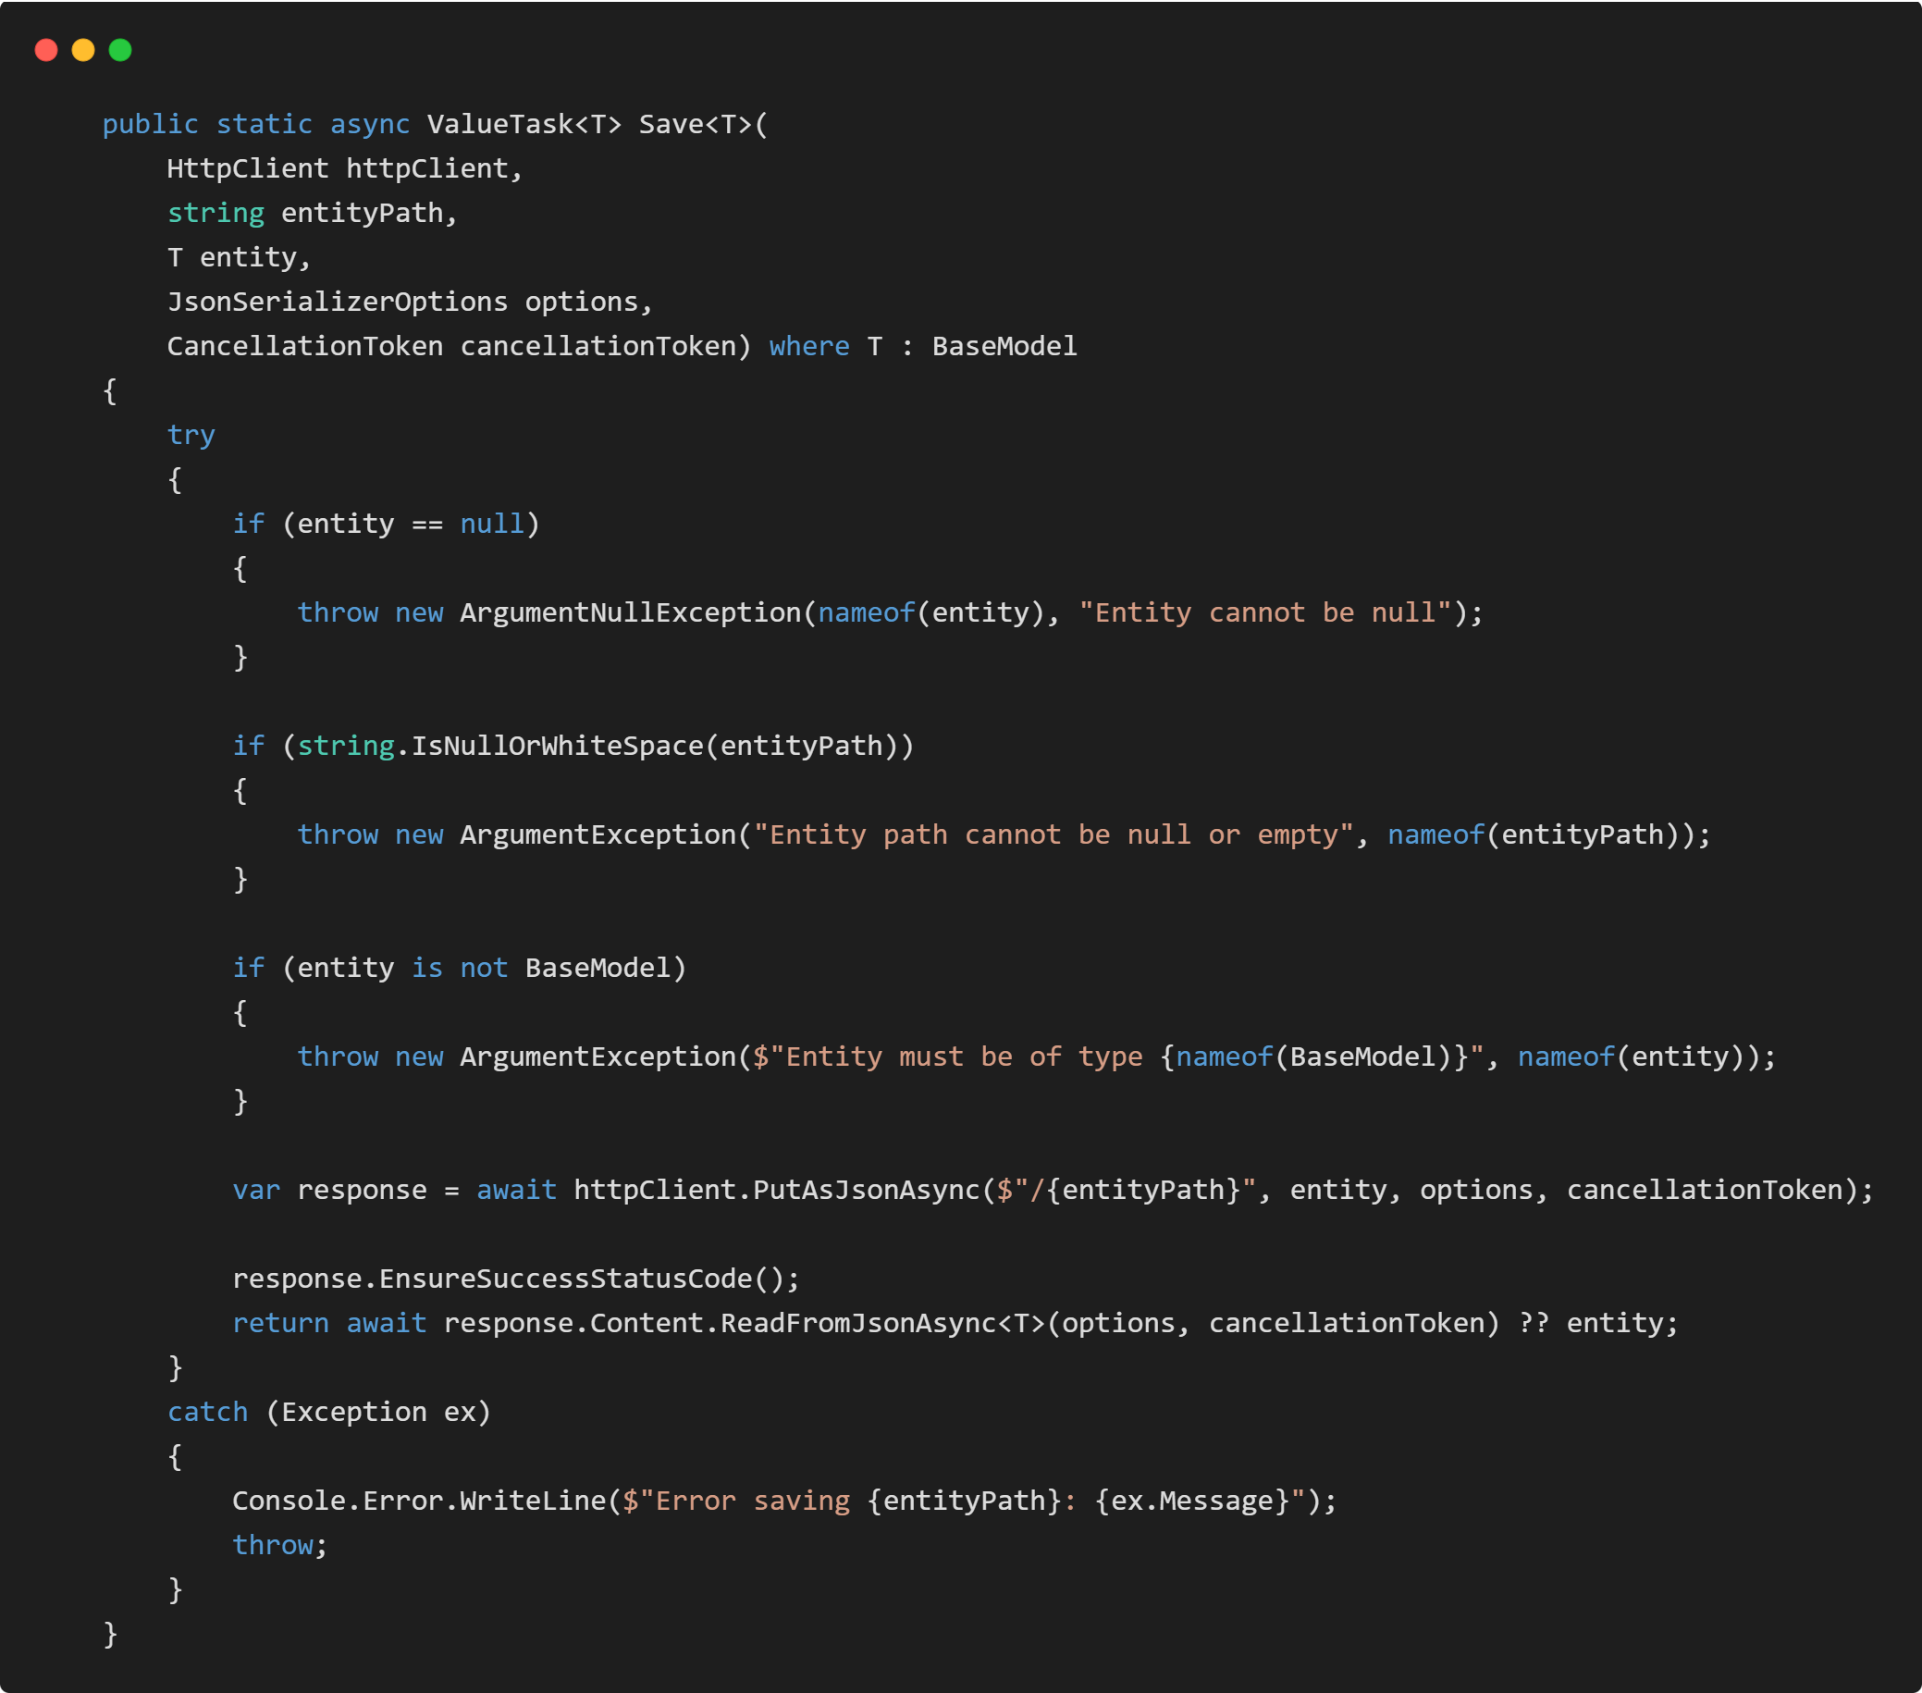
MCP Server Tool Helpers
Notes:
A generic Save. Wrapped over HTTP Put method of our API.

Slide 35
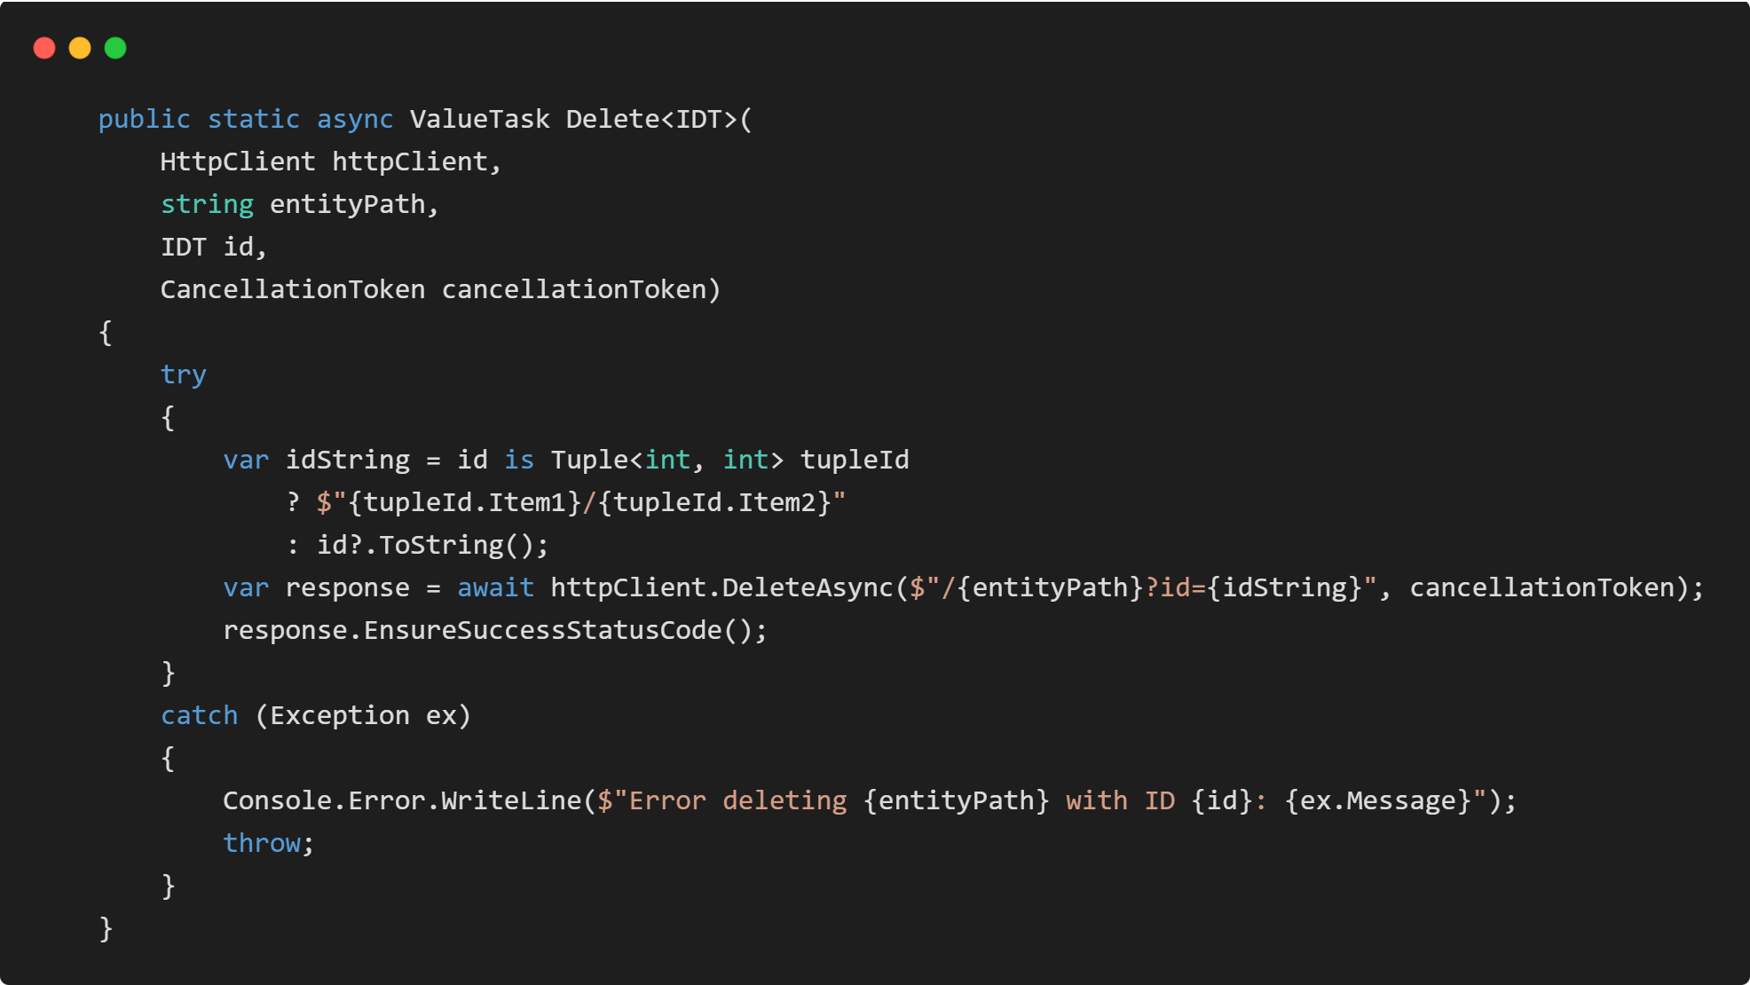
MCP Server Tool Helpers
Notes:
A generic Delete. Wrapped over HTTP Delete method of our API.

Slide 36
MCP SERVER
TOOLS
Notes:
Since the tool helper methods according to our Gateway API are ready, we can now develop the actual tools for AI Agent inside our MCP Server.

Slide 37
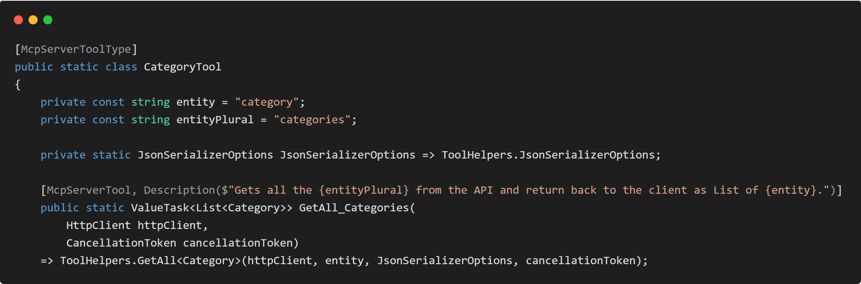
MCP Server - Tools
Notes:
Let's start with Category
First, we create a static class called CategoryTool with McoServerToolType attribute. This attribute in the assembly will indicate this static class is a toolset.
For further usage I will define the entity name and its plural as constants here. I will use those to create generic descriptions. That makes easy to create copies of the descriptions across tools now.
Since the helper methods are created, we can easily create a Get All method for categories. What is important here is the McpServerTool attribute and its description. AI Agents will look upon to this attribute and understand the functionality from its description.

Slide 38
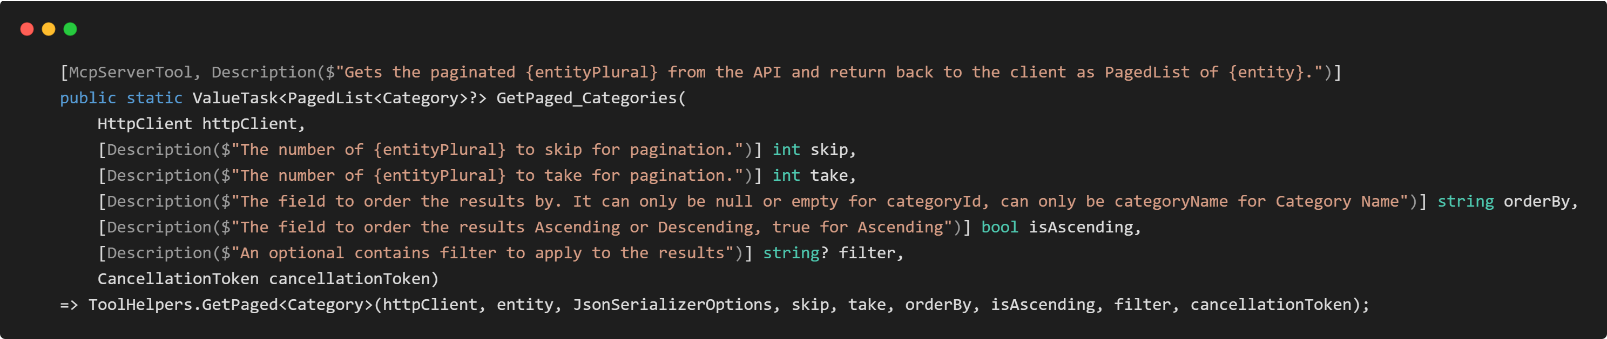
MCP Server - Tools
Notes:
Same way we can easily create a Get Paged method for categories. Return Types are our DTO’s as you can see

Slide 39
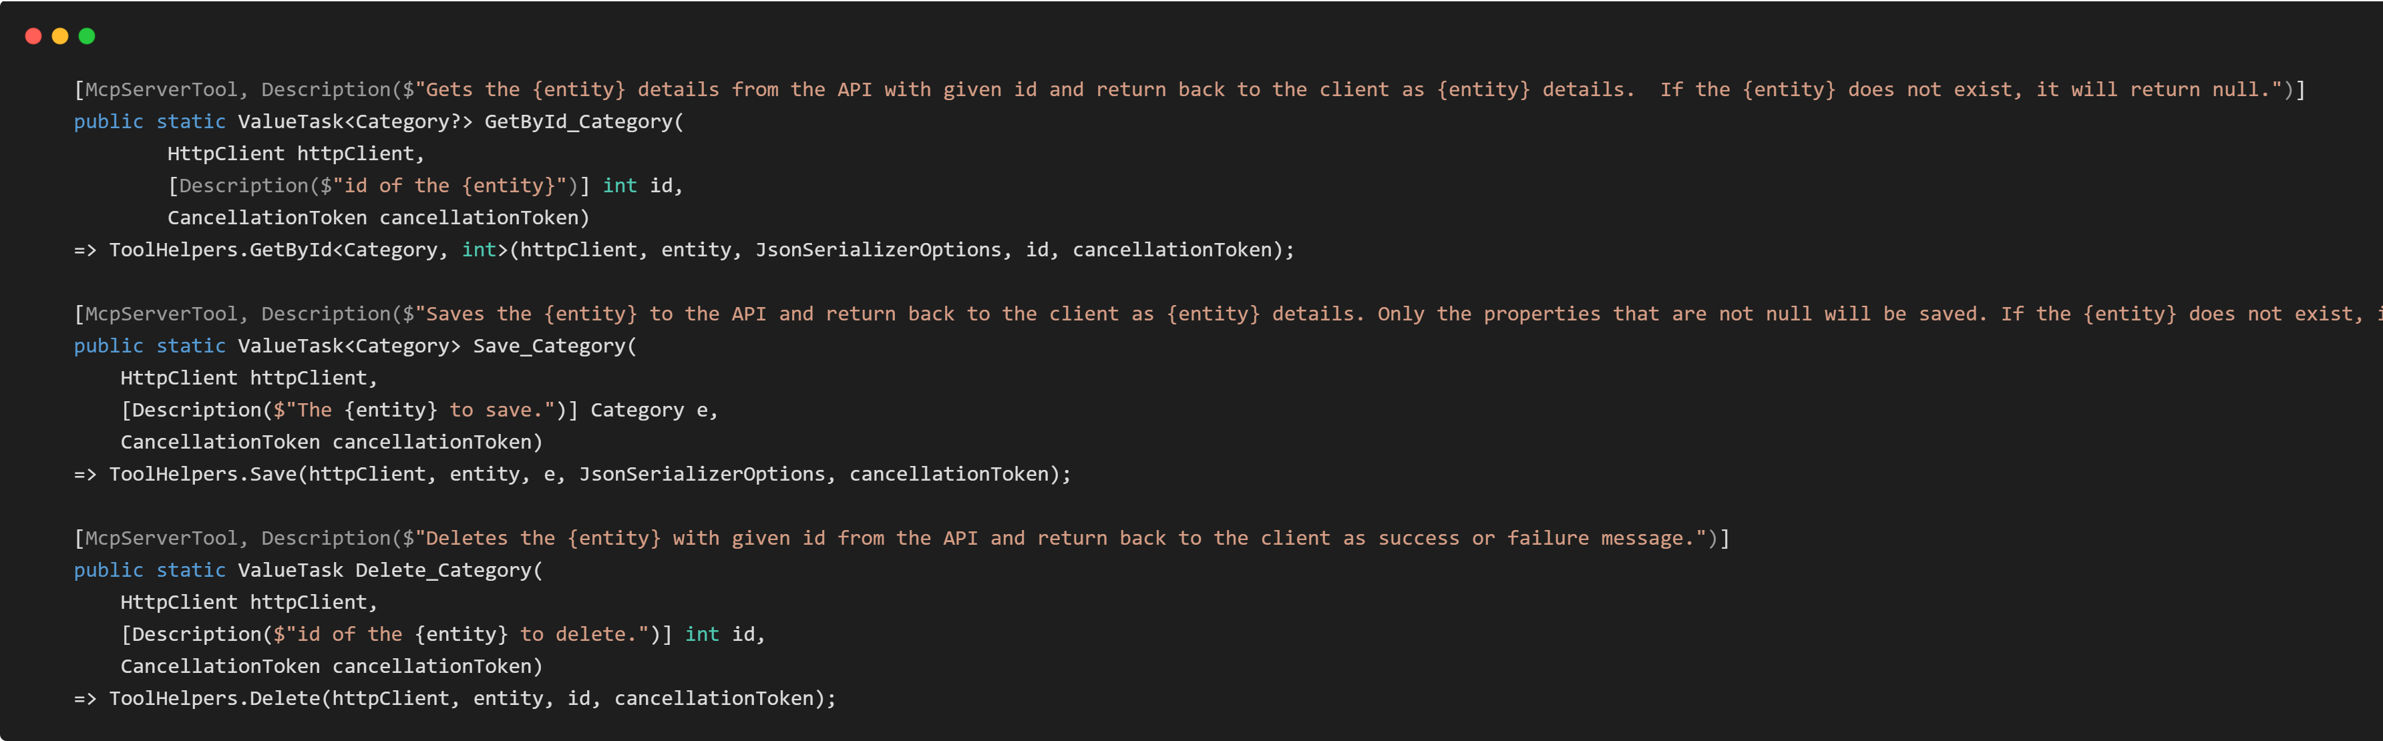
MCP Server - Tools
Notes:
Same way we can easily create other methods like Get By Id, Save and Delete for categories.

Slide 40
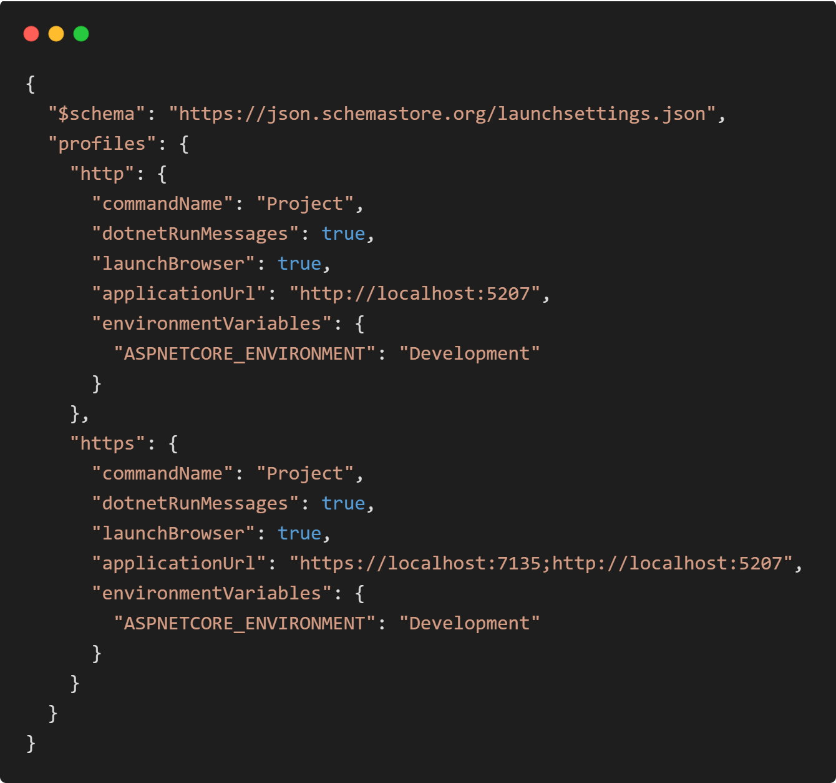
MCP Server Launch Config
Notes:
Let's put in the launch setting an http profile that will run this MCP server at the port 5207.
We can move on to testing now.

Slide 41
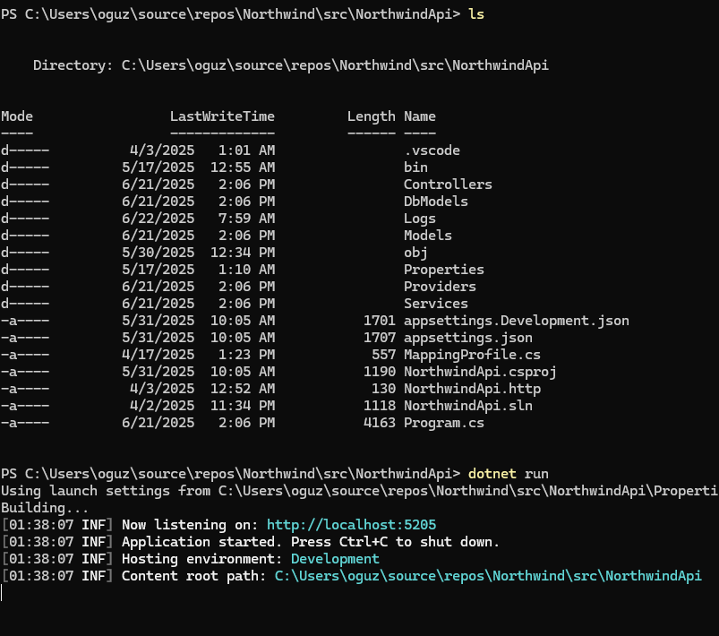
MCP Server Test
Notes:
First start the API at the port 5205.

Slide 42
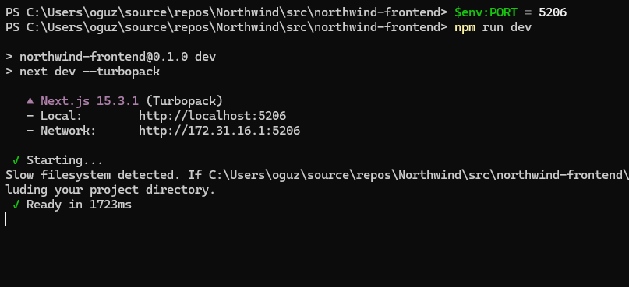
MCP Server Test
Notes:
Optionally start the React UI at the port 5206.

Slide 43
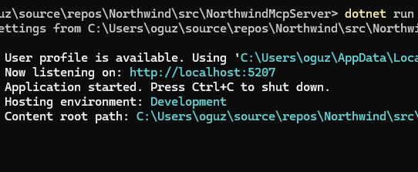
MCP Server Test
Notes:
We can start the MCP Server at the port 5207.

Slide 44
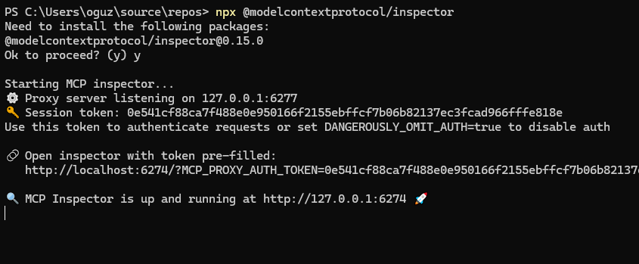
MCP Server Test
Notes:
With npx @modelcontextprotocol / inspector command at the powershell we can start the mcp inspector. The MCP inspector is a developer tool for testing and debugging MCP servers. It is open source and can be found at the github.

Slide 45
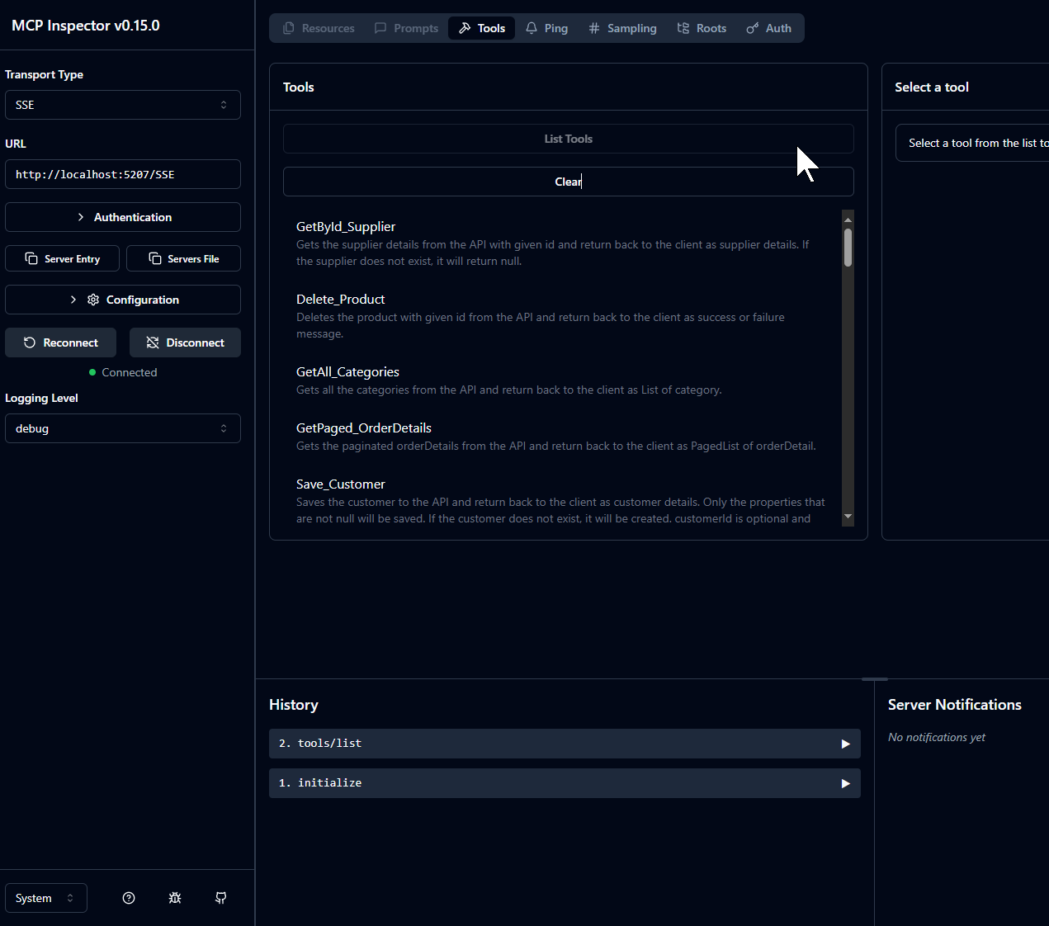
MCP Server Test
Notes:
For the mcp inspector use the url of the MCP Server with SSE, Server Sent Events transport type and the url localhost with port 5207/SSE. This will be the MCP Server Endpoint.
If we click the List Tools. We can see all the tools that we have implemented at the server.

Slide 46
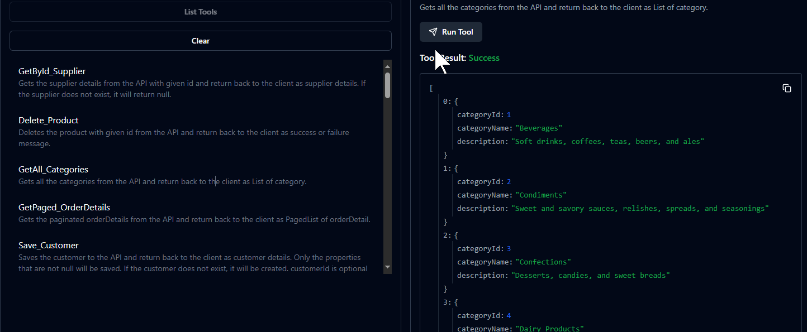
MCP Server Test
Notes:
For example, if we click the GetAll_Categories and Run Tool, we can observe the MCP Server make an API call to the Categories and retrieve all the categories data. This way we can test our MCP server and may write test cases with for unit testing. All the MCP tool responses needs to match the API Gateway responses.

Slide 47
Northwind MCP Architecture
DB
MCP SERVER
TOOLS
RESOURCES
PROMPTS
REST API CRUD FUNCTIONS
REACT UI
Notes:
We came so far to MCP Server.

Slide 48
Northwind MCP Architecture
DB
MCP SERVER
TOOLS
RESOURCES
PROMPTS
AGENT REST API
AGENTS
REST API CRUD FUNCTIONS
MCP CLIENT
REACT UI
Notes:
Next step, we will implement an AGENT REST API. There will be 2 components inside this API. Agents and MCP Client.

Slide 49
Northwind MCP Architecture
DB
MCP SERVER
TOOLS
RESOURCES
PROMPTS
AGENT REST API
AGENTS
REST API CRUD FUNCTIONS
MCP CLIENT
REACT UI
Notes:
MCP Client is the consumer of the MCP Server and make calls to the tools.

Slide 50
Northwind MCP Architecture
DB
OPENAI MODELS
MCP SERVER
TOOLS
RESOURCES
PROMPTS
AGENT REST API
AGENTS
REST API CRUD FUNCTIONS
MCP CLIENT
REACT UI
Notes:
Agents Integration will integrate OPEN AI Model or any other Agent capable LLMs. This component manage the communication between AI and MCP Tools.

Slide 51
Northwind MCP Architecture
DB
OPENAI MODELS
MCP SERVER
TOOLS
RESOURCES
PROMPTS
AGENT REST API
AGENTS
REST API CRUD FUNCTIONS
MCP CLIENT
REACT UI
Notes:
Finally React User Interface will consume this AGENT REST API along with CRUD REST API GATEWAY. Basically, React UI Post a prompt query to the AGENT REST API and this API will generate a response asking it to the OPEN AI Models, the model will use the data from the MCP Server Tools.

Slide 52
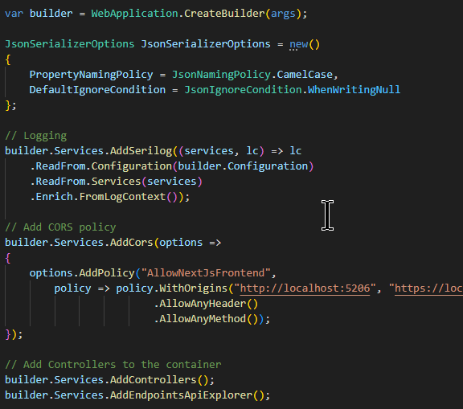
Agent REST API – Program.cs
Notes:
Let's start a dotnet web project to be able to make a Web API solution. Same drill like Gateway API.
Add Logging
Add Cors policy for REACT Next.JS UI. It will consume this service.
Add the controllers and Endpoints Api Explorer to the Dependency Injection Container.
Those were standard non MCP related stuff.

Slide 53
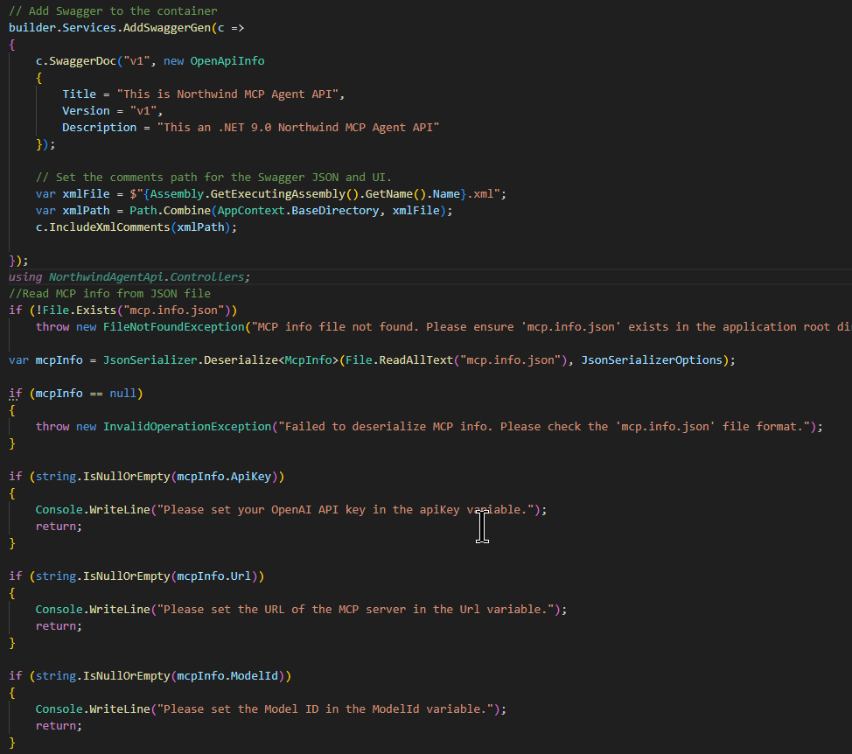
Agent REST API – Program.cs
Notes:
After adding the Swagger Stuff, we can put a code to read the mcpInfo from the mcp.info.json. This is a made-up file by me. I am storing at this file;
a Url to the mcp server for the mcp client usage. Url is on our example http://localhost:5207/SSE.
API key for OPEN AI. Can be created from their web portal. To use Chat GPT as a Agent here.
Model Id can be for example gpt-4.1 or other chat gpt models.

Slide 54
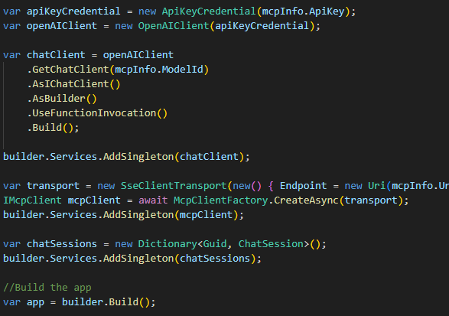
Agent REST API – Program.cs
Notes:
According to the Api Key We construct an OpenAIClient. From this OpenAI Client, we will use the model Id and create a chat client with factory pattern. We can now inject to the DI container as Singleton Instance. This instance will be used by controllers to query prompts to the Open AI LLM Models.
To consume the MCP Server Tools, we will construct a Server Side Event Client Transport with MCP Server URL, with that transport we construct a mcpClient and Inject it as a singleton object to the DI.
Also, we implement a dictionary of Guid and ChatSession. Here we are storing the chat history with Agent in memory. ChatSession is a custom class that I have created, and I will come to that in upcoming slides.

Slide 55
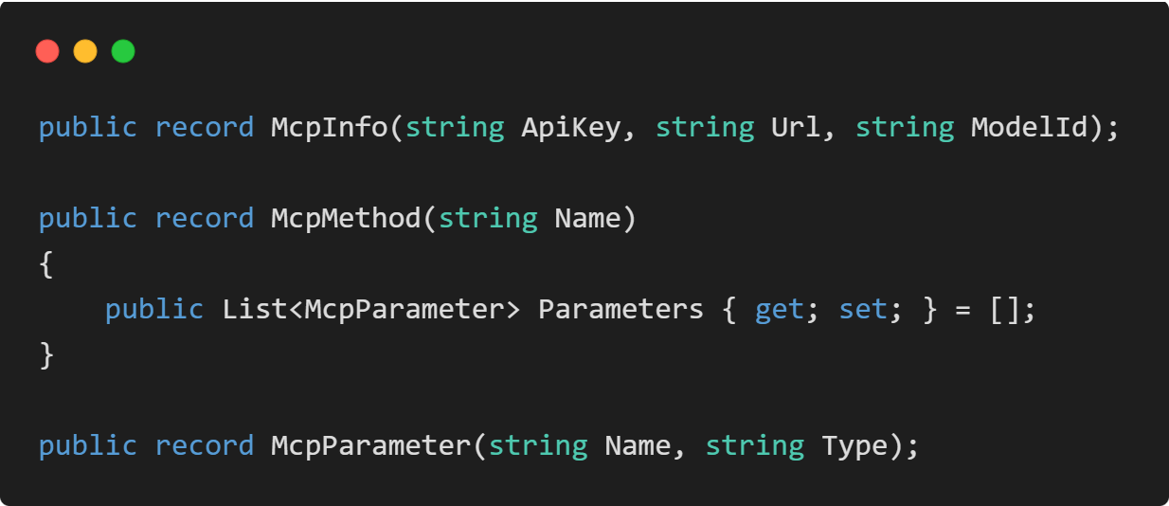
Agent REST API – MCP Classes
Notes:
Let’s implement some classes like McpInfo, McpMethod, McpParameter as records.

Slide 56
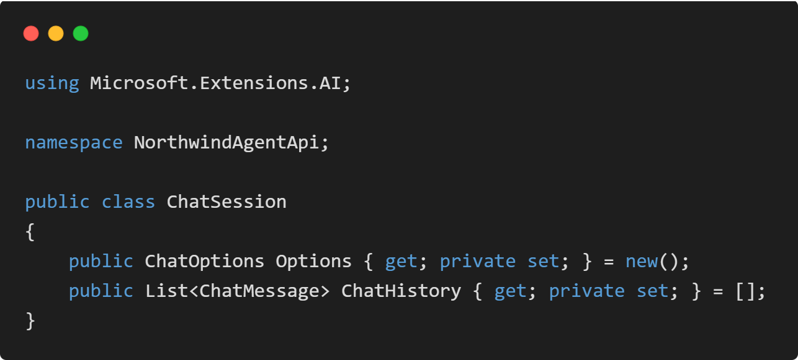
Agent REST API – Chat Session
Notes:
Chat Session class is a memory template to store the chat history and options.

Slide 57
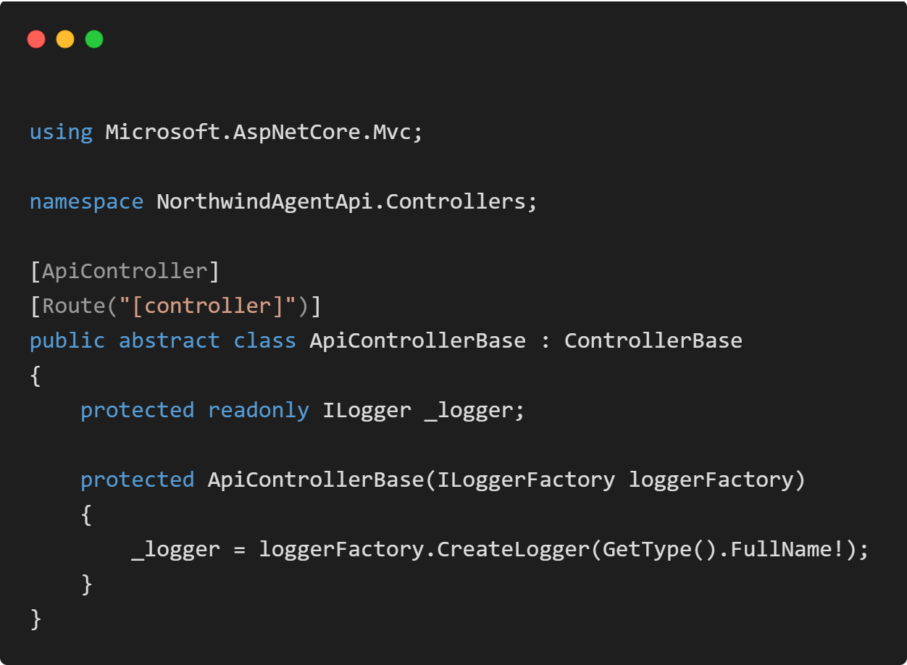
Agent REST API – Api Controller Base
Notes:
Same drill as Gateway API implement an Api Controller Base.

Slide 58
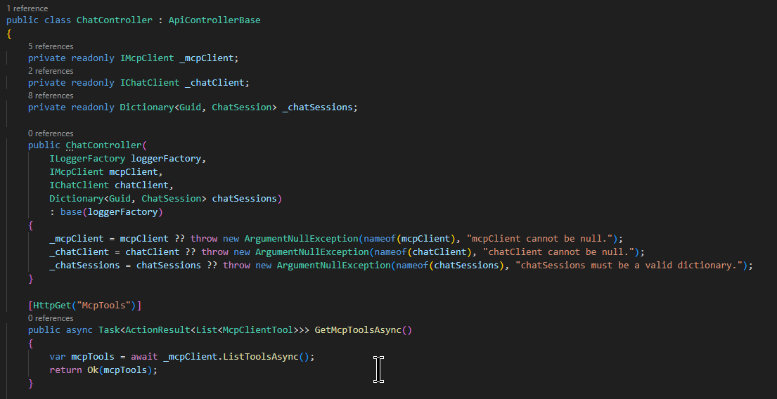
Agent REST API – Chat Controller
Notes:
Implement a ChatController, has mcp client, chat client, chat sessions components.
Implement a http get method that returns the mcp tool list. Get Mcp Tools Async.

Slide 59
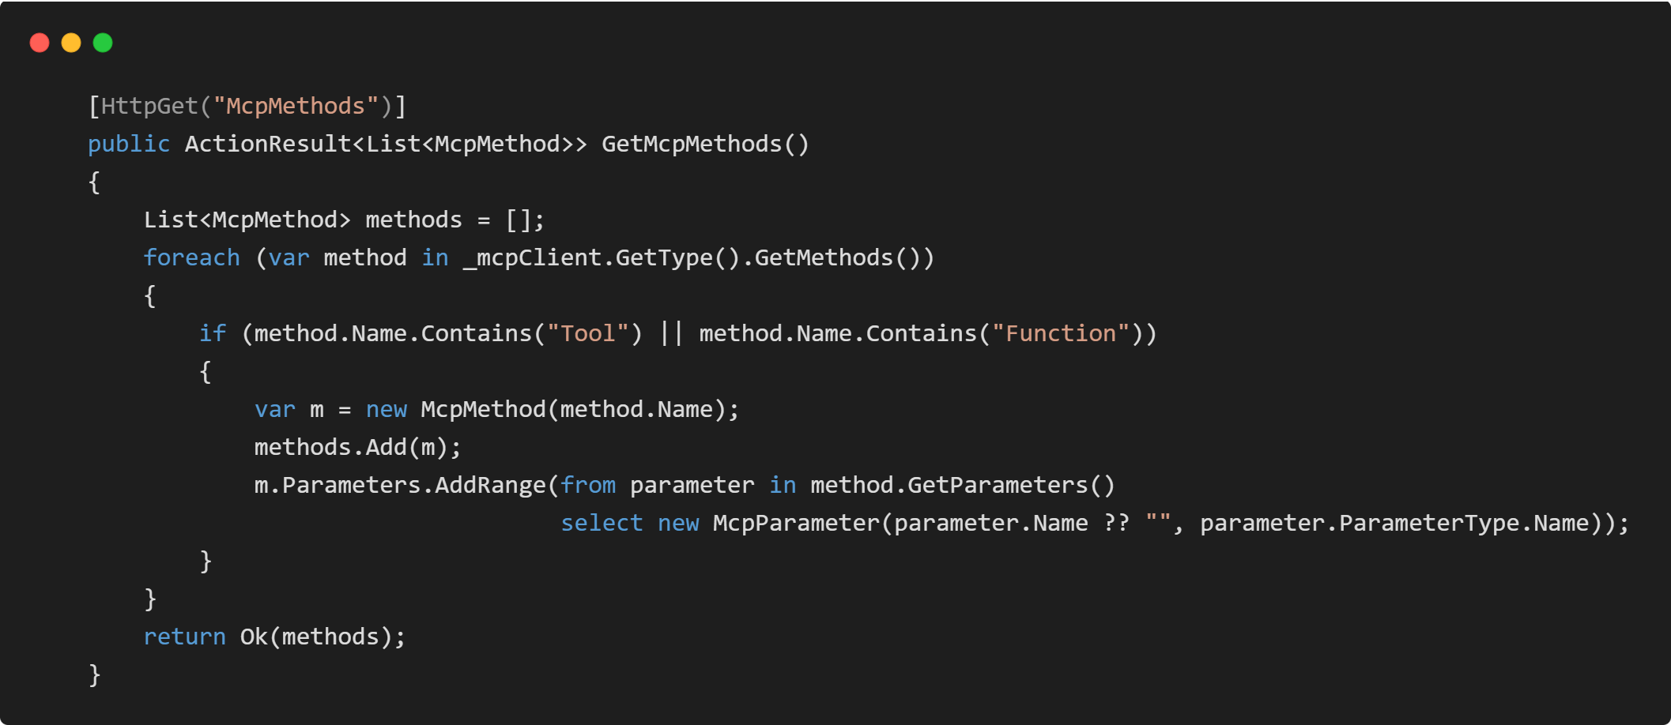
Agent REST API – Chat Controller
Notes:
Implement a http get method that returns the mcp methods list. Get Mcp Methods.

Slide 60
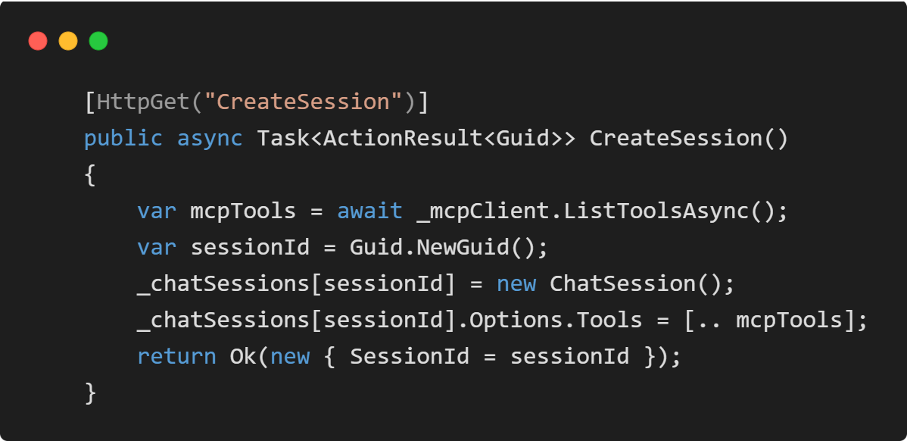
Agent REST API – Chat Controller
Notes:
A Http get method for Create Session and returning the session Id. The chat session will be stored along with the mcp tools.

Slide 61
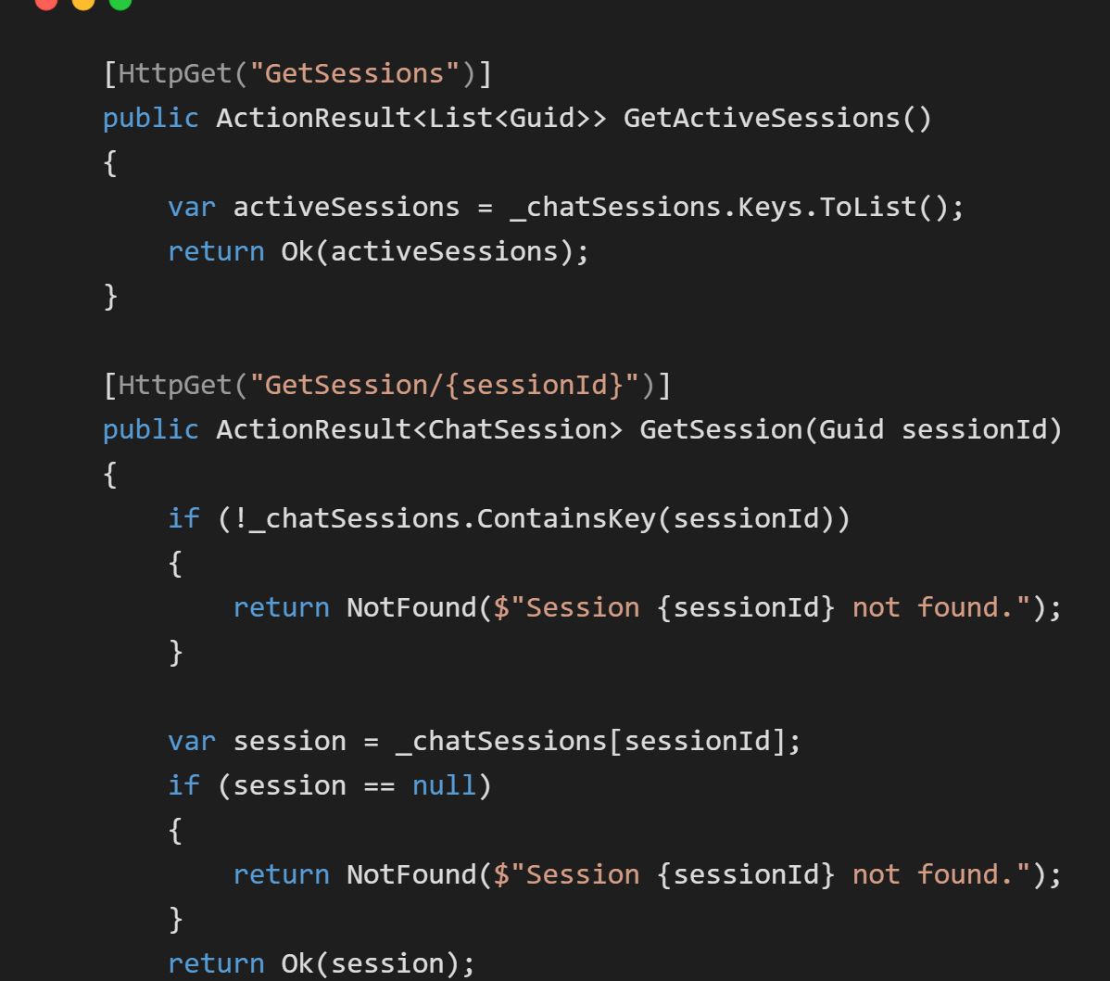
Agent REST API – Chat Controller
Notes:
Http get methods for retrieve sessions can be implemented like this.

Slide 62
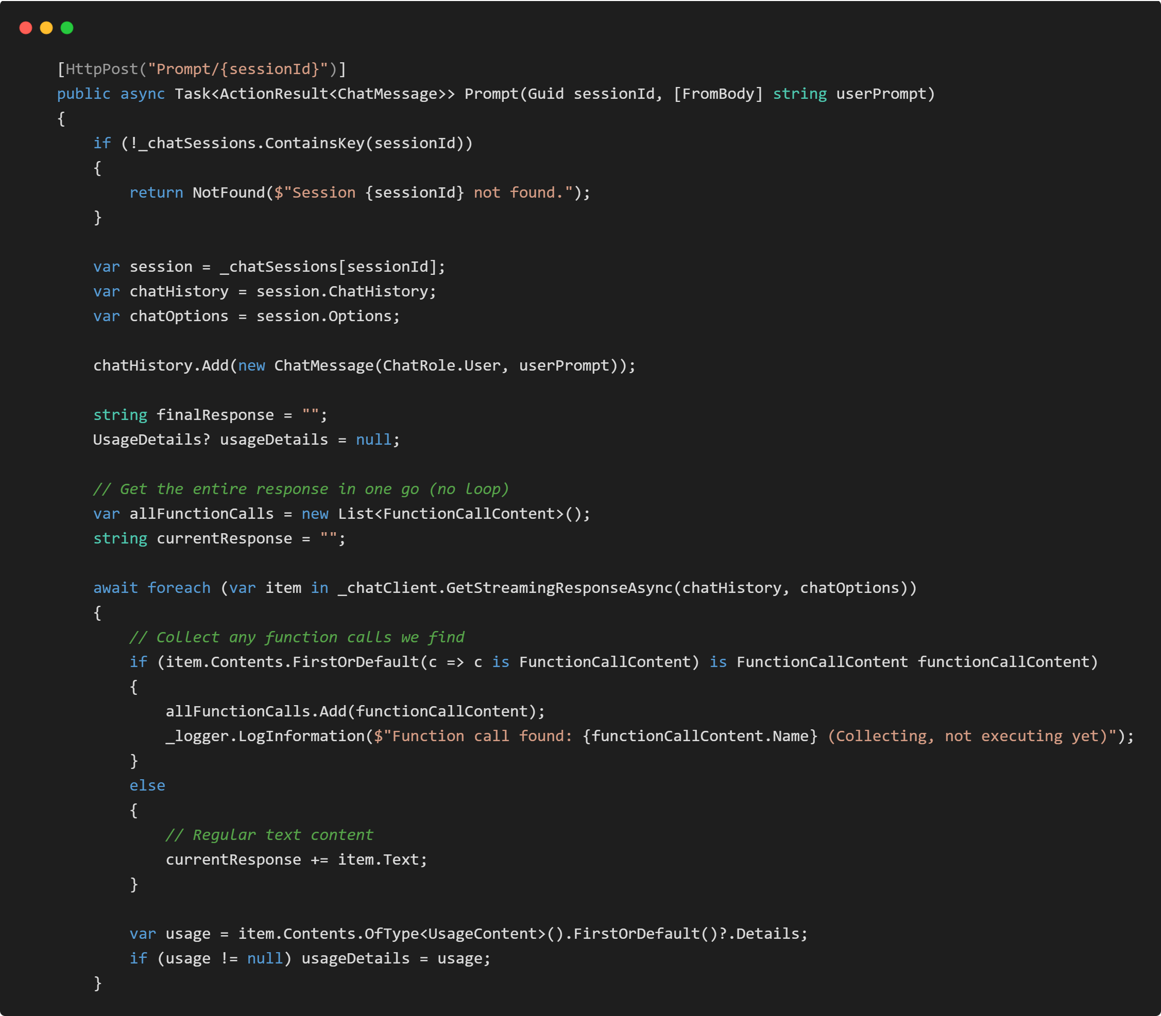
Agent REST API – Chat Controller
Notes:
Let's create the most important function of this Chat Controller. Getting the prompt with Chat / Prompt / SessionId as Http Post Method.
Add the user prompt.
Get the entire response in one go (no loop)
Get the Streaming Response from chat client
Collect any function calls we find
Collect any regular text content in currentResponse text.
Collect usage details.

Slide 63
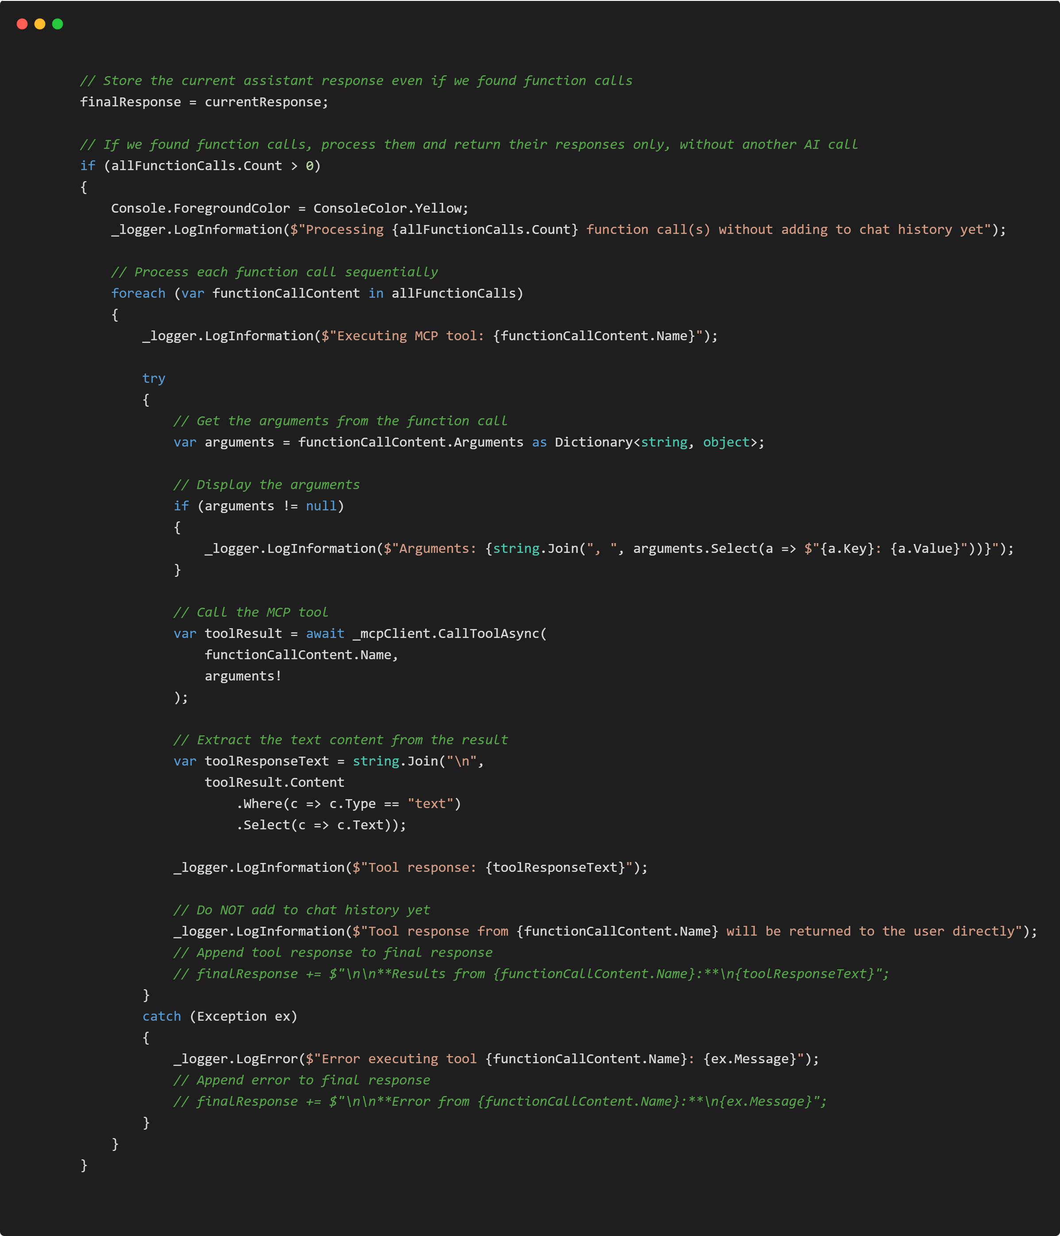
Agent REST API – Chat Controller
Notes:
Store the current assistant response even if we found function calls.
If we found function calls, process them and return their responses only, without another AI call
Process each function call sequentially
Get the arguments from the function call
Display the arguments
Call the MCP tool
Extract the text content from the result

Slide 64
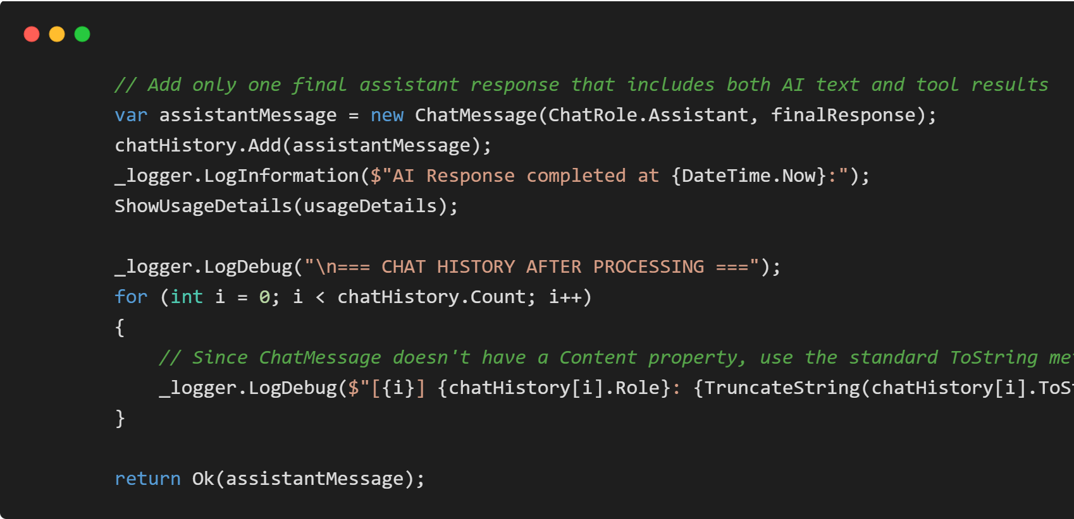
Agent REST API – Chat Controller
Notes:
Add only one final assistant response that includes both AI text and tool results
Since ChatMessage doesn't have a Content property, use the standard ToString method
Return Assistant Message.

Slide 65
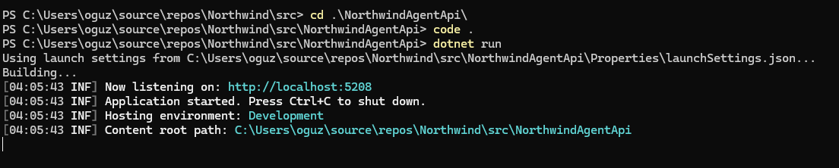
Agent REST API – Chat Controller
Notes:
Let's run the MCP Agent API a.t the port 5208

Slide 66
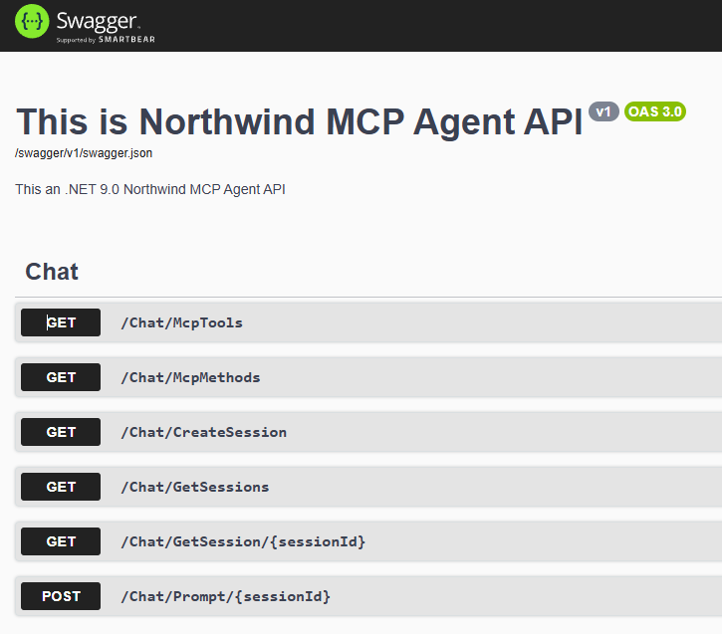
Agent REST API – Chat Controller
Notes:
We can observe the Northwind MCP Agent API Swagger output. It is ready to consumed by the REACT UI.

Slide 67
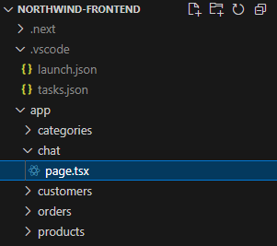
REACT UI – Chat Page
Notes:
We dive into the react next js code base and create a chat page type script file.

Slide 68
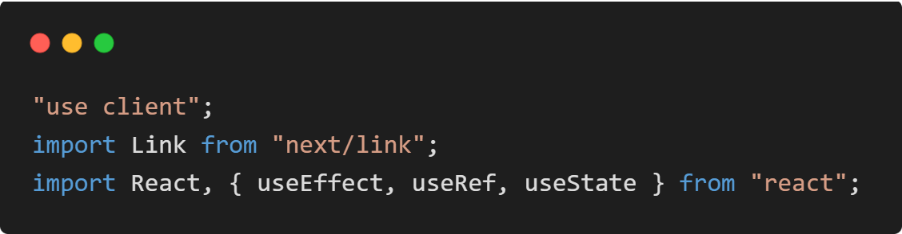
REACT UI – Chat Page
Notes:
First import the dependencies, next.js link and react useEffect, useRef and useState.

Slide 69
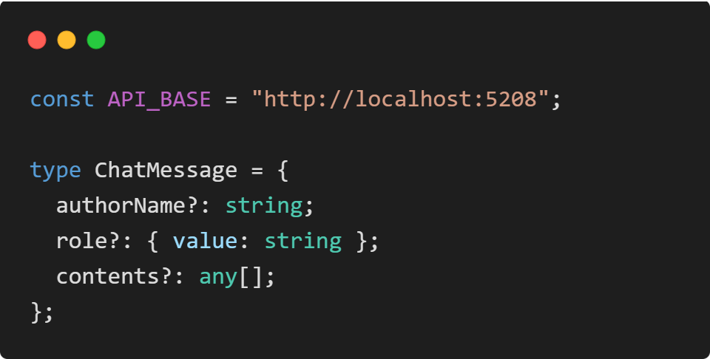
REACT UI – Chat Page
Notes:
Define an API Base URL for the Agent API and the ChatMessage class. This is the POCO representation of Microsoft.Extensions.AI.ChatMessage. This was the response type of the Prompt HTTP POST of the API.

Slide 70
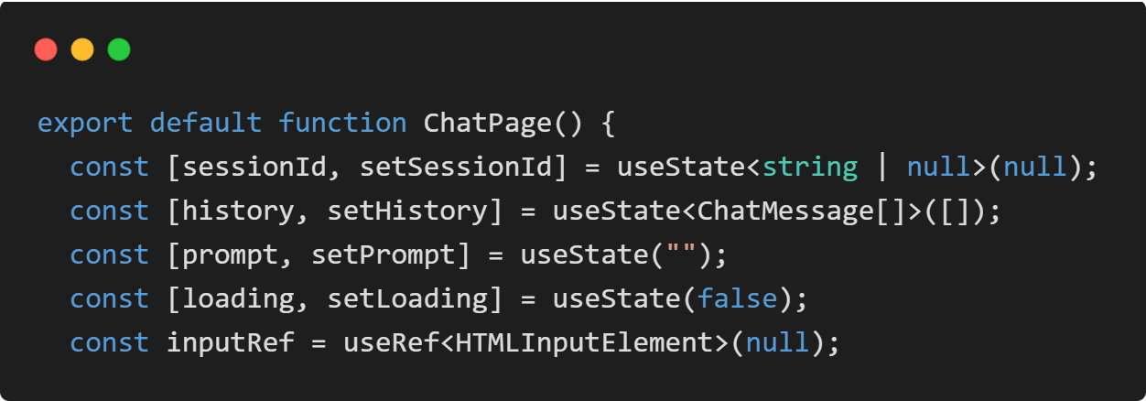
REACT UI – Chat Page
Notes:
We define the bindable properties that we are showing in the UI. Session Id, Chat History, User Prompt that user will edit on the runtime to send to server, loading indicator and inputRef HTMLInputElement to be able to manage focus after loading the page.

Slide 71
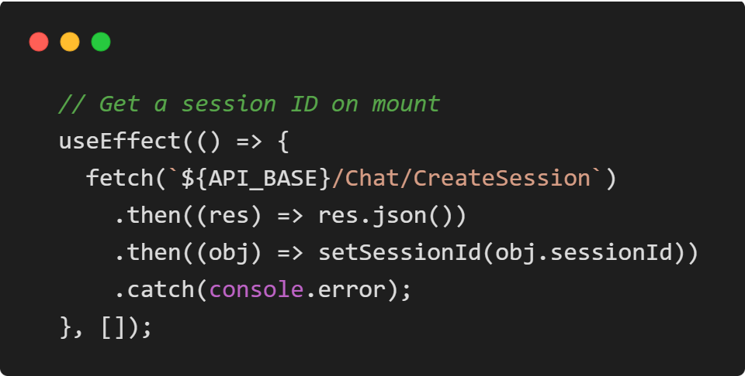
REACT UI – Chat Page
Notes:
Get a session ID on mount

Slide 72
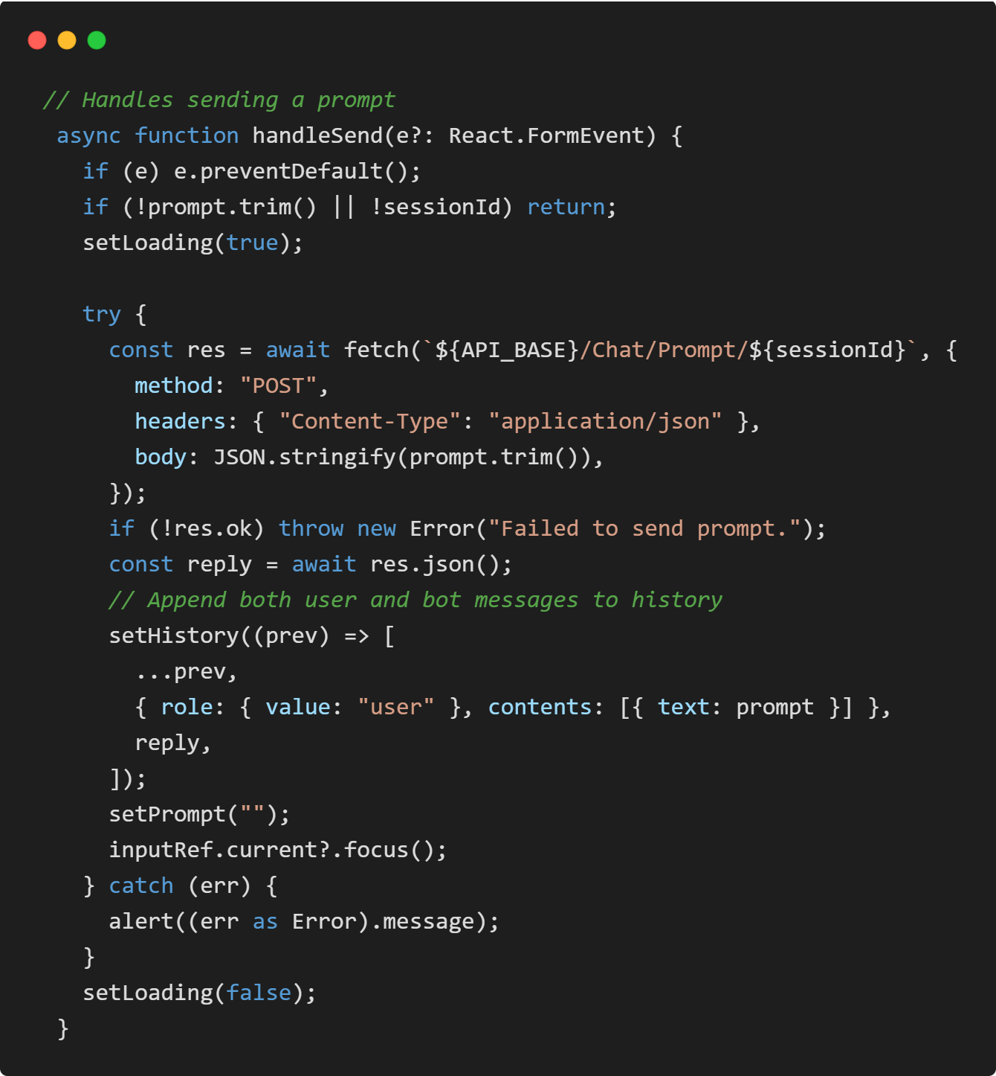
REACT UI – Chat Page
Notes:
Handle sending a prompt like this. When a reply is received append both user and bot messages to history.

Slide 73
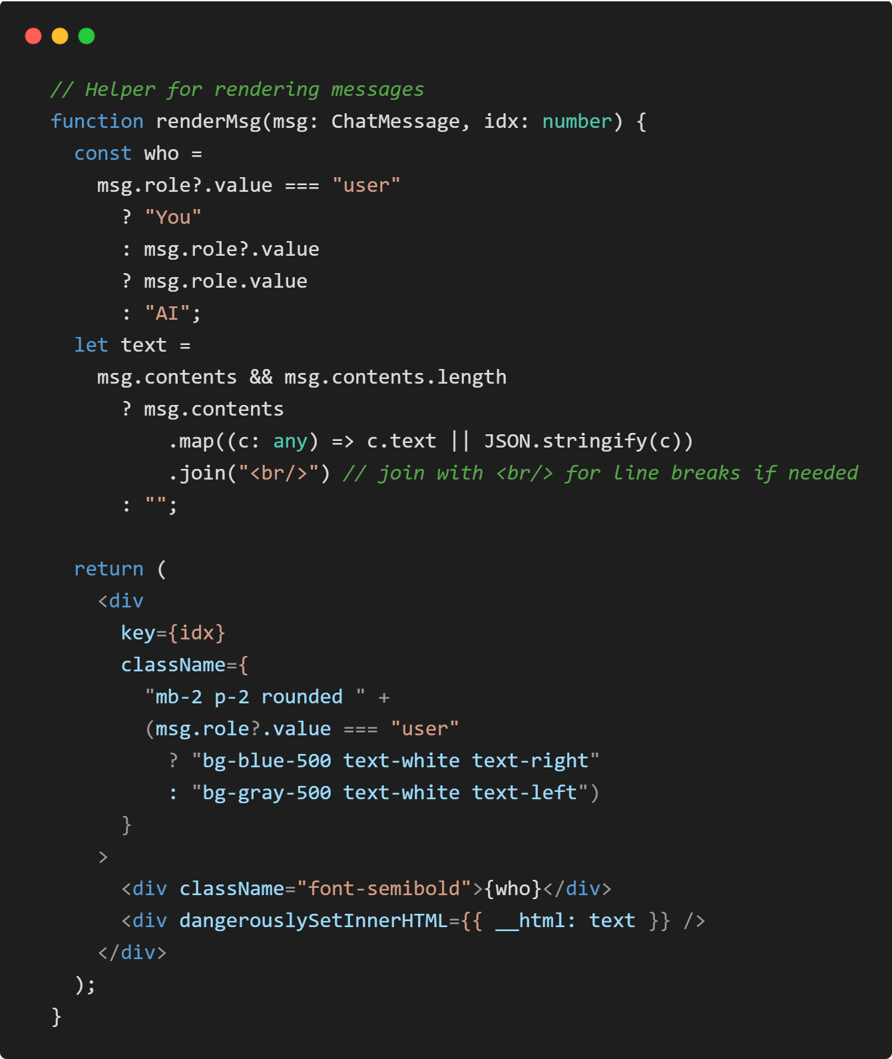
REACT UI – Chat Page
Notes:
This way we can render messages from the agent api.

Slide 74

REACT UI – Chat Page
Notes:
Finally, we render the html of the chat page now. A Home button, a title called Chat with MCP Agent, Session Id underneath. Until it gets it will show Initializing the the session ıd.
It will render chat history and an inputbox with send button to be able to send prompt to the server.

Slide 75

REACT UI – Chat Page
Notes:
Let's put a button to our new chat page.

Slide 76

REACT UI – Chat Page
Notes:
In the end let's make it a demo along with testing the whole system. Initial Chat page will look like this.

Slide 77

REACT UI – Chat Page
Notes:
A basic question like ‘get me the top 5 categories ordered by name’. Gets a correct answer. It is very straight forward tool call and easy to respond by chat gpt when MCP server tools are present.

Slide 78

Agent API Logs
Notes:
Let's check the logs what happening step by step when we ask this basic question. First the Agent API.
As the logs indicates; Open API Agent Model Chat GPT 4 understands the prompt and the tools from MCP Server. Finds out the necessary tool called GetPaged_Categories. Execute and collect the top 5 category by name in 6 seconds.

Slide 79
MCP Server LOGS
Notes:
We can observe the tool call also at the MCP Server Logs.

Slide 80

CRUD REST API LOGS
Notes:
Also, if we dig dive and go to the REST Gateway API Logs. The category service call is triggered with parameters skip 0, take 5, order by category name ascending. A corresponding SQL Command has been generated via Entity Framework and SQL Server does the query and responded back to the Gateway API.

Slide 81

Check actual Categories
Notes:
Let's check the actual data is correct or not. We went back to operational react user interface and check the categories.

Slide 82

Notes:
Yes, if we compare the result of the Agent and Traditional UI, we see the Agent is correct.

Slide 83

More complex queries
Notes:
Ok, but there are more beneficiary usage of the agentic web, think about it.
A new business requirement is coming up; a user of this app needs to sort out categories according to the product count for example.
Our user interface has lack of design and capability to fulfil this requirement.
Times before Agentic web what we do was limited with development, either we need to develop some reporting service and dynamic reporting pages for this types of requirements or we improve the user interface via development processes.

Slide 84

More complex queries
Notes:
Today with Agentic web the reporting and user interface become obsolete. Because now through MCP server and LLMs we can talk with our existing application.
Let's do in action. Ask ‘Could you please show me top 5 categories with most products in a html table.’ That’s it, you get the answer. The Agent does every Api calls necessary and collected that information in a html table and showing to you. Now your application is smarter. You can chat with your application and data.

Slide 85

More complex queries
Notes:
Try another one; lets ask ‘What is the top ordered product and how many times it has been ordered?’. This is very time consuming via using this UI to find out that the answer is Chartreuse verte with 750cc per bottle. And it is ordered 311 times.

Slide 86

Not just queries also executions.
Notes:
Agents can do more if allowed. Our Gateway API is not just read-only; it can do anything what react UI can do.
Let's ask him ‘Please create a random category and create 2 random products in that category’

Slide 87

Not just queries also executions.
Notes:
It has created a category called Gourmet Snacks

Slide 88

Not just queries also executions.
Notes:
and 2 products Truffle Popcorn and Sriracha Almonds inside that category.

Slide 89

Source code
The source code of this at GitHub at this link https://github.com/ogu83/Northwind
Notes:
That’s is it. This is the end of our journey with MCP Server and Client Implementation over Northwind React Application.
The source code of this project is at github.

Slide 90
Thanks for watching.
Don’t forget to SUBSCRIBE the channel.
Don’t forget to LIKE this video.

