Slide 1
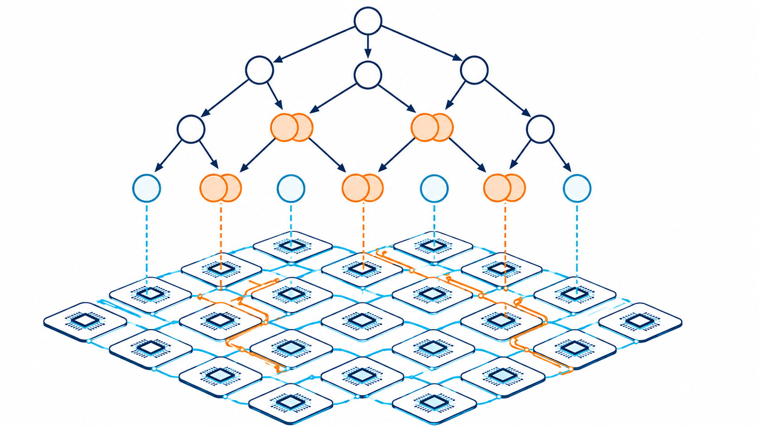
CMP720 — Embedded System Design | Progress Presentation
Contention-Aware Task Duplication Scheduler for NoCs
Barış Büyükyılmaz, Oğulcan Uğuroğlu
Hacettepe University, Department of Computer Engineering
Notes:
Hello everyone. My name is Barış Büyükyılmaz.
Today I will present our progress on Contention-Aware Task Duplication Scheduling for Networks-on-Chip.
The main idea is simple: we want to schedule tasks on multicore processors while considering communication delays inside the network.

Slide 2
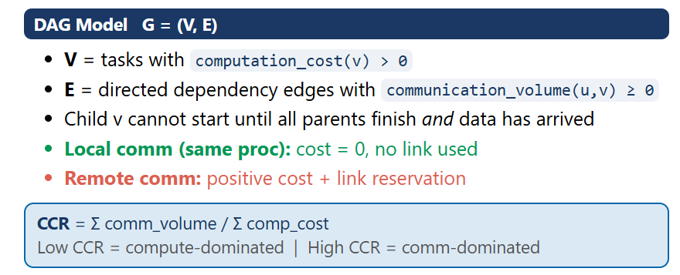
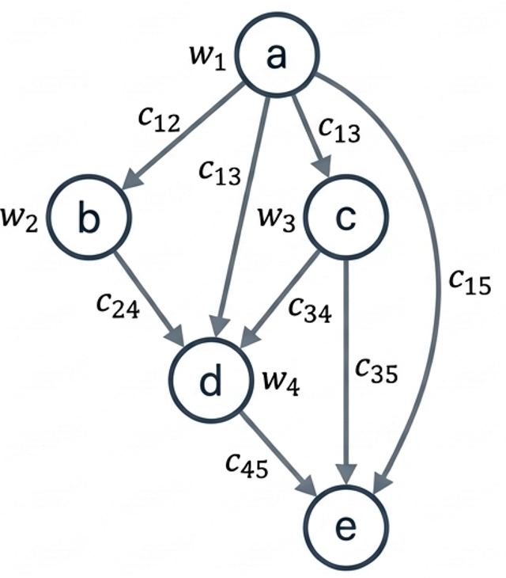
Problem Definition
Notes:
"Let me start with why this problem exists.
Modern embedded chips have dozens of cores onto a single chip. These cores communicate by sending packets through a network of routers and wires that we call a Network-on-Chip, or NoC.
Applications on these chips are naturally structured as DAGs. Each node is a computational task; each edge means the next task must wait for the previous task’s result.' The scheduler's job is to assign tasks to processors to minimize the total execution time.

Slide 3
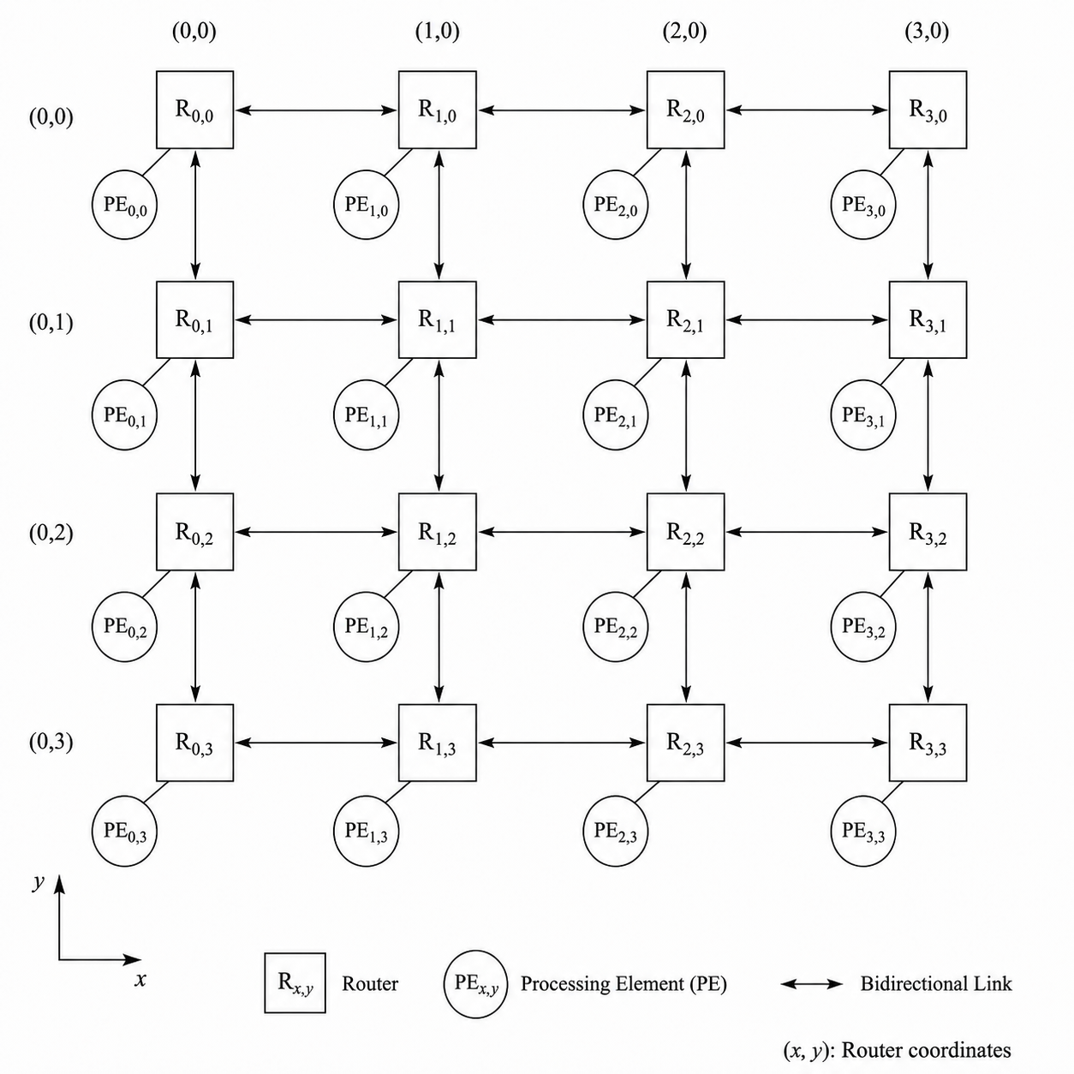
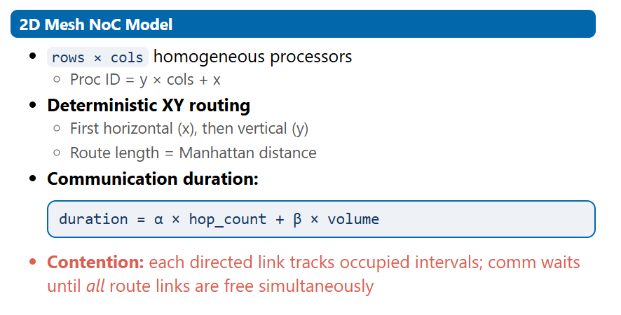
Problem Definition
Notes:
Our implemented network model is the 4×4 mesh. There are 16 processors, each connected to a router. Packets travel horizontally first, then vertically — that's XY routing.

Slide 4
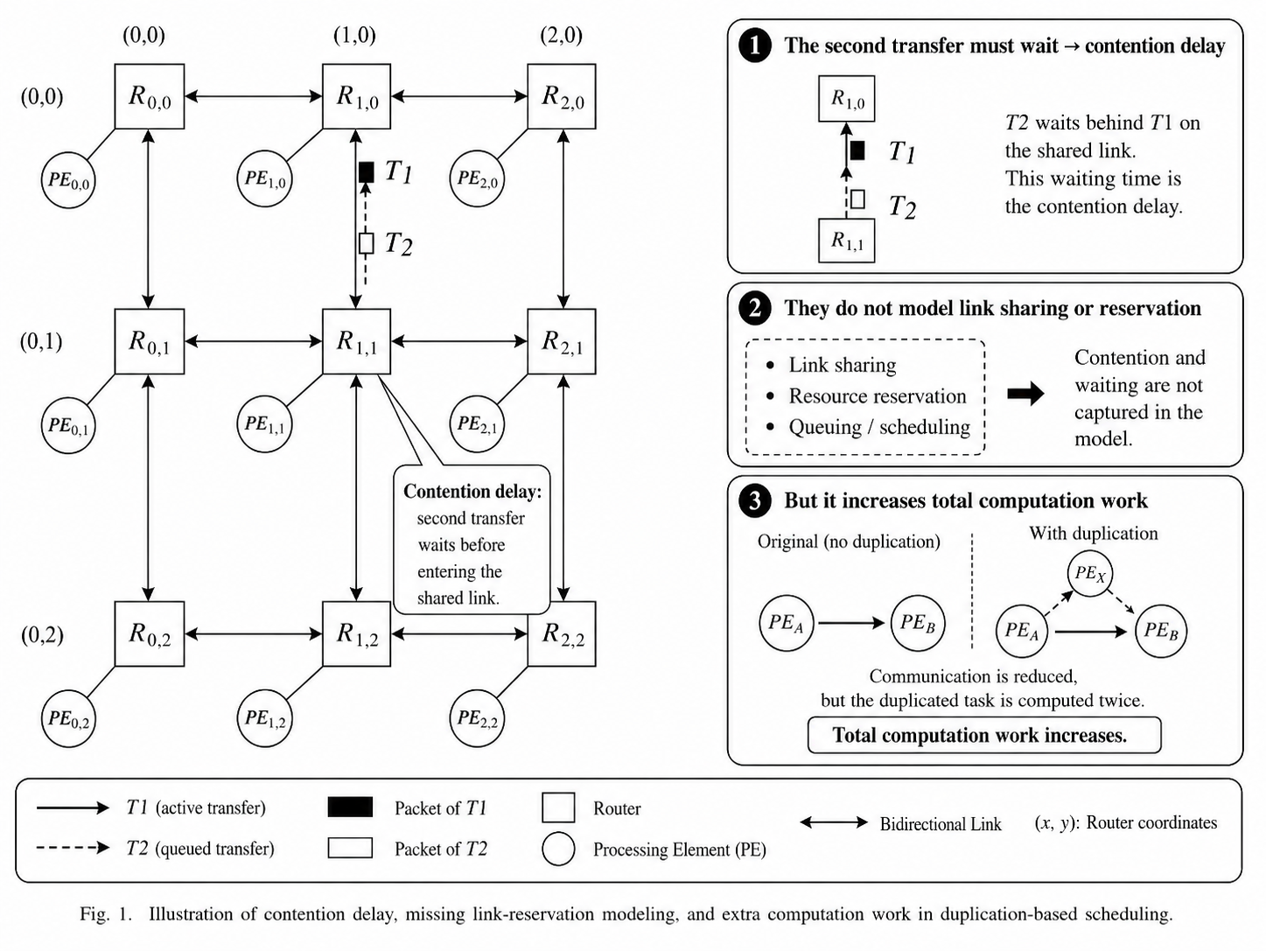
Problem Definition
Research Question: Can task duplication reduce makespan when scheduling on a NoC, if contention is accounted for during the scheduling decision itself?
2 / 12
Notes:
Now look at the diagram. Here's the problem. Two transfers — T1 and T2 — both need to use same link at the same time. T1 goes first. T2 has to wait. That waiting time is the contention delay.

Slide 5

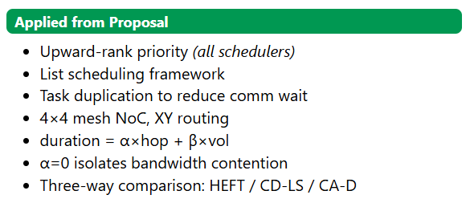
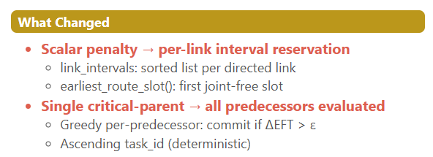

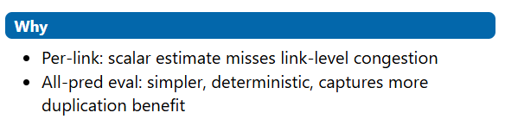
Methodology Updates: What Changed, and Why?
Key shift: from a scalar contention estimate to per-link interval reservation — enabling CA-D to make duplication decisions under realistic link occupancy.
5 / 12
Notes:
Three things stayed the same: the NoC model, the focus on duplication, and the upward-rank priority ordering.
The biggest change was the contention model itself. The proposal used a scalar penalty formula — multiply volume by a congestion estimate. We replaced this with per-link interval reservation. Every link maintains a list of occupied time intervals. When we want to send a message, we find the earliest slot where all links along the XY route.
It's more expensive but physically accurate. The second change was how duplication is triggered. The proposal followed critical-parent selection. We instead evaluate all predecessors greedily. Simpler, deterministic, and captures more duplication benefit under the contention model. And lastly, we added the fair replay methodology. Without it, comparing non-contention aware scheduler makespan to contention-modeled makespan will not fair.

Slide 6
Implemented System Architecture
DAG Generator 4 families: Chain, Fork, Out-tree, Fork-join
MeshNoC Model 4×4 mesh, XY routing, α=1, β=1
▼
▼
HEFT Analytic comm, no duplication
CD-LS Parent dup, analytic comm
CA-D Recursive ancestor dup, contention-aware
▼
ScheduleState — processor_intervals + link_intervals
▼
replay_under_contention() — re-run timing with link reservations
▼
Metrics Speedup, Overhead, Task Instance Ratio (TIR)
4 / 12
Notes:
This figure shows the implemented framework.
At the top, we have two inputs: the DAG generator and the MeshNoC model.
The DAG generator creates different graph families. The MeshNoC model defines the 4 by 4 network and XY routing.
Then, the same input is given to three schedulers: HEFT, CD-LS, and CA-D.
Each scheduler creates a schedule state.
The schedule state stores processor reservations and link reservations.
After that, we use the replay step. Replay recomputes the timing with real link contention.
Finally, we calculate metrics such as speedup, overhead and TIR.

Slide 7
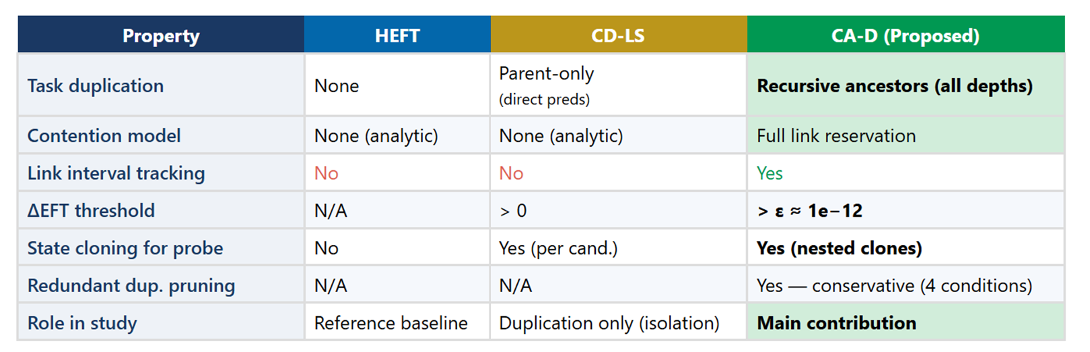
Reminder: Proposed Methodology
Communication model: duration = α × hop_count + β × volume NoC: 4×4 homogeneous 2D mesh | XY routing | 16 processors
3 / 12
Notes:
HEFT: no duplication, no contention model. Pure analytic. It's our reference.
CD-LS: parent-only duplication — it duplicates direct predecessors — but uses the analytic model. No link intervals.
CA-D, our proposed scheduler: Both duplication with full contention-aware link reservation

Slide 8
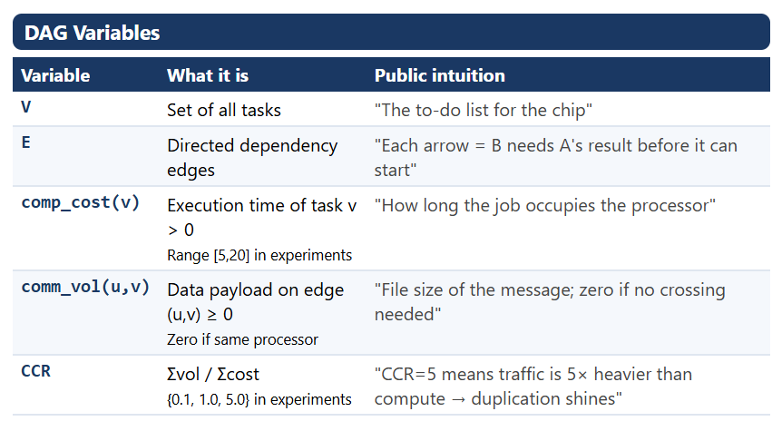
Variables I
3 / 12
Notes:
"Let me tell about the variables. I'll do this in four groups.
First, the DAG variables.
V is the task set — the nodes in the graph.
E is the edge set — the dependencies.
comp_cost(v) is how long task v takes on any processor.
comm_vol(u,v) is the data payload on edge u-v — it's zero when both tasks are on the same processor, because assume that local communication costs nothing.
CCR summarizes the workload character. CCR of 0.1 means computation dominates — tasks are heavy, communication is light. CCR of 5 means communication dominates — tasks are lightweight but generate lots of data.

Slide 9
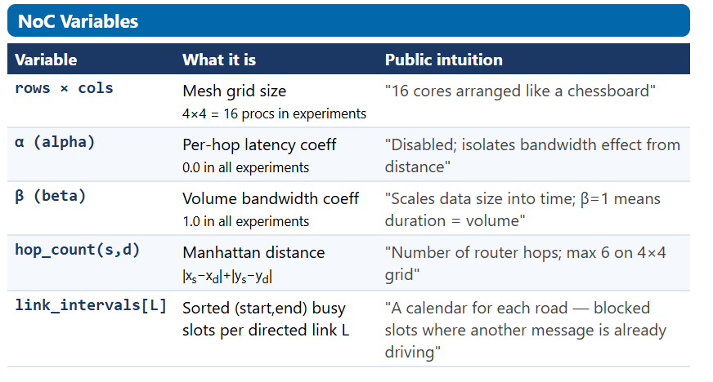
Variables II
3 / 12
Notes:
On the NoC side:
rows times cols gives us the grid size. In all experiments this is 4 by 4, so 16 processors.
Alpha is the per-hop latency coefficient.
Beta is the bandwidth coefficient.
hop_count is just Manhattan distance — number of router hops between source and destination.
And link_intervals[L] is the key data structure — a list of busy slots for each directed link. It ‘s kind a calender to book for each road. If a time slot is booked, the next message has to wait."

Slide 10
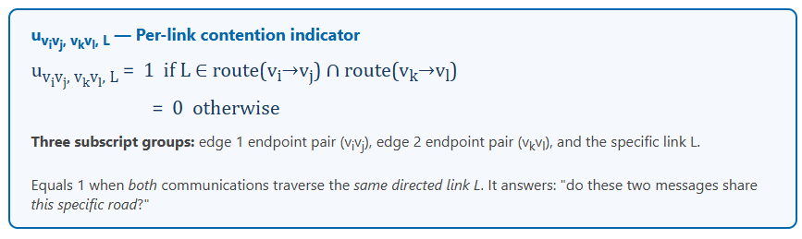
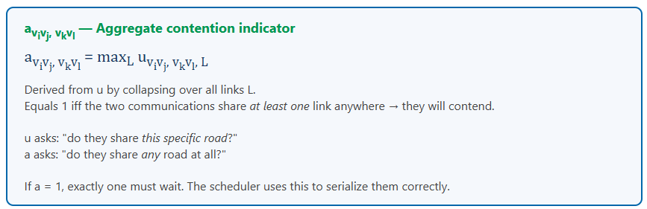
Variables III /Contention Model: u and a
3 / 12
Notes:
"Now the contention model variables. This is where the notation gets a bit dense but the idea is simple.
"u tells us if two messages share a specific road.
“a tells us if they share any road at all. If a = 1, one of them must wait — and our scheduler accounts for that wait when placing tasks."

Slide 11
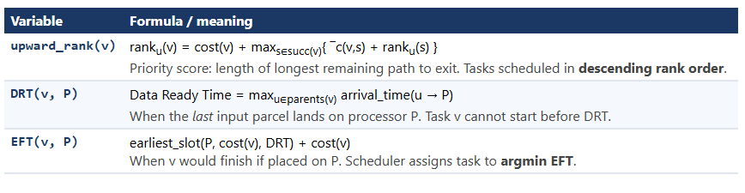
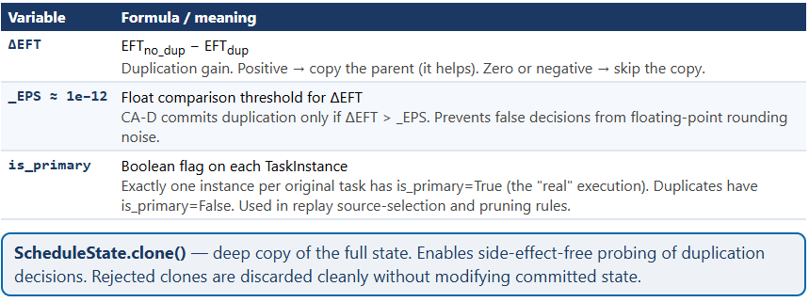
Variables IV /Scheduling Decision Variables
3 / 12
Notes:
Three more variables drive the scheduling decisions themselves.
upward_rank(v) is the priority score. it's the length of the longest remaining path from v to the exit.
DRT — Data Ready Time — for task v on processor P is the latest arrival time among all incoming data transfers. In other words: when is the last piece of input data available on processor P? The task cannot start before this time, regardless of when the processor is free.
EFT — Earliest Finish Time — combines the processor's free time, the DRT, and the task's computation cost.
Delta-EFT is the duplication gain — EFT without duplication minus EFT with duplication. If positive, duplicating a parent helps. If zero or negative, don't duplicate.
_EPS — epsilon, is a floating-point guard.
And is_primary: only one instance of each original task has this flag set to True . All duplicates have it False

Slide 12
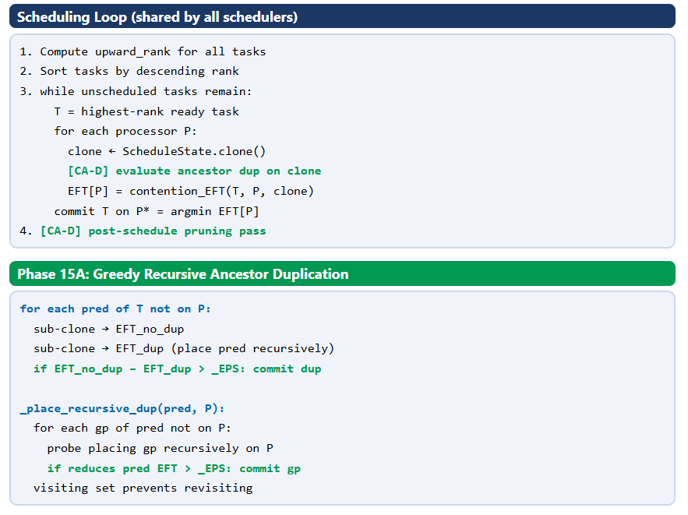
CA-D Algorithm
3 / 12
Notes:
"Now the algorithm itself. CA-D is built on top of a standard list scheduling loop.
Steps one and two are common to all three schedulers: compute upward ranks, sort tasks by descending rank. Step three is the main loop: take the highest-priority ready task T, evaluate it on every processor candidate, commit to the one with minimum EFT. What makes CA-D different from HEFT, happens inside the loop, in those green highlighted lines. For each processor candidate P, we don't just compute a scalar EFT. We: Clone the current ScheduleState.
On that clone, try to place each remote predecessor of T onto P.
If placing a predecessor reduces T's EFT by more than epsilon, commit that duplication on the clone
Then compute T's EFT on that clone. This is greedy recursive duplication. When we place a pred onto P, we recursively ask the same question for the grandparents. If placing a grandparent reduces pred's EFT on P by more than epsilon, we commit that too. We keep going up the ancestor chain, stopping when there's no more benefit or we hit the visited set.

Slide 13
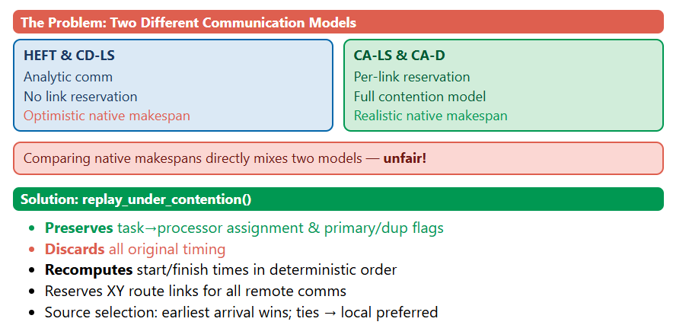
Fair Replay Methodology: Why and How
7 / 12
Notes:
"Before we look at results, I need to explain why we need the replay methodology — because without it, our comparison is invalid.
HEFT use an analytic communication model. It compute a scalar communication time and never reserve any links. Its schedule is optimistic — it assume no congestion.
CA-D use full per-link reservation. It model contention explicitly. Its schedule is realistic — it include all waiting times.
If we compare native makespans, we're comparing apples to oranges. HEFT says makespan is 100 using its optimistic model. CA-D says makespan is 130 using a realistic model. Does that mean HEFT is better? No — HEFT’s 100 would be 144 in reality.
The replay function solves this. It takes every schedule preserves only the task-to-processor assignment and the primary/duplicate flags, throws away all original timing, and recomputes everything from scratch using the same contention-aware NoC model. After replay, every comparison is on equal footing.

Slide 14
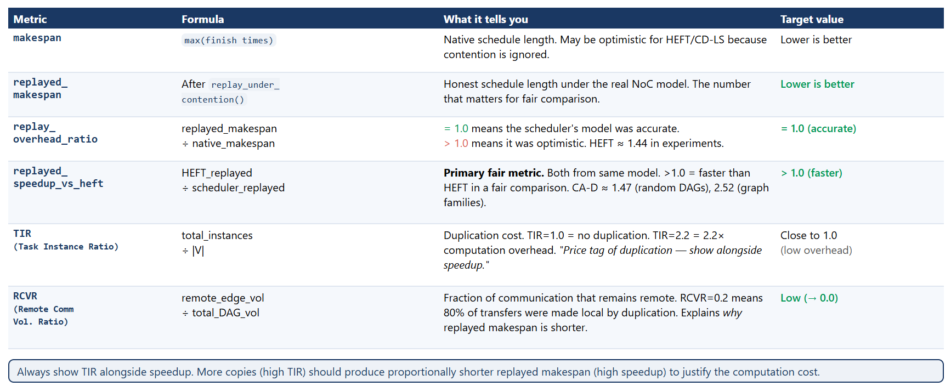
Evaluation Metrics
7 / 12
Notes:
"Our evaluation metrics seperated into three groups.
Makespan metrics: native makespan and replayed makespan. The replayed version is the fair one.
Speedup metrics: both native and replayed speedup versus HEFT. Again, the replayed version is the meaningful one.
Efficiency metrics: TIR — Task Instance Ratio — is the total number of task instances divided by the number of original tasks. If this is equal to 1 that means no duplication. Higher TIR means more computation overhead.

Slide 15
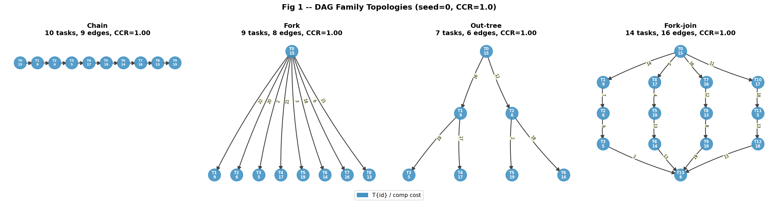
DAG Families Used for Evaluation
Chain
Fork
Out-tree
Fork-join
Linear dependency chain. Negative control: no parallelism.
Root → 8 leaves. Parent dup eliminates all remote comm.
Depth=2, branching=2. Recursive dup provides additional benefit.
4 branches, each length 3. Most sensitive to contention effects.
8 / 12
Notes:
We test the schedulers on four structured DAG families. Each family stresses a different scheduler behavior. The chain is the simplest case. It has no useful parallelism. We use it as a negative control: all schedulers should produce the same result. The fork DAG has one root and eight leaves. Here, parent duplication is sufficient. CA-D and CD-LS behave the same because there is only one ancestor level. The out-tree has two levels of hierarchy. This is where recursive ancestor duplication helps CA-D beyond CD-LS. CA-D can duplicate the root task onto the leaf processors, eliminating all ancestor communication. The fork-join is the most interesting case. It has four branches that all reconverge at a join task. Here, contention between branches becomes very significant, and contention-blind schedulers may produce worse results under replay.

Slide 16
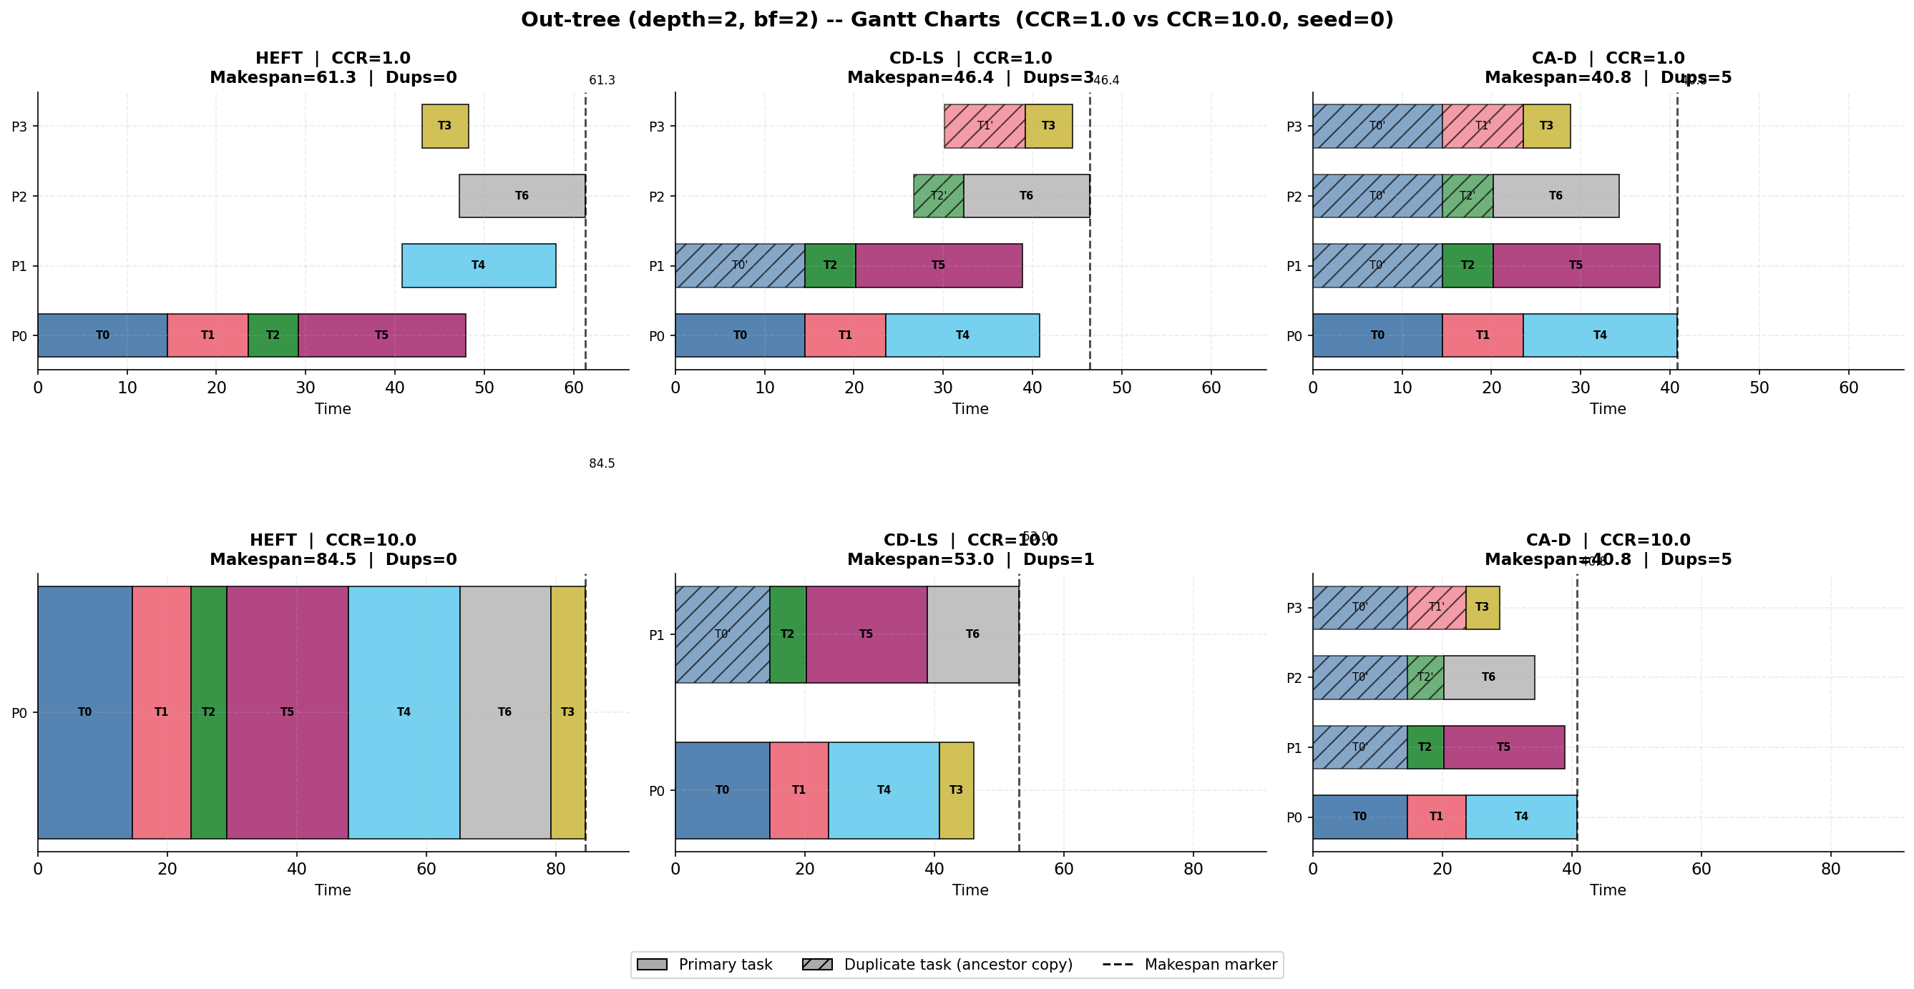
Schedule Examples: Out-tree Gantt Charts
• Out-tree (depth=2, branching=2): shows recursive duplication benefit clearly
• Each row = one processor. Solid bars = primary tasks. Hatched bars = duplicate tasks.
• CCR=1.0 (low): schedulers differ in placement. CCR=10.0 (high): CA-D eliminates remote comm.
9 / 12
Notes:
This slide shows the Gantt charts for the out-tree DAG. Each row is a processor. Each colored bar is a task. Hatched bars are duplicate task instances. Solid bars are primary instances. There are two rows of panels: CCR=1.0 at the top and CCR=10.0 at the bottom. Each row has three panels: HEFT, CD-LS, and CA-D. At CCR=1.0, the differences are moderate. At CCR=10.0, you can see a clear change. HEFT places most tasks on one processor because remote communication becomes very expensive. CD-LS duplicates direct parents, using a few processors. CA-D duplicates both the parent and grandparent tasks near the leaves. This allows all leaf tasks to start immediately with local data. The makespan difference between HEFT and CA-D is visible on the x-axis. CA-D achieves a significantly shorter makespan at high CCR.

Slide 17
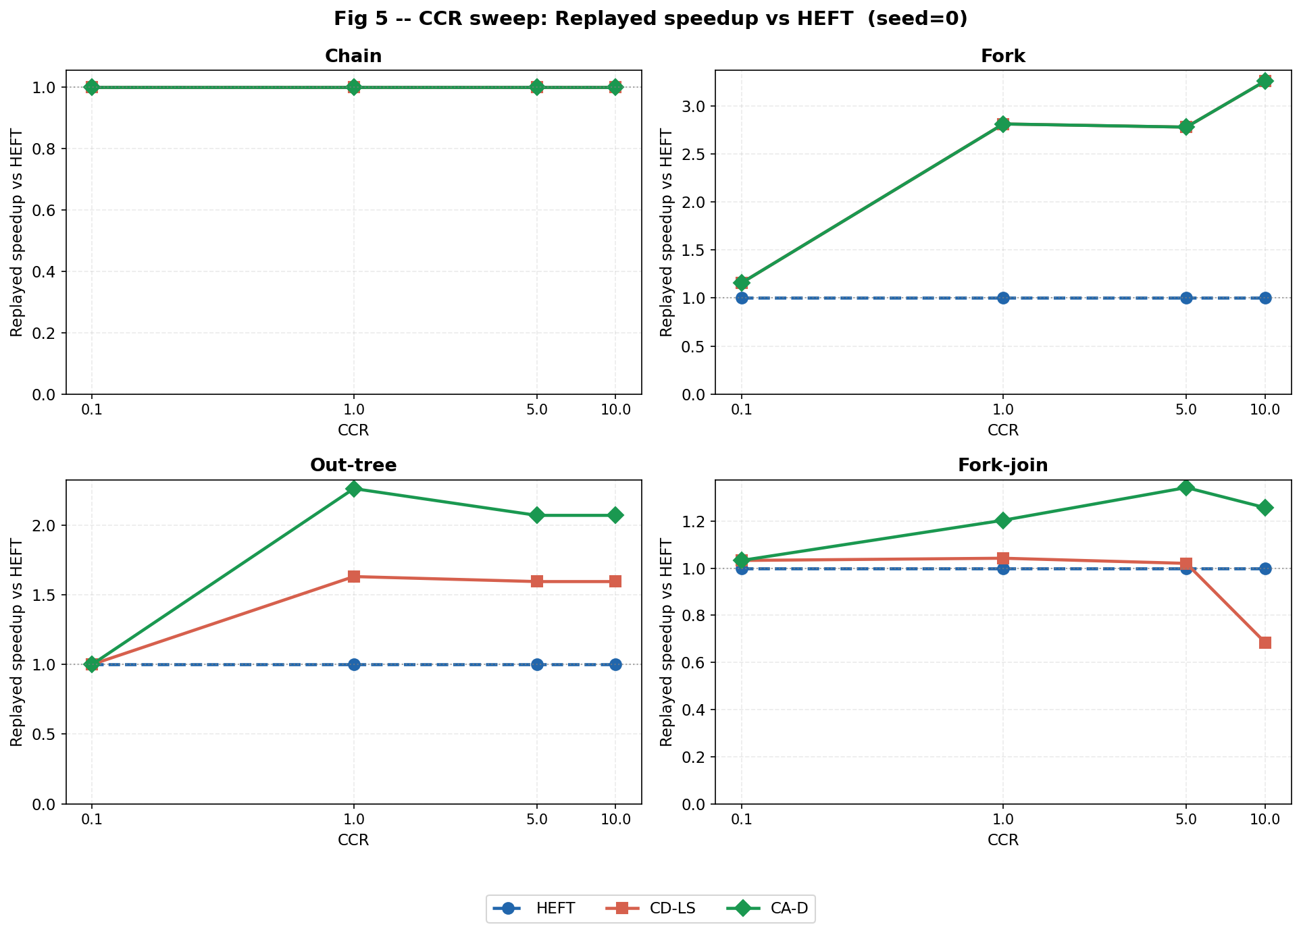
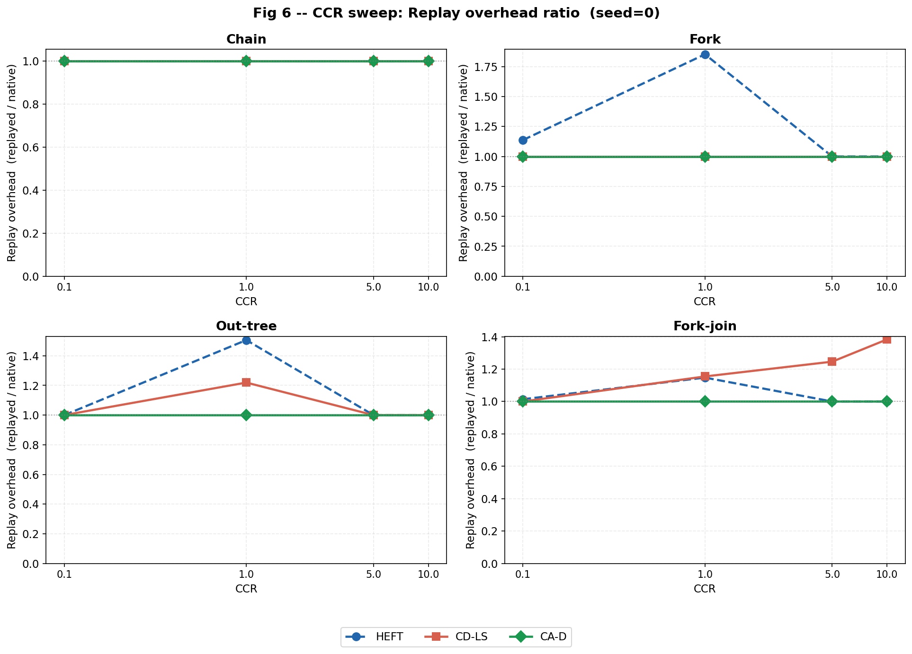
Results: Replayed Speedup and Replay Overhead vs CCR
• Replayed speedup vs HEFT = HEFT_replayed / scheduler_replayed (higher is better)
• Replay overhead ratio = replayed / native (1.0 = model was accurate)
• CCR: Communication-to-Computation Ratio — higher CCR = communication-dominated
Left: Speedup of CD-LS and CA-D vs HEFT. Right: Replay overhead ratio. Chain: all equal. Fork: CD-LS = CA-D. Out-tree/Fork-join: CA-D outperforms CD-LS.
10 / 12
Notes:
This is the main result slide. The left figure shows replayed speedup versus HEFT across CCR values for all four DAG families. On chain, all schedulers are equal. This confirms the negative control. On fork, CD-LS and CA-D both achieve around 2.8 times speedup at high CCR. They are equivalent because the fork has only one ancestor level. On out-tree, CA-D outperforms CD-LS because recursive ancestor duplication adds the root onto each leaf processor. On fork-join, CD-LS can drop below 1.0 at CCR=10, meaning it becomes worse than HEFT when evaluated fairly. CA-D stays above 1.0 consistently. The right figure shows replay overhead. CA-D maintains 1.0 overhead on all topologies. CD-LS shows 1.26 times overhead on fork-join, revealing that its native prediction was too optimistic. This confirms that contention-aware scheduling is necessary for accurate makespan prediction.

Slide 18
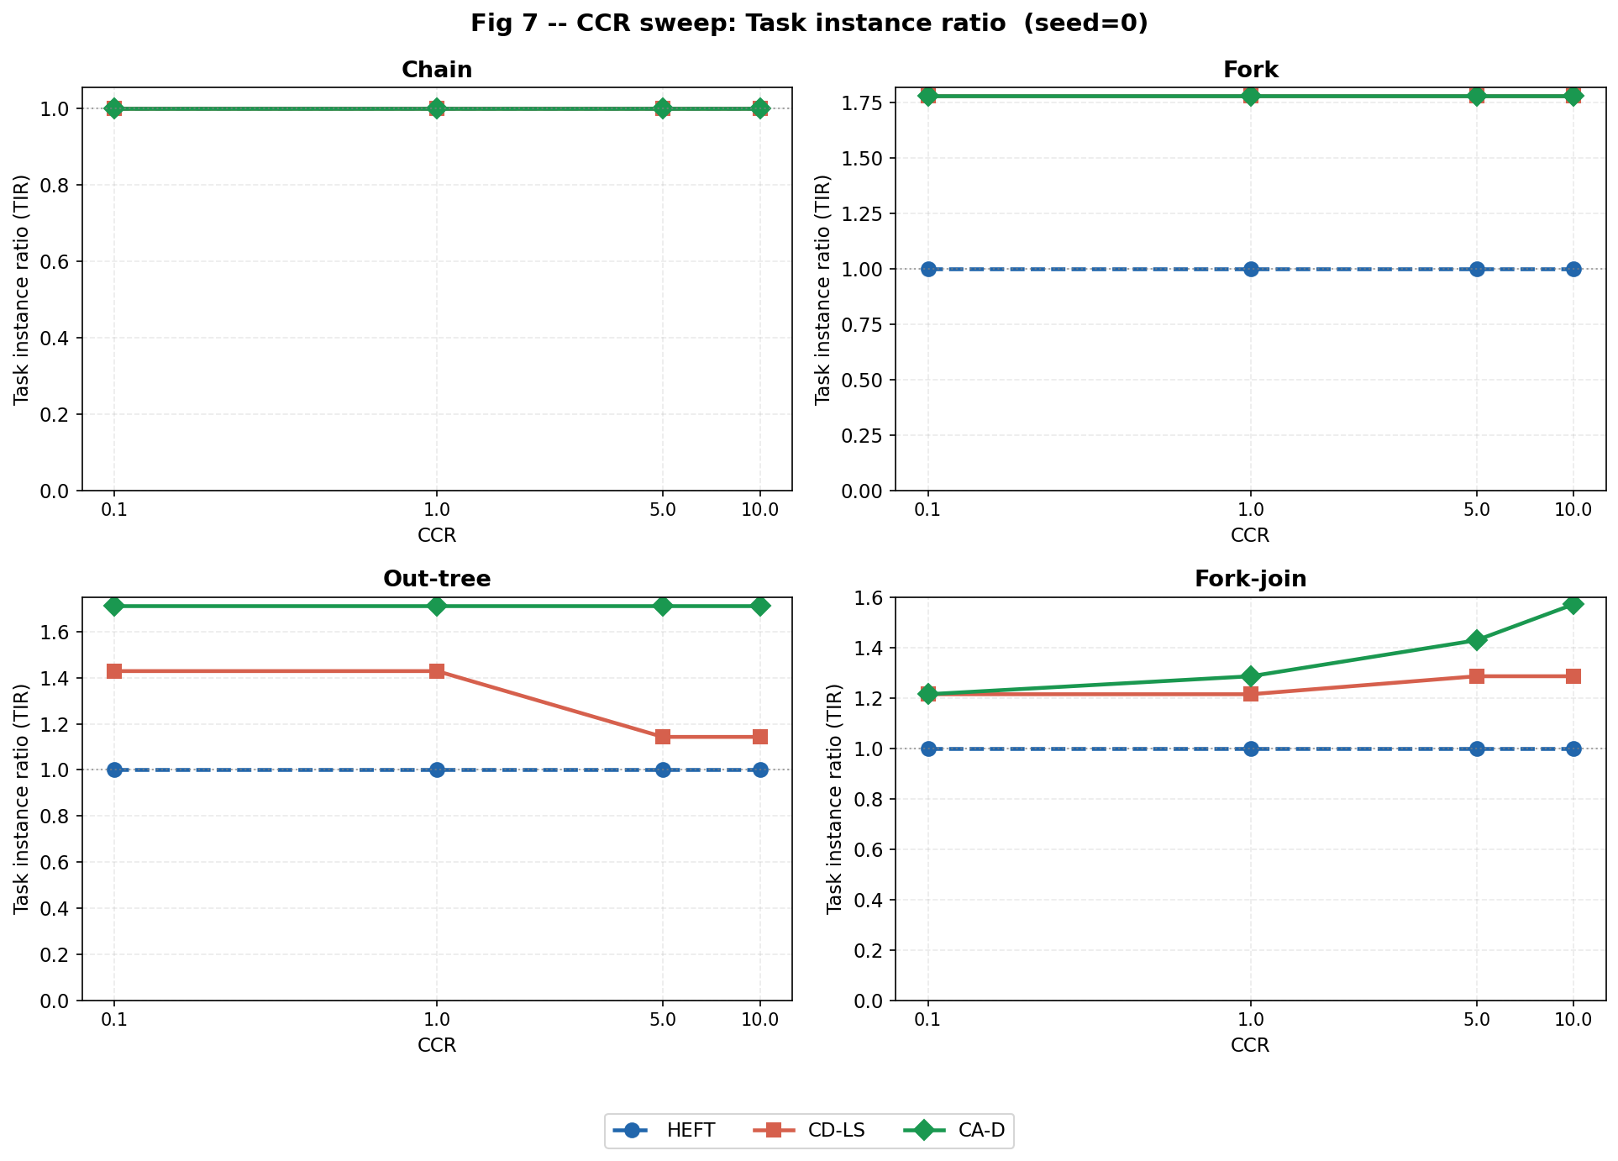
Duplication Cost and Remote Communication Reduction
• Task Instance Ratio (TIR) = total instances / original task count
– TIR = 1.0 means no duplication. Higher TIR = more computation overhead.
• Trade-off: higher TIR should produce lower RCVR and lower replayed makespan
Left: TIR vs CCR per DAG family. Right: RCVR vs CCR. CA-D achieves lower RCVR than CD-LS on out-tree and fork-join.
11 / 12
Notes:
This slide shows two metrics that explain the duplication behavior. The left figure shows the Task Instance Ratio, or TIR. This measures how many total task instances exist compared to the original task count. On chain, TIR is 1.0 for all schedulers because duplication does not help there. On fork and out-tree, CA-D and CD-LS show TIR above 1.0, meaning duplicates were created. On fork-join, CA-D creates more duplicates than CD-LS, but with better results. The right figure shows the Remote Communication Volume Ratio. This is a new metric I introduced. It tells us what fraction of total DAG communication remains as remote transfers in the native schedule. Lower is better. CA-D consistently achieves lower RCVR than CD-LS on out-tree and fork-join. This means CA-D eliminates more remote communication by placing more ancestor copies locally. The combination of TIR and RCVR explains why CA-D achieves lower replayed makespan even though it uses more task instances.

Slide 19
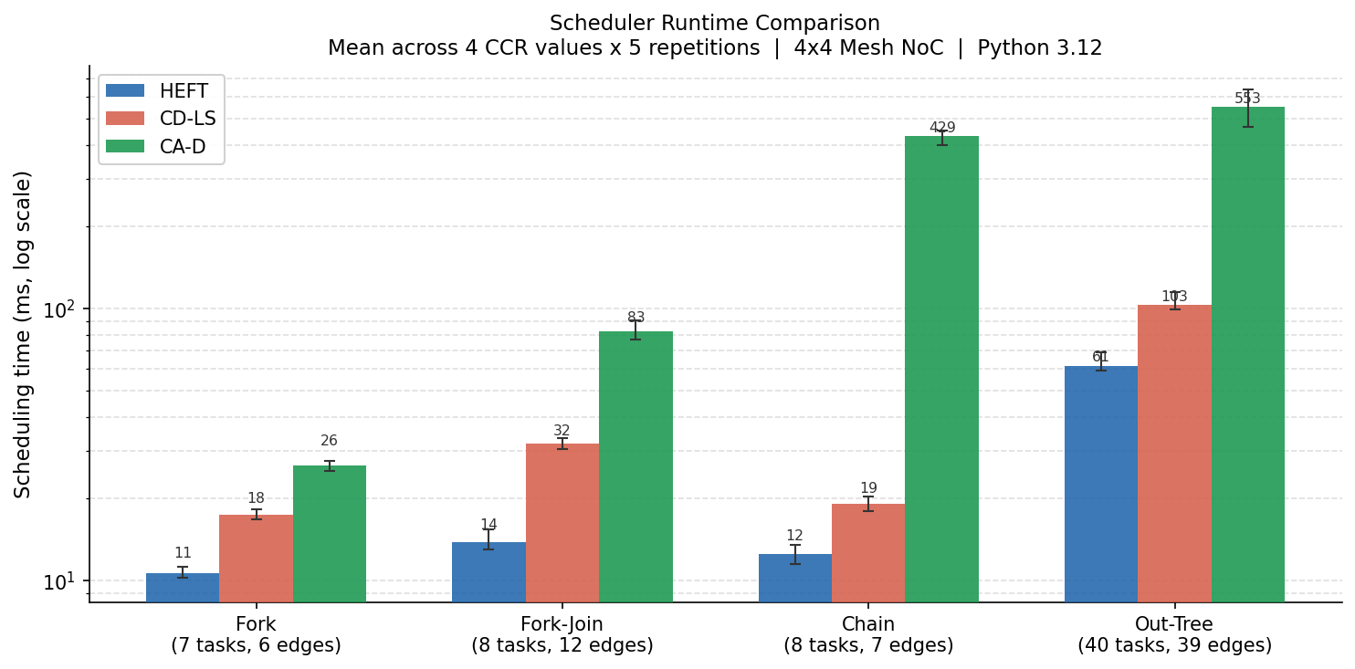
Scheduler Runtime Comparison
11 / 12

Slide 20
Discussion, Limitations, and Future Work
Achievements
Limitations
Future Work
• Full DAG/NoC scheduling framework
• HEFT, CD-LS, CA-D implemented
• Explicit link-level contention model
• Fair replay evaluator
• 4 DAG families × 4 CCR
• Synthetic DAGs only
• CA-D is greedy, not optimal
• Not full Sinnen critical-parent
• No cycle-accurate NoC simulation
• Single NoC topology tested
• Runtime grows for deep graphs
• Real application DAGs
• Energy-aware duplication cost
• Larger NoC topologies
• Runtime optimization of CA-D
• Comparison with more algorithms
Main finding: CA-D produces accurate and stable replayed makespans. Contention-aware scheduling matters most on multi-level, reconverging DAGs at high CCR.
12 / 12
Notes:
Let me conclude. On the achievements side, I have a working framework that includes all three schedulers, a contention-aware replay evaluator, and results across four DAG families and four CCR values. I also introduced a new metric, the Remote Communication Volume Ratio, which quantifies how much communication remains remote after duplication. On the limitations side, the most important is that these are synthetic DAGs. Results may differ on real application graphs. Also, CA-D is a greedy heuristic, not an optimal algorithm. It is not a full implementation of the Sinnen critical-parent algorithm. The conservative pruning step was implemented but did not trigger in any test case. For future work, the immediate next step is to finalize the report. Beyond the course, interesting directions include real application DAGs, energy-aware scheduling, and larger NoC topologies. The main finding is that contention-aware scheduling produces stable and accurate results, especially on topologies where multiple branches share NoC paths. Thank you. I am ready for questions.

