Slide 1
Contention-Aware Task Duplication for DAG Scheduling on NoC
CMP720 Master Project · Oğulcan Uğuroğlu
Hacettepe University — Department of Computer Engineering May 2026

Slide 2
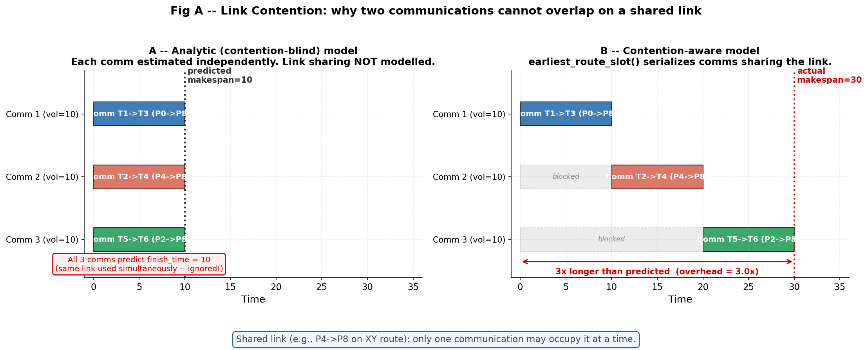
Problem Definition — Network Contention in DAG Scheduling
1
The Illusion of Ideal Networks: Classical DAG schedulers (e.g., HEFT) calculate inter-processor communication costs analytically, ignoring physical network traffic and link sharing.
The Reality of Contention: In 2D-Mesh NoC architectures, parallel tasks routing data across shared links create severe queuing delays — native makespan predictions are highly optimistic.
The Core Research Question: "Should we wait for data through a congested multi-hop path, or is it more efficient to duplicate the predecessor task locally?"
Our Core Focus: CA-D (Contention-Aware Duplication) — an offline scheduling heuristic that models physical NoC link reservations to make traffic-aware duplication decisions.
CMP720 — Contention-Aware DAG Scheduling on NoC
Notes:
In this project we solve the problem of statically assigning workloads on multi-core NoC systems. Algorithms like HEFT assume the network is always idle. We aim to close this optimism gap by modeling real-world network contention.

Slide 3
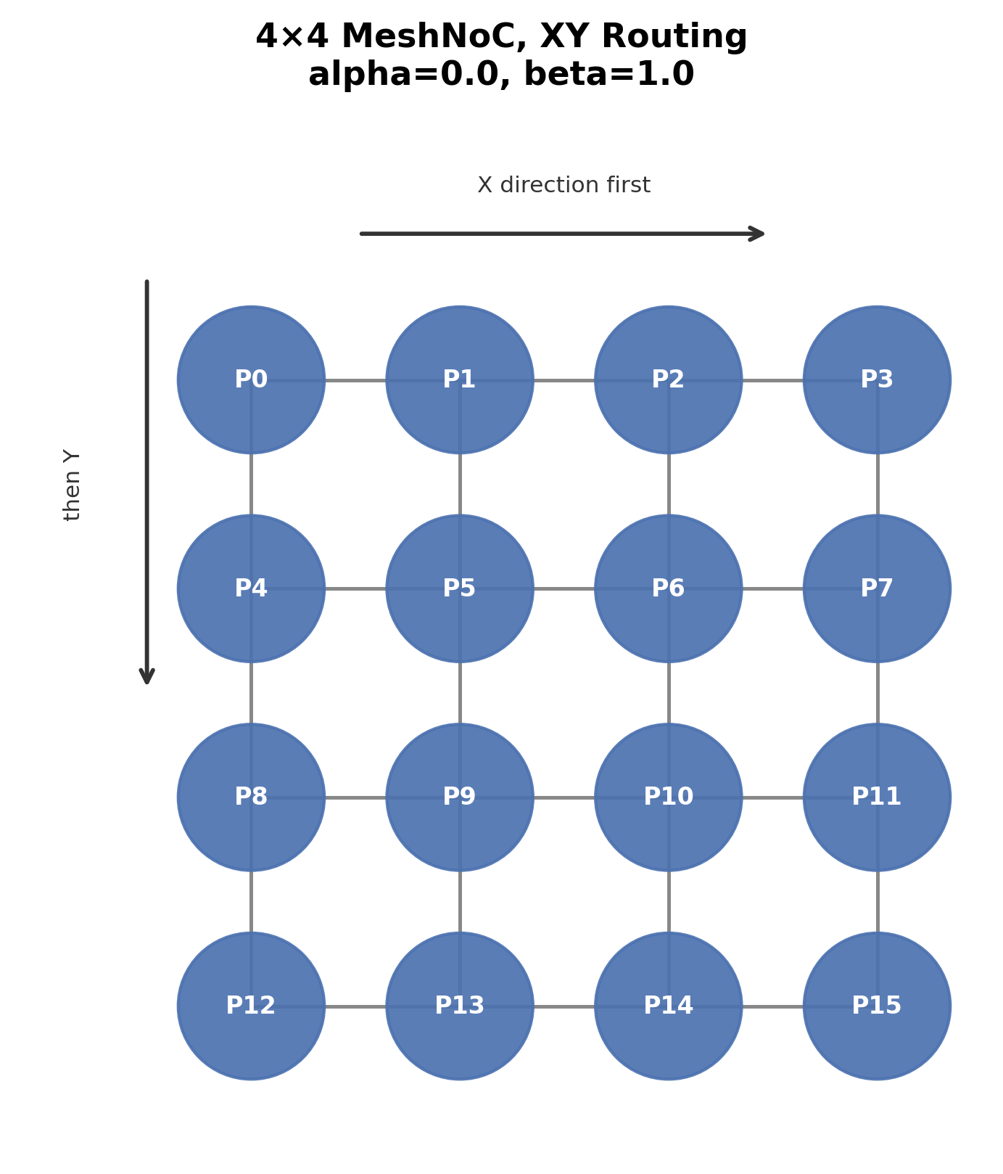
Target Framework & System Models
2
Application Model (DAG): Directed Acyclic Graphs — vertices represent computation costs; directed edges define data dependency volumes.
CCR Spectrum: Evaluated across 0.1 (compute-bound) to 10.0 (communication-bound).
Platform Model: 4×4 homogeneous 2D Mesh Network-on-Chip — 16 processing tiles.
Deterministic XY Routing: Packets move strictly along X-axis first, then Y-axis.
Link-Level Slot Reservation: Analytical delays replaced by directional, atomic interval reservations on physical NoC link channels.
CMP720 — Contention-Aware DAG Scheduling on NoC
Notes:
Instead of multiplying data transfers by simple coefficients, we process them as timed interval reservations on directional links along the XY routing path.

Slide 4
Implementation Status — The 4-Scheduler Evaluation
3
Custom Python Simulation Framework: Lightweight, reservation-based hardware execution simulator optimised for heavy state-cloning.
A 2×2 design matrix isolates the independent contributions of task duplication and contention-awareness.
Scheduler | Task Duplication | NoC Contention Model | Role
HEFT Baseline | No | No | Contention-blind, duplication-free list scheduler
CA-LS | No | Yes | No duplication; strict physical NoC reservations
CD-LS | Yes | No | Parent task replication; contention-blind network
CA-D (Proposed) | Yes | Yes | Co-optimises link contention + recursive duplication
CMP720 — Contention-Aware DAG Scheduling on NoC
Notes:
We developed 4 schedulers on the same infrastructure so we can isolate the effect of both duplication and contention-awareness independently.

Slide 5
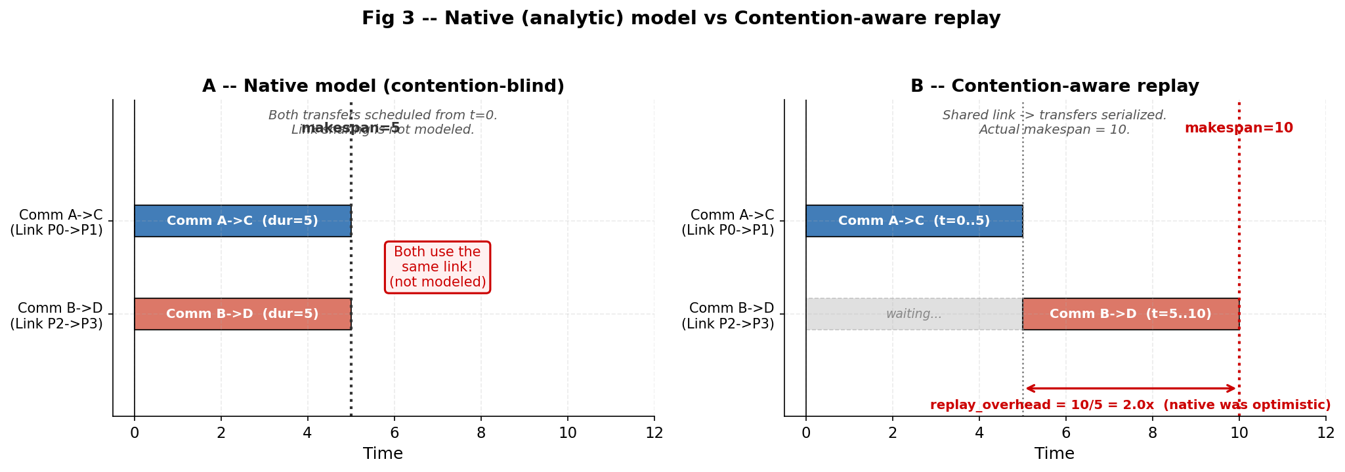
Architectural Deviations & Design Decisions
4
Deviation 1: Custom Interval Simulator over Cycle-Accurate Tools (BookSim)
Required for sub-microsecond state cloning during scheduler candidate exploration.
Decision 2: The "Fair Replay" Module
Contention-blind schedulers produce falsely optimistic end times.
A validation engine re-enforces all placements on the same physical NoC model to extract true makespans.
Decision 3: Structural Shallow-Copy Optimisation
Replaced deepcopy with shared immutable infrastructure — prevents recursion bottlenecks in the Clone-Discard pattern.
CMP720 — Contention-Aware DAG Scheduling on NoC
Notes:
One of our biggest innovations was the 'Fair Replay' module. Because HEFT does not see traffic, it looks very fast on paper. We re-run all algorithms' placement plans under the same physical NoC rules to make the comparison fair.

Slide 6
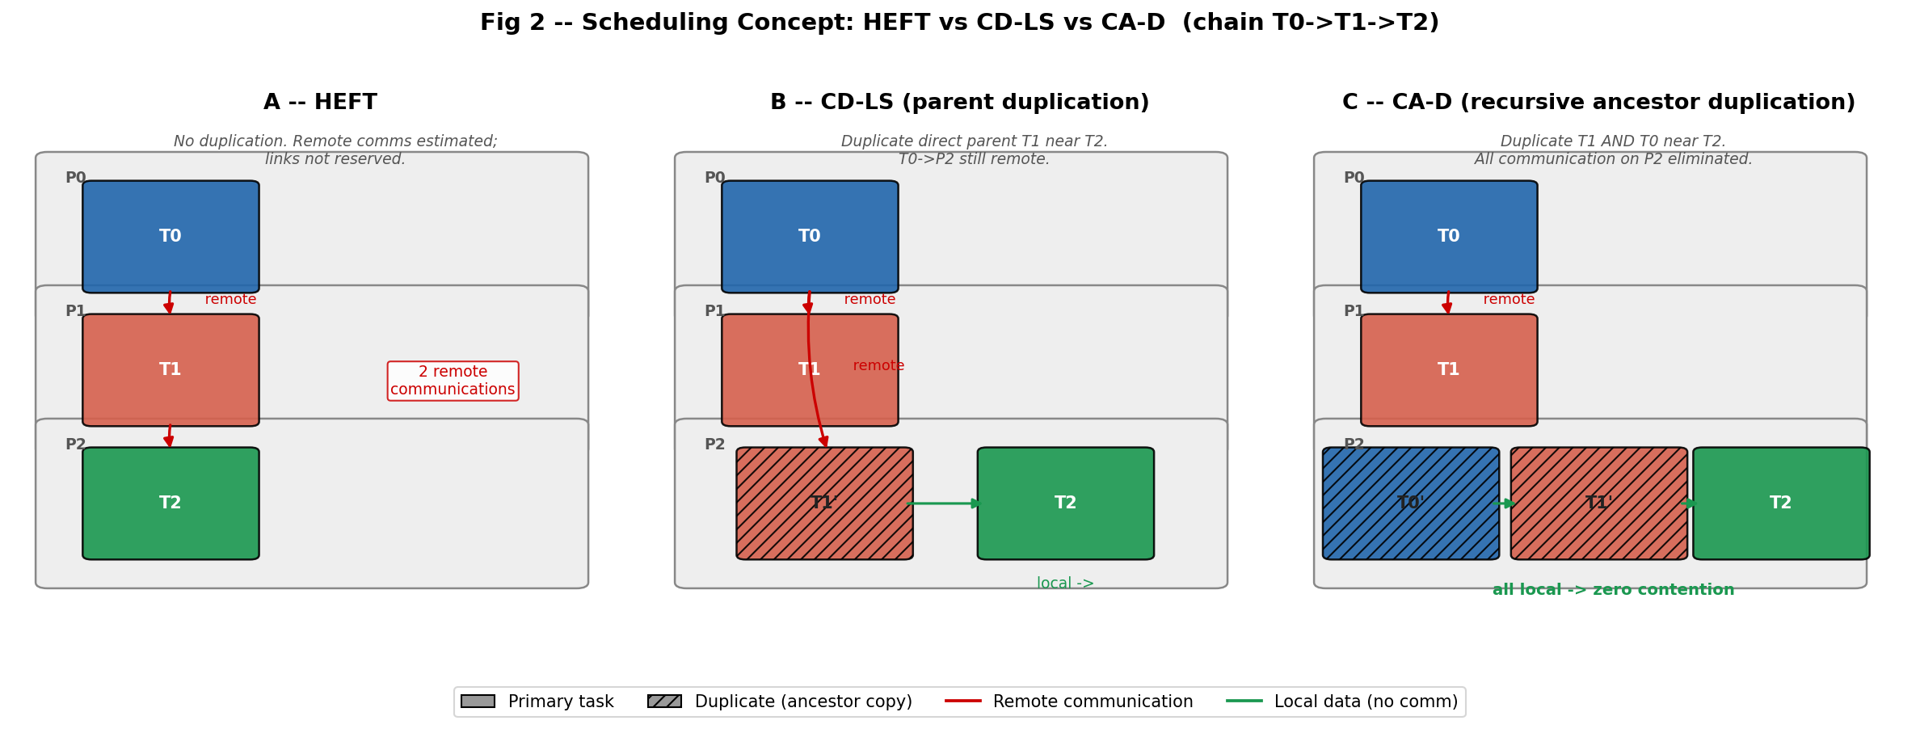
Deep Dive I — The CA-D Scheduling Pipeline
5
Stage 1: Upward Priority Ranking — Critical path priority assignment for all DAG tasks.
Stage 2: Candidate Processor Exploration — Evaluate all 4×4 grid tiles for each ready task.
Stage 3: Isolated State Branching — Clone-Discard pattern prevents data pollution across candidate evaluations.
Stage 4: Best Candidate Promotion — Commits the placement that minimises Earliest Finish Time (EFT).
Stage 5: Post-Processing Clean-up — Conservative pruning removes redundant task copies with no live consumers.
CMP720 — Contention-Aware DAG Scheduling on NoC
Notes:
Our CA-D algorithm works like a 5-stage pipeline. The 'Clone-Discard' software pattern we invented prevents uncertain trials from permanently polluting the scheduling table.

Slide 7
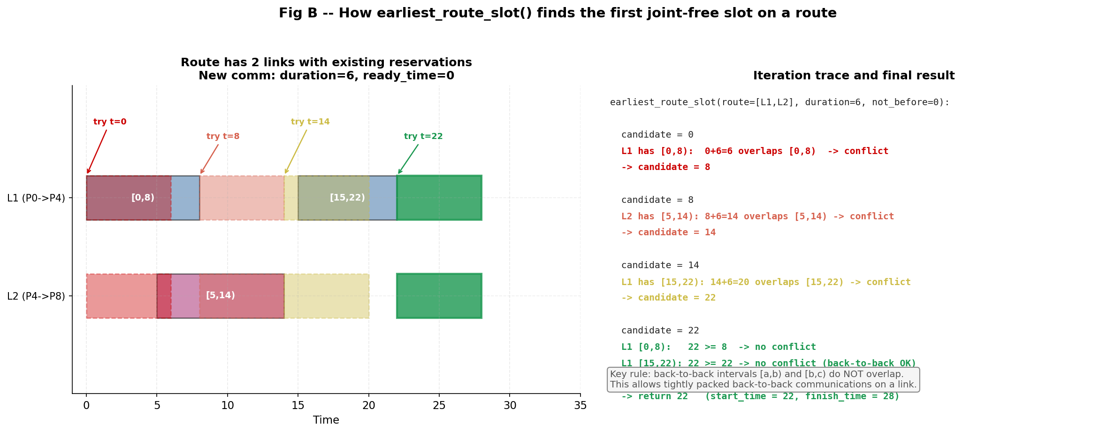
Deep Dive II — Recursive Ancestor Duplication Mechanics
6
The Core Evaluation Metric (ΔEFT):
Baseline (EFT_no_dup): Leave predecessor remote — suffer NoC contention delay.
Duplicated (EFT_dup): Replicate predecessor locally on the target core.
Commit Rule: ΔEFT = EFT_no_dup − EFT_dup > ε
Recursive Traversal: If local duplication helps, climb the ancestor tree and evaluate grandparents recursively.
Cycle Guard Constraint: A visiting set strictly blocks infinite loops during traversal.
CMP720 — Contention-Aware DAG Scheduling on NoC
Notes:
There is no blind copying here. If duplicating a parent is mathematically advantageous, we perform a backward recursive search looking at its parents as well.

Slide 8
Deep Dive III — Best-Instance Selection & Pruning
7
Data Source Selection Rule (priority order):
1. Earliest Arrival Time (under physical link contention)
2. Local Advantage — prefer local copy as tie-breaker
3. Determinism — smaller processor ID for stable ordering
Conservative Redundant Pruning — instance deleted if ALL hold:
Not a primary (first-scheduled) node instance
At least one valid instance of the task remains on the chip
No local successor or outgoing NoC communication depends on it
CMP720 — Contention-Aware DAG Scheduling on NoC
Notes:
Once scheduling is complete, the Conservative Pruning stage kicks in and safely removes copies that have no remaining demand and contribute nothing to performance.

Slide 9
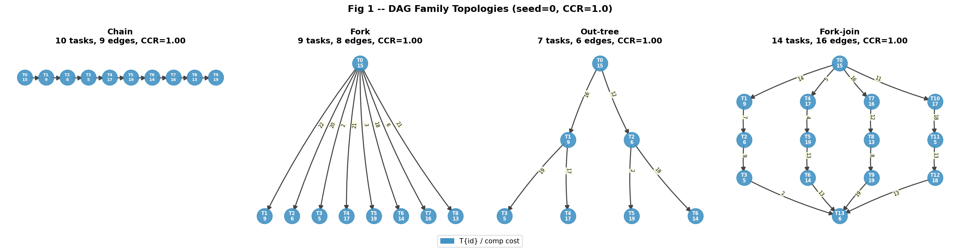
Experimental Setup & Target Workloads
8
960 Comprehensive Experimental Runs across all scheduler × DAG × CCR combinations.
4 Target Structural DAG Families: Chain, Fork, Out-tree, Fork-Join.
4 CCR Spectrum Points: 0.1 (compute-bound) → 1.0 → 5.0 → 10.0 (communication-bound).
Statistical Distribution: 20 distinct random seeds per configuration — ensures robust, reproducible averages.
CMP720 — Contention-Aware DAG Scheduling on NoC
Notes:
We tested our algorithm with 4 deterministic graph families. Using 4 different CCR ratios and 20 seeds per scenario, we ran a total of 960 large experimental runs.

Slide 10
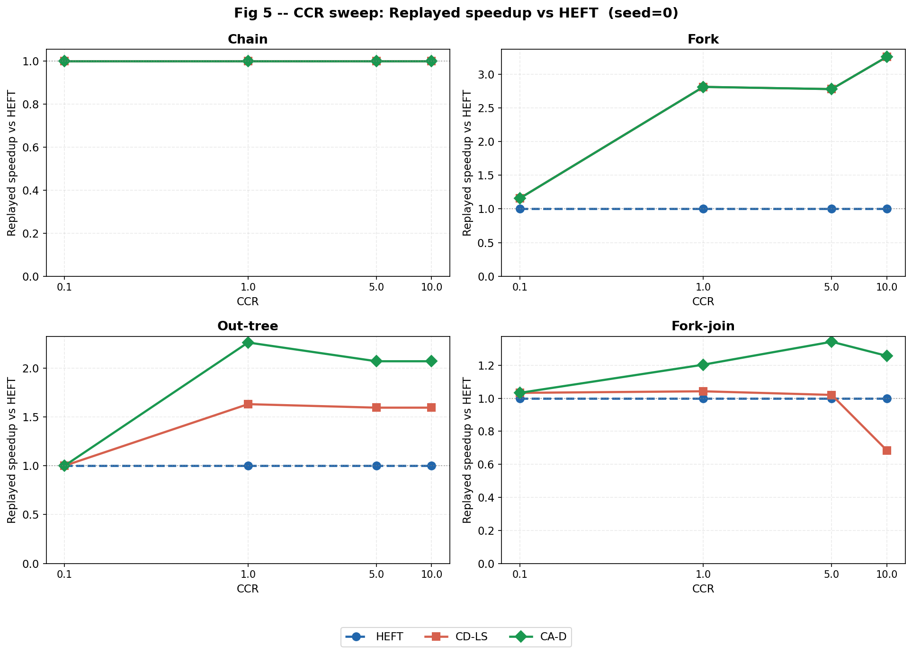
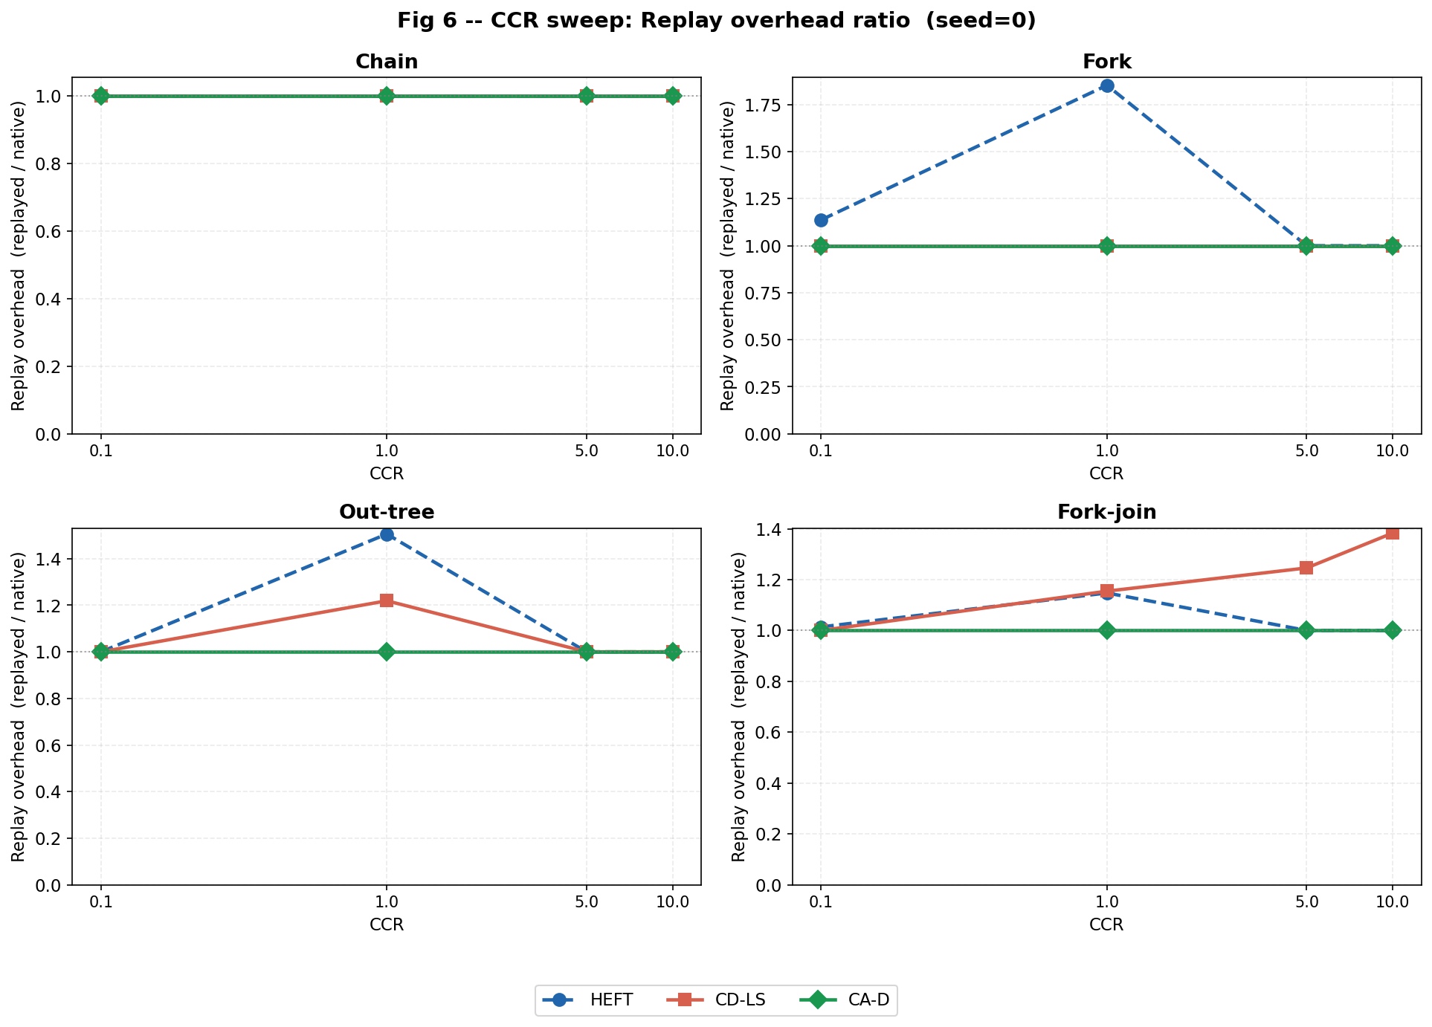
Quantitative Performance — Replayed Speedup & Overhead
9
Core Discovery (Replayed Speedup): At CCR=10.0, CA-D yields the highest speedup. CD-LS collapses — performing worse than HEFT (0.68× slowdown).
Illusion Exposed (Replay Overhead): HEFT and CD-LS show 38–85% optimistic error. CA-D holds a flat 1.0 line — no prediction gap.
Key Takeaway: Contention modelling is not optional at high CCR — it is the deciding factor between speedup and degradation.
CMP720 — Contention-Aware DAG Scheduling on NoC
Notes:
CD-LS, which duplicates without accounting for network traffic, performed even worse than HEFT at CCR=10. In the Replay Overhead chart, we proved that other algorithms present up to 85% illusory optimism, while CA-D matches real hardware 100%.

Slide 11
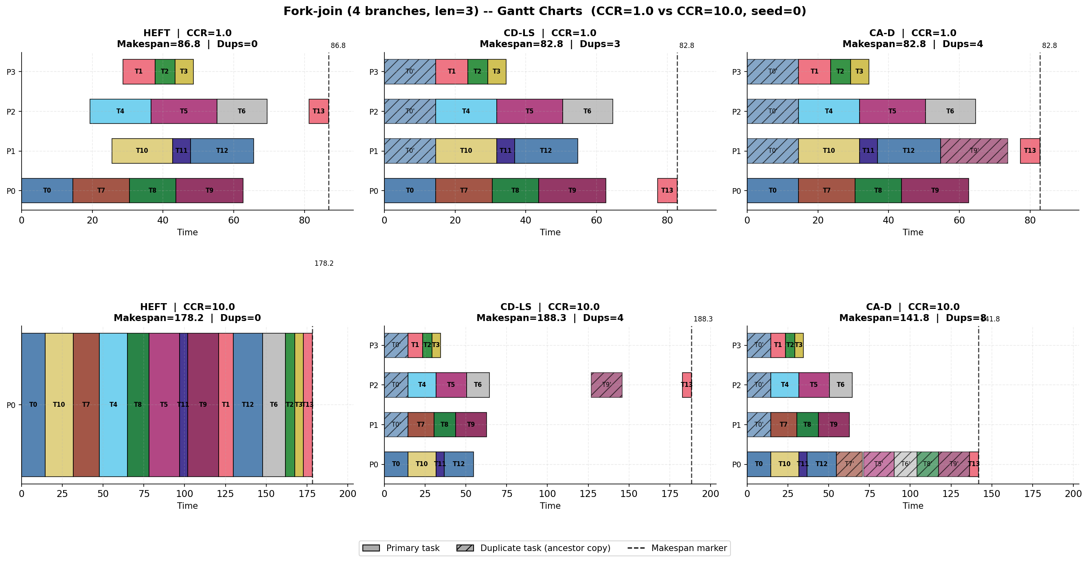
Qualitative Performance — Fork-Join Gantt Chart Analysis
10
HEFT Strategy: Stacks independent tasks onto fewer cores to avoid analytical multi-hop costs. Creates a narrow, tall schedule with poor parallelism.
CA-D Strategy: Spatially distributes tasks across the 4×4 mesh. Replicates high-frequency ancestor nodes directly onto target cores. Creates a wide, flat schedule.
Outcome: ~20% makespan reduction in dense Fork-Join workloads — achieved by trading a small amount of SRAM for significantly reduced network bandwidth.
CMP720 — Contention-Aware DAG Scheduling on NoC
Notes:
Looking at the Gantt chart, we see HEFT piling tasks onto a single processor. CA-D uses the full chip in a balanced way through duplications and compresses the finish time by 20%.

Slide 12
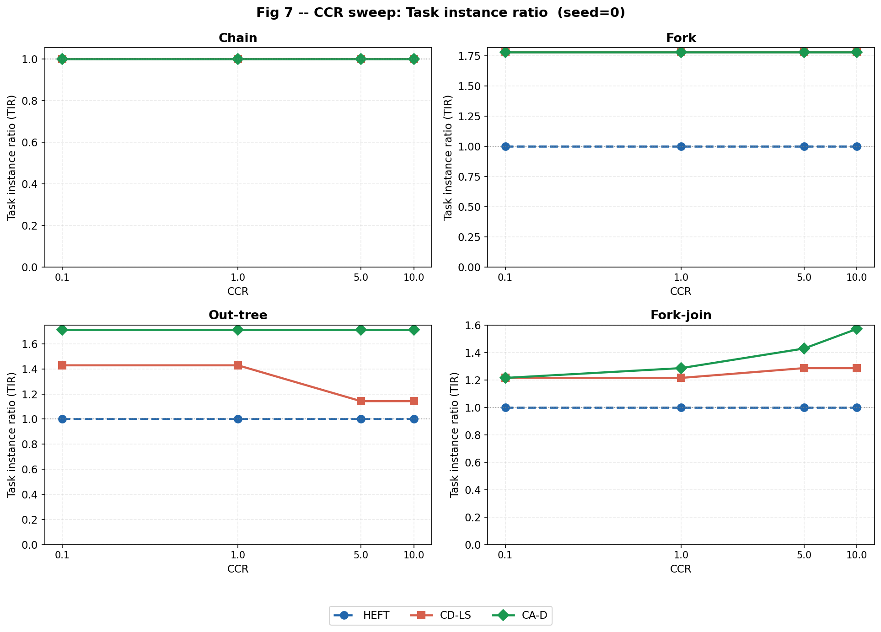
Discussion & Embedded System Design Trade-offs
11
Computational Cost: Contention-aware decisions require recursive state cloning — ~14× slower compilation runtime. Chain DAGs trigger maximum recursion depth.
Memory vs. Bandwidth: Task duplication reduces network congestion but consumes local instruction memory (SRAM) on each tile.
Power Balance: Excessive duplication increases dynamic switching power — making Conservative Pruning mandatory for power-constrained SoC targets.
Scalability: The heuristic is fully offline (compile-time) — zero runtime overhead on the physical target.
CMP720 — Contention-Aware DAG Scheduling on NoC
Notes:
CA-D makes very smart decisions but the cost is high compilation time and SRAM usage. For embedded systems, we can clearly see how vital the Pruning mechanism we designed is to prevent memory and power waste.

Slide 13
Conclusions and Future Work
12
Status: Physical 2D-Mesh NoC models, XY routing, recursive CA-D heuristic, and verification suites are fully implemented and experimentally validated.
Key Result: CA-D consistently outperforms all baselines at CCR ≥ 5.0 while maintaining zero replay overhead — proving contention-aware scheduling closes the simulation-to-hardware gap.
Future Work:
Support for heterogeneous computing tiles (GPU / DSP cores)
Active physical power estimation models
Online adaptive scheduling variants
CMP720 — Contention-Aware DAG Scheduling on NoC
Notes:
In conclusion, we completed all planned software and testing processes. CA-D achieves its design goals: better makespan at high communication intensity, with provably accurate predictions.

