Slide 1
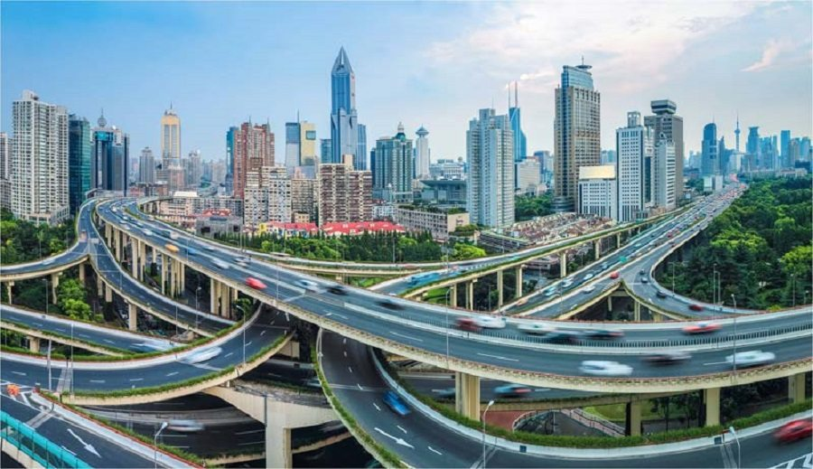
HOTEL SEGMENTATION IN THE CITY OF LAGOS
By Ogun Sewade Olaolu
For Data Science Capstone Project on Cousera.

Slide 2
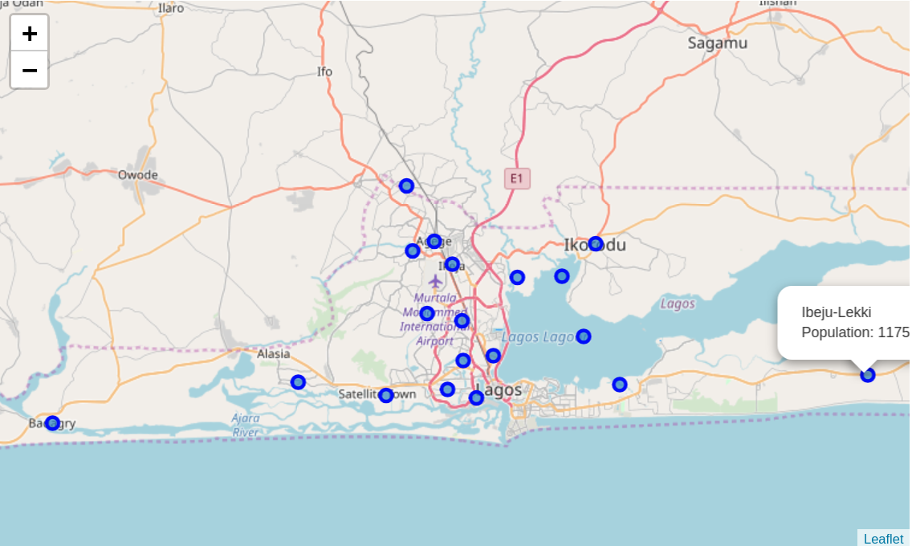
MAP OF LAGOS WITH ITS LOCAL GOVERNMENT AREAS.

Slide 3
INTRODUCTION
Lagos is the commercial city and the second most populous city in Nigeria. It has a thriving business community and welcomes people from various places within and outside Nigeria for business. Due to this, Hotels and Lodgement areas are good businesses which have opportunity to sell their market and create comfort. These hotels have varying grades, facilities, room sizes etc. Most times, customers clutter on the Island (the rich communities of Lagos) with the idea that the best hotels can only be found there. By creating a cluster using their facilities, customer ratings and room sizes, customers can see Hotels in the same category domiciled in other areas of Lagos where they can still have the same comfort, reducing congestion on the Lagos Island and also creating diversity in commerce.

Slide 4
Target Audience
Visitors who would like to compare hotels in various areas based on services they offer and facilities they have.
Tourists.
Anyone visiting Lagos.

Slide 5
DATA SOURCE
Wikipedia Page of Lagos State Local Government Areas (LGAs): This page contains the names of the lagos state local governments and the population of this area. This would help at the initial stage to know different areas to search for hotels in Lagos.
FourSquare API: The foursquare api would be used to collect data about hotels in the different LGAs of Lagos. The data collected would include location, address, category and name of hotels.
Hotels.ng - the leading online hotels booking agency in Nigeria. There have a platform that can produce the facilities data and rating for each hotel identified using the foursuare api. The have an api which I intend to utilize if open for use.
Update: I could not use the api as it was not available for use by an external party. I had to crawl the data myself.

Slide 6
METHODOLOGY
Firstly, I imported the list of Local Government Areas(LGAs) in Lagos with their population size and displayed them on a map (using folium) to have a feel of the city and how populated it is.
Next, I searched for hotels around a 3000m range for the first LGA, to get an idea of how to get out features from the JSON file returned, before automating the process for other LGAs
Created functions to get the data for other LGAS
Next, I diplayed the hotels on a map to show thier various locations in Lagos
I joined the facilities data gotten from hotels.ng to the dataframe and performed a onehot encoding
I then cleaned the data since there were duplicates of facilities in some instances. I also merged similar facilities
I was left with 92 unique facilities to explore

Slide 7
FACILITIES CONSIDERED
['24 hour Front Desk', '24 hours Electricity', 'ATM', 'Adequate Parking Space', 'Air Conditioning', 'Airline Booking office', 'Airport pickup', 'Asun Spot', 'Babysitting', 'Banking services', 'Banquet Hall', 'Bar', 'Barbecue grill(s)', 'Bathtub', 'Beauty Service', 'Breakfast', 'Bush Bar', 'Business Centre', 'CCTV camera', 'Cable TV', 'Car rental', "Children's Playground", 'Climate Control', 'Coffee Tea Maker', 'Concierge', 'Conference facility', 'Convenience Shop', 'Daily newspaper', 'Dinner', 'Double bed', 'Dry Cleaning', 'Electric Fence', 'Electronic Room Keys', 'Elevator/Lift', 'Event Hall', 'Fan', 'Fenced compound', 'Free WiFi', 'Free parking', 'Gift Shop', 'Gym', 'Handicap Accessible', 'House Keeping', 'In House Dining', 'In-room safe', 'Inter Comm Telephone', 'Ironing', 'Jacuzzi', 'Key Card system', 'King sized bed', 'Kitchen', 'Live Band Entertainment', 'Luggage Storage', 'Lunch', 'Make Up Mirror', 'Meeting Rooms', 'Night Club', 'Non Smoking Rooms', 'POS', 'Parking Garage', 'Pool Bar', 'Private Bathroom', 'Proximity to Main Road', 'Quiet Neighbourhood', 'Refrigerator', 'Restaurant', 'Room service 24h', 'Room service(limited hours)', 'Sauna', 'Security', 'Shower', 'Single Bed', 'Sofa', 'Spa treatment', 'Study Desk', 'Suya Spot', 'Swimming Pool', 'Taxi Pickup', 'Television', 'Tennis court', 'Toiletries', 'Tours/ticket assistance', 'Valet Parking', 'Wake Up Service', 'Wardrobe', 'Water heater', 'Wine/water', 'Wired Internet', 'Wireless Internet', 'conference facilities', 'nan', 'snooker board']

Slide 8
TOP 10 FACILITIES IN ALL HOTELS
Air Conditioning 105
Security 103
Bar 102
Restaurant 97
24 hours Electricity 91
Adequate Parking Space 83
Television 77
Wireless Internet 68
Room service 24h 51
Swimming Pool 51
Cable TV 48

Slide 9
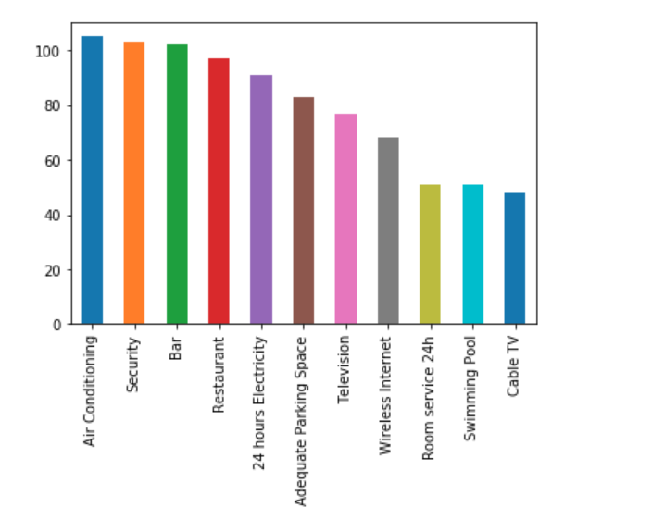
PLOT OF TOP 10 FACILITITES

Slide 10
LEAST FACILITIES
Handicap Accessible
Children's Playground
Convenience Shop
conference facilities
Proximity to Main Road
Barbecue grill(s)
Tours/ticket assistance
Jacuzzi
Suya Spot
Banking services
Asun Spot

Slide 11
KNN CLUSTERING
20 hotels in cluster 0
22 hotels in cluster 1
17 hotels in cluster 2
33 hotels in cluster 3
27 hotels in cluster 4

Slide 12
HIGHLIGHTS
Major Highlights of Cluster 0 Hotels.
There is Cable TV, 24 hours Electricity, with security, a bar and wireless internet in some. The rooms have Air conditioning.
Major Highlights of Cluster 1 Hotels.
There is Wireless Internet and 24 hours electricity, with security, a bar and restaurant and pool. The rooms have Air conditioning.
Major Highlights of Cluster 2 Hotels.
There is Adequate parking space, Security with Gym and Swimming Pool, restaurant. Some have Bar.

Slide 13
HIGHTLIGHTS CONTD
Major Highlights of Cluster 3 Hotels.
There is AC and Cable TV with Refridgerator. No dry cleaning service. Adequate parking space in most of the hotels.
Major Highlights of Cluster 4 Hotels.
Security and Adequate Parking Space in most, with Bar. No cable TV but Television is available in most of the hotels in this cluster. You can be lucky to find luggage storage facility and dry cleaning service.

Slide 14
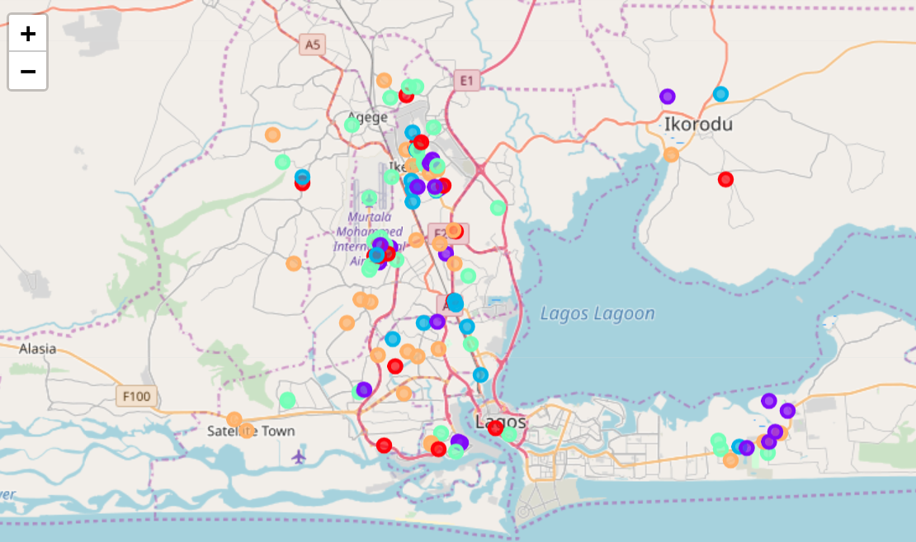
MAP OF HOTELS AS CLUSTERED

Slide 15
DISCUSSION
Cluster 1 and 2 are the most sophisticated in the hotel clusters having GYm, wireless internet and Gym.
Other clusters can be considered if you do not have much funds.

Slide 16
CONCLUSSION
Creating hotel segments can give insights to customers about the different kinds of facilities available and what to go for based on funds and comfortability. This project showed how this insight can be gotten using data science.

Slide 17
This project was created for the IBM Data Science Capstone Project on Cousera.
THANK YOU.

