Slide 1
FASHION SALES
DATA ANALYSIS
Using Python to understand sales patterns and support business decisions
CAPSTONE PROJECT PRESENTATION
Presented by:
Ogunyebi Monisola
October 2026

Slide 2
Project Background
CONTEXT
Business case
Business problem
Fashion retailers need to understand product demand, changing sales patterns, pricing and seasonal preferences.
Without analysing sales data, it can be difficult to identify strong products, slow periods and opportunities to improve decisions.
MAIN BUSINESS QUESTION
How can fashion sales data help us understand performance and improve pricing, promotions and inventory decisions?
Focus: monthly trends • products and categories • seasons • discounts • customers and regions
02

Slide 3
Dataset & Analysis Focus
DATA
Dataset source
Original size
Main fields
Generated by ChatGPT for this project.
5,018 entries and 15 columns before cleaning.
Orders, dates, products, quantity, price, discount, region and payment method.
QUESTIONS EXPLORED
• How do sales change over time and across seasons?
• Which products and categories contribute most to sales?
• Are discounts associated with higher quantity sold?
• How do sales vary across regions and payment methods?
03

Slide 4
Data Cleaning & Preparation
METHOD
Data cleaning
Feature engineering
• Checked missing values and duplicates.
• Found 15 duplicate records.
• Recovered some missing values using related fields where possible.
• Corrected date, price and quantity data types.
• Gross sales and discount amount
• Net sales
• Month, quarter and season
• Average order value
After cleaning and feature engineering, there are 4,584 entries and 21 columns
04

Slide 5
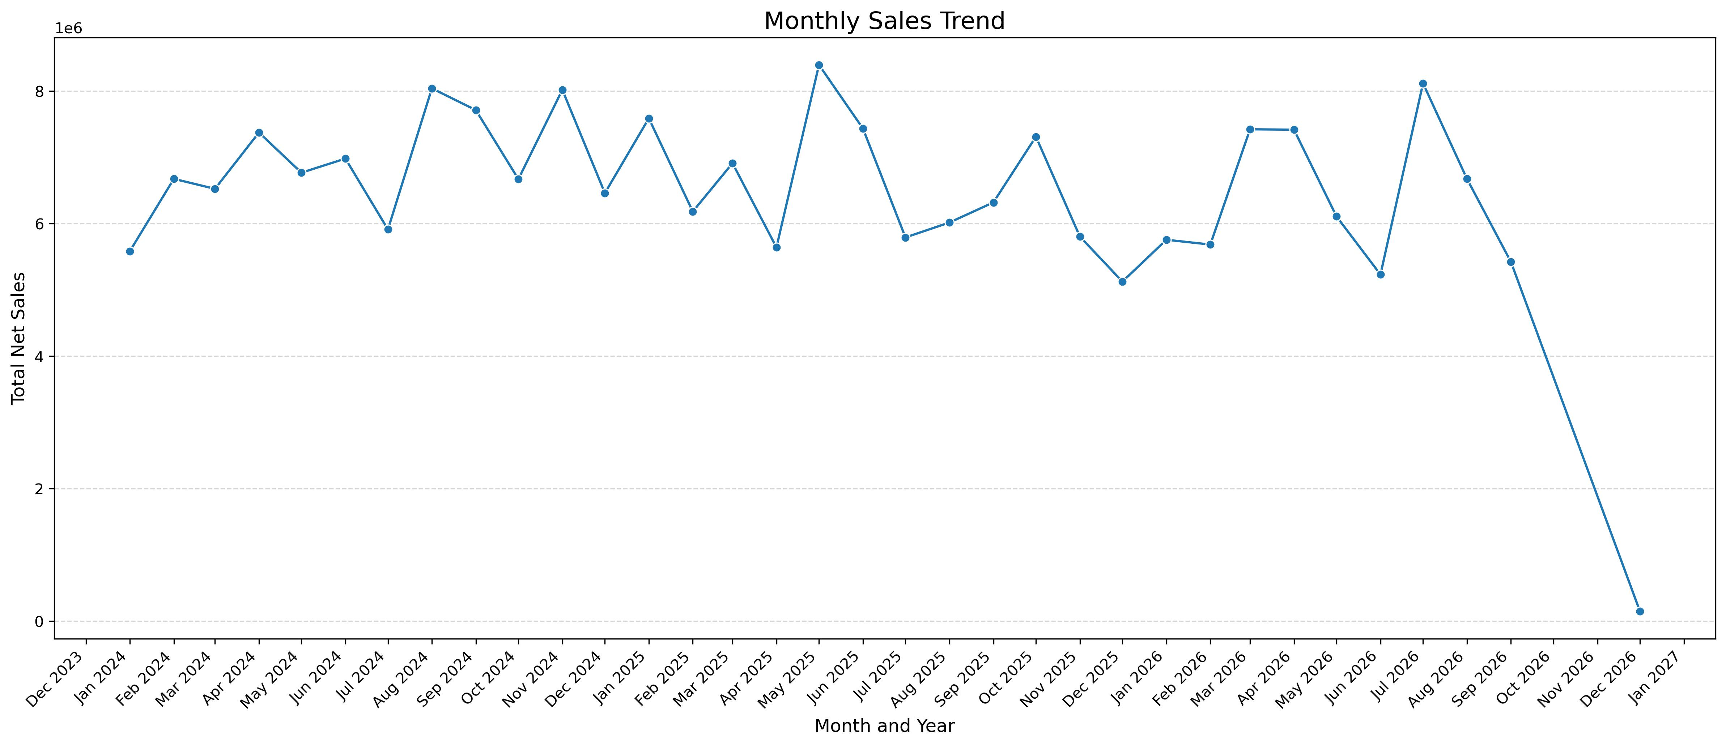
EDA 1 — Monthly Sales Trend
FINDINGS
Monthly sales line chart
Key findings
• May 2025 recorded the highest sales.
• July 2026 was another strong month.
• December 2025 and June 2026 were the lowest.
• There is a general poor sale recorded in the Month of December across the three years (2024-2026).
PLACE VISUAL HERE
Business implication
Investigate sales peaks and plan stock for higher-demand periods.
Use a high-resolution export; keep month labels readable
05

Slide 6
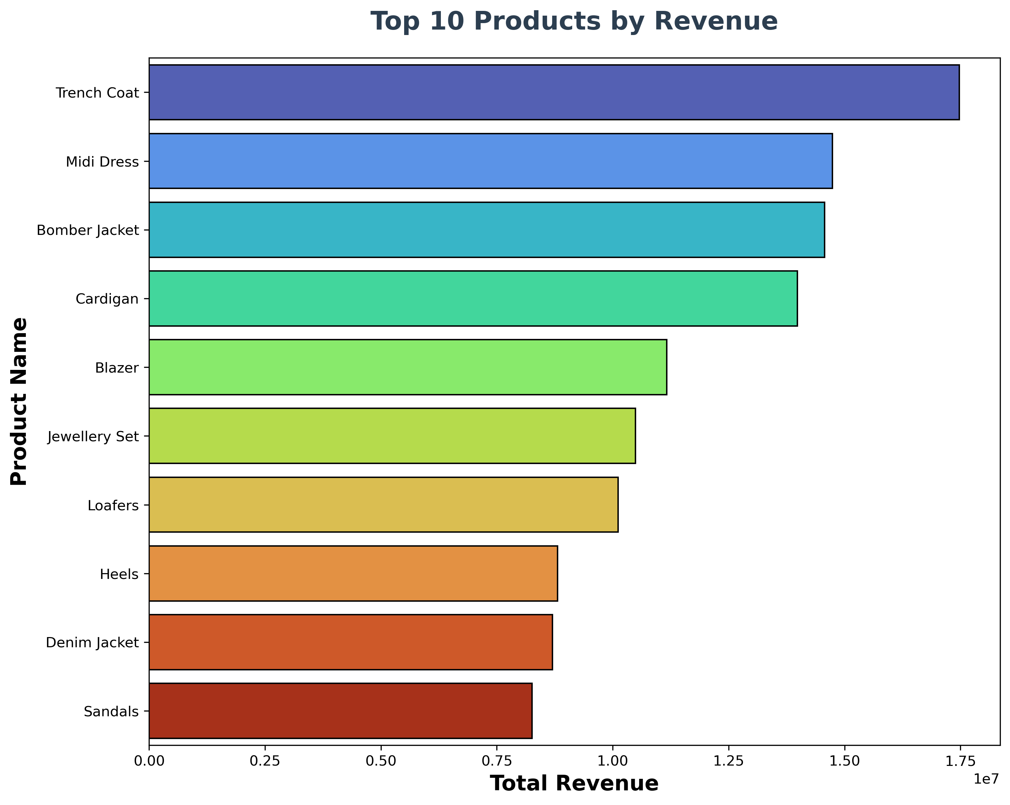
EDA 2 — Product Performance
FINDINGS
Product revenue or quantity chart
Key findings
• Trench coat led product revenue.
• Blazer led quantity sold.
• Some high-quantity products generated lower revenue.
PLACE VISUAL HERE
Business implication
Review pricing, quantity and costs together before judging performance.
Choose one clear chart; avoid squeezing several charts together
06

Slide 7
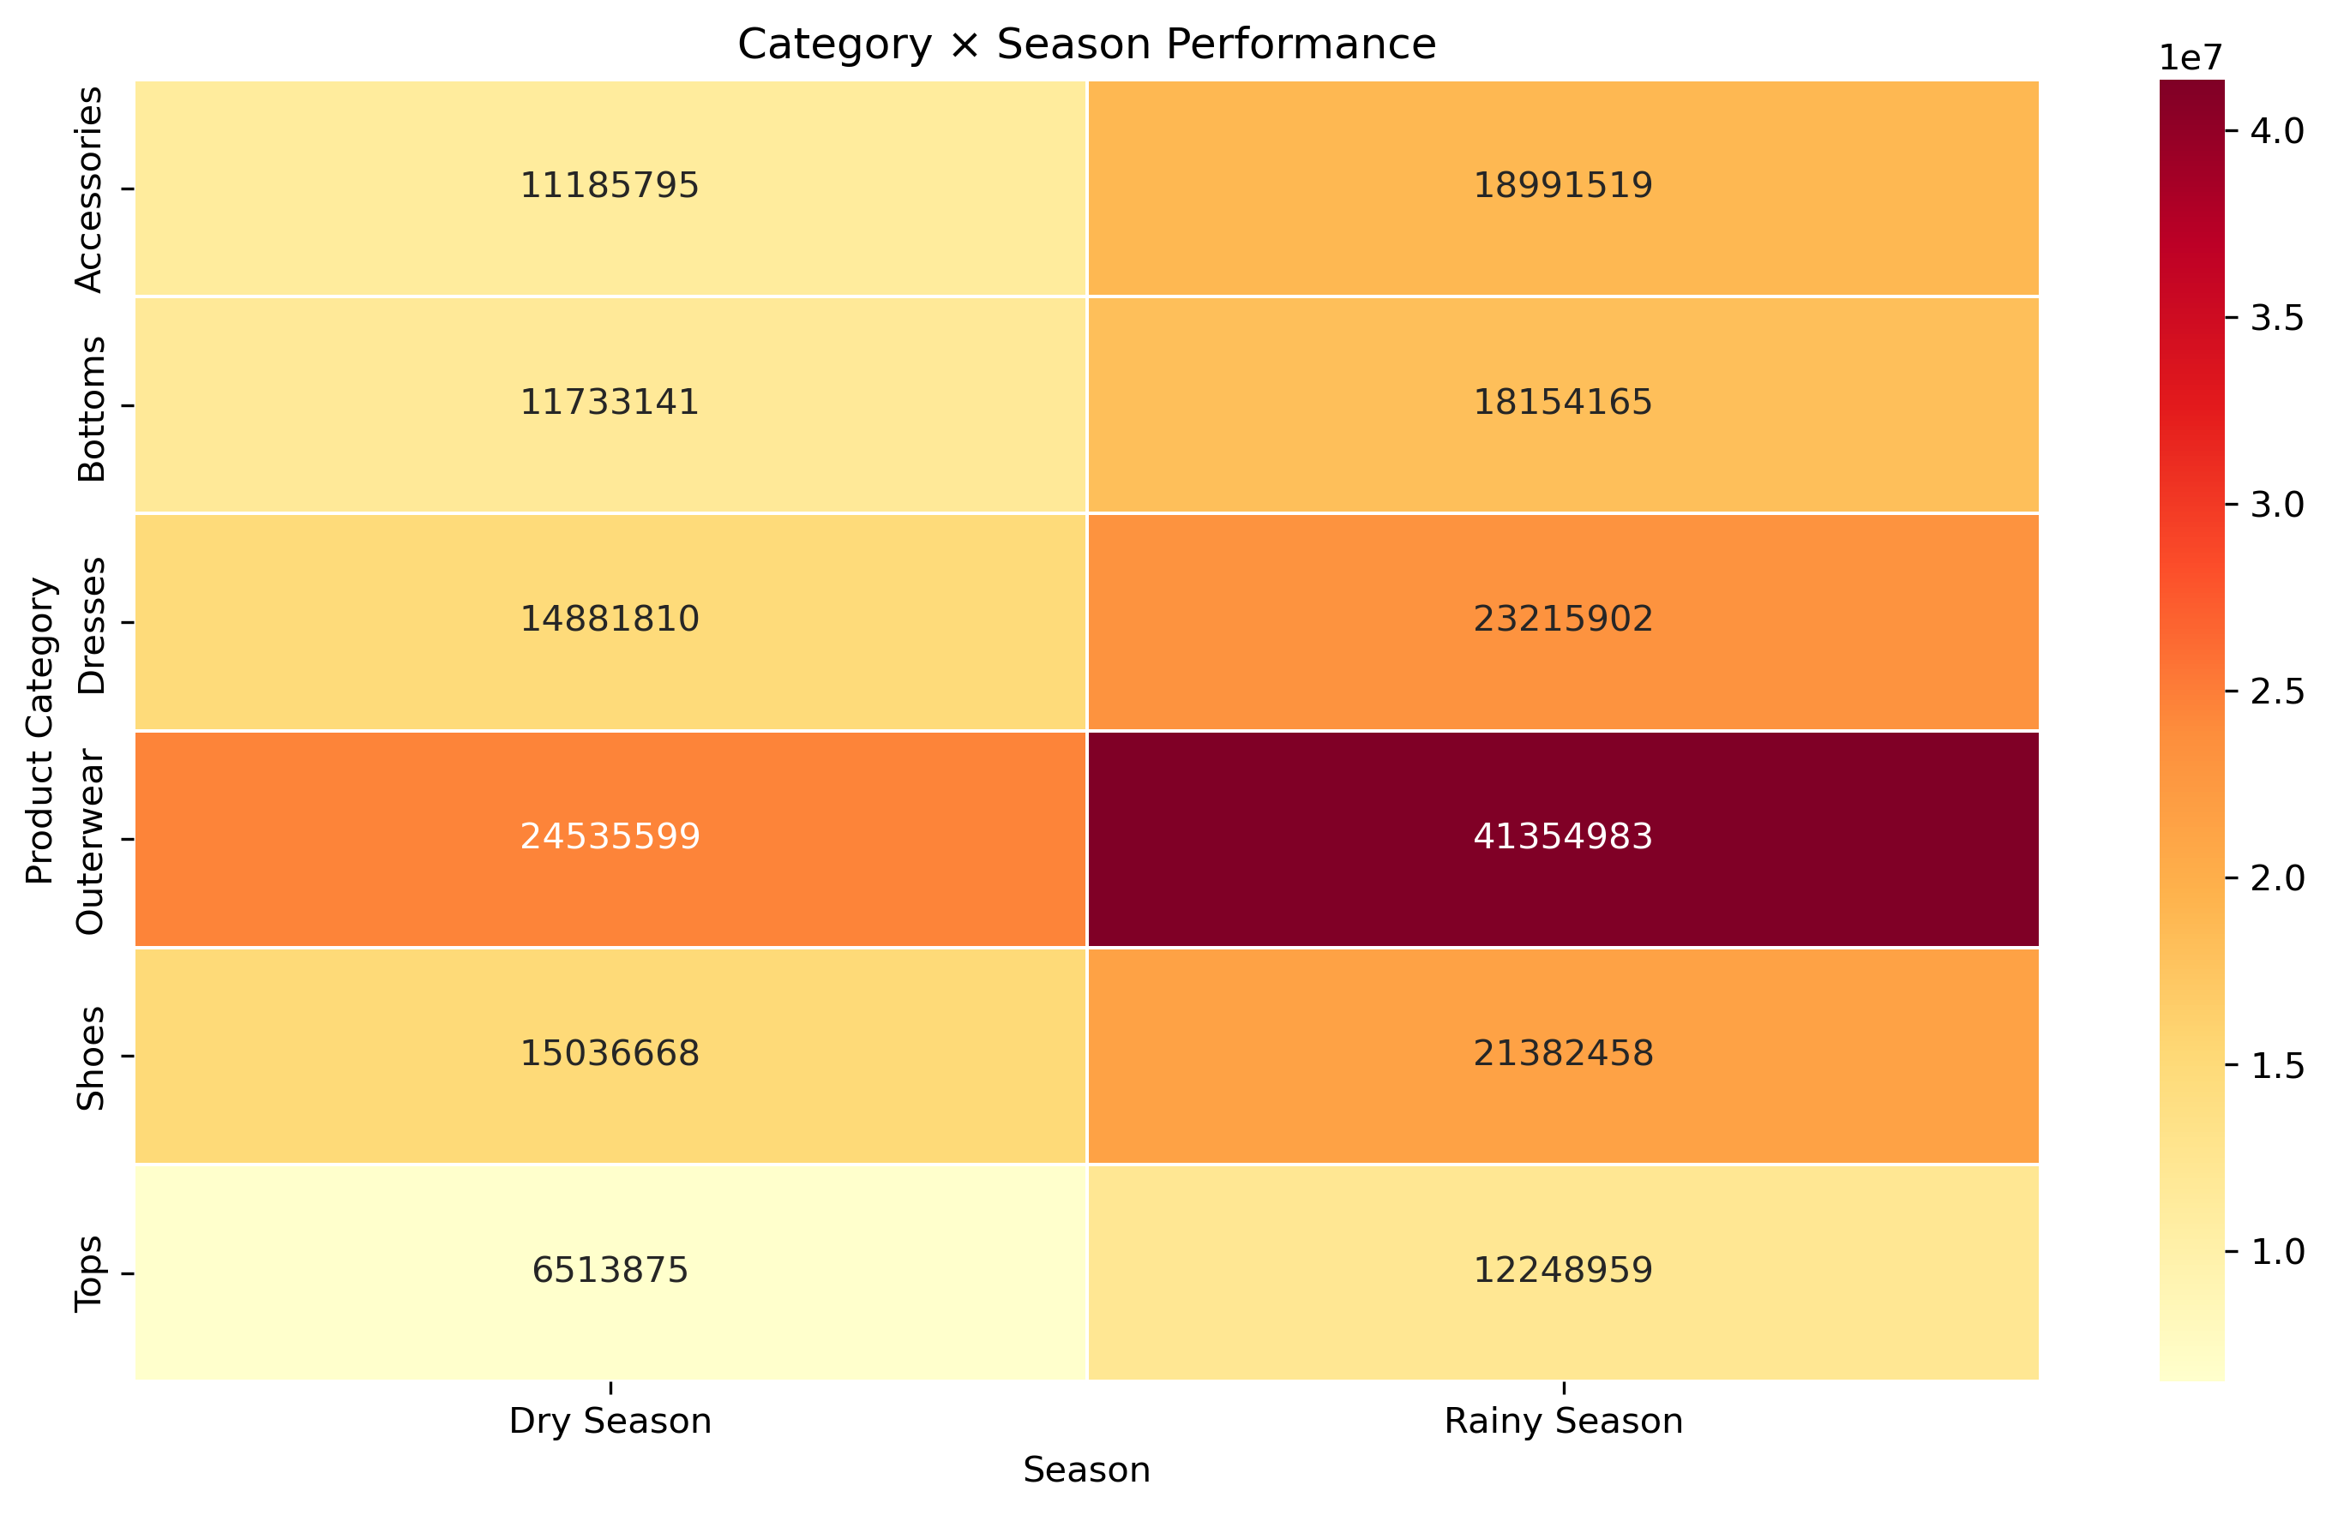
EDA 3 — Category & Seasonal Performance
FINDINGS
Category × season heatmap
Key findings
• Outerwear performed best in both season.
• Tops had the lowest performance in both season.
• Rainy-season sales were higher than dry-season sales.
PLACE VISUAL HERE
Business implication
Use seasonal patterns to guide stock planning and review low-performing categories.
Make sure category and season labels are visible
07

Slide 8
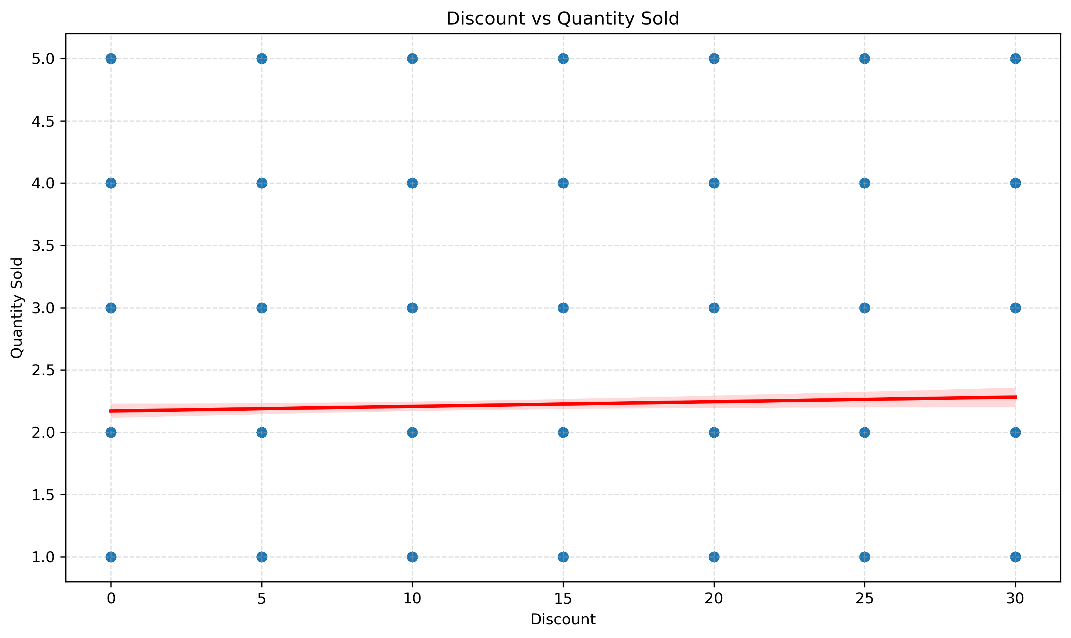
EDA 4 — Discount vs Quantity Sold
FINDINGS
Discount vs quantity scatter plot
Key finding
Correlation = 0.029
This indicates a very weak positive linear relationship between discount and quantity sold.
PLACE VISUAL HERE
Business implication
Discounts alone may not explain sales volume; assess promotions with other factors.
Include the trend line only if it helps explain the relationship
08

Slide 9
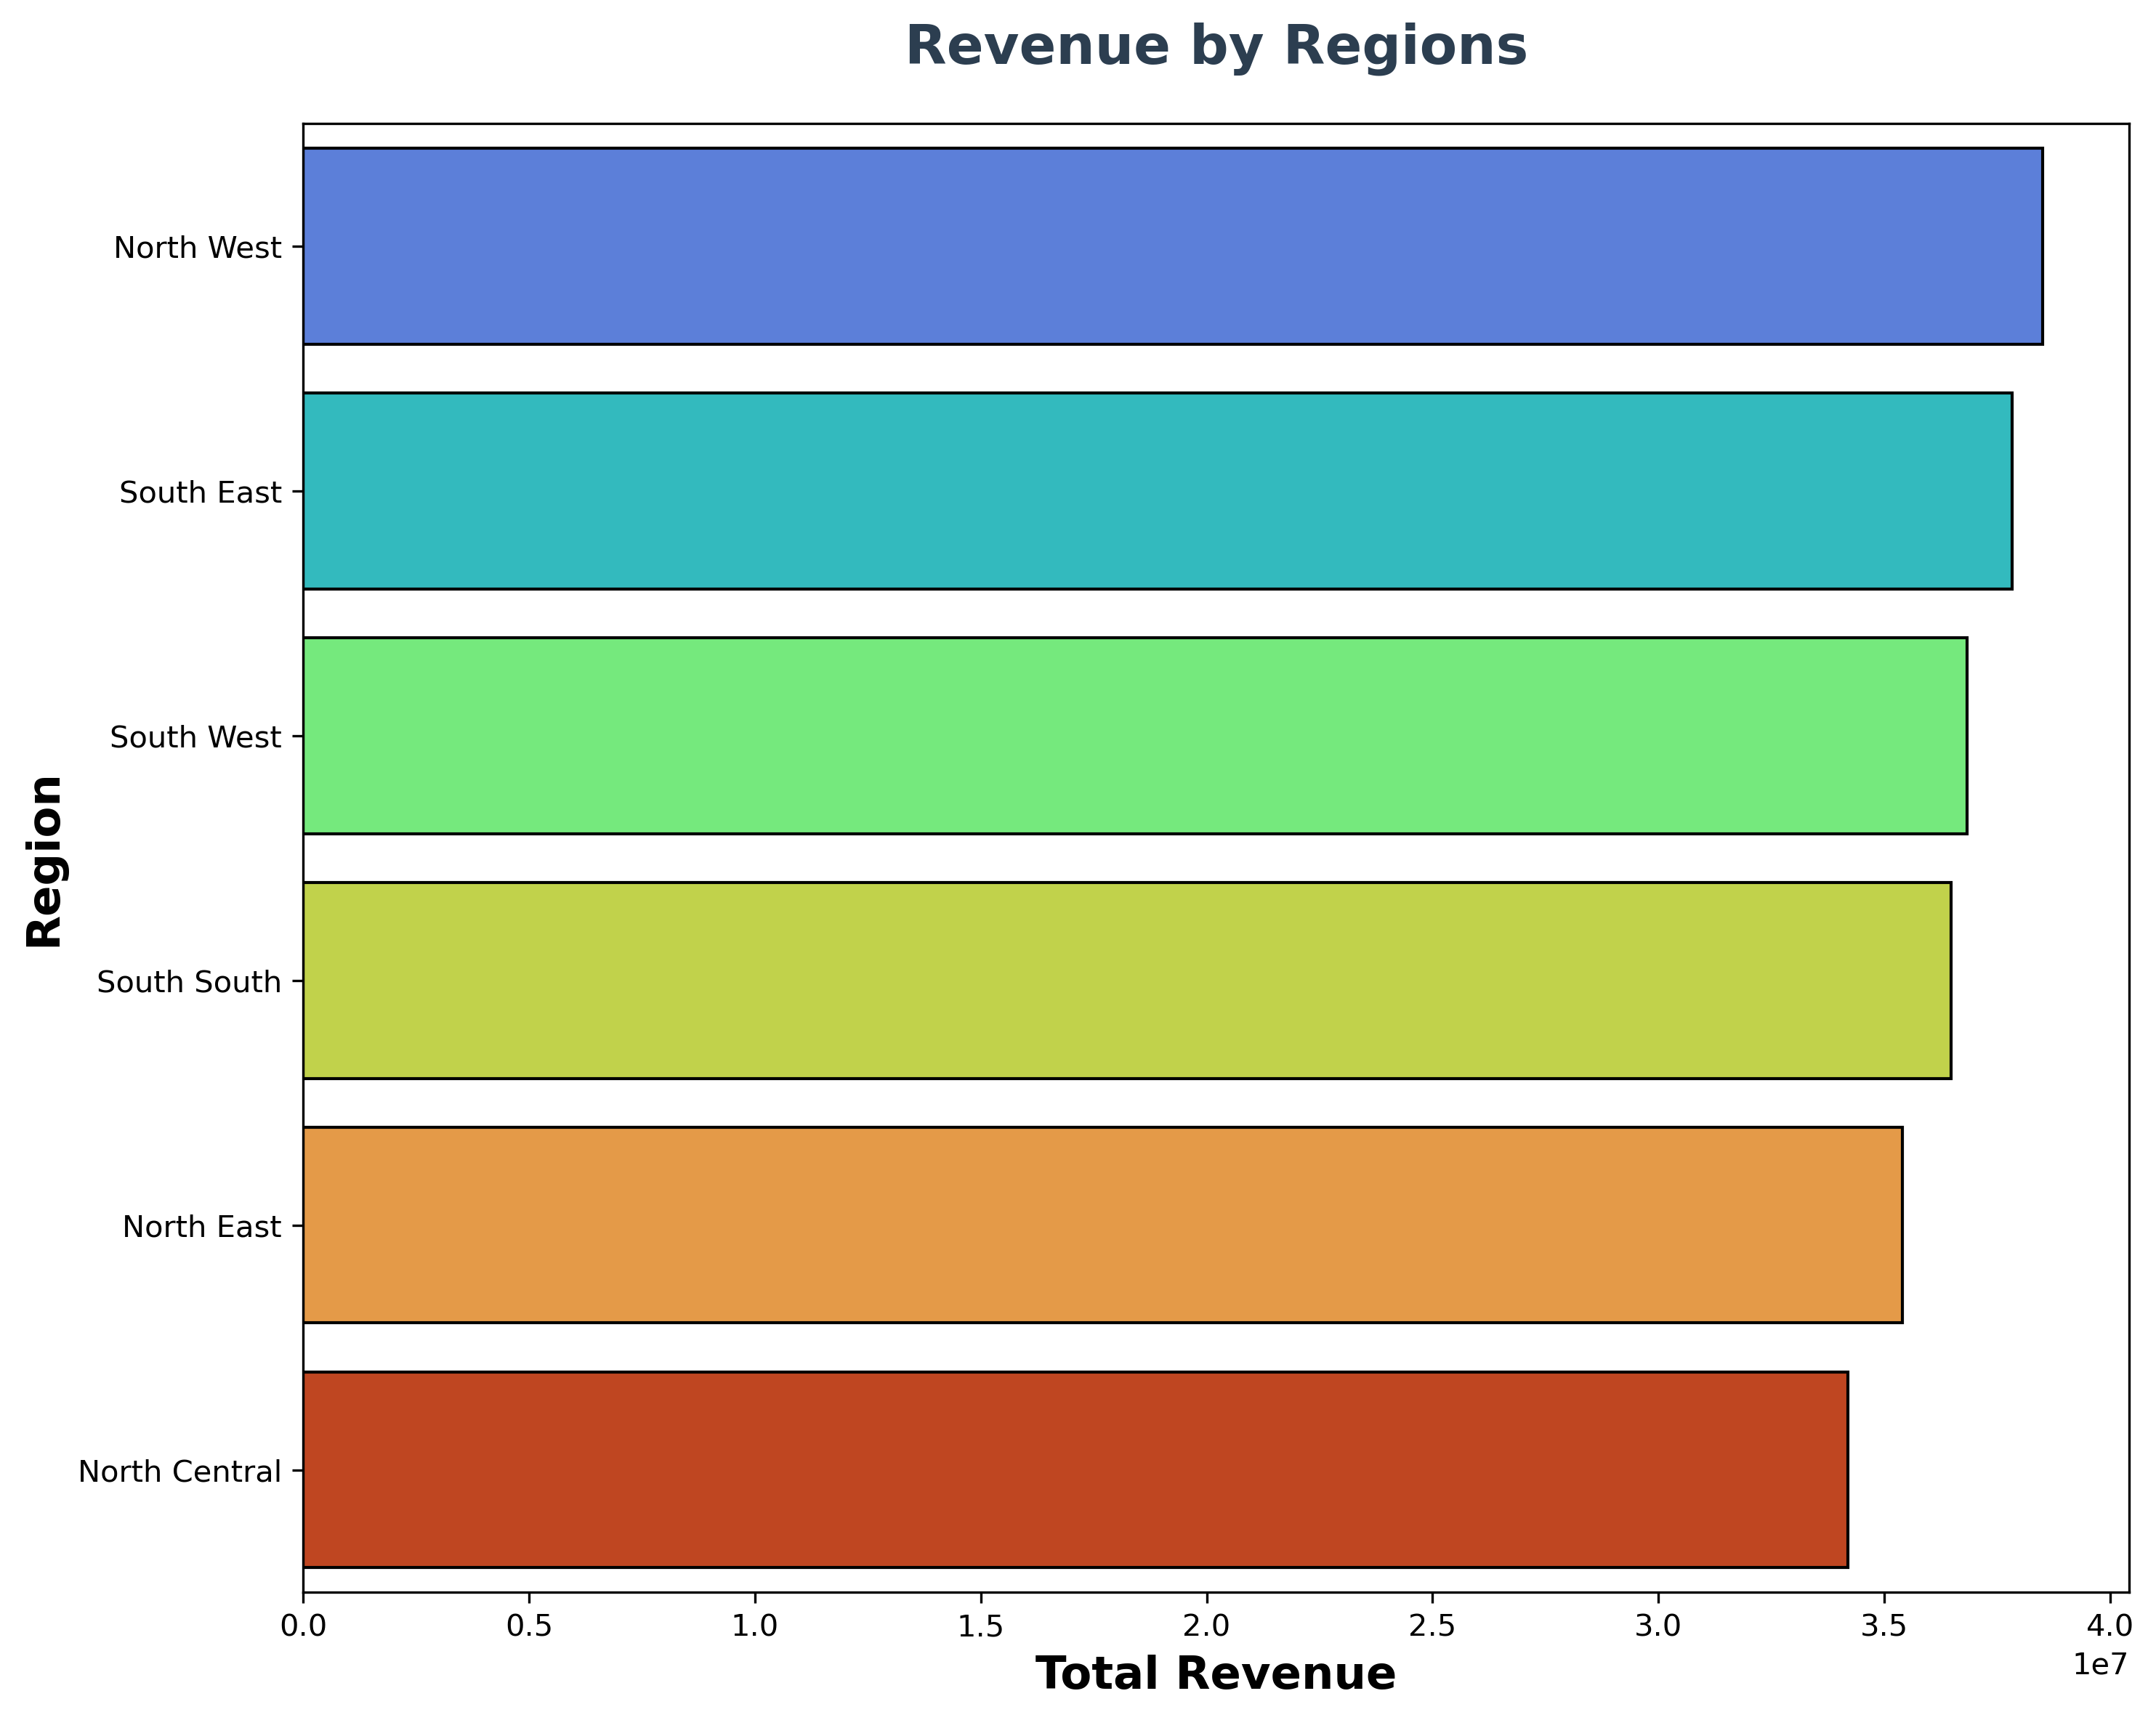
EDA 5 — Regional & Payment Patterns
FINDINGS
Regional revenue or payment method chart
Key findings
• North-West had the highest revenue.
• South-East had more customers than North-West.
PLACE VISUAL HERE
Business implication
Compare customer count, average order value and product mix by region.
Use one chart here; mention the second finding in the text
09

Slide 10
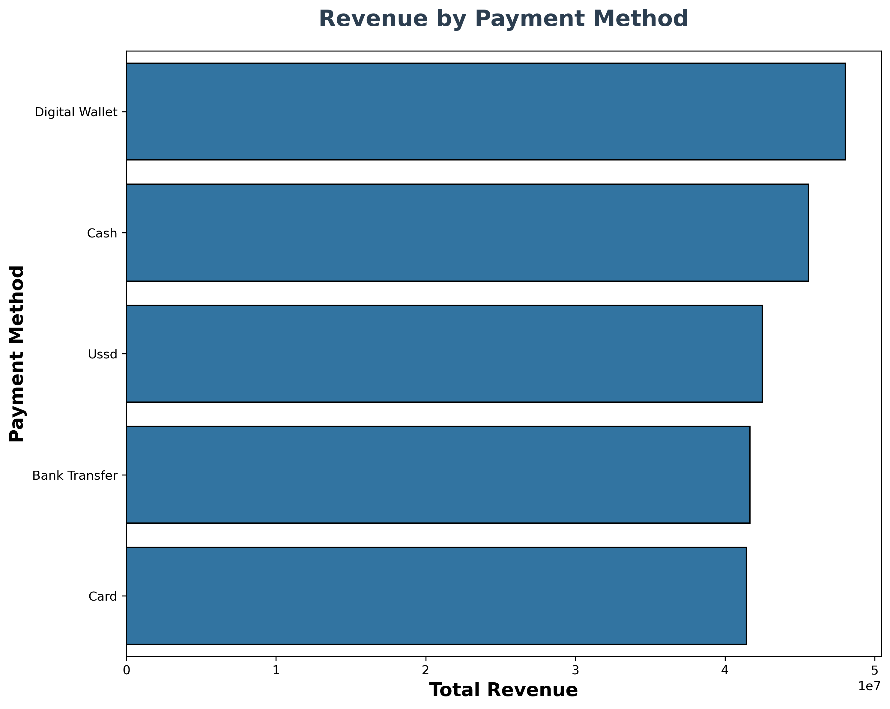
EDA 6 — Payment Method & Revenue
FINDINGS
Regional revenue or payment method chart
Key findings
• Digital wallets generated the most revenue.
• Cash and Card were the mostly used payment method
PLACE VISUAL HERE
Business implication
Compare the payment methods by the total revenue
Use one chart here; mention the second finding in the text
09

Slide 11
Other Key Findings
SUMMARY
Products
Payment methods
Customer preferences
High quantity did not always mean high revenue. Trench coats led revenue, while blazers led quantity.
Digital wallets led revenue, followed by cash. Card generated the least revenue but widely used by customers.
Yellow was the most popular color. OS was the most popular clothing size; size 42 led shoe sizes.
These patterns can help guide inventory and product decisions, but revenue alone does not show profit. Cost and margin data would be needed for profitability analysis.
10

Slide 12
Business Recommendations
ACTION
Plan for demand
Review products
Investigate sales peaks and prepare inventory for high-demand periods.
Assess pricing, discounts and costs for high-quantity, lower-revenue products.
Plan by season
Evaluate promotions
Use category and seasonal patterns to guide stock levels; review low-performing tops.
Do not rely only on discounts; compare quantity, net sales and profitability where cost data exists.
Compare regions
Use preference data
Review average order value, customer counts and product mix across regions.
Monitor popular colours and sizes while checking stock availability.
11

Slide 13
Conclusion
WRAP-UP
What the analysis showed
Tools & technologies
The analysis identified patterns in monthly sales, product and category performance, seasons, discounts, regions and payment methods. These findings can support better inventory and sales planning.
• Python
• Jupyter Notebook
• Pandas and NumPy
• Matplotlib and Seaborn
• CSV
Thank you
Questions?
12

