Slide 1







Applications of CM SAF SIS data for solar energy applications
R.W. Mueller & CM SAF Radiation Team
German Weather Service
D. Lee
University of Marburg

Slide 2
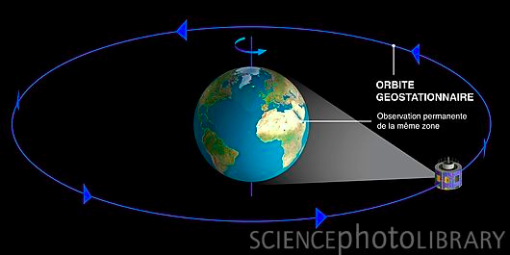
Basics:
Geosynchronous satellites
Source: Ducros 2012
Notes:
http://www.sciencephoto.com/media/432247/enlarge

Slide 3
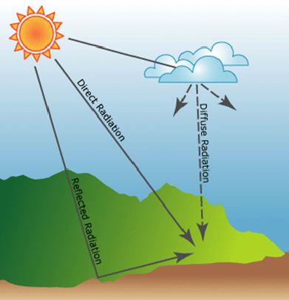
Basics:
Global vs. direct radiation
Source: State Government of Victoria 2012
Notes:
http://www.dpi.vic.gov.au/energy/sustainable-energy/renewable/part-2

Slide 4
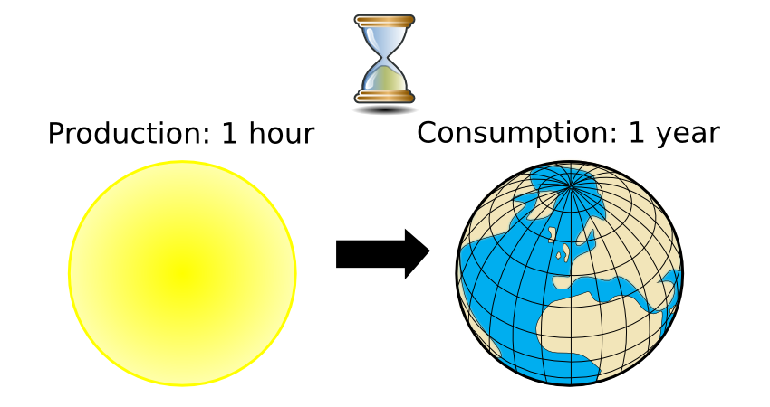
Motivation:
Solar energy

Slide 5
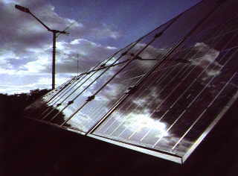
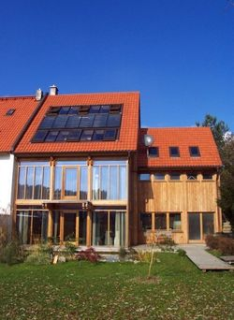
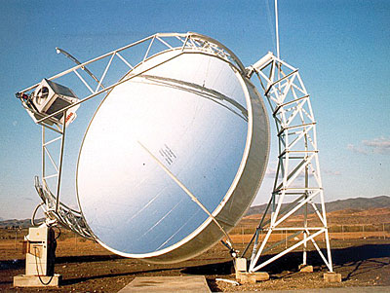
Motivation:
Solar energy
Global radiation:
Primarily for photoltaics
Direct radiation:
Can be concentrated

Slide 6
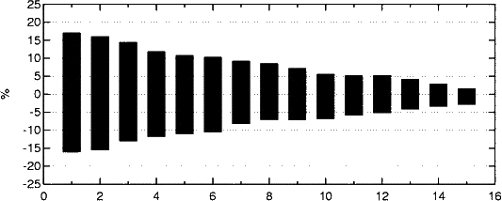
Motivation:
GEO satellites
Relevant deviation from 18-year mean
Years in data set
Source: Lohmann et al., DLR 2006
Notes:
Source S. Lohmann et al. DLR, Solar Energy Vol. 80, 2006. DNI

Slide 7
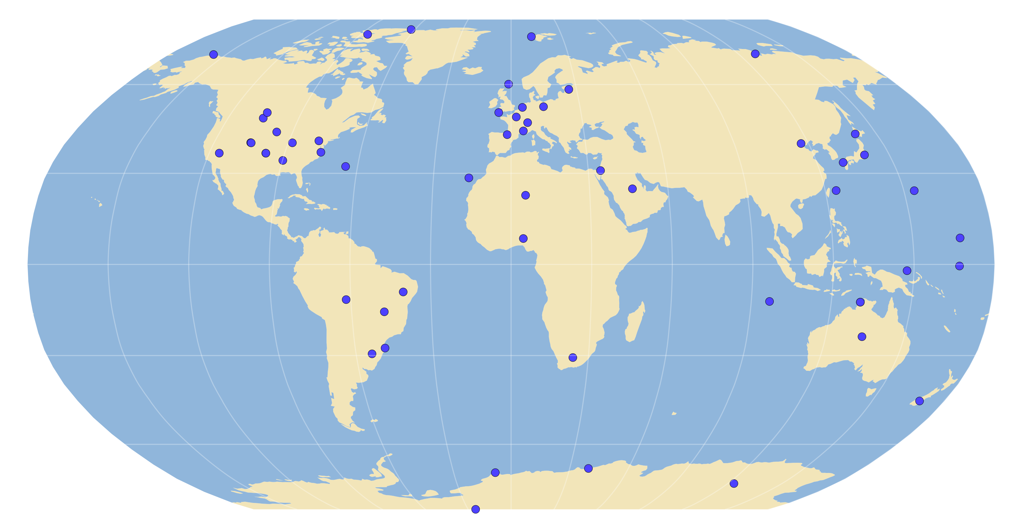
Motivation:
GEO satellites
Advantage: Continuous spatial coverage
Source: BSRN 2012, map by author

Slide 8
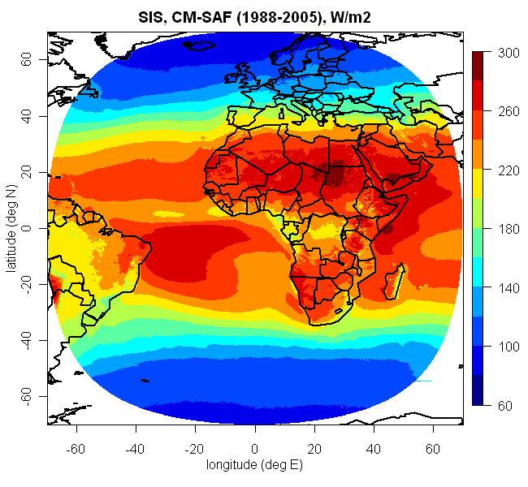
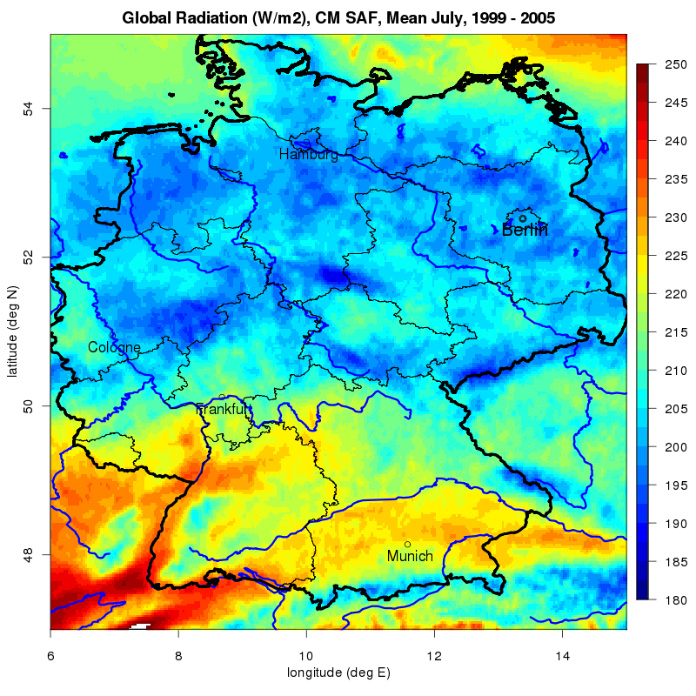
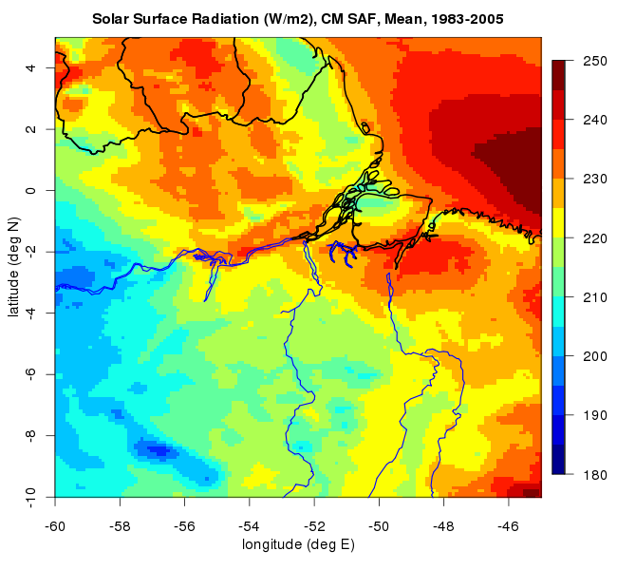
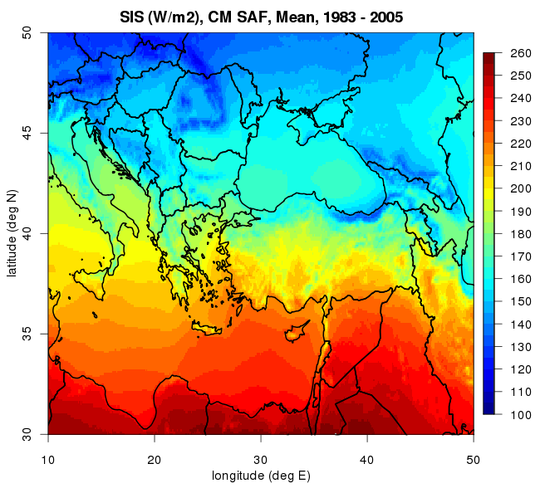
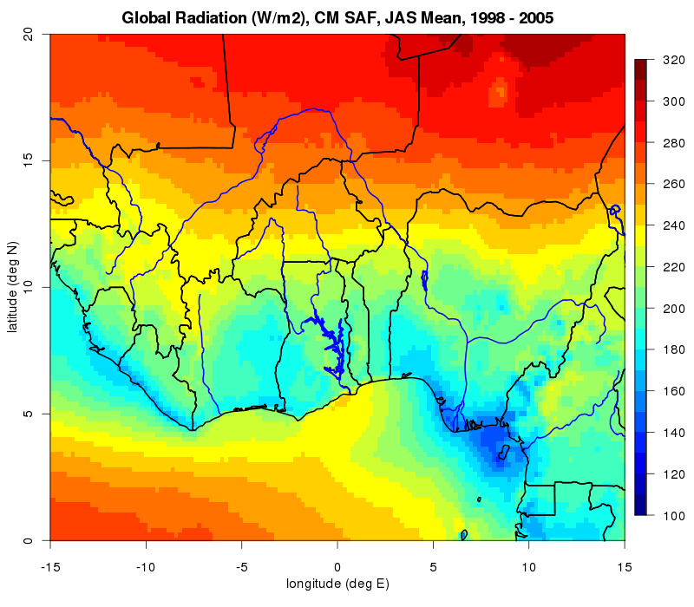
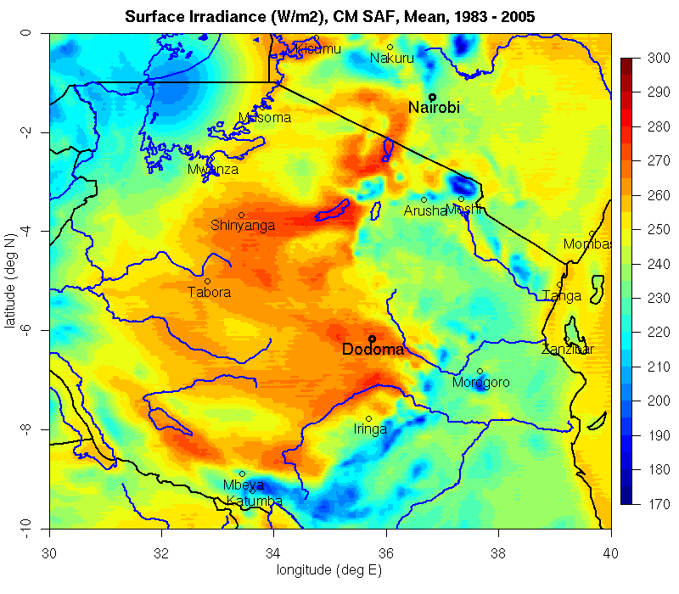
Motivation:
GEO satellites
Germany
Amazon
Mediterranean
West Africa
High resolution:
0.03° spatial
Daily/hourly temporal
Tanzania

Slide 9
Motivation:
GEO satellites
Accuracy targets compared to ground measurements
 | Global radiation (W/m²) |  |  | Direct radiation (W/m²)
 | Threshold | Target | Optimum | Threshold | Target | Optimum
Monthly | 15 | 10 | 8 | 20 | 15 | 12
Daily | 25 | 20 | 15 | 30 | 25 | 20
Source: Posselt et al 2012

Slide 10
Motivation:
GEO satellites
Accuracy targets compared to ground measurements
 | Global radiation (W/m²) |  |  | Direct radiation (W/m²)
 | Threshold | Target | Optimum | Threshold | Target | Optimum
Monthly | 15 | 10 | 8 | 20 | 15 | 12
Daily | 25 | 20 | 15 | 30 | 25 | 20
Source: Posselt et al 2012
Validation against BSRN stations
Data source | Bias (W/m²) | Mean absolute difference (W/m²) | Standard deviance (W/m²) | Anomaly correlation (%) | Fraction of time steps above validation target values
CM SAF | 4.24 | 7.76 | 8.23 | 0.89 | 10.71
ERAinterim | 5.48 | 10.41 | 12.15 | 0.8 | 24.6
GEWEX | -2.42 | 12.03 | 11.03 | 0.82 | 31.89
ISCCP | -0.02 | 11.56 | 11.25 | 0.78 | 29.16
Source: Posselt et al 2011

Slide 11
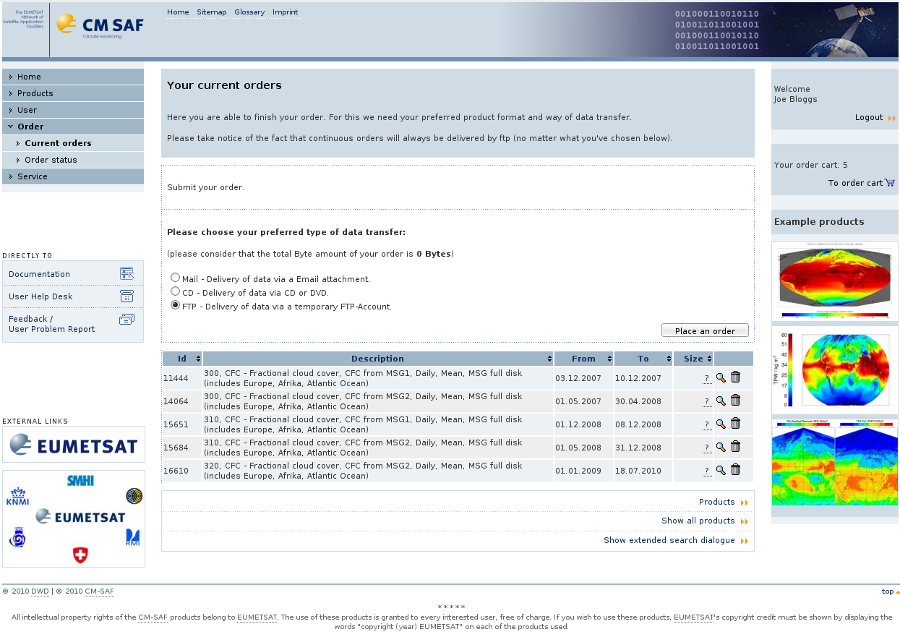
Motivation: GEO satellites
user-friendly data access via the Web User Interface: wui.cmsaf.eu
all data is freely available in netcdf format & Toolkit (example data + scripts) available: www.cmsaf.eu/tools

Slide 12
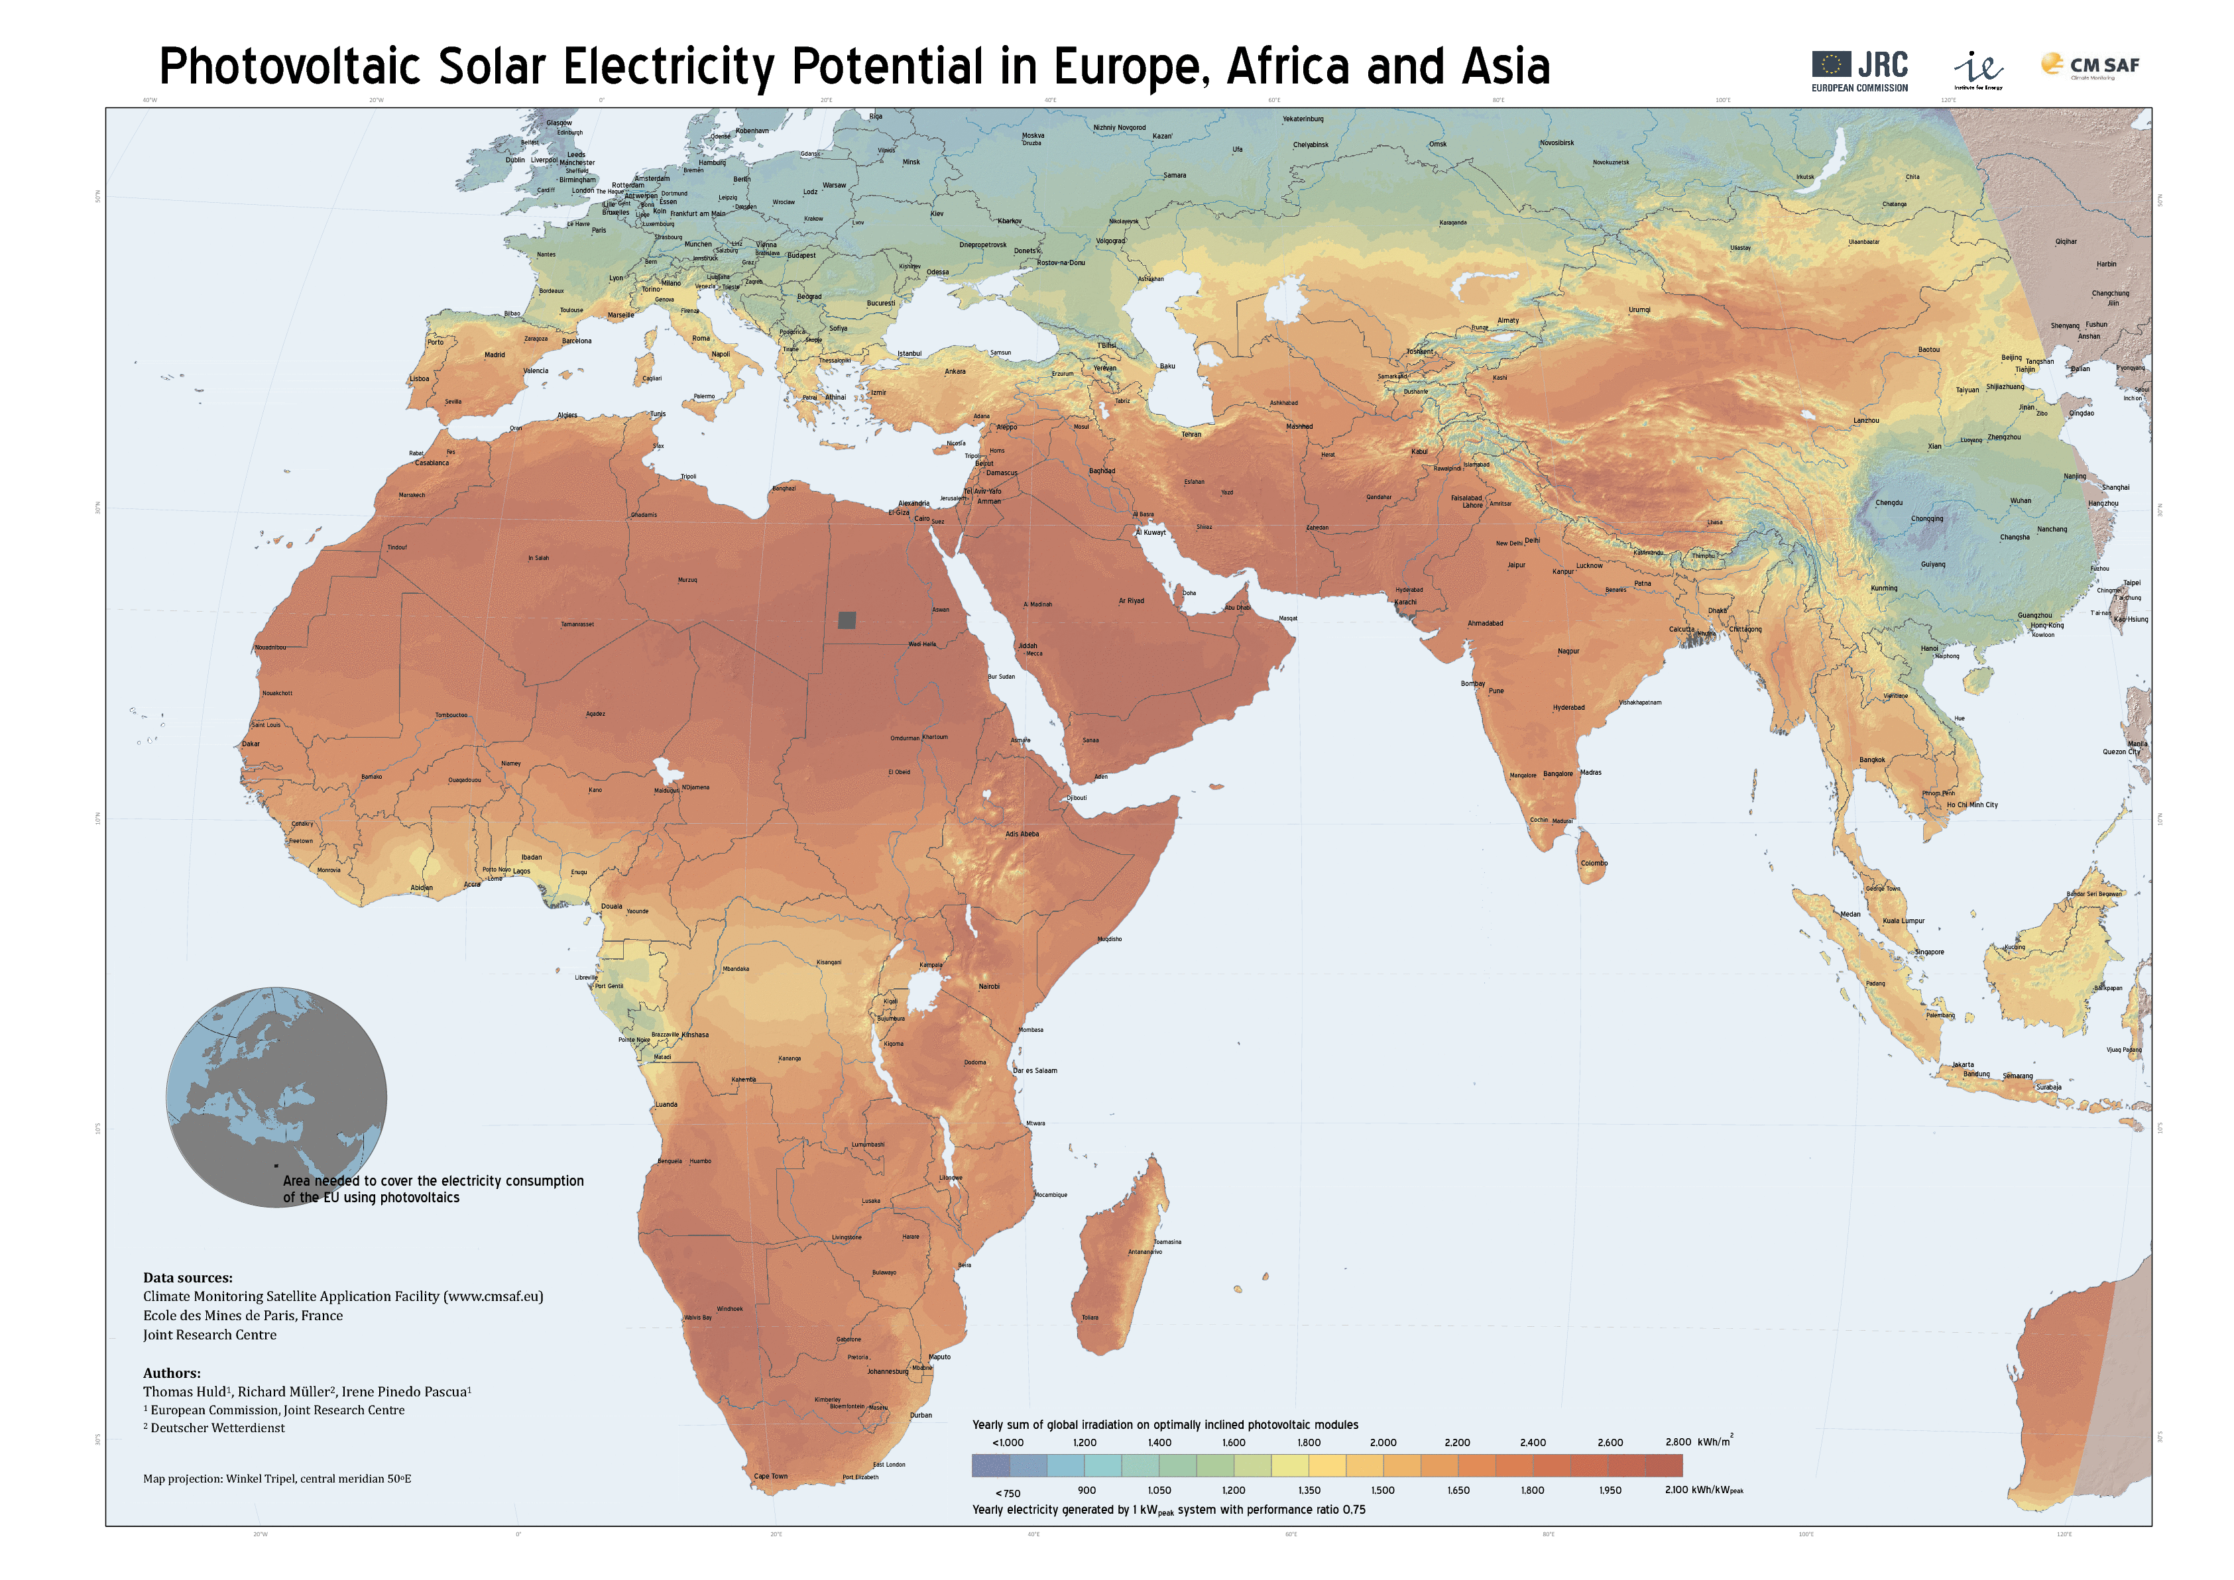
Applications:
Macroscale potential evaluation
Source: JRC 2012

Slide 13
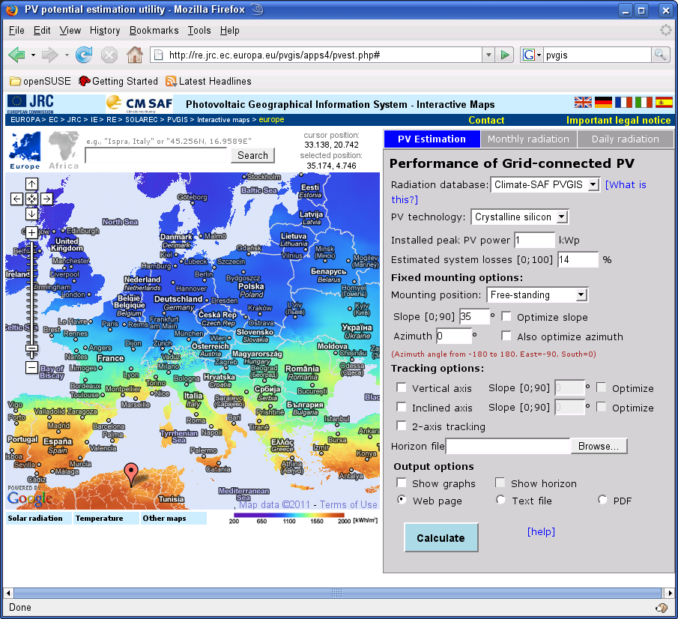
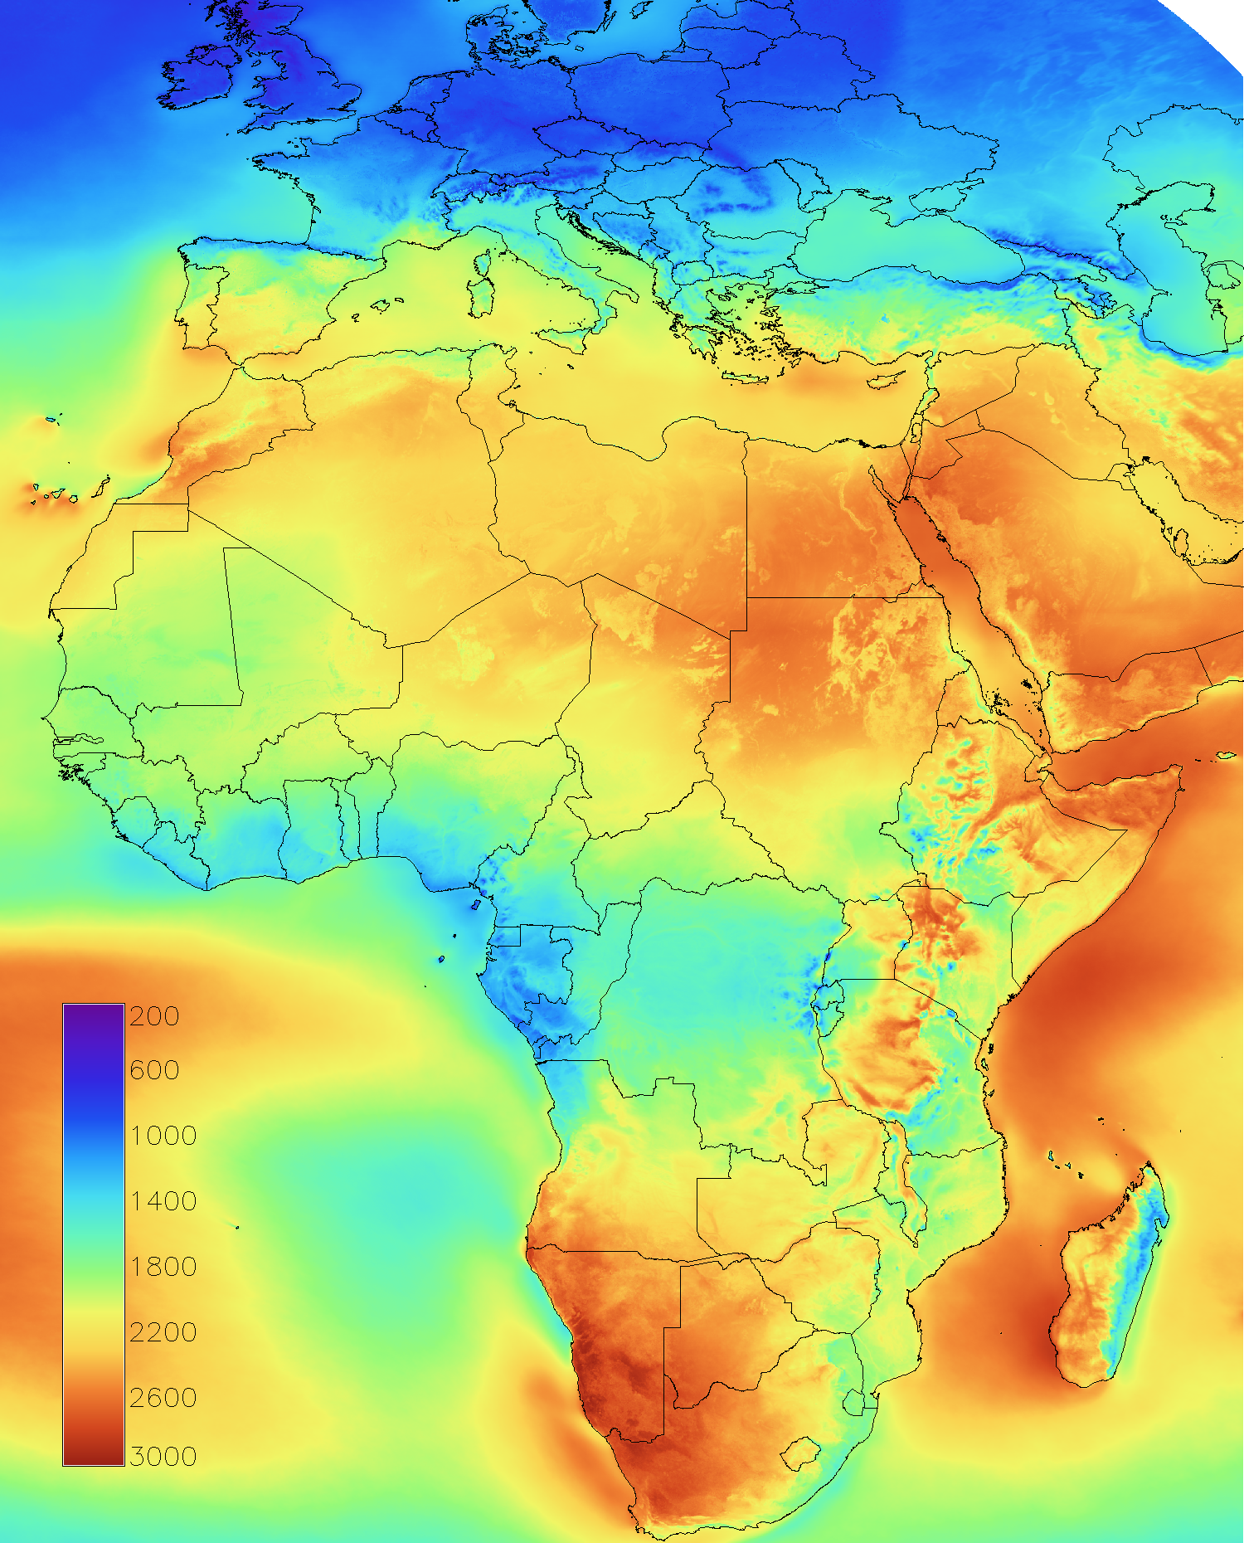
Applications:
Macroscale potential evaluation
Interactive online tool
Raw geodata
Source: JRC 2012

Slide 14
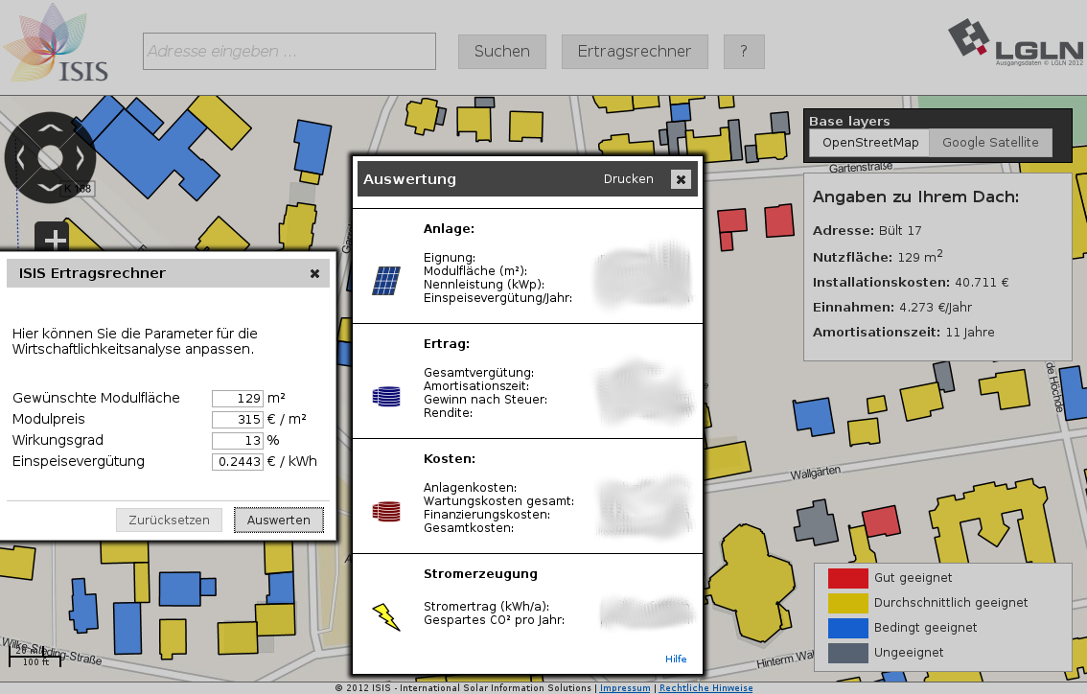
Applications:
Mesoscale potential evaluation
Source: ISIS 2012

Slide 15
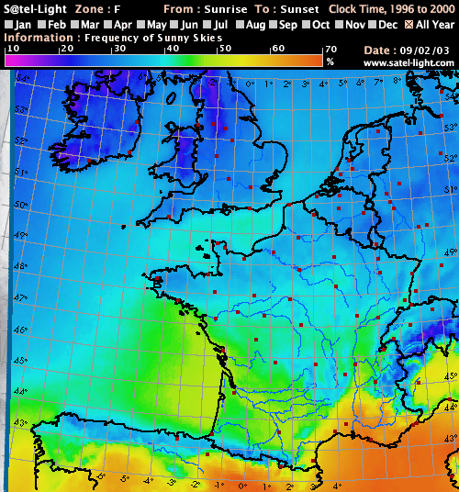
Applications:
Microscale potential evaluation
Architectural planning
Window size
Window positioning
Tint grade
Source: Satel-Light 2004

Slide 16
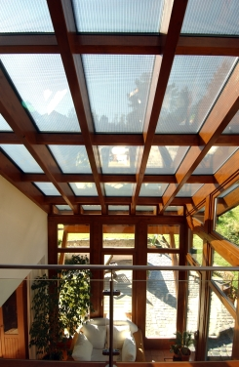
Applications:
Microscale potential evaluation
Architectural planning
Transparent thin film solar cells
Source: Schott Solar 2007

Slide 17
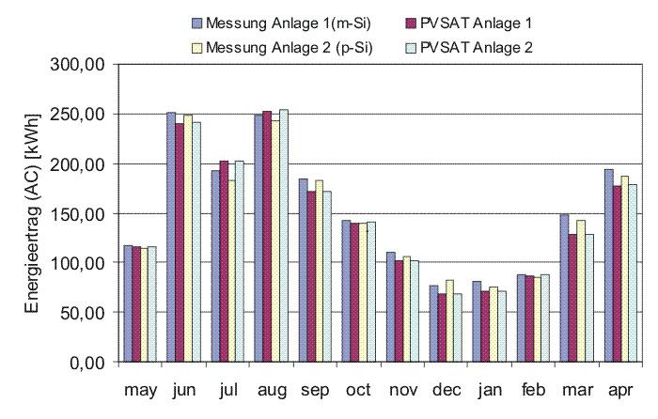
Applications:
Near-real time production monitoring
Source: PVSAT, University of Magdeburg 2012

Slide 18
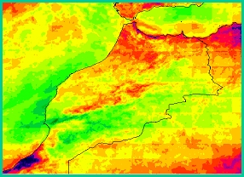
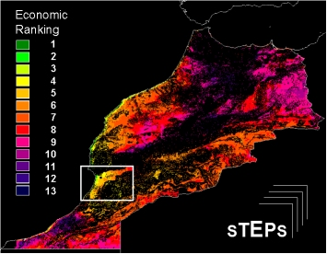
Applications:
Power plant profitability analysis
Economic ranking based on irradiance and additional factors
Direct irradiance in Morocco
Source: DLR & SOLEMI 2007

Slide 19
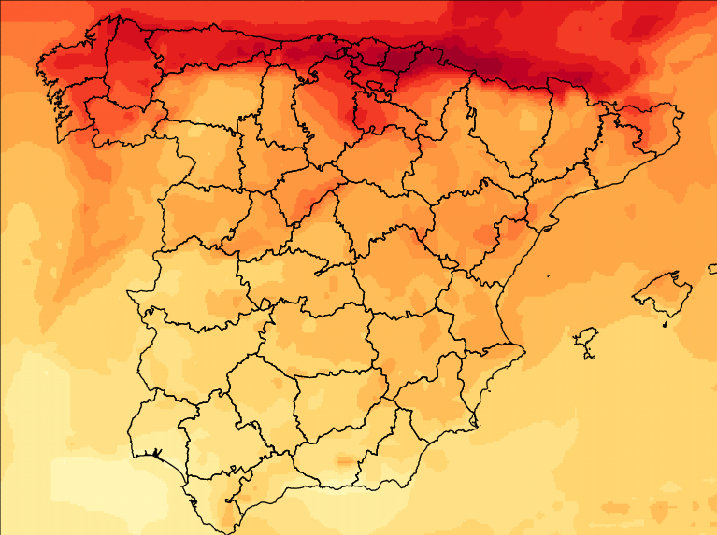
Do it yourself:
R
SolaR:
R package for
solar radiation and
photoltaic
simulations
Example:
Solar irradiance in
Spain
Source: Lamigueiro 2011

Slide 20
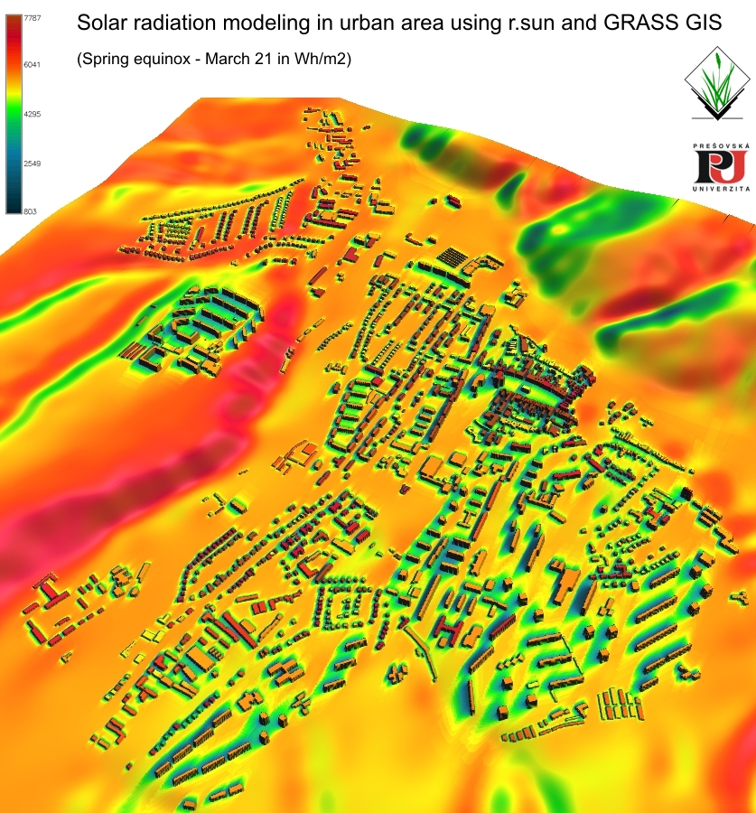
Do it yourself:
GRASS GIS
r.sun:
GRASS module for
solar radiation
Example:
Solar irradiance in urban
area of Slovakia
Source: Hofierka & Kaňuk 2006
Notes:
http://www.fhpv.unipo.sk/kagerr/pracovnici/hofierka/projekty/pv_results.html

Slide 21
Conclusions
Great data is available
We are excited to hear
what you're doing with it!

