Slide 1







HALO: Using CM SAF's MAGICSOL method to retrieve global and direct surface radiation from historical geosynchronous observations
R.W. Mueller
German Weather Service
D. Lee
University of Marburg

Slide 2
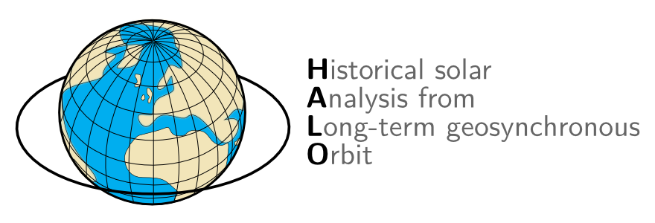
Proof of concept for a global solar ECV data set

Slide 3
Global solar data sets:
Requirements
Essential climate variables:
Relevant base variable
Long-term record
High quality measurements
Notes:
Measuring radiation
Radiation interacts with atmospheric constituents
This interaction alters the radiation and from this one can derive (back-reference) to the atmospheric constituents
Conversion of the measured radiation into geophysical information is an inversion problem (A. collard, ECMWF)

Slide 4
Global solar data sets:
Available data
Comparable data sets:
Helio-Clim
ERA-Interim
GEWEX SRB
ISCCP FD
FLASHFlux
CLARA
Notes:
Measuring radiation
Radiation interacts with atmospheric constituents
This interaction alters the radiation and from this one can derive (back-reference) to the atmospheric constituents
Conversion of the measured radiation into geophysical information is an inversion problem (A. collard, ECMWF)

Slide 5
Global solar data sets:
Available data
Comparable data sets:
Helio-Clim
ERA-Interim
GEWEX SRB
ISCCP FD
FLASHFlux
CLARA
Data needed with:
Robust data
requirements
Long time series
available
High resolution
Differentiation in
diffuse/beam radiation
Global spatial extent
Free to use/distribute
Notes:
Measuring radiation
Radiation interacts with atmospheric constituents
This interaction alters the radiation and from this one can derive (back-reference) to the atmospheric constituents
Conversion of the measured radiation into geophysical information is an inversion problem (A. collard, ECMWF)

Slide 6
Global solar data sets:
MAGICSOL
Advantages:
Robust and well tested
Low data requirements
Self-calibration – high data availability
Computation of direct and diffuse radiation
Relatively low computational costs
Best validation among comparable data sets
Open source – verifiable, modifiable, freely
usable
Notes:
Measuring radiation
Radiation interacts with atmospheric constituents
This interaction alters the radiation and from this one can derive (back-reference) to the atmospheric constituents
Conversion of the measured radiation into geophysical information is an inversion problem (A. collard, ECMWF)

Slide 7
HALO

Slide 8
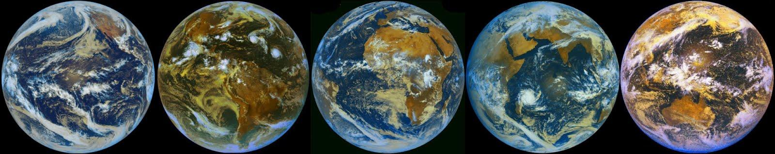
HALO:
Spatial coverage
Source: Météo-France 2009, composite by author

Slide 9
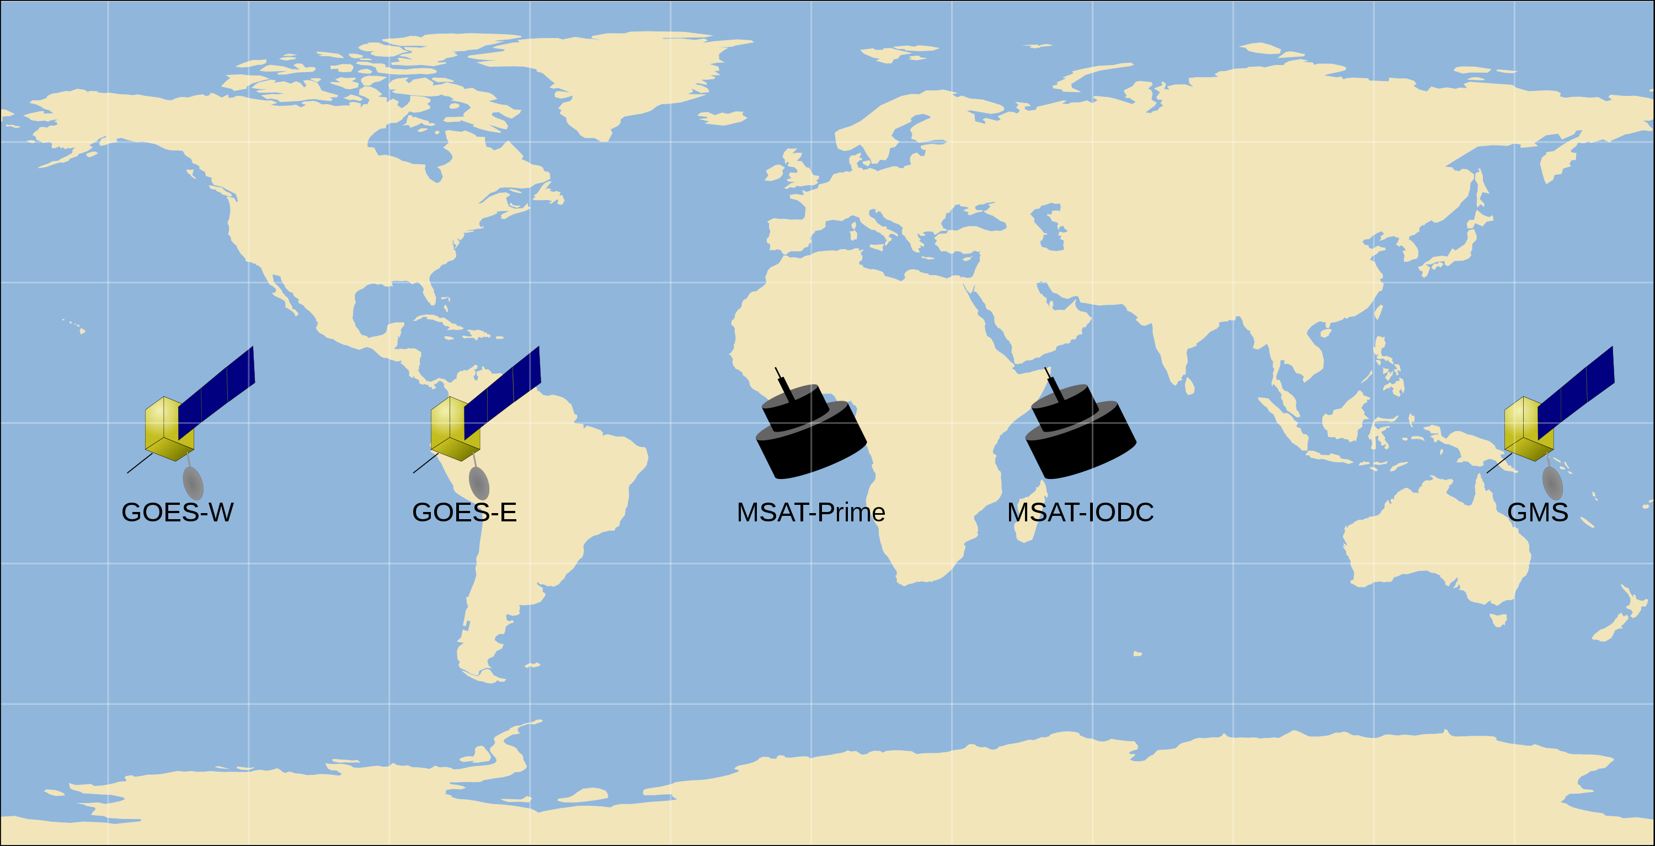
HALO:
Spatial coverage
Source: NOAA 2012, EUMETSAT 2012, map by author

Slide 10
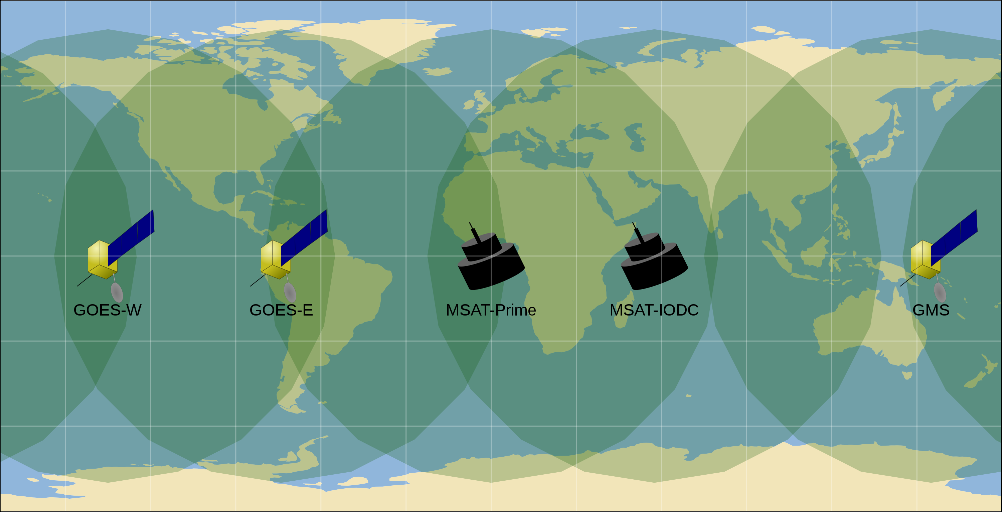
HALO:
Spatial coverage
Source: NOAA 2012, EUMETSAT 2012, map by author

Slide 11
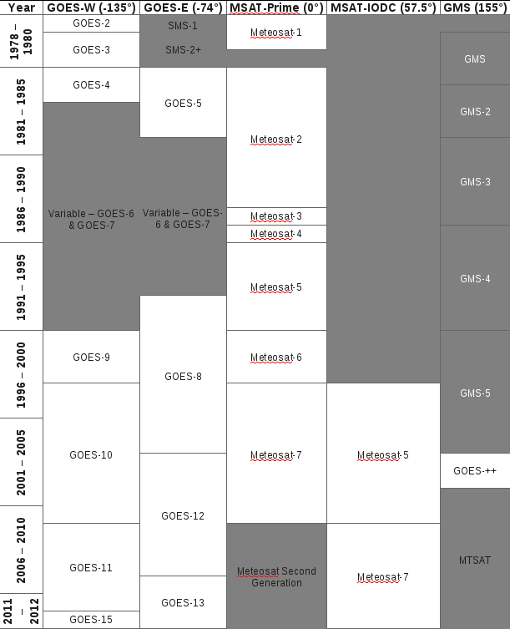
HALO:
Temporal coverage
Source: NOAA 2012, EUMETSAT 2012, JMA 2012, diagram by author

Slide 12
HALO:
Temporal coverage
Source: NOAA 2012, EUMETSAT 2012, JMA 2012, diagram by author

Slide 13
HALO:
Temporal coverage
1 month = ~ 3 TB
Chosen test month:
June 2003
Source: NOAA 2012, EUMETSAT 2012, JMA 2012, diagram by author

Slide 14
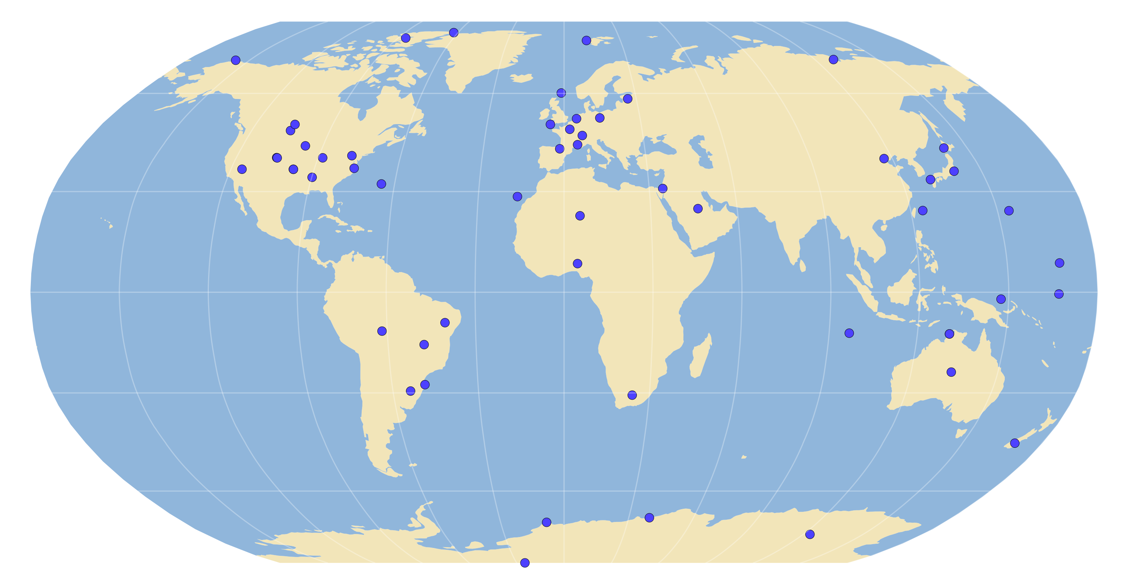
HALO:
Validation stations
Source: BSRN 2012, map by author

Slide 15

HALO:
Validation stations
Source: BSRN 2012, map by author

Slide 16
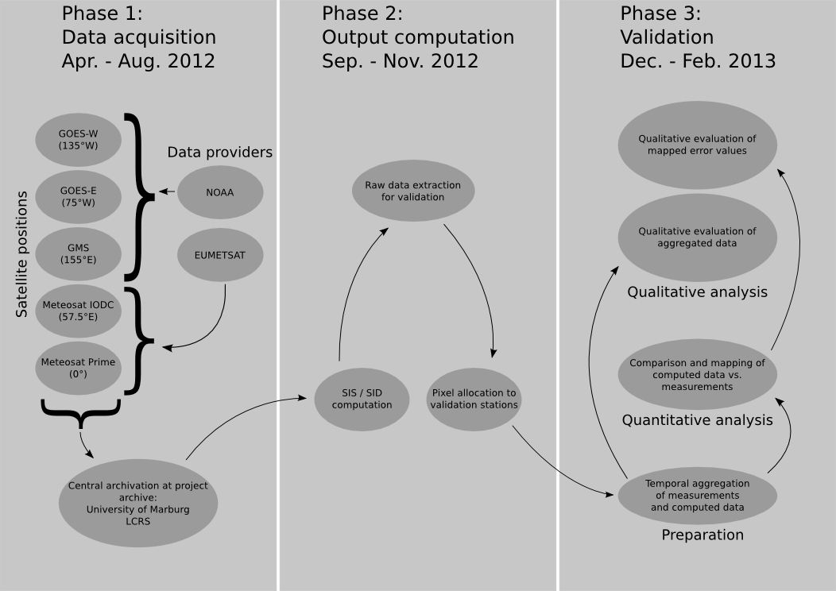
HALO:
Workflow

Slide 17
HALO:
Workflow

Slide 18
HALO:
Workflow

Slide 19
HALO:
Workflow

Slide 20
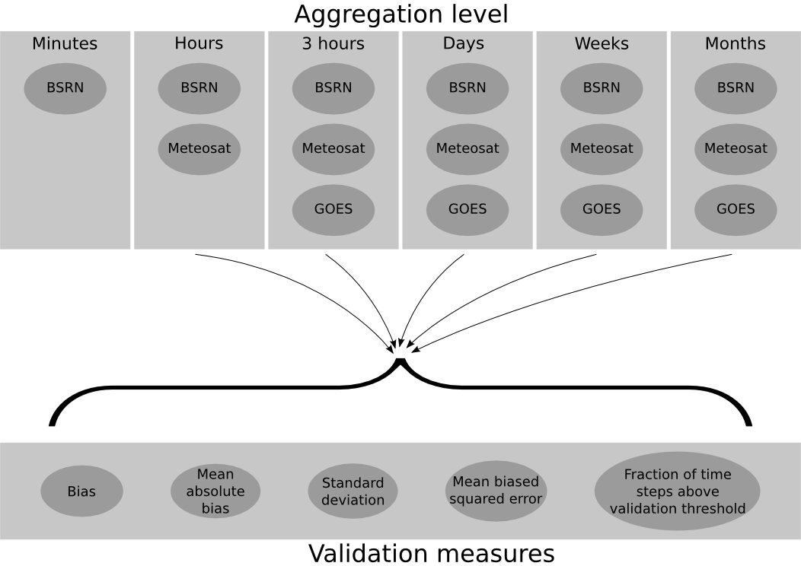
HALO:
Validation scheme

Slide 21
HALO:
Validation scheme

Slide 22
HALO:
Validation scheme

