Slide 1







A new satellite-based surface solar irradiance data set for climate analysis
R.W. Mueller, R.Cremer, C.Träger,
J. Trentmann
DWD
Rebekka Posselt, Reto Stöckli
MeteoSwiss

Slide 2
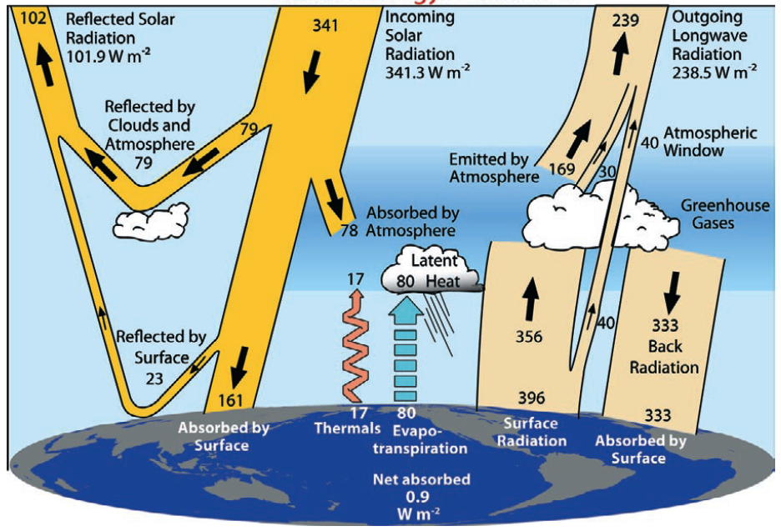
Motivation
Climate change (natural
& anthropogen) is driven
by radiation.
-There is a need to observe
& analyse variables involved
in radiation budget in order
to increase our under-
standing of climate system
and climate change.
Figure from Trendberth et al. (2009)
Notes:
Measuring radiation
Radiation interacts with atmospheric constituents
This interaction alters the radiation and from this one can derive (back-reference) to the atmospheric constituents
Conversion of the measured radiation into geophysical information is an inversion problem (A. collard, ECMWF)

Slide 3
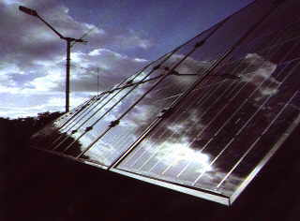
Motivation
Climate change (natural
& anthropogen) is driven
by radiation.
-There is a need to observe
& analyse variables involved
in radiation budget in order
to increase our under-
standing of climate system
and climate change.
Figure from Trendberth et al. (2009)
Solar energy is climate protection, solar
irradiance data is needed for planning &
monitoring.
Notes:
Measuring radiation
Radiation interacts with atmospheric constituents
This interaction alters the radiation and from this one can derive (back-reference) to the atmospheric constituents
Conversion of the measured radiation into geophysical information is an inversion problem (A. collard, ECMWF)

Slide 4
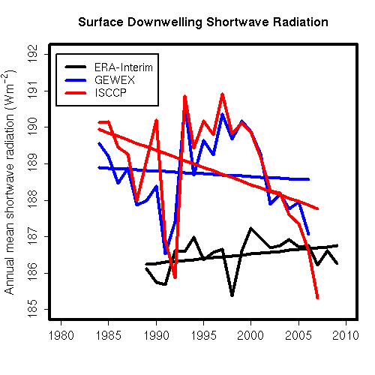
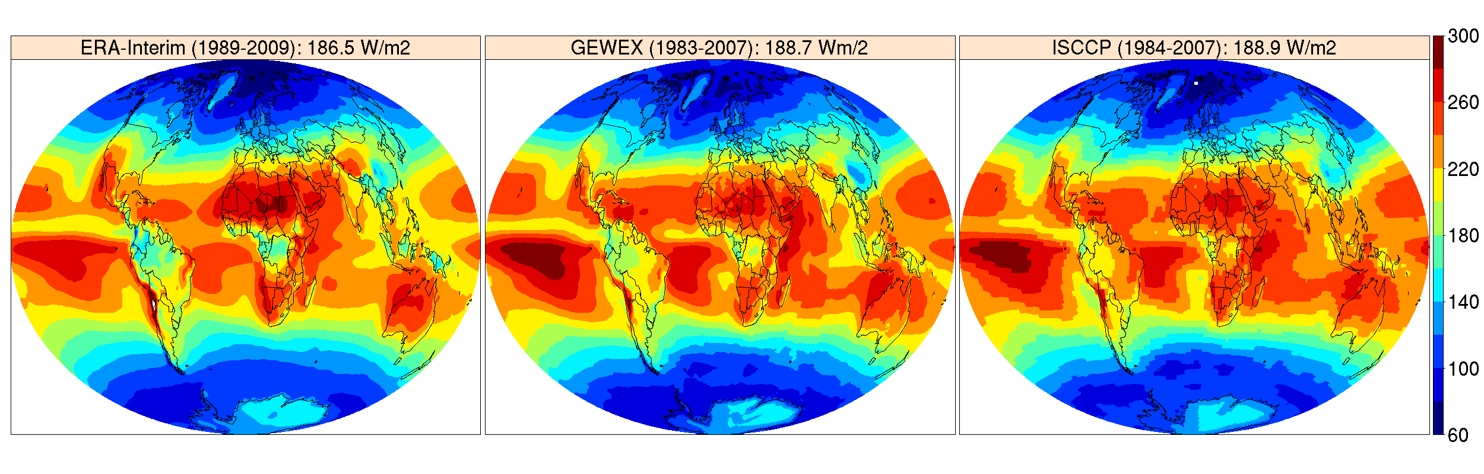
Why a new data set ?
Available data sets (ISCCP, GEWEX, ERA-Interim) agree well on the mean but differ substantially in the temporal evolution & spatial distribution!
Coarse spatial resolution &
limited quality for regional climate monitoring.

Slide 5
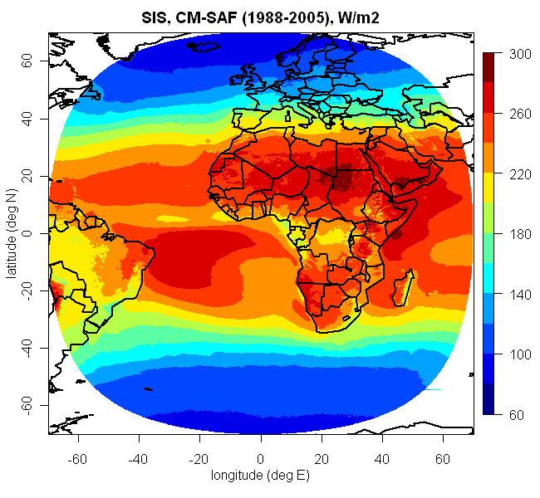
The CM-SAF data set
Surface solar irradiance (SIS), direct irradiance (SID) and effective cloud albedo from Meteosat satellites (1983 – today) in high spatial and temporal resolution (hm,dm,mm,0.03°); the data & R,cdo tools for analysis/ visualisation are available free
of charge at www.cmsaf.eu.
Validated with BSRN surface station data.
Compared with alternative
satellite based data sets.

Slide 6
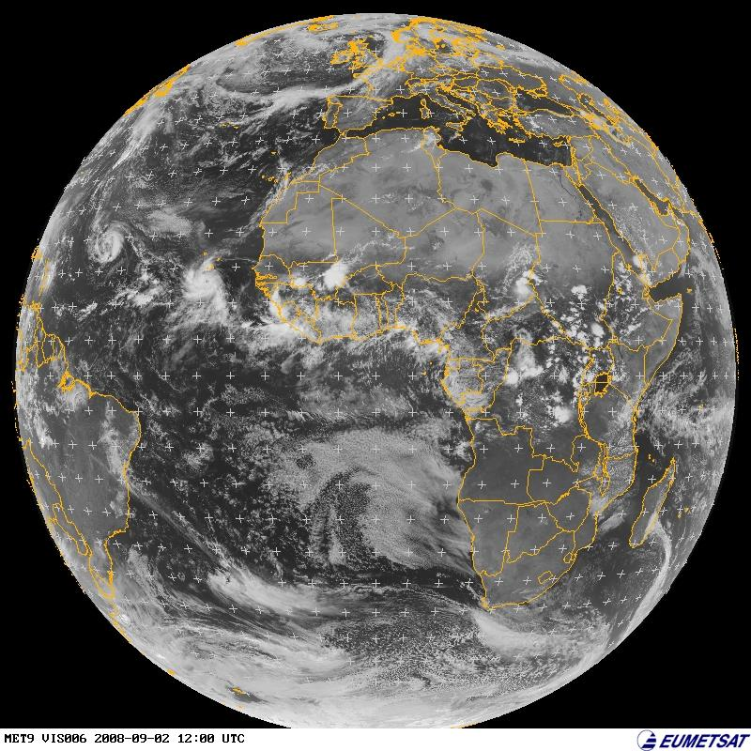
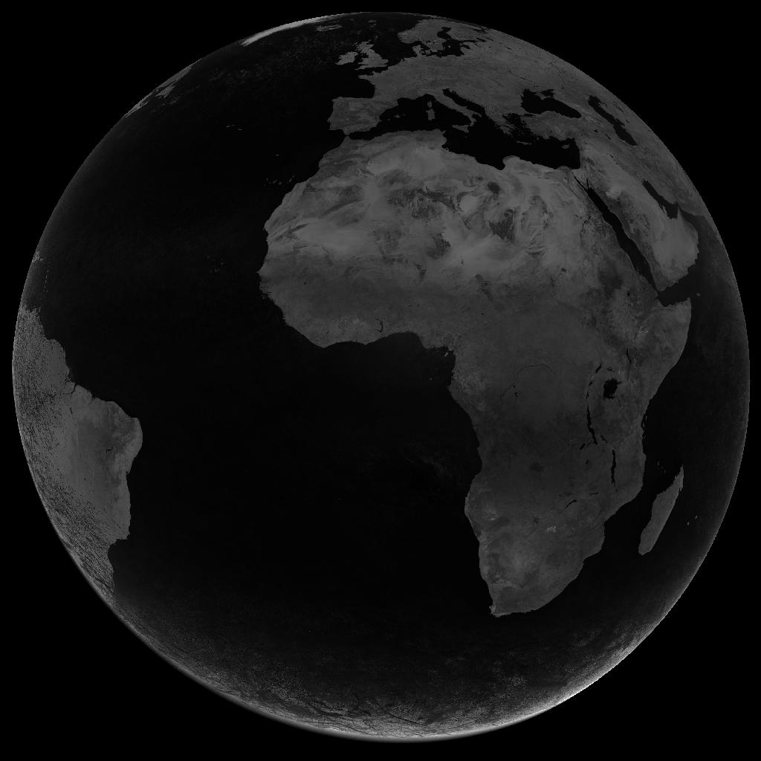
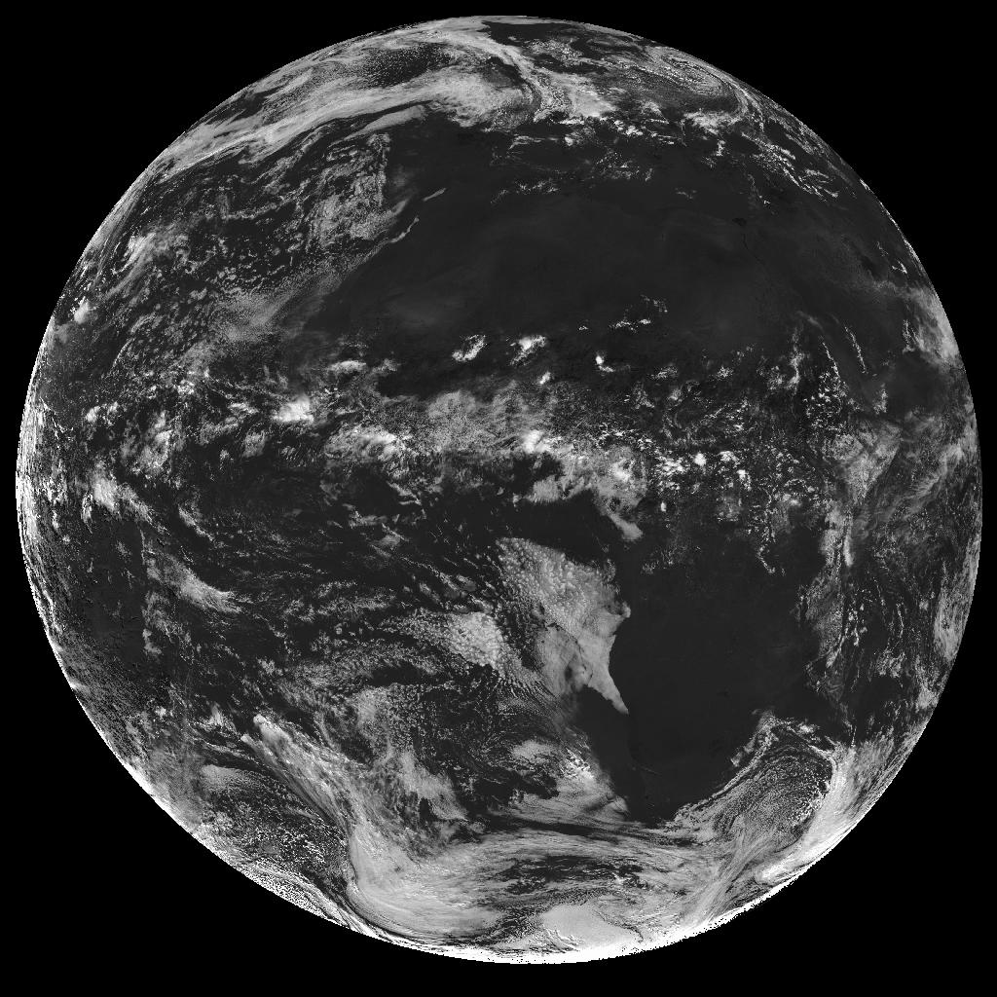
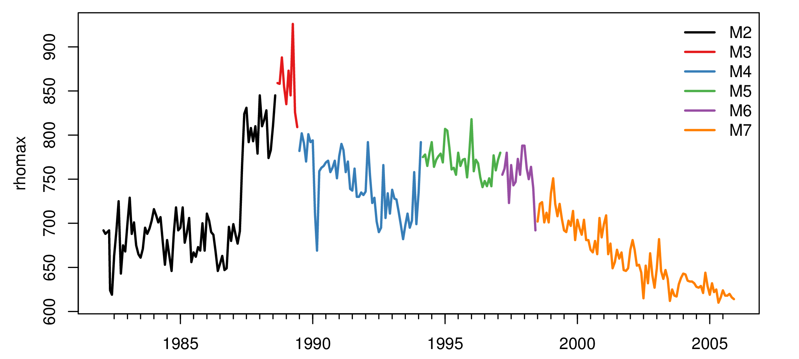
Basic Retrieval Principle
R the reflection observed by satellite.
Rmin corrects the clear sky reflection, derived from monthly statistics (per slot).
Rmax corrects changes in sensitivity and aging of optical instruments.
Observed
Reflection.
Effective Cloud Albedo
Cano et al. (1986), Beyer et al. (1996), Hammer et al. (2003), Mueller et al. (2011)
Notes:
Selfcalibration Rmax
All counts in region in histogramm for one month at 1pm → distribution
Take value of 95% percentile for Rmax
Rmax = „satellite constant“ = proxy for maximum detectable signal
Chosen region in south atlantic is very often cloudy („roaring 40ies“) → Mainly frontal systems, hardly any hight convection (as in the tropics)
13:00 (1 pm) = Rmax is most constant throughout the year
One month: to get enough cloudy pixels for percentile statistic

Slide 7
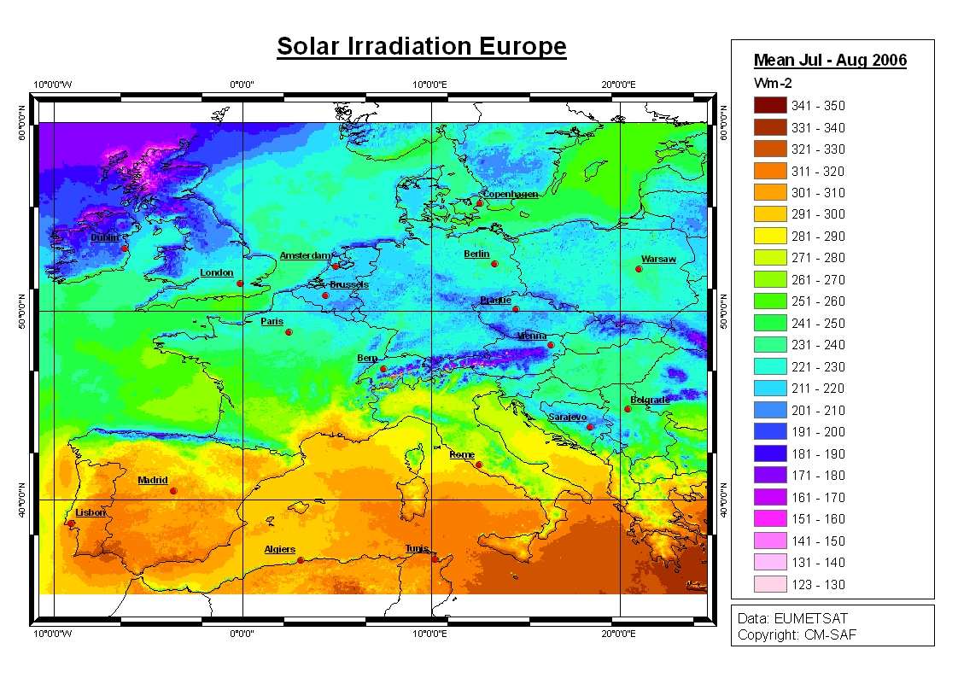
MAGICSOL method
SIS
CAL-1 ~
SISclear
Clear sky model
gnu-MAGIC
Effective cloud Albedo 1.7.2005, 11 h UTC
Well established method: MAGICSOL (Posselt et al 2010, Mueller et al. 2011) based on improved Heliosat (Cano et al.,1986, Hammer et al., 2003) and MAGIC (Mueller et al 2009)
http://sourceforge.net/projects/gnu-magic/

Slide 8
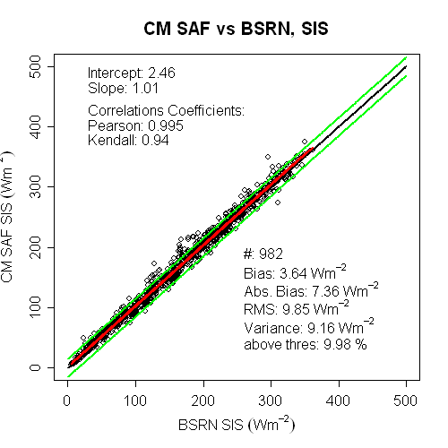
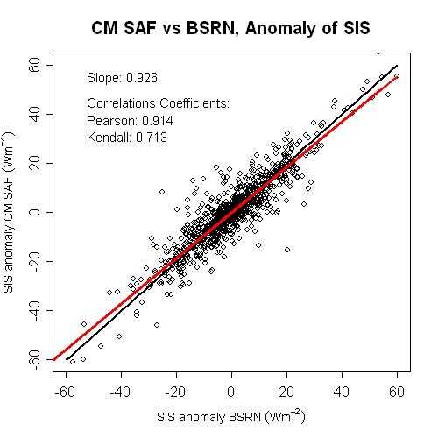
Validation & Comparison

Slide 9
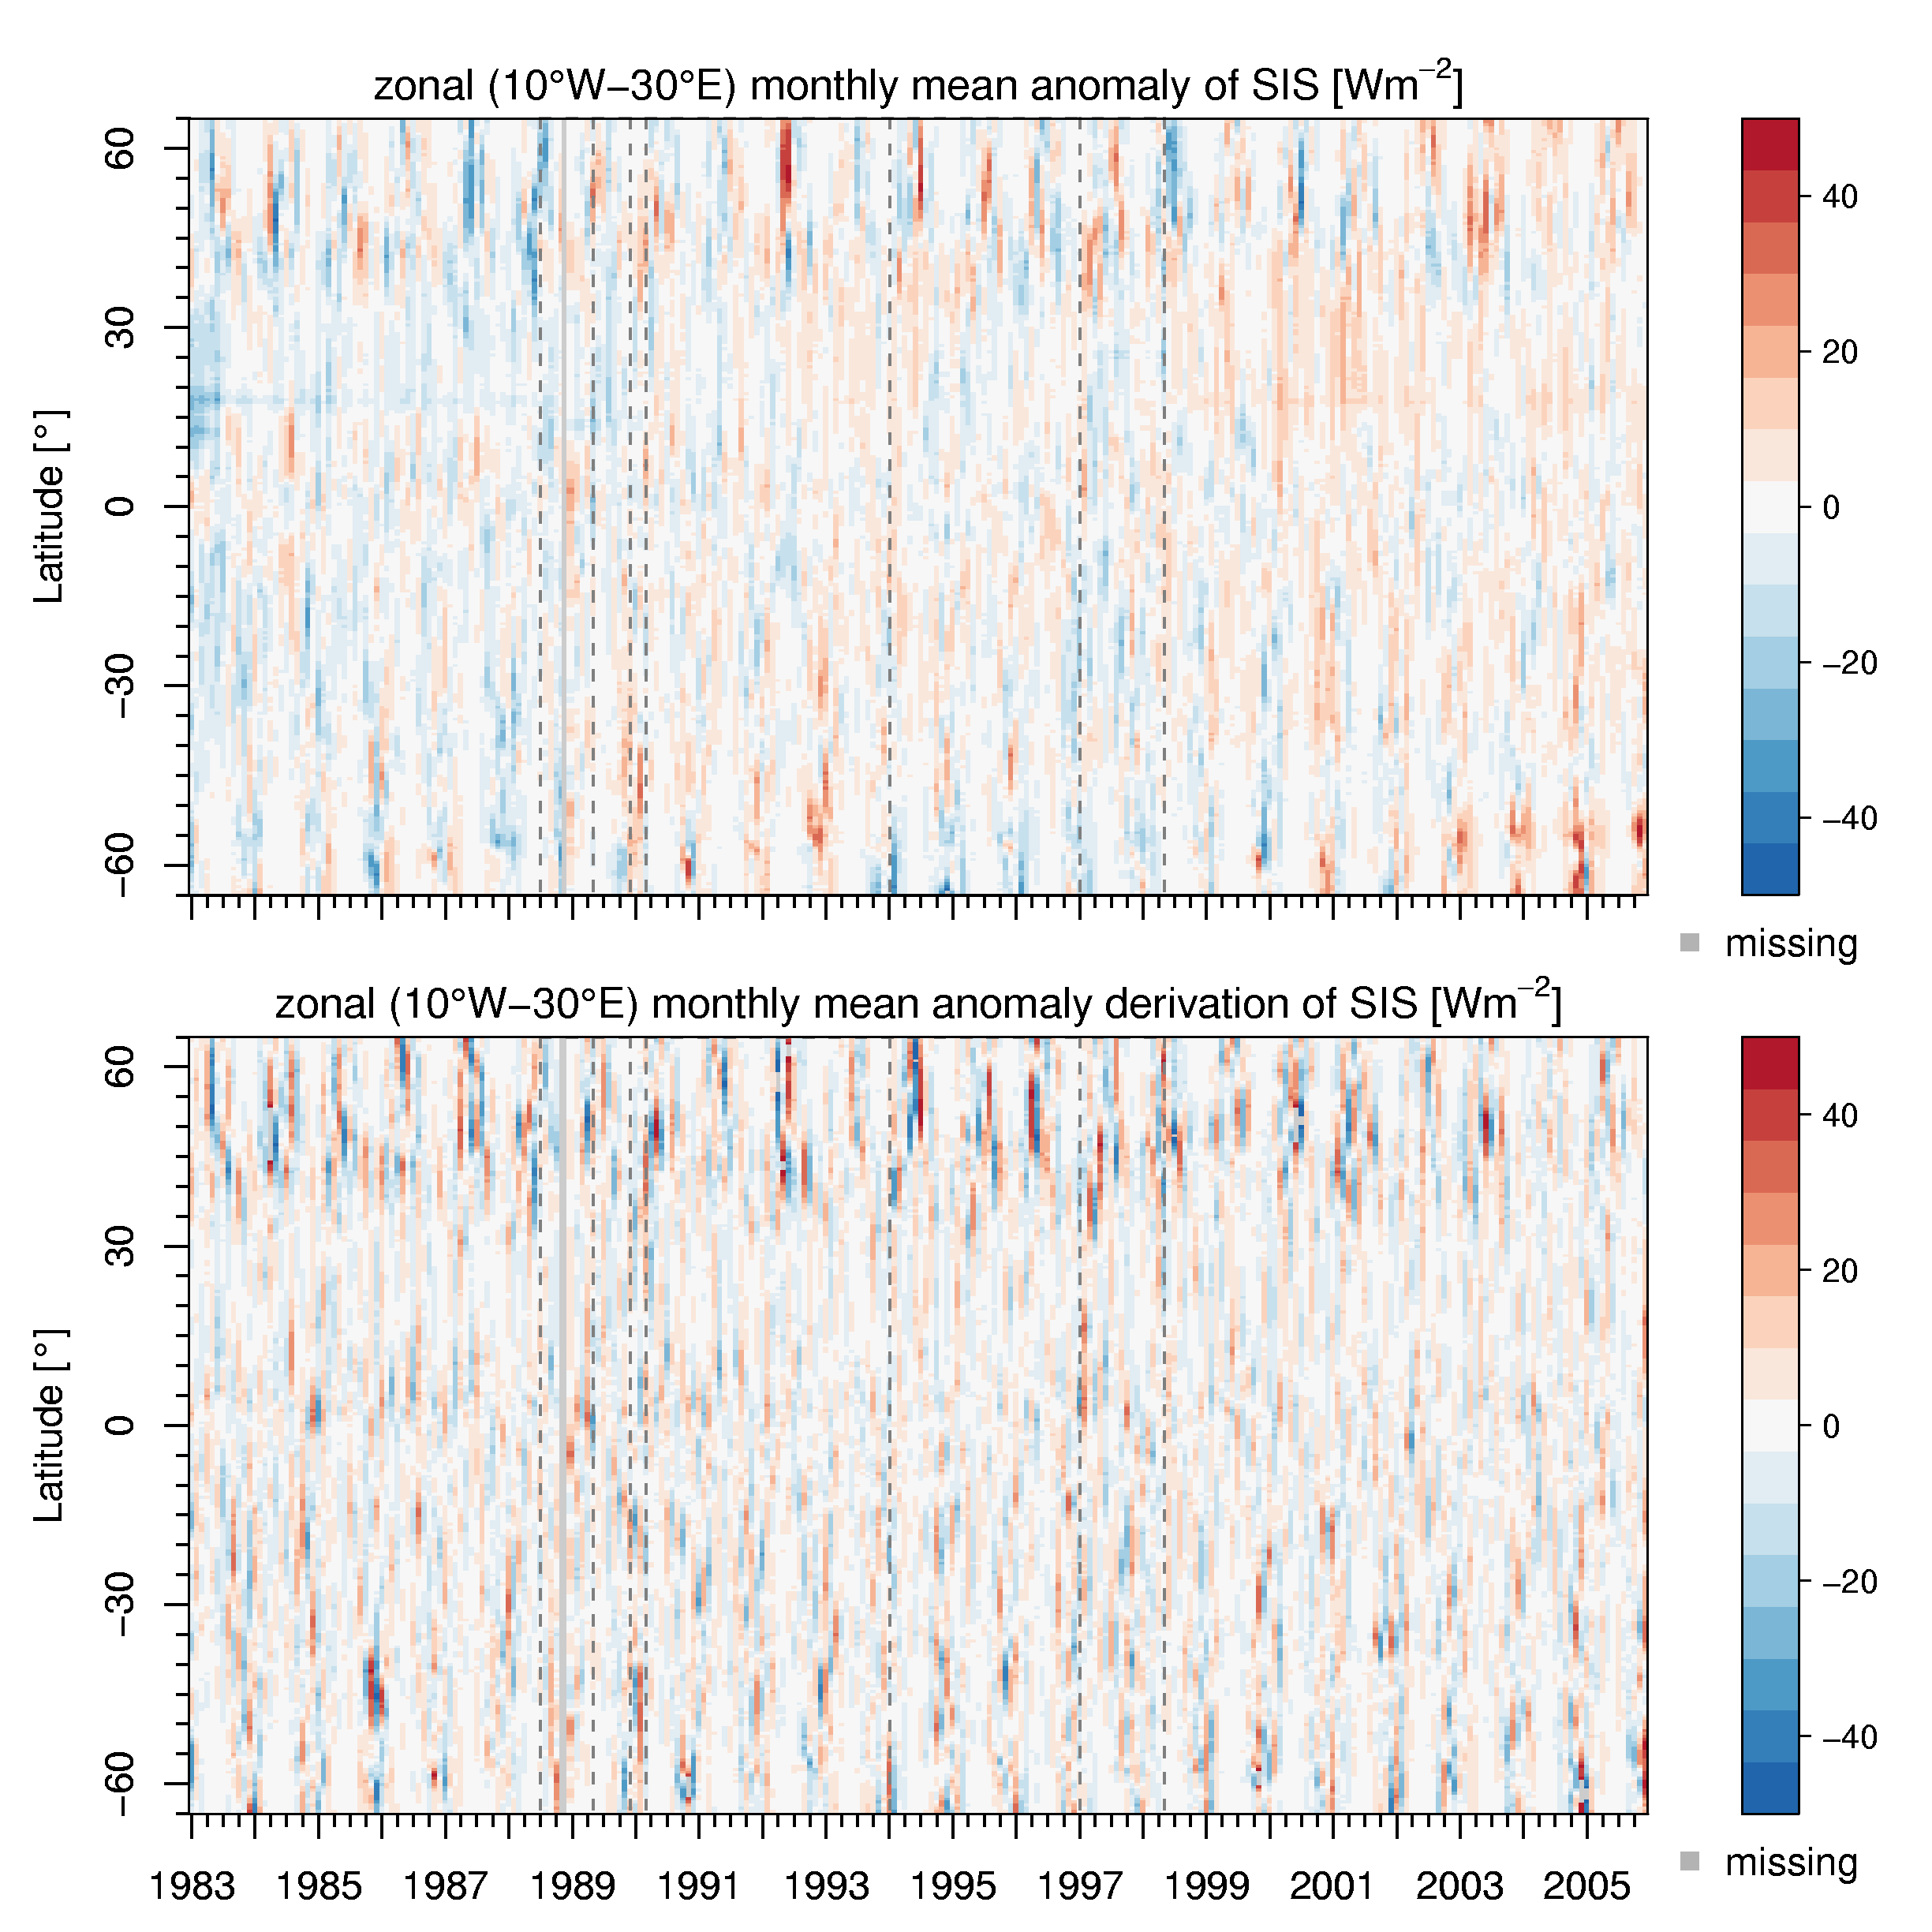
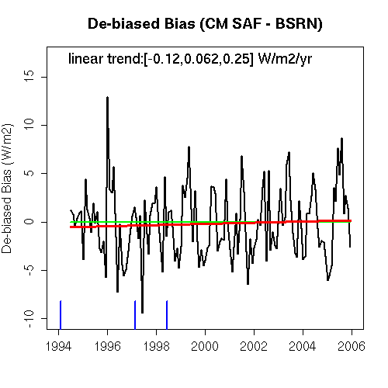
Evaluation Homogeneity
b) Temporal evolution of the bias
to BSRN surface stations
a) Hovmöller Diagram
c) Standard techniques to detect change points (ongoing project, University Frankfurt): Significant hints for inhomogeneities in some regions for M2/M3 period, but M4-M7 period are very homogeneous.

Slide 10
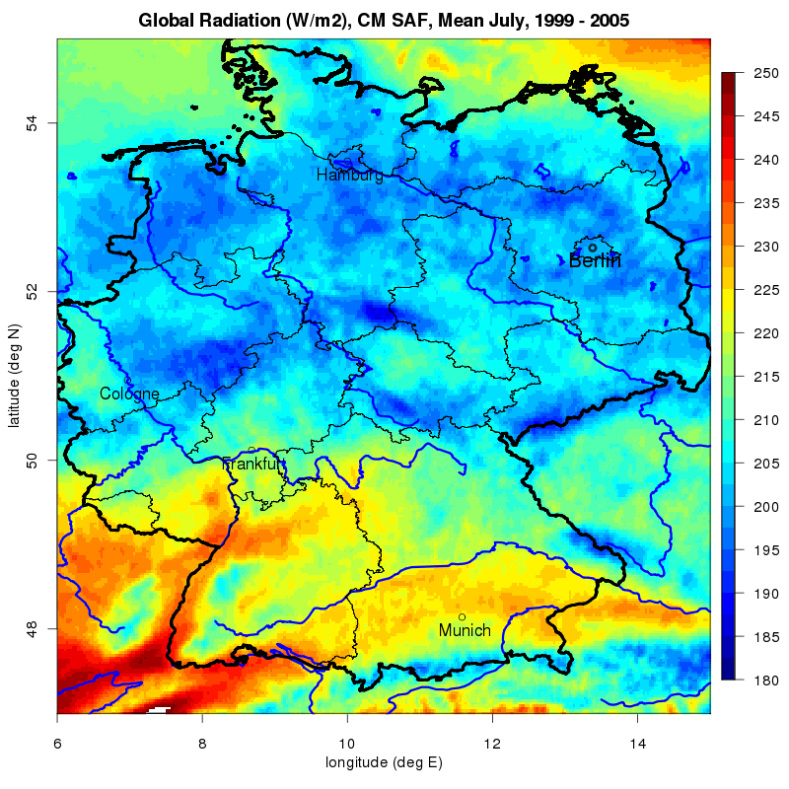
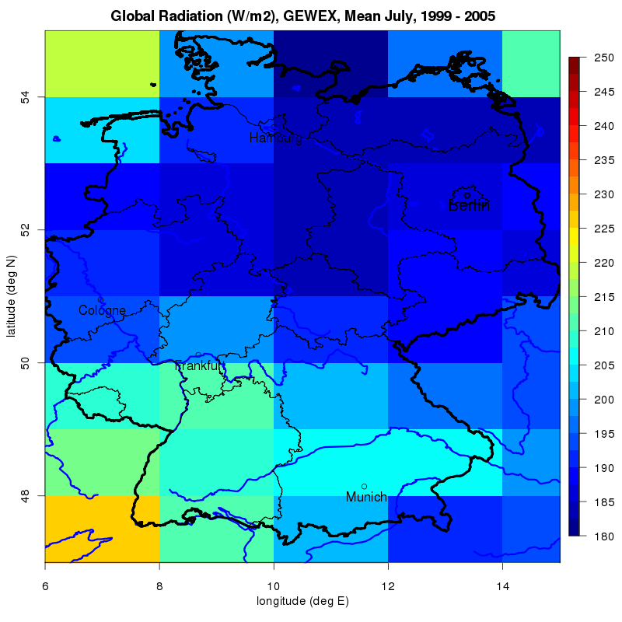
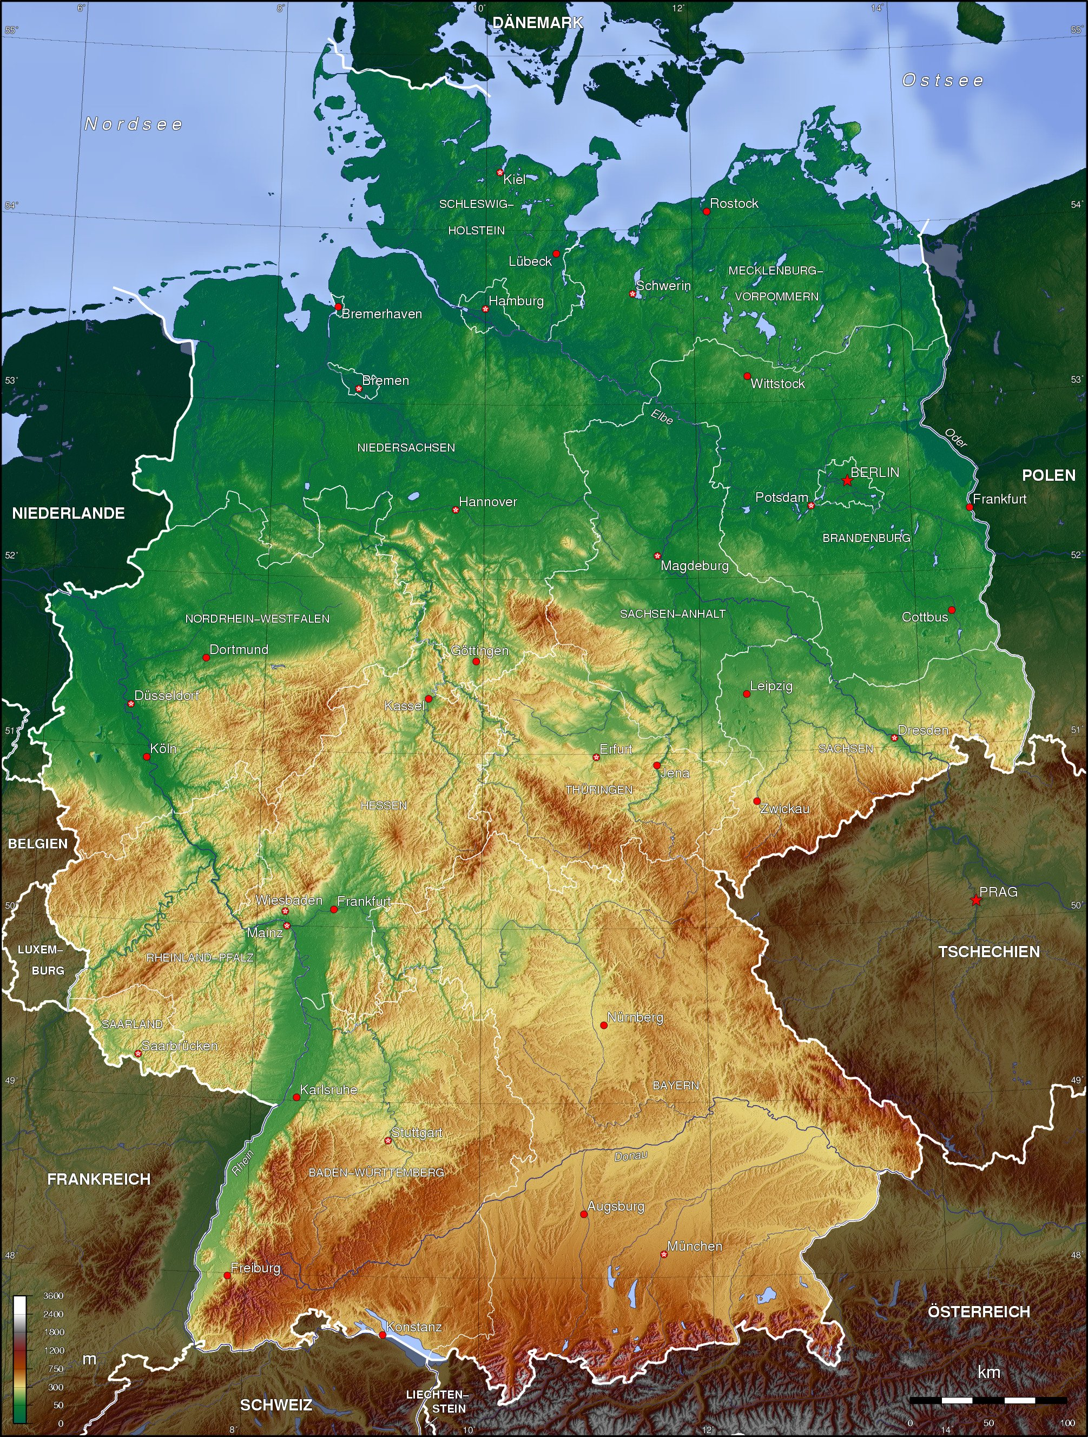
Spatial Resolution
Surface Irradiance, Mean July, CM SAF
GEWEX
Topography
Excellent correspondence with topographic features. Solar irradiance used to model spring snow melting.
GEWEX SRB data misses details due to coarse resolution, limited value for regional climate analysis.

Slide 11
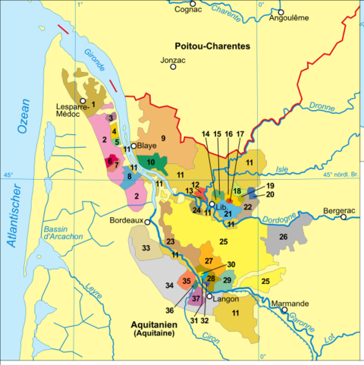
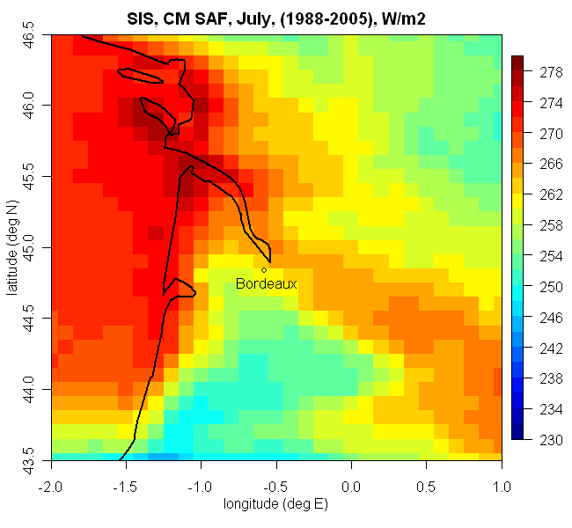
Spatial Resolution
Solar Irradiance in the Bordeaux Wine Regions. Wine farming
is significantly affected by change of regional climate !
People are interested on the climate in their living area,
Hence high spatial resolution is a must for regional climate
monitoring and analysis.

Slide 12
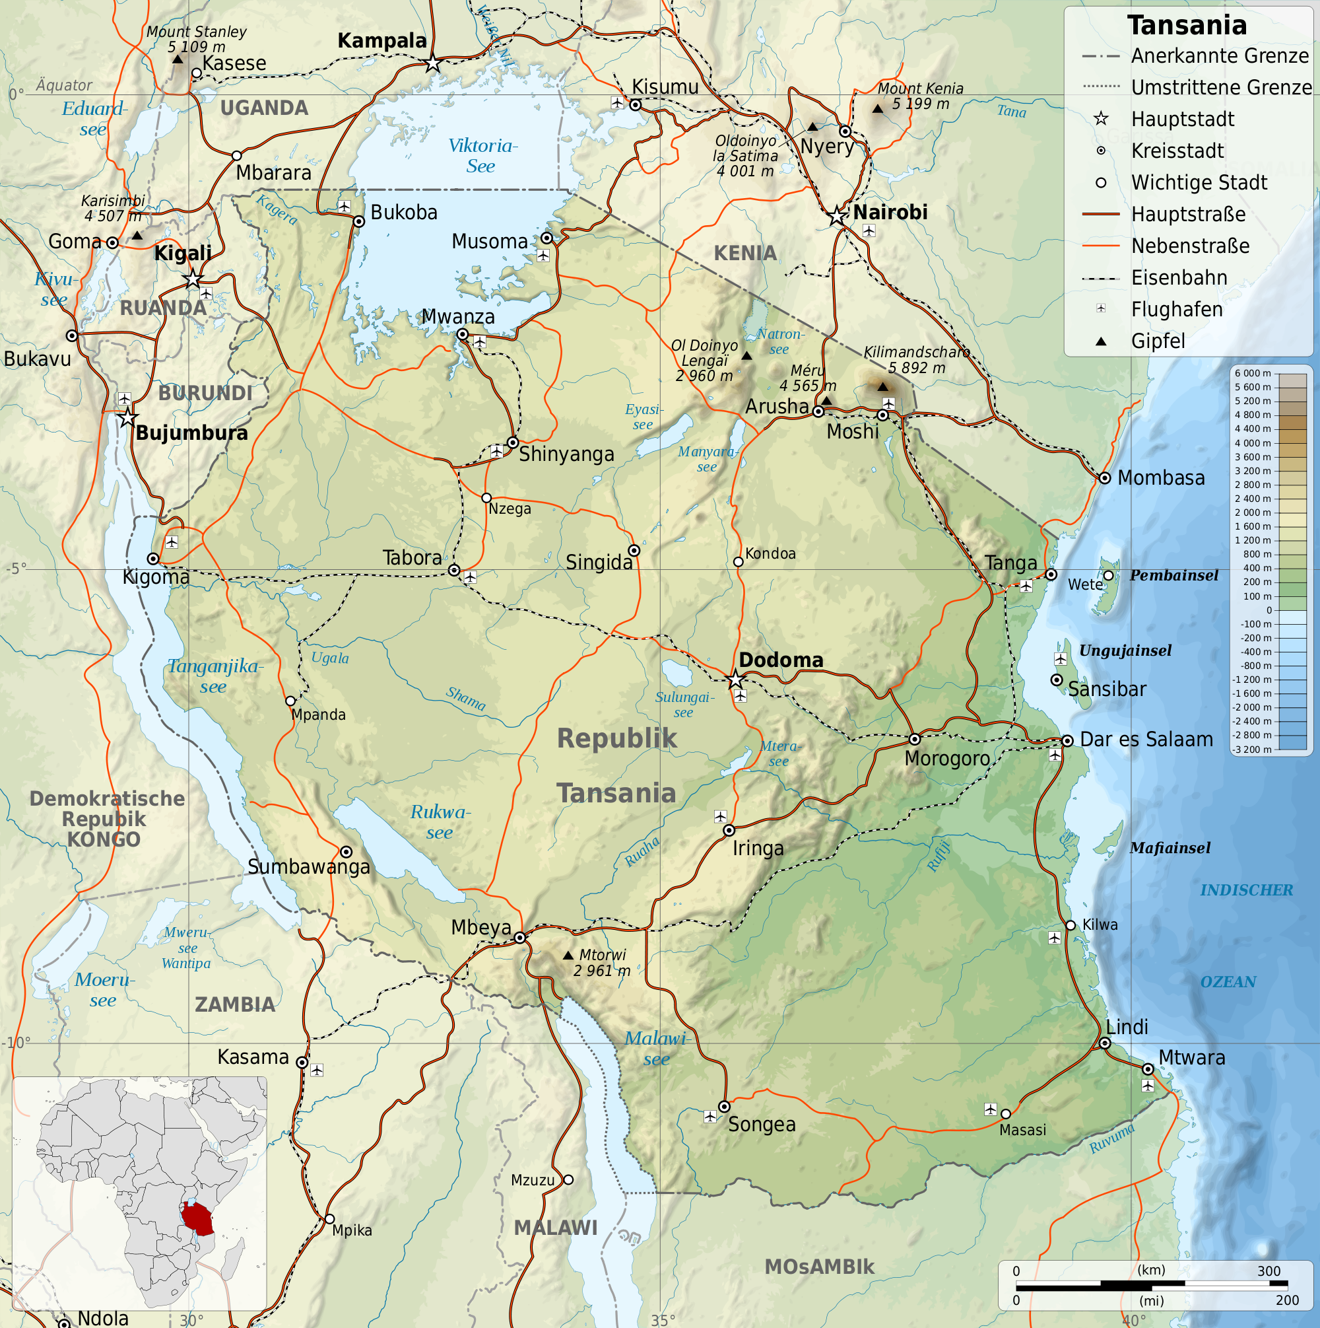
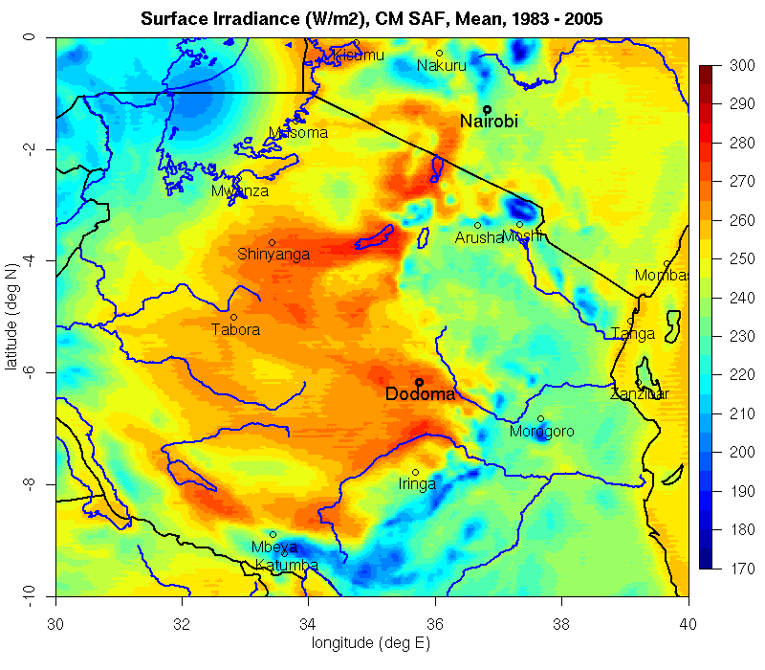
Cooperation Univ. Marburg
Mean Surface Irradiance, Tanzania
No surface network available
Significant decrease of Glacier.
Substantially reduced SIS around Kilimanjaro.
Cooperation with Prof. Jörg Bendix, University Marburg
Notes:
Tanzania is mountainous in the northeast, where Mount Kilimanjaro,[22] Africa's highest peak, is situated. To the north and west are the Great Lakes of Lake Victoria (Africa's largest lake) and Lake Tanganyika (Africa's deepest lake, known for its unique species of fish). Central Tanzania comprises a large plateau, with plains and arable land. The eastern shore is hot and humid, with the island of Zanzibar lying just offshore.

Slide 13
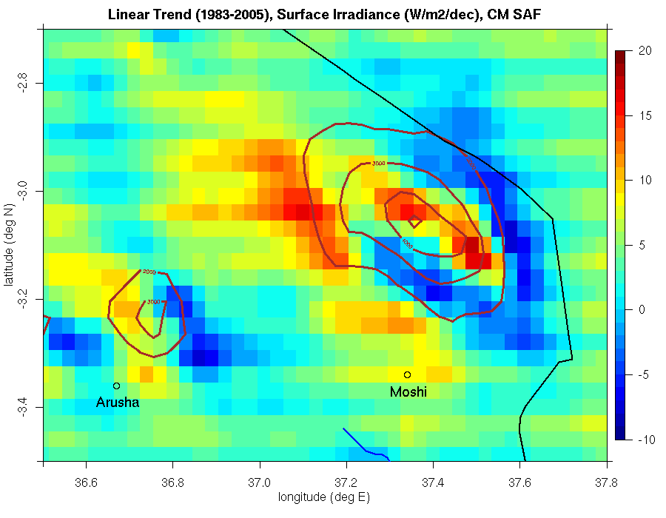
Cooperation Univ. Marburg
Linear Trend in Surface Radiation
(W/m²/dec)
There are significant trends in the surface radiation at Mt. Kilimanjaro between 1983 and 2005
Strong increase of surface radiation (more than 15 W/m²/dec) over the summit (> 3000 m)
Decrease along the northern and southern slopes

Slide 14
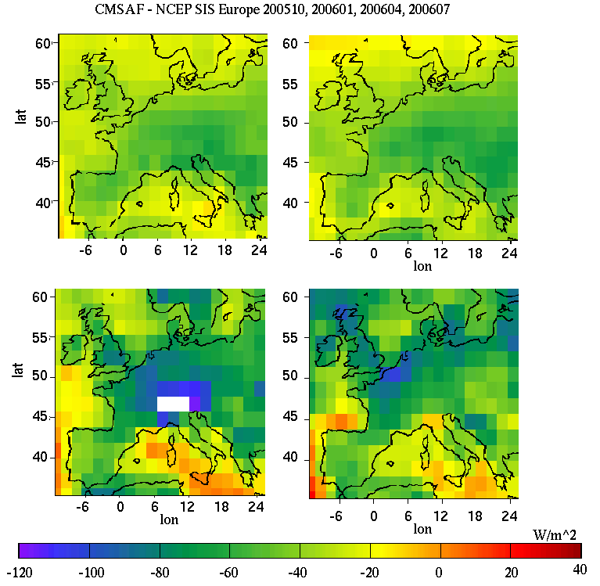
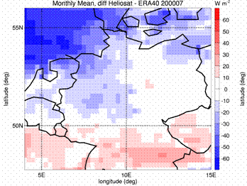
Verification of Reanalysis
Difference between Heliosat and ERA-40. Other months performs better. In general better performance than NCEP.
Absolute difference in W/m² between
CM-SAF and NCEP solar surface
Irradiance. NCEP values are significantly
too high over Central-Europe due to
underestimation of cloudiness.
Träger et al, Meteorologische
Zeitschrit, 2010
Babst et al, Remote Sensing
Letters, 2008

Slide 15
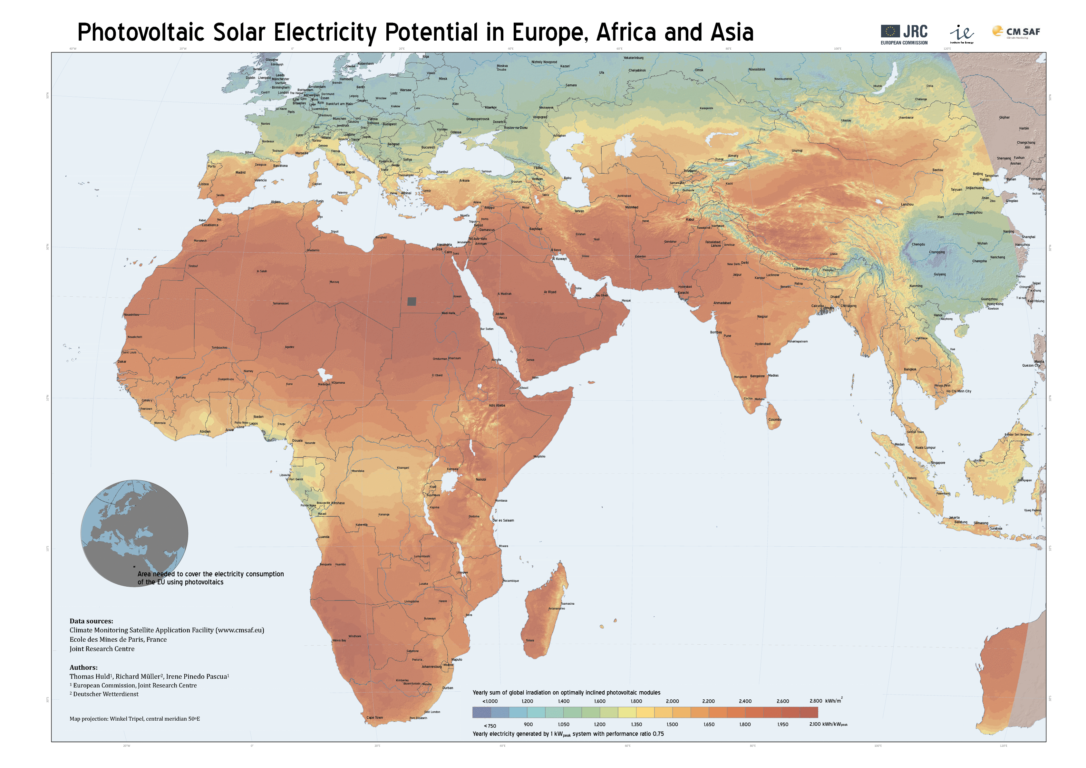
Solar Energy
Climate Protection
First free PV map of Asia
Generated by Thomas Huld JRC !!

Slide 16
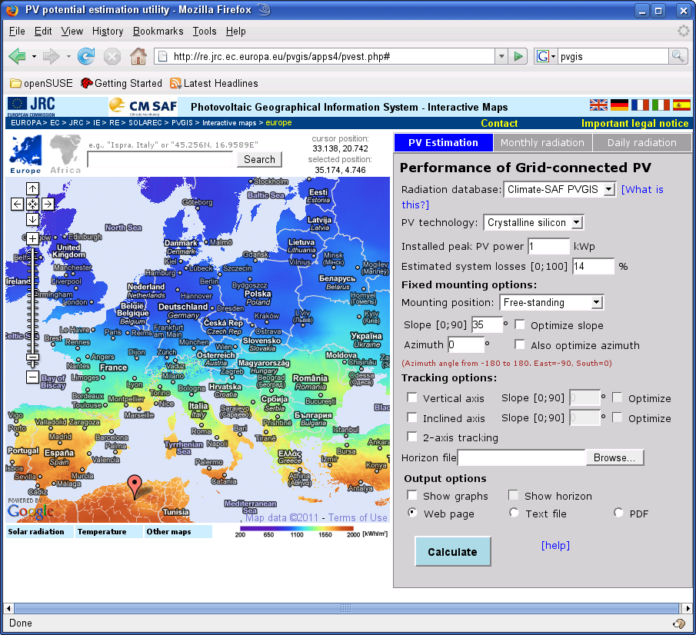
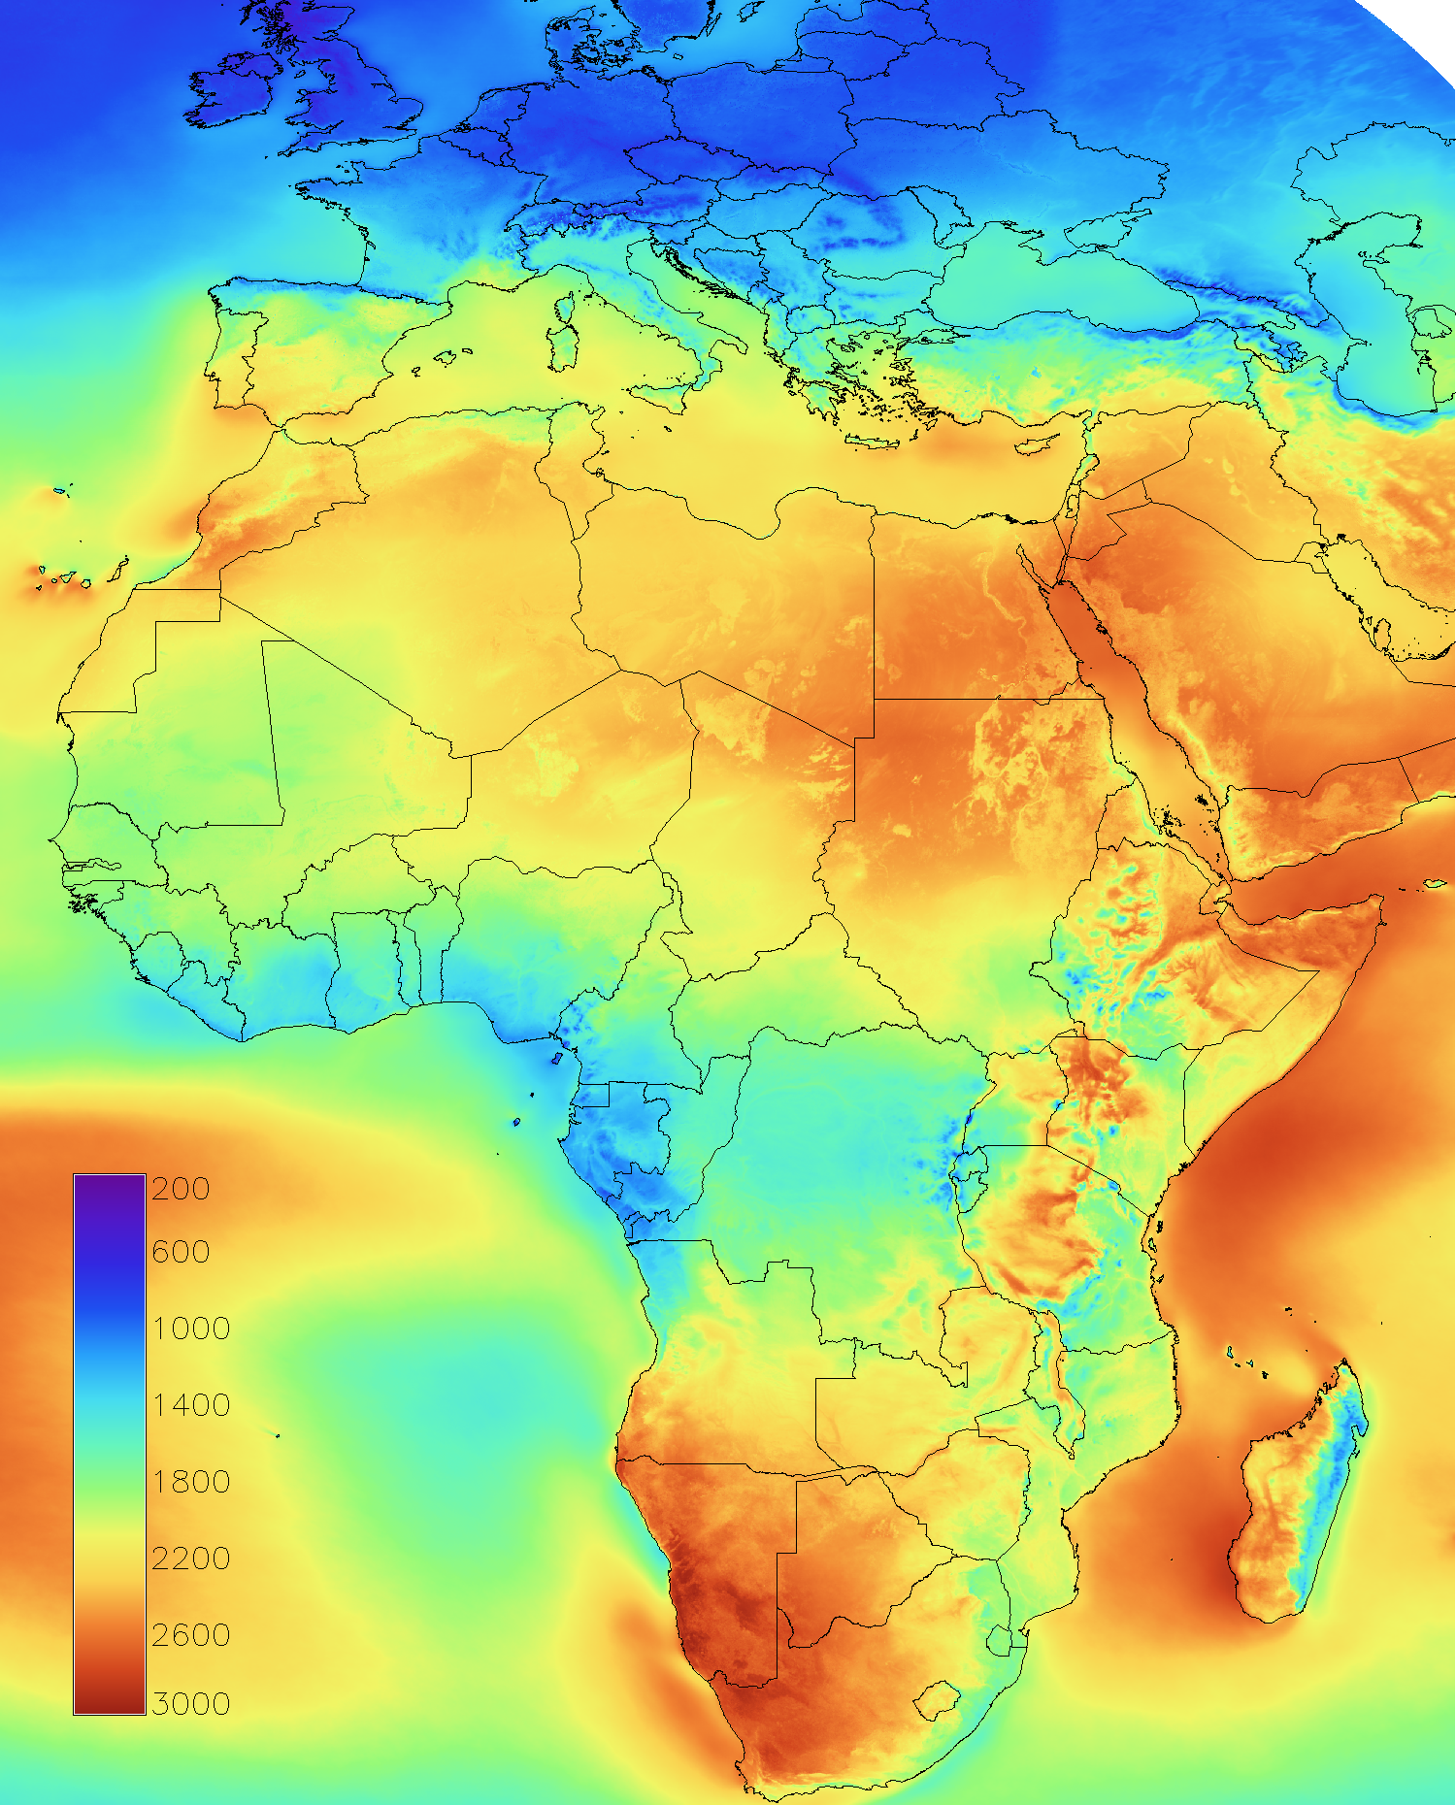
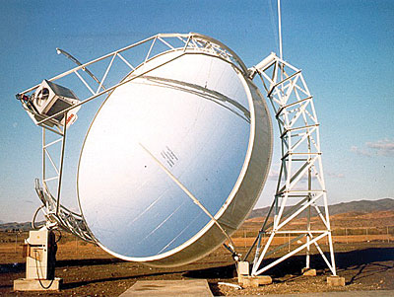
Cooperation with JRC
PV online tool free
of charge & new
DNI maps for thermal
power plants.
Annual average
Direct Normal
Irradiance in
kWh/m²

Slide 17
Conclusion & Summary
It is a good data set, concerning accuracy and resolution
It is well suited for regional climate analysis & solar energy
applications, you should start to use it.
Validation showed that monitoring & analysis
of extremes should work well.
Trend analysis should be done carefully !!
Data set is homogeneous from 1990 onwards
in the majority of the regions. No hints of inhomogeneities
concerning tests with BSRN data !
Before 1990 clear hints for in-homogeneities of the data in
some regions relative to ERA. More details will be provided
in a report available from the CM-SAF page
Next release will overcome this limitation.

Slide 18
Acknowledgements
-Eumetsat for support of the SAFs & implementation of
free SAF data policy.
- Thanks to the European tax payers for the
funding of our research and work.
Manager of money sometime believe the money
are given by them, but indeed it is given by the
tax payers !
-Thanks to NCAR/NCEP for free and user friendly data
access.

Slide 19
Limitations of Heliosat
Large bias values might occur in regions with permanent snow cover, due to small differences of R relative to Rmin -> the effect of clouds on I is not well defined.
MeteoSwiss has generated a specific Alpine data set which
overcomes limitations introduced by mountains:
www.cmsaf.eu
-> data access
-> golden data set

Slide 20
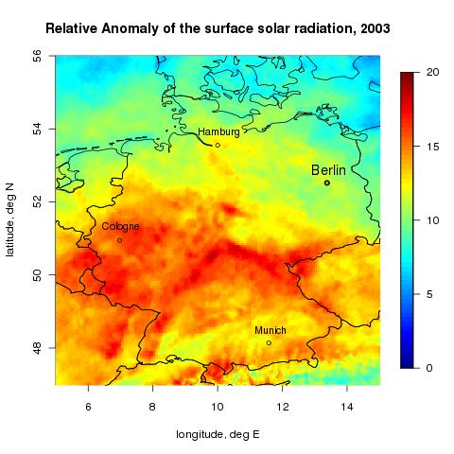
What you can do
Trend Analysis
Anomaly of the solar irradiance of August 2003 in %. Up to 35000 people died due to the serious heat stress [Int. Fed.of Red Cross] in summer 2003. Reference period for the calculation of the radiation anomaly has been 1995-2005.
Operational anomaly service within RCC.

Slide 21
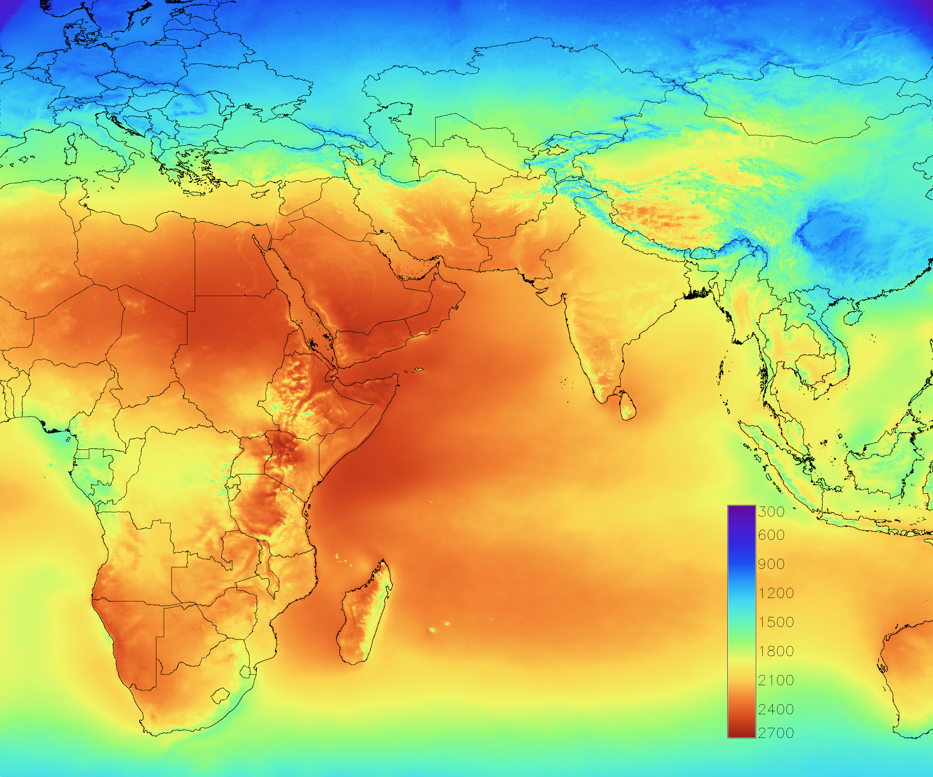
What you can do
Solar Energy
Solar surface irradiance
for planning and monitoring of PV systems. Data used within PVGIS, JRC.
Meteosat East, already 6 years has been processed

Slide 22
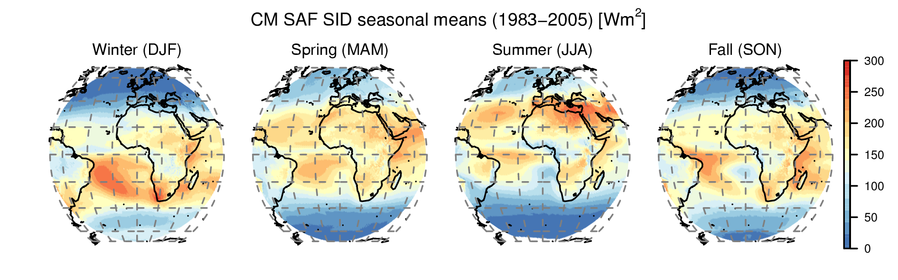
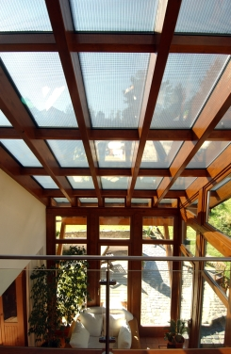
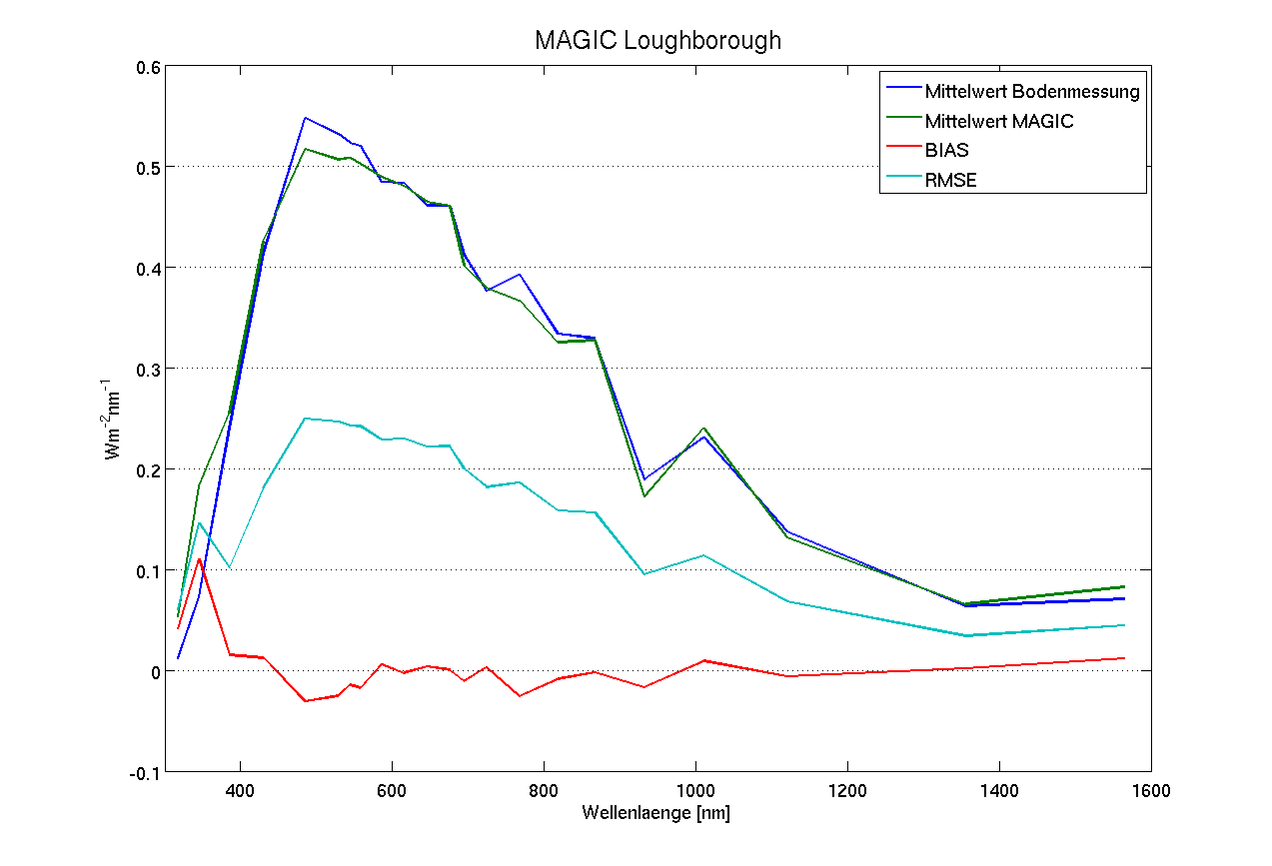
What you can do
Solar Energy
Direct irradiance for planning and monitoring of thermal power plants. An extremly increasinf market.
Spectral resolved
irradiance for planning
and monitoring
of thin solar cells.
Of course, also for climate
analysis.

Slide 23
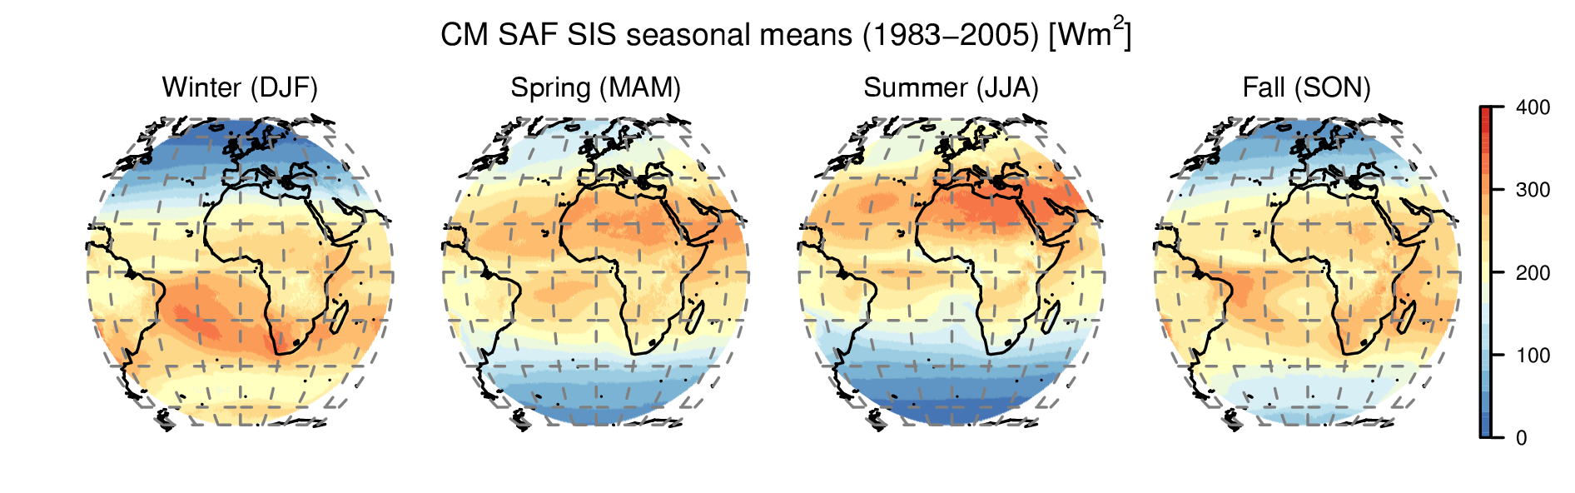
This is the End
MAGICSOL is applied to Meteosat Satellites to derive solar surface irradiance from 1983 to 2005 in unique spatial and temporal res.
Validation with BSRN surface measurements shows high quality of the CM SAF satellite-derived data set.
Spatial resolution allows detailed local studies on trends and extremes, solar energy applications and validation of reanalysis and regional climate model output.
The Data Set is freely available in CF-netcdf-format at www.cmsaf.eu, software tools are also provided

Slide 24
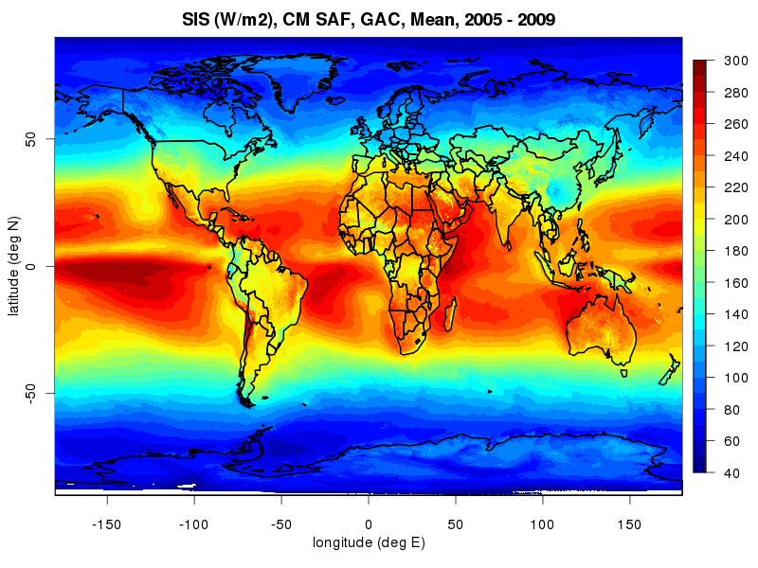
This is the End
MAGICSOL is applied to Meteosat Satellites to derive solar surface irradiance from 1983 to 2005 in unique spatial and temporal res.
Validation with BSRN surface measurements shows high quality of the CM SAF satellite-derived data set.
Spatial resolution allows detailed local studies on trends and extremes, solar energy applications and validation of reanalysis and regional climate model output.
The Data Set is freely available in CF-netcdf-format at www.cmsaf.eu, software tools are also provided
Processing of the global AVHRR satellite data (1989 – 2009) ongoing.

Slide 25
Acknowledgements
-Thanks to the tax payers in Europe. In the end, the money
for our work is coming from them.
- Eumetsat for support & funding of the SAFs &
implementation of free SAF data policy.
- Thanks to NCAR/NCEP for user friendly data
access free of charge (for everyone).
- Finally special thanks to MeteoSwiss (R.Posselt,
R. Stökli) for the processeing of the Heliosat CDR.

Slide 26
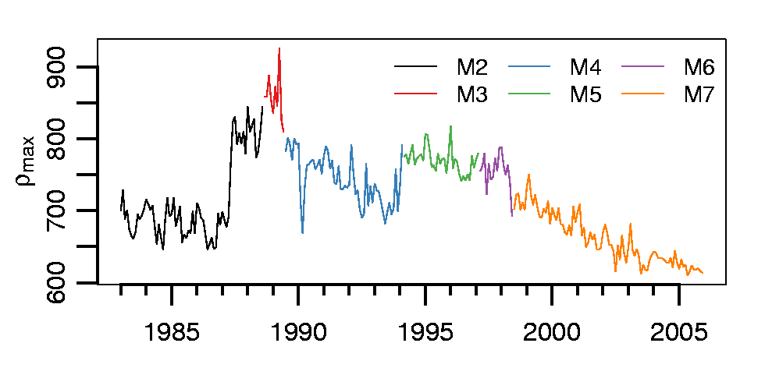
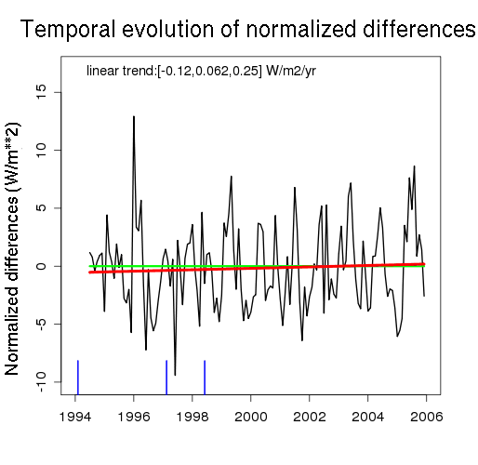
The feral part of MAGICSOL
Max. reflectance: 95 % percentile of counts during one month in the reference region. Feral: temporal evolution of max.
No trend in overall bias between
BSRN and satellite derived solar
irradiance. Self-calibration works
properly.

Slide 27
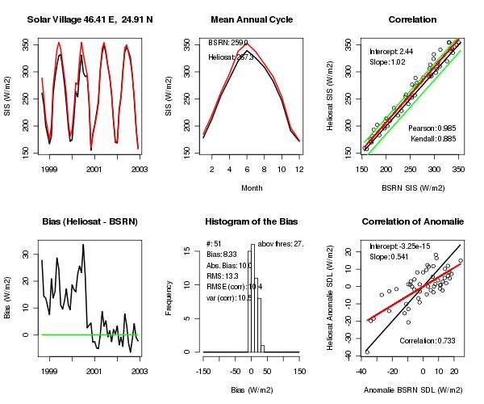
Accuracy of Heliosat
-> The accuracy of the satellite products is higher than given by
the „error“ quantities, as uncertainties and errors of ground
stations has
to be considered.
Calibration or
Recalibration ?!
SIS

Slide 28
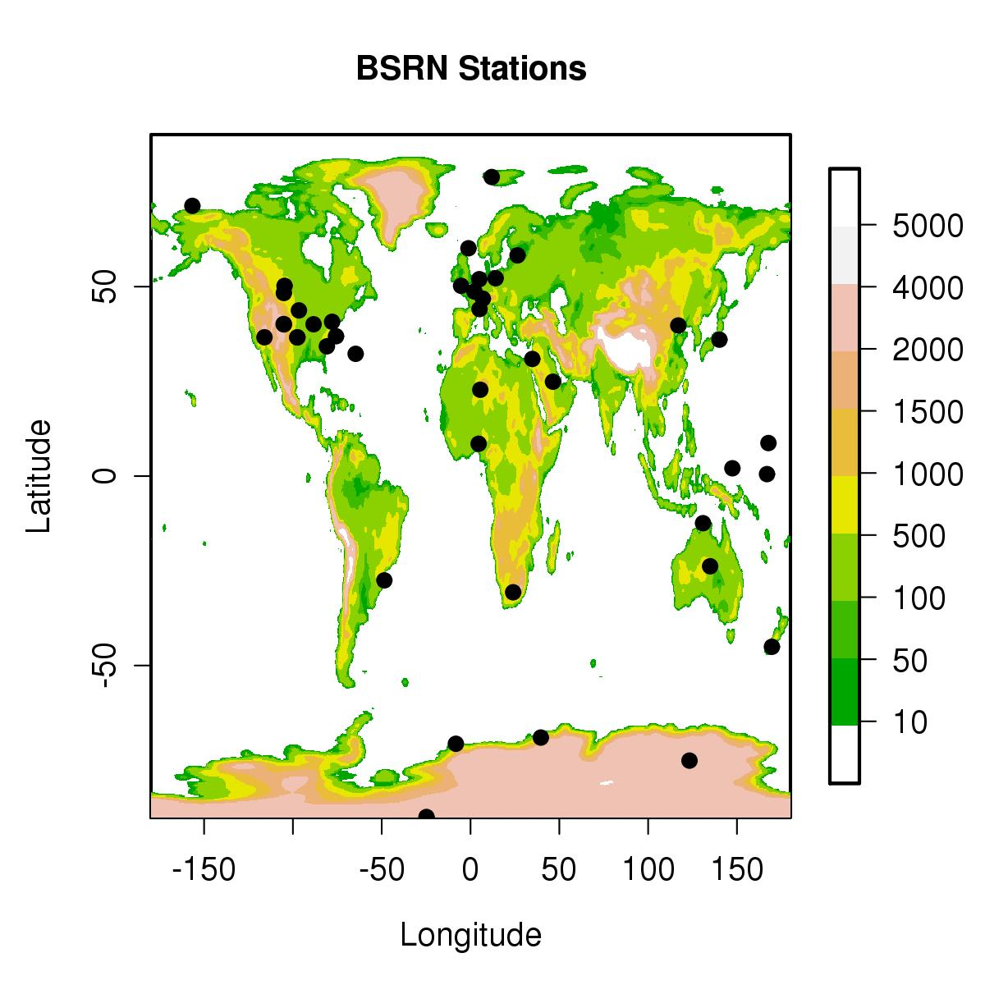
Methodology
use monthly mean BSRN surface observations as reference
assume an uncertainty of 5 Wm⁻²
consider GCOS accuracy requirement: 10 Wm⁻²
calculate for each station:
Bias; absolute Bias; RMSE; fraction of months, in which the absolute bias exceeds 15 Wm⁻²
BSRN: Baseline Surface Radiation Network
GCOS: Global Climate Observing System

Slide 29
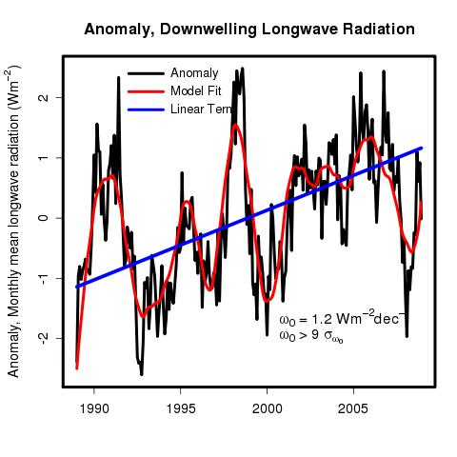
Trend in SDL, ERA
Very significant positive trend of 1.2 Wm⁻²dec⁻¹ in surface downwelling longwave radiation based on ERA-Interim data

Slide 30
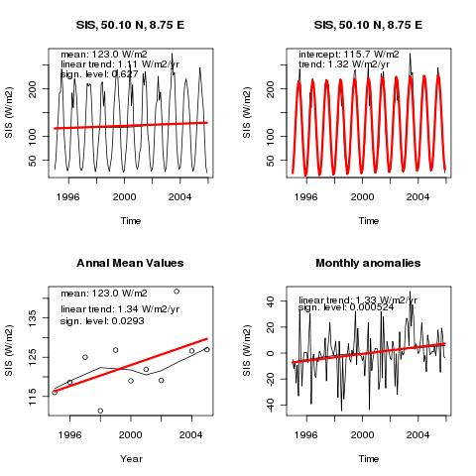
R Trend analysis
-first results-
Trend Analysis:
Trend analysis
shows a statistically
significant positive
trend of solar cloud forcing in Offenbach between 1995 and 2005.
The answer to „what
is CM-SAF“ doing for DWD !

Slide 31
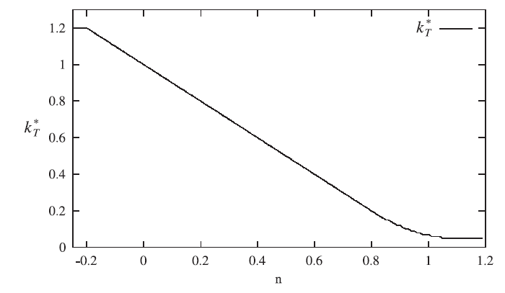


The Heliosat method
The cloud index, n, is related to the clear-sky index, k.
The clear-sky index, k, is the ratio between the all-sky surface irradiance, G, and the clear-sky surface irradiance, G_{clear}
clear sky index
cloud index

Slide 32
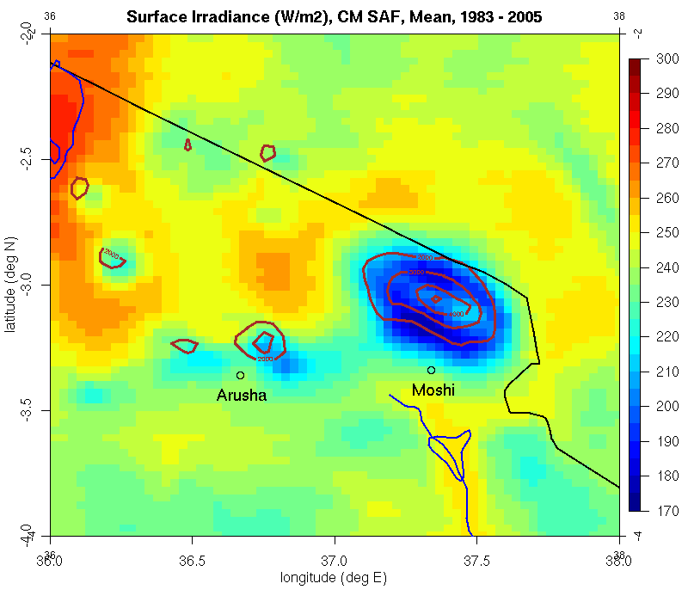
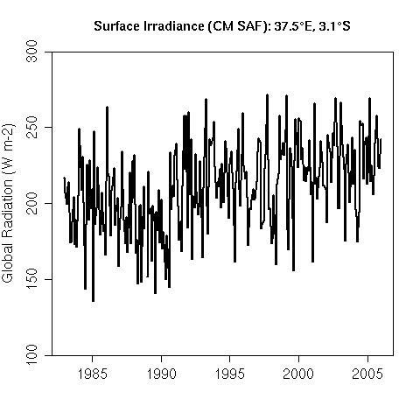
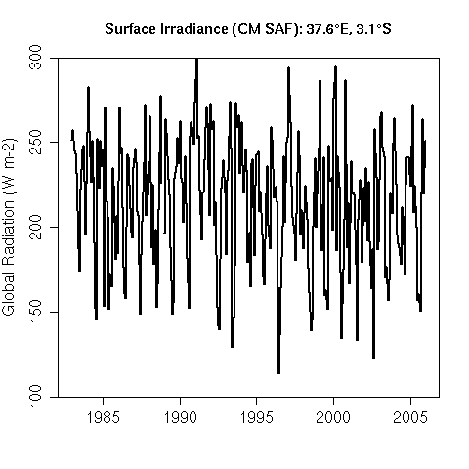
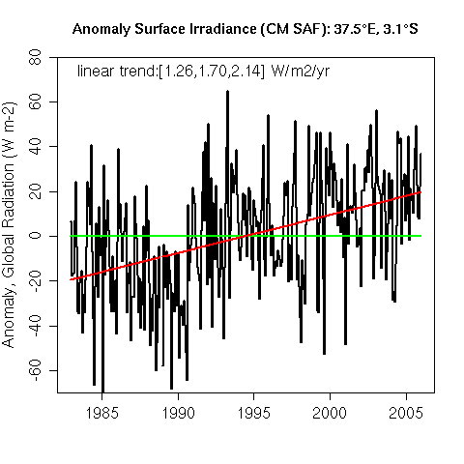
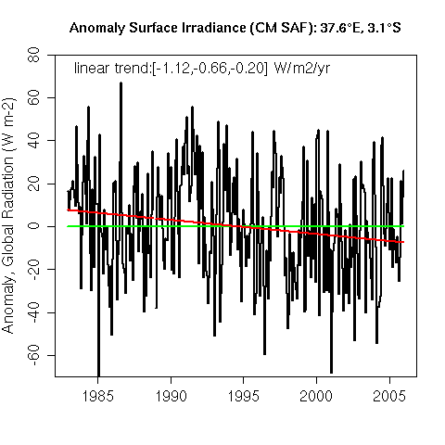
Applications
Time Series of Surface Radiation
37.5° E, 3.1° S
37.6° E, 3.1° S

Slide 33
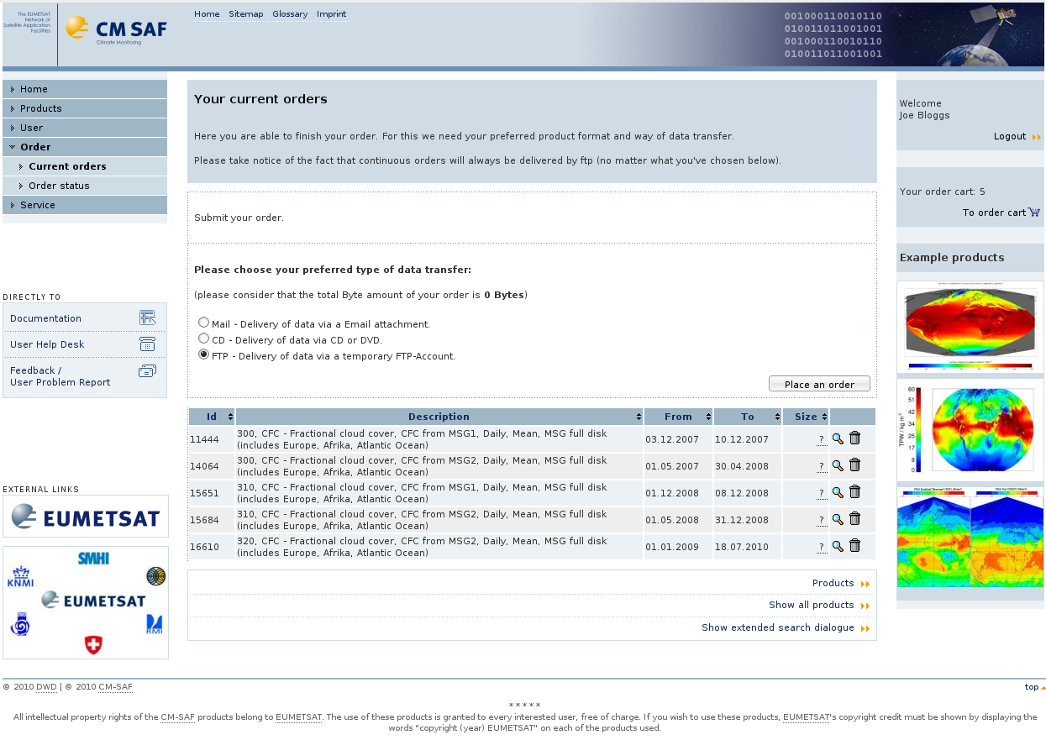
Data access
user-friendly data access via the Web User Interface: wui.cmsaf.eu
all data is freely available in netcdf format & Toolkit (example data + scripts) available: www.cmsaf.eu/tools

Slide 34
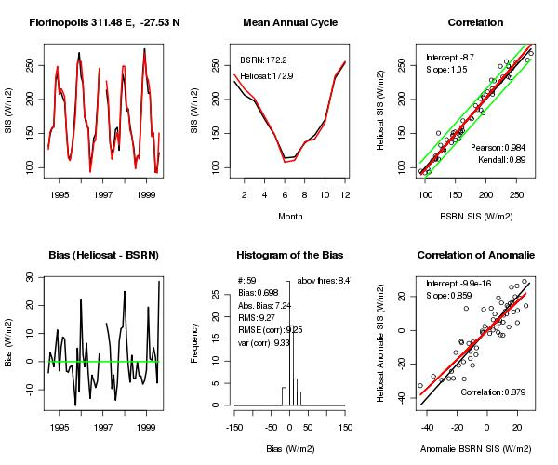
Evaluation in Florinopolis, Brazil

Slide 35
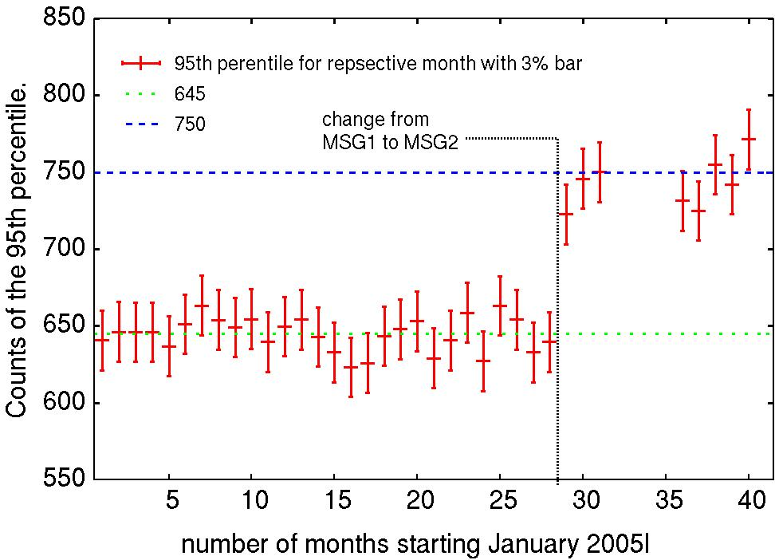
The climate Heliosat version
Verification of calibration

Slide 36



Applications
Close-up Views
Germany
Amazon
Mediterranean
West Africa
Tanzania

Slide 37


Application Examples
-Anomalies-
Anomaly of the solar irradiance of August 2003 in %. Up to 35000 people died due to the serious heat stress [Int. Fed. of Red Cross] in summer 2003. Reference period for the calculation of the radiation anomaly has been 1995-2005. (Data from University of Oldenburg).

Slide 38





Surface Temperature
IPCC, 2007

