Slide 1







The role of the effective cloud albedo in climate analysis
R.W. Mueller, R.Cremer, C.Träger,
J. Trentmann
DWD
Rebekka Posselt, Reto Stöckli
MeteoSwiss

Slide 2
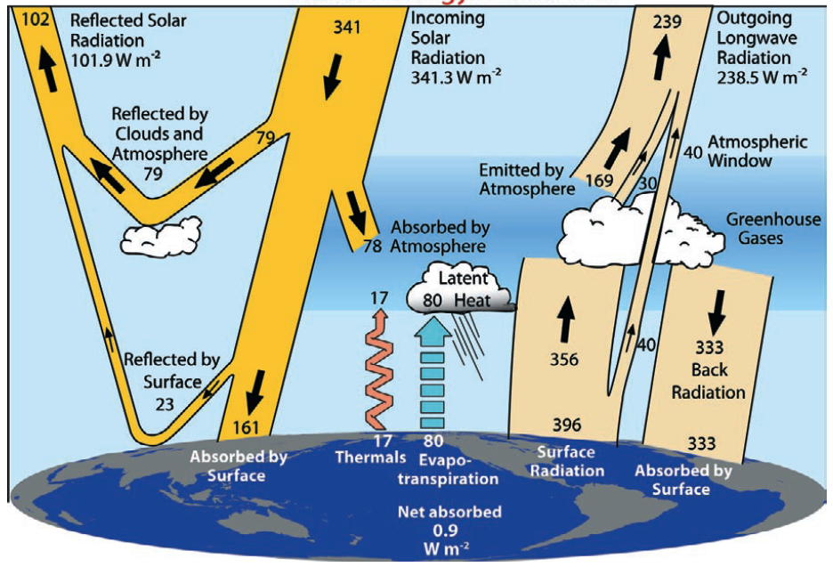
Motivation
Climate change
(anthropogenic &
natural) is driven
by radiation.
-There is a need
to observe & analyse
variables involved in
radiation budget
in order to increase
understanding of
climate system and
change.
Figure from Trendberth et al. (2009)
Notes:
Measuring radiation
Radiation interacts with atmospheric constituents
This interaction alters the radiation and from this one can derive (back-reference) to the atmospheric constituents
Conversion of the measured radiation into geophysical information is an inversion problem (A. collard, ECMWF)

Slide 3
Motivation
Climate change
(anthropogenic &
natural) is driven
by radiation.
-There is a need
to observe & analyse
variables involved in
radiation budget
in order to increase
understanding of
climate system and
change.
Figure from Trendberth et al. (2009)
Only absorbed radiation can heat
the Earth, Cloud reflection is the most
dynamic variable affecting the reflection.
Notes:
Measuring radiation
Radiation interacts with atmospheric constituents
This interaction alters the radiation and from this one can derive (back-reference) to the atmospheric constituents
Conversion of the measured radiation into geophysical information is an inversion problem (A. collard, ECMWF)

Slide 4

Motivation
The reflection of clouds plays a dominant role in the Earth's radiation and energy budget.
  Without clouds the Earth's albedo would be halved. The reflected solar energy would drop from ~ 100 to 50 W/m² and the absorbed solar energy would increase from ~ 240 to 290 W/m².
  In a non-cloud earth this effect could only partly be compensated by an increase of the emitted thermal radiation.
> Clouds have a net cooling effect !

Slide 5
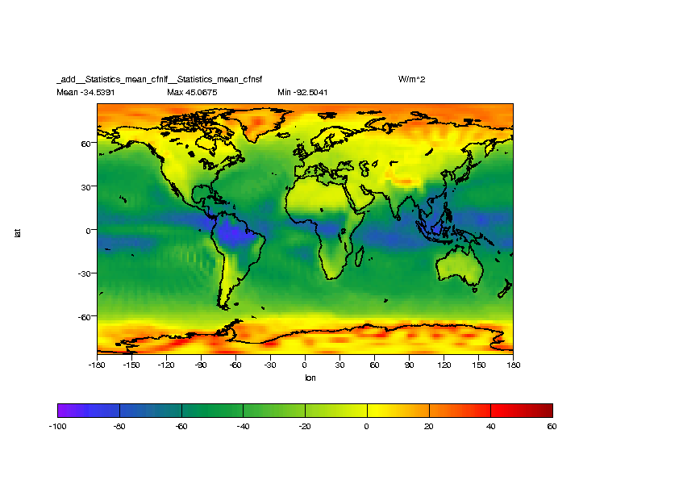
Motivation
The net cooling effect of clouds is several times higher than the anthropogenic
radiative forcing by increase of greenhouse gases. Trends in the cloud albedo
would significantly affect the climate on a global and regional scale.
Data source:
NCAR/NCEP
Reanalysis
Data.

Slide 6
Why effective cloud albedo
Why effective cloud albedo and not cloud albedo.
  The cloud albedo can not be observed directly, but has to be calculated in order to correct the effect of the surface albedo on the reflection signal.
  The effective cloud albedo is the normalized difference of the reflection in cloudy and and cloud free situations. It can be observed from satellites and does directly provide the cloud effect on the Earth's albedo, hence the solar radiation budget.
    How is it observed ?

Slide 7
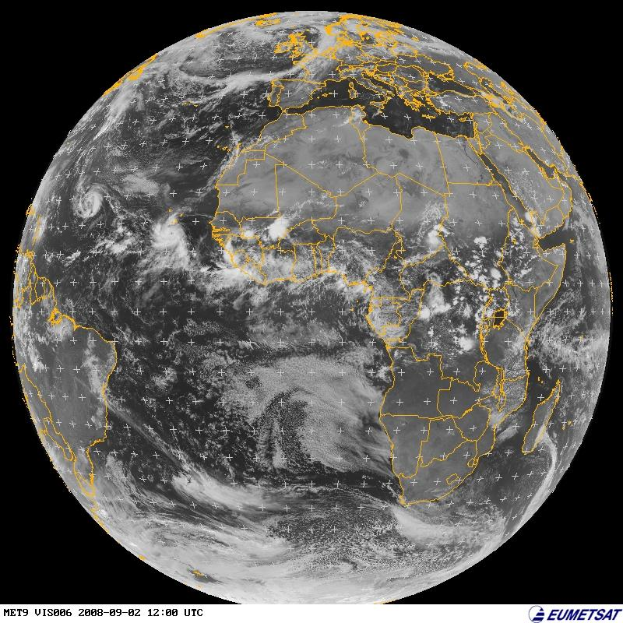
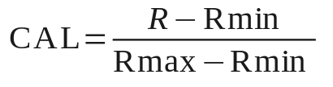
MAGICSOL/Heliosat Method
R the reflection observed by satellite, strong signal from clouds in the visible.
R: Meteosat VIS image
Eff. Cloud Albedo
Cano et al. (1986), Beyer et al. (1996), Hammer et al. (2003), Mueller et al. (2011)
Notes:
Selfcalibration Rmax
All counts in region in histogramm for one month at 1pm → distribution
Take value of 95% percentile for Rmax
Rmax = „satellite constant“ = proxy for maximum detectable signal
Chosen region in south atlantic is very often cloudy („roaring 40ies“) → Mainly frontal systems, hardly any hight convection (as in the tropics)
13:00 (1 pm) = Rmax is most constant throughout the year
One month: to get enough cloudy pixels for percentile statistic

Slide 8
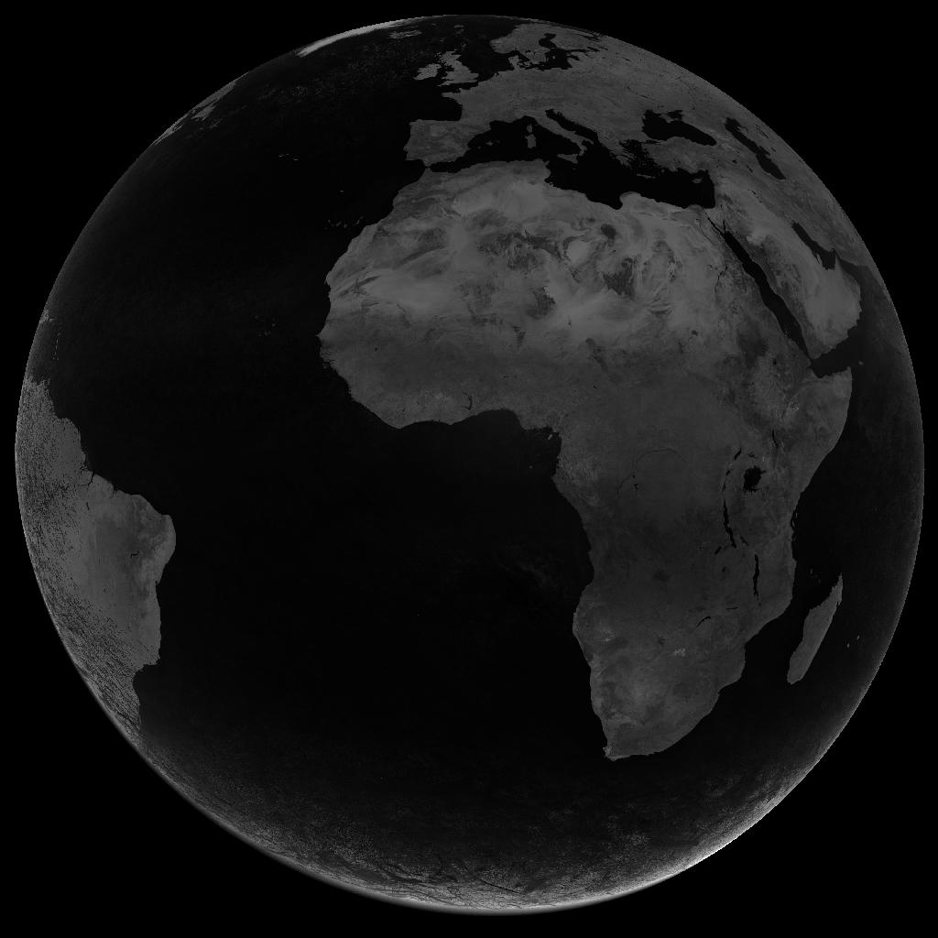
MAGICSOL/Heliosat Method
R the reflection observed by satellite,
Rmin, monthly minimum per slot & pixel, corrects (filters) the clear sky reflection,
R: Meteosat VIS image
Rmin: „clear sky
reflection“
Eff. Cloud Albedo
Cano et al. (1986), Beyer et al. (1996), Hammer et al. (2003), Mueller et al. (2011)
Notes:
Selfcalibration Rmax
All counts in region in histogramm for one month at 1pm → distribution
Take value of 95% percentile for Rmax
Rmax = „satellite constant“ = proxy for maximum detectable signal
Chosen region in south atlantic is very often cloudy („roaring 40ies“) → Mainly frontal systems, hardly any hight convection (as in the tropics)
13:00 (1 pm) = Rmax is most constant throughout the year
One month: to get enough cloudy pixels for percentile statistic

Slide 9
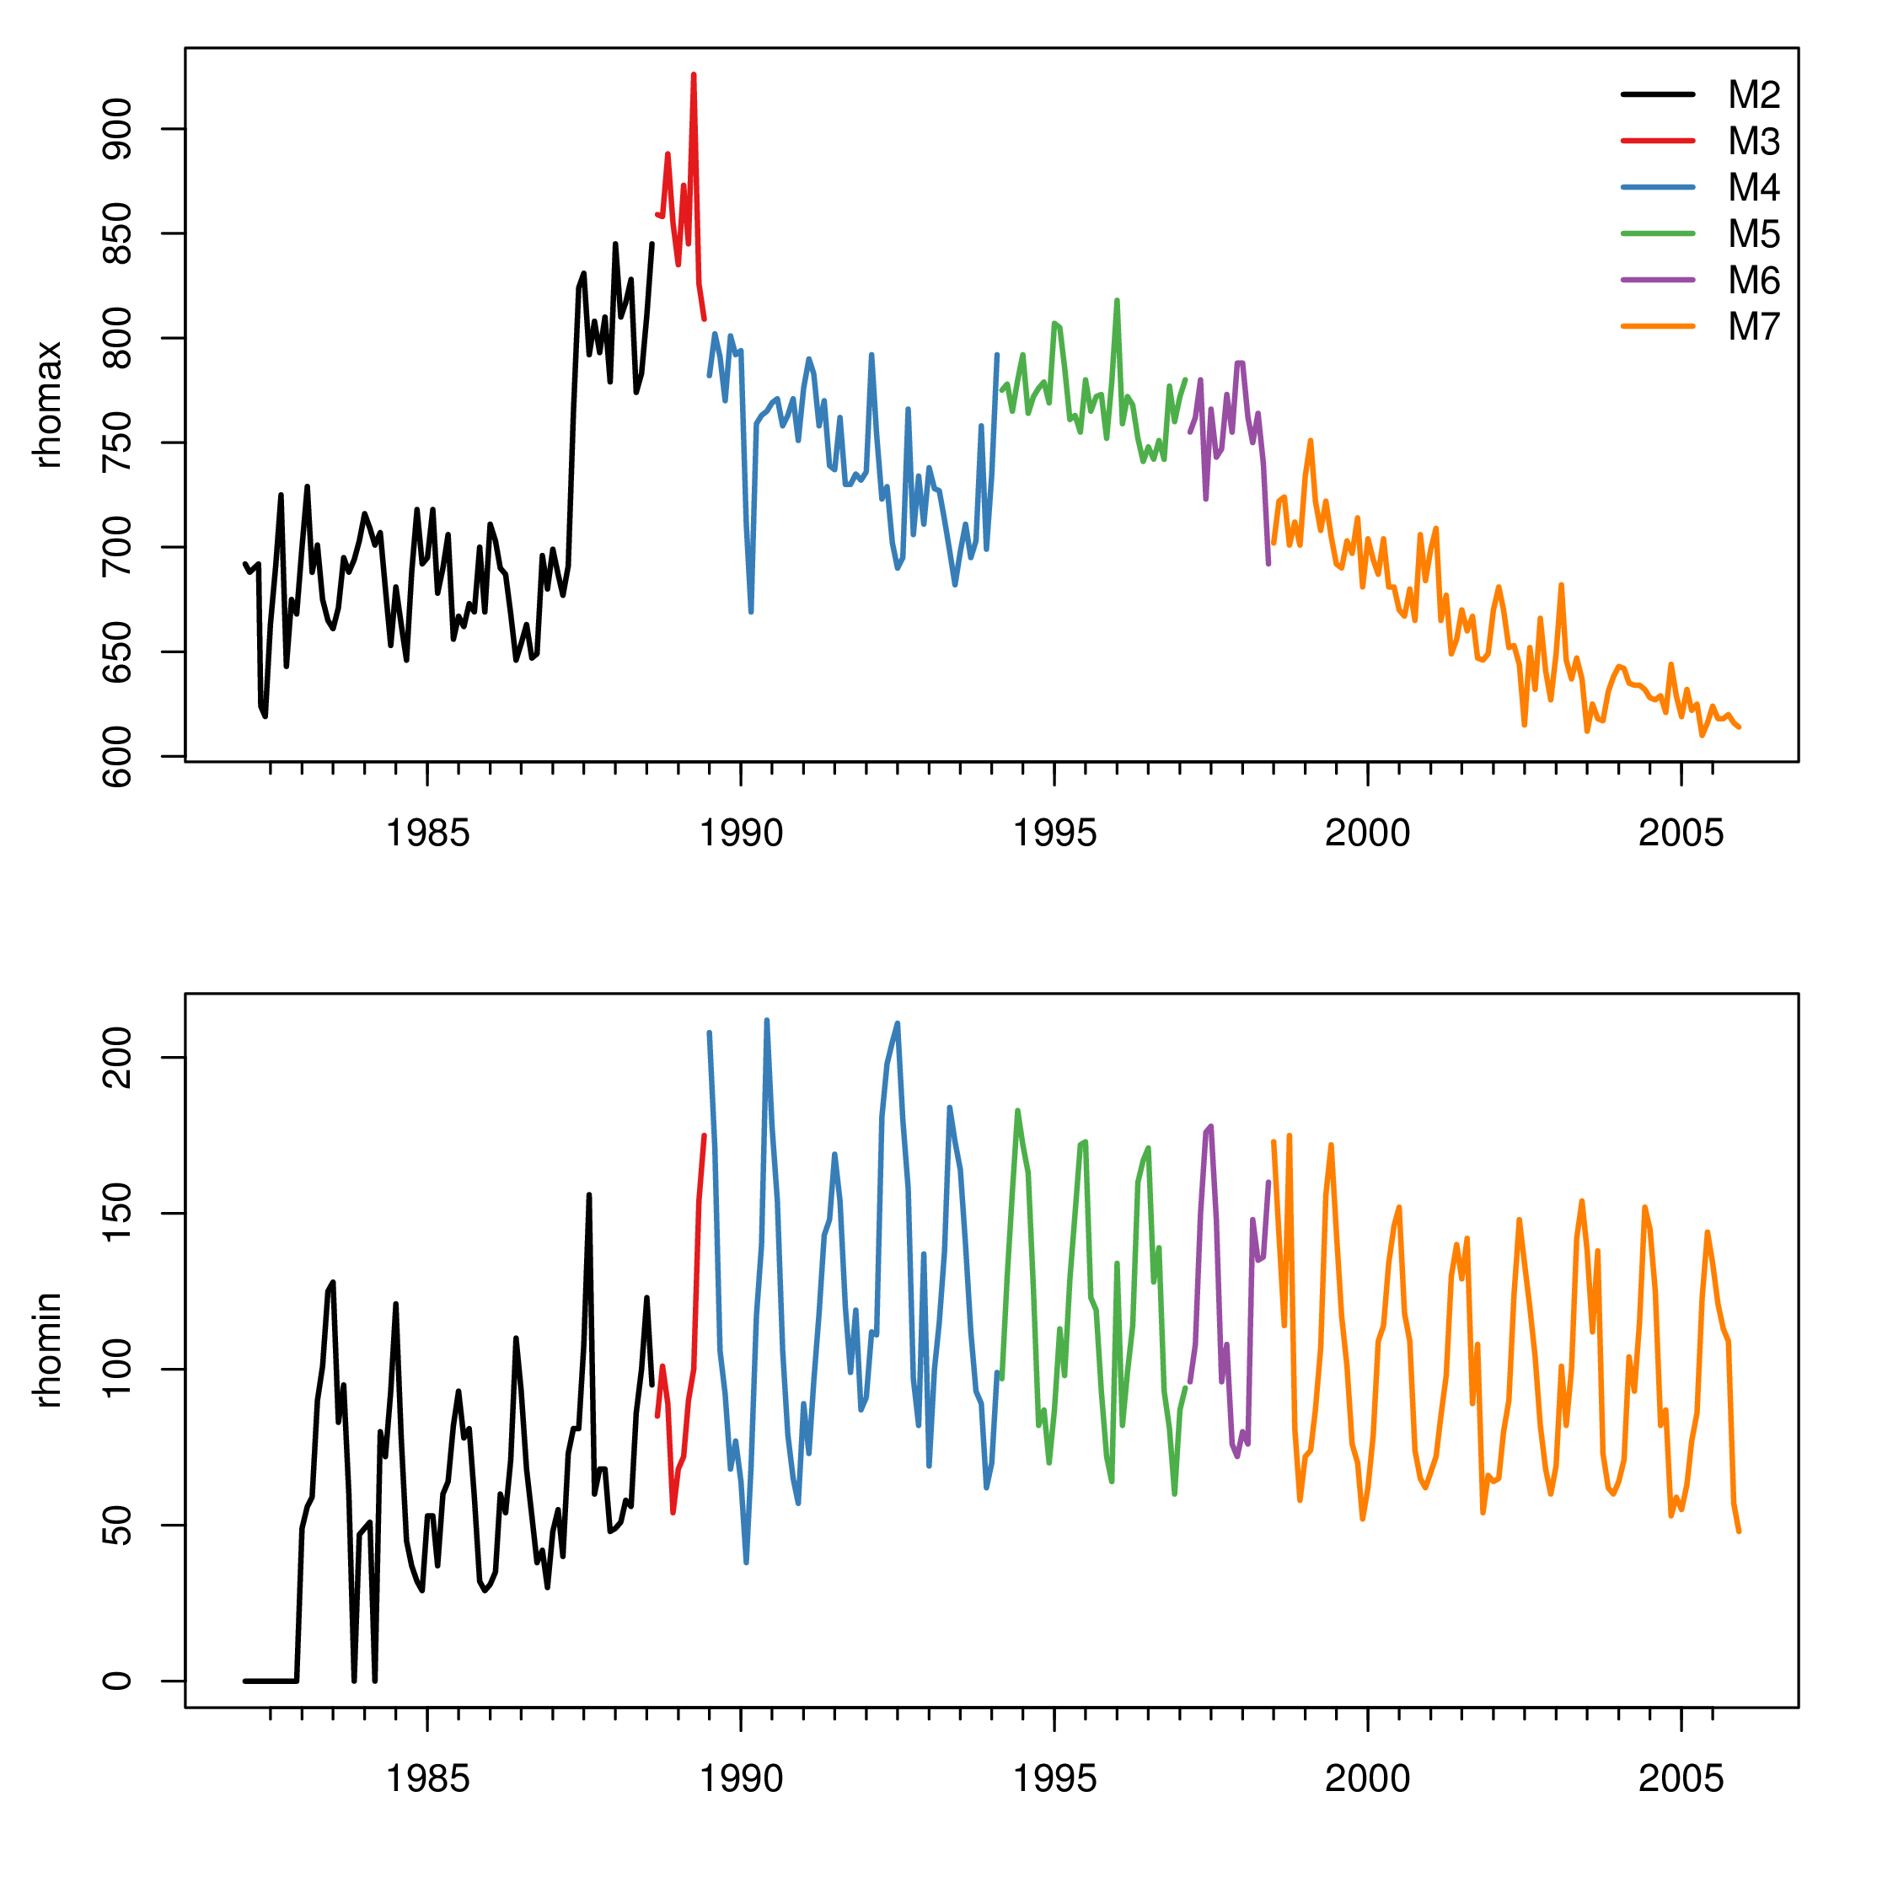
MAGICSOL/Heliosat Method
R the reflection observed by satellite.
Rmax corrects changes in sensitivity and aging of optical instruments.
R: Meteosat VIS images.
Rmin: „clear sky
reflection“
Rmax: „monthly
maximum reflection“
Eff. Cloud Albedo
Cano et al. (1986), Beyer et al. (1996), Hammer et al. (2003), Mueller et al. (2011)
Notes:
Selfcalibration Rmax
All counts in region in histogramm for one month at 1pm → distribution
Take value of 95% percentile for Rmax
Rmax = „satellite constant“ = proxy for maximum detectable signal
Chosen region in south atlantic is very often cloudy („roaring 40ies“) → Mainly frontal systems, hardly any hight convection (as in the tropics)
13:00 (1 pm) = Rmax is most constant throughout the year
One month: to get enough cloudy pixels for percentile statistic

Slide 10
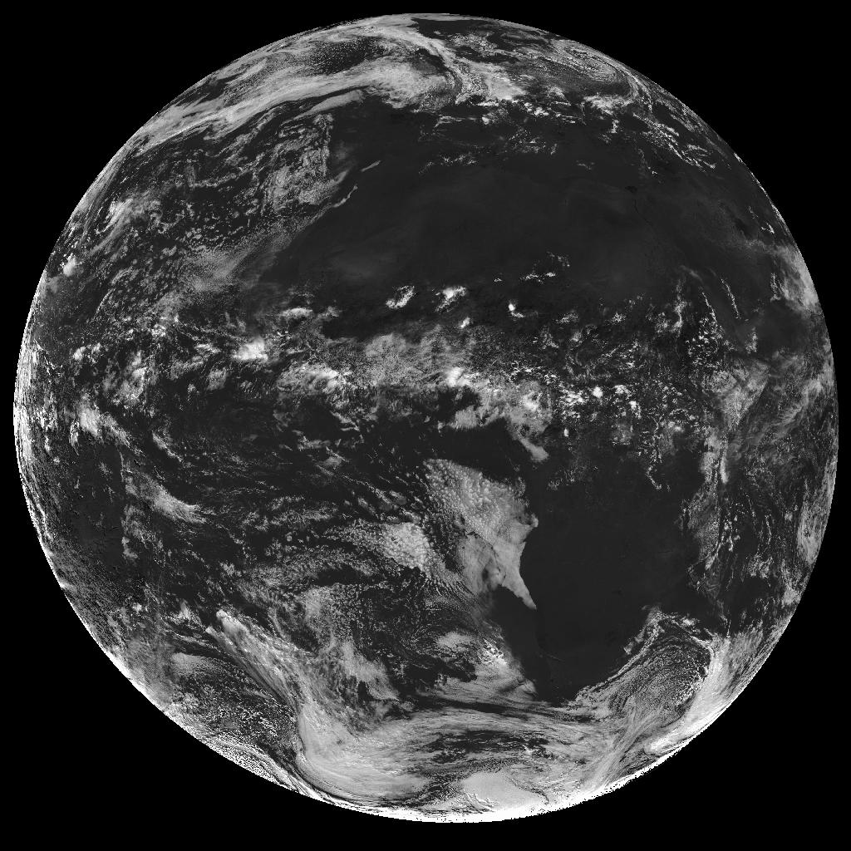
MAGICSOL/Heilosat Method
R the reflection observed by satellite.
Rmin corrects the clear sky reflection, derived from monthly statistics (per slot).
Rmax corrects changes in sensitivity and aging of optical instruments.
Effective Cloud Albedo provides the amount of reflected solar radiation relative to clear sky.
R: Meteosat VIS image
Rmin:
Observable
Rmax“
Eff. Cloud Albedo
Cano et al. (1986), Beyer et al. (1996), Hammer et al. (2003), Mueller et al. (2011)
Notes:
Selfcalibration Rmax
All counts in region in histogramm for one month at 1pm → distribution
Take value of 95% percentile for Rmax
Rmax = „satellite constant“ = proxy for maximum detectable signal
Chosen region in south atlantic is very often cloudy („roaring 40ies“) → Mainly frontal systems, hardly any hight convection (as in the tropics)
13:00 (1 pm) = Rmax is most constant throughout the year
One month: to get enough cloudy pixels for percentile statistic

Slide 11
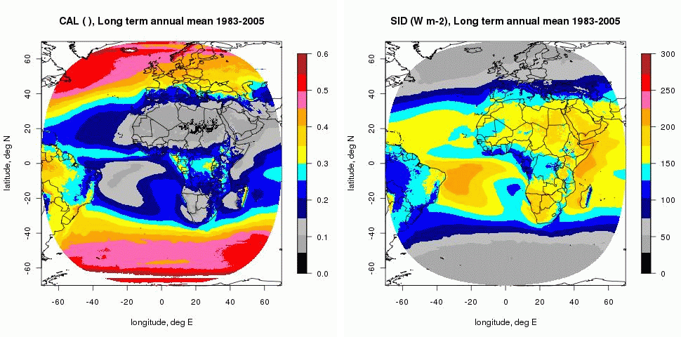
Application 1
Retrieval of solar irradiance
CAL is used to retrieve solar irradiance !
Effective cloud albedo and derived surface irrradiance is available from 1983 to 2006 (will be extended to 2011).
Monthly,daily means, spatial resolution 0.03 °.
Effective cloud albedo 1983-2005
Solar Surface irradiance 1983-2005

Slide 12
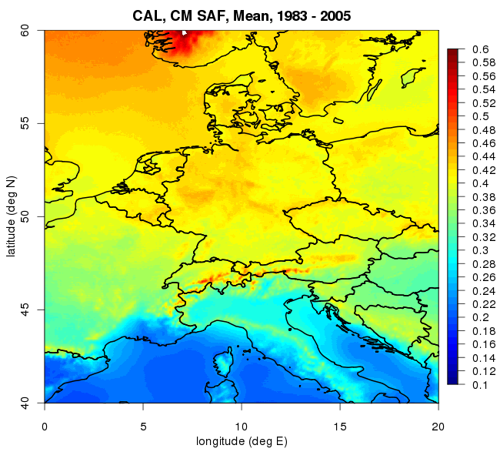
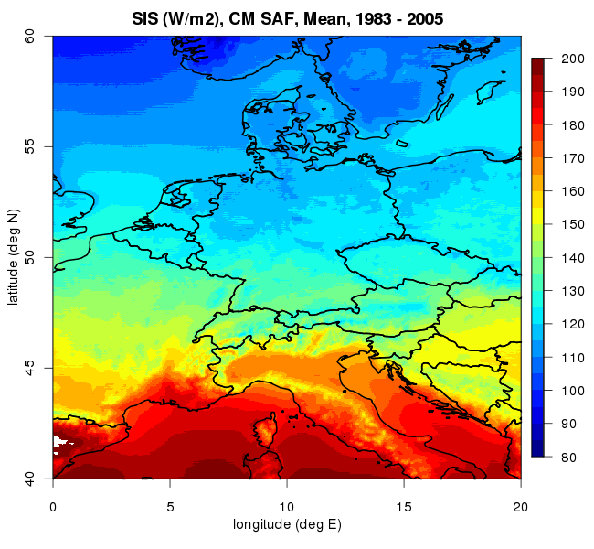
Application 1
Retrieval of solar irradiance
CAL is used to retrieve solar irradiance !
High spatial & temporal resolution allows the analysis of regional climate.
Following slides provide examples of trend analysis.
Effective cloud albedo 1983-2005
Solar Surface irradiance 1983-2005

Slide 13
Trend analysis
Brightening and dimming has been intensively discussed (e.g. Wild, JGR, 2009). However, the findings and analysis is mainly based on ground based observations which are scarce over ocean.

Slide 14
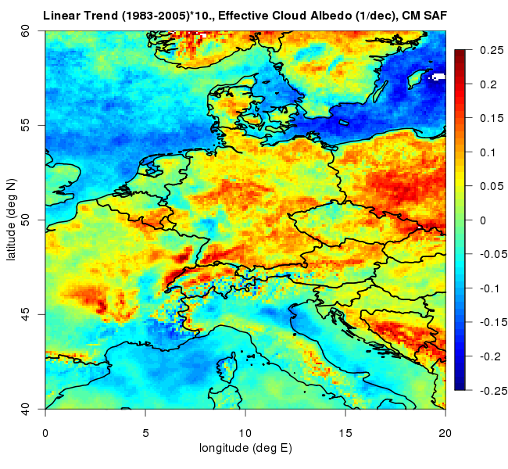
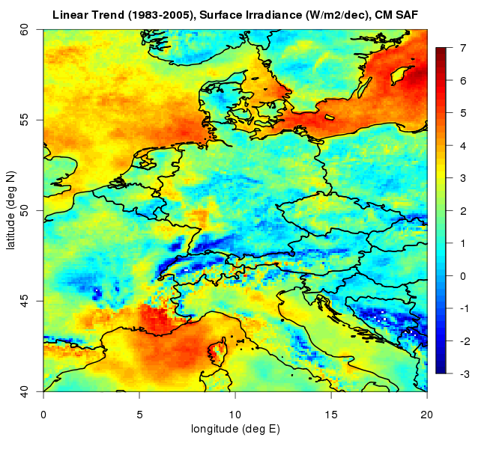
Trend analysis
Brightening and dimming has been intensively discussed (e.g. Wild, JGR, 2009). However, the findings and analysis is mainly based on ground based observations which are scarce over ocean.
Opposite trends over ocean and land demonstrate the importance of observational data (satellite) over the ocean for climate monitoring.
1983-2005
Fixed aerosol amount !

Slide 15
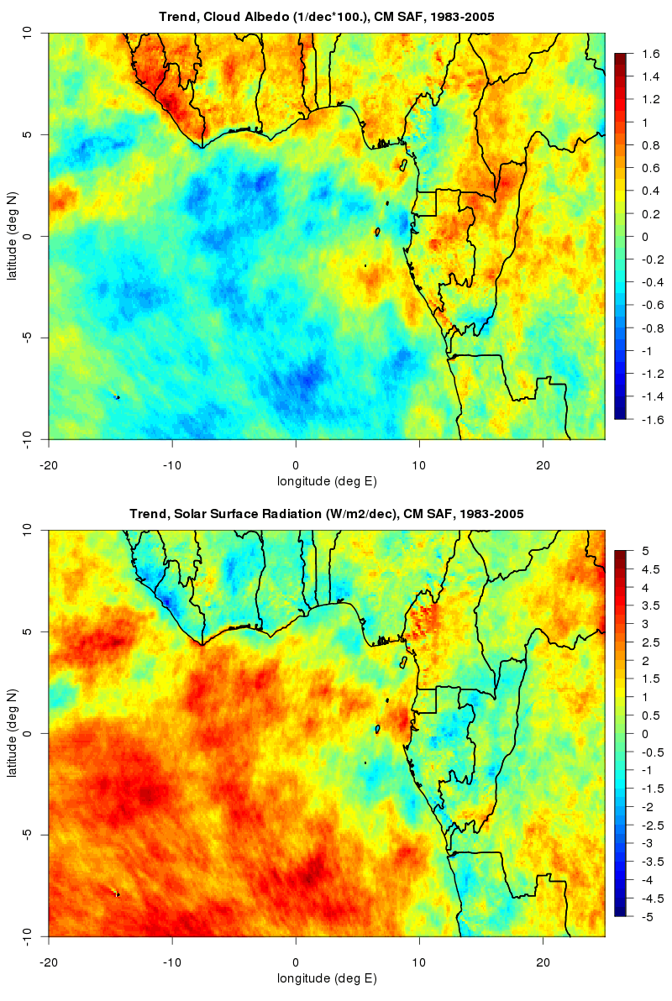
Trend analysis
Opposite
trends
are
apparent
also in
other
regions

Slide 16
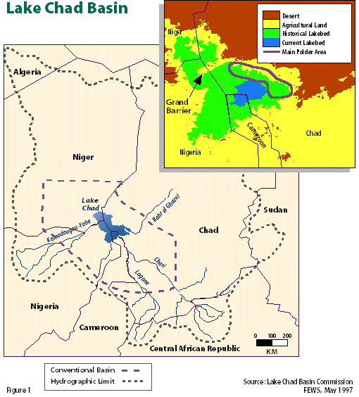
Trend Analysis: Lake Chad
Lake Chad is a very important water reservoir in Central Africa.
The water level of the lake is dramatically decreased. Knowledge of reasons is needed for the
sustainable water
management and is a
question of survival.
One reason could be a
significant increase of
evaporation induced by
a decrease of CAL
-> increase in SIS.
In discussion with GIZ
(Society of International Cooperation) of the FRG
the CM-SAF analyzed trends
in CAL & SIS.

Slide 17
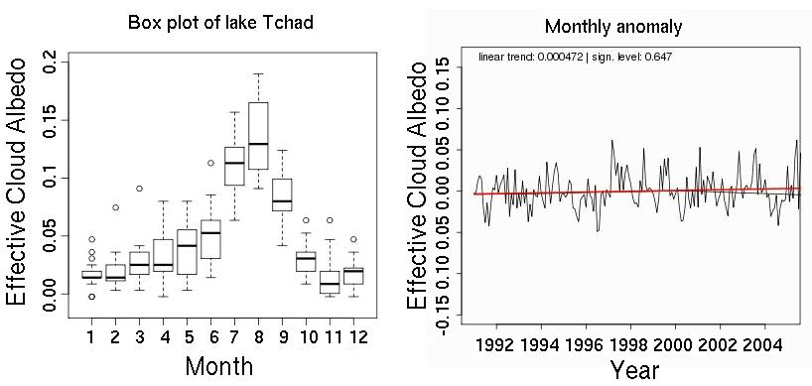
Trend Analysis: Lake Chad
No significant trend detectable. Increase of evaporation (1990-2006) driven by trends in cloudiness is unlikely. However, the majority of the water level decrease probably took place before 1990. Extension of time series needed.
More about Lake Chad at:
http://earthshots.usgs.gov/LakeChad/LakeChad

Slide 18

Conclusions
CAL is an essential input to retrieve solar surface
  irradiance which is in turn an essential climate variable.
  CAL provides essential information for climate analysis, e.g. Lake Chad, Amazon basin, Tanzania (not shown) and for brightening/dimming.
    Regional CAL trends leading to a solar forcing up to 7 W/m2/dec are apparent over the North Sea and Baltic Sea.
    Opposite CAL trends over ocean and land observed. This highlights the importance of observational CAL data over the ocean for climate analysis, in particular for the analysis of brightening and dimming, which in turn significantly affects the temperature on Earth.
ww

Slide 19
Conclusions
CAL is an essential input to retrieve solar surface
  irradiance which is in turn an essential climate variable.
  CAL provides essential information for climate analysis, e.g. Lake Chad, Amazonas basin, Africa and for brightening/dimming.
    Regional CAL trends leading to a solar forcing up to 7 W/m2/dec has been found over the North Sea and Baltic Sea.
    Opposite CAL trends over ocean and land observed. This highlights the importance of observational CAL data over the ocean for climate analysis, in particular brightening and dimming which significantly affects the temperature on Earth.
ww
GIVE US MORE CAL

Slide 20
Acknowledgements
-Eumetsat for support of the SAFs & implementation of
free SAF data policy.
- Thanks to the European tax payers for the
funding of our research and work.
Administrators of money sometimes believe the money
are given by them, but instead it is given by the
tax payers !
-Thanks to NCAR/NCEP for free and user friendly data
access.

Slide 21
The End

Slide 22
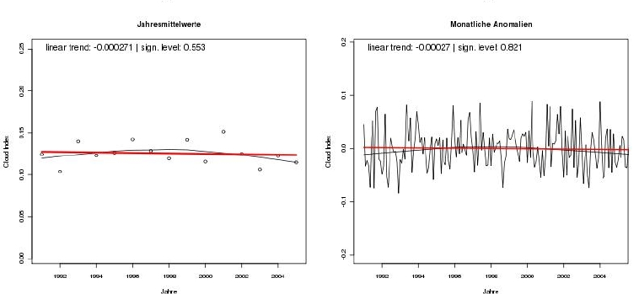
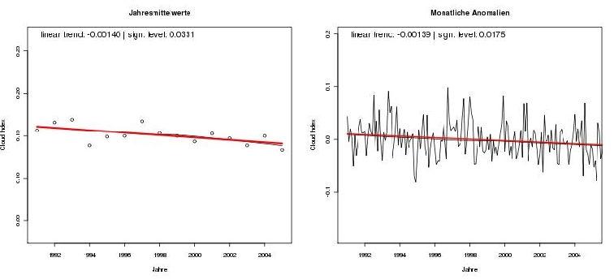
Trend Analysis
SA Land:
30 S, 17 E
Mean 0.13
Trend/dec=0
SA Ocean:
30 S, 12 E
Mean 0.15
Trend/dec
~ 10 %

Slide 23
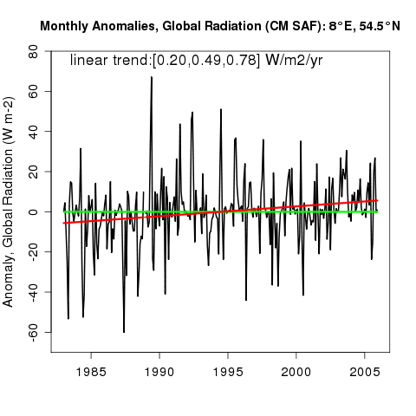
Applications

Slide 24
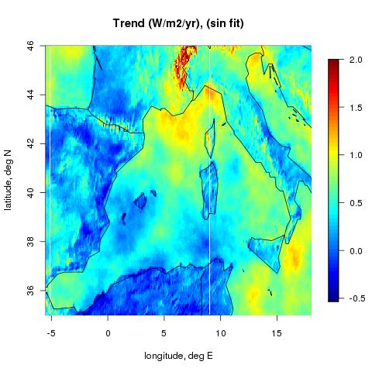
Application examples
-R trend analysis-
Trend Analysis:
Trend in solar incoming surface radiation derived from Heliosat (1995 – 2005)
Satellite data provides spatial patterns, also over ocean. Trend information over ocean is very important as energy uptake over ocean is larger than over land.

Slide 25
Motivation
The net cooling effect of clouds which is approximately 5 times higher
as the direct greenhouse effect. Changes in the cloud albedo would significantly affect
the climate on a global and regional scale.

Slide 26

What the hell is Heliosat
Cloud index is retrieved from the VIS channel of Meteosat satellites.
Cloud index describes the cloud transmission. It is clearly related to SSI.
Desired solar surface irradiance
SSI
n-1~
SSIclear
Solar surface irradiance for cloud
free sky, provided by clear sky
model. (RTM models clear sky
accurately)‏

Slide 27
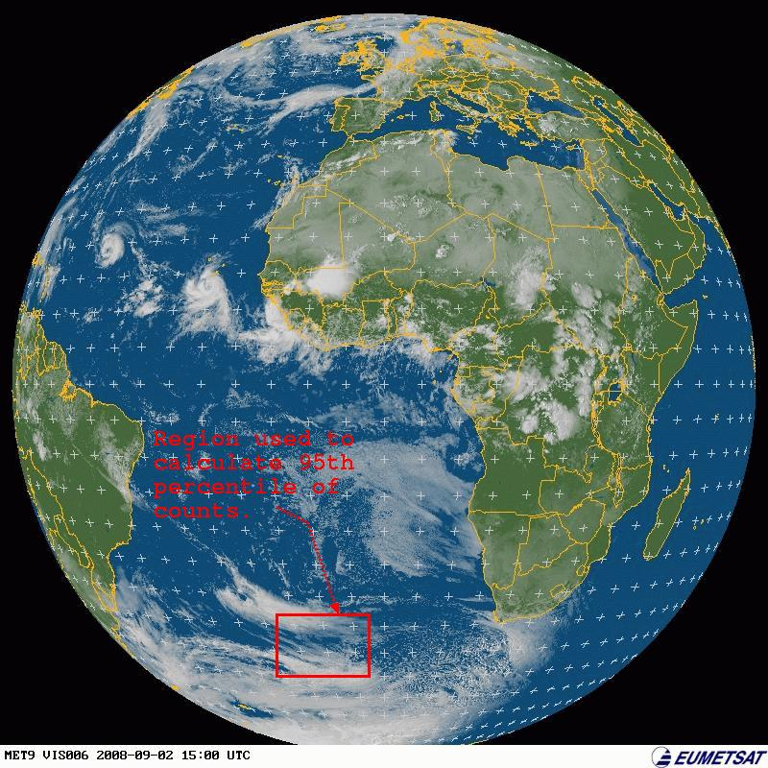
Cloud index - self calibration:
Rmax calculated for
every month:
95th percentile of all
counts in the region
illustrated.
Anisotropy effect
is corrected
Empirically.
-> automatic & fas
self-calibration.

Slide 28
What you can do
Trend Analysis
Substantial spatial variability of ‘solar brightening’ in Europe, ocean land contrast, published brightening studies are pre-dominantly based on surface observations. Hence, there is a risk for misleading interpretations, data over ocean is needed in addition.
Significant increase of energy uptake in Baltic sea.

Slide 29
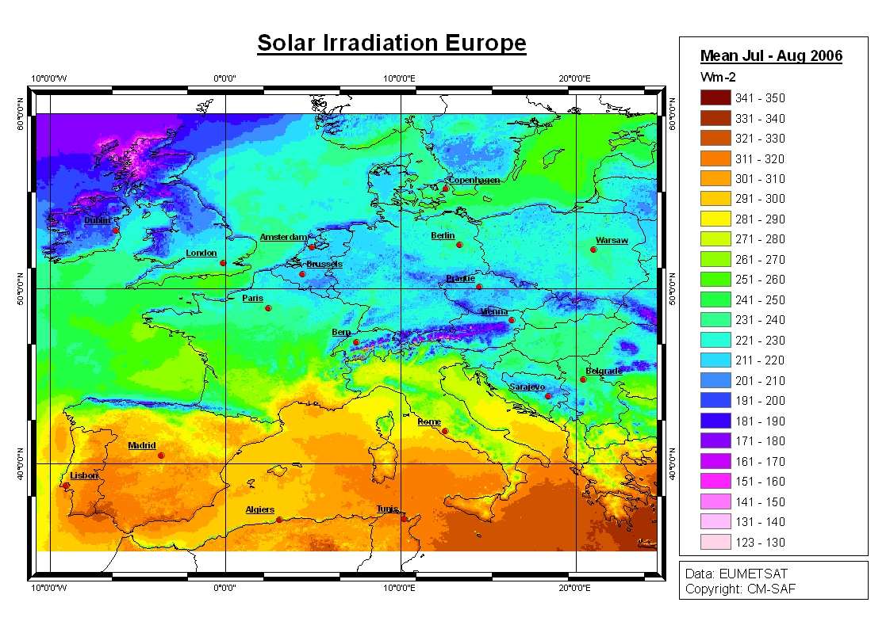
What the hell is Heliosat
SSI
n-1~
SSIclear
Clear sky model
MAGIC
Cloud index 1.7.2005, 11 h UTC

Slide 30
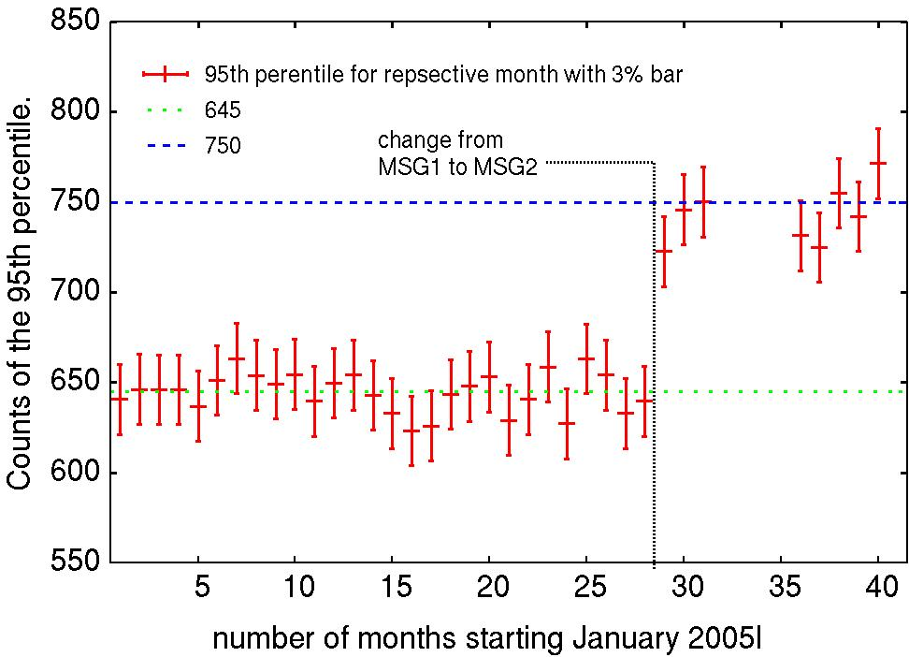
The climate Heliosat version
Verification of calibration

Slide 31
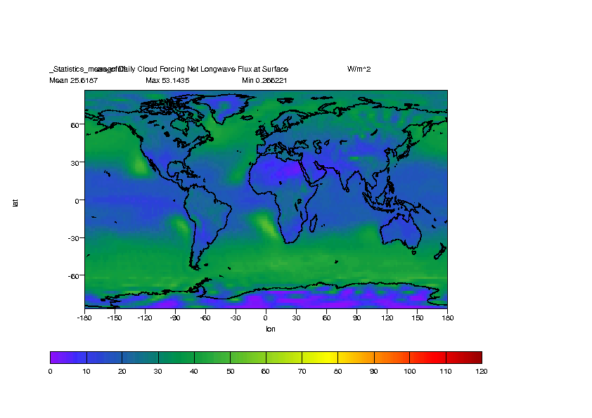
Motivation

Slide 32
Basic Retrieval Principle
Incoming radiation is either reflected or absorbed by the surface or the atmosphere. Information about the reflected radiation is measured by the satellites.
  Leads to the
effective cloud albedo.
  Strong signal in the VIS
enables the retrieval with
good accuracy also from MFG.
Enables the generation of long time series.
incoming
reflected
absorbed

Slide 33
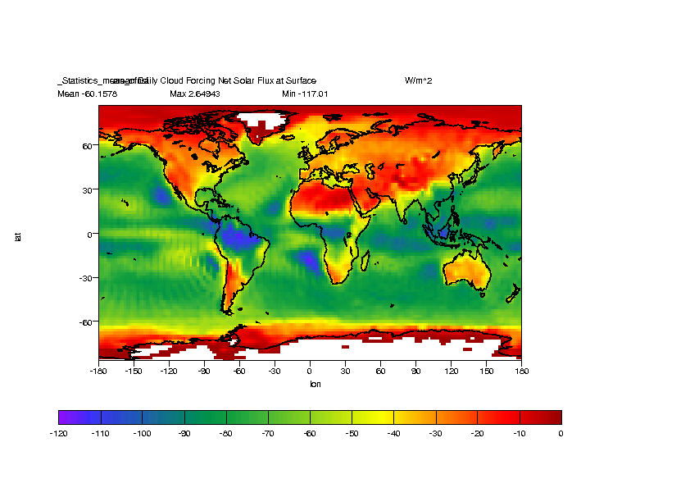
Motivation

Slide 34
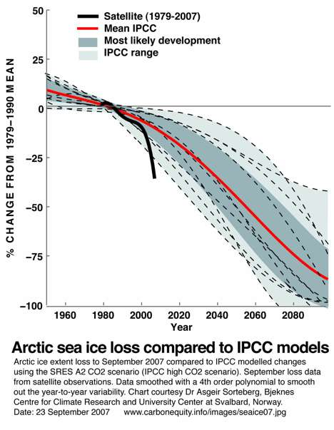
Motivation
-dramatic decrease of sea ice
not predicted by models.
-there is a need to observe,
monitor & analyse ECVs in order
to increase understanding.
-cloud physics not well
reflected by models.
-Certain cloud parameters can
be retrieved well by satellites.
The (effective) cloud albedo
is one of those.

Slide 35
Principle of Retrieval
Finally the cloud index a measure of the effective cloud albedo:
R - Rmin
n =
Rmax - Rmin
R: VIS reflectance
measured by satellite
1.7.2005, 11 h UTC

Slide 36
Principle of Retrieval
One minus the cloud index provides the cloud transmission. For the purpose of the talk (limited time) the effect of cloud albedo changes is expressed in terms of trends in solar cloud forcing in W/m²/yr.

Slide 37
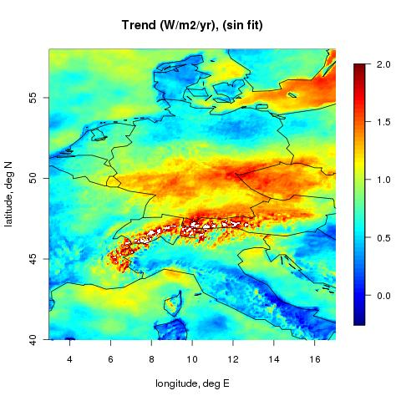
R Trend analysis
-first results-
Trend Analysis:
Trend in solar cloud forcing derived from Heliosat data (1995 – 2005, University of Oldenburg) for central
Europe.
Trend information over ocean is very important as energy uptake over ocean is larger than over land.

Slide 38
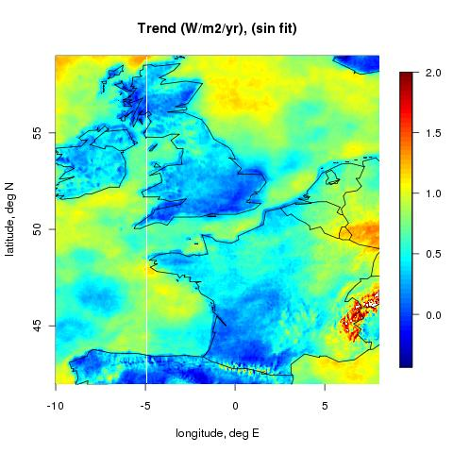
R Trend analysis
-first results-
Trend Analysis:
Trend in solar cloud forcing derived from Heliosat data (1995 – 2005, University of Oldenburg) for central
Europe.

Slide 39
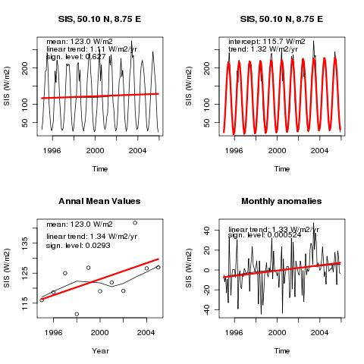
R Trend analysis
-first results-
Trend Analysis:
Trend analysis
shows a statistically
significant positive
trend of solar cloud forcing in Offenbach between 1995 and 2005.
The answer to „what
is CM-SAF“ doing for DWD !

Slide 40
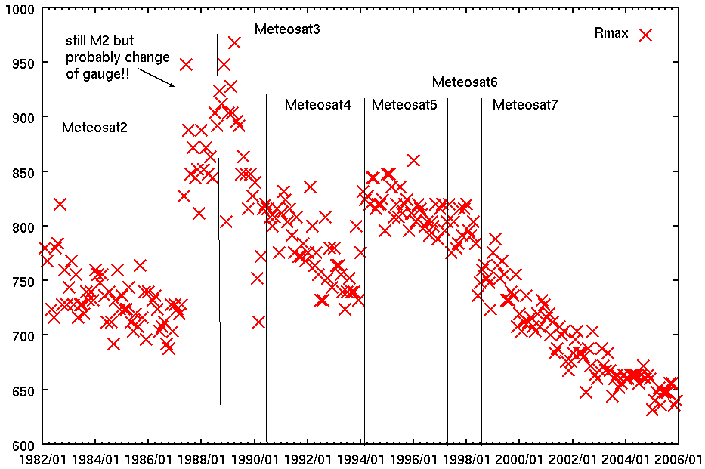
The Heliosat method
Max. reflectance, R_{max}:
95 % percentile of counts during one month in the reference region
Reflectivity, 12 UTC, 2 Sept 2008
Temporal evolution of R_{max}

Slide 41
Principle of Retrieval
From satellite raw image: Rmax,Rmin
Statistical method (“minima”) to
separate clouds -> monthly mean
per slot of planetary clear sky albedo.
Rmin
95th percentil of counts within
Reference region (monthly)
Rmax

