Slide 1
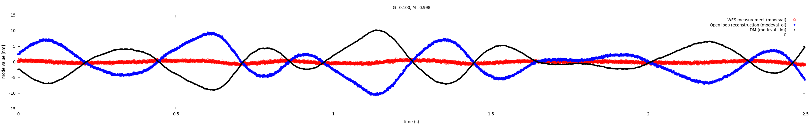
Open loop reconstruction
Turbulence injected:
8m/s wind speed, slightly filtered Kolmogorov spectrum (LOcoeff=0.1), 50nm RMS on DM (100nm WF), speed = 8 m/s
written to DM every 300us (3.333 kHz frequency)
Showing Open loop (blue) and WFS measured (red) modal coefficient #30
Data acquition start synchronized to turbulence sequence start
PyWFS running at 2kHz, 125mas modulation radius. Total delay = 2.6 frame

Slide 2
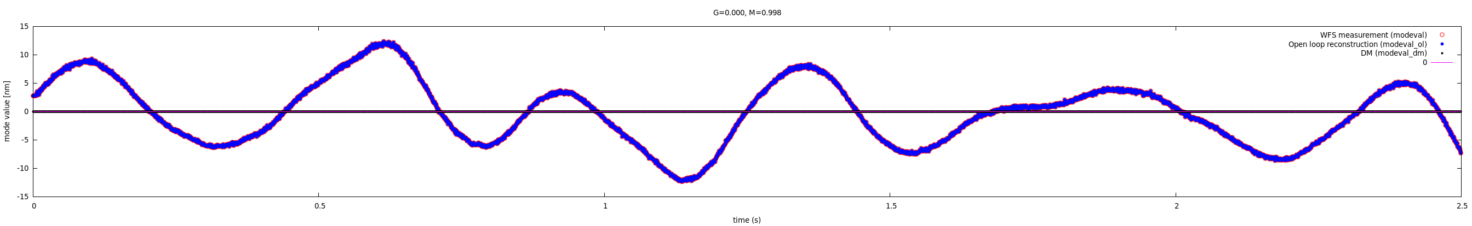
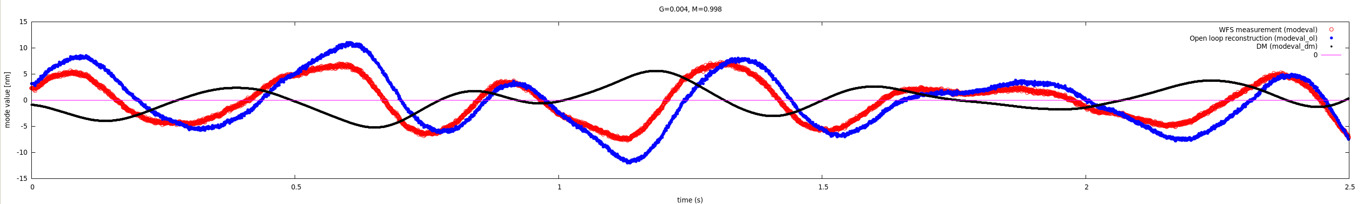
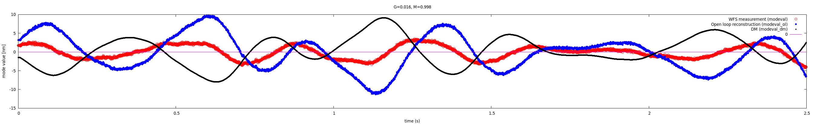
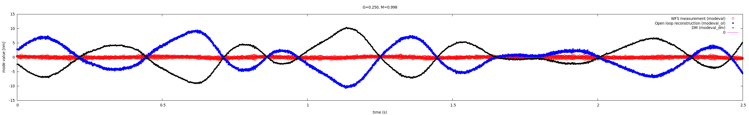
Open loop reconstruction: Changing gain (M=0.998)

Slide 3
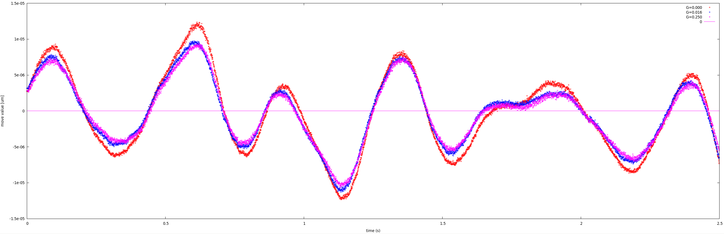
Open loop reconstruction
Comparison between gain values
G=0.000 → over-estimates OL values
All G>0.0 reconstructions match at %-level
G=0.000 test relies entirely on WF residuals for OL estimation
G>0.000 tests rely mostly on DM values for OL estimation
Test shown here uses full speed RM acquisition which underestimates RM by ~15% due to DM time-of-motion → reconstructed WFs from WFS are over-estimated by ~15%

Slide 4
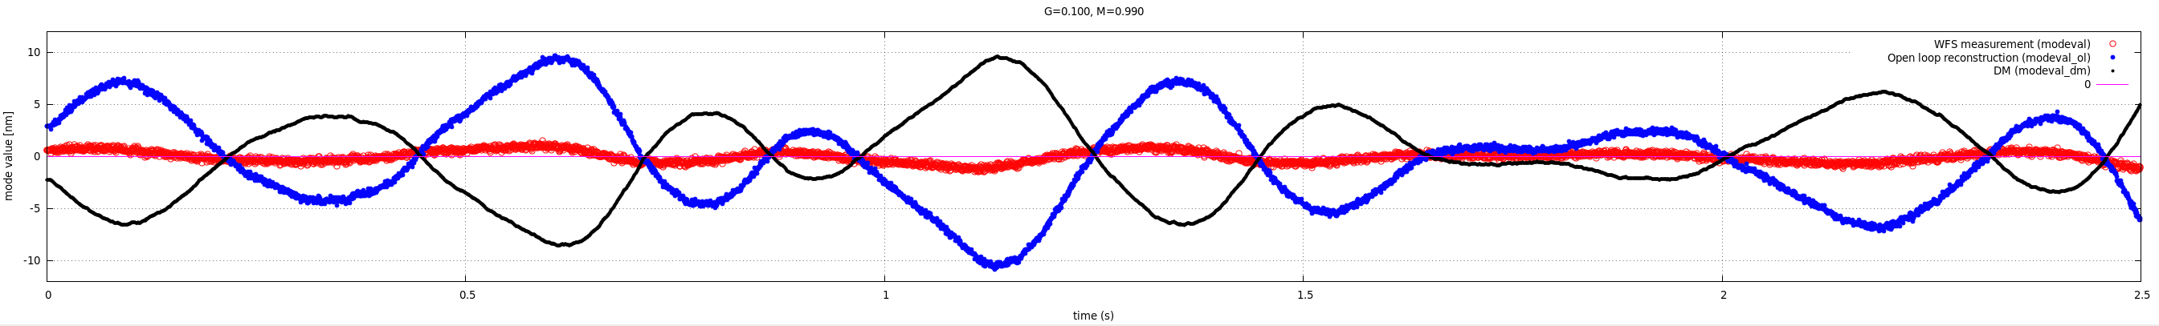
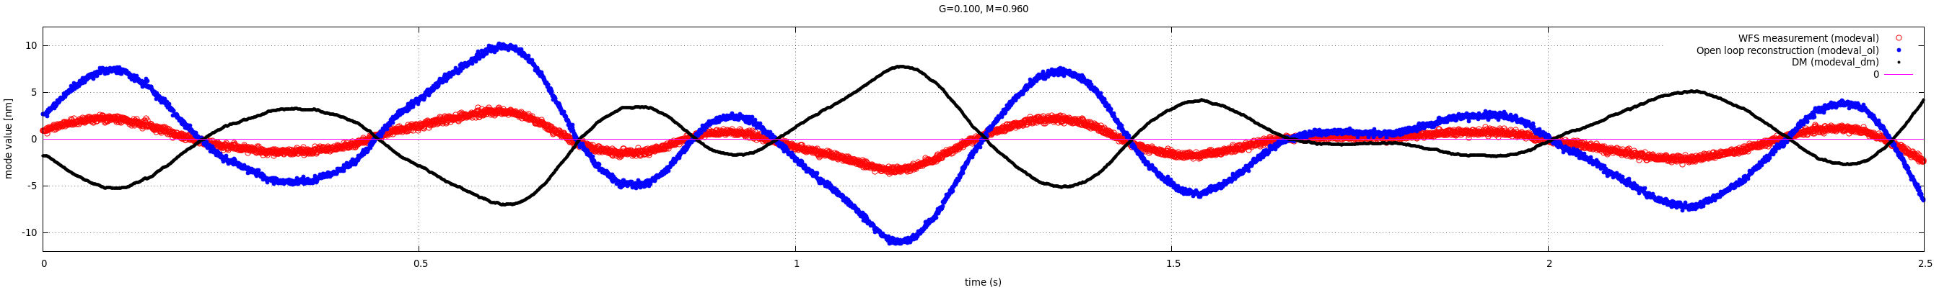
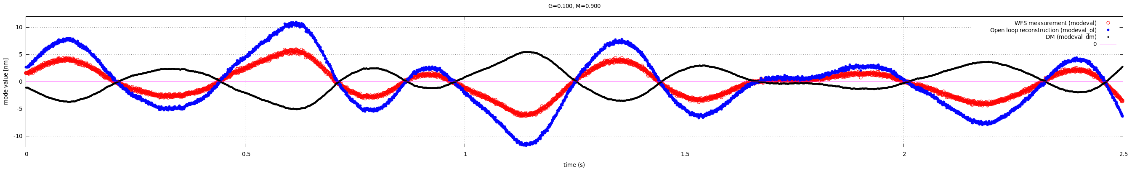
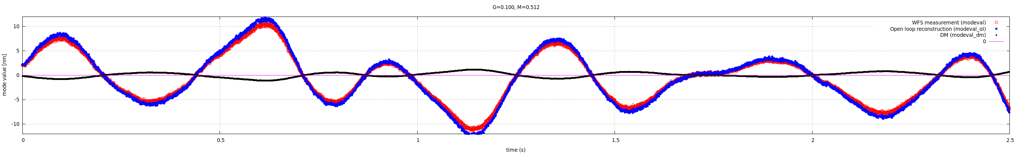
Open loop reconstruction: Changing mult factor (G=0.100)

Slide 5
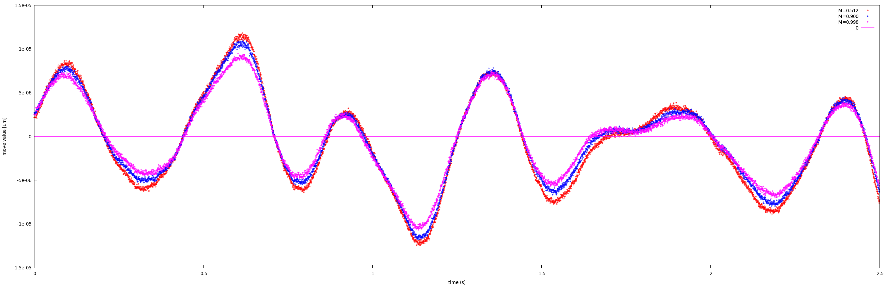
Open loop reconstruction
Comparison between Mult factor
Small M over-estimates OL values
→ same effect as G=0.0 over-estimation
M<<1 tests rely mostly on WF residuals for OL estimation
M~1 tests rely mostly on DM values for OL estimation
Test shown here uses full speed RM acquisition which underestimates RM by ~15% due to DM time-of-motion → reconstructed WFs from WFS are over-estimated by ~15%

Slide 6
Open loop reconstruction: noise propagation
NOISE = σ x sqrt( 1 + M² G² / (1-M²))
Open loop mode coefficients
aol#_modeval_ol
NOISE σ'
subtract
modal DM correction at time of available WFS measurement
modal DM correction, circular buffer
aol#_modeval_dm
aol#_modeval_dm_C
NOISE σ'
WFS-measured DM mode coefficients
Current modal DM correction, filtered
Current modal DM correction
aol#_modeval_dm_now_filt
NOISE σ
aol#_modeval
aol#_modeval_dm_now
WFS modes
pixels → modes
block gains
aol#_gainb
mult x ( modeval_dm_C – gain x modeval)
loop gain
σ' = M x G / sqrt(1-M²) x σ
WFS image
loop mult

