Slide 1
AO Loop Control Software
Overview
Linux-based
Open-source, no closed library
C code (~100k lines) + high-level scripts (baseline control interface using bash scripts provided)
Uses libraries: CUDA & MAGMA (GPU computing, optional), FFTW, FITSIO, GNU scientific library, readline
Source code + example simulated AO system: https://github.com/oguyon/AdaptiveOpticsControl

Slide 2
Hardware
Hardware Requirements / compatibility:
RTS runs on a single multi-core computer. Minimum ~15 cores system, 128GB ram (heavy use of shared memory and shielded processes running on single core)
CPU only or CPU+GPU computing engine. Requires GPU(s) for high speed / high actuator count. Supports NVIDIA hardware (CUDA lib).
Can span multiple computers (for example, camera or DM driven by computer other than main RTS). Software uses and configures fast private low-latency TCP link (eg. 10GbE or 40GbE fibers) for transfers.
Interfaces to hardware through shared memory structure. Hardware already coupled with RTS: BMC deformable mirror, Ocam2k camera, SAPHIRA camera (with UH readout electronics), OwlCam InGaAs Raptor Photonics camera, Andor sCMOS.

Slide 3
Capabilities
Speed
Largely limited by hardware. Fully system timing stable at 10us level, and RTS latency due to IPC, TCP transfers between computers, and GPU transfers is <100us total → can drive ~10 kHz loop on multi-computer system, and ~20 kHz loop on single computer.
SCExAO implementation drives 2000-actuator, 14,400-sensor loop at 3.5kHz, limited by camera readout speed.
Flexible architecture
All input, output and intermediate data is stored as shared memory. A common format for all shared memory data streams facilitates software development. Multiple processes run simultaneously to perform operations on shared memory streams. Additional processes can be deployed (for example, real-time analysis of an intermediate data stream) without impacting existing processed.
IPC is built in the shared memory structure which contains POSIX semaphores (default of 10 semaphores, more if needed): 10 different processes can run on the same input. Each process waits on input stream(s), and posts output stream(s) semaphore(s) → Real-time operations can be chained, with multiple branches

Slide 4
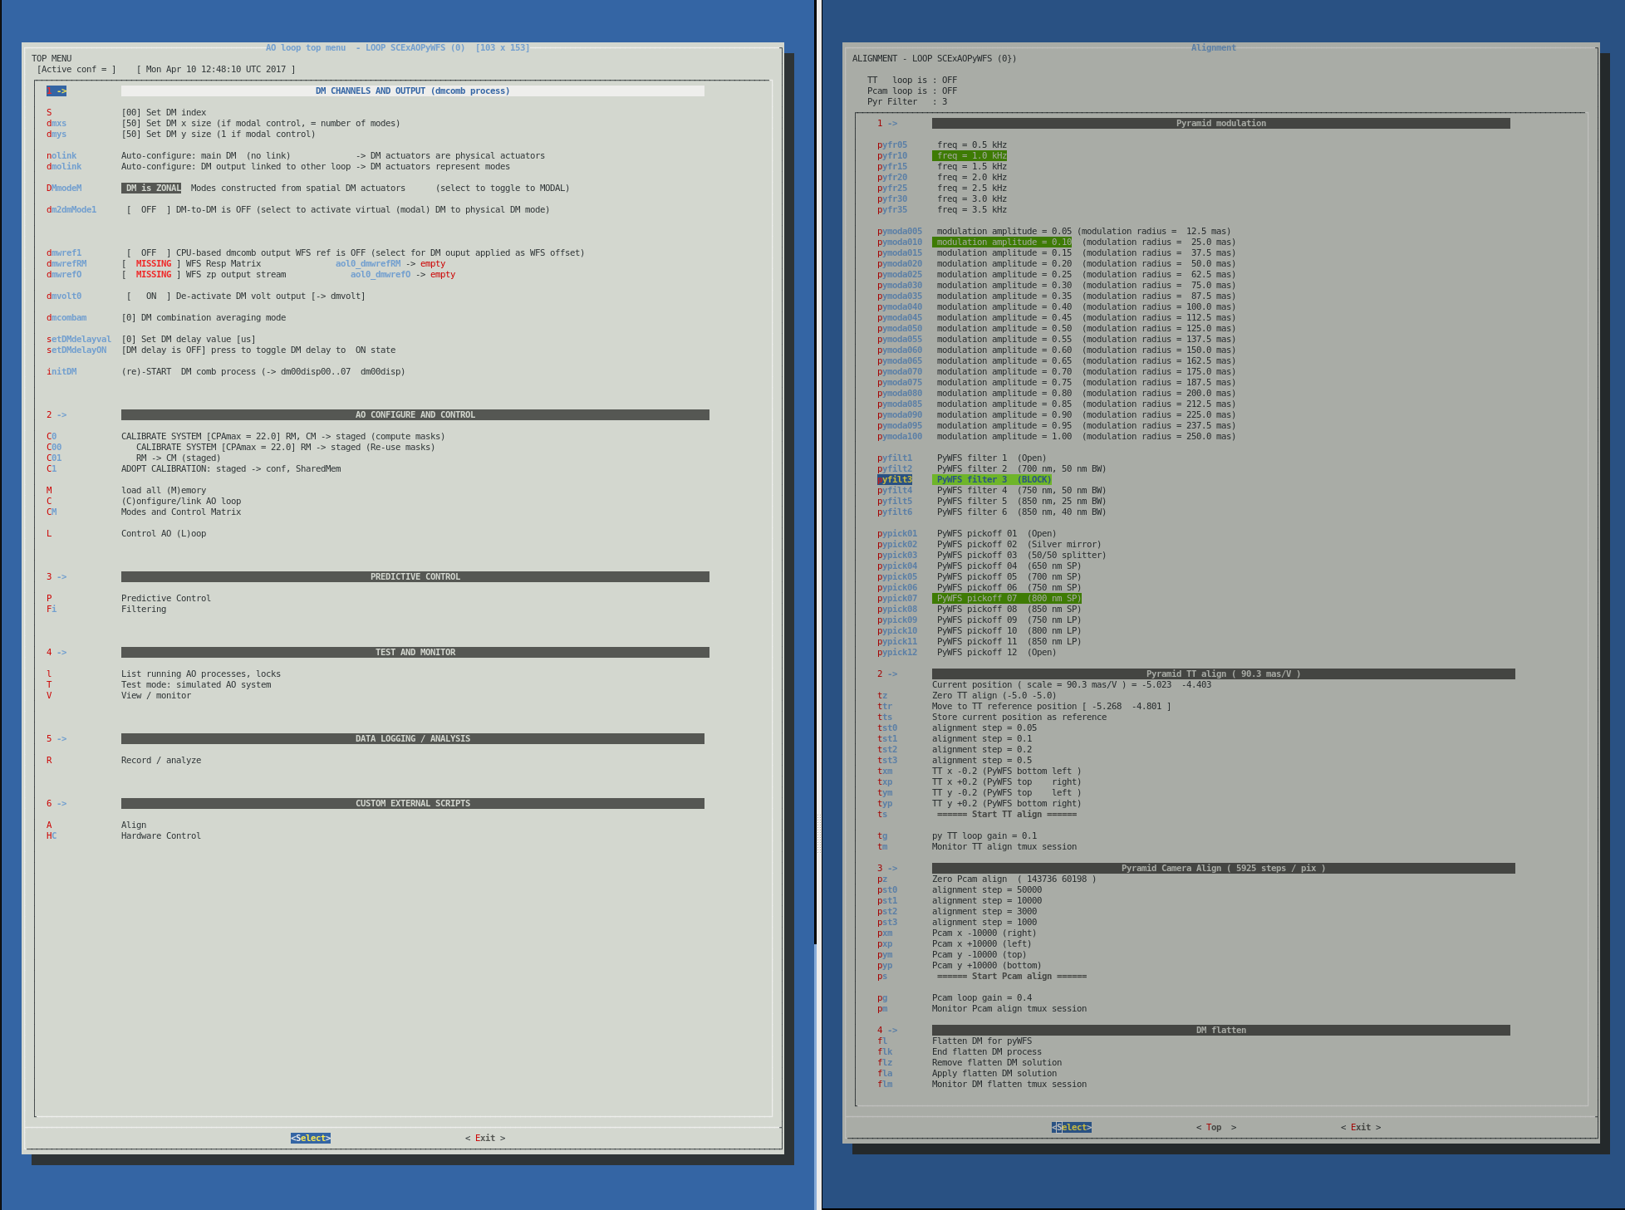
Example control GUI (bash scripts)

Slide 5
Calibration Work Flow
For each file:
conf_<name>_name.txt points to archived file location
conf/conf_<name>_name.txt are read by function ReadConfFile for loading into shared memory and FITS copy to ./conf/aol#_<name>.fits
Conventions :
Modal DM: “actuators” indices have no spatial meaning
→ No spatial filtering options
→ “Direct write” CM and “Modal” CM are the same (1 mode = 1 actuator)
Zonal DM: actuator indices correspond to spatial coordinates
→ Need linear transformation between mode coefficients and actuators
If re-using masks, keep from previous calibration
./conf/RMmat.fits
./conf/RMpixindex.fits
./conf/RMpokeCube.fits
High order / zonal calibration
./conf_staged/
copy
wfsref0.fits
zrespM.fits
dmmap.fits
wfsmap.fits
dmmaskRM.fits
dmslaved.fits
dmmask.fits
wfsmask.fits
LOrespM.fits
LOwfsref0.fits
LODMmodes.fits
conf_wfsref0_name.txt
conf_zrespM_name.txt
conf_dmmap_name.txt
conf_wfsmap_name.txt
conf_dmmaskRM_name.txt
conf_dmslaved_name.txt
conf_dmmask_name.txt
conf_wfsmask_name.txt
conf_LOrespM_name.txt
conf_LOwfsref0_name.txt
DMmodes##
respM##
contrM##
contrMc##
contrMcact##_00
respM
DMmodes
contrM
acquire HO RM
[aolMeasureZrespmat2]
./dmmask.fits
./wfsmaskRM.fits
Make DM slaved
[mkDMslavedActprox]
./zrespmat0.fits
./wfsref00.fits
– or – (DMmode branch)
copy
decode & process
[aolCleanZrespmat2]
./zrespM.fits
./dmmap.fits
./wfsmap.fits
Make masks
[aolmkMasks]
./dmslaved.fits
./dmmask.fits
Compute modes & CM
copy
./conf_zrm_staged/zrespM.fits
./conf_zrm_staged/dmmap.fits
./conf_zrm_staged/wfsmap.fits
./wfsref00.fits
flux-normalize
./wfsref0.fits
configuration update
Low order / modal calibration
(optional, only if Zonal DM)
copy
./conf/conf_<name>_name.txt
configuration load files
./conf/aol#_<name>.fits
SHARED MEMORY: aol#_<name>

Slide 6
LOWFS LOOP
loopnb = 1
DMindex = 01
LOWFS modes (modal actuators)
Mode coeffs
Mode DM maps
OFFSET (flat)
Resp matrix
AO control
Mode PyWFS resp
Zero pt offset
aoloopcontrolDMcomb
(AOloopControl_DM_CombineChannels)
LOWFS image
LOWFS resp mat
(modal)
LOWFS
wfsref0
LOWFS
wfsref
aol1_wfszpo0
aol1_wfszpo1
aol1_wfszpo2
aol1_wfszpo3
MASTER LOOP
Main DM channels (physical actuators)
OFFSET (flat)
TT LQG
PyWFS RM
PyWFS control
DM control
Total DM displacement
PyWFS LOOP
loopnb = 0
DMindex = 00
LOWFS
speckle probes
speckle control
ZAP
aolzpwfsloop
(AOloopControl_WFSzupdate_loop)
zpoffset #1
zpoffset #2
zpoffset #3
Zernike offsets
Astrom grid
Turbulence
AO sim
Astrom offset
LOWFS offset
FPWFS probe offset
PyWFS offset
zpoffset #4
zpoffset #5
zpoffset #6
PyWFS resp matrix
PyWFS image
aol0_wfszpo0
aol0_wfszpo1
aol0_wfszpo2
aol0_wfszpo3
process aolrun (see next slide)
PyWFS wfsref0
PyWFS reference
aolzpwfscloop
(AOloopControl_WFSzeropoint_sum_update_loop)
FPWFS image
FPWFS Modulation maps
Mode FPWFS resp
LOWFS + HOWFS + FPWFS
wavefront control architecture
FPWFS LOOP
loopnb = 2
FPWFS
probe images
FP solution

Slide 7
Control Matrix Computation Modes
WFSnorm (./conf/param_WFSnorm.txt) WFS normalization mode C code: WFSnormalize
0: Do not normalize WFS images
1: Normalize WFS images (default)
WFSnorm should be left unchanged between RM acquisition and Loop control
DMprimaryWrite (./conf/param_DMprimaryWriteON.txt) DM primary write C code: DMprimaryWriteON
0: DM primary write is off (default)
1: DM primary write is on
DMfilteredWrite (./conf/param_DMfilteredWriteON.txt) DM filtered write C code: DMfilteredWriteON
0: DM filtered write is off (default)
1: DM filtered write is on
CMMODE (./conf/param_CMMODE.txt) Combined Control matrix mode C code: CMMODE
0: (not combined): control matrix is WFS pixels → modes
→ Linking aol#_DMmode_meas ↔ aol#_modeval
→ modesextractwfs reads from aol_DMmode_meas instead of computing
1: (combined): control matrix is WFS pixels → DM actuators
DMMODE (./conf/param_DMMODE.txt) DM mode (zonal vs. modal) C code: DMMODE
0 (ZONAL): pixel coordinates correspond to DM actuators physical location
→ spatial filtering enabled for DM modes creation
→ blocks built by spatial frequencies, user can set independent gain values for mode blocks
1 (MODAL): DM pixels correspond to abstract modes
→ no spatial filtering, setting 1 block only
Note: DMMODE=0 → CMMODE=0 (CPA-splitting of modes into blocks)
GPU (./conf/param_GPU.txt) # of GPUs to use for CM multiplication C code: AOconf[loop].GPU
0: use CPU
1+: number of GPUs
if CMmode=1 and GPUmode>0:
GPUall (./conf/param_GPUall.txt) Use GPU for all computations C code: AOconf[loop].GPUall = COMPUTE_GPU_SCALING
0: Use CPU for WFS reference subtraction and normalization
→ WFS reference subtraction and normalization done by CPU (imWFS0→ imWFS1→ imWFS2)
→ CM multiplication input is imWFS2 (GPU or CPU)
1: Use GPU for all computation
→ WFS reference subtraction and normalization done by GPU
→ GPU-based CM multiplication input is imWFS0

Slide 8
Computing Modes and Control Matrices
block gains
main gain
CMMODE=1
aol#_contrMcact
aol#_meas_act
DMprimaryWrite=1
If GPUall=1, include normalization and wfsref subtraction within CUBLAS call. (GPU mode only)
If GPUall=0, need to normalize and ref-subtract prior to matrix multiplication.
runs on GPUset0 or CPU
MEXOL=1
aol#_contrM
main gain
runs on single GPU
block gains
GPUall=1
CMMODE=0
DMprimaryWrite=1
aol#_imWFS0
aol#_contrM
aol#_DMmode_meas
aol#_DMmode_cmd
runs on GPUset0 or CPU
DMMODE=1
GPUall=0
sym link
normalize
aol#_modeval
aol#_DMmodes
aol#_imWFS1
block gains
main gain
ref subtract
MEXOL=1
runs on GPUset1 or CPU
aol#_imWFS2
aol#_modeval_dm_now
DMFW=1
aol#_modeval_dm_now_filt
DMfilteredWrite=1
aol#_DMmodes
aol#_dmC
aol#_modeval_ol
runs on GPU only
DMMODE=1

Slide 9
Supported Computing Modes
GPUset0=0 → GPUall=OFF
CMMODE | GPUset0 | GPUall | DMprimaryWrite | GPUset1 | DMFWB | Comments
0 (modal control) | 0 (CPU mode) | OFF | 0 | N/A | 0 | Note: DOES NOTE WRITE TO DM
0 (modal control) | 0 (CPU mode) | OFF | 0 | N/A | 1 | OK
0 (modal control) | 0 (CPU mode) | OFF | 1 | 0 (CPU mode) | 0 | OK
0 (modal control) | 0 (CPU mode) | OFF | 1 | 0 (CPU mode) | 1 | Note: 2 DM writes per iteration
0 (modal control) | 0 (CPU mode) | OFF | 1 | >0 (GPU mode) | 0 | OK
0 (modal control) | 0 (CPU mode) | OFF | 1 | >0 (GPU mode) | 1 | Note: 2 DM writes per iteration
0 (modal control) | >1 (GPU mode) | OFF | 0 | N/A | 0 | Note: DOES NOTE WRITE TO DM
0 (modal control) | >1 (GPU mode) | OFF | 0 | N/A | 1 | OK
0 (modal control) | >1 (GPU mode) | OFF | 1 | 0 (CPU mode) | 0 | OK
0 (modal control) | >1 (GPU mode) | OFF | 1 | 0 (CPU mode) | 1 | Note: 2 DM writes per iteration
0 (modal control) | >1 (GPU mode) | OFF | 1 | >0 (GPU mode) | 0 | OK
0 (modal control) | >1 (GPU mode) | OFF | 1 | >0 (GPU mode) | 1 | Note: 2 DM writes per iteration
0 (modal control) | >1 (GPU mode) | ON | 0 | N/A | 0 | Note: DOES NOTE WRITE TO DM
0 (modal control) | >1 (GPU mode) | ON | 0 | N/A | 1 | PREFERRED MODE FOR GPU-BASED MODAL ExAO PRIMARY LOOP
0 (modal control) | >1 (GPU mode) | ON | 1 | 0 (CPU mode) | 0 | OK
0 (modal control) | >1 (GPU mode) | ON | 1 | 0 (CPU mode) | 1 | Note: 2 DM writes per iteration
0 (modal control) | >1 (GPU mode) | ON | 1 | >0 (GPU mode) | 0 | OK
0 (modal control) | >1 (GPU mode) | ON | 1 | >0 (GPU mode) | 1 | Note: 2 DM writes per iteration
1 (zonal control) | 0 (CPU mode) | OFF | 0 | N/A | 0 | Note: DOES NOTE WRITE TO DM (→ aol0_meas_act)
1 (zonal control) | 0 (CPU mode) | OFF | 1 | 0 (CPU mode) | 0 | OK
1 (zonal control) | 0 (CPU mode) | OFF | 1 | >0 (GPU mode) | 0 | OK
1 (zonal control) | >1 (GPU mode) | OFF | 0 | N/A | 0 | Note: DOES NOTE WRITE TO DM
1 (zonal control) | >1 (GPU mode) | OFF | 1 | N/A | 0 | OK
1 (zonal control) | >1 (GPU mode) | ON | 0 | N/A | 0 | Note: DOES NOTE WRITE TO DM
1 (zonal control) | >1 (GPU mode) | ON | 1 | N/A | 0 | OK
Green: GPU computation
Gray : CPU computation

Slide 10

Open & pseudo open loop
vector
Time t-t1
Time t
modal DM correction, circular buffer
Open loop mode coefficients
_
subtract
modal DM correction at time of available WFS measurement
aol#_modeval_ol
+
aol#_modeval_dm
aol#_mv_dm_C
Pseudo open loop
WFS modes
pixels → modes
WFS-measured DM mode coefficients
Current modal DM correction
Current modal DM correction, filtered
Modes → DM actuators
aol#_WFS_res
aol#_modeval_dm_corr
aol#_modeval_dm_filt
block gains
aol#_gainb
Modal clipping
aol#_DMmode_MULTF
aol#_DMmode_LIMIT
Close loop
WFS image
Direct DM Write → actuators
if DMprimaryWrite_ON
DM primary Write
DM “actuators”
DM filtered Write

Slide 11
Predictive Control
vector
Time t-t1
disk
Time t
Telemetry
Computing predictive control filter
aol#_modeval_ol_logbuff0
Prediction filter compute
Open loop mode coefficients
buffer for predictive block
aol#_outPFb0
aol#_modeval_ol_logbuff1
Applying predictive control filter
aol#_modevalol_PFb0
Predicted mode coefficients
aol#_modevalPFb0
Open loop mode coefficients
aol#_modeval_ol
+
_
Predicted mode coeff at a time of available OL coeff
Predicted mode coeff,
Circular buffer
Predicted mode coefficients
aol#_modevalPF_sync
aol#_modevalPF_C
aol#_modevalPF
aol#_mv_PFres
Test of quality of the PF
It can be mixed with the non predicttve control
loop ARPFgain
Pseudo open loop
WFS-measured DM mode coefficients
Close loop
aol#_WFS_res
WFS image

Slide 12
computation step
sem0+ : semaphore 0 post
sem0- : semaphore 0 wait
semaphore- (wait)
semaphore+ (post)
Process aolrun (Direct DM write)
process / function
GPU=0, CMMODE = 0
DM
[thread]
GPU=0, CMMODE = 1
GPU>0, CMMODE = 0 (GPUall = 0)
DM offset
shared memory stream
GPU>0, CMMODE = 1 (GPUall = 0)
aol#_dmdisp
local memory
GPU>0, CMMODE = 0 (GPUall = 1)
← Preferred mode for speed
GPU>0, CMMODE = 1 (GPUall = 1)
aol#_dmZP: sem0-
initialization (CMmode = 1)
file system
GPUall = GPU_COMPUTE_SCALING
CMmode = MATRIX_COMPUTATION_MODE
aol#_dmZP
DM comb
00
STATUS index (corresponding timers)
aol#_dmZP: sem1-
aol#_dmC
aol#_dmRM
wfsmask
dmmask
00
timer index
compute WFS offset
22
23
20
24
compute mapping
compute mapping
aol#ZP / AOloopControl_WFSzpupdate_loop
18
19
+= *gain
*= mult
14
wfs2active
DM_active_map
initialization
aolrun /
AoloopControl_InitializeMemory
computation triggered by sem1 on aol#_wfsref
aolrun / set_DM_modes
aol#_meas_act
contrM
contrMc
aol#_wfszp0
21
aolrun /
AOcompute
contrMcact
AOconf.shm
aol#_wfszp1
conf/conf_LOOPNAME.txt
aol#_wfsdark
aol#_wfszp2
aol#_DMmode_cmd
conf/conf_GPU.txt
default = 0
aol#_wfsref0
aol#_wfszp3
NB GPUs threads
conf/conf_GPUall.txt
default = 0
aol#_imWFS0
aol#_wfsref
conf/conf_COMPUTE_TOTAL_ASYNC.txt
aol#_imWFS1
aol#_DMmode_meas
[Matrix multiplication]
gpumatmultconf[index].semptr1[ptn]-
GPU stream computation
gpumatmultconf[index].semptr5[ptn]+
conf/conf_CMmode.txt
default = 1
aol#_imWFS2
aol#zploop/
AOloopControl_WFSzeropoint_sum_update_loop
25
conf/dark.fits
aol#_dmC
CPU mult contrM
conf/refwfs0.fits
aol#_DMmodes
CPU mult contrMc
remap
07
08
26
aol#_DMmode_cmd
aol#_imWFS2
aol#_meas_act_active
GPUs (xNB GPUs)
aolrun /
AoloopControl_loadconfigure
aol#_DMmode_meas
16
28
27
aolrun / GPU_loop_MultMat_execute
aol#_DMmode_AVE
05
10
09
GPU mult cmat
y = GPU_alpha M x + GPU_beta y
aol#_DMmode_RMS
remove reference
conf/aol#_DMmodes.fits
check size
aol#_DMmode_GAIN
17
06
pre-computed
y = M wfsref
aol#_DMmode_LIMIT
aol#_imWFS1
aol#_DMmode_MULTF
normfloorcoeff
aolrun /
Read_cam_frames
15
04
aol#_imWFS2active_00
conf/aol#_dmmask.fits
aol#_respM
conf/aol#_wfsmask.fits
aol#_contrM
GPU_alpha ~ 1/Aoconf[#].WFStotalflux
GPU_beta ~ -1
conf/aol#_respM.fits
aol#_respM
AOconf[#].WFStotalflux
totalinv
Normalize
conf/aol#_contrM.fits
aol#_contrM
14
03
if AOLCOMPUTE_TOTAL_ASYNC = 1
conf/aol#_gainb.fits
aol#_gainb
Compute Total
[image total thread]
COMPUTE_TOTAL_ASYNC_sem_name-
subtract dark
COMPUTE_TOTAL_ASYNC_sem_name+
conf/aol#_contrMcact.fits
aol#_contrMcact
if AOLCOMPUTE_TOTAL_ASYNC = 0
conf/aol#_contrMc.fits
aol#_contrMc
01
02
for each mode block
sum
sum
aol#_imWFS0
conf/aol#_DMmodes##.fits
aol#_DMmodes##
40
dark subtract
conf/aol#_respM##.fits
aol#_respM##
19
20
wait for image
8x threads
conf/aol#_contrM##.fits
aol#_contrM##
00
01
[dark subtract threads]
AOLCOMPUTE_DARK_SUBTRACT_sem_name-
subtract dark
AOLCOMPUTE_DARK_SUBTRACT_RESULT_sem_name+
conf/aol#_contrMc##.fits
aol#_contrMc##
WFS Camera
aol#_wfsim: sem0-
conf/aol#_contrMcact##.fits
aol#_contrMcact##
aol#_wfsim: sem0+
aol#_wfsim

Slide 13
[process name] (same name as tmux session)
aol0RT : CPU set
Processes, output to DM (main loop)
01
status index
gain[m] = loopgain * gainb[block] * aol#_DMmode_GAIN[m]
mult[m] = loopmult * multb[block] * aol#_DMmode_MULT[m]
limit[m] = loopmaxlimit * limitb[block] * aol#_DMmode_LIMIT[m]
M=00
statusM index (modal control string)
M1=00
statusM1 index (modal OL comp string)
Telemetry
Zonal DM only
00
timer index
aol#_modeval_ol_logbuff0
Predictive Filter
(shown here for block #0)
Predictive filter compute
[aol#PFb0comp]
shmim
aol#_modeval_ol_logbuff1
Predictive filter block input watch
[aol#PFb0watchin]
Prediction filter
aol#_outPFb0
Modal DM only
Extract Open Loop WFS modes
[aol#meol] in aol#RT
runs in AoloopControl, CPU
Open loop mode coefficients
buffer for predictive block
DM map (test)
script aolOLcoeffs2dmmap
aol#_modevalol_PFb0
Predictive filter engine
[aol#PFb0apply] in aol0RT1
Predicted DM map
Open loop mode coefficients
_
aol#_dmPFout
sem2
aol#_modeval_ol
+
aol#_modevalPFres
sem10+block
Predicted mode coefficients
aol#_modevalPFb0
subtract
M1=01
latency [frame] =
hardlatency_frame +
wfsmextrlatency_frame
12
M1=04
M1=03
11
09
DM map (test)
script aolPFcoeffs2dmmap
modal DM correction, circular buffer
10
latency [frame] =
hardlatency_frame +
wfsmextrlatency_frame
Compute Telemetry
modal DM correction at time of available WFS measurement
M1=02
Predicted DM map
13
M1=05
aol#_modeval_dm
aol#_modeval_dm_C
Predicted mode coefficients
Circular buffer
Predicted mode coefficients
sem3
aol#_dmPFout
aol#_modevalPFsync
aol#_modevalPF_C
aol#_modevalPF
Extract WFS modes
[aol#mexwfs] in aol#RT1
auxscripts/modesextractwfs
GPU or CPU
no sem
M1=00
WFS-measured DM mode coefficients
03
Current modal DM correction, filtered
06
07
Current modal DM correction
04
M=06
M=10
TIMING ORIGIN
aol#_modeval
sem4
M=03
aol#_modeval_dm_corr
M=04
aol#_modeval_dm_now_filt
sem2
loop ARPFgain
05
Main process
[aol#run] in aol#RT
script auxscripts/aolrun
CPU (+ GPU)
WFS pixels → modes
block gains
aol#_DMmode_GAIN
Current modal DM correction
M=05
Modal clipping
GPU-based DM filtered write
[aol#dmfw] in aol0RT
auxscripts/aolmcoeffs2dmmap
GPU or CPU
aol#_gainb
aol#_DMmode_MULTF
aol#_modeval_dm_now
aol#_DMmode_LIMIT
00
01
02
sem3
02
M=00
M=01
M=02
if CMMODE=0
loop gain
Modes → DM actuators
WFS image
00
dark subtract
Normalize
01
Direct DM Write → actuators
loop mult
should match
M=20
08
if DMprimaryWrite_ON
DM primary Write
DM “actuators”
DM filtered Write
20
complatency_frame (measured by aolMeasureTiming)
20
wfsmextrlatency_frame (measured by aolMeasureTiming)
20
Note: DM map & coefficients show correction applied
→ open loop = WFS residual – dm
→ Wfresidual = Open loop WF + dm
→ dm = Wfresidual – open loop
20

Slide 14
Auxillary processes
Decompose WFS measurements in modes
DMmodes
aol#_meas_act
Matrix-vector multiply
aol#_modeval
size: #modes x 1
aol#_modeval_ave
size: #modes x 10
averaging = 2^jj
aol#_modeval_rms
size: #modes x 10
averaging = 2^jj
Decompose DM commands in modes + apply modal mult gains
DMmodes
aol#_dmC
Matrix-vector multiply
aol#_modevalc
size: #modes x 1
aol#_modevalc_ave
size: #modes x 10
averaging = 2^jj
initialize at 0.99 value for each mode
aol#_modevalc_rms
size: #modes x 10
averaging = 2^jj
aol#_mfiltmult
vector-vector multiply
Matrix-vector multiply
aol#_dmC

Slide 15
Zonal response matrix acquisition → masks
function_zresp_on → function_zresp_off
./auxscripts/aolMeasureZrespmat
./zrespmtmp/zrespmat_pos.NNN.fits (negative pokes)
./zrespmtmp/zrespmat_neg.NNN.fits (positive pokes)
./zrespmtmp/wfsref0_NNN.fits (WFS reference - accumulates)
./zrespmtmp/wfsimRMS.fits (WFS image RMS - accumulates)
./conf/conf_DMmaskRMp0.txt : DM mask RM: low level percentile (p0)
./conf/conf_DMmaskRMc0.txt : DM mask RM: low level coefficient (c0)
./conf/conf_DMmaskRMp1.txt : DM mask RM: high level percentile (p1)
./conf/conf_DMmaskRMc1.txt : DM mask RM: high level coefficient (c1)
→subtract (perc(im,p0) * c0) →im1 → measure lim = perc(im1,p1) * c1
→ select, in im1, actuators values > lim
./conf/conf_WFSmaskRMp0.txt : WFS mask RM: low level percentile (p0)
./conf/conf_WFSmaskRMc0.txt : WFS mask RM: low level coefficient (c0)
./conf/conf_WFSmaskRMp1.txt : WFS mask RM: high level percentile (p1)
./conf/conf_WFSmaskRMc1.txt : WFS mask RM: high level coefficient (c1)
./auxscripts/aolCleanZrespmat
aolcleanzrm
zrespmat.fits
dmmap.fits
wfsmap.fits
./auxscripts/aolmkMasks
./conf/conf_WFSmaskSNRr.txt : fraction of elements rejected due to low SNR
./<name>/<name>_$datestr.fits
./conf/conf_<name>_name.txt
./conf_zrm_staged/
aolRMmkmasks
wfsmask.fits
dmmaskRM.fits
./auxscripts/mkDMslaveActprox
dmslaved.fits
dmmask.fits
aolmkslact

Slide 16
Making control modes (Zonal DM)
Create or load
dmmask
active DM actuators
RMMmodes
low order modes
Create
Create or load
Create or load
CPAmodes
Fourier modes
emodes
Excluded modes
zrespM
zonal RM
RMMresp
low order response
wfsmask
active DM actuators
dmslaved
slaved DM actuators
remove
extrapolate
3034
separate
fmodes0all
multiply
project
ORTHOGONALIZE MODES IN WFS SPACE
fmodes0_xx
remove null space within each block
[SVDlim01]
LOcoeff.txt
fmodes2_xx
fmodesWFS00all
remove null space within each block
[SVDlim00]
fmodes2all
2056
SVDcoeff01_xx.txt
remove DM modes contained in previous blocks, and enforce DM-space orthogonality between blocks [rmslim0]
fmodes2b_xx
multiply
project
fmodesWFS0_xx
fmodes2ball
fmodesWFS0all
fmodes1_xx
CREATE DM MODE BLOCKS
Modes are DM-orthogonal within and between blocks
fmodes1all
remove WFS modes contained in previous blocks, and enforce WFS-space orthogonality between blocks [rmslim1]
2386
fmodes3_xx
fmodes3all
fmodesWFS1_xx
fmodesWFS1all
SVDcoeff_xx.txt
remove WFS null space within each block
[SVDlim]
(Modal DM)
SVD pseudo-inv
cmatc_xx
cmatcact_xx
DMmodes
fmodesWFS_xx
zrespmat
fmodesWFSall
SVD pseudo-inv
cmat.fits

Slide 17
OFFSETTING
LOWFS (loop #1, dm01) → PyWFS (loop #0, dm00)
Green color: process is part of loop #1
Loop 0 DM modes
dm01disp
Loop 0 WFS modes
DM channels, loop 0
CPU (part of dmcomb)
dmwref0
00
01
02
03
dm2dm
OR
OFFSET (flat)
TT LQG
PyWFS RM
PyWFS control
GPU modal WFS offset [GPUdm2wfsrefM_dm#]
CPU (part of dmcomb)
04
05
06
07
GPU zonal WFS offset [GPUdm2wfsrefZ_dm#]
ZAP
LOWFS
speckle probes
speckle control
aol0_dmZP0
aol0_dmZP1
aol0_dmZP2
aol0_dmZP3
08
09
10
11
aol0_wfszpo0
aol0_wfszpo1
aol0_wfszpo2
aol0_wfszpo3
Zernike offsets
Astrom grid
CPU zonal WFS offset [aol0zploop#]
aol0_wfszpo4
aol0_wfszpo5
aol0_wfszpo6
aol0_wfszpo7
Turbulence
AO sim
aol0_dmZP4
aol0_dmZP5
aol0_dmZP6
aol0_dmZP7
“Zonal zero point” settings in WF control menu
(activate after loop process is ON)
script “aolWFSresoffloadloop”
slow offload of WFS average
LOWFS offsetting notes
From PyWFS loop:
- Do not turn on zonal offsetting ZP1
- Turn on zero pt offset process
aol0_wfsres_ave
aol0_wfsresm_ave
aol0_wfsref0
masked
Note: total flux = 0 over mask
zero point offset process
(in process list)
script “aolmkWFSres”
aol0_imWFS0tot
aol0_imWFS0
aol0_wfsref
aol0_wfsref
aol0_wfsmask

Slide 18
Hardware Latency
Definition:
Time offset between DM command issued, and mid-point between 2 consecutive WFS frames with largest difference
SCExAO measured hardware latencies:
1 kHz : 1253 / 1260/ 1269 → 1261 us
1.5 kHz : 1083 / 1065/ 1081 → 1076 us
2 kHz : 987 / 982 / 985→ 985 us
2.5 kHz : 922 / 921 / 926→ 923 us
3 kHz : 881 / 876 / 884→ 880 us
difference 2kHz - 3kHz = 105 us
expected difference = (1/2000-1/3000)/2 = 83 us
→ 22us discrepancy
difference 1kHz - 3kHz = 361 us
expected difference = (1/1000-1/3000)/2 = 333 us
→ 28us discrepancy
issue DM command
Measured DM motion
estimated from max frame rate without send dropouts
estimated
measured
Add DM channels
Displ → voltage
DM volt process & send
DM comm and electronics
DM physical latency
15 us
13 us
80 us
150 us
45 us
Camera exposure
Camera exposure
Camera exposure
Camera exposure
Readout
260 us
100 us
Readout
transfer, decoding
transfer, decoding
200 us
processing
processing
½ cam_exposure - dt
50 us
167 us
HardwareLatency = DM soft + DM elec + DM phys + CAM readout/transfer + CAM processing + ½ exposure time
HardwareLatency = N x cam_exposure + dt

Slide 19
RM acquisition - Timing
WFS frame arrives in stream
RM acquisition runs in CPU set aol#RT2
Frames excluded
Frames excluded
Frames averaged → RM
Frames averaged → RM
-
+
+
+
+
+
+
-
-
-
-
-
-
RMdelay
0.5
frexcl/2
# delay frames
RMdelay1
hardware delay
DM moves here
RMdelay + 0.5 + #frames_excluded/2 = hardwdelay
→ RMdelay = hardwdelay - 0.5 - #frame_excluded/2
→ #delay_frames = ceil(RMdelay)
→ RMdelay1 = #delay_frame - RMdelay
DM moves here
DM command
Loop:
Wait on and read WFS frame → allocate WFS frame to appropriate frame block
If poke required: wait RMdelay1, then poke

Slide 20
Predictive Control Implementation Notes
Predictive control implementation…
… must be compatible with multi-WFS architecture. See slide #6 for SCExAO multi-loop architecture, showing how master loop (Pyramid WFS) is offset by secondary loops (LOWFS and speckle control)
… must be able to smoothly transition from/to conventional zonal DM write. Slide #9 shows the details of the “direct fast DM write” mode, which is a GPU-based matrix multiplication going from WFS pixels to DM actuators (no modal step). Slide #9 shows the red arrow in the center-left part of slide #6
… operates on modes that are constructed from the master WFS response. Slide #6 shows how the modes are constructed. Slides #19-23 show actual reconstruction performance in real-time (in lab)
… requires accurate and stable (at ~10us level) timings to allow pseudo open-loop telemetry reconstruction. Slide #15 shows the timing diagram for SCExAO
… requires reliable WFS & DM calibration. This is achieved by frequently taking on-sky response matrix at full speed modulation (3 kHz) while the loop the closed. Slide #16 shows how timing info allows fast RM acquisition: SCExAO now takes a RM in 2 sec by modulating the DM at 3 kHz (frames excluded = 0, frames averaged = 1)
Slide #14 shows the overall data flow with predictive control, including real-time pseudo open-loop reconstruction.

Slide 21
Automatic Gains Setting – Fast Mode
C code: AOloopControl_AutoTuneGains Script: auxscripts/aolautotunegains
Goal: Find optimal gain for each mode in non-predictive mode in bright star regime. This mode should be very reactive and robust, and able to recompute 1200 optimal gains in < 300 us to allow gain updates @ up to 3 kHz.
Bright star regime: input WF mode evolves linearly with time (control frequency > vibrations)
→ Error is quadratic sum of time lag and measurement noise, which can be expressed as simple functions of recent measurements.
With integrator (gain = g)
Time lag error:
σ_{TL} = a ( lag + 1/g )
Measurement noise propagation:
σ_{MN} = sqrt(g/(1-g)) σ
lag
measurements: m_{k} = a k ± σ
differences:
d1 = m_{k} – m_{k-1}
d2 = m_{k} – m_{k-2}
mode value
d1
Estimating slope (a) and measurement noise (σ)
<d1²> = a² + 2 σ²
<d2²> = 4 a² + 2 σ²
<d3²> = 9 a² + 2 σ²
<d4²> = 16 a² + 2 σ²
a² = ( <d2²> - <d1²> ) / 3 = ( <d4²> - <d2²> ) / 12
σ² = ( 4<d1²> - <d2²> ) / 6 = ( 4<d2²> - <d4²> ) / 6
MstdDev² = <m²>-σ²
d2
time (index k)
Real time process steps:
- Compute open loop coefficient mode values while loop is closed
- Update slope and measurement noise from running averages of d1² and d2²
- Optimize σ_{TL}² + σ_{MN}² as a function of gain → update optimal gain

Slide 22
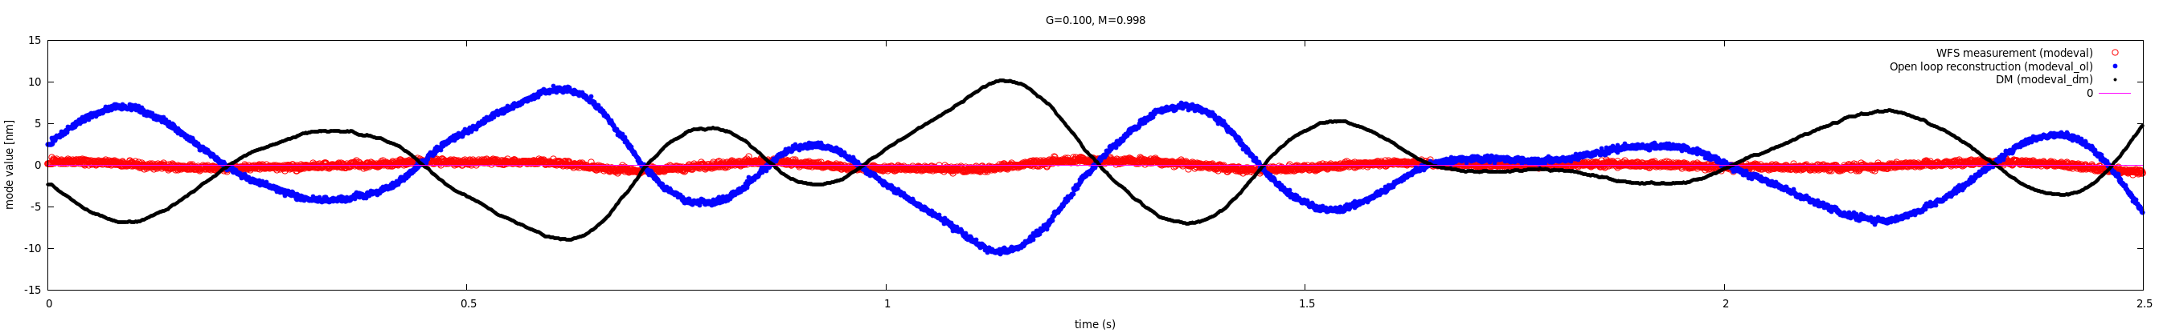
Open loop reconstruction
Turbulence injected:
8m/s wind speed, slightly filtered Kolmogorov spectrum (LOcoeff=0.1), 50nm RMS on DM (100nm WF), speed = 8 m/s
written to DM every 300us (3.333 kHz frequency)
Showing Open loop (blue) and WFS measured (red) modal coefficient #30
Data acquition start synchronized to turbulence sequence start
PyWFS running at 2kHz, 125mas modulation radius. Total delay = 2.6 frame

Slide 23
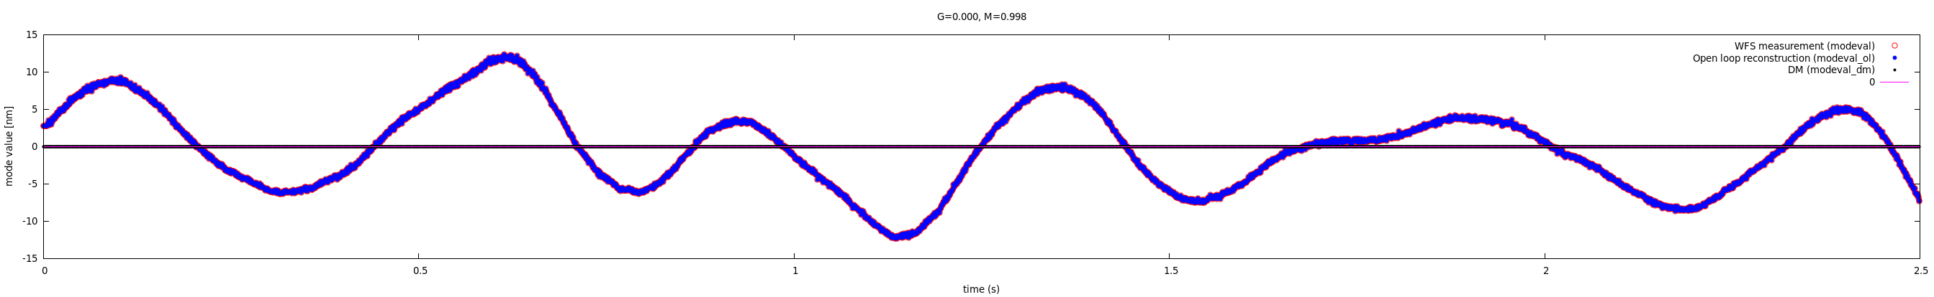
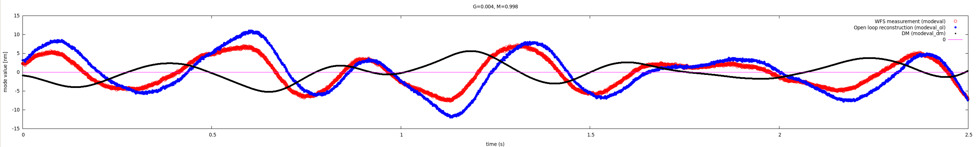
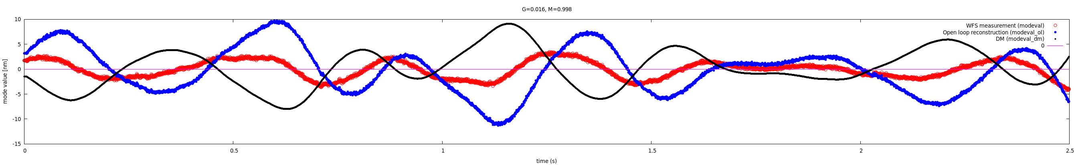
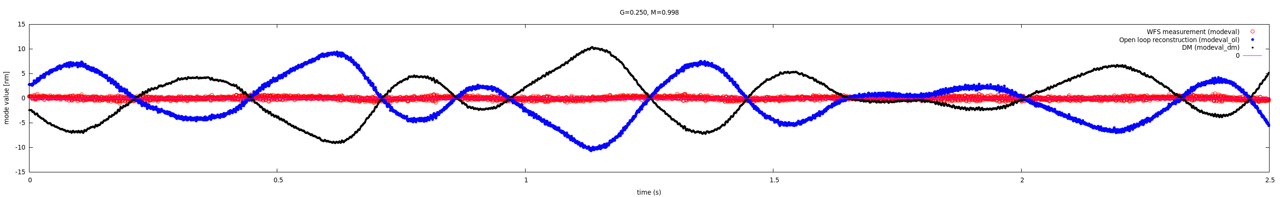
Open loop reconstruction: Changing gain (M=0.998)

Slide 24
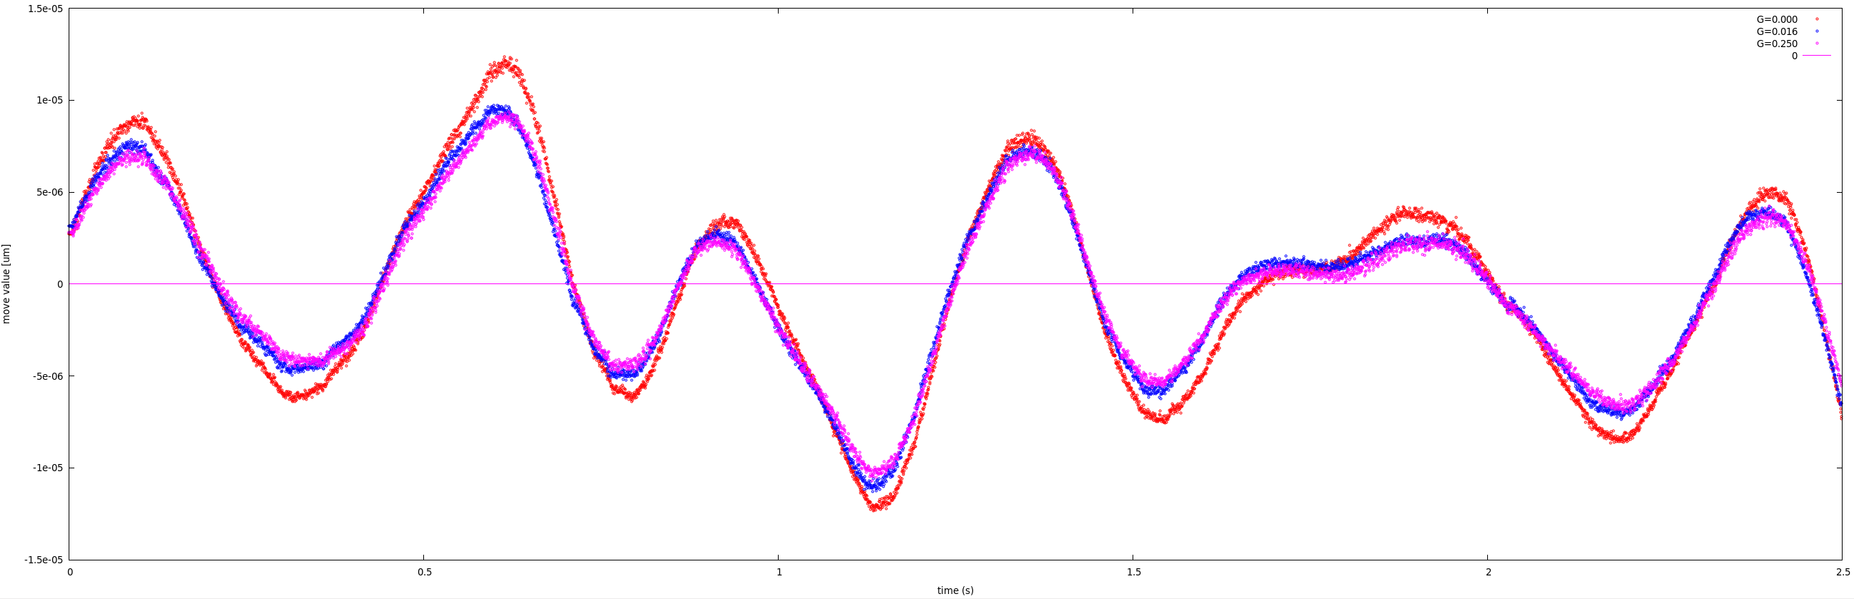
Open loop reconstruction
Comparison between gain values
G=0.000 → over-estimates OL values
All G>0.0 reconstructions match at %-level
G=0.000 test relies entirely on WF residuals for OL estimation
G>0.000 tests rely mostly on DM values for OL estimation
Test shown here uses full speed RM acquisition which underestimates RM by ~15% due to DM time-of-motion → reconstructed WFs from WFS are over-estimated by ~15%

Slide 25
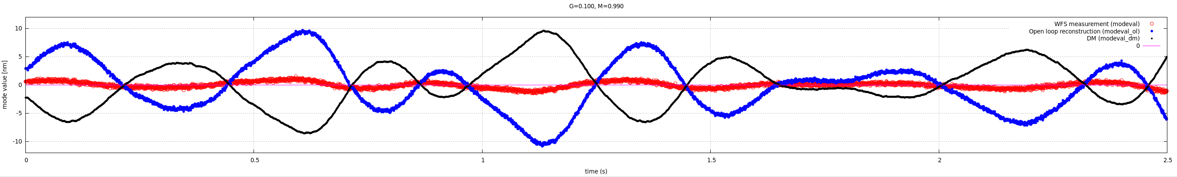
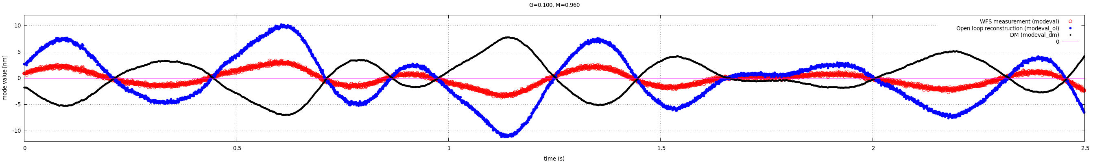
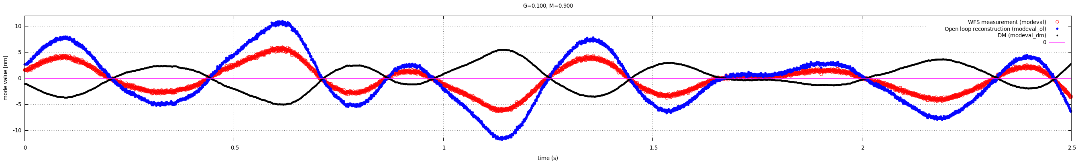
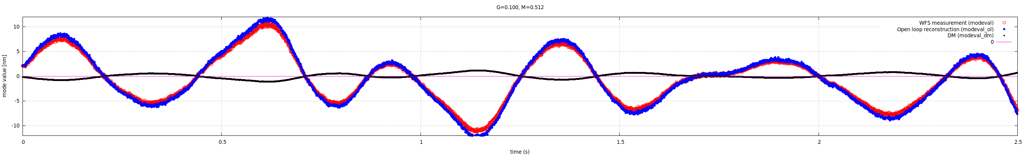
Open loop reconstruction: Changing mult factor (G=0.100)

Slide 26
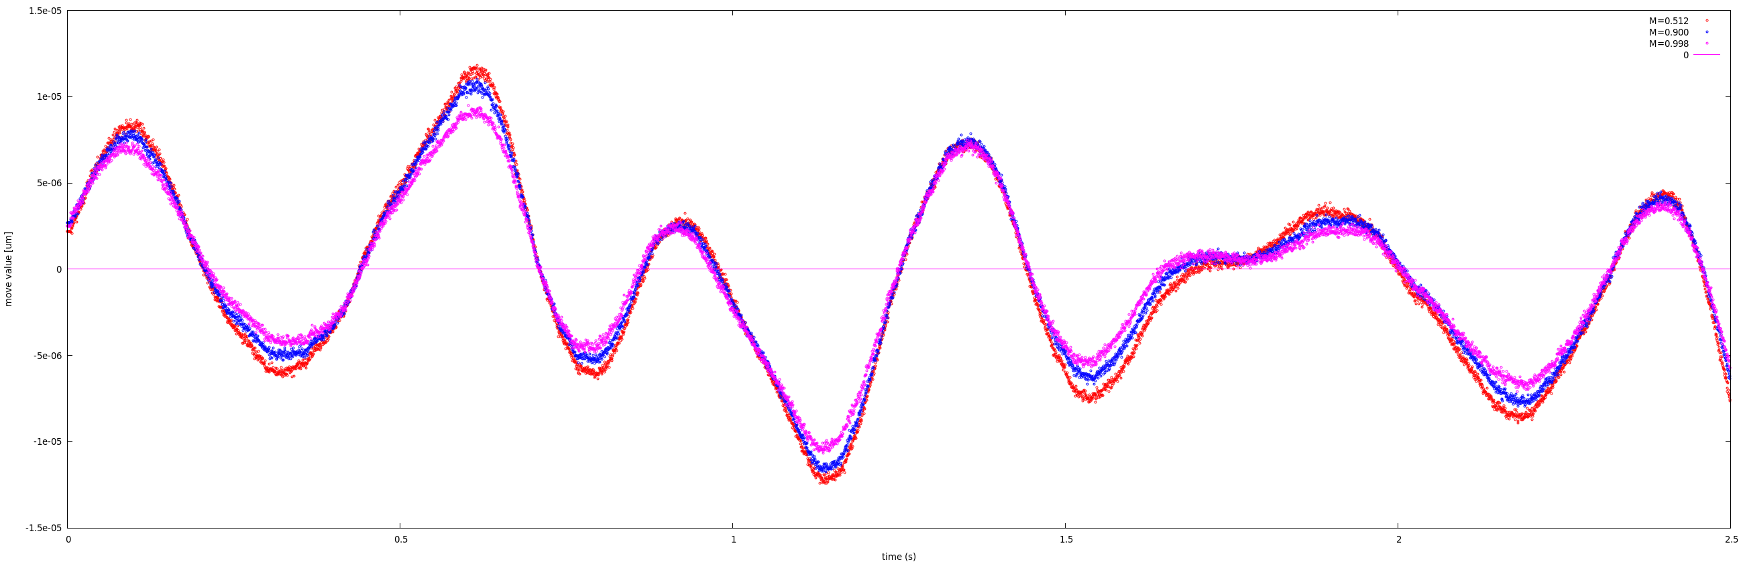
Open loop reconstruction
Comparison between Mult factor
Small M over-estimates OL values
→ same effect as G=0.0 over-estimation
M<<1 tests rely mostly on WF residuals for OL estimation
M~1 tests rely mostly on DM values for OL estimation
Test shown here uses full speed RM acquisition which underestimates RM by ~15% due to DM time-of-motion → reconstructed WFs from WFS are over-estimated by ~15%

Slide 27
Open loop reconstruction: noise propagation
NOISE = σ x sqrt( 1 + M² G² / (1-M²))
Open loop mode coefficients
aol#_modeval_ol
NOISE σ'
subtract
modal DM correction at time of available WFS measurement
modal DM correction, circular buffer
aol#_modeval_dm
aol#_modeval_dm_C
NOISE σ'
WFS-measured DM mode coefficients
Current modal DM correction, filtered
Current modal DM correction
aol#_modeval_dm_now_filt
NOISE σ
aol#_modeval
aol#_modeval_dm_now
WFS modes
pixels → modes
block gains
aol#_gainb
mult x ( modeval_dm_C – gain x modeval)
loop gain
σ' = M x G / sqrt(1-M²) x σ
WFS image
loop mult

Slide 28
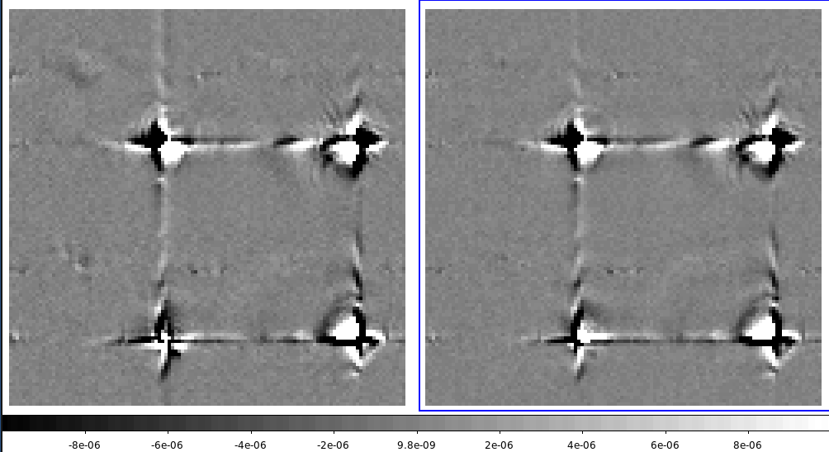
Removing temporal DM response from response matrix by using two poke sequences
Temporal bleeding from previous poke pattern (should be removed from RM)
Camera readout RF coupling between pixels
~1% electronic ghosts at 2kHz frame rate
Needs to be kept in RM
RM assembled from single poke sequence:
+- +- +- +-
RM assembled from average of two poke sequences:
+- +- +- +-
+- -+ +- -+
RMs reconstructed from Hadamard pokes, 2kHz modulation (DM moves during EMCCD frame transfer)

