Slide 1
t-SNE visualization of n-grams
11/21/2016

Slide 2
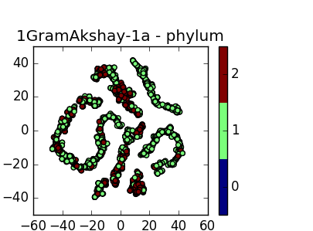
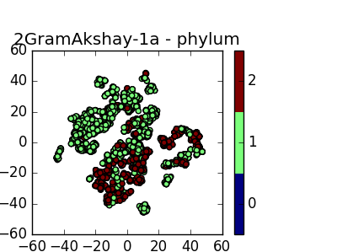
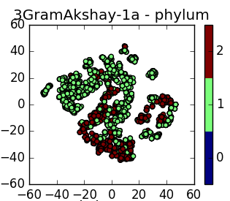
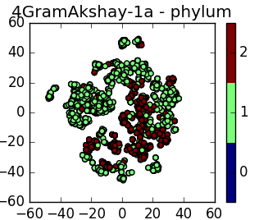
Notes:
1. Gram positive vs. gram-negative vs. no cell wall at phylum, class & genus levels [7? gram]
a. Ternicutes(phylum) vs. Proteobacteria (phylum) vs. Firmicutes (phylum)
b. Bacilli (class) vs. Gammaproteobacteria (class)
c. Staphylococcus (genus) vs. Escherichia (genus) vs. Mycoplasma (genus)
Note that Bacilli(class) = “Firmicutes - Bacilli”
and that Firmicutes (phylum) = “Firmicutes - Bacilli" + "Firmicutes - Clostridia" + "Firmicutes-Others".

Slide 3
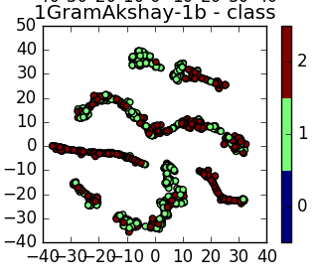
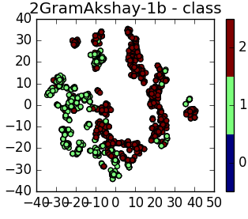
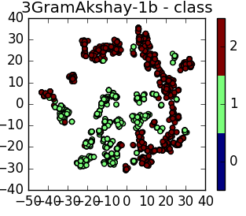
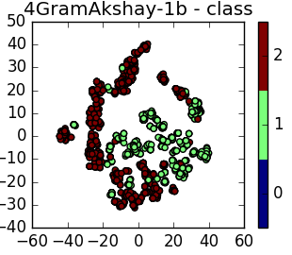
Notes:
1. Gram positive vs. gram-negative vs. no cell wall at phylum, class & genus levels [7? gram]
a. Ternicutes(phylum) vs. Proteobacteria (phylum) vs. Firmicutes (phylum)
b. Bacilli (class) vs. Gammaproteobacteria (class)
c. Staphylococcus (genus) vs. Escherichia (genus) vs. Mycoplasma (genus)
Note that Bacilli(class) = “Firmicutes - Bacilli”
and that Firmicutes (phylum) = “Firmicutes - Bacilli" + "Firmicutes - Clostridia" + "Firmicutes-Others".

Slide 4
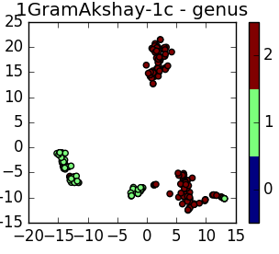
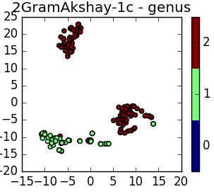
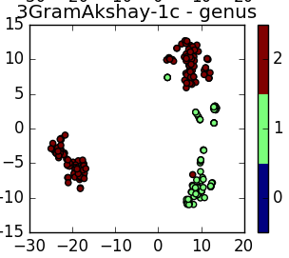
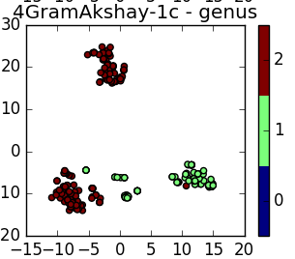
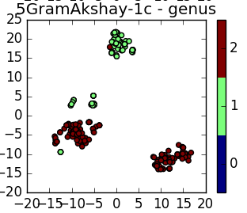
Notes:
1. Gram positive vs. gram-negative vs. no cell wall at phylum, class & genus levels [7? gram]
a. Ternicutes(phylum) vs. Proteobacteria (phylum) vs. Firmicutes (phylum)
b. Bacilli (class) vs. Gammaproteobacteria (class)
c. Staphylococcus (genus) vs. Escherichia (genus) vs. Mycoplasma (genus)
Note that Bacilli(class) = “Firmicutes - Bacilli”
and that Firmicutes (phylum) = “Firmicutes - Bacilli" + "Firmicutes - Clostridia" + "Firmicutes-Others".

Slide 5
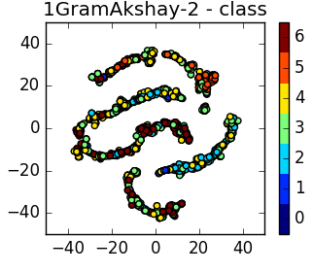
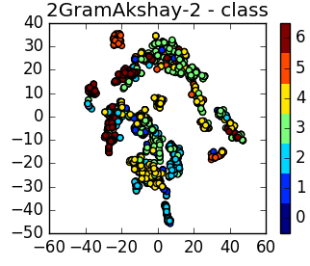
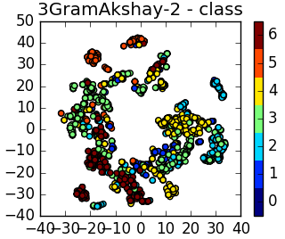
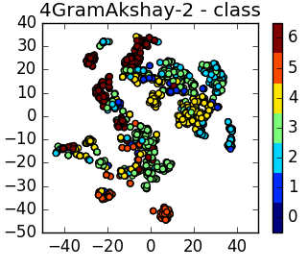
Notes:
2. Gram negative clustering at class level [7? gram]
a.Clustering of classes within the “Proteobacteria” phylum (all are gram-negative): alphaproteobacteria vs. Betaproteobacteria vs gammaproteobacteria vs deltaproteobacteria vs epsilonproteobacteria

Slide 6
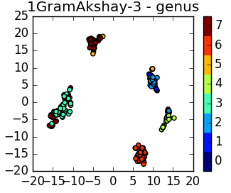
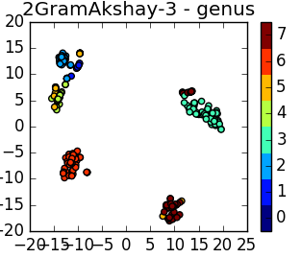
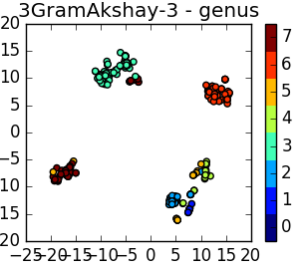
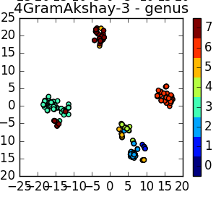
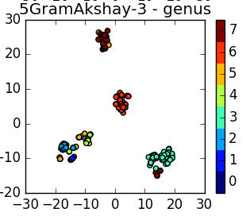
Notes:
3. Gram negative clustering at genus level [7? gram] -- [might expect shigella to have more overlap w/ Escherichia]
a. Clustering of genuses within the Gammaproteobacteria class: Escherichia, Salmonella, Shigella, Enterobacter, Cronobacter, Klebsiella, Serratia, Yersinia

