Slide 1

Analyze and Present A/B Test Results Project
www.oguzerdogan.com

Slide 2

01
02
Average Bidding
Maximum Bidding
04
Facebook binding type analysis for
bombabomba.com
03
Conclusions & Advices
Click Per Rate Ratio
Date | November 2020

Slide 3





Positive user feedbacks
on sikayetvar.com
The majority of users are
young people
some
informations about
bombabomba.com
Low level Alexa scoring
Good & Smooth interface
This reporting is just an impression of any of your customers by doing a short research about you. For more detailed analysis we can help your agency

Slide 4

We have prepared scientific and statistical tests for your company about your new system .

Slide 5
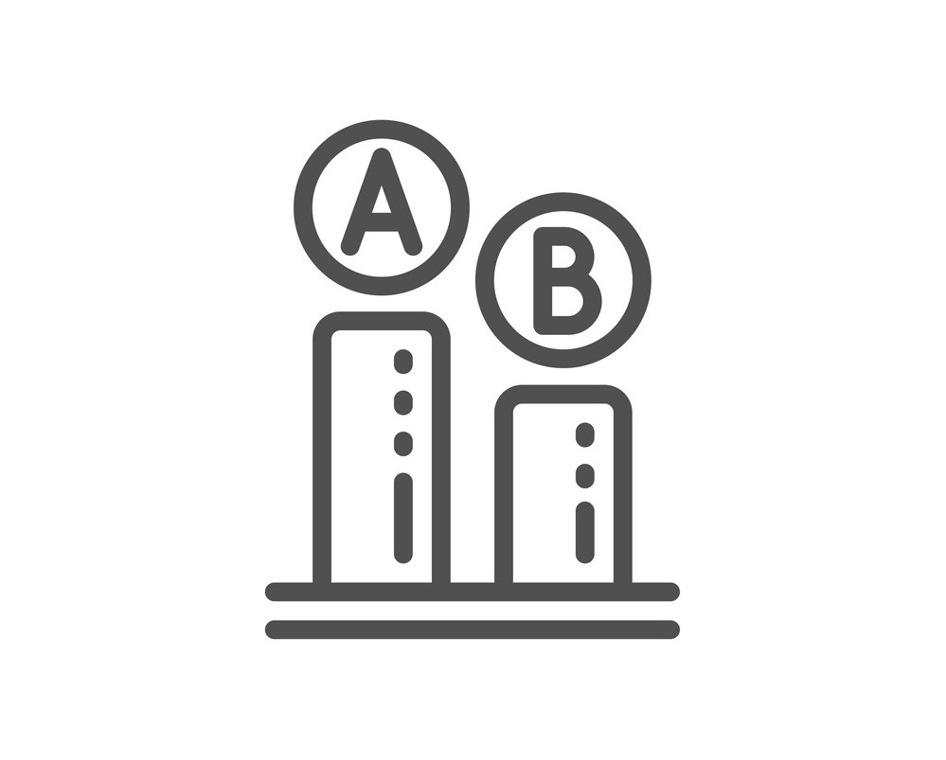


AB Test
Is the new system
«average bidding « good enough?
Tests for your company's action decisions
CTR Test
Did the user who saw the ad click on the ad in the new system?
CR Test
Did visitors buy the product in the new system?

Slide 6
550
Maximum Bidding
mean
AB Test Results
When we looking at the averages of these two groups, the test group "average bidding", looks better.
However, this is only a mathematical inference and no business decision shouldn't be made based on this result.
Whether the result is random or not should be statistically investigated.
The main question is;
Is there a statistically significant difference between these two average of groups?
A
582
Average Bidding
mean
B

Slide 7
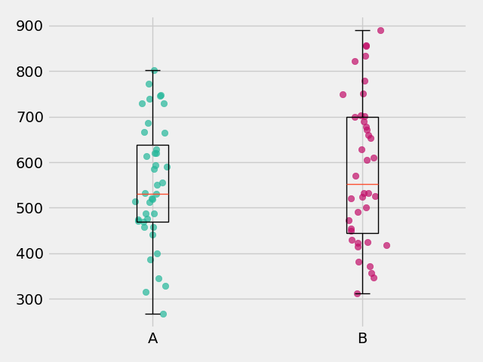
It was proved statistically and scientifically that there was no significant difference between the averages of the two groups with 95% confidence.
MAX
AB Test Results
A
In line with these results, there is not statistically significant difference between purchase of the control group (Max Bidding) and purchase of the test group (Average Bidding)
AVG
B
As a result of the statistical tests applied to the data obtained by the two groups in the research, the groups provided all the necessary statistical assumptions in the literature.

Slide 8
Did the user who saw the ad click on the ad?
Website Click Through Rate
Test (CTR)
0,0501
Maximum Bidding
Ad Clicks / Ad Shows
A
Rates of these two groups, the control group «maximum bidding", looks better.
However, this is only a mathematical inference and no business decision shouldn't be made based on this result.
Whether the result is random or not should be statistically investigated.
The main question is;
Is the experiment has statistically significantly effect on user behavior ?
0.0329
Average Bidding
Ad Clicks / Ad Shows
B

Slide 9
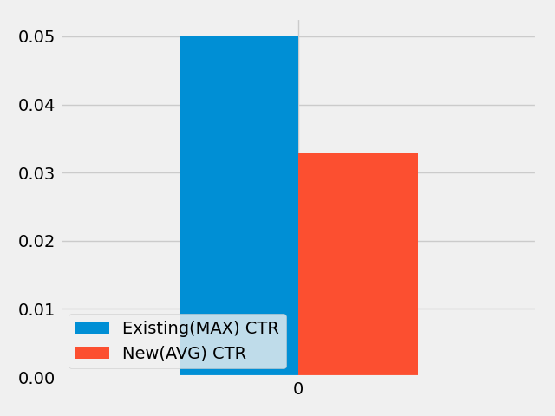
Did the user who saw the ad click on the ad?
Website Click Through Rate Analysis (CTR)
When the bidding methods are examined, the effect of these methods on user behavior (clicks) is different.
And this difference is in favor of the current
"max bidding" method.

Slide 10
Did visitors buy the product in the new system?
0,0054
Maximum Bidding
Ad Clicks / Ad Shows
Conversion Rate
A
Rates of these two groups, the control group «maximum bidding", looks better.
However, this is only a mathematical inference and no business decision shouldn't be made based on this result.
Whether the result is random or not should be statistically investigated.
The main question is;
Is the experiment has statistically significantly effect on user behavior ?
0.0048
Average Bidding
Ad Clicks / Ad Shows
B

Slide 11
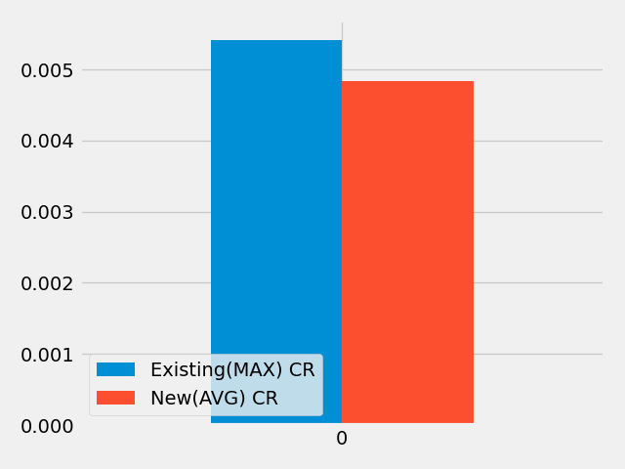
Did visitors buy the product in the new system?
Conversion Rate
When the bidding methods are examined, the effect of these methods on user behavior (clicks) is different.
And this difference is in favor of the current
"max bidding" method.

Slide 12

RESULTS

Slide 13

Analysis Steps
Control and test group data were analyzed.
No NA value was observed in both groups.
When looked with the boxplot method, it was observed that there was no outlier in both groups.
Testing was done between these two groups. Control group using the max bidding method as called A Test group using the new method, average bidding as called B
Two independent samples t test was deemed appropriate for this comparison.
For two independent samples t test; variance homogeneity and normality assumption were provided.

Slide 14

Is the new system advantageous ?
As a result of the statistical tests applied to the data obtained by the two groups in the research, the groups provided all the necessary statistical assumptions in the literature.
In this direction, it was proved statistically and scientifically that there was no significant difference between the averages of the two groups with 95% confidence.
In line with these results, there is not statistically significant difference between purchase of the control group (Max Bidding) and purchase of the test group (Average Bidding).

Slide 15
Clicked on the ad?
There is a difference in Clicking between the two methods, but this is in favor of "Maximum Bidding",, which is the system your agency currently use.

Slide 16
Visitors buy the product in the new system?
There is a difference in Purchasing between the two methods, but this is in favor of "Maximum Bidding", which is the system your agency currently use.

Slide 17

Action Suggestions by Our Company.

Slide 18


We recommend that you continue with the existing system.
As a result of the statistical tests carried out, the new system "Average Bidding" has not been observed to benefit your company.

Slide 19

A new test can be done by increasing the number of samples.

Slide 20

also,
For different cases, your agency may be interested in

Slide 21

Nowadays, regaining our current passive users is as important as gaining new users.
RFM Segmentation Service
With our RFM Segmentation Service, you can go to your efforts to gain existing users with the budget you will allocate to the new system.

Slide 22

User Sentiment Analysis
Also we think that you can increase your earnings by our using User Sentiment Analysis system as well as RFM segmentation.

Slide 23
Thanks
Positive user feedbacks
on sikayetvar.com
The majority of users are
young people
For choosing us
Low level Alexa scoring
Good & Smooth interface

