Slide 1
Data exploratıon results
11/10/2020
Team 6:
Oguzhan Akan
Darius Hooks
Jaymish Raju Patel
Jason Sabal
Bibinur Zhursinbek
California State University, Northridge
COMP 541 – Data Mining – F2020
Assignment 3

Slide 2
Contents
1. Preparing the Data
1.1. Importing Libraries
1.2. Combining the Source Tables
1.3. Transforming Features to their Correct Types
2. Data Exploration
2.1. Exploring Continuous Features
2.1.1. Feature Overview
2.1.2. Correlation Matrix
2.2. Exploring Categorical Features
2.2.1. Class Distributions & Imbalance
2.2.2. Categorical Feature Dependency Using Chi-Square Test
2.2.2.1. Chi-square Test for Each Feature
2.2.2.2. Chi-square Test - Summary
3. Frequent Pattern Analysis
3.1. Genres (Genre List)
3.2. Spoken Languages
3.3. Keywords
3.4. Overview
4. Results
4.1. Data Exploration Results - Continuous Features
4.2. Data Exploration Results - Categorical Features
4.3. Frequent Pattern Analysis Results

Slide 3
1. Preparing the Data 1.1. & 1.2. Combining the Source Tables
> Reading raw data:
metadata; records: 45466, fields: 11
keywords; records: 46419, fields: 2
movies; records: 4638, fields: 18
> Removing duplicate rows from each table:
> After the removal, we end up with the following number of rows for each table: metadata; records: 39943, fields: 11
keywords; records: 44447, fields: 2
movies; records: 4570, fields: 18
> Combining movies+metadata+keywords tables using movie titles
df = movies + metadata + keywords --> records: 3524, fields: 30
The last table, "df" is the combined data from three sources and thus will be used in throughout the project. We will still manipulate the data in terms of preprocessing and feature engineering, but we do not expect any further reduction in number of rows. Still, it can happen due to corrupt data issues
metadata
keywords
“df”
movies

Slide 4
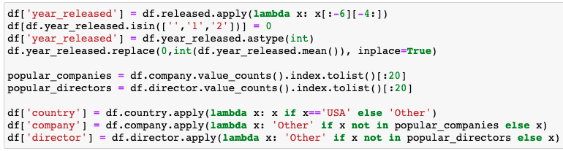
1. Preparing the Data 1.3. Transforming Features to their Correct Types
By observing the data, we see that following columns need not any initial transformation:
genre, company, budget, country, director, overview, tagline
And the following features had to change due to:
released: this is a date column with dd.mm.yyyy format. For the sake of simplicity, we are only interested in the year the movies are released. Therefore we apply a transformation to extract year information from this column and write it to year_released column.
We also limited company and director columns to have at most 20 unique values, and country to have 2 unique values, to simplify data analysis processes.

Slide 5
2. Data Exploration 2.1. Exploring Continuous Features
Our data has the following columns that we can use to conduct the statistical description:
Budget
Gross
Profitability ratio
In the following slides, we generate an initial outlook to these continuous features.

Slide 6
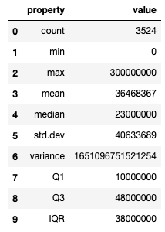
2. Data Exploration 2.1. Exploring Continuous Features - Budget
The table on the left represents the data summary based on statistical description of the feature budget.
There are measures of central tendency (mean, median), dispersion (quartiles, variance, standard deviation, interquartile range), and some other statistical descriptions, like minimum, maximum and count.
The count() function returns the number of cells for each row or column. The budget column has 3524 non-empty cells.
The minimum value of the budget is 0, while the maximum - 300,000,000.

Slide 7
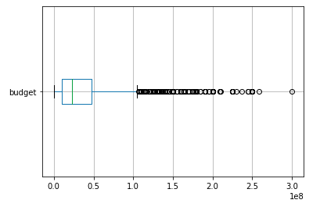
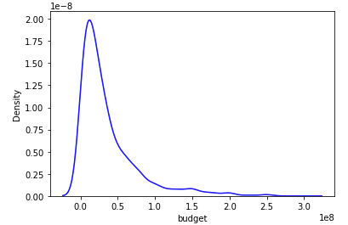
2. Data Exploration 2.1. Exploring Continuous Features - Budget
The figure on the left shows the boxplot of the feature budget. The graph represents five number summary: “minimum, first quartile, median, third quartile, and ''maximum”. The ends of the box are the quartiles, Q1 and Q3, while the box length is interquartile range (IQR). While from the graph, we can get an approximate value of Q1 and Q3, it can be seen that the exact value of Q1 is 10,000,000 and Q3 is 48,000,000 from the table in previous slide. The median is marked as the line within the box, which is equal to 23,000,000. Two lines (called whiskers) outside the box extend to the smallest (Minimum) and largest (Maximum) observations. The circles are the outliers.
The figure on the right demonstrates that the budget’s distribution is asymmetrical, because the tail is skewed to the right. As the tail is longer towards the right-hand side, the value of skewness is positive. The value of the skewness is 2.253961, which means that the distribution is highly skewed.

Slide 8
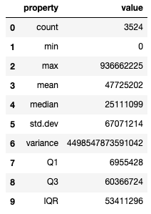
2. Data Exploration 2.1. Exploring Continuous Features - Gross
The table on the left represents the data summary based on statistical description of the feature gross.
There are measures of central tendency (mean, median), dispersion (quartiles, variance, standard deviation, interquartile range), and some other statistical descriptions, like minimum, maximum and count.
The gross column has 3524 non-empty cells. The minimum value of the budget is 0, while the maximum - 93,662,225.

Slide 9
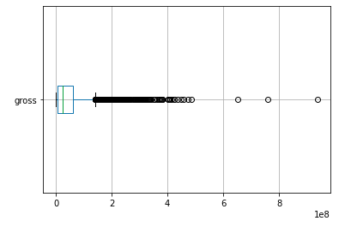
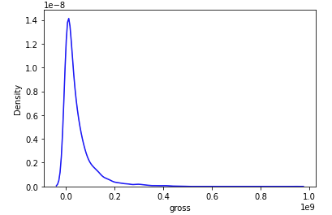
2. Data Exploration 2.1. Exploring Continuous Features - Gross
The figure on the left shows the boxplot of the feature gross. The graph represents five number summary: “minimum, first quartile, median, third quartile, and ''maximum”. The ends of the box are the quartiles, Q1 and Q3, while the box length is interquartile range (IQR). While from the graph, we can get an approximate value of Q1 and Q3, it can be seen that the exact value of Q1 is 6,955,428 and Q3 is 60,366,724 from Figure 4. The median is marked as the line within the box, which is equal to 25,111,099. Two lines (called whiskers) outside the box extend to the smallest (Minimum) and largest (Maximum) observations. The circles are the outliers.
The figure on the right demonstrates that the grosst’s distribution is asymmetrical, because the tail is skewed to the right. As the tail is longer towards the right-hand side, the value of skewness is positive. The value of the skewness is 3.49795, which means that the distribution is highly skewed.

Slide 10
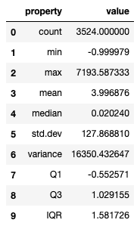
2. Data Exploration 2.1. Exploring Continuous Features - Profitability
The table on the left represents the data summary based on statistical description of the feature profitability ratio.
There are measures of central tendency (mean, median), dispersion (quartiles, variance, standard deviation, interquartile range), and some other statistical descriptions, like minimum, maximum and count.
The profitability ratio column has 3524 non-empty cells.
The minimum value of the budget is -0.999979, while the maximum - 7,193.587333.

Slide 11
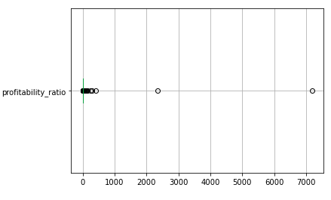
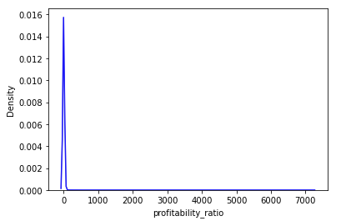
2. Data Exploration 2.1. Exploring Continuous Features - Profitability
The figure on the left shows the boxplot of the feature profitability ratio. The graph represents five number summary: “minimum, first quartile, median, third quartile, and ''maximum”. The ends of the box are the quartiles, Q1 and Q3, while the box length is interquartile range (IQR). While from the graph, we can get an approximate value of Q1 and Q3, it can be seen that the exact value of Q1 is -0.552571 and Q3 is 1.029155 from Figure 7. The median is marked as the line within the box, which is equal to 0.02024. Two lines (called whiskers) outside the box extend to the smallest (Minimum) and largest (Maximum) observations. The circles are the outliers.
The figure on the right demonstrates that the profitability ratio’s distribution is asymmetrical, because the tail is skewed to the right. As the tail is longer towards the right-hand side, the value of skewness is positive. The value of the skewness is 52.233907, which means that the distribution is highly skewed.

Slide 12
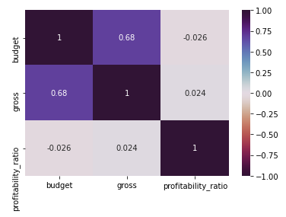
2. Data Exploration 2.1. Exploring Continuous Features - Correlations
The figure on the right shows the correlation matrix of our continuous features.
As can be noticed, gross and budget are positively correlated with 68%.
Profitability ratio’s correlation with budget and gross are very small so that they are negligible.

Slide 13
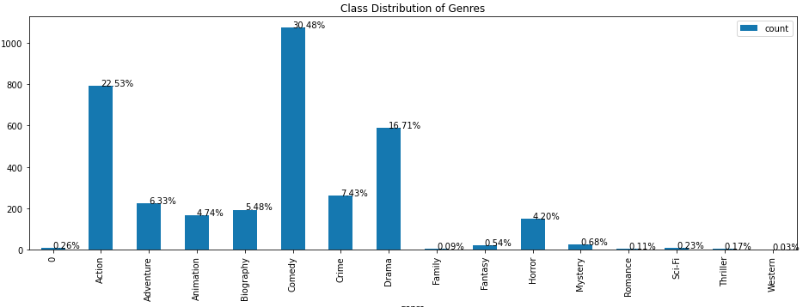
2. Data Exploration 2.1. Exploring Categorical Features - Genre
The bar chart below shows the distribution of genre among our dataset, and subsequently we share the imbalances of each genre.
Action is Slightly Imbalanced
Adventure is Severely Imbalanced
Animation is Severely Imbalanced
Biography is Severely Imbalanced
Comedy is balanced
Crime is Severely Imbalanced
Drama is Slightly Imbalanced
Family is Severely Imbalanced
Fantasy is Severely Imbalanced
Horror is Severely Imbalanced
Mystery is Severely Imbalanced
Romance is Severely Imbalanced
Sci-Fi is Severely Imbalanced
Thriller is Severely Imbalanced
Western is Severely Imbalanced

Slide 14
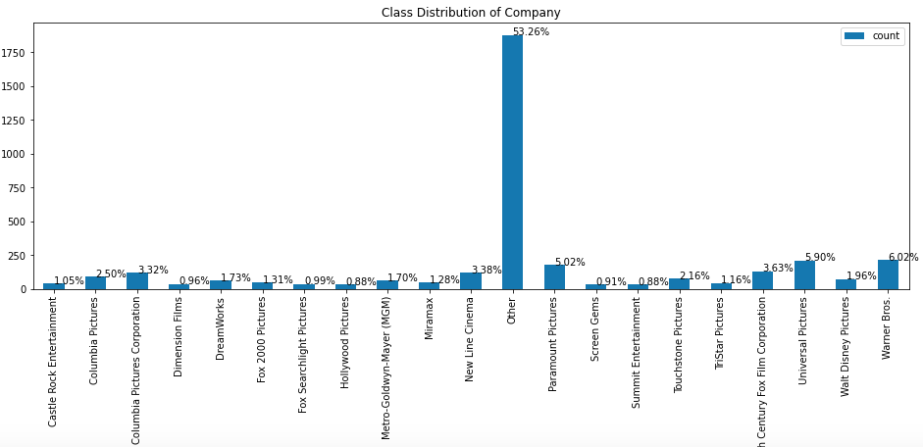
2. Data Exploration 2.1. Exploring Categorical Features - Company
The bar chart below shows the distribution of company among our dataset, and subsequently we share the imbalances of each company.
Castle Rock Entertainment is Severely Imbalance
Columbia Pictures is Severely Imbalance
Columbia Pictures Corporation is Severely Imbalance
Dimension Films is Severely Imbalance
DreamWorks is Severely Imbalance
Fox 2000 Pictures is Severely Imbalance
Fox Searchlight Pictures is Severely Imbalance
Hollywood Pictures is Severely Imbalance
Metro-Goldwyn-Mayer (MGM) is Severely Imbalance
Miramax is Severely Imbalance
New Line Cinema is Severely Imbalance
Other is balanced
…

Slide 15
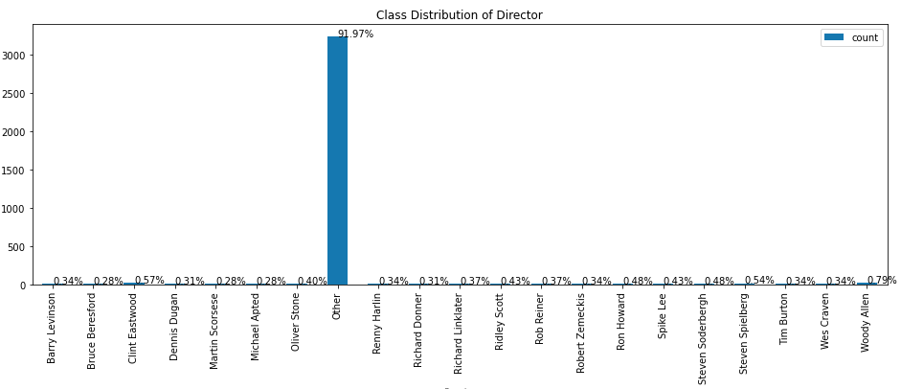
2. Data Exploration 2.1. Exploring Categorical Features - Director
The bar chart below shows the distribution of director among our dataset, and subsequently we share the imbalances of each director.
Barry Levinson is Severely Imbalance
Bruce Beresford is Severely Imbalance
Clint Eastwood is Severely Imbalance
Dennis Dugan is Severely Imbalance
Martin Scorsese is Severely Imbalance
Michael Apted is Severely Imbalance
Oliver Stone is Severely Imbalance
Other is balanced
Renny Harlin is Severely Imbalance
Richard Donner is Severely Imbalance
…

Slide 16
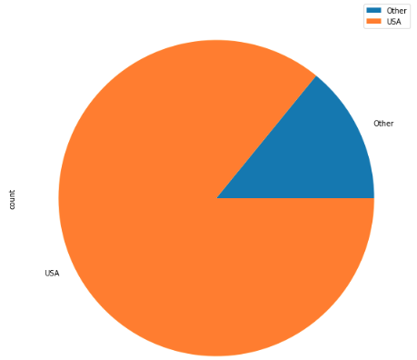
2. Data Exploration 2.1. Exploring Categorical Features - Country
The bar chart below shows the distribution of country among our dataset, and subsequently we share the imbalances.
Other is Slightly Imbalance
USA is balanced

Slide 17
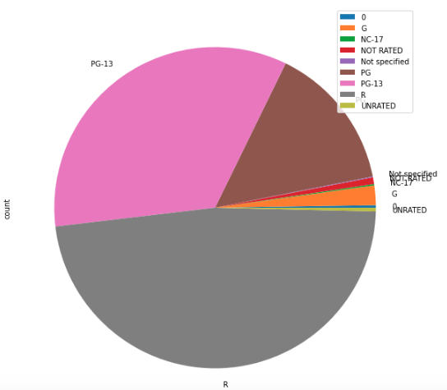
2. Data Exploration 2.1. Exploring Categorical Features - Rating
The bar chart below shows the distribution of rating among our dataset, and subsequently we share the imbalances.
G is Severely Imbalance
NC-17 is Severely Imbalance
NOT RATED is Severely Imbalance
PG is Slightly Imbalance
PG-13 is balanced
R is balanced
UNRATED is Severely Imbalance

Slide 18
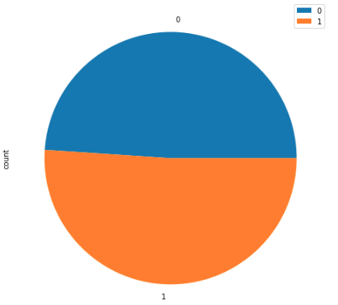
2. Data Exploration 2.1. Exploring Categorical Features – Isprofit
The bar chart below shows the distribution of isprofit among our dataset, and subsequently we share the imbalances.
0.0 (False) is balanced
1.0 (True) is balanced

Slide 19
2. Data Exploration 2.2. Categorical Feature Dependency Using Chi-Square Test
Our data has the following columns that we can use to conduct the chi-square test on:
Genre
Company
Country
Director
Rating
Released
Isprofit
> We want to find out whether two categorical attributes are independent or dependent by using the chi-square test. We do this by getting all combinations of length two from the list above and conducting the chi-square test on each of the categorical pairs. > After writing some general formulas, we will conduct the test on all 21 combinations.

Slide 20
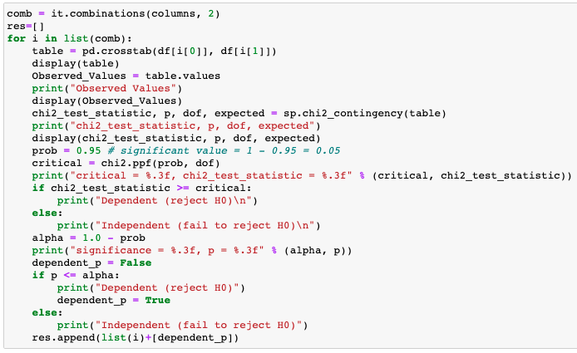
2. Data Exploration 2.2. Categorical Feature Dependency Using Chi-Square Test
Using the code on the right, we conduct chi-square test for each pair. Please refer to the summary at the end of this section, or the HTML report for detailed results of the chi-square tests. The summary table contains the information of dependency while the HTML report also contains the test statistics and p-values.

Slide 21
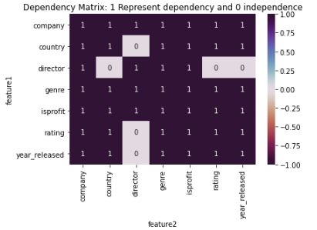
2. Data Exploration 2.2. Categorical Feature Dependency Using Chi-Square Test
In results of chi-square test (see figure on the right), we observe there are quite enough couple of features that are dependent and independent.
For example, *company* and *country* are correlated as we initially expected, because most of the movies in our data is made in the US.

Slide 22
3. Frequent Pattern Analysis 2.2. Categorical Feature Dependency Using Chi-Square Test
Our data has the following columns that we can perform frequent pattern analysis on:
Genres_edited
Spoken_languages_edited
Keywords_edited
Overview
> We want to find out whether there are recurring relationships in the data. For example, which genres are frequently used together to produce movies? Or which keyword combinations are frequent? After performing the analyses, we can decide, for example, which genres to produce in order to make the most profit. > After writing some general functions, we will perform the analyses one by one.

Slide 23
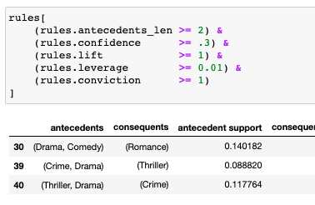
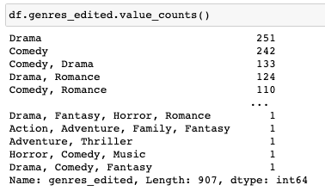
3. Frequent Pattern Analysis 3.1. Genres
First, we show how does our *genres* feature look like in the figure below.
After applying apriori algorithm and calculating the association metrics, we generate the following rules:

Slide 24
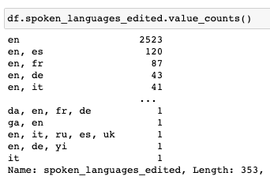
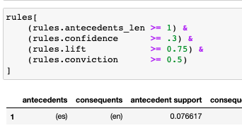
3. Frequent Pattern Analysis 3.2. Spoken Languages
First, we show how does our *spoken languages* feature look like in the figure below.
After applying apriori algorithm and calculating the association metrics, we generate the following rule. Although the rule is not very strong, it represent a somewhat frequent pattern:

Slide 25
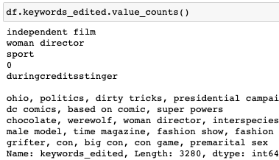
3. Frequent Pattern Analysis 3.3. Keywords
First, we show how does our *keywords* feature look like in the figure below.
For the keywords, we cannot create a strong rule, due to:
the data is not clean enough
and/or
the keywords specified by different individuals so we cannot find a good association rule.

Slide 26
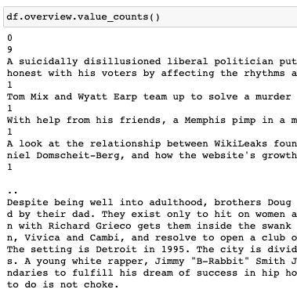
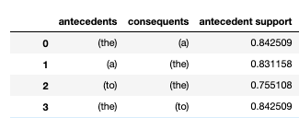
3. Frequent Pattern Analysis 3.4. Overview
First, we show how does our *overview* feature look like in the figure below.
After applying apriori algorithm and calculating the association metrics, we generate the following rule. the *overview* feature consists of plain English sentences, therefore, although we find so many (~70 thousand) strong association rules, they are meaningless. All the strong rules in *overview* are the prefixes and conjunctions, like "a", "an", "the", "and", etc.

Slide 27
4. Results 4.1. Data Exploration Results - Continuous Features
As we analyze three continuous features in Section 2.1., namely budget, gross (revenue), and profitability_ratio, the data seems clean enough to build our model on. Even though all the three features are positively skewed, we do not observe so many outliers that will disturb training the model.
Our initial hypothesis was that our three continuous features were meant to be correlated, because intiutively, the budget and gross and profitability of a movie sound correlated. That is, however, not the case, at least for profitability ratio and the others.
Nonetheless, we can conclude that budget and gross are correlated. Although this information does not help us predicting the profitability ratio, we understand how independent the profitability ratio is and take it into account when we build our Machine Learning models.

Slide 28
4. Results 4.2. Data Exploration Results - Categorical Features
After analyzing our categorical features in Section 2.2., we see somewhat imbalance in our 6 features. Although we have to take the imbalance problem while modeling, the one feature, *isprofit*, turns out to be very balanced. Since the *isprofit* feature is our target feature, we will choose a metric that objectively evaluates model performance in our classification problem.
After calculating the imbalances, we performed chi-square tests for each pair possible out of our 7 categorical features. In results of chi-square test (shared in Section 2.2.2.2.), we observe there are quite enough couple of features that are dependent and independent. For example, *company* and *country* are correlated as we initially expected, because most of the movies in our data is made in the US.

Slide 29
4. Results 4.3. Frequent Pattern Analysis Results
Our data included a set of features that we could perform frequent pattern analysis on, which we used for building association rules in Section 3.
Since our dataset is not a kind of transactional data, these rules are not meant to be used for modeling. However, we still wanted to conduct this analysis in order to turn the learnings from our lectures into practice.
For feature *genres* (Section 3.1.), we built the following association rules, after setting thresholds for confidence, leverage, conviction, and lift:
(Family) => (Comedy)
(Romance) => (Drama)
(Mystery) => (Thriller)
(Crime, Drama) => (Thriller)
When we think about those rules, they actually makes sense! For example, most of the family movies have comedy inside as well.

