Slide 1
FEATURE SELECTION
12/8/2020
Team 6:
Oguzhan Akan
Darius Hooks
Jaymish Raju Patel
Jason Sabal
Bibinur Zhursinbek
California State University, Northridge
COMP 541 – Data Mining – F2020
Assignment 5

Slide 2
Contents
1. Feature selection and improve accuracy of data mining results
1.1. Importing Libraries
1.2. Converting categorical data to numerical
1.3. Correlation Matrix
1.4. Heat-Map of correlation Matrix
1.5. Relevant attributes to improve the accuracy of data mining results

Slide 3
1. Feature selection and improve accuracy of data mining results 1.1. and 1.2. Converting categorical data to numerical
> Reading raw data:
Dividing the features into categorical_features, continuous_features, normalized_features, and target_features groups.
Converting, required categorical_features to numerical data as follow
By running this code the first company name is replaced by 0 and all its occurrence is also converted to 0.
Similarly, the second company name is replaced by 1 and all its occurrence is also replaced and so on.

Slide 4
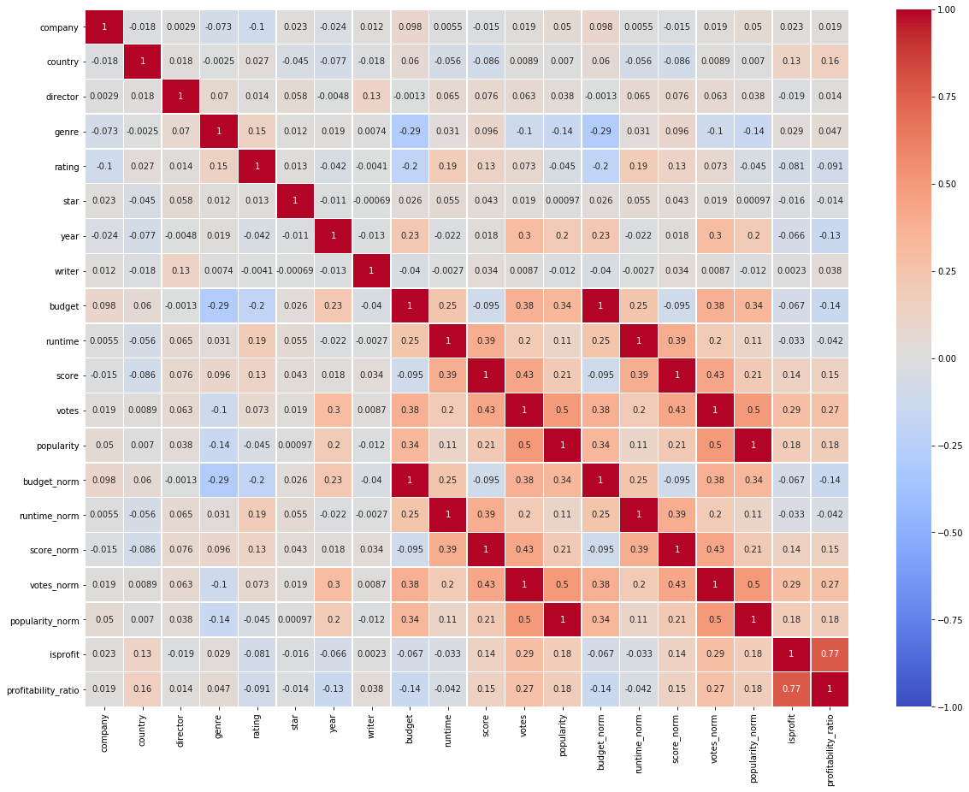
1. Feature selection and improve accuracy of data mining results 1.3. and 1.4 Correlation Matrix and Heat-map
By using corr() function the correlation matrix of all the features can be calculated.
A 20 x 20 matrix is obtained showing the correlations between the features.
A heatmap is also created of the matrix obtained.
From the heatmap we can visualize that how much a feature is correlated to other feature.

Slide 5
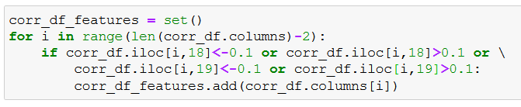
1. Feature selection and improve accuracy of data mining results 1.5. Relevant attributes to improve the accuracy of data mining results
From the correlation matrix obtained it is necessary to determine the features that will affect the accuracy of the data mining results.
Here our aim is to find the maximum profitability ratio.
So here it is necessary to obtain features that are highly correlated to the profitability ratio.
The features that have correlation higher than 0.1 or less than -0.1 with profit and profitability ratio are selected.

