Slide 1
MODELING
12/08/2020
Team 6:
Oguzhan Akan
Darius Hooks
Jaymish Raju Patel
Jason Sabal
Bibinur Zhursinbek
California State University, Northridge
COMP 541 – Data Mining – F2020
Assignment 6

Slide 2
Contents
1. Selected Modeling Algorithms & Performance Metrics
2. Modeling Strategy
2.1. Training and Test Data Splits
2.2. K-Fold Cross Validation
3. Model Parameters & Results
3.1. Classification Models
3.2. Regression Models
4. Model Comparisons
5. Conclusion

Slide 3
1. Selected Modeling Algorithms & Performance Metrics
Tools/Language
Python
Algorithms
K-Nearest Neighbors: Fast to implement and interpret
Random Forest: Ensemble decision trees that decides according to a voting algorithm
Gradient Boosting: Ensemble decision trees that reduces its error in every other iteration
Performance Metrics
Classification: Accuracy, Sensitivity, Precision - F1 Score
Regression - MedianAE, MeanAE, RMSE

Slide 4
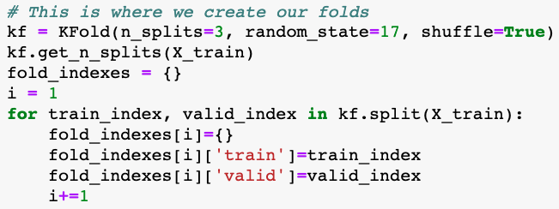
2. Modeling Strategy
Train-Test Data Split:
We decided to split our training and test data by 80%-20% as we wanted to have enough data for objective evaluation on both train and test sets.
The X_train and X_test is the same for both classification and regression models. We achieved this by setting a random state for each split.
Splitting made by using Sklearn’s train_test_split function.
K-Fold Cross Validation
We applied 3-fold stratified split to our training dataset in order to overcome possible overfitting issue:

Slide 5
3. Model parameters & results Classification Models

Slide 6
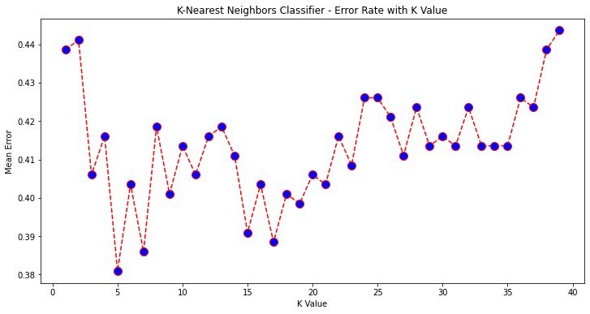
Modeling - Classification Model - KNN
Parameter setting:
n_neighbors (k) = 2, …, 20
weights = ‘uniform’
Best value of k → 5
Note that both very-low and very-high number of neighbors result in high error rate. Very-low neighbors cause underfitting and very-high neighbors cause overfitting.

Slide 7
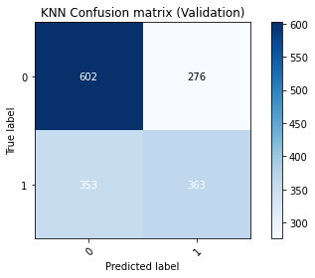
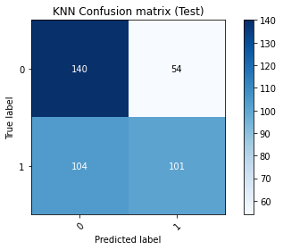
Modeling - Classification Model - KNN
Once we decided that n_neighbors = 5, we ran the 3-fold CV and built confusion matrices for validation and test data separately.
As can be seen from the figures on the right, KNN model reached ~0.6 accuracy and ~0.5 F-1 score in validation and test data.
Accuracy: 0.605
Sensitivity : 0.507
Precision : 0.568
F-1 Score : 0.536
Accuracy: 0.604
Sensitivity : 0.493
Precision : 0.652
F-1 Score : 0.561

Slide 8
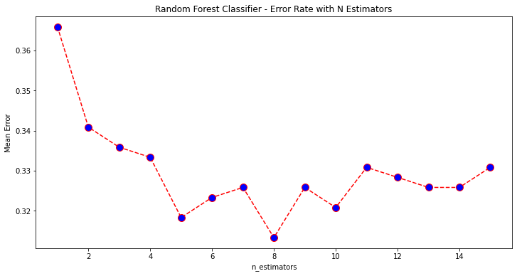
Modeling - Classification Model - Random Forest
Parameter setting:
n_estimators = 1, …, 15
min_samples_split = 60
min_samples_leaf = 20
max_depth = 7
max_leaf_nodes = 14
Best value of n_estimators → 8
Again, using a lot of trees may increase the error rate by causing overfitting.

Slide 9
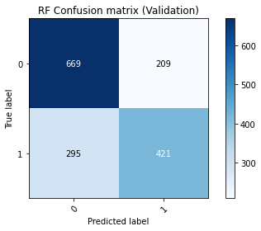
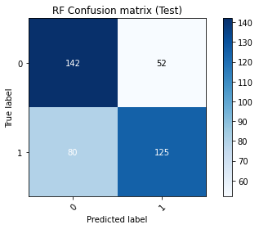
Modeling - Classification Model - Random Forest
Once we decided that n_estimators = 8, we ran the 3-fold CV and built confusion matrices for validation and test data separately.
As can be seen from the figures on the right, Random Forest model reached ~0.68 accuracy and ~0.65 F-1 score in validation and test data.
Accuracy: 0.684
Sensitivity : 0.588
Precision : 0.668
F-1 Score : 0.626
Accuracy: 0.669
Sensitivity : 0.610
Precision : 0.706
F-1 Score : 0.654

Slide 10
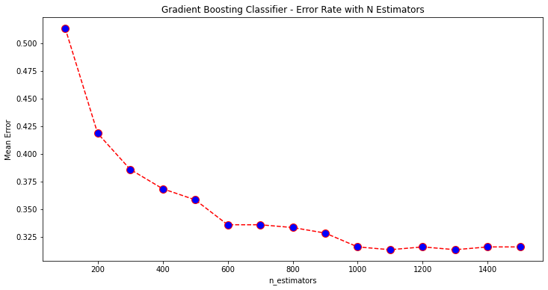
Modeling - Classification Model - Gradient Boosting
Parameter setting:
n_estimators=100, 200, …, 1500
learning_rate=0.001
criterion='friedman_mse'
min_samples_split=60
min_samples_leaf=20
max_depth=7
max_leaf_nodes=14
Best value of n_estimators → 1000
Note that when n_estimators >= 1000, the improvement is negligible.
The overfitting problem observed in KNN and Random Forest is non-existent for Gradient Boosting algorithm, because Gradient Boosting works in a way that improves its errors. Thus, we do not expect the error rate to increase as we iterate over n_estimators.

Slide 11
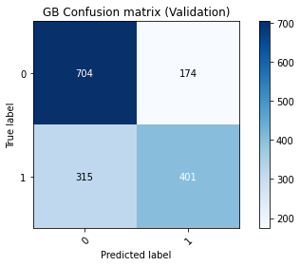
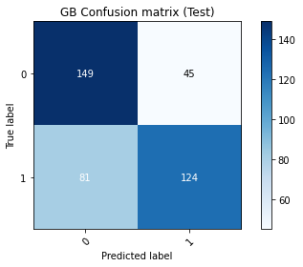
Modeling - Classification Model - Gradient Boosting
Once we decided that n_estimators = 1000, we ran the 3-fold CV and built confusion matrices for validation and test data separately.
As can be seen from the figures on the right, KNN model reached ~0.69 accuracy and ~0.65 F-1 score in validation and test data.
Accuracy: 0.693
Sensitivity : 0.560
Precision : 0.697
F-1 Score : 0.621
Accuracy: 0.684
Sensitivity : 0.605
Precision : 0.734
F-1 Score : 0.663

Slide 12
3. Model parameters & results Regression Models

Slide 13
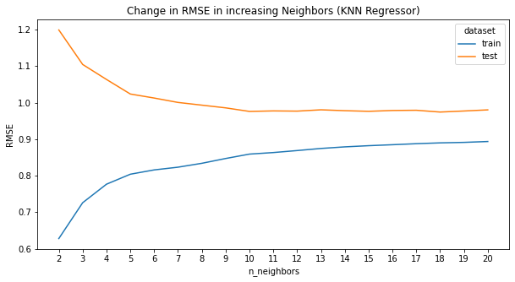
Modeling - Regression Model - KNN Regression
Parameter setting:
n_neighbors (k) = 2, …, 20
Best value of k → 18
This regression model can be considered as low-bias and average-error model. If only the train & test lines came closer, it would be almost perfect!
At k = 18;
[TRAIN] >> median_abs_err = 0.546, mean_abs_err = 0.678, RMSE = 0.890
[TEST] >> median_abs_err = 0.597, mean_abs_err = 0.742, RMSE = 0.974

Slide 14
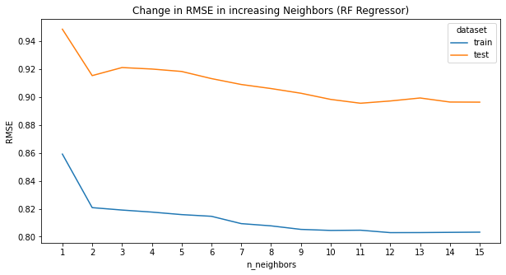
Modeling - Regression Model - Random Forest
Parameter setting:
n_estimators = 1, …, 15
min_samples_split = 60
min_samples_leaf = 20
max_depth = 7
max_leaf_nodes = 14
Best value of n_estimators → 15
At n_estimators = 15;
[TRAIN] >> median_abs_err = 0.474, mean_abs_err = 0.605, RMSE = 0.803
[TEST] >> median_abs_err = 0.528, mean_abs_err = 0.667, RMSE = 0.896

Slide 15
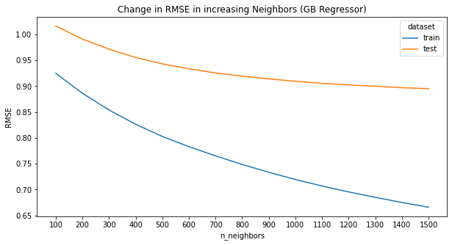
Modeling - Regression Model - Gradient Boosting
Parameter setting:
n_estimators=100, 200, …, 1500
learning_rate=0.001
criterion='friedman_mse'
min_samples_split=60
min_samples_leaf=20
max_depth=7
max_leaf_nodes=14
Best value of n_estimators → 1500
At n_estimators = 1500;
[TRAIN] >> median_abs_err = 0.406, mean_abs_err = 0.508, RMSE = 0.666
[TEST] >> median_abs_err = 0.488, mean_abs_err = 0.652, RMSE = 0.895

Slide 16
4. MODEL COMPARISONS

Slide 17
Evaluation - Classification Models
Model Ranking according to F-1 Score: Gradient Boosting > Random Forest > KNN
 | Validation |  |  |  | Test
 | Accuracy | Sensitivity | Precision | F-1 Score | Accuracy | Sensitivity | Precision | F-1 Score
KNN | 0.605 | 0.507 | 0.568 | 0.536 | 0.604 | 0.493 | 0.652 | 0.561
Random Forest | 0.684 | 0.588 | 0.668 | 0.626 | 0.669 | 0.610 | 0.706 | 0.654
Gradient Boosting | 0.693 | 0.560 | 0.697 | 0.621 | 0.684 | 0.605 | 0.734 | 0.663
Overall, how often is the classifier correct?
When it's actually yes, how often does it predict yes?
When it predicts yes, how often is it correct?
Harmonic mean of sensitivity and precision
Overall, how often is the classifier correct?
When it's actually yes, how often does it predict yes?
When it predicts yes, how often is it correct?
Harmonic mean of sensitivity and precision

Slide 18
Evaluation - Regression Models
Model Ranking according to RMSE: Gradient Boosting ~= Random Forest > KNN
 | Validation |  |  | Test
 | Median Abs. Err. | Mean Abs. Err. | RMSE | Median Abs. Err. | Mean Abs. Err. | RMSE
KNN | 0.546 | 0.678 | 0.890 | 0.597 | 0.742 | 0.974
Random Forest | 0.474 | 0.605 | 0.803 | 0.528 | 0.667 | 0.896
Gradient Boosting | 0.406 | 0.508 | 0.666 | 0.488 | 0.652 | 0.895
Midpoint of the sorted absolute errors
Average of the absolute errors
Root Mean Squared Error
Midpoint of the sorted absolute errors
Average of the absolute errors
Root Mean Squared Error

Slide 19
Conclusion
All of our classification models reached to our initial F-1 score target which was 0.4. Actually, the Random Forest and Gradient Boosting models reached to 0.65 which is significantly good.
Besides, the difference between Validation and Test data metrics is very low, indicating a non-overfitting conclusion.
Our Regression models also performed really promising as they all had a RMSE of less than 1.
Nonetheless, a movie success depends on a lot of features that are related to the movies, situation in the country, and so on.
The movie profitability prediction helps movie production companies to invest in the movie projects.

