Slide 1
NEXT.JS
CRUD Operations

Slide 2
Next.js supports: GET POST, PUT, PATCH, DELETE, HEAD, and OPTİONS
If an unsupported method is called, Next.js Will return a 405 Method Not Allowed response.

Slide 3
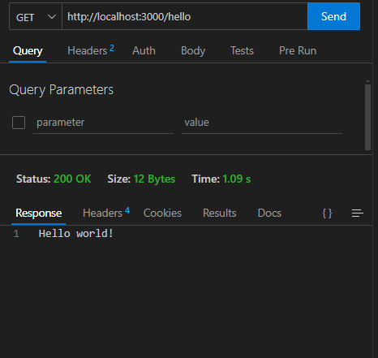
GET()
Basics
export async function GET() {
return new Response("Hello world!");
}

Slide 4
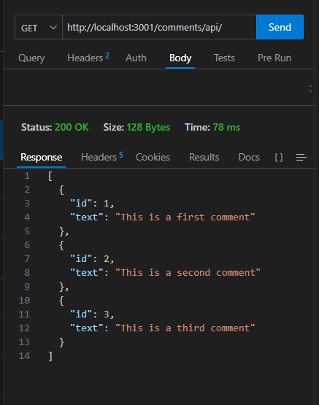
GET()
import { comments } from "../../data";
export async function GET(
_request: Request,
{
params,
}: {
params: Promise<{ id: string }>;
}
) {
const { id } = await params;
const getIdCommnent = comments.find((comment) => comment.id === parseInt(id));
return Response.json(getIdCommnent);
}

Slide 5
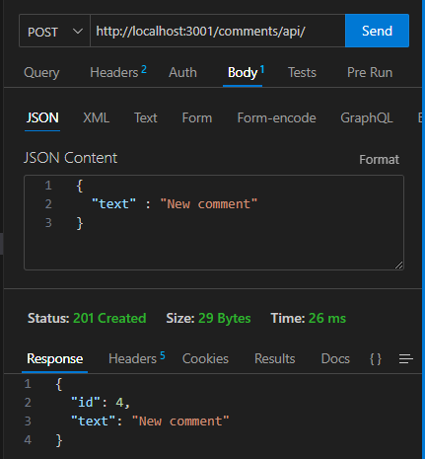
POST()
import { comments } from "../data";
export async function GET() {
return Response.json(comments);
}
export async function POST(request: Request) {
const comment = await request.json();
const newComment = {
id: comments.length + 1,
text: comment.text,
};
comments.push(newComment);
return new Response(JSON.stringify(newComment), {
headers: { "Content-Type": "application/json" },
status: 201,
});
}

Slide 6
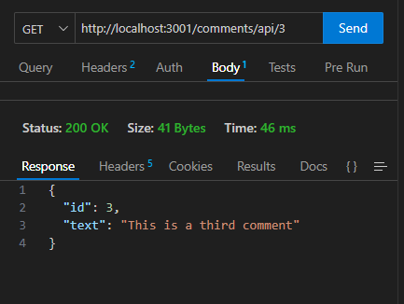
DYNAMİC ROUTE HANDLERS
import { comments } from "../../data";
export async function GET(
_request: Request,
{
params,
}: {
params: Promise<{ id: string }>;
}
) {
const { id } = await params;
const getIdCommnent = comments.find((comment) => comment.id === parseInt(id));
return Response.json(getIdCommnent);
}

Slide 7
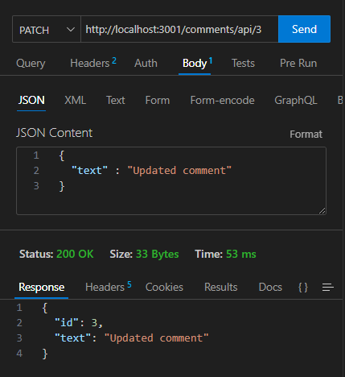
PATCH()
import { comments } from "../../data";
export async function PATCH(
request: Request,
{
params,
}: {
params: Promise<{ id: string }>;
}
) {
const { id } = await params;
const body = await request.json();
const { text } = body;
const index = comments.findIndex((comment) => comment.id === parseInt(id));
comments[index].text = text;
return Response.json(comments[index]);
}

Slide 8
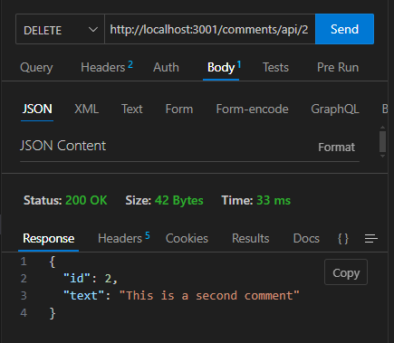
DELETE()
import { comments } from "../../data";
export async function DELETE(
_request: Request,
{
params,
}: {
params: Promise<{ id: string }>;
}
) {
const { id } = await params;
const index = comments.findIndex((comment) => comment.id === parseInt(id));
const deletedComment = comments[index];
comments.splice(index, 1);
return Response.json(deletedComment);
}

