Slide 1
Next.js Fundamentals
https://github.com/oguzhandilek
albeyazimsoft
Layouts
npx create-next-app@latest layout-demo

Slide 2
Layouts
In Next.js, layout.tsx is a component that defines the page layout
and contains structures shared across multiple pages, such as headers,
footers, or sidebars.
Important note: If you delete layout.tsx, Next.js will automatically generate a new one.
This happens because every Next.js app requires a default layout to
ensure a structured page design.
With this approach:
A consistent structure is maintained across pages.
Redundant component usage is avoided.
The user experience remains organized and seamless. 🚀

Slide 3
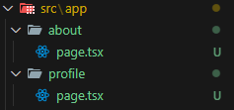
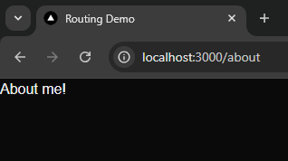
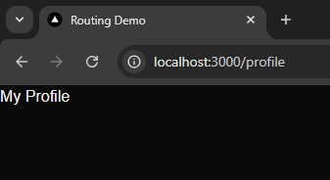
Scenario 1 (Routing)
export default function About() {
return (
<>
<h1>About me!</h1>
</>
);
}
export default function Profile() {
return (
<>
<h1>My Profile</h1>
</>
);
}
npm run dev

Slide 4
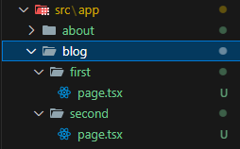
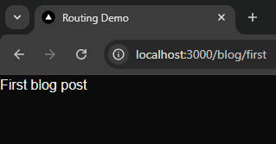
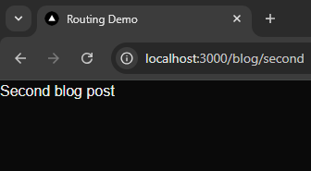
Scenario 2 (Nested Routed)
https://github.com/oguzhandilek
export default function FirstBlog() {
return (
<>
<h1>First blog post</h1>
</>
);
}
export default function SecondPage() {
return (
<>
<h1>Second blog post</h1>
</>
);
}
npm run dev

Slide 5
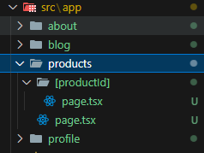
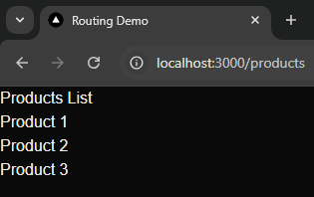
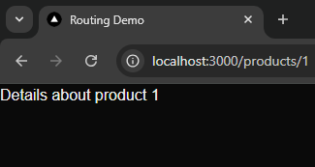
Scenario 3 (Dynamic Routes)
https://github.com/oguzhandilek
export default function Products() {
return (
<>
<h1>Products List</h1>
<ul>
<li>Product 1</li>
<li>Product 2</li>
<li>Product 3</li>
</ul>
</>
);
}
export default async function ProductDetails({
params,
}: {
params: Promise<{ productId: string }>;
}) {
const { productId } = await params;
return (
<>
<h1>Details about product {productId}</h1>
</>
);
}
npm run dev

Slide 6
Scenario 4 (Nested Routes)
https://github.com/oguzhandilek
export default function Products() {
return (
<>
<h1>Products List</h1>
<ul>
<li>Product 1</li>
<li>Product 2</li>
<li>Product 3</li>
</ul>
</>
);
}
export default async function ProductDetails({
params,
}: {
params: Promise<{ productId: string }>;
}) {
const { productId } = await params;
return (
<>
<h1>Details about product {productId}</h1>
</>
);
}
npm run dev

Slide 7
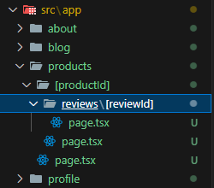
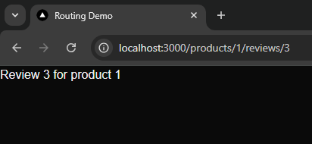
Scenario 5 (Dynamic Nested Routes)
https://github.com/oguzhandilek
export default async function ProductReview({
params,
}: {
params: Promise<{ productId: string; reviewId: string }>;
}) {
const { productId, reviewId } = await params;
return (
<>
<h1>
Review {reviewId} for product {productId}
</h1>
</>
);
}

Slide 8

Next.js Fundamentals
export default function AlbeyazimSoft() {
return (
<>
<h1>The series will continue...</h1>
<h1>Don't forget to like and share!</h1>
</>
);
}
Oğuzhan Dilek
https://github.com/oguzhandilek

