Slide 1



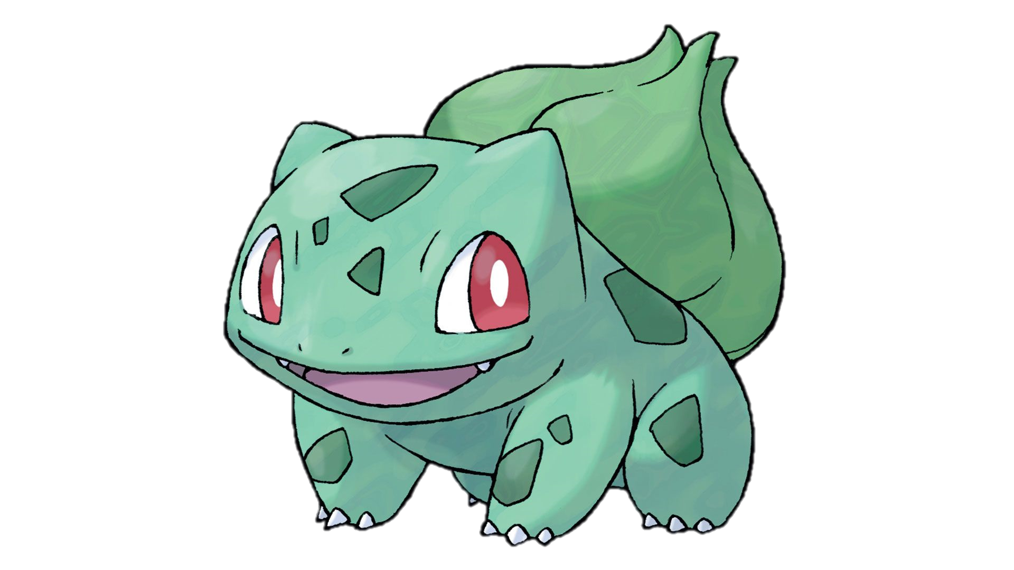
NEXT.JS
CATCH ALL SEGMENTS

Slide 2

Do you want to create a Pokémon battle in Next.js?
Then you need to know who your opponent is… and for that, catch all segments will be your Pokédex!

Slide 3
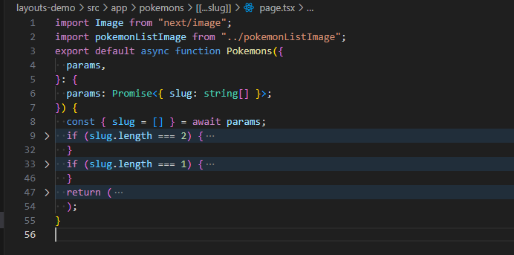
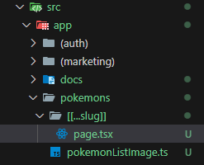
📂[[…slug]]

Slide 4
URL Scenarios:
/POKEMON/PIKACHU/VS/BULBASAUR → Pikachu is battling Bulbasaur!
/pokemon/fire/charizard/vs/water/blastoise → Even multi-segment battles are possible.
Why Use Catch All Segments?
Flexibility: Easily handle COMPLEX and deeply nested URL structures.
Advanced Routing: Embed battles, abilities, element types, and more directly into the path.
Real-World Applications: Perfect for blogs, nested categories, dynamic content, and more.

Slide 5


If we’re building Pokémon battles in Next.js, then Catch All Segments are our Ultra Ball!
export default function AlbeyazimSoft() {
return (
<>
<h1>The series will continue...</h1>
<h1>Don't forget to like and share!</h1>
</>
);
}
Oğuzhan Dilek
https://github.com/oguzhandilek

