Slide 1
Next.js Fundamentals
https://github.com/oguzhandilek
albeyazimsoft
Layouts
npx create-next-app@latest layout-demo

Slide 2
Layouts
layout.tsx is a component that defines the page layout in Next.js.
It contains shared structures like headers, footers, or sidebars.
If you delete layout.tsx, Next.js will automatically create a new one.
Every Next.js app requires a default layout for proper structure.
This ensures a consistent look across all pages.
It avoids repeating the same components on each page.
The user experience stays clean and seamless.

Slide 3
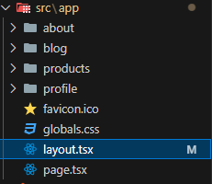
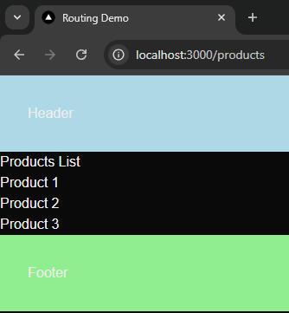
Scenario 1 (Header-Body-Footer)
https://github.com/oguzhandilek
📌
import type { Metadata } from "next";
import "./globals.css";
export const metadata: Metadata = {
title: "Routing Demo",
description: "Routing Demo",
};
export default function RootLayout({
children,
}: Readonly<{
children: React.ReactNode;
}>) {
return (
<html lang="en">
<body>
<header style={{ backgroundColor: "lightblue", padding: "2rem" }}>
<h1>Header</h1>
</header>
{children}
<footer style={{ backgroundColor: "lightgreen", padding: "2rem" }}>
<h1>Footer</h1>
</footer>
</body>
</html>
);
}
📌
npm run dev

Slide 4
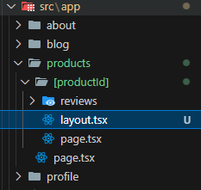
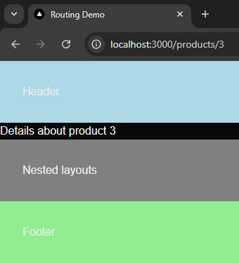
Scenario 2 (Nested Layout)
https://github.com/oguzhandilek
📌
import React from "react";
export default function ProductDetailLayout({
children,
}: {
children: React.ReactNode;
}) {
return (
<>
{children}
<h2 style={{ backgroundColor: "grey", padding: "2rem" }}>
Nested layouts
</h2>
</>
);
}
📌
npm run dev

Slide 5

Bonus Information!
Thank you for following me and making it this far.
I hope I've been able to add value to you!
Now, I'm going to share an advanced-level piece of information with you!
Let’s keep moving forward. --▶
Oğuzhan Dilek
https://github.com/oguzhandilek

Slide 6
Multiple Root Layouts and Route Groups
Organize our project structure without affecting the URLs
Apply layouts selectively to specific parts of our app
This approach (Route Groups) enhances modularity, making code maintenance more efficient, especially in larger projects.
To create a route group, it's enough to wrap the main folder in parentheses — for example, (auth) or (marketing).

Slide 7
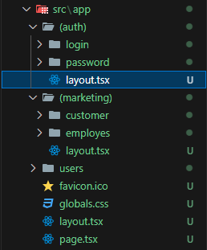
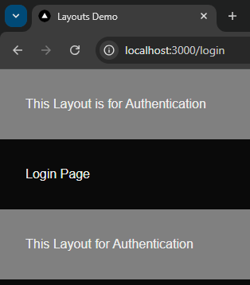
Scenario Bonus (Multiple Layout Routing and Route Groups)
📌
import React from "react";
export default function RootLayout({
children,
}: {
children: React.ReactNode;
}) {
return (
<>
<html lang="en">
<body>
<header style={{ backgroundColor: "grey", padding: "2rem" }}>
{" "}
This Layout is for Authentication
</header>
{children}
<footer style={{ backgroundColor: "grey", padding: "2rem" }}>
This Layout for Authentication
</footer>
</body>
</html>
</>
);
}
📌
npm run dev

Slide 8
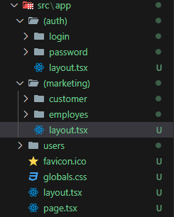
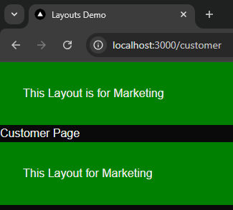
Scenario Bonus (Multiple Layout Routing and Route Groups)
📌
📌
export default function RootLayout({children}:{
children:React.ReactNode;
}) {
return <>
<html lang="en">
<body>
<header style={{ backgroundColor: "green", padding: "2rem" }}>
This Layout is for Marketing
</header>
{children}
<footer style={{ backgroundColor: "green", padding: "2rem" }}>
This Layout for Marketing
</footer>
</body>
</html>
</>
}
You can visit my GitHub profile to see the complete code.
npm run dev
https://github.com/oguzhandilek/Next.js-Fundamentals

Slide 9
Next.js Fundamentals
export default function AlbeyazimSoft() {
return (
<>
<h1>The series will continue...</h1>
<h1>Don't forget to like and share!</h1>
</>
);
}
Oğuzhan Dilek
https://github.com/oguzhandilek

