Slide 1

PrimeIT
PrimeIT Middleware
Şubat 2023
PrimeIT – Allianz

Slide 2
PrimeIT
https://digitall.allianz.com.tr
Transaction typle’ların ortalama süreleri
En uzun response süresi olan Methodlar
Inbound url’ler response süreleri ve transaction sayıları
Outbond url’ler response süreleri ve transaction sayıları
En fazla alınan hatalar
PrimeIT – Allianz

Slide 3
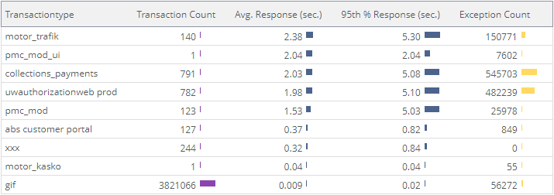
Transaction type’ların ortalama süreleri
PrimeIT
21.02.2023 08:00 – 21.02.2023 22:00
https://digitall.allianz.com.tr
PrimeIT – Allianz
Notes:
url = '*digitall.allianz.com.tr* | statistics -group_by transactiontype -sort_by avg_response_time
Top 200000
xxx - >/OnewebCustomerPortal/rest-service//getBesLeavingStatus
Gif -> png, js, jpg, css, gif

Slide 4
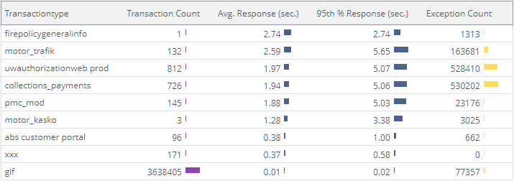
Transaction type’ların ortalama süreleri
PrimeIT
22.02.2023 08:00 – 22.02.2023 22:00
https://digitall.allianz.com.tr
PrimeIT – Allianz
Notes:
url = '*digitall.allianz.com.tr* | statistics -group_by transactiontype -sort_by avg_response_time
Top 200000
xxx - >/OnewebCustomerPortal/rest-service//getBesLeavingStatus
Gif -> png, js, jpg, css, gif

Slide 5
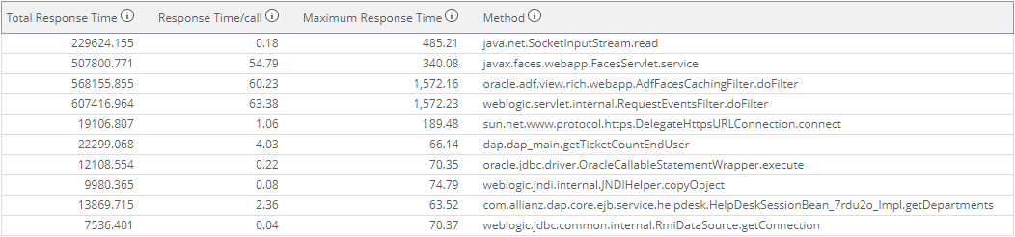
PrimeIT
21.02.2023 08:00 – 21.02.2023 22:00
En uzun response süresi olan Methodlar
https://digitall.allianz.com.tr
PrimeIT – Allianz
Notes:
url = '*digitall.allianz.com.tr*' AND transactiontype != 'gif' | calls -exclude_column 1 -exclude_column 2 -exclude_column 3 -limit 10 -type class.method -sort_by total_processing_time
Top 200000

Slide 6
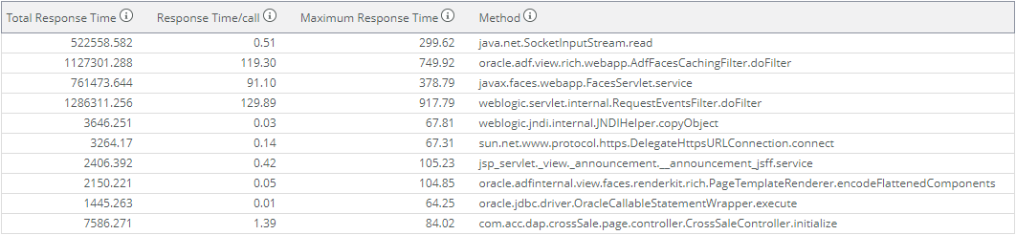
PrimeIT
22.02.2023 08:00 – 22.02.2023 22:00
En uzun response süresi olan Methodlar
https://digitall.allianz.com.tr
PrimeIT – Allianz
Notes:
url = '*digitall.allianz.com.tr*' AND transactiontype != 'gif' | calls -exclude_column 1 -exclude_column 2 -exclude_column 3 -limit 10 -type class.method -sort_by total_processing_time
Top 200000

Slide 7
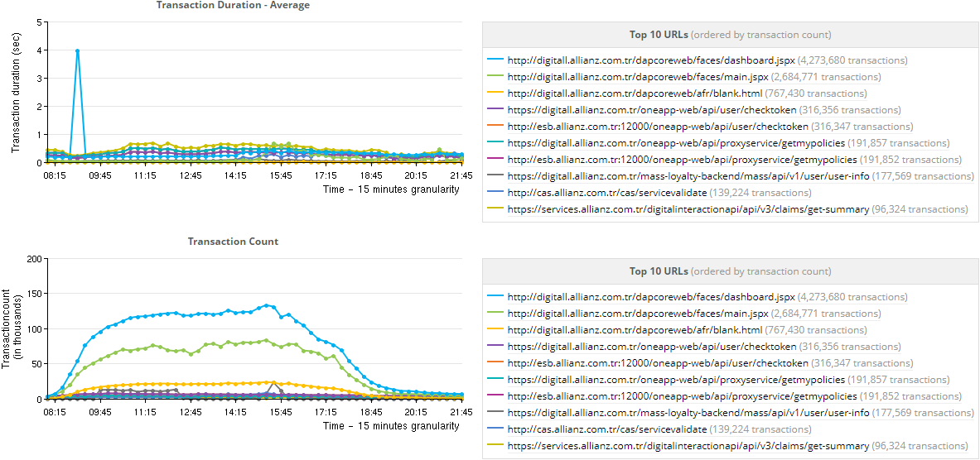
Inbound urller response süreleri ve transaction sayıları
PrimeIT
21.02.2023 08:00 – 21.02.2023 22:00
https://digitall.allianz.com.tr
PrimeIT – Allianz
Notes:
url = '*digitall.allianz.com.tr*' | timeseries -calc avg(responsetime),transactioncount() -limit 10 -order_by transactioncount() -group_by url
Top 200000

Slide 8
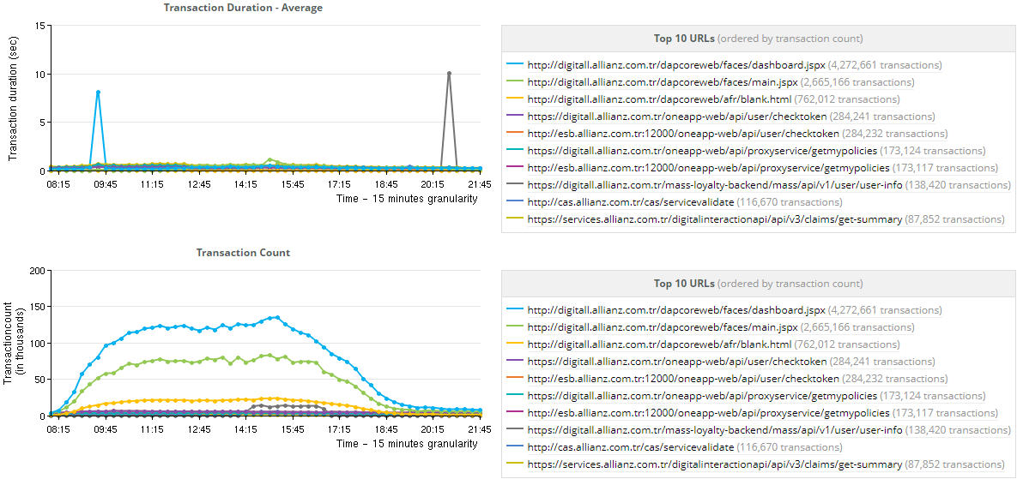
Inbound urller response süreleri ve transaction sayıları
PrimeIT
22.02.2023 08:00 – 22.02.2023 22:00
https://digitall.allianz.com.tr
PrimeIT – Allianz
Notes:
url = '*digitall.allianz.com.tr*' | timeseries -calc avg(responsetime),transactioncount() -limit 10 -order_by transactioncount() -group_by url
Top 200000

Slide 9
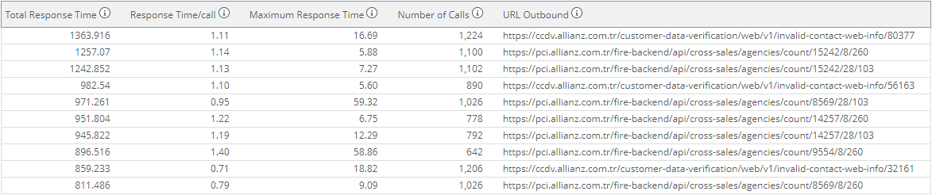
Outboundurl ler response süreleri ve transaction sayıları
PrimeIT
21.02.2023 08:00 – 21.02.2023 22:00
https://digitall.allianz.com.tr
PrimeIT – Allianz
Notes:
url = '*digitall.allianz.com.tr*' | calls -exclude_column 1 -exclude_column 2 -exclude_column 3 -limit 10 -sort_by total_duration -type urloutbound
Top 30000

Slide 10
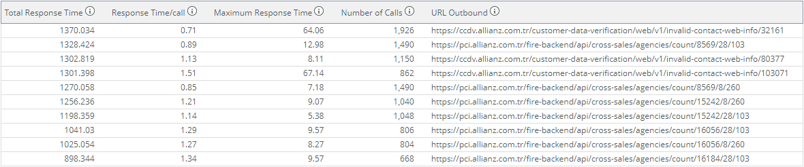
PrimeIT
22.02.2023 08:00 – 22.02.2023 22:00
Outboundurl ler response süreleri ve transaction sayıları
https://digitall.allianz.com.tr
PrimeIT – Allianz
Notes:
url = '*digitall.allianz.com.tr*' | calls -exclude_column 1 -exclude_column 2 -exclude_column 3 -limit 10 -sort_by total_duration -type urloutbound
Top 30000

Slide 11
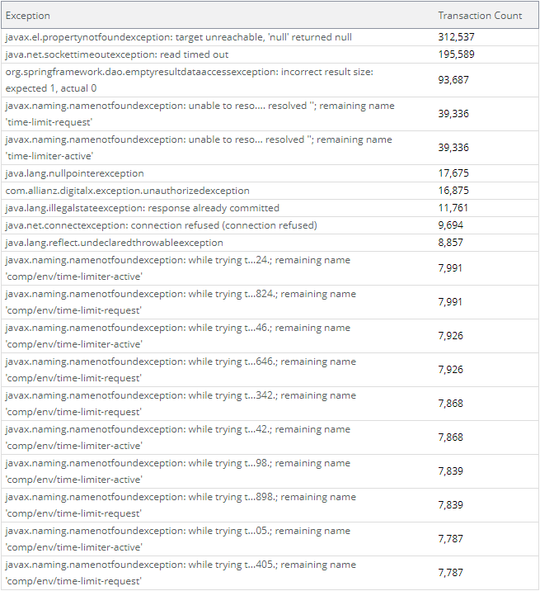
PrimeIT
21.02.2023 08:00 – 21.02.2023 22:00
En fazla alınan hatalar
https://digitall.allianz.com.tr
PrimeIT – Allianz
Notes:
url = '*digitall.allianz.com.tr*' | transactioncount -visualization table -limit 20 -group_by exception
Top 30000

Slide 12
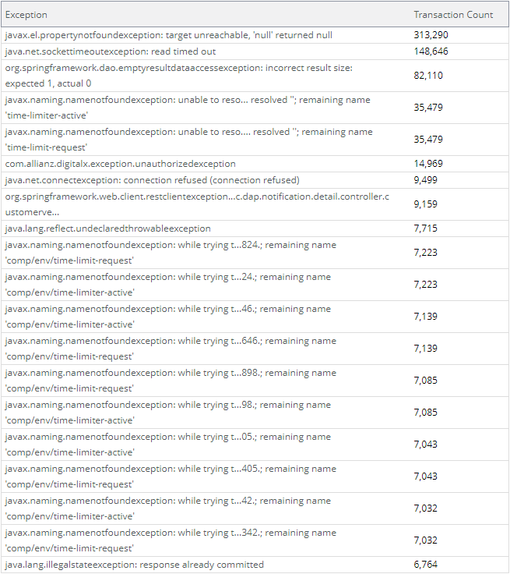
PrimeIT
22.02.2023 08:00 – 22.02.2023 22:00
En fazla alınan hatalar
https://digitall.allianz.com.tr
PrimeIT – Allianz
Notes:
url = '*digitall.allianz.com.tr*' | transactioncount -visualization table -limit 20 -group_by exception
Top 30000

Slide 13
PrimeIT
https://aznet.allianz.com.tr
Transaction typle’ların ortalama süreleri
En uzun response süresi olan Methodlar
Inbound url’ler response süreleri ve transaction sayıları
Outbond url’ler response süreleri ve transaction sayıları
En fazla alınan hatalar
PrimeIT – Allianz

Slide 14
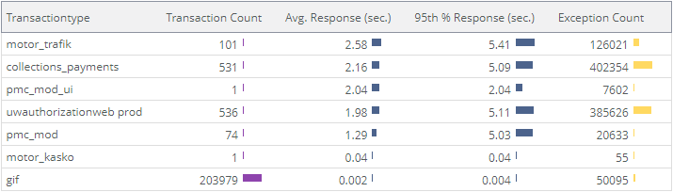
Transaction type’ların ortalama süreleri
PrimeIT
21.02.2023 08:00 – 21.02.2023 22:00
https://aznet.allianz.com.tr
PrimeIT – Allianz
Notes:
url = ‘*aznet.allianz.com.tr*’ | statistics -group_by transactiontype -sort_by avg_response_time
Top 200000
Gif ->cas, Agencywebportal, awphealtweb

Slide 15
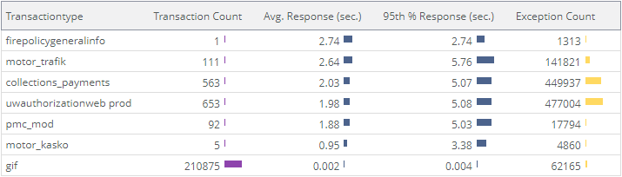
Transaction type’ların ortalama süreleri
PrimeIT
22.02.2023 08:00 – 22.02.2023 22:00
https://aznet.allianz.com.tr
PrimeIT – Allianz
Notes:
url = ‘*aznet.allianz.com.tr*’ | statistics -group_by transactiontype -sort_by avg_response_time
Top 200000
Gif ->cas, Agencywebportal, awphealtweb

Slide 16
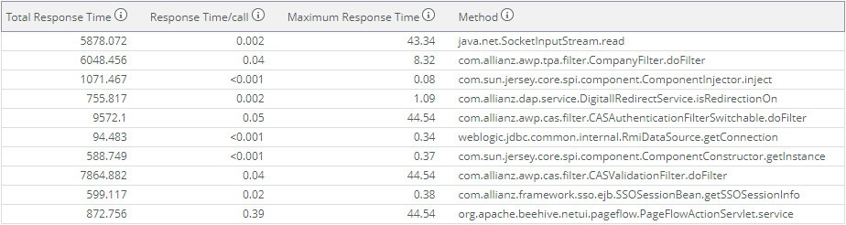
PrimeIT
21.02.2023 08:00 – 21.02.2023 22:00
En uzun response süresi olan Methodlar
https://aznet.allianz.com.tr
PrimeIT – Allianz
Notes:
url = ‘*aznet.allianz.com.tr*' AND transactiontype != 'gif' | calls -exclude_column 1 -exclude_column 2 -exclude_column 3 -limit 10 -type class.method -sort_by total_processing_time
Top 200000

Slide 17
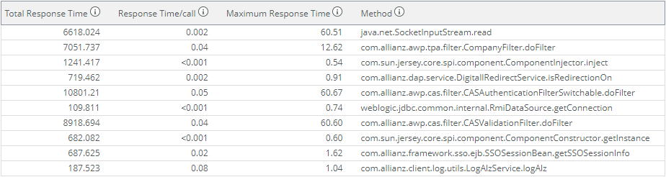
PrimeIT
22.02.2023 08:00 – 22.02.2023 22:00
En uzun response süresi olan Methodlar
https://aznet.allianz.com.tr
PrimeIT – Allianz
Notes:
url = ‘*aznet.allianz.com.tr*' AND transactiontype != 'gif' | calls -exclude_column 1 -exclude_column 2 -exclude_column 3 -limit 10 -type class.method -sort_by total_processing_time
Top 200000

Slide 18
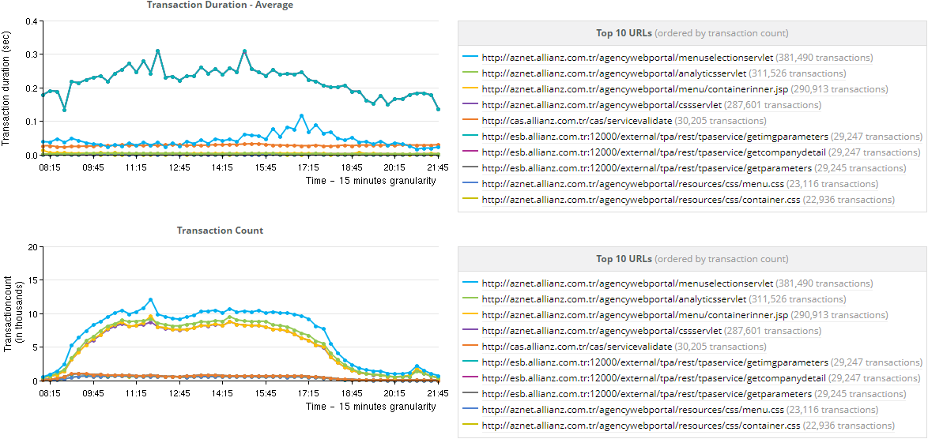
Inbound urller response süreleri ve transaction sayıları
PrimeIT
21.02.2023 08:00 – 21.02.2023 22:00
https://aznet.allianz.com.tr
PrimeIT – Allianz
Notes:
url = ‘*aznet.allianz.com.tr*' | timeseries -calc avg(responsetime),transactioncount() -limit 10 -order_by transactioncount() -group_by url
Top 200000

Slide 19
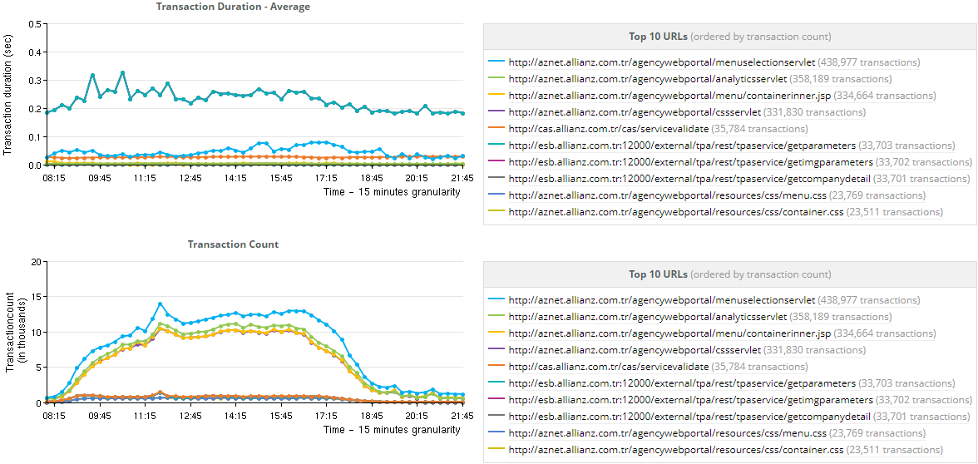
Inbound urller response süreleri ve transaction sayıları
PrimeIT
22.02.2023 08:00 – 22.02.2023 22:00
https://aznet.allianz.com.tr
PrimeIT – Allianz
Notes:
url = ‘*aznet.allianz.com.tr*' | timeseries -calc avg(responsetime),transactioncount() -limit 10 -order_by transactioncount() -group_by url
Top 200000

Slide 20
Outboundurl ler response süreleri ve transaction sayıları
PrimeIT
21.02.2023 08:00 – 21.02.2023 22:00
https://aznet.allianz.com.tr
PrimeIT – Allianz
Notes:
url = ‘*aznet.allianz.com.tr*' | calls -exclude_column 1 -exclude_column 2 -exclude_column 3 -limit 10 -sort_by total_duration -type urloutbound
Top 30000

Slide 21
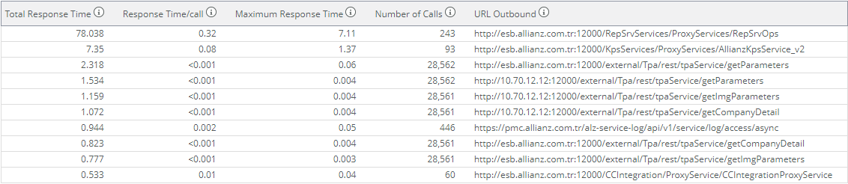
PrimeIT
22.02.2023 08:00 – 22.02.2023 22:00
Outboundurl ler response süreleri ve transaction sayıları
https://aznet.allianz.com.tr
PrimeIT – Allianz
Notes:
url = ‘*aznet.allianz.com.tr*' | calls -exclude_column 1 -exclude_column 2 -exclude_column 3 -limit 10 -sort_by total_duration -type urloutbound
Top 30000

Slide 22
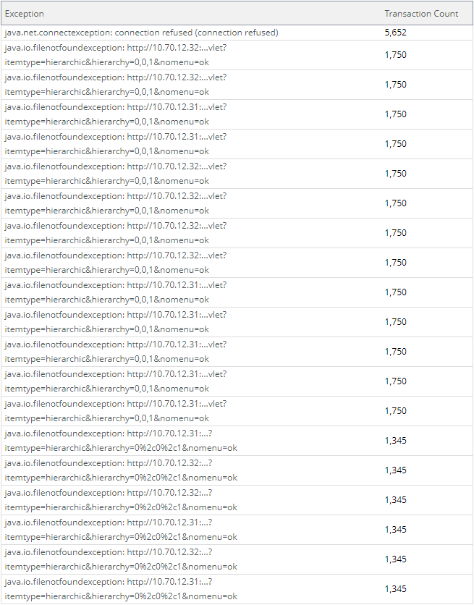
PrimeIT
21.02.2023 08:00 – 21.02.2023 22:00
En fazla alınan hatalar
https://aznet.allianz.com.tr
PrimeIT – Allianz
Notes:
url = ‘*aznet.allianz.com.tr*' | transactioncount -visualization table -limit 20 -group_by exception
Top 30000

Slide 23

PrimeIT
22.02.2023 08:00 – 22.02.2023 22:00
En fazla alınan hatalar
https://aznet.allianz.com.tr
PrimeIT – Allianz
Notes:
url = ‘*aznet.allianz.com.tr*' | transactioncount -visualization table -limit 20 -group_by exception
Top 30000

Slide 24
PrimeIT
https://pci.allianz.com.tr
Transaction typle’ların ortalama süreleri
En uzun response süresi olan Methodlar
Inbound url’ler response süreleri ve transaction sayıları
Outbond url’ler response süreleri ve transaction sayıları
En fazla alınan hatalar
PrimeIT – Allianz

Slide 25
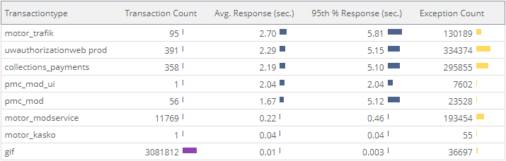
Transaction type’ların ortalama süreleri
PrimeIT
21.02.2023 08:00 – 21.02.2023 22:00
https://pci.allianz.com.tr
PrimeIT – Allianz
Notes:
url = ‘*pci.allianz.com.tr*’ | statistics -group_by transactiontype -sort_by avg_response_time
Top 200000
Gif ->cas, common-ui, personal-health-application-form-ui

Slide 26
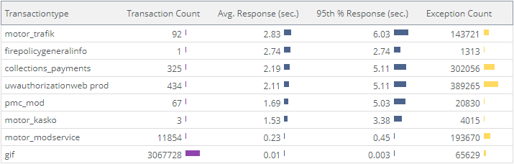
Transaction type’ların ortalama süreleri
PrimeIT
22.02.2023 08:00 – 22.02.2023 22:00
https://pci.allianz.com.tr
PrimeIT – Allianz
Notes:
url = ‘*pci.allianz.com.tr*’ | statistics -group_by transactiontype -sort_by avg_response_time
Top 200000
Gif ->cas, common-ui, personal-health-application-form-ui

Slide 27
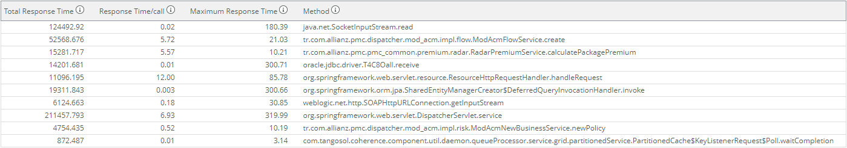
PrimeIT
21.02.2023 08:00 – 21.02.2023 22:00
En uzun response süresi olan Methodlar
https://pci.allianz.com.tr
PrimeIT – Allianz
Notes:
url = ‘*aznet.allianz.com.tr*' AND transactiontype != 'gif' | calls -exclude_column 1 -exclude_column 2 -exclude_column 3 -limit 10 -type class.method -sort_by total_processing_time
Top 30000

Slide 28
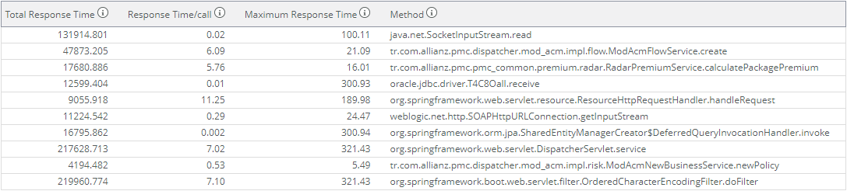
PrimeIT
22.02.2023 08:00 – 22.02.2023 22:00
En uzun response süresi olan Methodlar
https://pci.allianz.com.tr
PrimeIT – Allianz
Notes:
url = ‘*pci.allianz.com.tr*' AND transactiontype != 'gif' | calls -exclude_column 1 -exclude_column 2 -exclude_column 3 -limit 10 -type class.method -sort_by total_processing_time
Top 30000

Slide 29
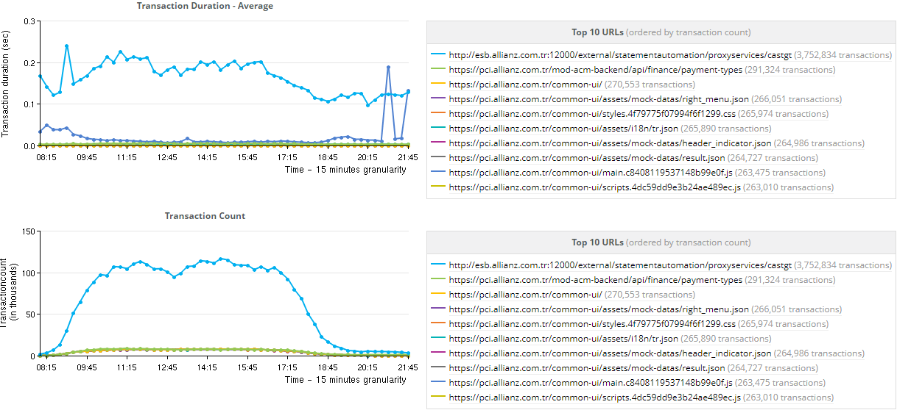
Inbound urller response süreleri ve transaction sayıları
PrimeIT
21.02.2023 08:00 – 21.02.2023 22:00
https://pci.allianz.com.tr
PrimeIT – Allianz
Notes:
url = ‘*pci.allianz.com.tr*' | timeseries -calc avg(responsetime),transactioncount() -limit 10 -order_by transactioncount() -group_by url
Top 200000

Slide 30
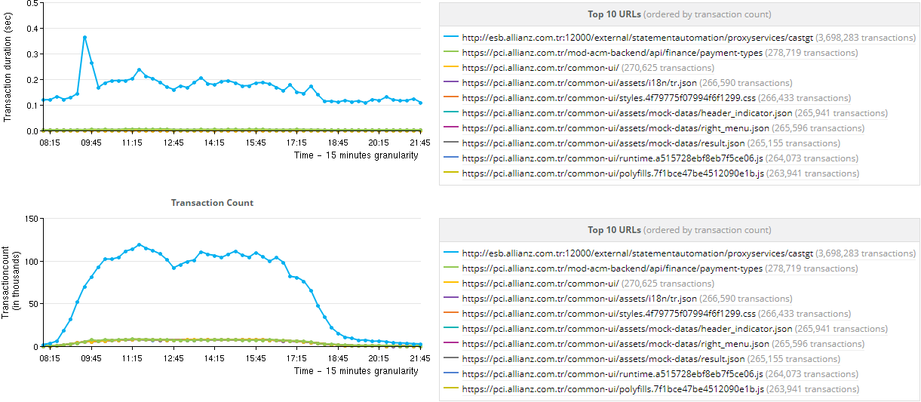
Inbound urller response süreleri ve transaction sayıları
PrimeIT
22.02.2023 08:00 – 22.02.2023 22:00
https://pci.allianz.com.tr
PrimeIT – Allianz
Notes:
url = ‘*pci.allianz.com.tr*' | timeseries -calc avg(responsetime),transactioncount() -limit 10 -order_by transactioncount() -group_by url
Top 200000

Slide 31
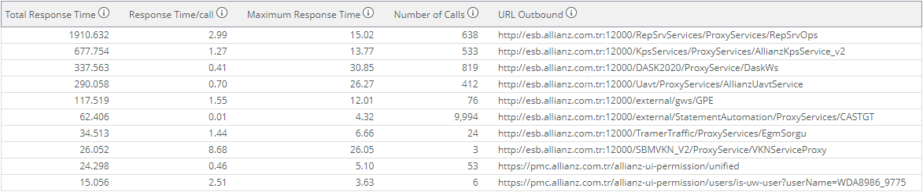
Outboundurl ler response süreleri ve transaction sayıları
PrimeIT
21.02.2023 08:00 – 21.02.2023 22:00
https://pci.allianz.com.tr
PrimeIT – Allianz
Notes:
url = ‘*pci.allianz.com.tr*' | calls -exclude_column 1 -exclude_column 2 -exclude_column 3 -limit 10 -sort_by total_duration -type urloutbound
Top 30000

Slide 32
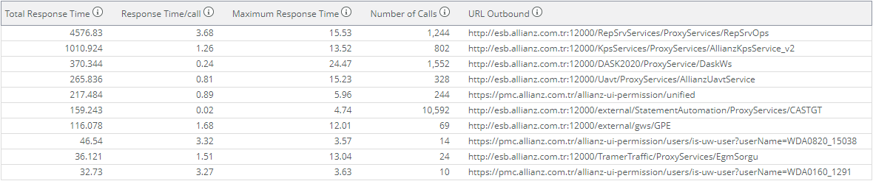
PrimeIT
22.02.2023 08:00 – 22.02.2023 22:00
Outboundurl ler response süreleri ve transaction sayıları
https://pci.allianz.com.tr
PrimeIT – Allianz
Notes:
url = ‘*pci.allianz.com.tr*' | calls -exclude_column 1 -exclude_column 2 -exclude_column 3 -limit 10 -sort_by total_duration -type urloutbound
Top 30000

Slide 33
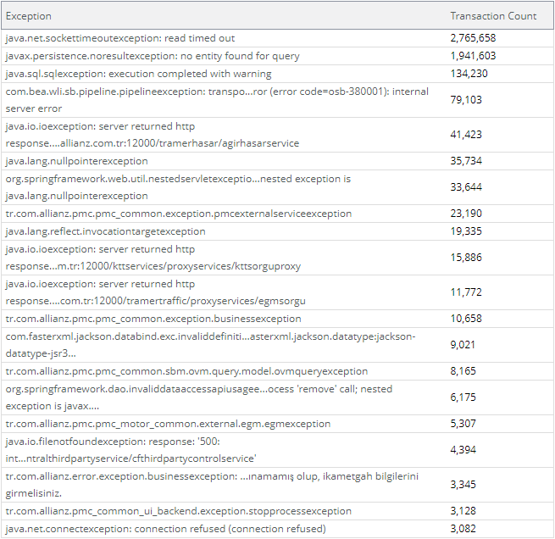
PrimeIT
21.02.2023 08:00 – 21.02.2023 22:00
En fazla alınan hatalar
https://pci.allianz.com.tr
PrimeIT – Allianz
Notes:
url = ‘*pci.allianz.com.tr*' | transactioncount -visualization table -limit 20 -group_by exception
Top 30000

Slide 34
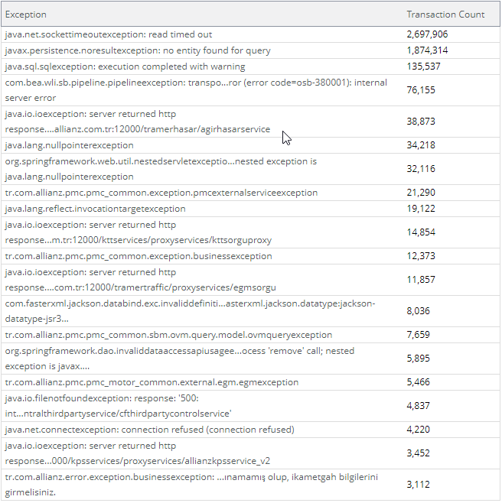
PrimeIT
22.02.2023 08:00 – 22.02.2023 22:00
En fazla alınan hatalar
https://pci.allianz.com.tr
PrimeIT – Allianz
Notes:
url = ‘*aznet.allianz.com.tr*' | transactioncount -visualization table -limit 20 -group_by exception
Top 30000

Slide 35
PrimeIT
https://pmc.allianz.com.tr
Transaction typle’ların ortalama süreleri
En uzun response süresi olan Methodlar
Inbound url’ler response süreleri ve transaction sayıları
Outbond url’ler response süreleri ve transaction sayıları
En fazla alınan hatalar
PrimeIT – Allianz

Slide 36
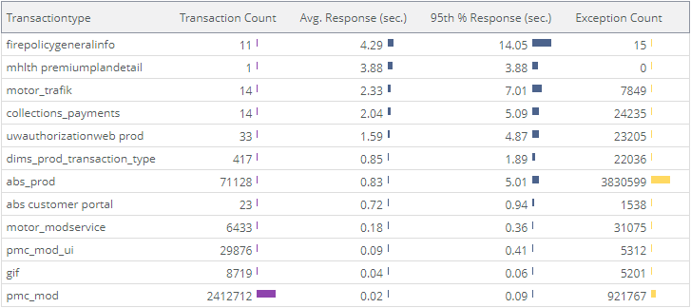
Transaction type’ların ortalama süreleri
PrimeIT
21.02.2023 08:00 – 21.02.2023 22:00
https://pmc.allianz.com.tr
PrimeIT – Allianz
Notes:
url = ‘*pmc.allianz.com.tr*’ | statistics -group_by transactiontype -sort_by avg_response_time
Top 200000
Gif ->archer, mod-ui, Awphealthweb,

Slide 37
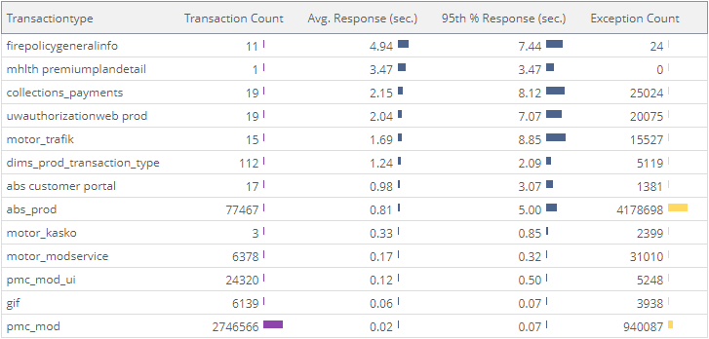
Transaction type’ların ortalama süreleri
PrimeIT
22.02.2023 08:00 – 22.02.2023 22:00
https://pmc.allianz.com.tr
PrimeIT – Allianz
Notes:
url = ‘*pmc.allianz.com.tr*’ | statistics -group_by transactiontype -sort_by avg_response_time
Top 200000
Gif ->archer, mod-ui, Awphealthweb,

Slide 38
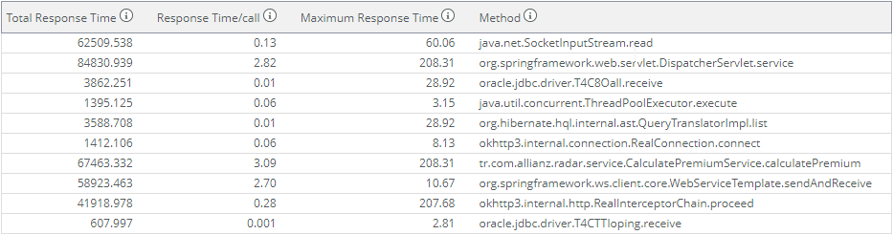
PrimeIT
21.02.2023 08:00 – 21.02.2023 22:00
En uzun response süresi olan Methodlar
https://pmc.allianz.com.tr
PrimeIT – Allianz
Notes:
url = ‘*pmc.allianz.com.tr*' AND transactiontype != 'gif' | calls -exclude_column 1 -exclude_column 2 -exclude_column 3 -limit 10 -type class.method -sort_by total_processing_time
Top 30000

Slide 39
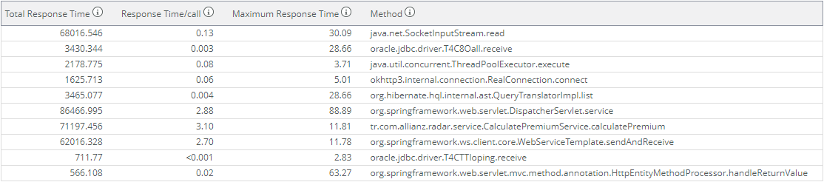
PrimeIT
22.02.2023 08:00 – 22.02.2023 22:00
En uzun response süresi olan Methodlar
https://pmc.allianz.com.tr
PrimeIT – Allianz
Notes:
url = ‘*pmc.allianz.com.tr*' AND transactiontype != 'gif' | calls -exclude_column 1 -exclude_column 2 -exclude_column 3 -limit 10 -type class.method -sort_by total_processing_time
Top 30000

Slide 40
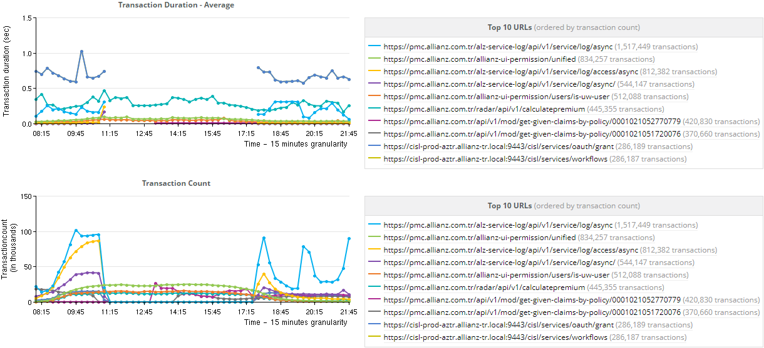
Inbound urller response süreleri ve transaction sayıları
PrimeIT
21.02.2023 08:00 – 21.02.2023 22:00
https://pmc.allianz.com.tr
PrimeIT – Allianz
Notes:
url = ‘*pmc.allianz.com.tr*' | timeseries -calc avg(responsetime),transactioncount() -limit 10 -order_by transactioncount() -group_by url
Top 200000

Slide 41
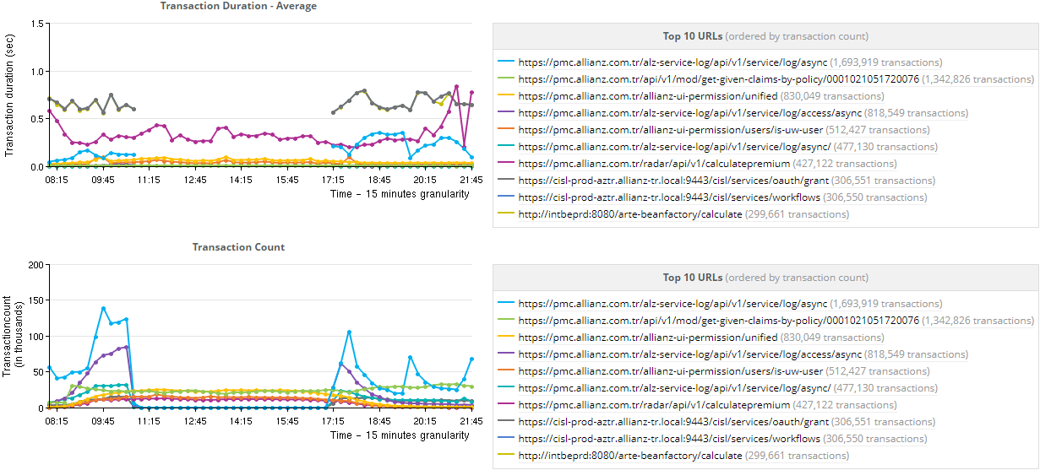
Inbound urller response süreleri ve transaction sayıları
PrimeIT
22.02.2023 08:00 – 22.02.2023 22:00
https://pmc.allianz.com.tr
PrimeIT – Allianz
Notes:
url = ‘*pmc.allianz.com.tr*' | timeseries -calc avg(responsetime),transactioncount() -limit 10 -order_by transactioncount() -group_by url
Top 200000

Slide 42
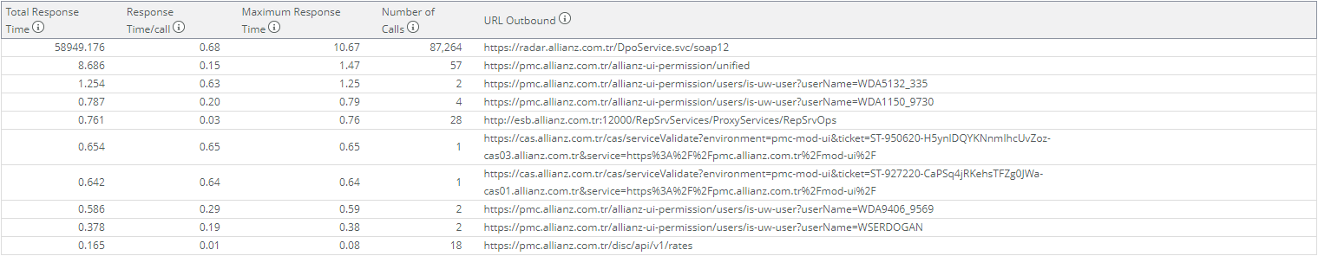
Outboundurl ler response süreleri ve transaction sayıları
PrimeIT
21.02.2023 08:00 – 21.02.2023 22:00
https://pmc.allianz.com.tr
PrimeIT – Allianz
Notes:
url = ‘*pmc.allianz.com.tr*' | calls -exclude_column 1 -exclude_column 2 -exclude_column 3 -limit 10 -sort_by total_duration -type urloutbound
Top 30000

Slide 43
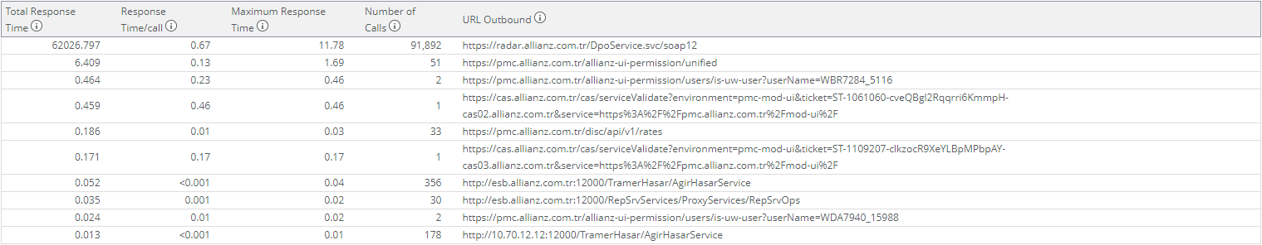
PrimeIT
22.02.2023 08:00 – 22.02.2023 22:00
Outboundurl ler response süreleri ve transaction sayıları
https://pmc.allianz.com.tr
PrimeIT – Allianz
Notes:
url = ‘*pmc.allianz.com.tr*' | calls -exclude_column 1 -exclude_column 2 -exclude_column 3 -limit 10 -sort_by total_duration -type urloutbound
Top 30000

Slide 44
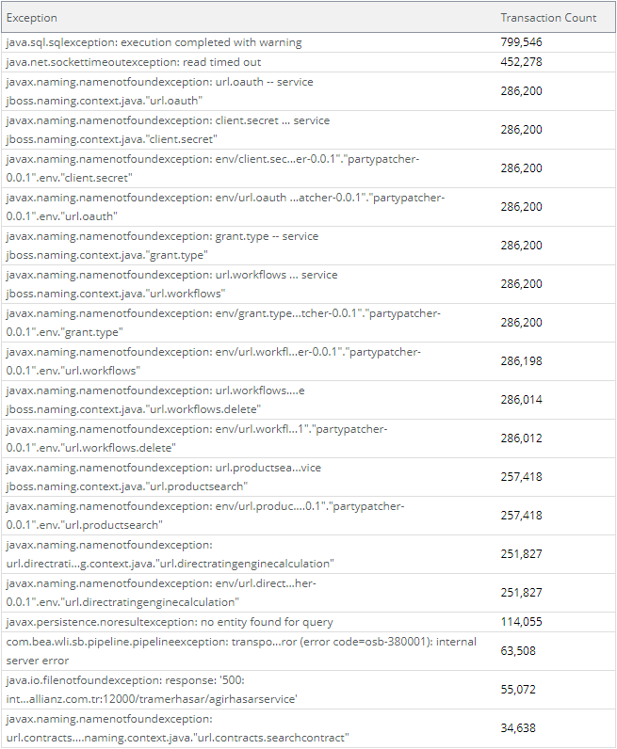
PrimeIT
21.02.2023 08:00 – 21.02.2023 22:00
En fazla alınan hatalar
https://pmc.allianz.com.tr
PrimeIT – Allianz
Notes:
url = ‘*pmc.allianz.com.tr*' | transactioncount -visualization table -limit 20 -group_by exception
Top 30000

Slide 45
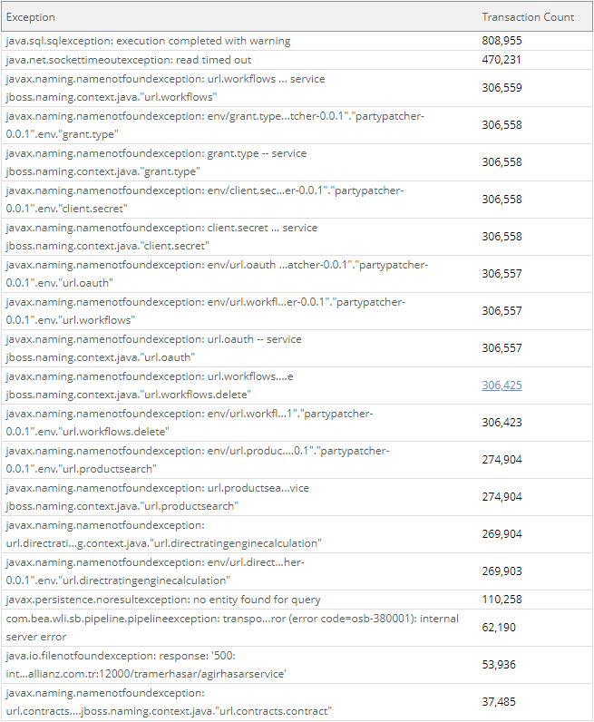
PrimeIT
22.02.2023 08:00 – 22.02.2023 22:00
En fazla alınan hatalar
https://pmc.allianz.com.tr
PrimeIT – Allianz
Notes:
url = ‘*pmc.allianz.com.tr*' | transactioncount -visualization table -limit 20 -group_by exception
Top 30000

Slide 46
PrimeIT
https://adf.allianz.com.tr
Transaction typle’ların ortalama süreleri
En uzun response süresi olan Methodlar
Inbound url’ler response süreleri ve transaction sayıları
Outbond url’ler response süreleri ve transaction sayıları
En fazla alınan hatalar
PrimeIT – Allianz

Slide 47
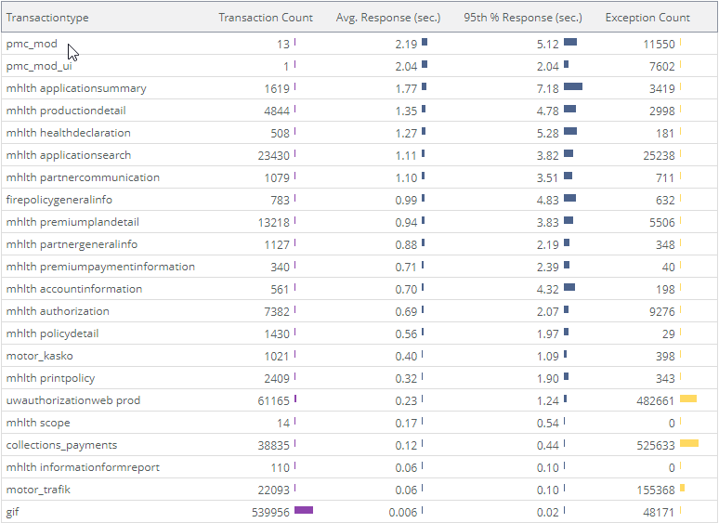
Transaction type’ların ortalama süreleri
PrimeIT
21.02.2023 08:00 – 21.02.2023 22:00
https://adf.allianz.com.tr
PrimeIT – Allianz
Notes:
url = ‘*adf.allianz.com.tr*’ | statistics -group_by transactiontype -sort_by avg_response_time
Gif ->cas, h2qi grouphealthportalweb, uwauthorazationweb, modularhealthweb, greencardweb, zytapp, collectionweb, modularcorparationweb, transportpolicyweb,

Slide 48
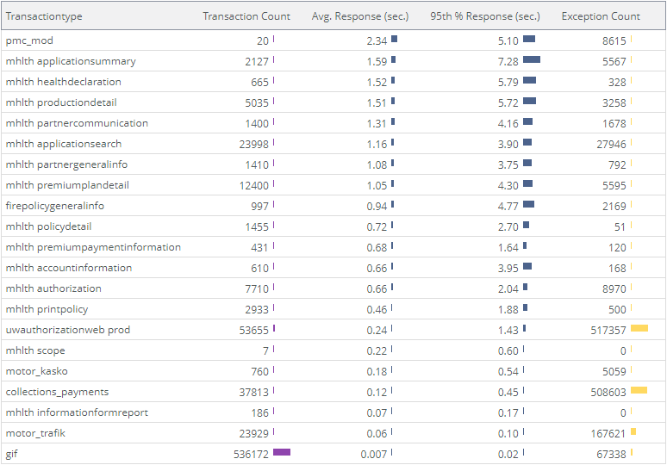
Transaction type’ların ortalama süreleri
PrimeIT
22.02.2023 08:00 – 22.02.2023 22:00
https://adf.allianz.com.tr
PrimeIT – Allianz
Notes:
url = ‘*adf.allianz.com.tr*’ | statistics -group_by transactiontype -sort_by avg_response_time
Top 200000
Gif ->cas, h2qi grouphealthportalweb, uwauthorazationweb, modularhealthweb, greencardweb, zytapp, collectionweb, modularcorparationweb, transportpolicyweb,

Slide 49
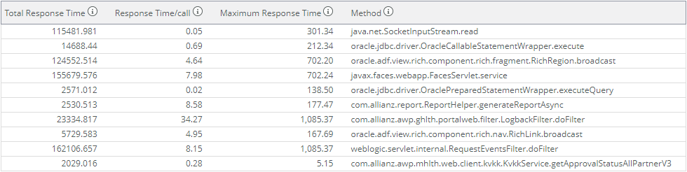
PrimeIT
21.02.2023 08:00 – 21.02.2023 22:00
En uzun response süresi olan Methodlar
https://adf.allianz.com.tr
PrimeIT – Allianz
Notes:
url = ‘*adf.allianz.com.tr*' AND transactiontype != 'gif' | calls -exclude_column 1 -exclude_column 2 -exclude_column 3 -limit 10 -type class.method -sort_by total_processing_time
Top 20000

Slide 50
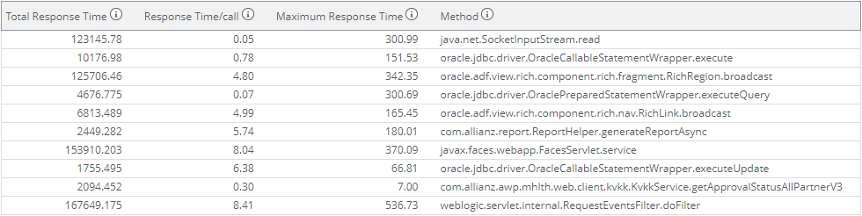
PrimeIT
22.02.2023 08:00 – 22.02.2023 22:00
En uzun response süresi olan Methodlar
https://adf.allianz.com.tr
PrimeIT – Allianz
Notes:
url = ‘*adf.allianz.com.tr*' AND transactiontype != 'gif' | calls -exclude_column 1 -exclude_column 2 -exclude_column 3 -limit 10 -type class.method -sort_by total_processing_time
Top 20000

Slide 51
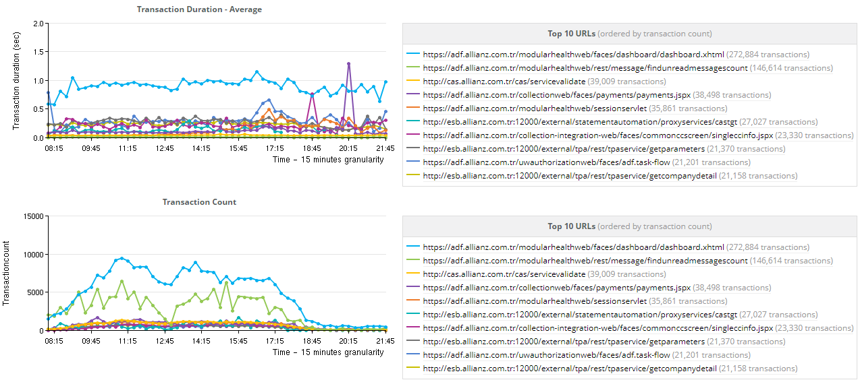
Inbound urller response süreleri ve transaction sayıları
PrimeIT
21.02.2023 08:00 – 21.02.2023 22:00
https://adf.allianz.com.tr
PrimeIT – Allianz
Notes:
url = ‘*adf.allianz.com.tr*' | timeseries -calc avg(responsetime),transactioncount() -limit 10 -order_by transactioncount() -group_by url
Top 200000

Slide 52
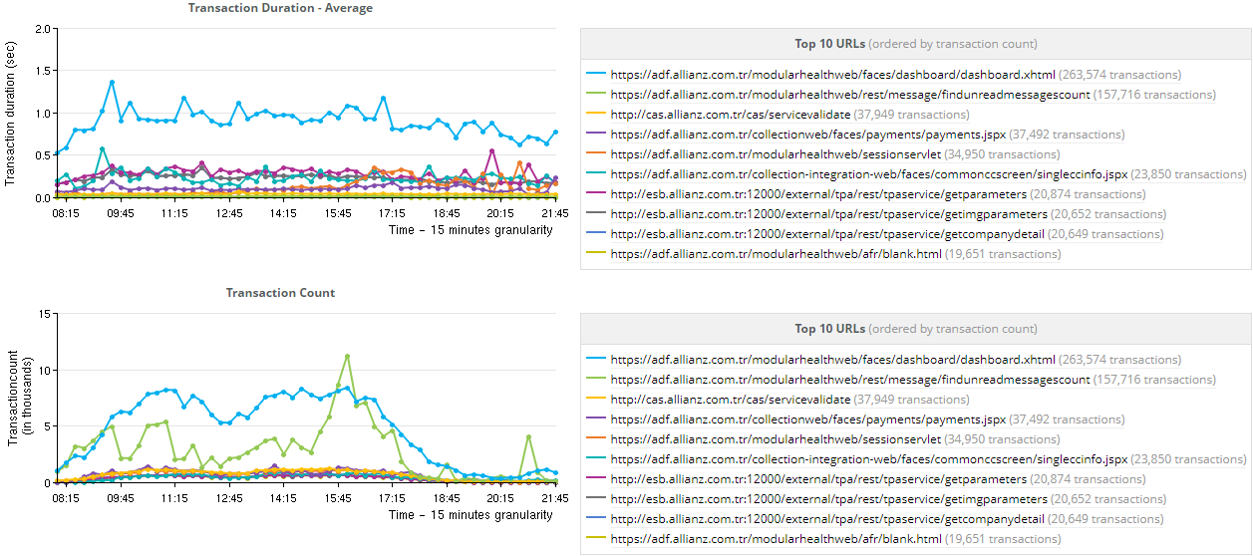
Inbound urller response süreleri ve transaction sayıları
PrimeIT
22.02.2023 08:00 – 22.02.2023 22:00
https://adf.allianz.com.tr
PrimeIT – Allianz
Notes:
url = ‘*adf.allianz.com.tr*' | timeseries -calc avg(responsetime),transactioncount() -limit 10 -order_by transactioncount() -group_by url
Top 200000

Slide 53
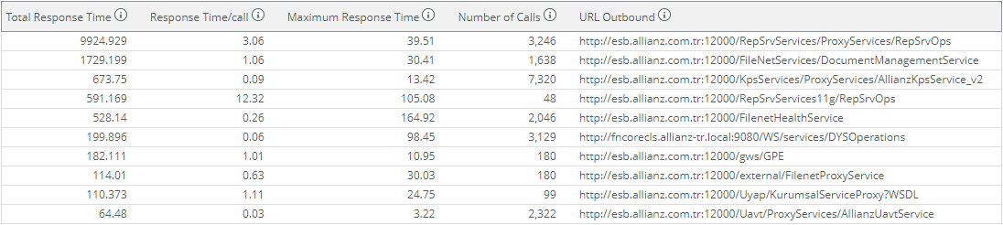
Outboundurl ler response süreleri ve transaction sayıları
PrimeIT
21.02.2023 08:00 – 21.02.2023 22:00
https://adf.allianz.com.tr
PrimeIT – Allianz
Notes:
url = ‘*adf.allianz.com.tr*' | calls -exclude_column 1 -exclude_column 2 -exclude_column 3 -limit 10 -sort_by total_duration -type urloutbound
Top 30000

Slide 54
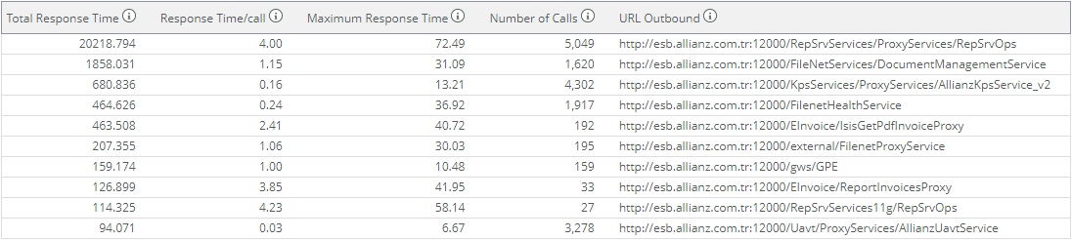
PrimeIT
22.02.2023 08:00 – 22.02.2023 22:00
Outboundurl ler response süreleri ve transaction sayıları
https://adf.allianz.com.tr
PrimeIT – Allianz
Notes:
url = ‘*adf.allianz.com.tr*' | calls -exclude_column 1 -exclude_column 2 -exclude_column 3 -limit 10 -sort_by total_duration -type urloutbound
Top 30000

Slide 55
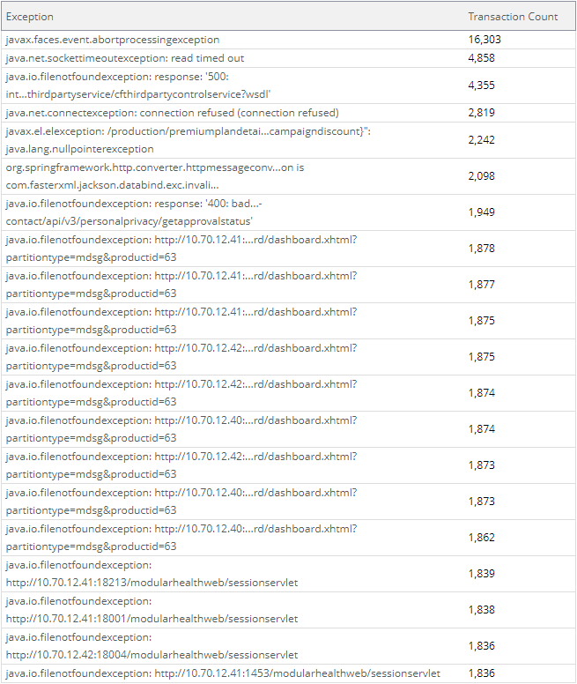
PrimeIT
21.02.2023 08:00 – 21.02.2023 22:00
En fazla alınan hatalar
https://adf.allianz.com.tr
PrimeIT – Allianz
Notes:
url = ‘*adf.allianz.com.tr*' | transactioncount -visualization table -limit 20 -group_by exception
Top 30000

Slide 56
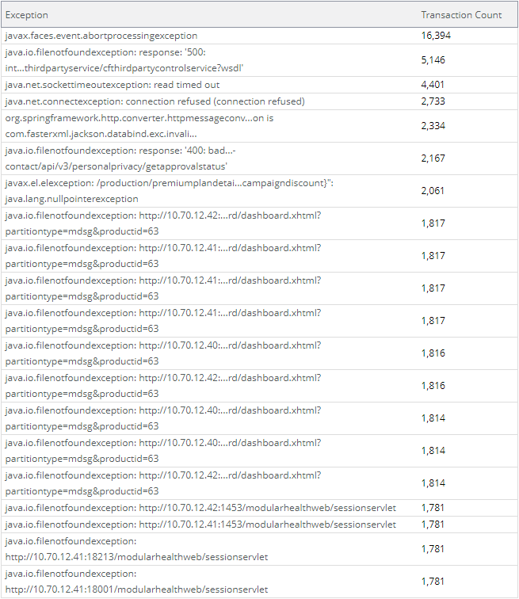
PrimeIT
22.02.2023 08:00 – 22.02.2023 22:00
En fazla alınan hatalar
https://adf.allianz.com.tr
PrimeIT – Allianz
Notes:
url = ‘*adf.allianz.com.tr*' | transactioncount -visualization table -limit 20 -group_by exception
Top 30000

Slide 57
PrimeIT
https://health.allianz.com.tr
Transaction typle’ların ortalama süreleri
En uzun response süresi olan Methodlar
Inbound url’ler response süreleri ve transaction sayıları
Outbond url’ler response süreleri ve transaction sayıları
En fazla alınan hatalar
PrimeIT – Allianz

Slide 58
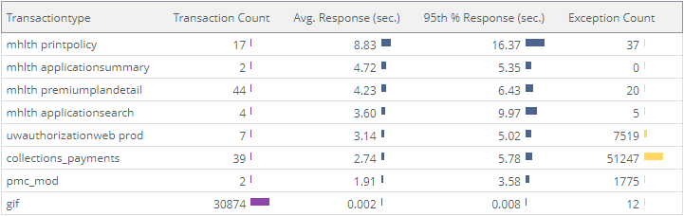
Transaction type’ların ortalama süreleri
PrimeIT
21.02.2023 08:00 – 21.02.2023 22:00
https://health.allianz.com.tr
PrimeIT – Allianz
Notes:
url = ‘*health.allianz.com.tr*’ | statistics -group_by transactiontype -sort_by avg_response_time
Top 200000
Gif ->cas, common-ui, personal-health-application-form-ui

Slide 59
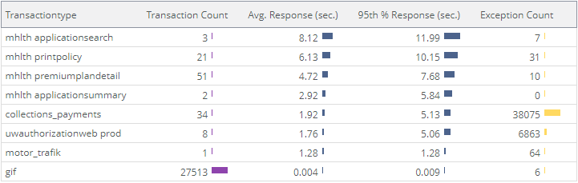
Transaction type’ların ortalama süreleri
PrimeIT
22.02.2023 08:00 – 22.02.2023 22:00
https://health.allianz.com.tr
PrimeIT – Allianz
Notes:
url = ‘*health.allianz.com.tr*’ | statistics -group_by transactiontype -sort_by avg_response_time
Top 200000
Gif ->cas, h2qi grouphealthportalweb, uwauthorazationweb, modularhealthweb, greencardweb, zytapp, collectionweb, modularcorparationweb, transportpolicyweb,

Slide 60

PrimeIT
21.02.2023 08:00 – 21.02.2023 22:00
En uzun response süresi olan Methodlar
https://health.allianz.com.tr
PrimeIT – Allianz
Notes:
url = ‘*health.allianz.com.tr*' AND transactiontype != 'gif' | calls -exclude_column 1 -exclude_column 2 -exclude_column 3 -limit 10 -type class.method -sort_by total_processing_time
Top 30000

Slide 61

PrimeIT
22.02.2023 08:00 – 22.02.2023 22:00
En uzun response süresi olan Methodlar
https://health.allianz.com.tr
PrimeIT – Allianz
Notes:
url = ‘*health.allianz.com.tr*' AND transactiontype != 'gif' | calls -exclude_column 1 -exclude_column 2 -exclude_column 3 -limit 10 -type class.method -sort_by total_processing_time
Top 30000

Slide 62

Inbound urller response süreleri ve transaction sayıları
PrimeIT
21.02.2023 08:00 – 21.02.2023 22:00
https://health.allianz.com.tr
PrimeIT – Allianz
Notes:
url = ‘*health.allianz.com.tr*' | timeseries -calc avg(responsetime),transactioncount() -limit 10 -order_by transactioncount() -group_by url
Top 200000

Slide 63

Inbound urller response süreleri ve transaction sayıları
PrimeIT
22.02.2023 08:00 – 22.02.2023 22:00
https://health.allianz.com.tr
PrimeIT – Allianz
Notes:
url = ‘*health.allianz.com.tr*' | timeseries -calc avg(responsetime),transactioncount() -limit 10 -order_by transactioncount() -group_by url
Top 200000

Slide 64

Outboundurl ler response süreleri ve transaction sayıları
PrimeIT
21.02.2023 08:00 – 21.02.2023 22:00
https://health.allianz.com.tr
PrimeIT – Allianz
Notes:
url = ‘*health.allianz.com.tr*' | calls -exclude_column 1 -exclude_column 2 -exclude_column 3 -limit 10 -sort_by total_duration -type urloutbound
Top 30000

Slide 65

PrimeIT
22.02.2023 08:00 – 22.02.2023 22:00
Outboundurl ler response süreleri ve transaction sayıları
https://health.allianz.com.tr
PrimeIT – Allianz
Notes:
url = ‘*health.allianz.com.tr*' | calls -exclude_column 1 -exclude_column 2 -exclude_column 3 -limit 10 -sort_by total_duration -type urloutbound
Top 30000

Slide 66

PrimeIT
21.02.2023 08:00 – 21.02.2023 22:00
En fazla alınan hatalar
https://health.allianz.com.tr
PrimeIT – Allianz
Notes:
url = ‘*health.allianz.com.tr*' | transactioncount -visualization table -limit 20 -group_by exception
Top 30000

Slide 67

PrimeIT
22.02.2023 08:00 – 22.02.2023 22:00
En fazla alınan hatalar
https://health.allianz.com.tr
PrimeIT – Allianz
Notes:
url = ‘*health.allianz.com.tr*' | transactioncount -visualization table -limit 20 -group_by exception
Top 30000

Slide 68
PrimeIT
https://hclm.allianz.com.tr
Transaction typle’ların ortalama süreleri
En uzun response süresi olan Methodlar
Inbound url’ler response süreleri ve transaction sayıları
Outbond url’ler response süreleri ve transaction sayıları
En fazla alınan hatalar
PrimeIT – Allianz

Slide 69
Transaction type’ların ortalama süreleri
PrimeIT
21.02.2023 08:00 – 21.02.2023 22:00
https://health.allianz.com.tr
PrimeIT – Allianz
Notes:
url = ‘*health.allianz.com.tr*’ | statistics -group_by transactiontype -sort_by avg_response_time
Top 200000
Gif ->health-claim-ui

Slide 70

Transaction type’ların ortalama süreleri
PrimeIT
22.02.2023 08:00 – 22.02.2023 22:00
https://health.allianz.com.tr
PrimeIT – Allianz
Notes:
url = ‘*health.allianz.com.tr*’ | statistics -group_by transactiontype -sort_by avg_response_time
Top 200000
Gif ->health-claim-ui

Slide 71

PrimeIT
21.02.2023 08:00 – 21.02.2023 22:00
En uzun response süresi olan Methodlar
https://health.allianz.com.tr
PrimeIT – Allianz
Notes:
url = ‘*health.allianz.com.tr*' AND transactiontype != 'gif' | calls -exclude_column 1 -exclude_column 2 -exclude_column 3 -limit 10 -type class.method -sort_by total_processing_time
Top 20000

Slide 72

PrimeIT
22.02.2023 08:00 – 22.02.2023 22:00
En uzun response süresi olan Methodlar
https://health.allianz.com.tr
PrimeIT – Allianz
Notes:
url = ‘*health.allianz.com.tr*' AND transactiontype != 'gif' | calls -exclude_column 1 -exclude_column 2 -exclude_column 3 -limit 10 -type class.method -sort_by total_processing_time
Top 20000

Slide 73

Inbound urller response süreleri ve transaction sayıları
PrimeIT
21.02.2023 08:00 – 21.02.2023 22:00
https://hclm.allianz.com.tr
PrimeIT – Allianz
Notes:
url = ‘*health.allianz.com.tr*' | timeseries -calc avg(responsetime),transactioncount() -limit 10 -order_by transactioncount() -group_by url
Top 200000

Slide 74

Inbound urller response süreleri ve transaction sayıları
PrimeIT
22.02.2023 08:00 – 22.02.2023 22:00
https://health.allianz.com.tr
PrimeIT – Allianz
Notes:
url = ‘*health.allianz.com.tr*' | timeseries -calc avg(responsetime),transactioncount() -limit 10 -order_by transactioncount() -group_by url
Top 200000

Slide 75

Outboundurl ler response süreleri ve transaction sayıları
PrimeIT
21.02.2023 08:00 – 21.02.2023 22:00
https://hclm.allianz.com.tr
PrimeIT – Allianz
Notes:
url = ‘*hclm.allianz.com.tr*' | calls -exclude_column 1 -exclude_column 2 -exclude_column 3 -limit 10 -sort_by total_duration -type urloutbound
Top 30000

Slide 76

PrimeIT
22.02.2023 08:00 – 22.02.2023 22:00
Outboundurl ler response süreleri ve transaction sayıları
https://hclm.allianz.com.tr
PrimeIT – Allianz
Notes:
url = ‘*hclm.allianz.com.tr*' | calls -exclude_column 1 -exclude_column 2 -exclude_column 3 -limit 10 -sort_by total_duration -type urloutbound
Top 30000

Slide 77

PrimeIT
21.02.2023 08:00 – 21.02.2023 22:00
En fazla alınan hatalar
https://hclm.allianz.com.tr
PrimeIT – Allianz
Notes:
url = ‘*hclm.allianz.com.tr*' | transactioncount -visualization table -limit 20 -group_by exception
Top 30000

Slide 78

PrimeIT
22.02.2023 08:00 – 22.02.2023 22:00
En fazla alınan hatalar
https://hclm.allianz.com.tr
PrimeIT – Allianz
Notes:
url = ‘*hclm.allianz.com.tr*' | transactioncount -visualization table -limit 20 -group_by exception
Top 30000

Slide 79
PrimeIT
https://services.allianz.com.tr
Transaction typle’ların ortalama süreleri
En uzun response süresi olan Methodlar
Inbound url’ler response süreleri ve transaction sayıları
Outbond url’ler response süreleri ve transaction sayıları
En fazla alınan hatalar
PrimeIT – Allianz

Slide 80

Transaction type’ların ortalama süreleri
PrimeIT
21.02.2023 08:00 – 21.02.2023 22:00
https://services.allianz.com.tr
PrimeIT – Allianz
Notes:
url = ‘*services.allianz.com.tr*’ | statistics -group_by transactiontype -sort_by avg_response_time
Top 200000
Gif ->cas, common-ui, personal-health-application-form-ui

Slide 81

Transaction type’ların ortalama süreleri
PrimeIT
22.02.2023 08:00 – 22.02.2023 22:00
https://services.allianz.com.tr
PrimeIT – Allianz
Notes:
url = ‘*services.allianz.com.tr*’ | statistics -group_by transactiontype -sort_by avg_response_time
Top 200000
Gif ->cas, h2qi grouphealthportalweb, uwauthorazationweb, modularhealthweb, greencardweb, zytapp, collectionweb, modularcorparationweb, transportpolicyweb,

Slide 82

PrimeIT
21.02.2023 08:00 – 21.02.2023 22:00
En uzun response süresi olan Methodlar
https://services.allianz.com.tr
PrimeIT – Allianz
Notes:
url = ‘*services.allianz.com.tr*' AND transactiontype != 'gif' | calls -exclude_column 1 -exclude_column 2 -exclude_column 3 -limit 10 -type class.method -sort_by total_processing_time
Top 20000

Slide 83

PrimeIT
22.02.2023 08:00 – 22.02.2023 22:00
En uzun response süresi olan Methodlar
https://services.allianz.com.tr
PrimeIT – Allianz
Notes:
url = ‘*services.allianz.com.tr*' AND transactiontype != 'gif' | calls -exclude_column 1 -exclude_column 2 -exclude_column 3 -limit 10 -type class.method -sort_by total_processing_time
Top 20000

Slide 84

Inbound urller response süreleri ve transaction sayıları
PrimeIT
21.02.2023 08:00 – 21.02.2023 22:00
https://services.allianz.com.tr
PrimeIT – Allianz
Notes:
url = ‘*services.allianz.com.tr*' | timeseries -calc avg(responsetime),transactioncount() -limit 10 -order_by transactioncount() -group_by url
Top 200000

Slide 85

Inbound urller response süreleri ve transaction sayıları
PrimeIT
22.02.2023 08:00 – 22.02.2023 22:00
https://services.allianz.com.tr
PrimeIT – Allianz
Notes:
url = ‘*services.allianz.com.tr*' | timeseries -calc avg(responsetime),transactioncount() -limit 10 -order_by transactioncount() -group_by url
Top 200000

Slide 86

Outboundurl ler response süreleri ve transaction sayıları
PrimeIT
21.02.2023 08:00 – 21.02.2023 22:00
https://services.allianz.com.tr
PrimeIT – Allianz
Notes:
url = ‘*services.allianz.com.tr*' | calls -exclude_column 1 -exclude_column 2 -exclude_column 3 -limit 10 -sort_by total_duration -type urloutbound
Top 30000

Slide 87

PrimeIT
22.02.2023 08:00 – 22.02.2023 22:00
Outboundurl ler response süreleri ve transaction sayıları
https://services.allianz.com.tr
PrimeIT – Allianz
Notes:
url = ‘*services.allianz.com.tr*' | calls -exclude_column 1 -exclude_column 2 -exclude_column 3 -limit 10 -sort_by total_duration -type urloutbound
Top 30000

Slide 88

PrimeIT
21.02.2023 08:00 – 21.02.2023 22:00
En fazla alınan hatalar
https://services.allianz.com.tr
PrimeIT – Allianz
Notes:
url = ‘*services.allianz.com.tr*' | transactioncount -visualization table -limit 20 -group_by exception
Top 30000

Slide 89

PrimeIT
22.02.2023 08:00 – 22.02.2023 22:00
En fazla alınan hatalar
https://services.allianz.com.tr
PrimeIT – Allianz
Notes:
url = ‘*services.allianz.com.tr*' | transactioncount -visualization table -limit 20 -group_by exception
Top 30000

