Slide 1

Introduction to Computing
Chapter 0
The AVR microcontroller
and embedded
systems
using assembly and c

Slide 2
Topics
Internal organization of computers
  The different parts of a computer
    I/O
    Memory
    CPU
  Connecting the different parts
    Connecting memory to CPU
    Connecting I/Os to CPU
  How computers work

Slide 3
Internal organization of computers
CPU
Memory
I/O
  Input
    E.g. Keyboard, Mouse, Sensor
  Output
    E.g. LCD, printer, hands of a robot

Slide 4
Memory
Everything that can store, retain, and recall information.
  E.g. hard disk, a piece of paper, etc.

Slide 5
Memory characteristics
Capacity
  The number of bits that a memory can store.
    E.g. 128 Kbits, 256 Mbits
Organization
  How the locations are organized
    E.g. a 128 x 4 memory has 128 locations, 4 bits each
Access time
  How long it takes to get data from memory
4 bits
0
1
2
128 locations
…
127

Slide 6
Semiconductor memories
ROM
  Mask ROM
  PROM (Programmable ROM)
  EPROM (Erasable PROM)
  EEPROM (Electronic Erasable PROM)
  Flash EPROM
RAM
  SRAM (Static RAM)
  DRAM (Dynamic RAM)

Slide 7
Memory\ROM\Mask ROM
Programmed by the IC manufacturer

Slide 8
Memory\ROM\PROM (Programmable ROM)
OTP (One-Time Programmable)
  You can program it only once

Slide 9

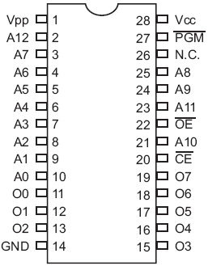
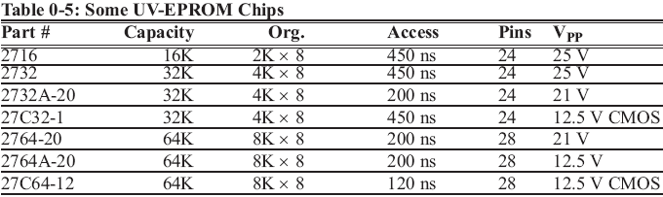
Memory\ROM\EPROM (Erasable Programmable ROM)
UV-EPROM
  You can shine ultraviolet (UV) radiation to erase it
  Erasing takes up to 20 minutes
  The entire contents of ROM are erased
2764

Slide 10
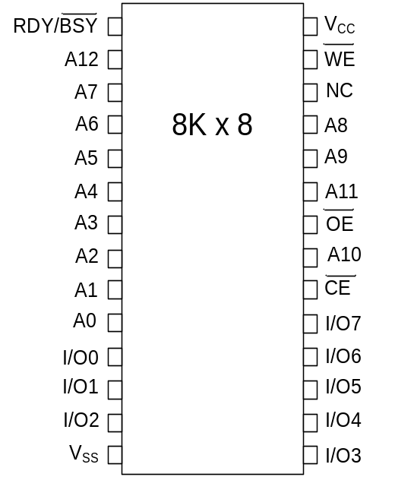
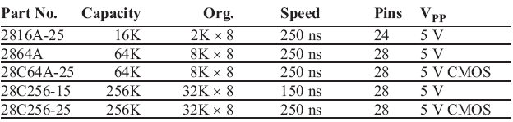
Memory\ROM\EEPROM (Electrically Erasable Programmable ROM)
Erased Electrically
  Erased instantly
  Each byte can be erased separately

Slide 11
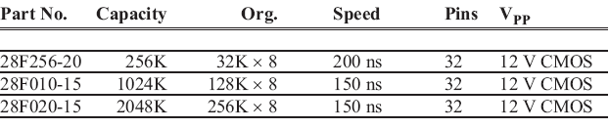
Memory\ROM\Flash ROM
Erased in a Flash
the entire device is erased at once

Slide 12
Semiconductor memories
ROM
  Mask ROM
  PROM (Programmable ROM)
  EPROM (Erasable PROM)
  EEPROM (Electronic Erasable PROM)
  Flash EPROM
RAM
  SRAM (Static RAM)
  DRAM (Dynamic RAM)

Slide 13
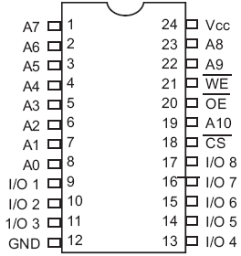
Memory\RAM\SRAM (Static RAM)
Made of flip-flops (Transistors)
Advantages:
  Faster
  No need for refreshing
Disadvantages:
  High power consumption
  Expensive
2K x 8
SRAM

Slide 14
Memory\RAM\DRAM (Dynamic RAM)
Made of capacitors
Advantages:
  Less power consumption
  Cheaper
  High capacity
Disadvantages:
  Slower
  Refresh needed

Slide 15
Internal parts of computers\CPU
Tasks:
  It should execute instructions
    It should recall the instructions one after another and execute them

Slide 16
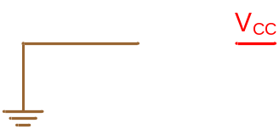
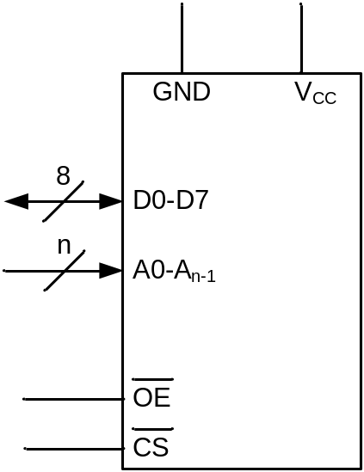

Connecting memory to CPU
Memory pin out

Slide 17
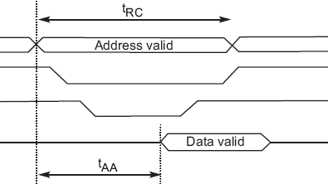
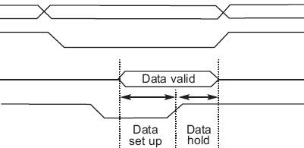
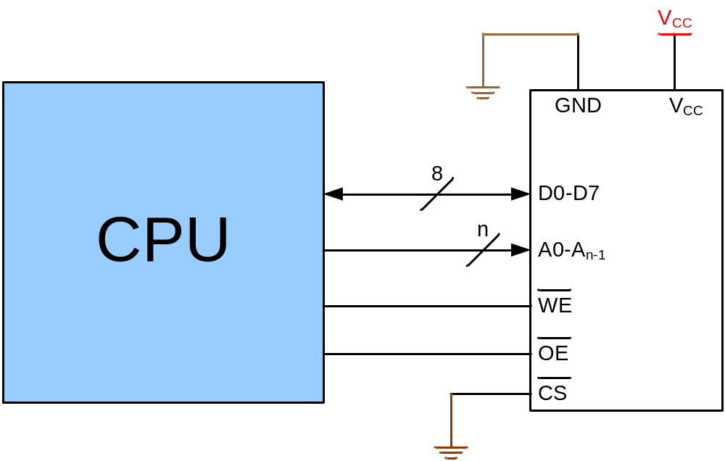
Connecting memory to CPU
Writing to memory
Reading from memory
Address
Address
CS
CS
OE
Data
Data
WE
WE
Time
Time

Slide 18
Connecting I/Os to CPU
CPU should have lots of pins!
Mouse
CPU
Network
Keyboard
Sound Card
Graphic Card

Slide 19
Connecting I/Os to CPU using bus
CPU
Address bus
Data bus
Control bus
Write
Read
I/O 0
I/O 1
I/O 2
I/O n

Slide 20
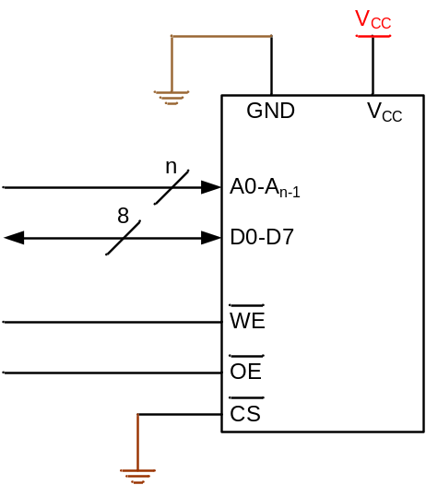
Connecting I/Os and Memory to CPU
CPU
Address bus
Data bus
Control bus
Write
Read
I/O 0
I/O 1
I/O 2
I/O n

Slide 21
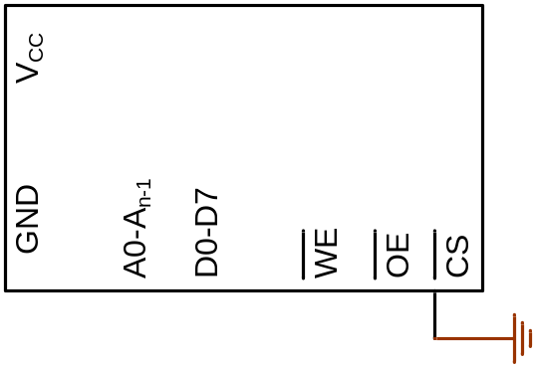
Connecting I/Os and memory to CPU using bus
0
1
2
3
How could we manage it?
CPU
0
Address bus
Data bus
Control bus
Write
Read
I/O 0
I/O 1
I/O 2
I/O n

Slide 22
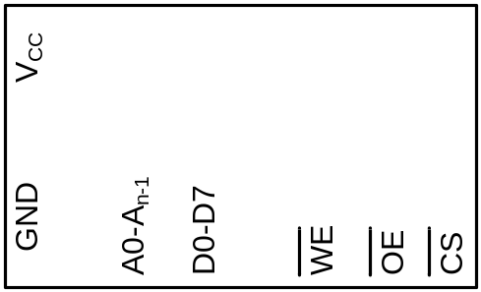
Connecting I/Os and Memory to CPU using bus
(Peripheral I/O)
0
1
..
63
CPU
Address bus
Data bus
Write
Control bus
Read
IO/MEM
I/O 0
I/O 1
I/O 2
I/O n

Slide 23
Connecting I/Os and Memory to CPU using bus
(Memory Mapped I/O)
The logic circuit enables CS when address is between 0 and 15
0
1
..
15
How could we make the logic circuit?
CPU
Logic circuit
Address bus
Data bus
Solution
1. Write the address range in binary
Control bus
Write
Read
2. Separate the fixed part of address
3. Using a NAND, design a logic circuit whose output activates when the fixed address is given to it.
a7
a6
a5
a4
a3
a2
a1
From address 0 ➔
a0
a4
0 0 0 0 0 0 0 0
I/O 17
I/O n
I/O 16
I/O 18
a5
CS
To address15 ➔
0 0 0 0 1 1 1 1
a6
a7

Slide 24
Another example for address decoder
Design an address decoder for address of 300H to 3FFH.
Solution
1. Write the address range in binary
2. Separate the fixed part of address
3. Design the logic circuit.
a10
a7
a6
a5
a3
a8
a9
a11
a8
a11 a10 a9 a8
a4
a2
a1
From address 300H ➔
a0
a9
0 0 1 1 0 0 0 0 0 0 0 0
a10
CS
To address 3FFH ➔
0 0 1 1
a11
0 0 1 1 1 1 1 1 1 1 1 1
An easy way of
designing

Slide 25
Inside the CPU
PC (Program Counter)
Instruction decoder
ALU (Arithmetic Logic Unit)
Registers
Status Flags
CPU
ALU
PC
A
B
C
Instruction decoder
D
registers
Status Flags

Slide 26
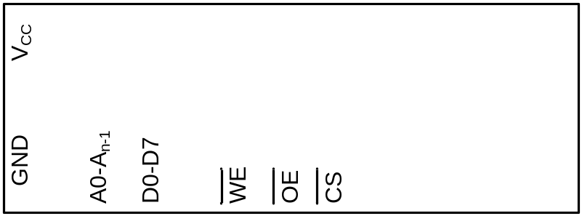
How computers work
31h
C4h
26h
81h
EAh
0h
5h
A← [17]
B ← A
A ← [6]
A←A+B
[7]←A
31
0
1
2
3
4
5
6
7
CPU
Address bus
Logic circuit
Status Flags
Data bus
Control bus
Write
Read
ALU
A
B
PC:
1
C
0
0
D
I/O 16
I/O 17
I/O 18
I/O n
Inst. Dec.
registers

Slide 27
How computers work
31h
C4h
26h
81h
EAh
0h
5h
A← [17]
B ← A
A ← [6]
A←A+B
[7]←A
0
1
2
3
4
5
6
7
CPU
Address bus
17
Logic circuit
Status Flags
Data bus
Control bus
Write
Read
ALU
A
B
PC:
1
C
9
D
I/O 16
I/O 17
I/O 18
I/O n
Inst. Dec.
registers
31

Slide 28
How computers work
31h
C4h
26h
81h
EAh
0h
5h
A← [17]
B ← A
A ← [6]
A←A+B
[7]←A
0
1
2
3
4
5
6
7
C4
26
5
CPU
17
Logic circuit
Address bus
6
Status Flags
Data bus
Control bus
Write
Read
9
ALU
9
A
B
PC:
1
2
2
1
C
3
D
I/O 16
I/O 17
I/O 18
I/O n
Inst. Dec.
registers

Slide 29
How computers work
31h
C4h
26h
81h
EAh
0h
5h
A← [17]
B ← A
A ← [6]
A←A+B
[7]←A
0
1
2
3
4
5
6
7
81
EA
CPU
Address bus
7
Logic circuit
Status Flags
Data bus
Eh
Control bus
Write
Read
E
5
ALU
5
+
A
E
9
9
B
PC:
4
4
3
C
3
5
D
I/O 16
I/O 17
I/O 18
I/O n
Inst. Dec.
registers

Slide 30
How Instruction decoder works
Opcode
Operand
Opcode
Operand
Instruction
Instruction
Operation Code | Meaning
000 | A ← x
001 | A ← [x]
010 | A ← A – register (x)
011 | A ← A + x
100 | A ← A + register (x)
101 | A ← A – x
110 | Register (x_{H}) ← Register (x_{L})
111 | [x] ← A
0011 0001
1100 0100
0010 0110
1000 0001
1110 1010
0000 0000
0000 0101
31h
C4h
26h
81h
EAh
0h
5h
A← [17]
B ← A
A ← [6]
A←A+B
[7]←A
0
1
2
3
4
5
6
7

Slide 31
Von Neumann vs. Harvard architecture
CPU
Code
Memory
Data bus
Data bus
Data
Memory
Address bus
Address bus
Control bus
Control bus
Harvard architecture
Code
Memory
Data
Memory
CPU
Data bus
Address bus
Control bus
Von Neumann architecture

Slide 32
Rastgele Erişimli Bellek
(Random Access Memory: RAM)

Slide 33
Bir bellek biriminin blok diyagramı
n veri giriş hatları
k adres hattı
Okuma
Yazma
Sözcük başına n bitlik
2^{k} sözcüklü
2^{k} x n’lik bellek birimi
n veri çıkış hatları

Slide 34
1024x16’lık bir belleğin içeriği
Bellek Adresi
İkili
0000000000
0000000001
0000000010
1111111101
1111111110
1111111111
Onlu
0
1
2
•
•
•
•
1021
1022
1023
AACFLRZ0
Bellek içeriği
1011010101011101
1010101110001001
0000110101000110
•
•
•
•
1001110100010100
0000110100011110
1101111000100101

Slide 35
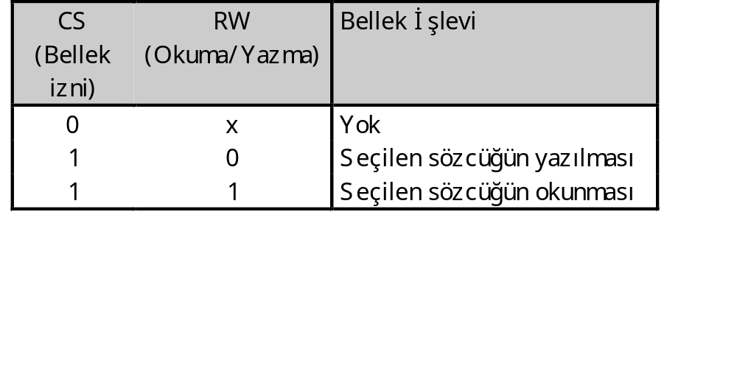
Bir bellek biriminin blok diyagramı
2^{k} x n bellek
VERİ ÇIKIŞ
ADRS
CS
RW
n
n
k

Slide 36
Bellek hücresi
Seçme
Giriş
BC
Çıkış
Seçme
Okuma/Yazma
Blok Diyagramı
S
Çıkış
Giriş
R
Okuma/Yazma
Lojik Diyagramı

Slide 37
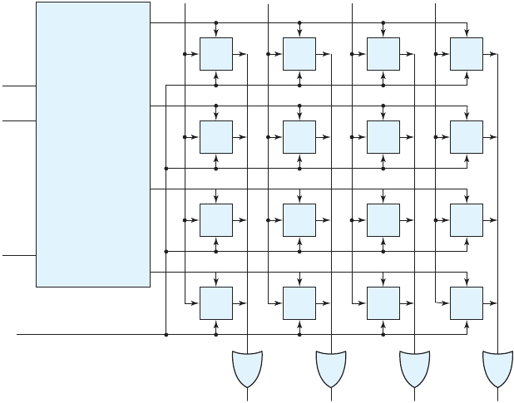
4x4 RAM’ın Lojik Yapısı
Veri Girişleri
Sözcük 0
BC
BC
BC
BC
Address
girişleri
Sözcük 1
BC
BC
BC
BC
2 x 4
Dekoder
Sözcük 2
BC
BC
BC
BC
Bellek izni
CS
Sözcük 3
BC
BC
BC
BC
Okuma/Yazma
Veri Çıkışları

Slide 38
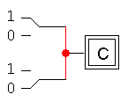
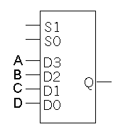
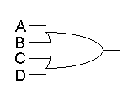
Çıkış Sinyallerinin Birleştirilmesi
Tüm çıkışları doğrudan birbirine bağlamak hatalıdır. Farklı hücrelerin çıkışları farklı olursa çakışma yaşanır.
Çıkışları birleştirmenin ilk akla gelebilecek yolu VEYA kapıları ya da MUX (veri seçici) kullanmaktır.
Bu çözüm pek de iyi değildir. İletkenlerin bağlanması ve çok fazla sayıda girişe sahip kapı tasarlanması işleri karmaşıklaştırır.

Slide 39
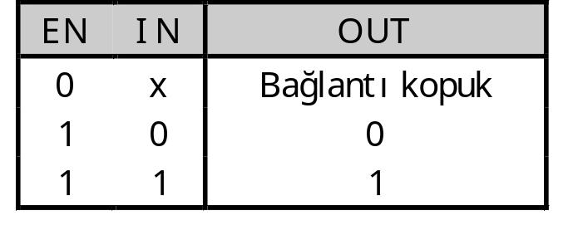

3-durumlu tampon (buffer)
EN girişi bulunan aşağıdaki tampon 3-durumlu tampon’dur.
Normal lojik kapılardan farklı olarak, çıkış sinyali 3 farklı duruma sahip olabilir.
“Bağlantı kopuk” herhangi bir çıkış değerinin görünmemesidir. Bağlantı telin kopmasıyla aynı durum demektir. Bu durum teknik olarak yüksek empedans (high impedance) veya Hi-Z ile de ifade edilir.

Slide 40
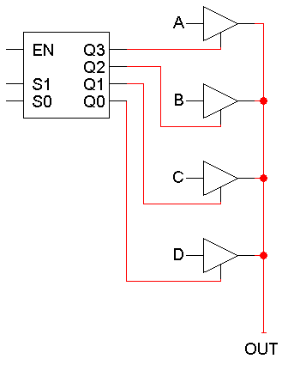
3-durumlu tamponların birlikte bağlantısı
3-durumlu tamponlardan herhangi bir anda sadece birinin aktifleştirileceği garanti ediliyorsa, bu tamponların çıkışları birbirine bağlanabilir.
Bunu yapmanın en kolay yolu dekoder kullanmaktır!
Dekoder aktifleştirilmemişse tüm 3 durumlu tamponların çıkış ile bağlantısı kopuk demektir ve herhangi bir çıkış alınmaz.
Dekoder aktifleştirilmişse, sadece bir tane çıkışı 1 olabilir ve bu sayede 3 durumlu tamponlardan sadece 1 tanesi çıkışa bağlanmış olur.

Slide 41
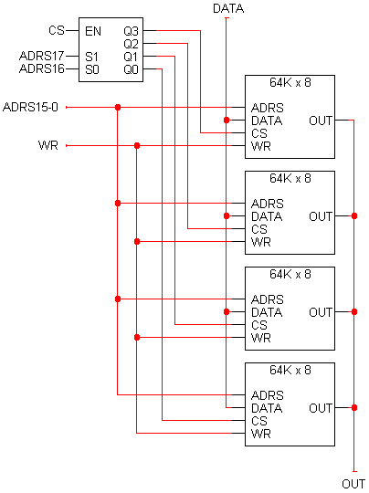
64K x 8 RAM’lerden 256K x 8 RAM
8
16
8

Slide 42
Adres aralıkları
8
16
11 1111 1111 1111 1111 (0x3ffff)
to
11 0000 0000 0000 0000 (0x30000)
10 1111 1111 1111 1111 (0x2ffff)
to
10 0000 0000 0000 0000 (0x20000)
01 1111 1111 1111 1111 (0x1ffff)
to
01 0000 0000 0000 0000 (0x10000)
00 1111 1111 1111 1111 (0x0ffff)
to
00 0000 0000 0000 0000 (0x00000)
8

Slide 43
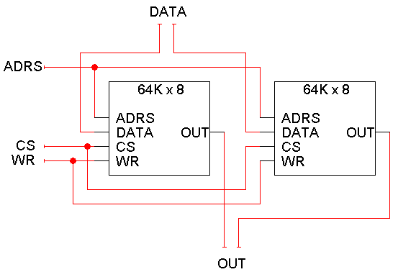
64K x 16 RAM
8
8
16
8
8

