Slide 1

Introduction to AVR
Chapter 1
The AVR microcontroller
and embedded
systems
using assembly and c

Slide 2
General Purpose Microprocessors vs. Microcontrollers
General Purpose Microprocessors
General
Purpose
Micro
processor
Data BUS
RAM
ROM
Timer
Serial
COM
Port
IO
Port
Address BUS
Control BUS
Microcontrollers
CPU
RAM
ROM
Serial
Port
Timer
I/O

Slide 3
Most common microcontrollers
8-bit microcontrollers
  AVR
  PIC
  HCS12
  8051
32-bit microcontrollers
  ARM
  PIC32

Slide 4
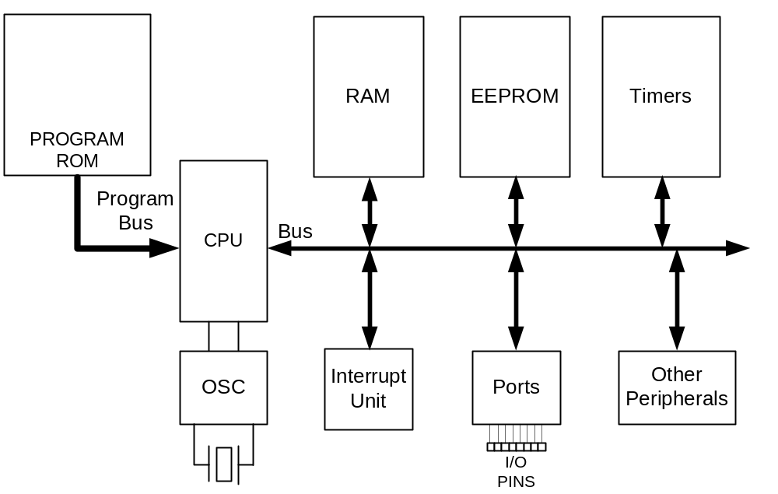
AVR internal architecture

Slide 5
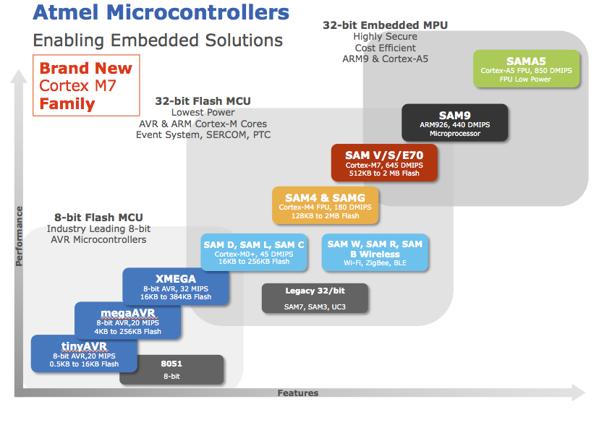
* Image taken from https://atmelcorporation.wordpress.com/tag/microcontroller-for-medical-devices/

Slide 6

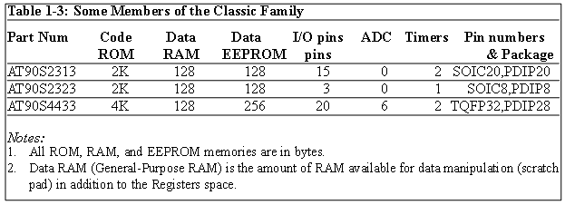
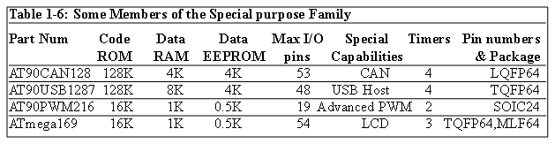
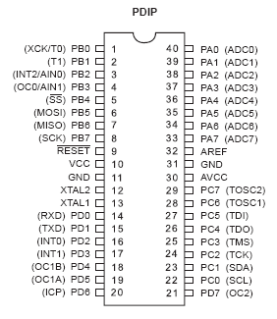
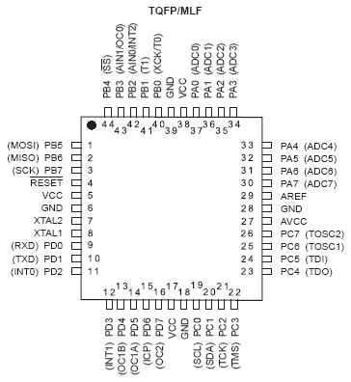
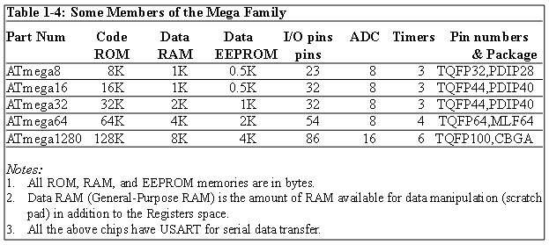
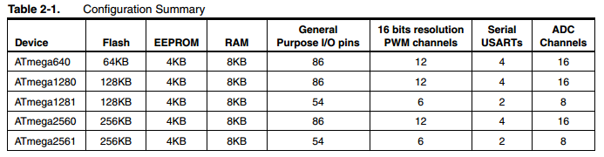
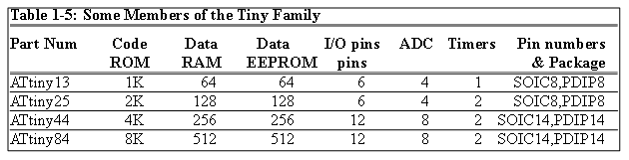
AVR different groups
Classic AVR
  e.g. AT90S2313, AT90S4433
Mega
  e.g. ATmega8, ATmega32, ATmega128
Tiny
  e.g. ATtiny13, ATtiny25
Special Purpose AVR
  e.g. AT90PWM216,AT90USB1287

Slide 7
Let’s get familiar with the AVR part numbers
ATmega2560
Atmel
group
Flash =256K
ATtiny44
AT90S4433
Atmel
Tiny group
Flash =4K
Atmel
Classic group
Flash =4K

Slide 8
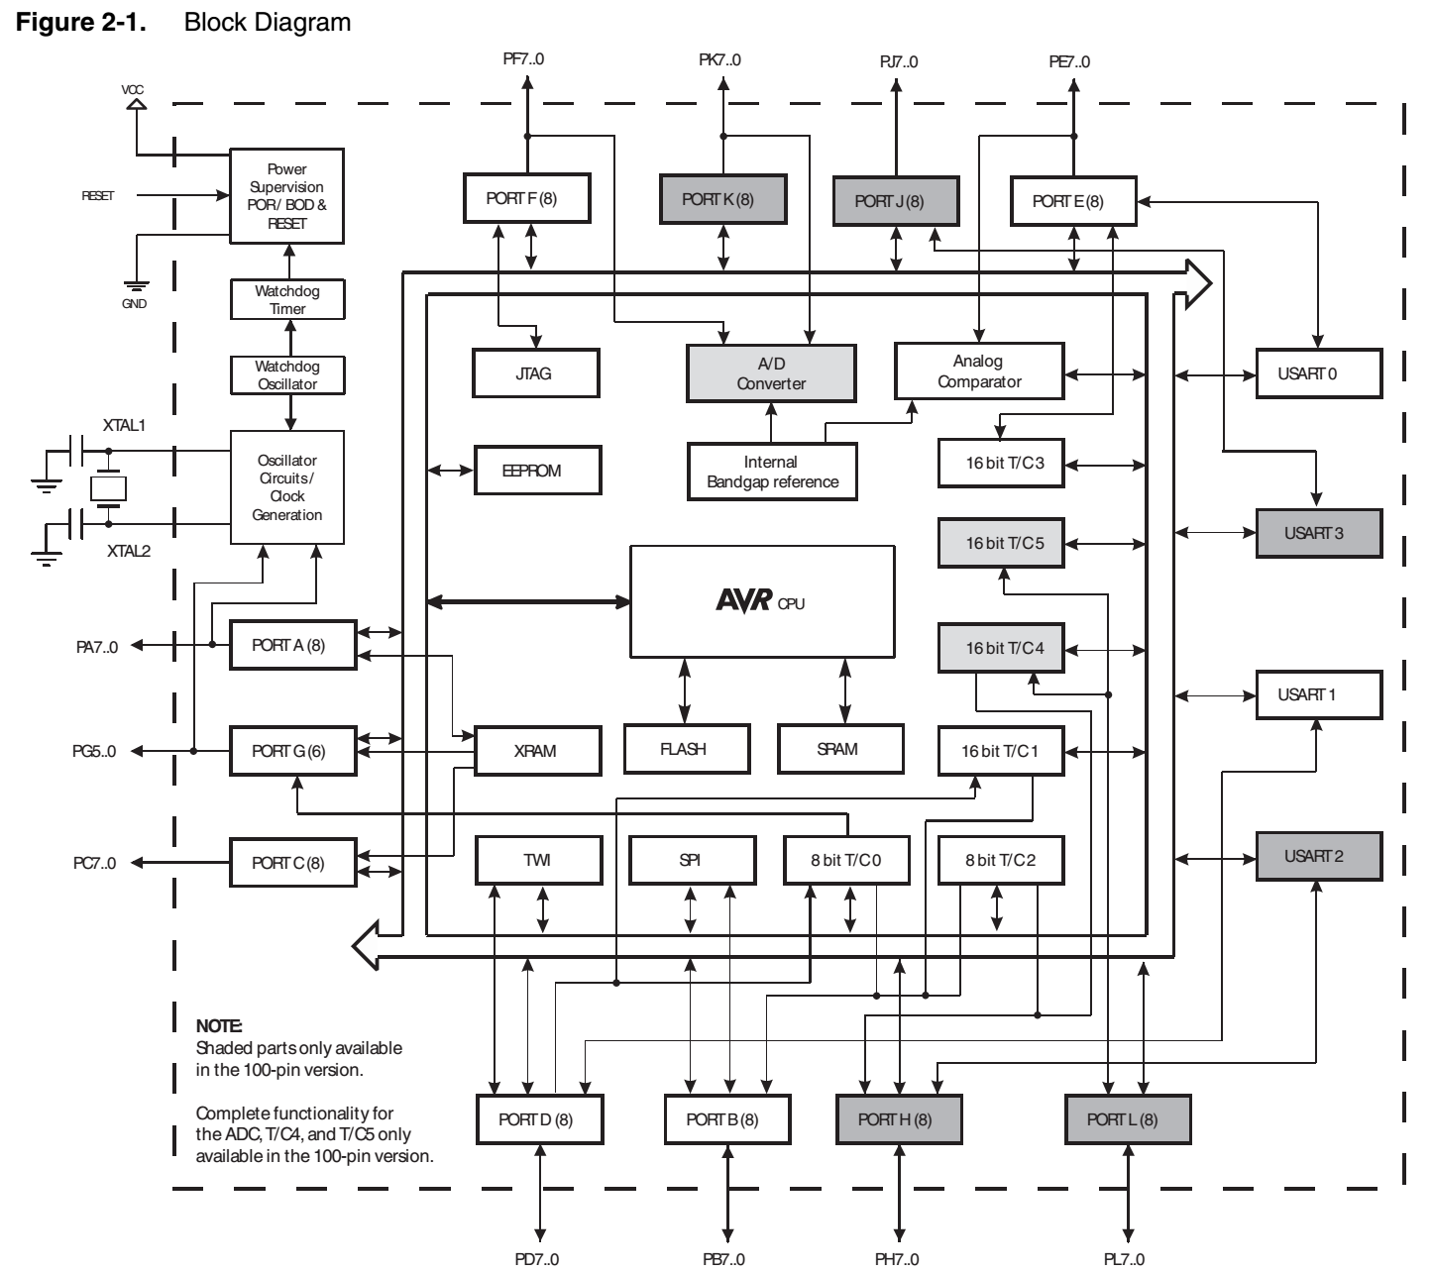

Slide 9
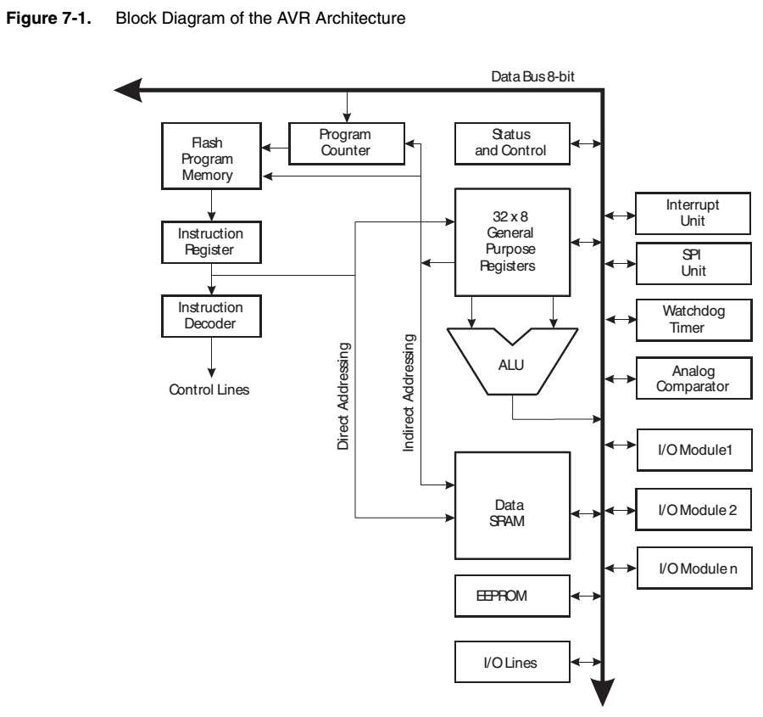

Slide 10
