Slide 1

Introduction to Assembly
Chapter 2
The AVR microcontroller
and embedded
systems
using assembly and c

Slide 2
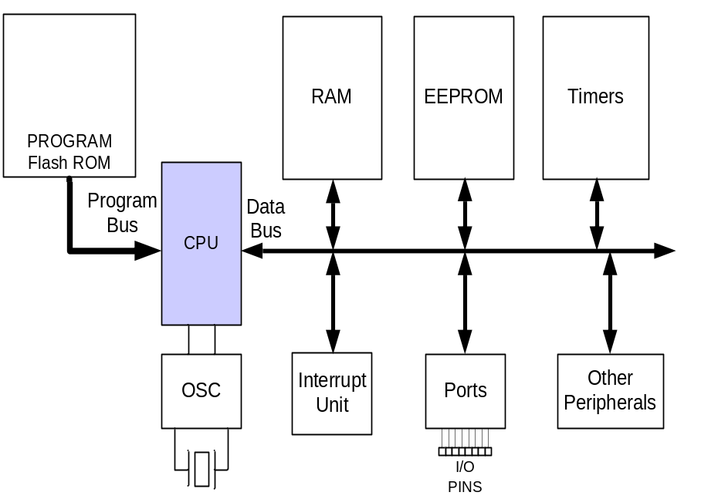
Topics
AVR’s CPU
  Its architecture
  Some simple programs
Data Memory access
Program memory
RISC architecture

Slide 3
AVR’s CPU
AVR’s CPU
  ALU
  32 General Purpose registers (R0 to R31)
  PC register
  Instruction decoder
CPU
ALU
R0
R1
R2
…
SREG:
H
N
Z
I
T
S
V
C
R15
R16
R17
PC
…
Instruction decoder
R30
R31
Instruction Register
registers

Slide 4
Some simple instructions
1. Loading values into the general purpose registers
LDI (Load Immediate)
LDI Rd, k
  Its equivalent in high level languages:
  Rd = k
Example:
  LDI R16,53
    R16 = 53
  LDI R19,132
  LDI R23,0x27
    R23 = 0x27
CPU
ALU
R0
R1
R2
…
SREG:
H
N
Z
I
T
S
V
C
R15
R16
R17
PC
…
Instruction decoder
R30
R31
Instruction Register
registers

Slide 5
Some simple instructions
2. Arithmetic calculation
There are some instructions for doing Arithmetic and logic operations; such as:
  ADD, SUB, MUL, AND, etc.
ADD Rd,Rs
  Rd = Rd + Rs
  Example:
  ADD R25, R9
    R25 = R25 + R9
  ADD R17,R30
    R17 = R17 + R30
CPU
ALU
R0
R1
R2
…
SREG:
H
N
Z
I
T
S
V
C
R15
R16
R17
PC
…
Instruction decoder
R30
R31
Instruction Register
registers

Slide 6
A simple program
Write a program that calculates 19 + 95
LDI R16, 19 ;R16 = 19
LDI R20, 95 ;R20 = 95
ADD R16, R20 ;R16 = R16 + R20
CPU
ALU
R0
R1
R2
…
SREG:
H
N
Z
I
T
S
V
C
R15
R16
R17
PC
…
Instruction decoder
R30
R31
Instruction Register
registers

Slide 7
A simple program
Write a program that calculates 19 + 95 + 5
LDI R16, 19 ;R16 = 19
LDI R20, 95 ;R20 = 95
LDI R21, 5 ;R21 = 5
ADD R16, R20 ;R16 = R16 + R20
ADD R16, R21 ;R16 = R16 + R21
LDI R16, 19 ;R16 = 19
LDI R20, 95 ;R20 = 95
ADD R16, R20 ;R16 = R16 + R20
LDI R20, 5 ;R20 = 5
ADD R16, R20 ;R16 = R16 + R20

Slide 8
Some simple instructions
2. Arithmetic calculation
SUB Rd,Rs
  Rd = Rd - Rs
Example:
  SUB R25, R9
    R25 = R25 - R9
  SUB R17,R30
    R17 = R17 - R30
CPU
ALU
R0
R1
R2
…
SREG:
H
N
Z
I
T
S
V
C
R15
R16
R17
PC
…
Instruction decoder
R30
R31
Instruction Register
registers

Slide 9
Some simple instructions
2. Arithmetic calculation
INC Rd
  Rd = Rd + 1
Example:
  INC R25
    R25 = R25 + 1
DEC Rd
  Rd = Rd - 1
Example:
  DEC R23
    R23 = R23 - 1
CPU
ALU
R0
R1
R2
…
SREG:
H
N
Z
I
T
S
V
C
R15
R16
R17
PC
…
Instruction decoder
R30
R31
Instruction Register
registers

Slide 10
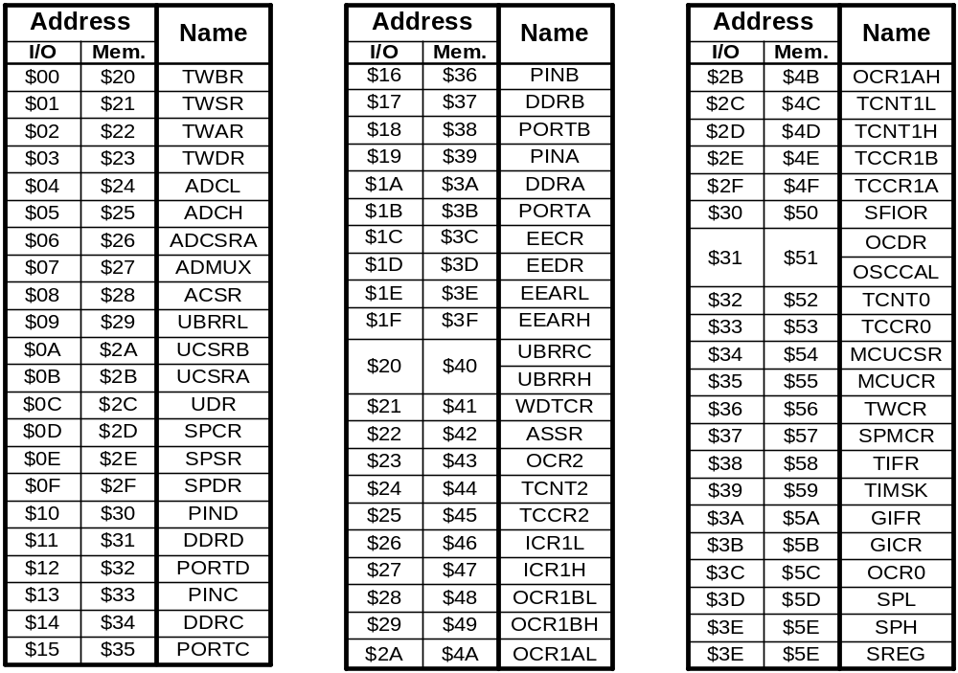
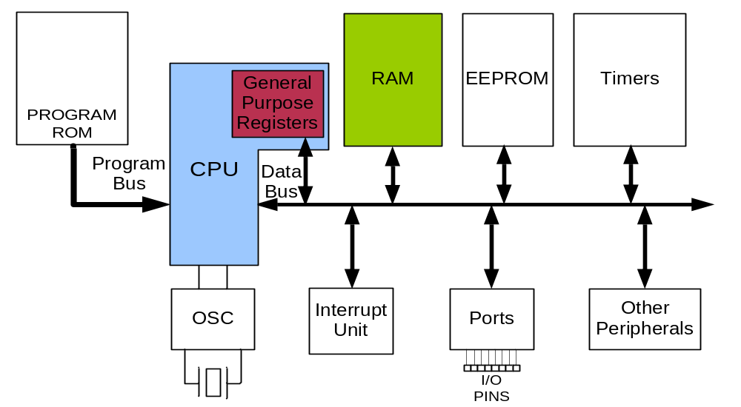
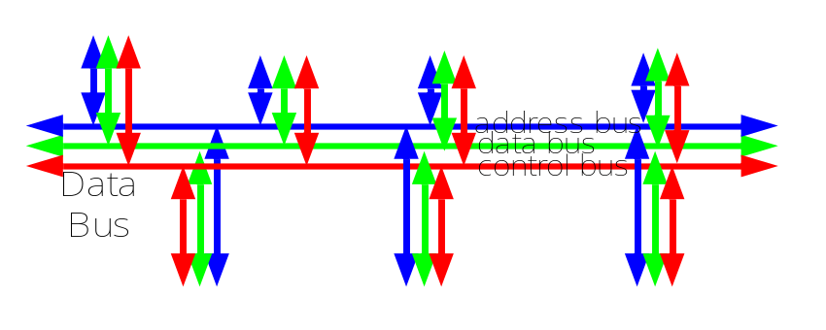
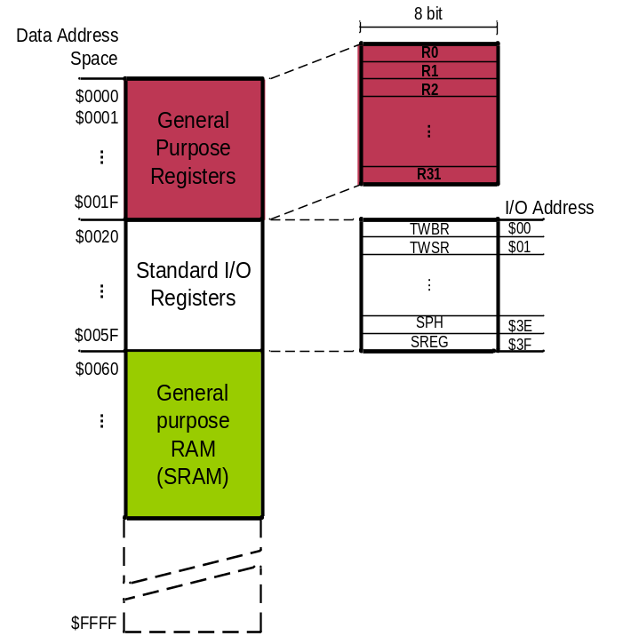
Data Address Space
Example: Add contents of location 0x90 to contents of location 0x95 and store the result in location 0x313.
Example: Store 0x53 into the SPH register. The address of SPH is 0x5E
Example: What does the following instruction do?
LDS R20,2
LDS (Load direct from data space)
STS (Store direct to data space)
Example: Write a program that stores 55 into location 0x80 of RAM.
Example: Write a program that copies the contents of location 0x80 of RAM into location 0x81.
Solution:
LDS R20, 0x90 ;R20 = [0x90]
LDS R21, 0x95 ;R21 = [0x95]
ADD R20, R21 ;R20 = R20 + R21
STS 0x313, R20 ;[0x313] = R20
LDS Rd, addr ;Rd = [addr]
STS addr,Rd ;[addr]=Rd
Solution:
LDI R20, 0x53 ;R20 = 0x53
STS 0x5E, R20 ;SPH = R20
Solution:
LDI R20, 55 ;R20 = 55
STS 0x80, R20 ;[0x80] = R20 = 55
Answer:
It copies the contents of R2 into R20; as 2 is the address of R2.
Example:
LDS R1, 0x60
Example:
STS 0x60,R15 ; [0x60] = R15
Solution:
LDS R20, 0x80 ;R20 = [0x80]
STS 0x81, R20 ;[0x81] = R20 = [0x80]

Slide 11
Data Address Space
Example: Write a program that adds the contents of the PINC IO register to the contents of PIND and stores the result in location 0x90 of the SRAM
OUT (OUT to IO location)
IN (IN from IO location)
Solution:
IN R20,PINC ;R20 = PINC
IN R21,PIND ;R21 = PIND
ADD R20,R21 ;R20 = R20 + R21
STS 0x90,R20 ;[0x90] = R20
OUT IOAddr,Rd ;[addr]=Rd
IN Rd,IOaddress ;Rd = [addr]
Using Names of IO registers
Example:
OUT SPH,R12 ;OUT 0x3E,R12
IN R15,SREG ;IN R15,0x3F
Example:
OUT 0x3F,R12 ;SREG = R12
OUT 0x3E,R15 ;SPH = R15
Example:
IN R1, 0x3F ;R1 = SREG
IN R17,0x3E ;R17 = SPH

Slide 12
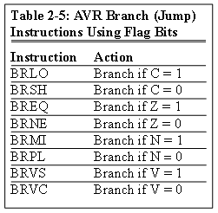
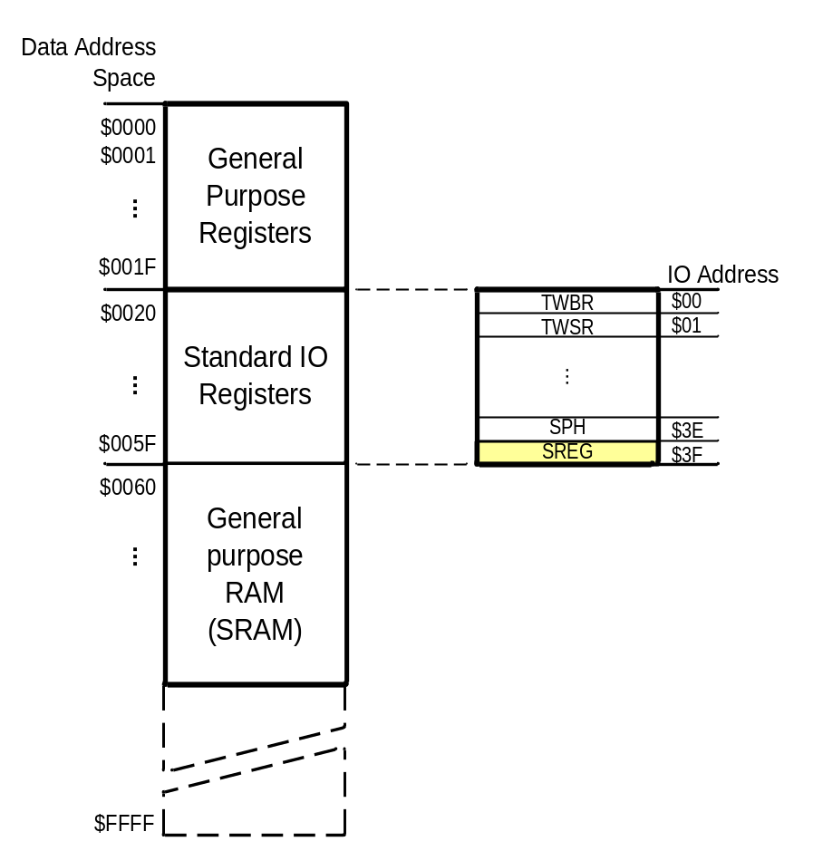
Status Register (SREG)
SREG:
I
T
H
S
V
N
Z
C
Interrupt
Carry
oVerflow
Zero
Temporary
Sign
N+V
Negative
Half carry
Example: Show the status of the C, H, and Z flags after the subtraction of 0x9C from 0x9C in the following instructions:
LDI R20, 0x9C
LDI R21, 0x9C
SUB R20, R21 ;subtract R21 from R20
Example: Show the status of the C, H, and Z flags after the subtraction of 0x23 from 0xA5 in the following instructions:
LDI R20, 0xA5
LDI R21, 0x23
SUB R20, R21 ;subtract R21 from R20
Example: Show the status of the C, H, and Z flags after the subtraction of 0x73 from 0x52 in the following instructions:
LDI R20, 0x52
LDI R21, 0x73
SUB R20, R21 ;subtract R21 from R20
Example: Show the status of the C, H, and Z flags after the addition of 0x9C and 0x64 in the following instructions:
LDI R20, 0x9C
LDI R21, 0x64
ADD R20, R21 ;add R21 to R20
Example: Show the status of the C, H, and Z flags after the addition of 0x38 and 0x2F in the following instructions:
LDI R16, 0x38 ;R16 = 0x38
LDI R17, 0x2F ;R17 = 0x2F
ADD R16, R17 ;add R17 to R16
CPU
ALU
R0
R1
R2
…
SREG:
Solution:
$52 0101 0010
- $73 0111 0011
$DF 1101 1111 R20 = $DF
C = 1 because R21 is bigger than R20 and there is a borrow from D8 bit.
Z = 0 because the R20 has a value other than zero after the subtraction.
H = 1 because there is a borrow from D4 to D3.
I
T
H
S
V
N
Z
C
Solution:
$9C 1001 1100
- $9C 1001 1100
$00 0000 0000 R20 = $00
C = 0 because R21 is not bigger than R20 and there is no borrow from D8 bit.
Z = 1 because the R20 is zero after the subtraction.
H = 0 because there is no borrow from D4 to D3.
Solution:
$A5 1010 0101
- $23 0010 0011
$82 1000 0010 R20 = $82
C = 0 because R21 is not bigger than R20 and there is no borrow from D8 bit.
Z = 0 because the R20 has a value other than 0 after the subtraction.
H = 0 because there is no borrow from D4 to D3.
Solution: 1
$9C 1001 1100
+ $64 0110 0100
$100 1 0000 0000 R20 = 00
C = 1 because there is a carry beyond the D7 bit.
H = 1 because there is a carry from the D3 to the D4 bit.
Z = 1 because the R20 (the result) has a value 0 in it after the addition.
Solution: 1
$38 0011 1000
+ $2F 0010 1111
$67 0110 0111 R16 = 0x67
C = 0 because there is no carry beyond the D7 bit.
H = 1 because there is a carry from the D3 to the D4 bit.
Z = 0 because the R16 (the result) has a value other than 0 after the addition.
R15
R16
R17
PC
…
Instruction decoder
R30
R31
Instruction Register
registers

