Slide 1

Introduction to Assembly
Chapter 2
The AVR microcontroller
and embedded
systems
using assembly and c

Slide 2
Assembler Directives
.EQU and .SET
.EQU name = value
  Example:
.EQU COUNT = 0x25
  LDI R21, COUNT ;R21 = 0x25
  LDI R22, COUNT + 3 ;R22 = 0x28
.SET name = value
  Example:
  .SET COUNT = 0x25
  LDI R21, COUNT ;R21 = 0x25
  LDI R22, COUNT + 3 ;R22 = 0x28
  .SET COUNT = 0x19
  LDI R21, COUNT ;R21 = 0x19

Slide 3
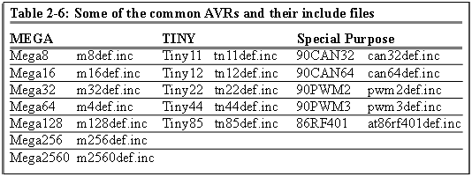
Assembler Directives
.INCLUDE
.INCLUDE “filename.ext”
M32def.inc
.equ SREG = 0x3f
.equ SPL = 0x3d
.equ SPH = 0x3e
....
.equ INT_VECTORS_SIZE = 42 ; size in words
Program.asm
.INCLUDE “M32DEF.INC”
LDI R20, 10
OUT SPL, R20

Slide 4
Assembler Directives
.ORG
.ORG address
00 E205
01 0000
02 0000
03 0000
04 0000
05 0000
06 0000
07 E314
08 E321
09 0000
0A 0000
Program.asm
.ORG 0
LDI R16, 0x25
.ORG 0x7
LDI R17, 0x34
LDI R18, 0x31
assembler

Slide 5
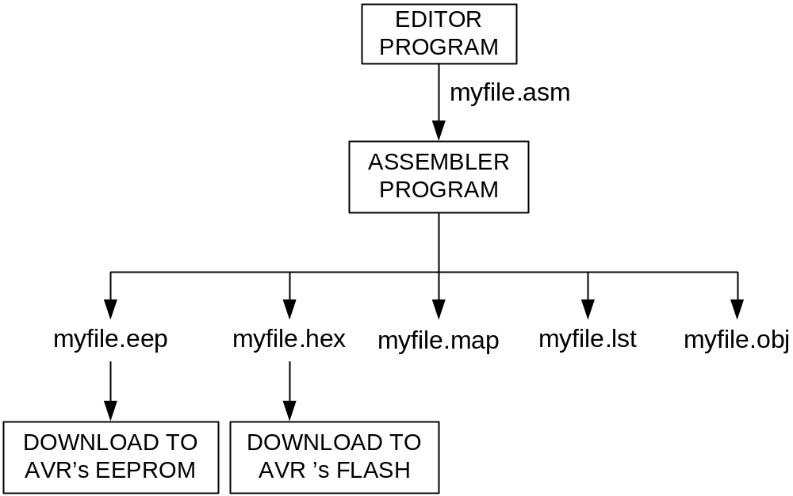
Assembler
Assembly
assembler
Machine
Language

