Slide 1


ROBOT GAMES
Oğuz Kağan EREN
Kağan EŞBAH
Yıldırım YANIKLARDAN

Slide 2

CONTENT
Description
Weekly Progress
Our differences

Slide 3
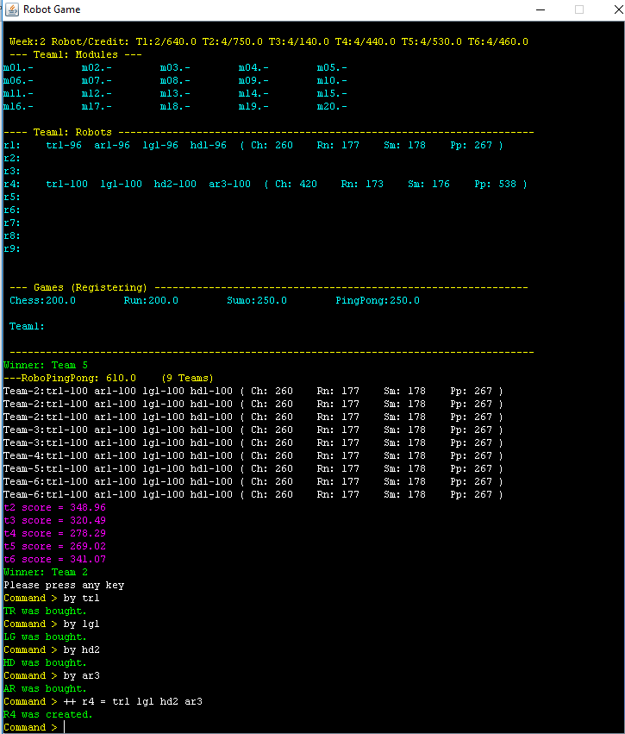
Description of the game

Slide 4
Modules(1-6)
Torso
Head
Legs
Arms

Slide 5
Robots(1-9)
Building a robot
++ robot name
Module name
Inventory name
Dividing a robot
-- robot name

Slide 6
Register
The Games you can register;
RoboChess
RoboRun
RoboSumo
RoboPingPong

Slide 7
Stages of the play
Playing A.I
Writing register robots
Calculating teams scores
Finding winners and giving prizes

Slide 8
Weekly PROGRESS

Slide 9
How did we do in the first week?
We determine;
what to do ?
how to start ?
what to search ?
what to use ?
we started;
Learn classes,
Print screen and basic operations.

Slide 10
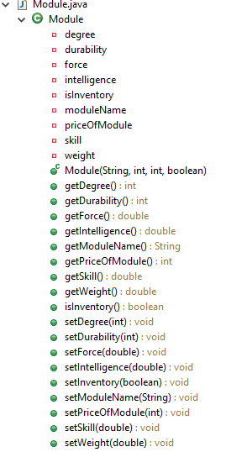
How did we do in the second week?
We started;
We have determined which classes are to be found.
Creating module class
This week also was the week where we individually learnt so much stuff from each other.

Slide 11
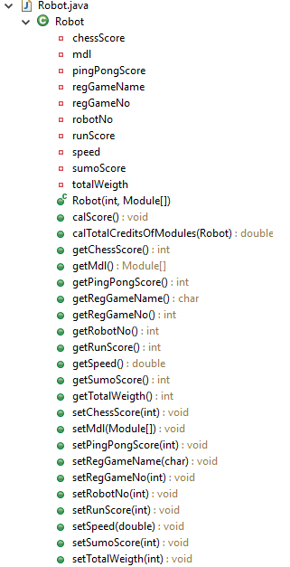
How did we do in the third week?
Creating robot class
Creating team class
We decided how to do artificial intelligence.

Slide 12

How did we do in the fourth week?
Preparing to presentation
We finished the project
This was a brain-burning experience for most of us

Slide 13
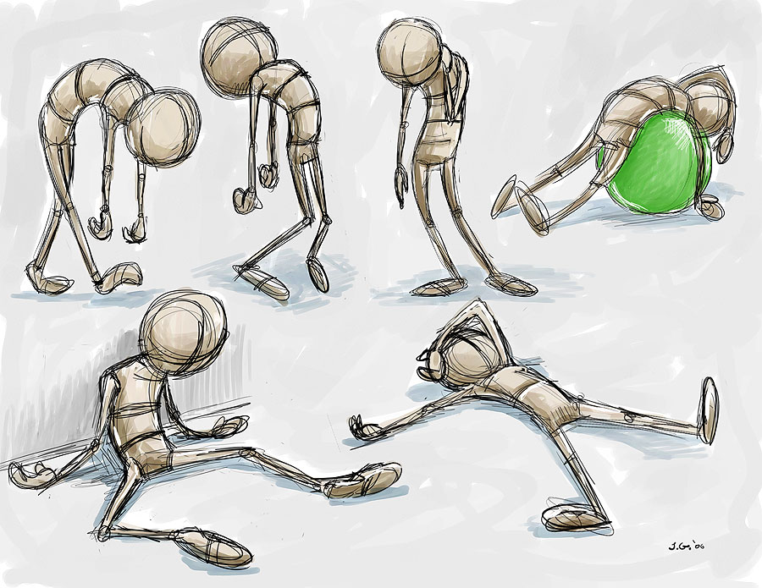
Evaluation
As the project is done, we necessarily evaluated what we have done for the project.
Even though the project is done, we still learn so much when thinking about ‘what more could it contain’.

Slide 14
Our
Differences

Slide 15
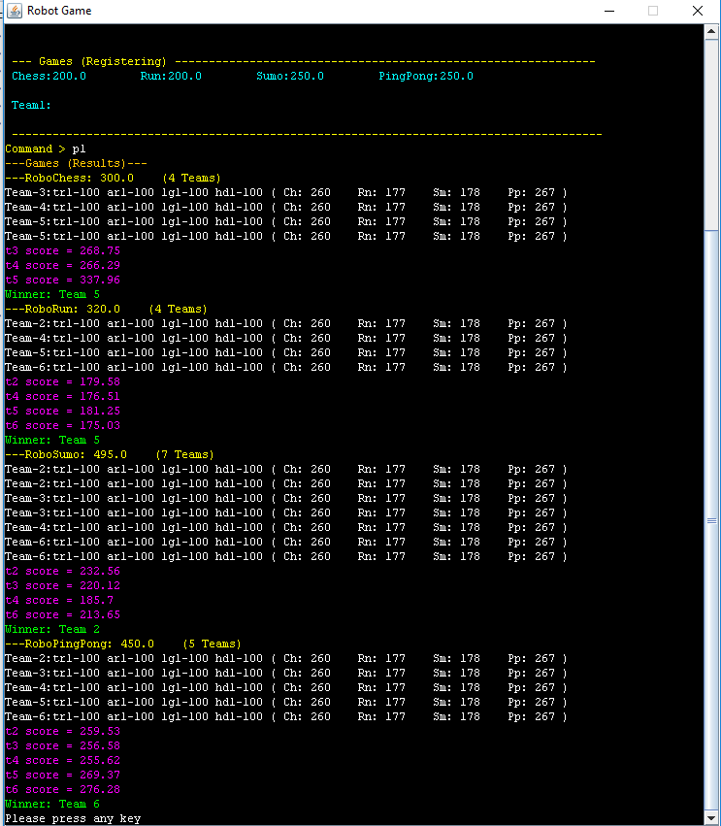
How does our artificial intelligence work?
Firstly buying four robots,
Secondly registering,
If it have a enough credits, it buy a new robot,
Saving money.

Slide 16
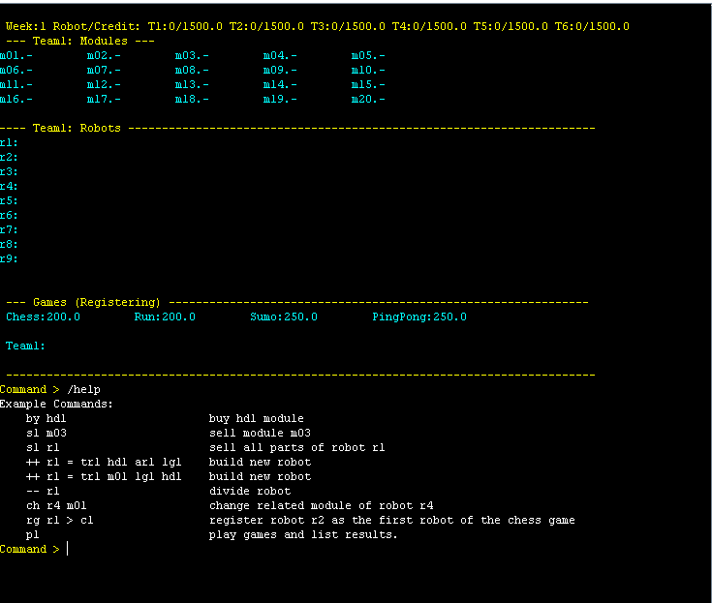
Our game have a help menu

Slide 17
Our game have
Streamlined command lines
Color Screen

Slide 18
Conclusion
Description of the game
Weekly progress
Our Differences
References
http://www.freepik.com/index.php?goto=74&idfoto=948542&term=brain
http://www.slidescarnival.com/category/free-templates/page/8

Slide 19
Thank you for your interest
Any questions?

