Slide 1
Software Process

Slide 2
What is a Software?
Documents
Database
Configuration scripts or data
Example:
Video game: models, programs, database of objects, behaviors…

Slide 3
Software Types
Generic Product
  Stand-alone systems
  Generic Tools
Customized products

Slide 4
What is software engineering?
Apply methods: coding, design
Apply tools: jsp, java, UML
To build a software
Sometimes use ad hoc methods, not completely formalized

Slide 5
What is Software Process?
Activities:
  Specification (what)
  Design (how)
  Coding/development
  Testing/validation
  Maintenance (change!)

Slide 6
Specification (What)
Feasibility study
  Can we do it using the tools, time and budget constraints?
Requirements Analysis
  Figuring out specifics of what we need to do. (You did part of that last class)
Requirements Spec
  Document everything you found out. Why?
Requirements Validation
  Show them to customers, do prototypes

Slide 7
Design (how)
Architecture
  Subsystems, and their relationships
Abstract spec.
  Subsystem services and constraints
Interface design
  Methods or messages between subsystems
  This is important. Why?

Slide 8
Design (how)
Component Design
  Services and interface
Data Structure or class design
Algorithm design

Slide 9
Structured Models
Data-flow model
Entity Relation model
(should have seen that in Dbase)
Object oriented methods
(inheritance, class/object interaction and relationship)
State Transition models

Slide 10
Programming
Modular programming
Even object oriented programming can become messy
Don’t be afraid of redesigning the code or starting from scratch

Slide 11
Testing
}
Unit Testing
Module/object testing
Subsystem testing
System testing
Acceptance testing
Done by
programmer
}
Done by
testing group

Slide 12
Software Myths
“ If we are behind the schedule, just add more programmers”
“Nine Women cannot make a baby in nine months”

Slide 13
Software Myths
“ Once we write the program and get it to work, our job is done”
“60%-80% of all effort expended on software will be expended after it is delivered for the first time”

Slide 14
What is Software Process?
Activities:
  Specification (what)
  Design (how)
  Coding/development
  Testing/validation
  Maintenance (change!)
In what order?

Slide 15
Challenges
Wiked problems
Customers don’t know what they want
Hard to change code, esp. with evolution of programming languages

Slide 16
Methods the people developed
The waterfall model
  Separate and distinct phases of specification and development
Evolutionary development
  Specification and development are interleaved
Formal systems development
  A mathematical system model is formally transformed to an implementation
Reuse-based development
  The system is assembled from existing components

Slide 17
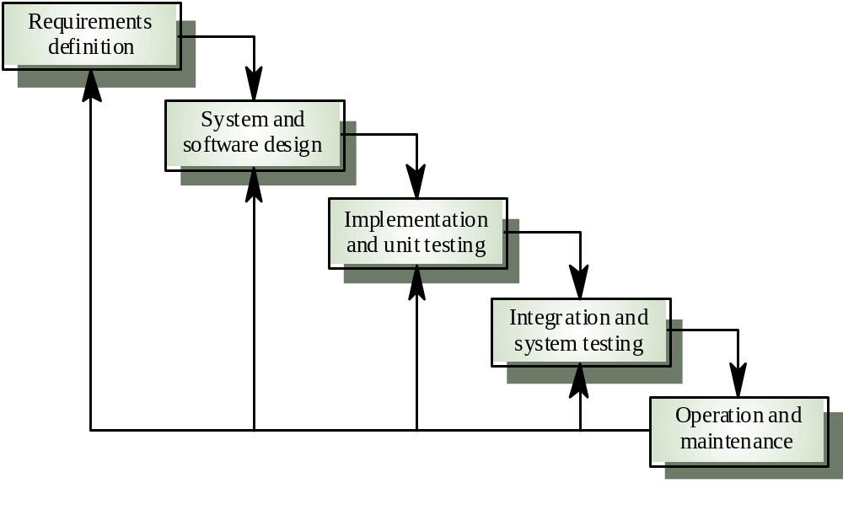
Waterfall Model (1970)

Slide 18
Advantages and Disadvantages
Good when requirements are understood and problem has been attached before
Cannot adapt to rapidly changing requirements or ill-defined problems

Slide 19
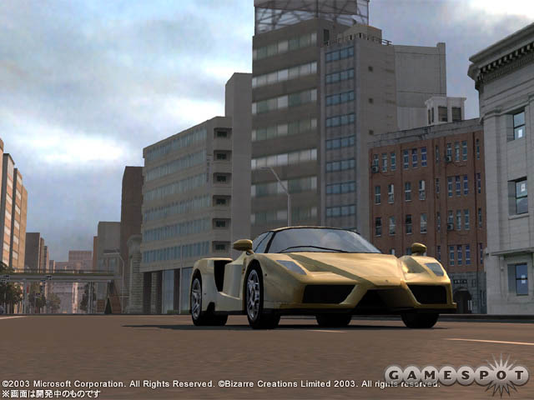
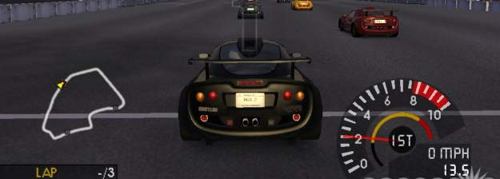
Building a software is like driving
“ Driving is not about getting the car going in the right direction. Driving is about constantly paying attention, making little correction this way, a little correction that way” – from XP

Slide 20
Evolutionary Development
Exploratory development
  Objective is to work with customers and to evolve a final system from an initial outline specification
Throw-away prototyping
  Objective is to understand the system requirements. Should start with poorly understood requirements

Slide 21
Evolutionary Development
Problems
  Lack of process visibility
  Systems are often poorly structured
  Special skills (e.g. in languages for rapid prototyping) may be required
Applicability
  For small or medium-size interactive systems
  For parts of large systems (e.g. the user interface)
  For short-lifetime systems

Slide 22
Reuse Oriented Development
Requirements Spec.
Research Existing Components
Rework Requirements
Design
Component Integration and testing

Slide 23
Process Iteration
System requirements ALWAYS evolve in the course of a project so process iteration where earlier stages are reworked is always part of the process for large systems
Two (related) approaches
  Incremental development
  Spiral development

Slide 24
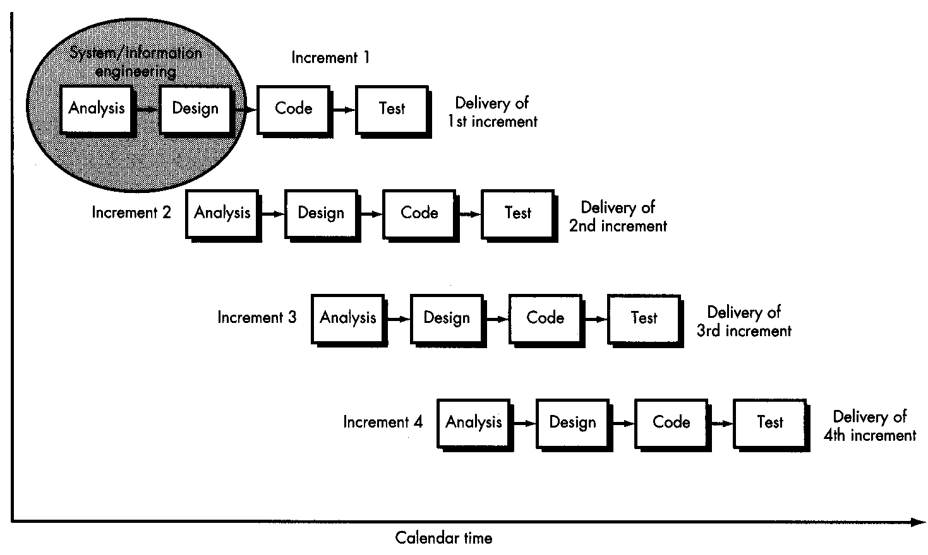
Incremental Method

Slide 25
Spiral Model
Process is represented as a spiral rather than as a sequence of activities with backtracking
Each loop in the spiral represents a phase in the process.
No fixed phases such as specification or design - loops in the spiral are chosen depending on what is required
Risks are explicitly assessed and resolved throughout the process

Slide 26
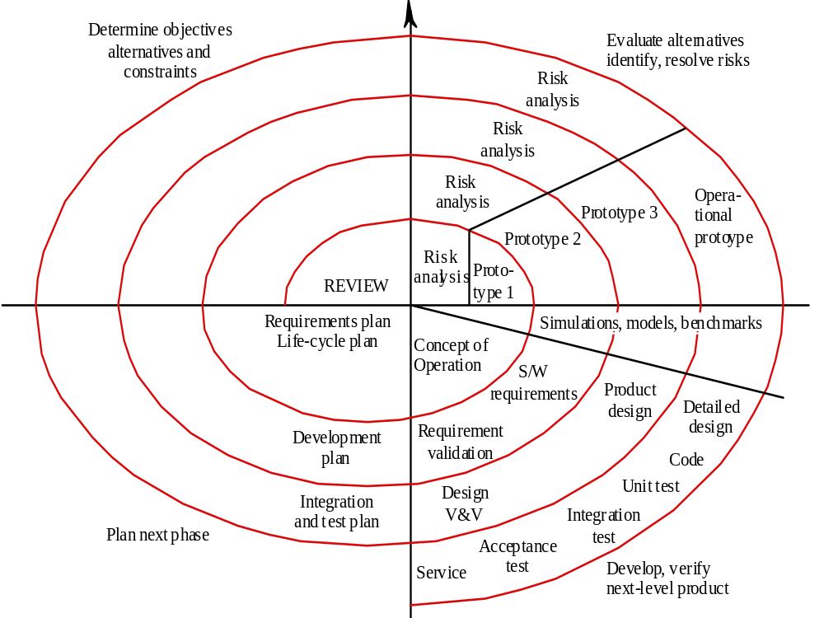
Spiral Method

Slide 27
Spiral Model
Objective setting
  Specific objectives for the phase are identified
Risk assessment and reduction
  Risks are assessed and activities put in place to reduce the key risks
Development and validation
  A development model for the system is chosen which can be any of the generic models
Planning
  The project is reviewed, and the next phase of the spiral is planned

