Slide 1
Use Case Modeling
What is use case modeling?
Core concepts
Diagram tour
When to model use cases
Modeling tips
Example: Online HR System
Introduction to UML

Slide 2
What is use case modeling?
use case model: a view of a system that emphasizes the behavior as it appears to outside users. A use case model partitions system functionality into transactions (‘use cases’) that are meaningful to users (‘actors’).
Introduction to UML

Slide 3
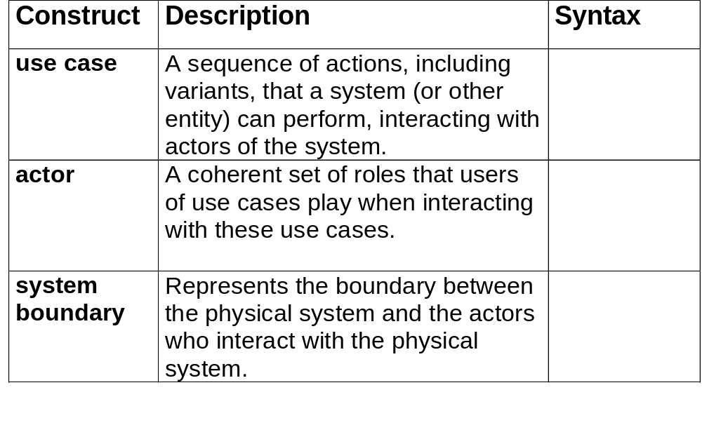
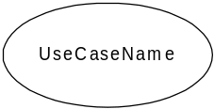
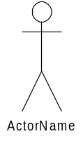

Use Case Modeling: Core Elements
Introduction to UML

Slide 4
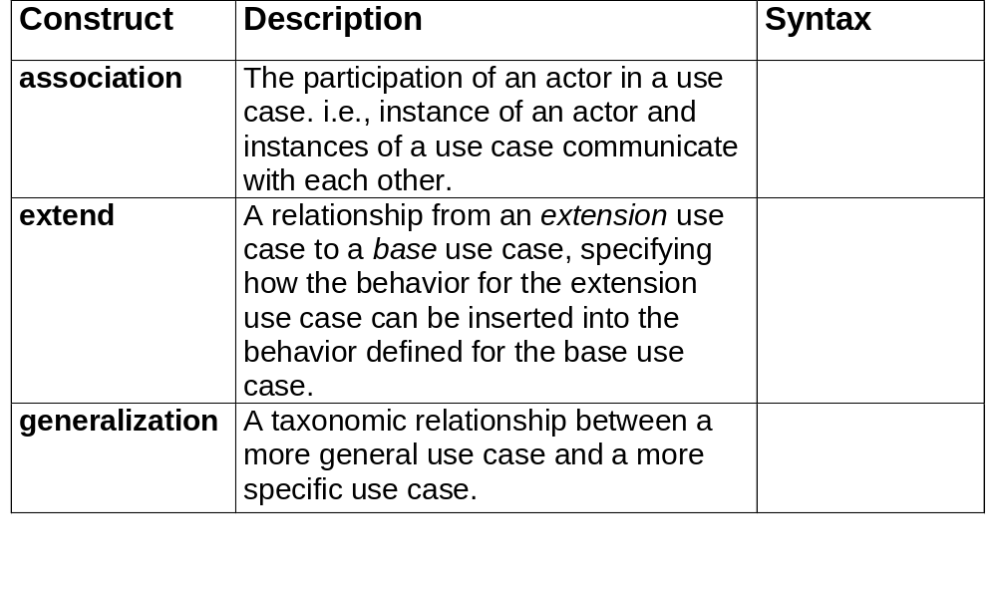
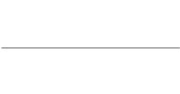


Use Case Modeling: Core Relationships
<<extend>>
Introduction to UML

Slide 5
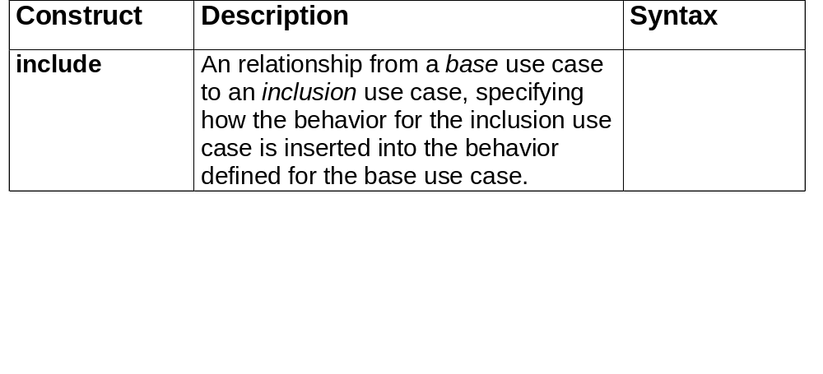
Use Case Modeling: Core Relationships (cont’d)
<<include>>
Introduction to UML

Slide 6
Use Case Diagram Tour
Shows use cases, actor and their relationships
Use case internals can be specified by text and/or interaction diagrams (see Lecture 2)
Kinds
  use case diagram
  use case description
Introduction to UML

Slide 7
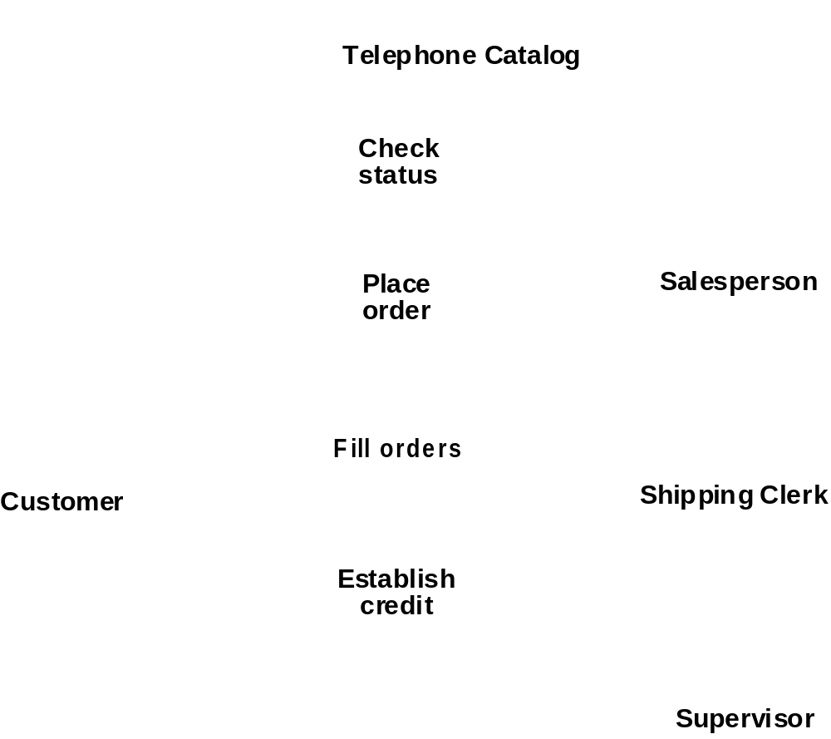
Use Case Diagram
Fig. 3-44, UML Notation Guide
Introduction to UML

Slide 8
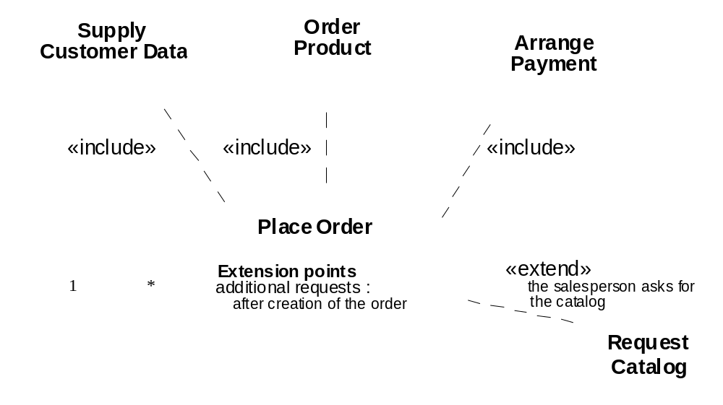
Use Case Relationships
Fig. 3-45, UML Notation Guide
Introduction to UML

Slide 9
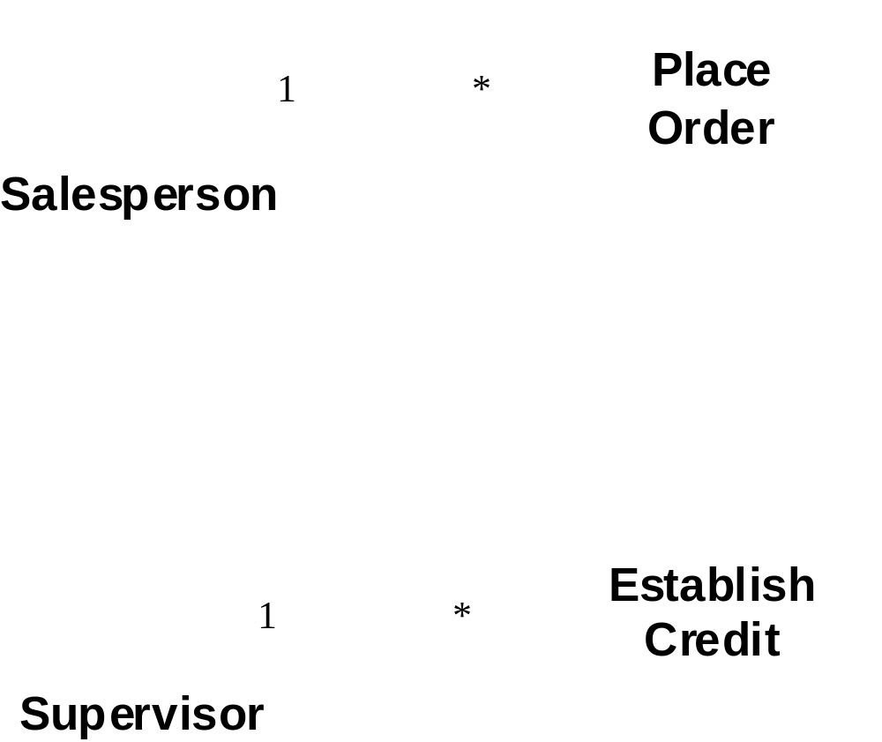
Actor Relationships
Fig. 3-46, UML Notation Guide
Introduction to UML

Slide 10
Use Case Description: Change Flight
Actors: traveler, client account db, airline reservation system
Preconditions:
  Traveler has logged on to the system and selected ‘change flight itinerary’ option
Basic course
  System retrieves traveler’s account and flight itinerary from client account database
  System asks traveler to select itinerary segment she wants to change; traveler selects itinerary segment.
  System asks traveler for new departure and destination information; traveler provides information.
  If flights are available then
  …
  System displays transaction summary.
Alternative courses
  If no flights are available then …
Introduction to UML

Slide 11
When to model use cases
Model user requirements with use cases.
Model test scenarios with use cases.
If you are using a use-case driven method
  start with use cases and derive your structural and behavioral models from it.
If you are not using a use-case driven method
  make sure that your use cases are consistent with your structural and behavioral models.
Introduction to UML

Slide 12
Use Case Modeling Tips
Make sure that each use case describes a significant chunk of system usage that is understandable by both domain experts and programmers
When defining use cases in text, use nouns and verbs accurately and consistently to help derive objects and messages for interaction diagrams (see Lecture 2)
Factor out common usages that are required by multiple use cases
  If the usage is required use <<include>>
  If the base use case is complete and the usage may be optional, consider use <<extend>>
A use case diagram should
  contain only use cases at the same level of abstraction
  include only actors who are required
Large numbers of use cases should be organized into packages (see Lecture 3)
Introduction to UML

Slide 13
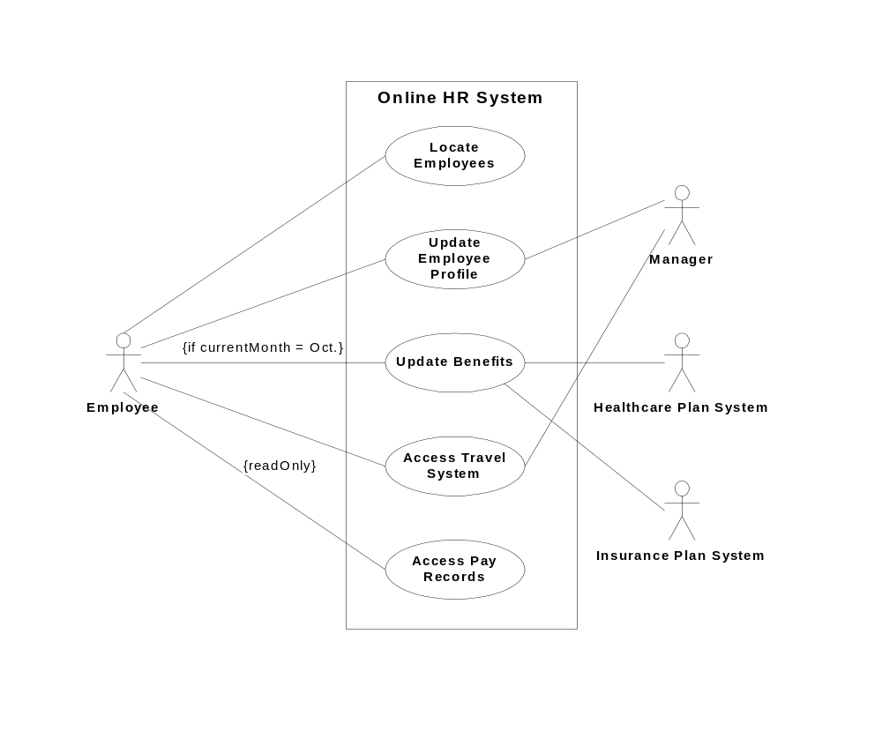
Example: Online HR System
Introduction to UML

Slide 14
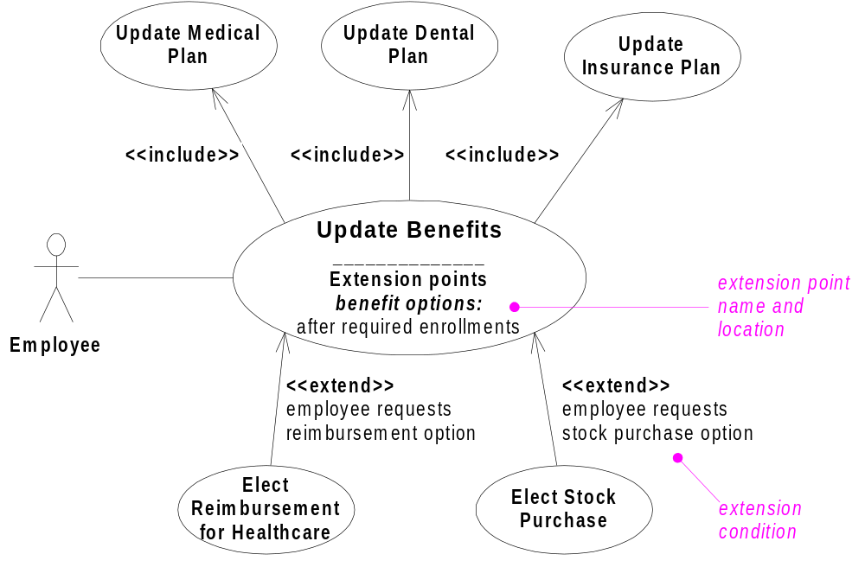
Online HR System: Use Case Relationships
Introduction to UML

Slide 15
Online HR System: Update Benefits Use Case
Actors: employee, employee account db, healthcare plan system, insurance plan system
Preconditions:
  Employee has logged on to the system and selected ‘update benefits’ option
Basic course
  System retrieves employee account from employee account db
  System asks employee to select medical plan type; include Update Medical Plan.
  System asks employee to select dental plan type; include Update Dental Plan.
  …
Alternative courses
  If health plan is not available in the employee’s area the employee is informed and asked to select another plan...
Introduction to UML

