Slide 1
.Gatekeeper
Decision support for the European Health Data Space
AIM Healthcare Hackathon Vienna 2026, Track 3. Oguz Nacar and Arda Sarikaya.
Notes:
No narration on the title slide. The spoken pitch starts on slide 2.

Slide 2
Reliable health data is expensive and complicated to access
Medical research depends on reliable health data.
Every application goes through a Health Data Access Body under Regulation (EU) 2025/327.
Applicants write the request, wait, and find out late which article blocks it.
That is why we created Gatekeeper.
EUR 4,000
Standard processing fee for one application in Germany.
Paid before anyone knows whether the request can be granted.
.Gatekeeper
Notes:
Medical research depends on reliable health data. Yet accessing it can be expensive and complicated. In Germany, for example, the standard processing fee for a single application costs €4,000. That's why we created Gatekeeper.

Slide 3
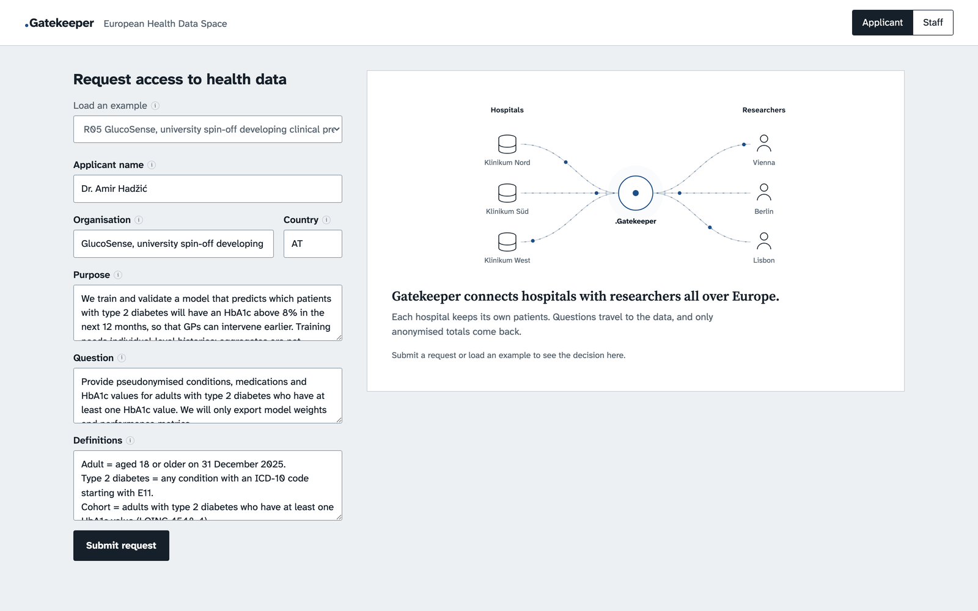
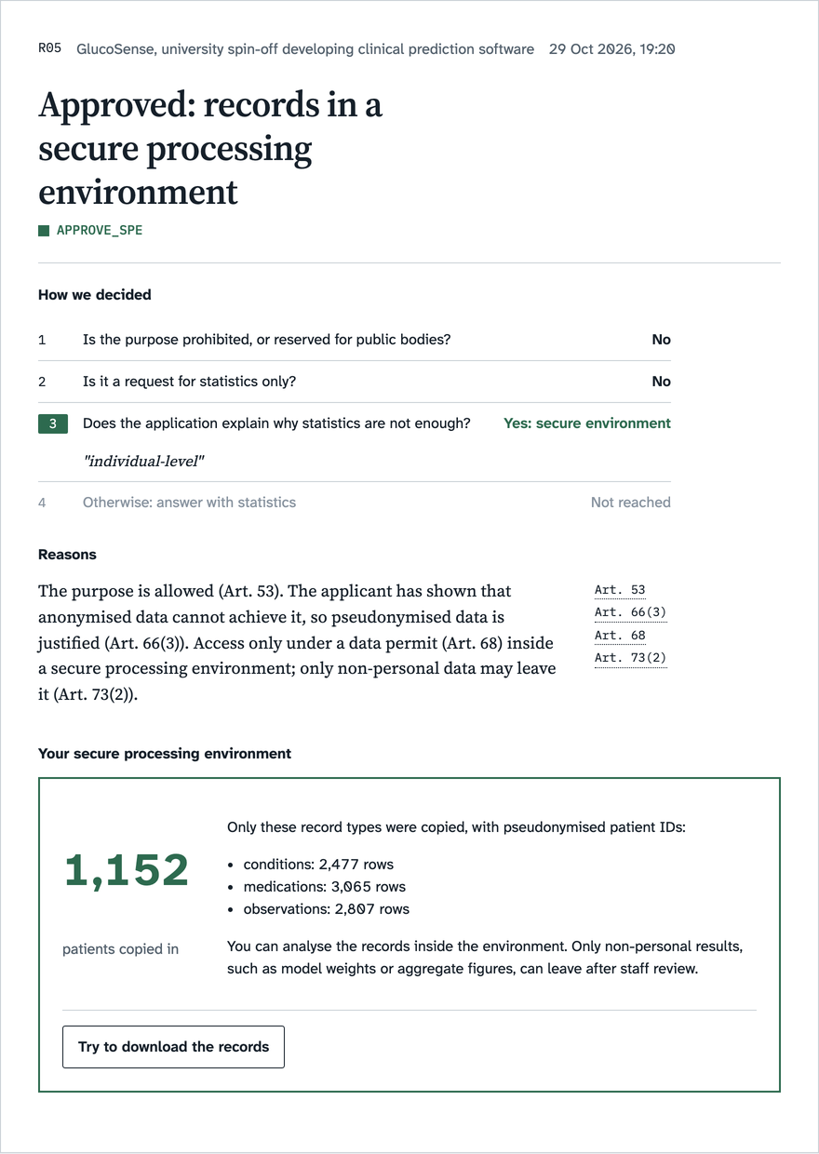
Applicant interface: submit, then see the decision
Request form: purpose, question, definitions.
Decision notice: APPROVE_SPE with Art. 53, 66(3), 68, 73(2).
.Gatekeeper
Notes:
Gatekeeper is an AI-powered decision-support platform for the European Health Data Space. Researchers can submit applications, specify their research objectives, and request access to healthcare data. Before official submission, our system identifies potential issues and helps prevent costly mistakes.

Slide 4
AI decision engine: structured, consistent, explainable
1
2
3
Each request is analyzed
Relevant requirements are checked
An explainable recommendation
Purpose, question and definitions are read as structured fields.
Chapter IV of Regulation (EU) 2025/327, rule by rule.
Every outcome names the rule applied and cites the articles.
Three possible outcomes
REJECT
APPROVE_STATISTICAL
APPROVE_SPE
Specialized decision models instead of a free-form LLM answer: the same request gets the same decision.
.Gatekeeper
Notes:
Unlike LLMs, our approach uses specialized decision models designed for structured and consistent evaluations. Gatekeeper analyzes each request, checks relevant requirements, and provides an explainable recommendation: rejection, statistical access, or access through a secure processing environment.

Slide 5
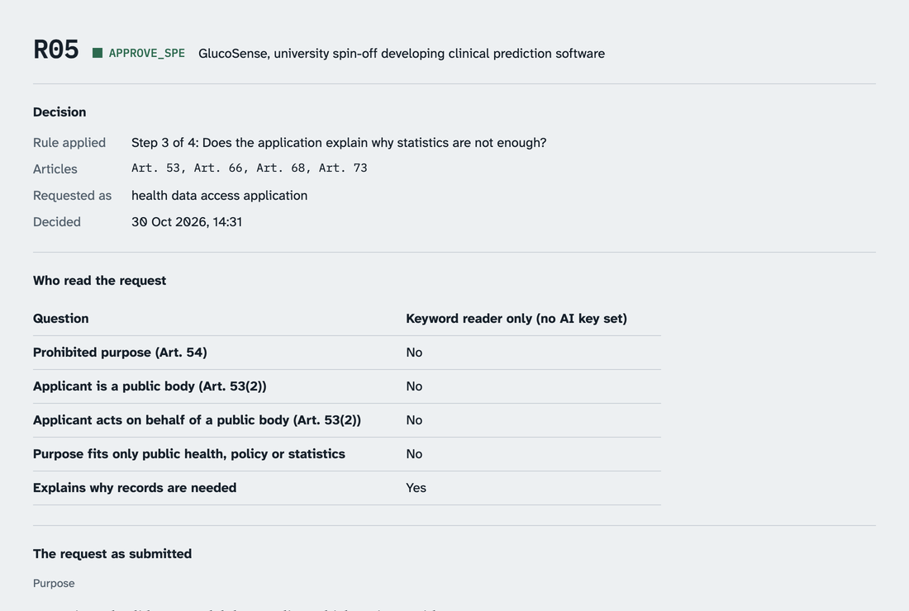
Staff interface and federated data
Klinikum Nord
Klinikum Süd
Health Data Access Body
Klinikum West
totals only, no patient rows
Queries run inside each hospital. Patient rows never leave; only totals are merged centrally.
Opted-out patients excluded. Counts under 10 shown as <10.
Staff case file: rule applied, articles, who read the request, numbers.
.Gatekeeper
Notes:
On the staff side, applications are organized into case files for review. Our federated architecture allows participating hospital databases to process queries locally, without unnecessarily centralizing sensitive patient information. The system also respects patient opt-outs and applies privacy safeguards.

Slide 6
Results on the 10 sample requests
10/10
6/6
0
10/10
12.7 s
correct decisions
correct numbers
privacy leaks
consistent over 3 runs
slowest request
Measured on the 10 sample requests, synthetic data.
Decision accuracy, statistical correctness, privacy protection, consistency, processing time.
.Gatekeeper
Notes:
We evaluate Gatekeeper using decision accuracy, statistical correctness, privacy protection, consistency, and processing time. Our goal is to minimize critical errors while making the evaluation process more efficient.

Slide 7
Vision and limitations
Today
Future work
Prototype runs the full workflow on synthetic hospital data.
Three hospital databases in one process; in production each sits behind its own service.
Cases live in memory; no login; runs locally.
Integration with real European healthcare infrastructure.
Help research institutions access and analyze health data more reliably, affordably, and securely.
Making European health research safer, smarter, and more accessible.
.Gatekeeper
Notes:
Our current prototype demonstrates this workflow using synthetic hospital data. Integration with real European healthcare infrastructure remains future work. Our vision is to help research institutions access and analyze health data more reliably, affordably, and securely. Gatekeeper: Making European health research safer, smarter, and more accessible.

