Slide 1

Chatbot v1.0
-The SMO-
Group: The SMO
-Oguz Sarac(Researcher, Developer)
-Mert Kaya(Developer, Planner)
-Sergey Kurapov(Developer, Code-Forming)

Slide 2

Before we start
We want apologize to you for GitLab. Two of us, tried to and fix it the week before and even now. We are hoping that we will fix that as soon as possible. In these difficult days, some of us backed their country. Even now, some of our classmates in quarantine.
Thank you for your understanding and stay safe.
-SMO

Slide 3
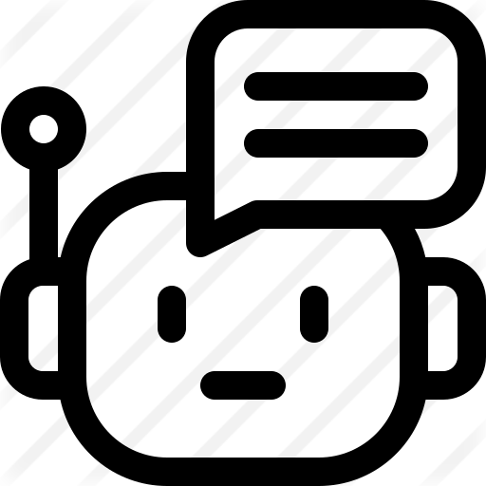
What is Chatbot?
A chatbot is an artificial intelligence (AI) software that can simulate a conversation (or a chat) with a user in natural language through messaging applications, websites, mobile apps or through the telephone.

Slide 4
Why are Chatbots important?
A chatbot is often described as one of the most advanced and promising expressions of interaction between humans and machines. However, from a technological point of view, a chatbot only represents the natural evolution of a Question Answering system leveraging Natural Language Processing (NLP). Formulating responses to questions in natural language is one of the most typical Examples of Natural Language Processing applied in various enterprises’ end-use applications.

Slide 5

Here is a simple example

Slide 6
As you can see on the example, user simply selecting given options from chatbot. If we think that as a developer or a company owner;
User is not able to do anything except selecting the option.
Chatbots are responding faster than a real-life call support.
you are only paying chatbots once, while you must pay monthly for your employees for (live-support etc.)
Limited Answering capacity.
Need to update in some period.
(https://nachosbot.business.site)

Slide 7
What SMO trying to do in their chabot?
-Simple Answering System
-Understandable
-Reaches young and old alike
-Well commented and good formed code

Slide 8

Chatbot
About us
Weather
Clothing
Location
Day based

Slide 9
What we discussed for First Milestone
-We split the things that we are going to do between of us.
-We created our Chatbot Template (First Version).
- We created JFRAME version for Chatbot.
-We commented and well-formed the Code.

Slide 10
What we are planning to do for next Milestone
-Add more complex functionality to chatbot
-Link with Google Assistant
-Comment and clean-up the Code

Slide 11
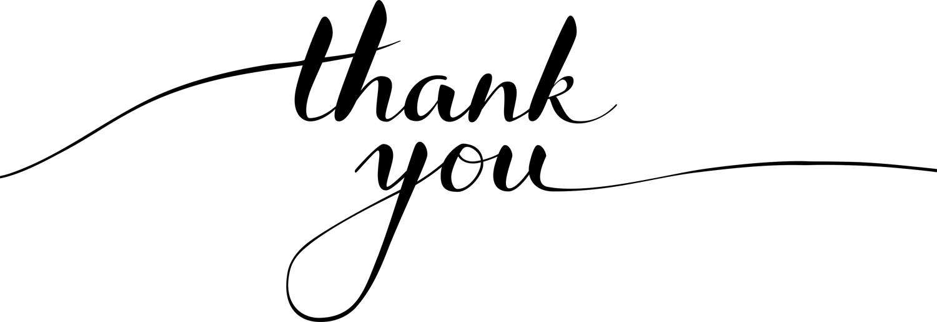
-The SMO-

