Slide 1
CS-210 Term Project
Group-17
Emir Can Ülkü 26740
Yavuz Mehmet Oğuz Şimşek 27920
Batuhan Kuğuoğlu 26566
Hüseyin Onur Onma 28154
Doğa Turak 27975
Bahri Baran Coşkun 28298

Slide 2
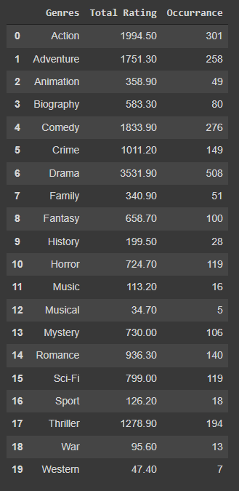
Going through the data
In the beginning of the project, data preprocessing and cleaning applied to the dataset to obtain a more easy-to-use dataset.
Then, displaying and several statistics such as occurrences, total and average rating to foreseen possible outputs

Slide 3
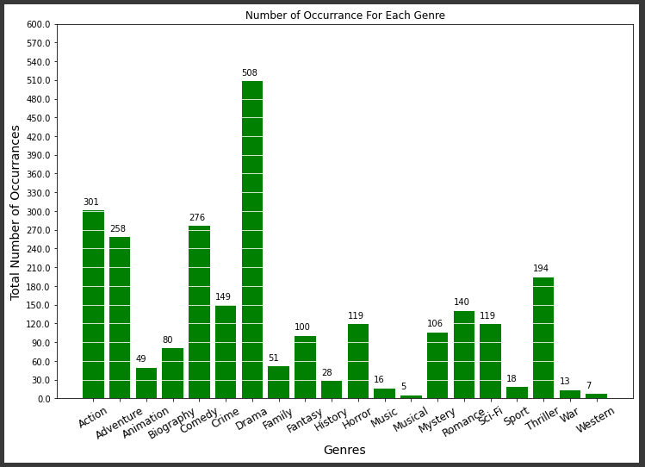
Going through the data
How many times each genre occurred

Slide 4
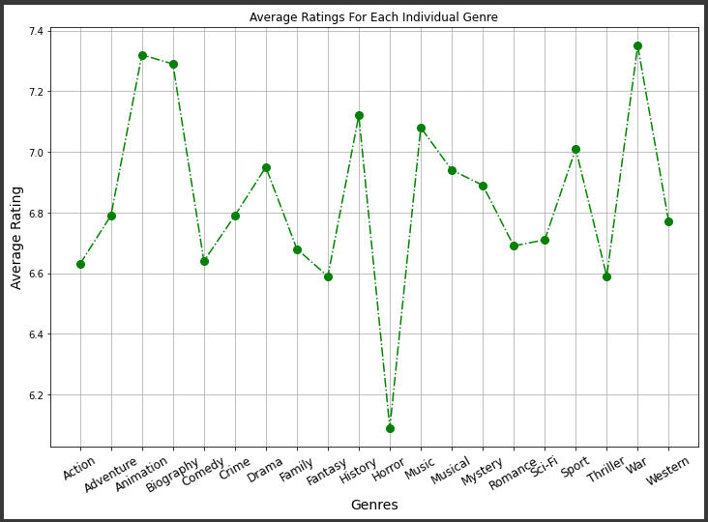
Going through the data
Average ratings per genres

Slide 5
Forming our initial(null) hypothesis
After data processing and evaluating outputs of preprocessing, null hypothesis is being formed.
Our claim is that average rating of Comedy movies is less than %20 of total number of genres. To verify the claim, it will be used pairwise hypothesis testing rather than a single test. Meaning that, each genre’s rating will be compared with Comedy’s rating by Z-Test which brings up 20 distinct hypothesis.

Slide 6
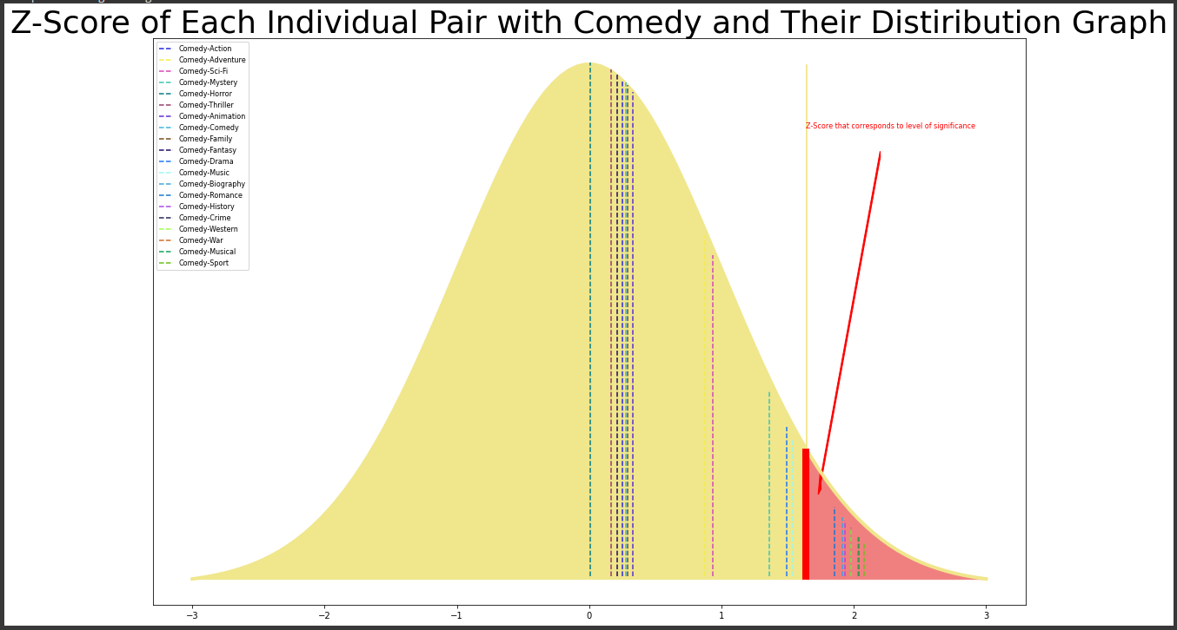
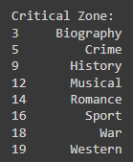
Hypothesis Testing
According to the each pairwise z-test 8 of the genres’ average rating is less than Comedy.

Slide 8
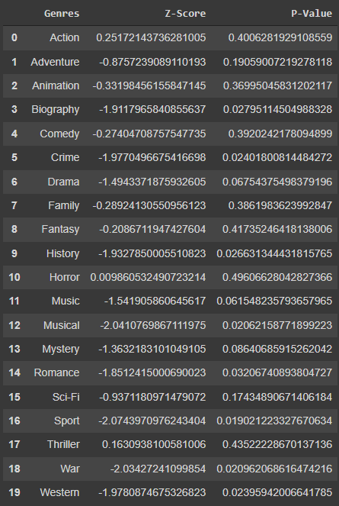
Z-score and P-value for each individual pair with comedy

Slide 9
Re-editing Hypothesis
Since the proportion of the genres that average rating is less than comedy is 0.4
Our initial hypothesis is declined since it was stating that the average is 0.2
Therefore, new hypothesis is set to be 0.5 of the genres has average rating less than comedy

Slide 10
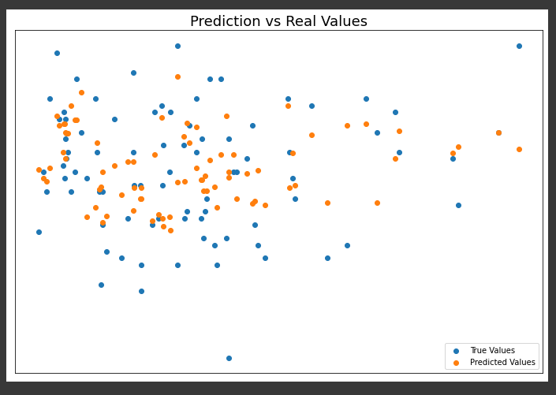
kNN and Random Forest
Training a kNN and random forest regressor with default values

Slide 11
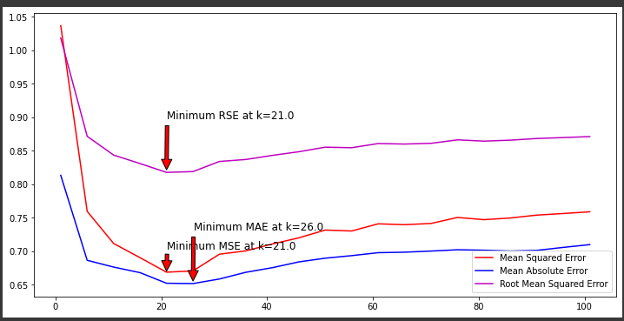
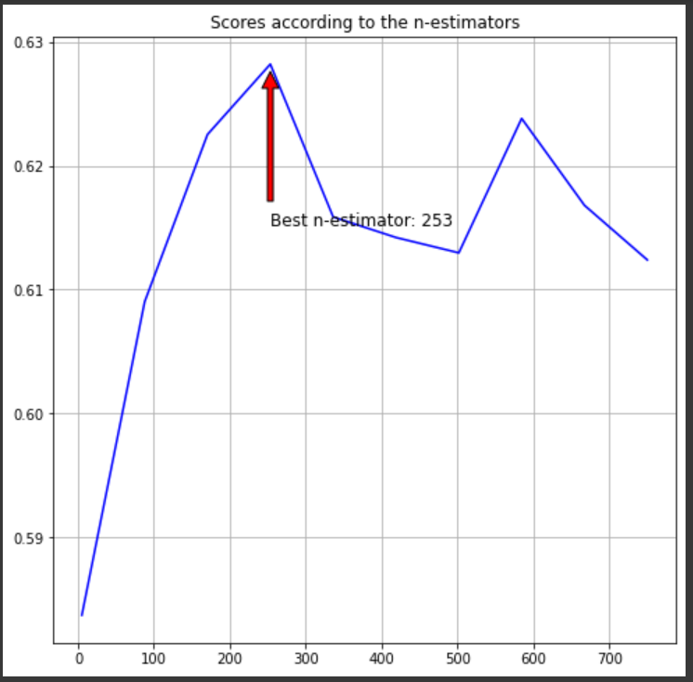
Hypermeter Tuning
To find optimum values for models, hypermeter tuning process is applied to both models
(Finding optimum k and n_estimators)

Slide 12
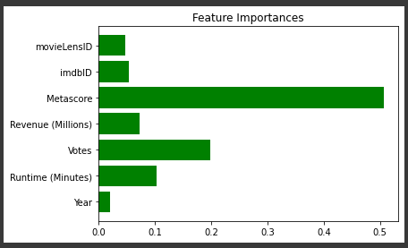
Importance of each feature in the data-set
We have discarded 3 of the least significant feature to get better results
Discarded features:
-Year
-movieLensID
-imdb-ID

Slide 13

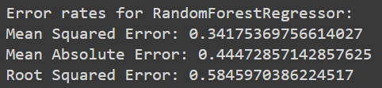
Error rates after hypermeter tuning

Slide 14
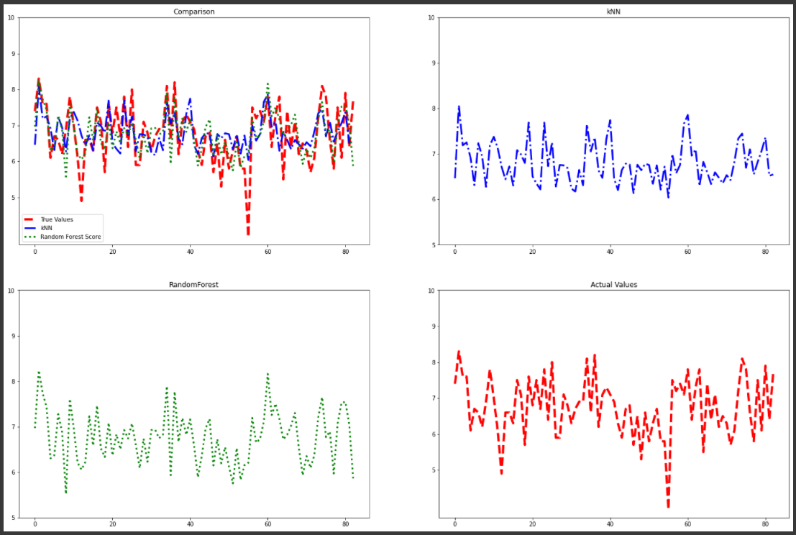
Contrasting the plotting of Regressors’ results
After hypermeter tuning and enhancing our model, we have trained each model again with optimum circumstances.
And displayed the output of test data for each model

Slide 16
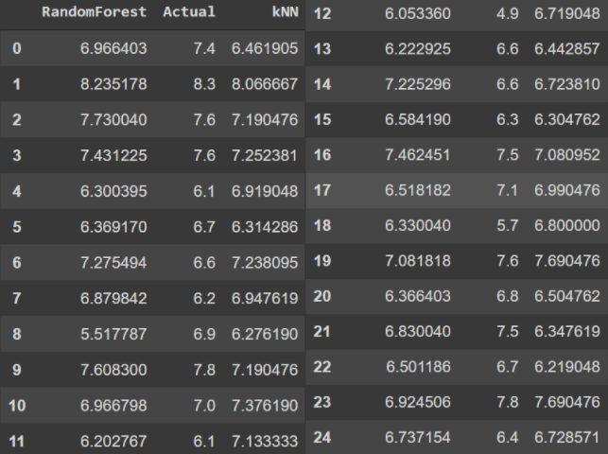
Contrasting Regressors’ results
For easier readability, displaying previous results with chart

Slide 17
Conclusion
Since random forest regressor has more accurate outputs, using random forest regressor for our project is more beneficial.

