Slide 1
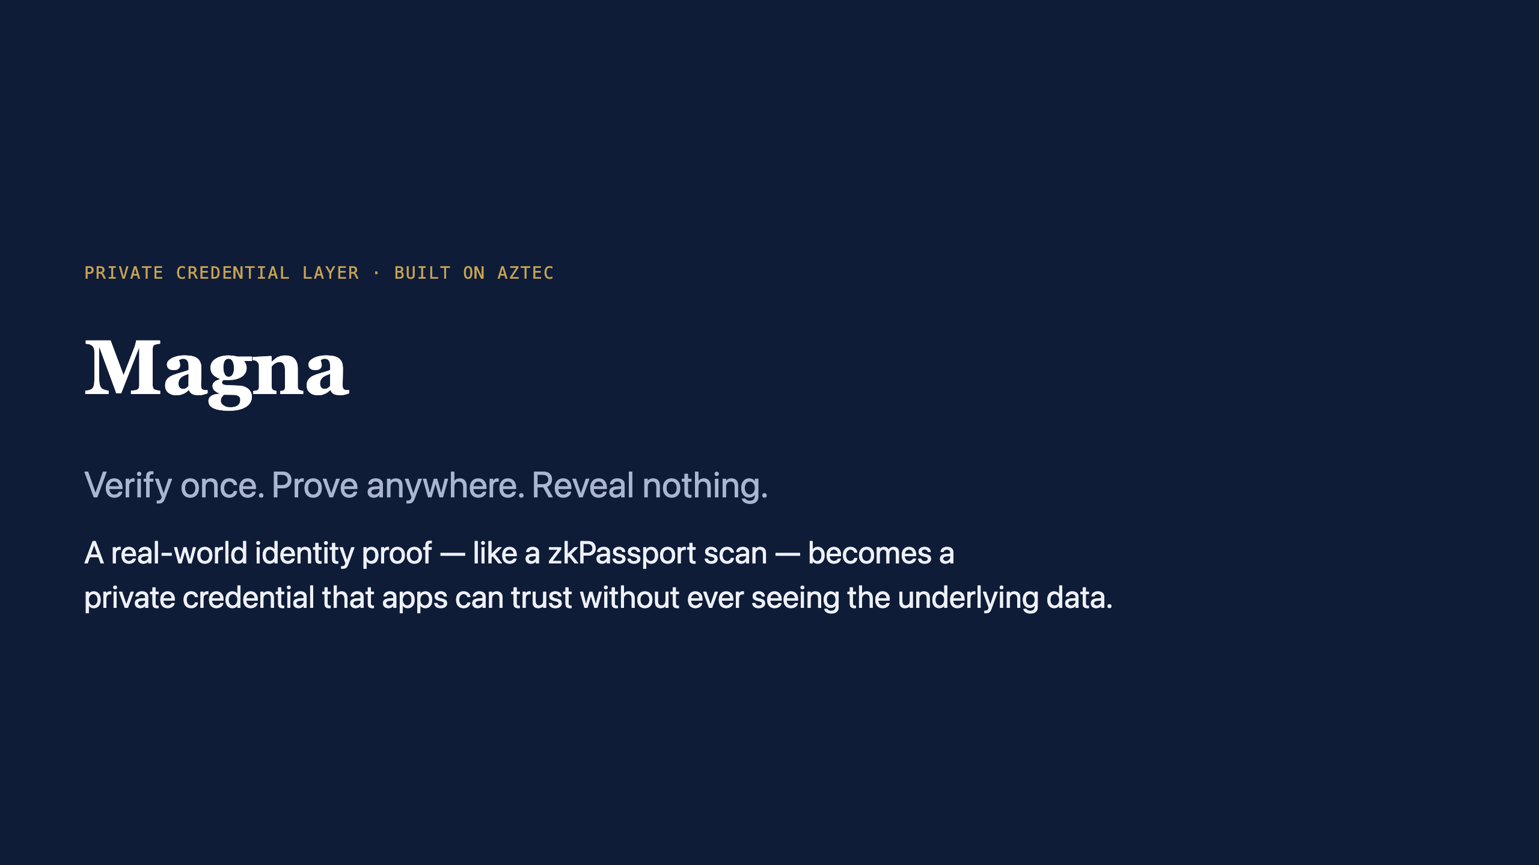
Notes:
Speaker notes:
- One-line hook: Magna is the privacy layer between "prove you're a real, eligible human" and "let an app act on that" — without anyone hoarding the personal data.
- Keep the cover slide to ~20 seconds. The story is on the next slides.

Slide 2
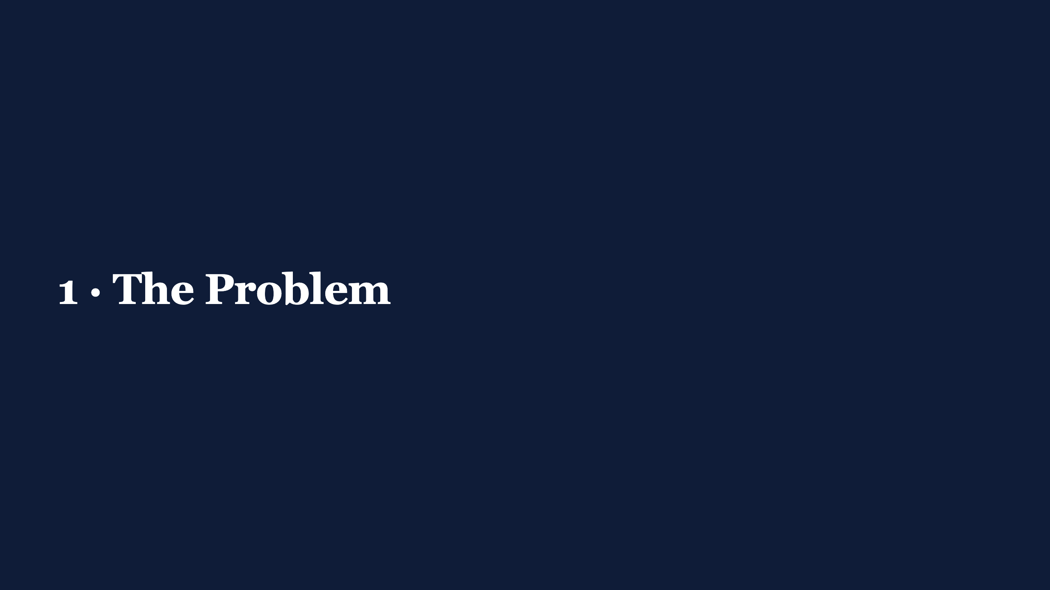

Slide 3
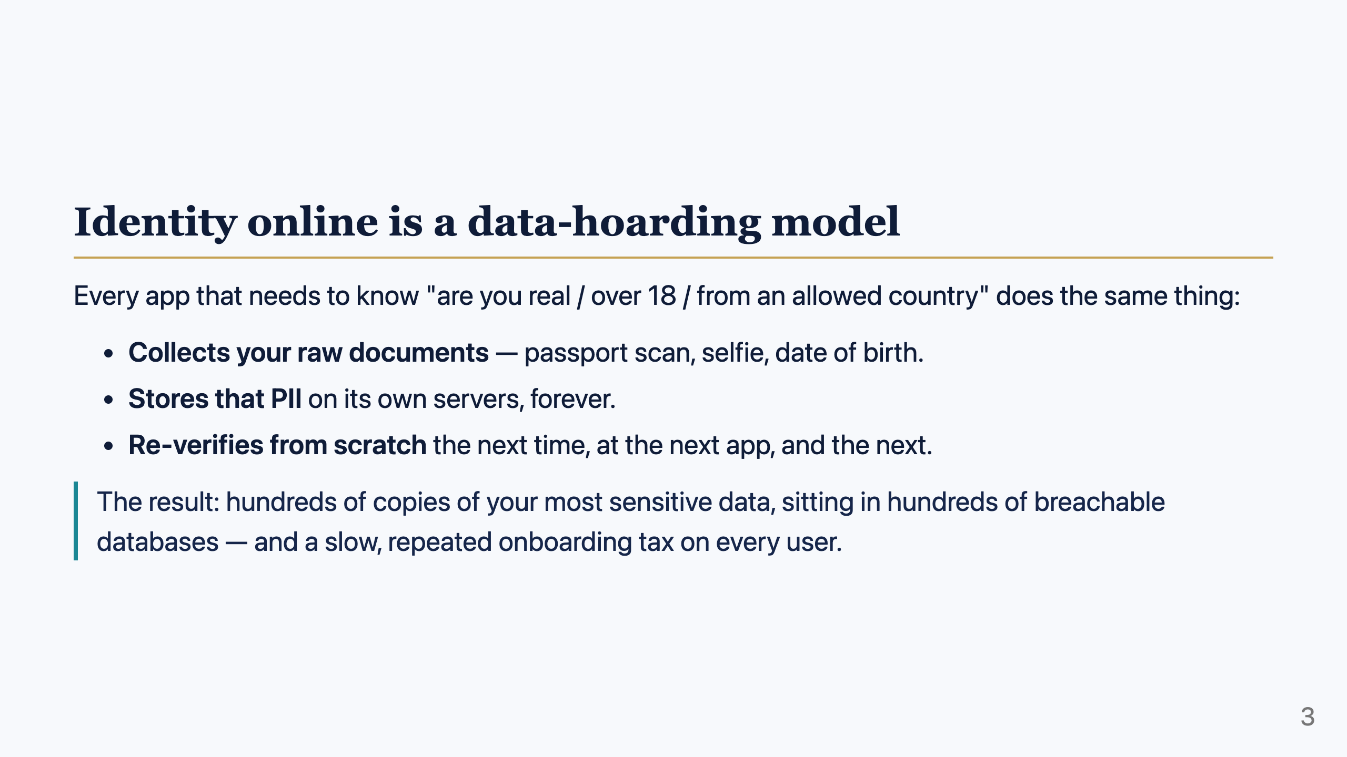
Notes:
Speaker notes:
- Three structural failures: data hoarding (privacy + breach risk), no reuse (cost), heavy friction (lost users).
- This is the status quo Magna replaces. Don't get technical yet — this is the "why anyone should care" slide.

Slide 4
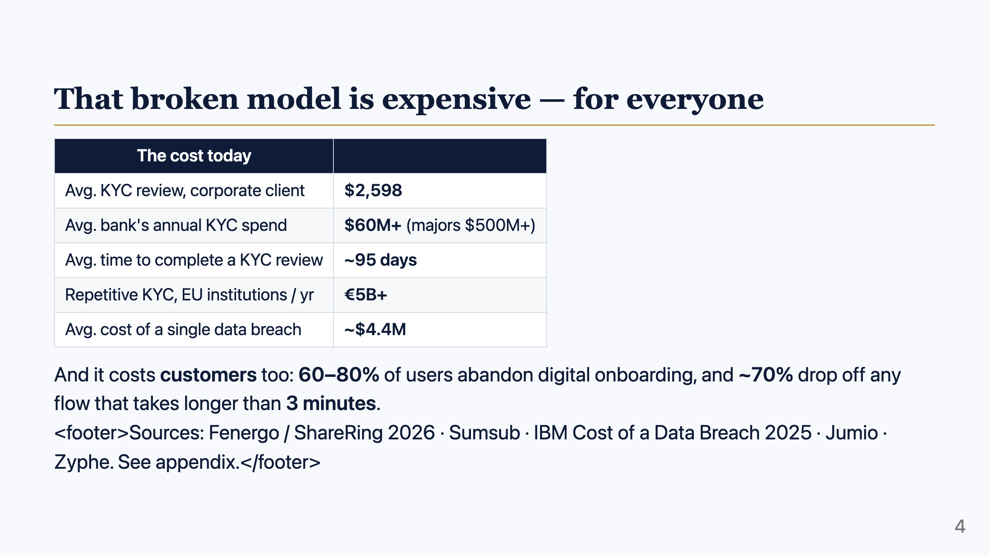
Notes:
Speaker notes:
- Two pains, two audiences: businesses pay (cost + breach liability), users leave (abandonment).
- These numbers justify both "reusable" (cost) and "private" (breach) parts of Magna's value prop.

Slide 5


Slide 6
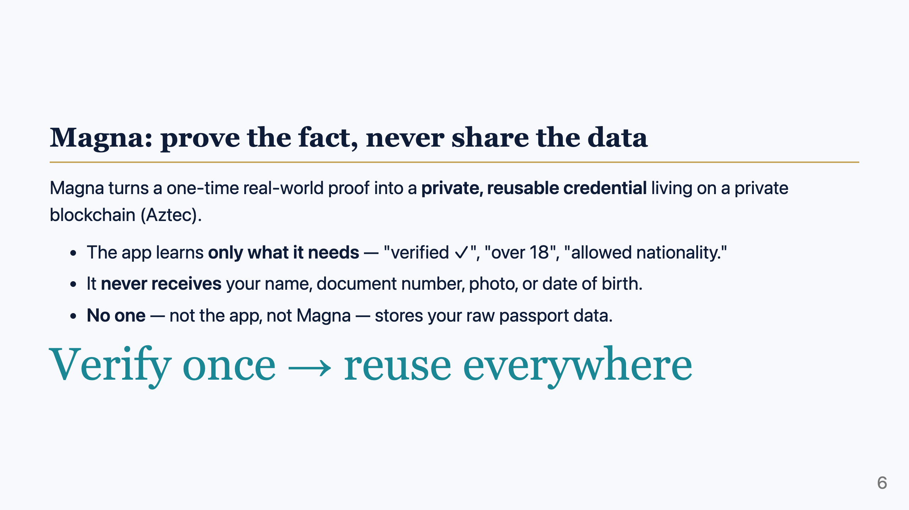
Notes:
Speaker notes:
- This is the core promise. Contrast directly with the previous slide: instead of N copies of raw PII, there are zero — only cryptographic commitments.
- "Login with Magna" is the consumer-facing shape of this (covered shortly).

Slide 7
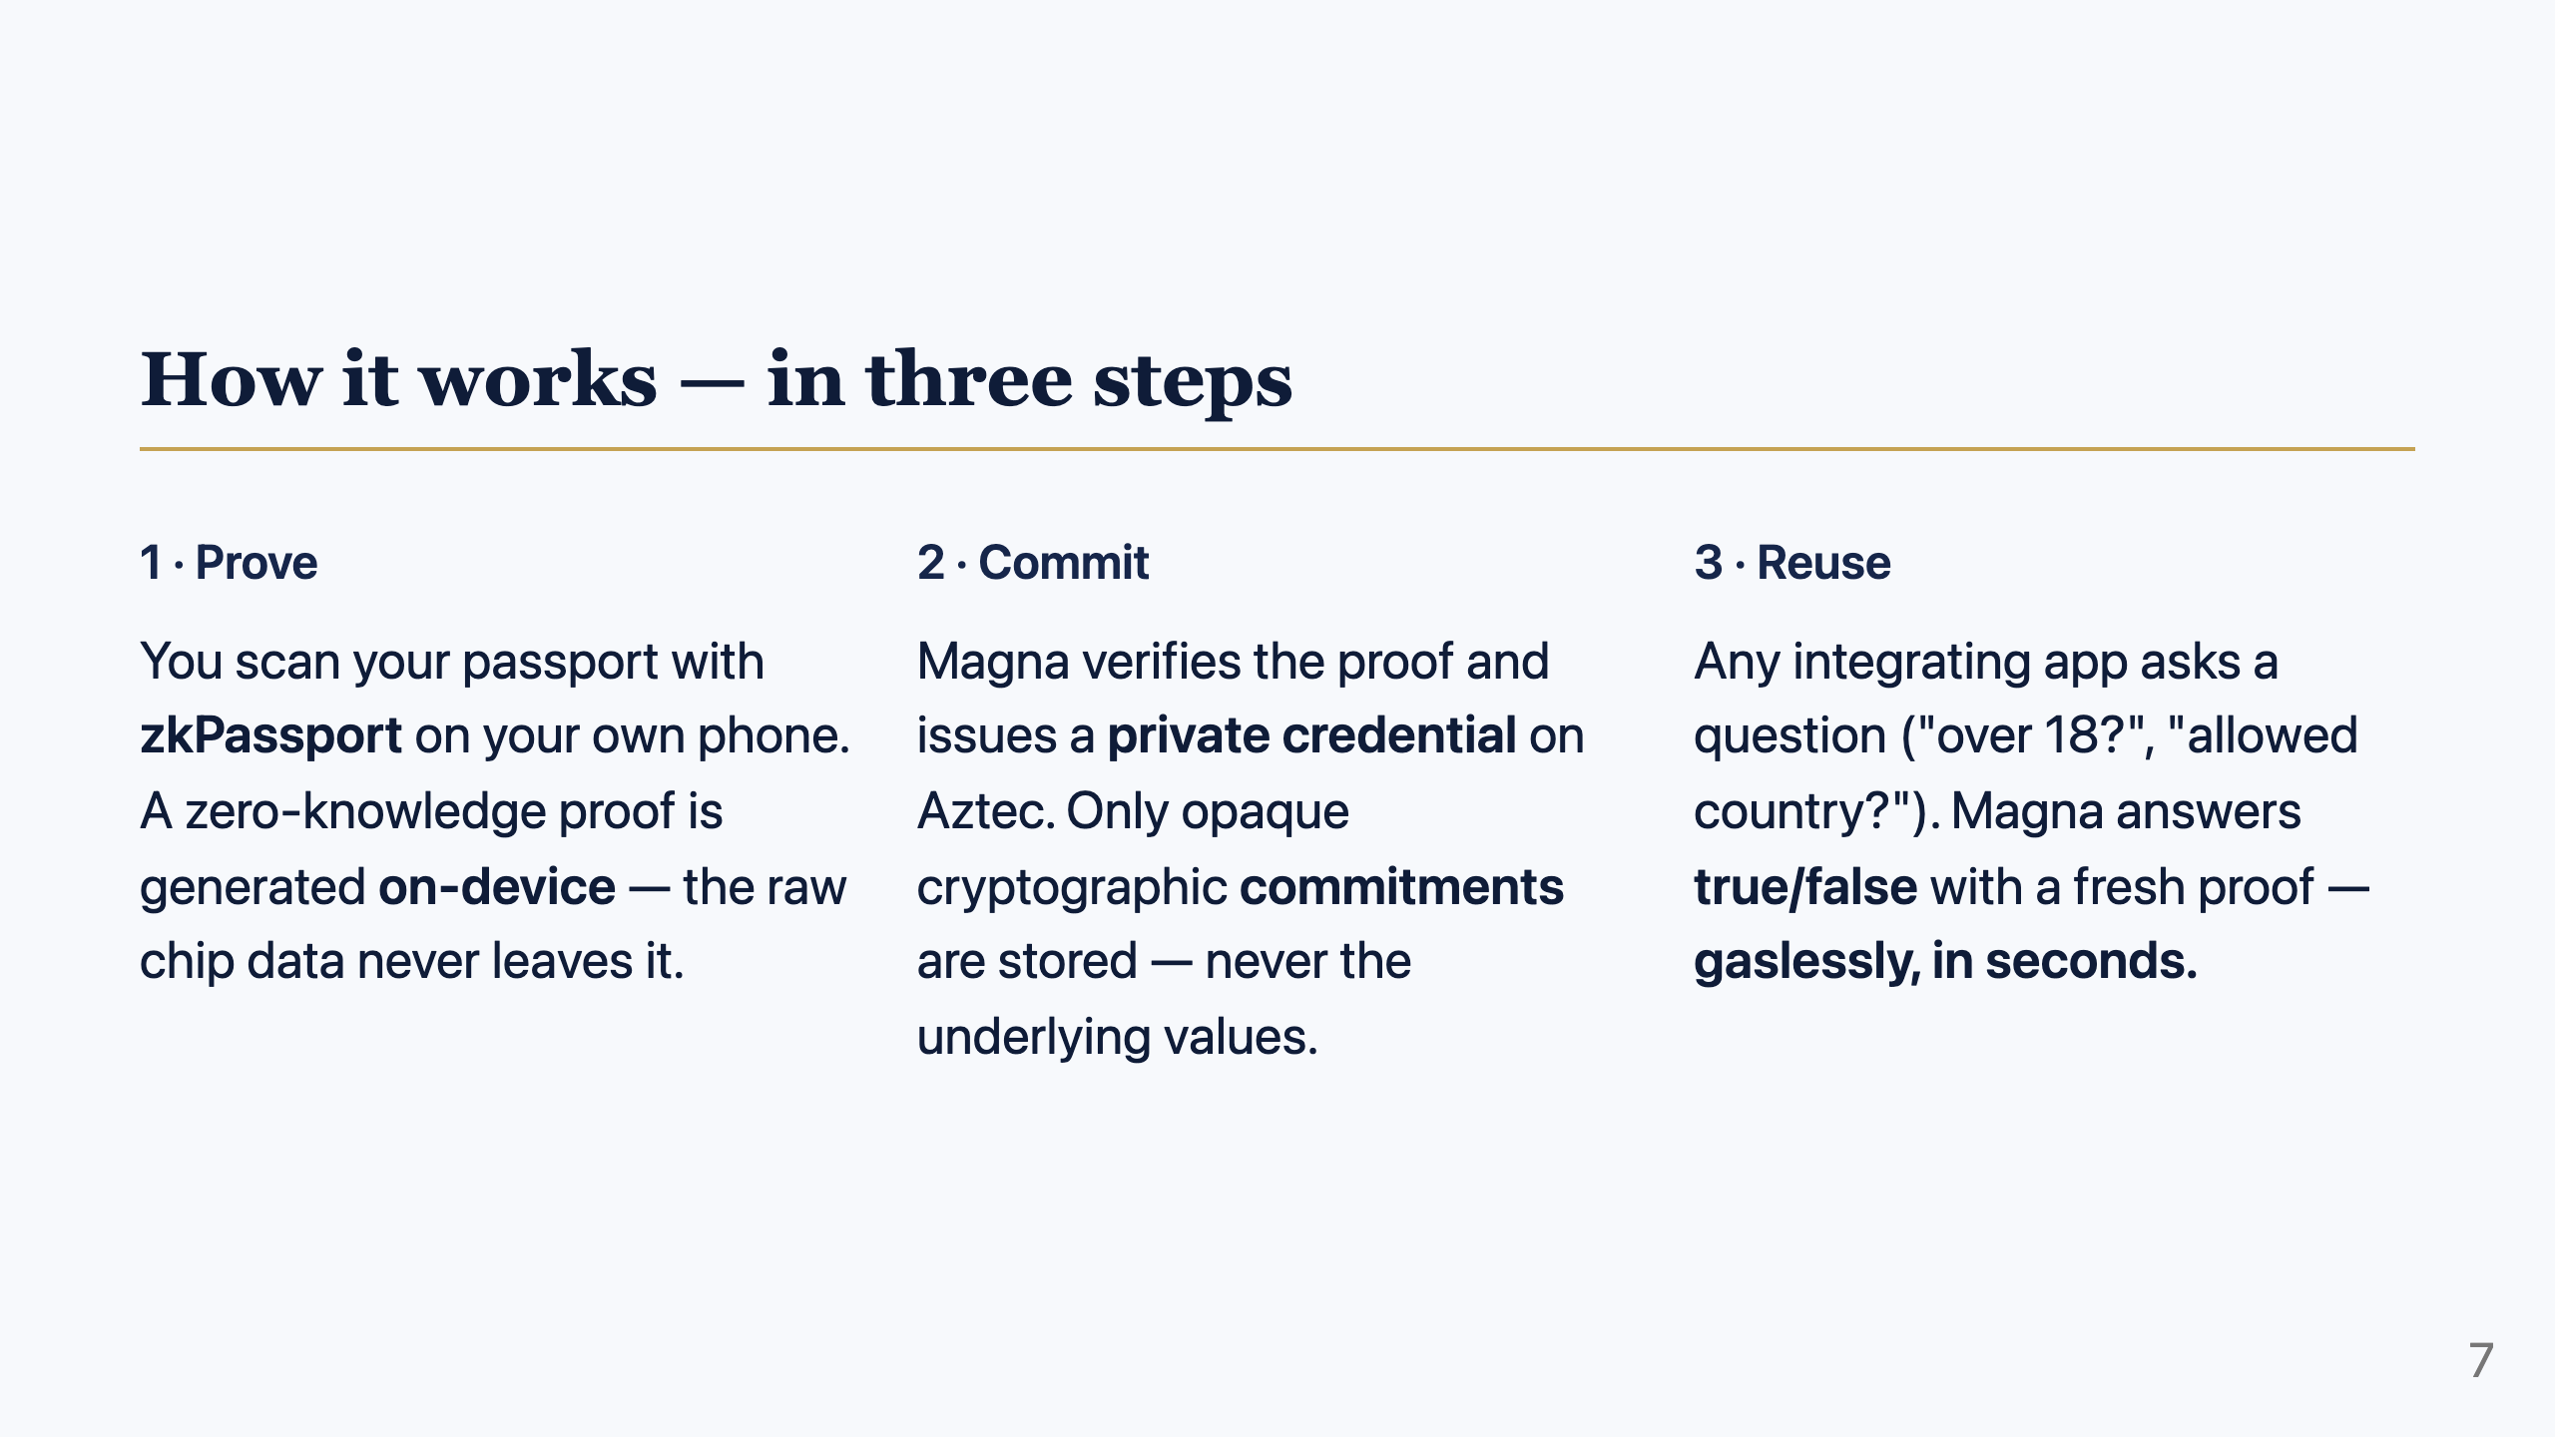
Notes:
Speaker notes:
- Keep this strictly non-technical for a general/investor audience.
- Step 1 = privacy at capture. Step 2 = privacy at rest (commitments, not data). Step 3 = the reuse + UX win.
- If the audience is technical, you can expand step 2 into the "commitment = sealed box, witness = key" idea.

Slide 8
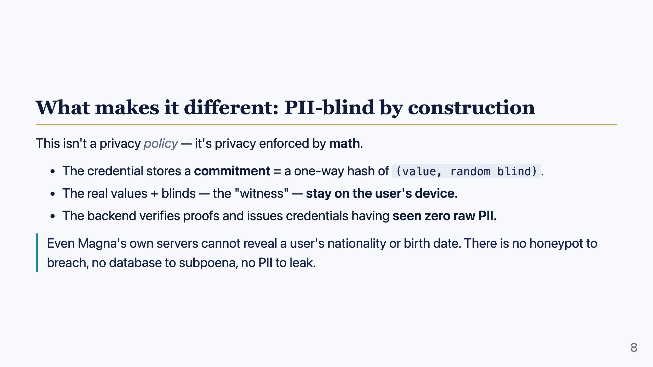
Notes:
Speaker notes:
- The defensibility angle: competitors who "promise" not to misuse data still HOLD the data. Magna structurally cannot.
- This is the regulatory tailwind (GDPR/CCPA data-minimization) turned into a product property.

Slide 9
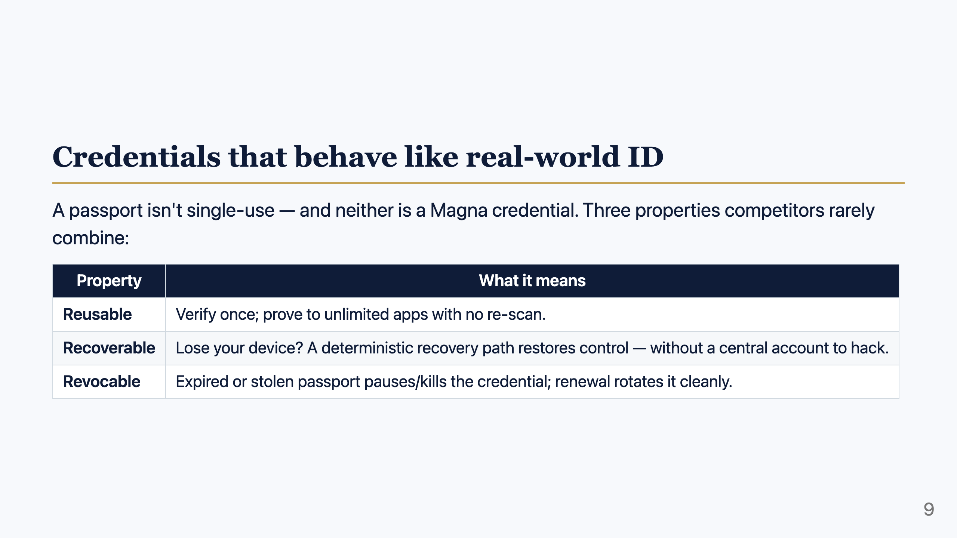
Notes:
Speaker notes:
- "Reusable, recoverable, revocable" is the memorable triad — straight from the product.
- Recovery uses a deterministic "ghost account"; revocation uses on-chain nullifiers + root authority refresh. Keep it plain unless asked.

Slide 10
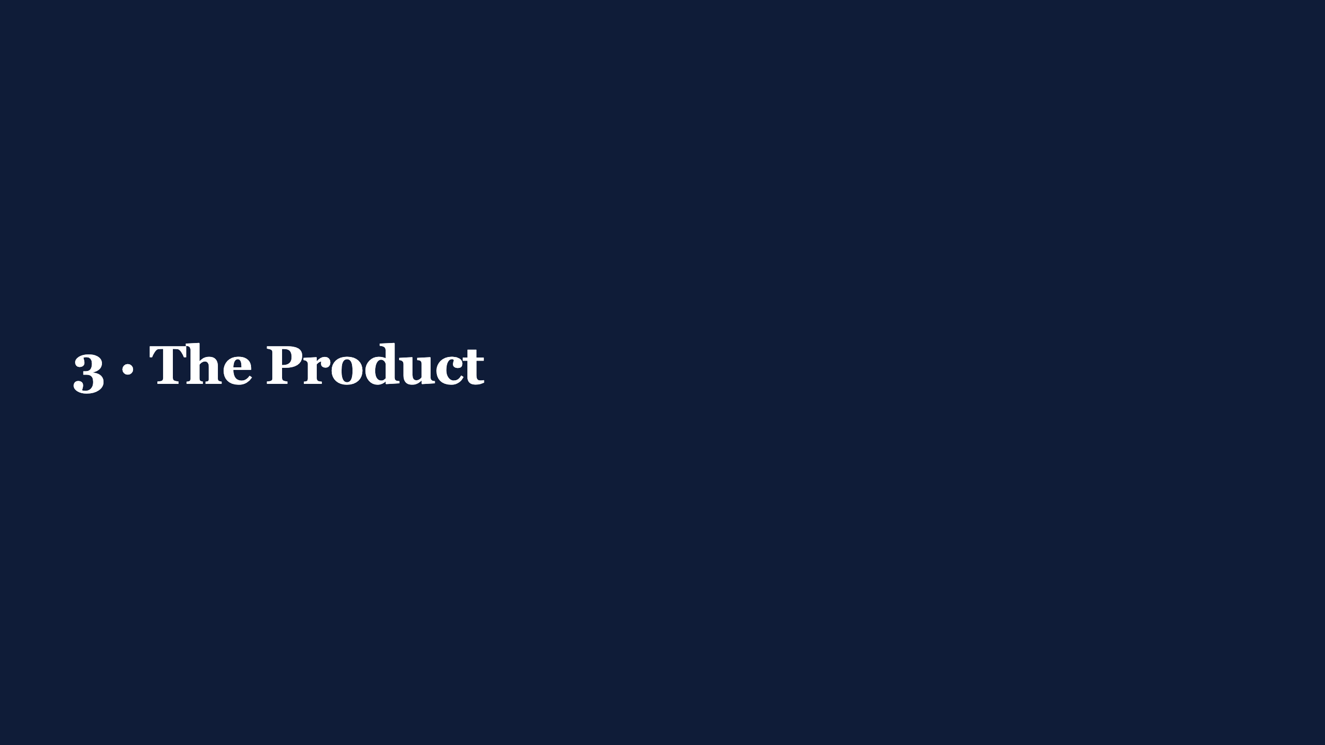

Slide 11
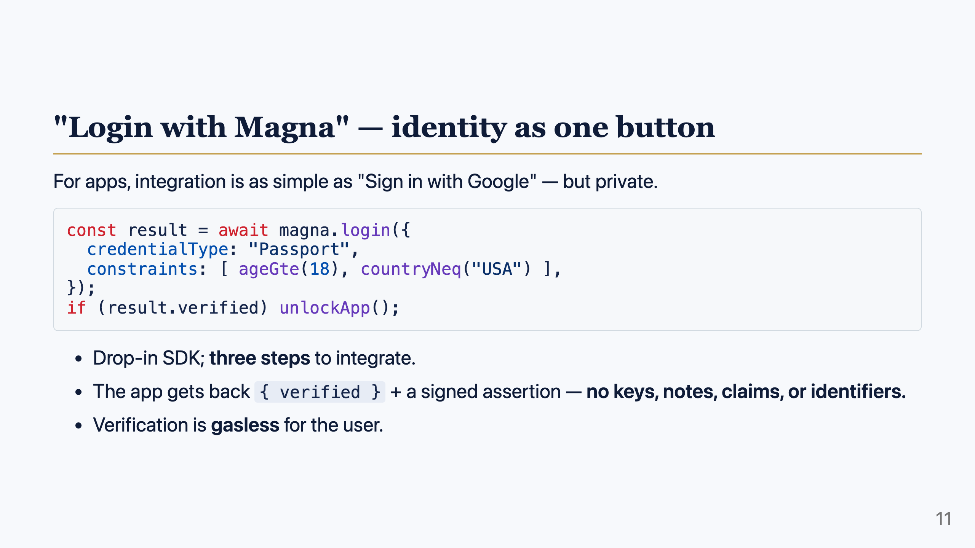
Notes:
Speaker notes:
- This is the wedge: developer-friendly distribution. The hard cryptography is hidden behind one call.
- The wallet (passkeys, proving, private state) lives on a Magna-owned origin — the dApp never touches it. Same trust model as federated login, but the dApp learns nothing about the person.

Slide 12
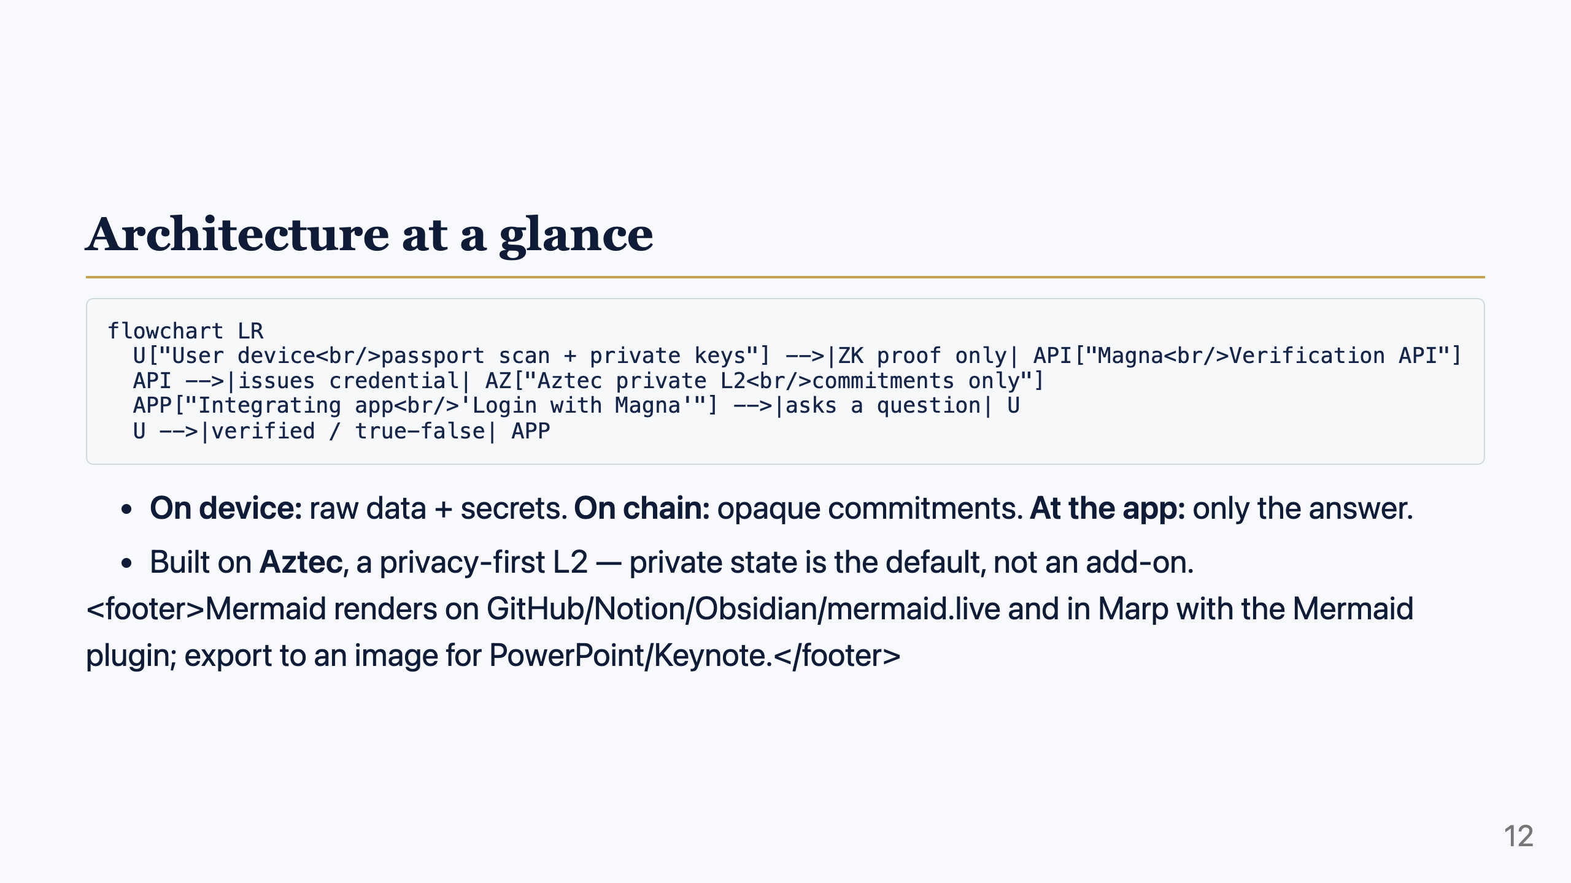
Notes:
Speaker notes:
- The three trust zones map exactly to the three steps. This is the whole security story in one picture.
- For non-Mermaid tools, export this slide to an image or redraw natively.

Slide 13
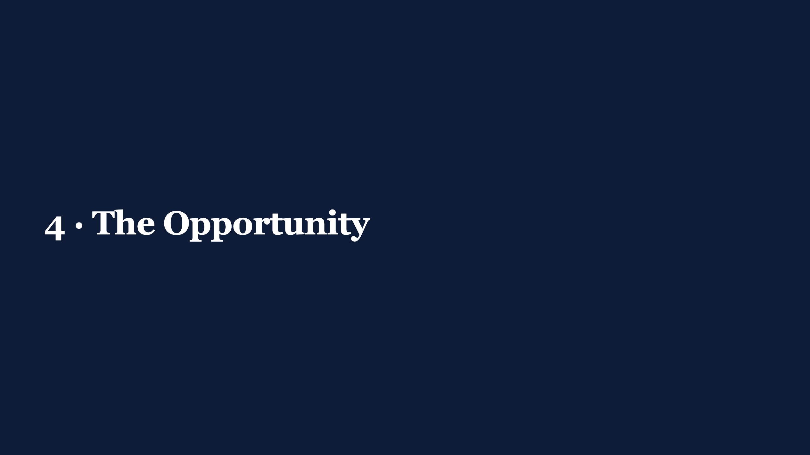

Slide 14
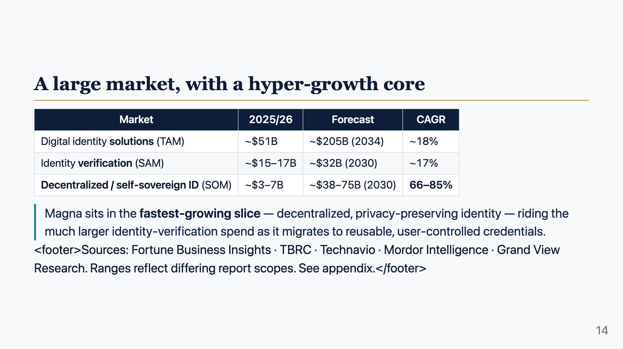
Notes:
Speaker notes:
- TAM / SAM / SOM framing: total identity solutions → verification spend → the SSI segment Magna directly plays in.
- The headline: the SSI segment grows ~4–5x faster than the broader market. Magna is positioned where the puck is going.

Slide 15
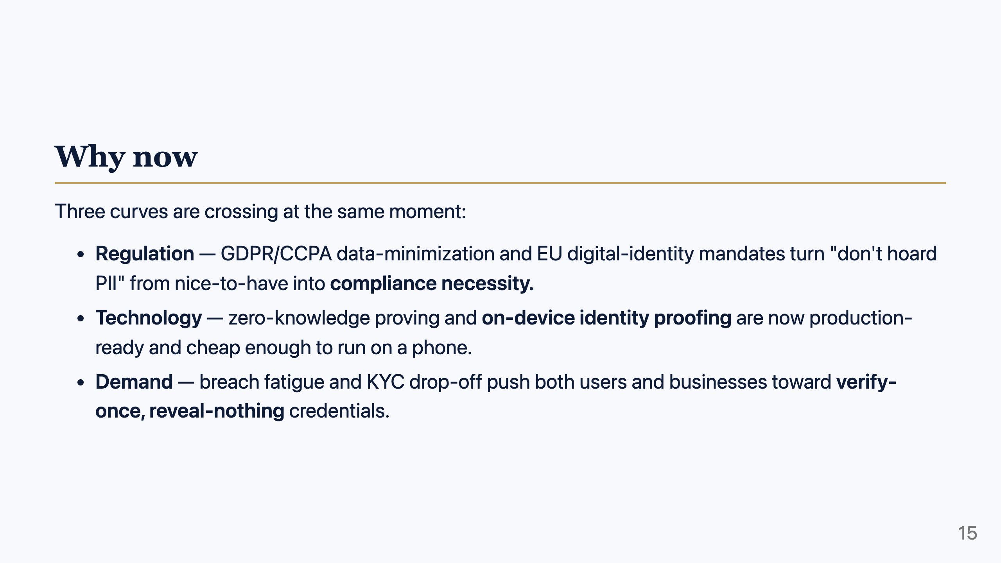
Notes:
Speaker notes:
- "Why now" answers the investor's "why didn't this exist before / why won't it wait." ZK maturity + regulation + breach fatigue.
- This is the moment the cost of the old model and the capability of the new model crossed.

Slide 16
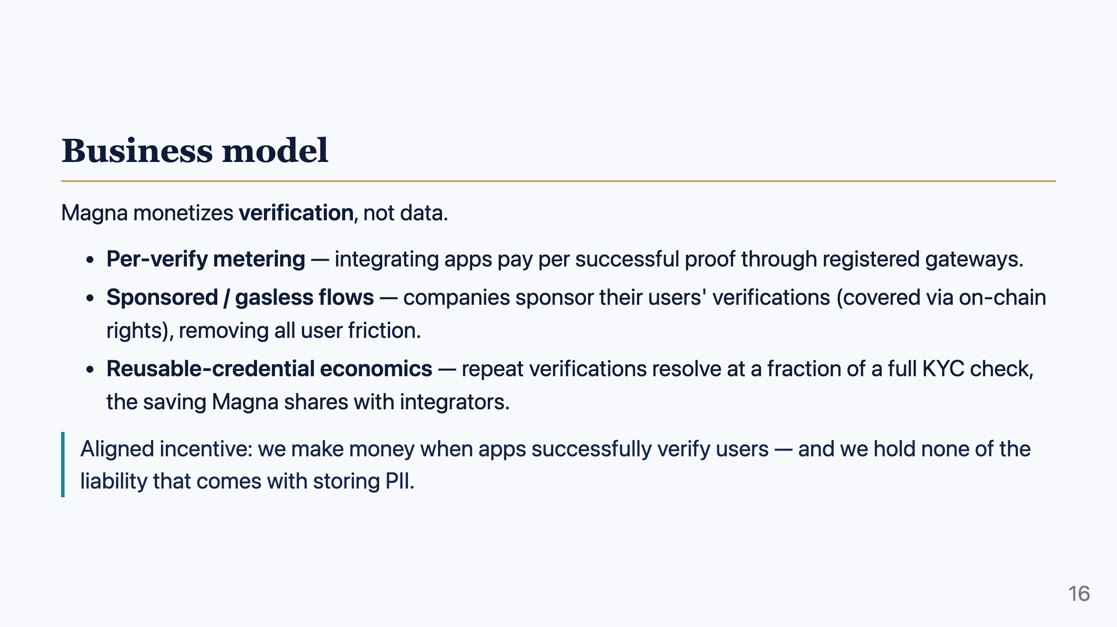
Notes:
Speaker notes:
- Revenue = metered verifies + sponsorship rails. No data-resale model — that's both an ethical and a moat point.
- Tie back to the cost slide: a reusable check is "cents on the dollar" vs a full KYC, so there's room to price well and still save the integrator money.

Slide 17
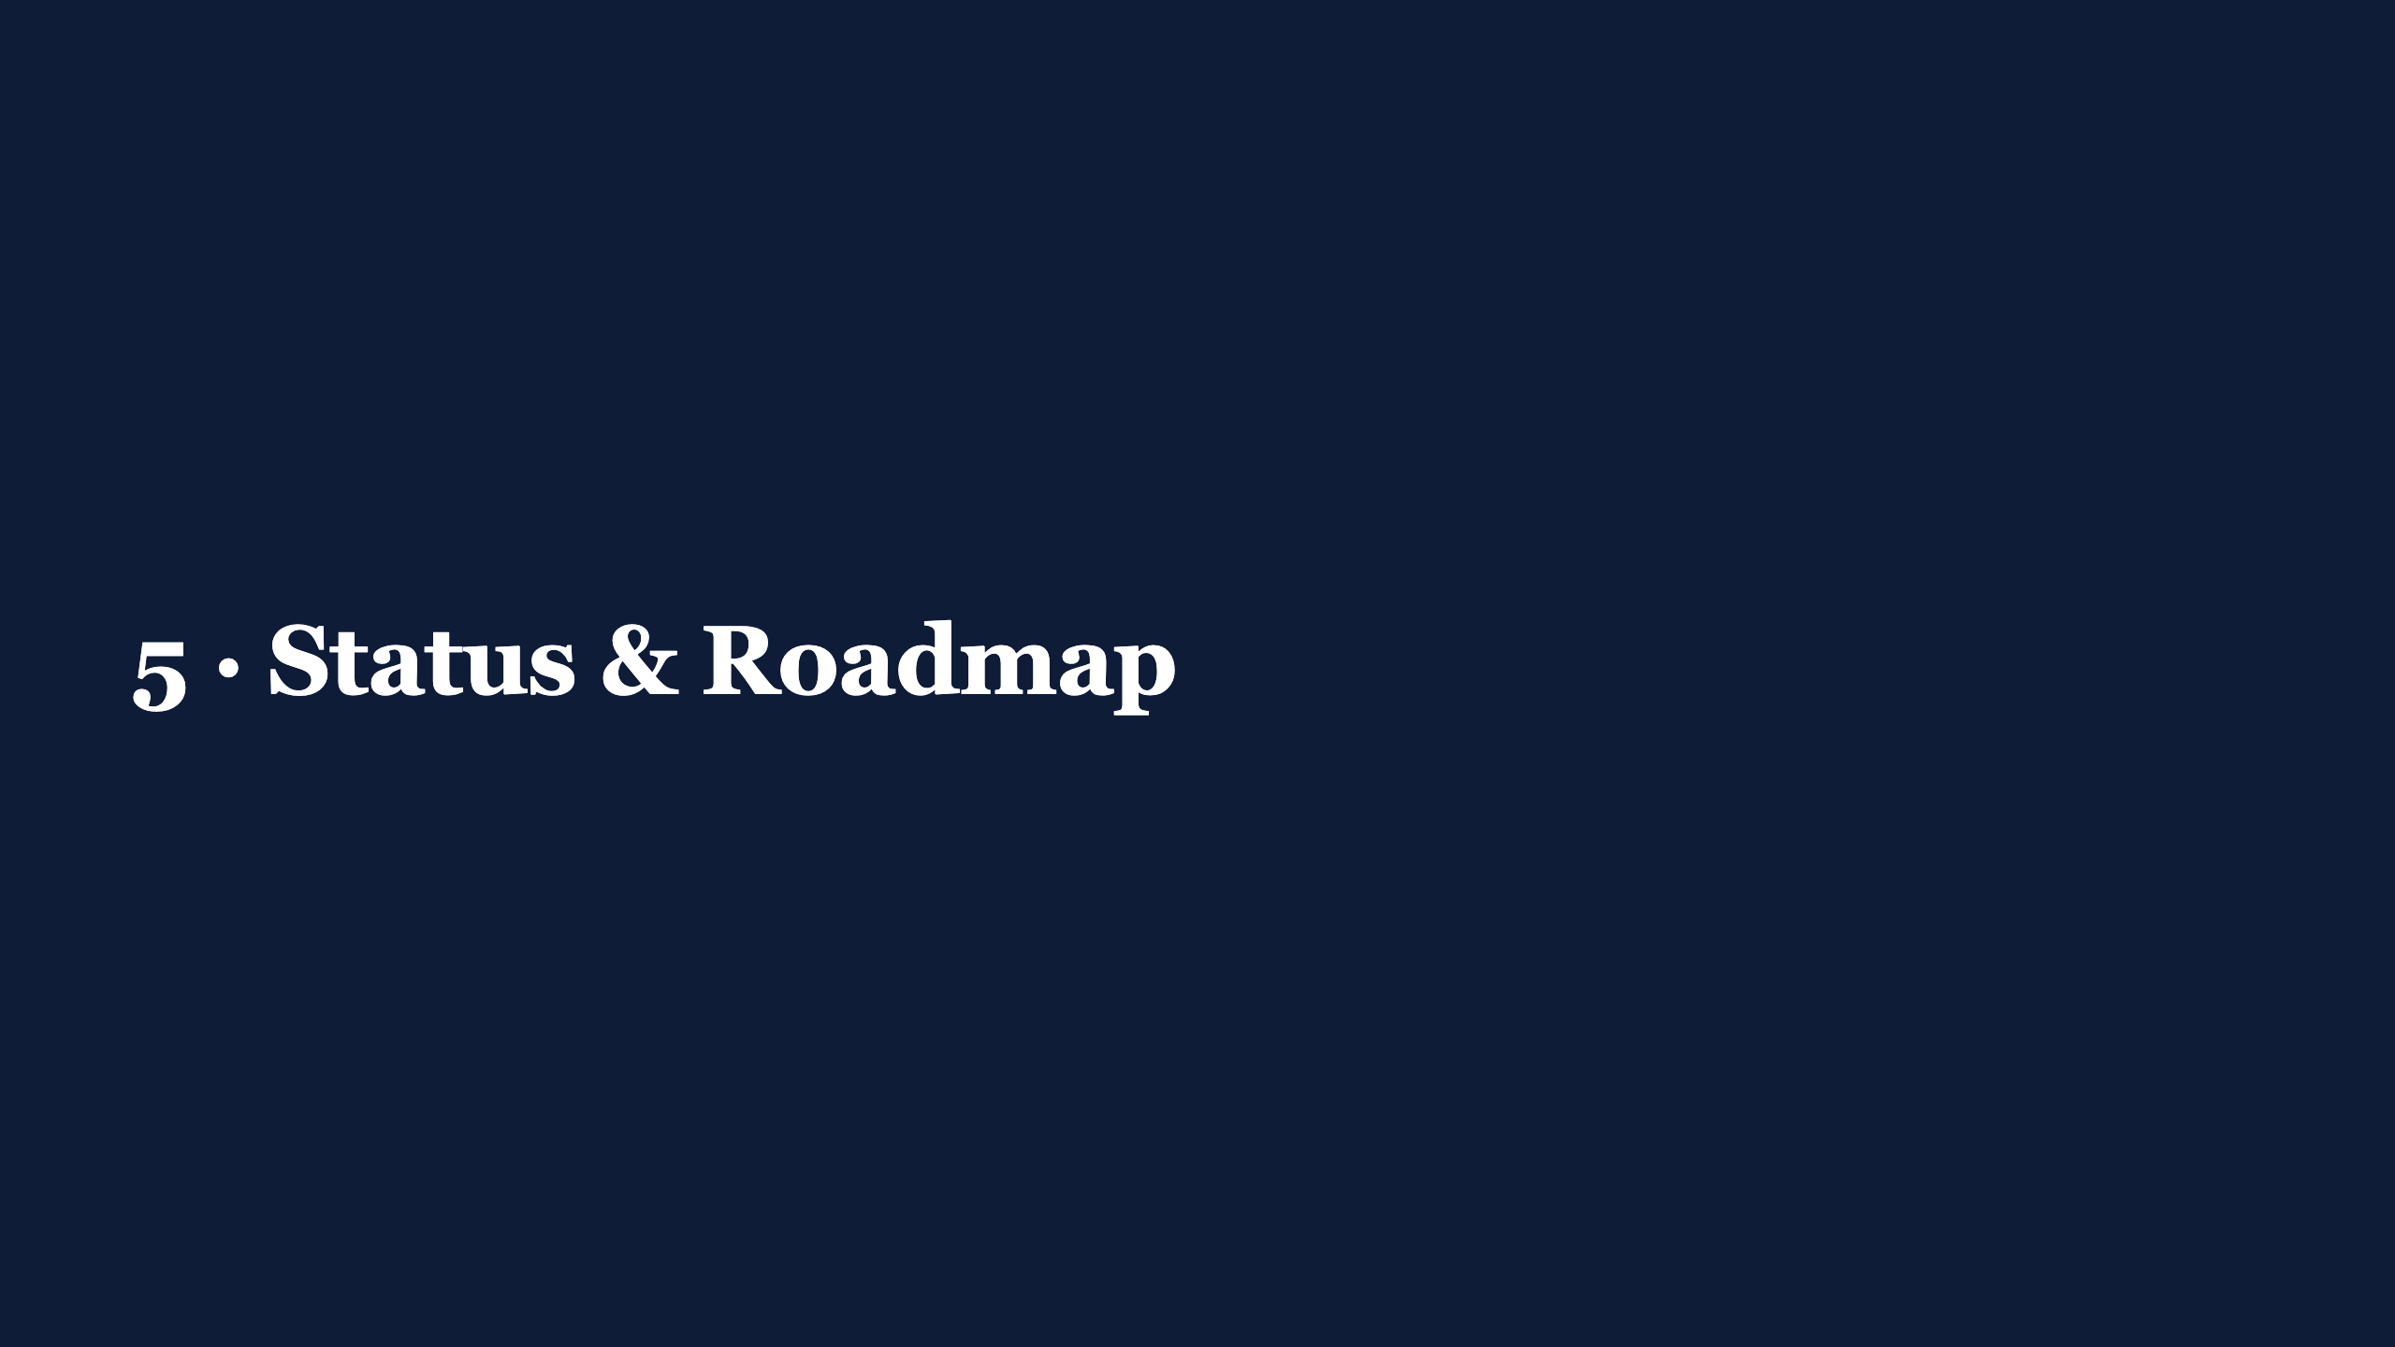

Slide 18
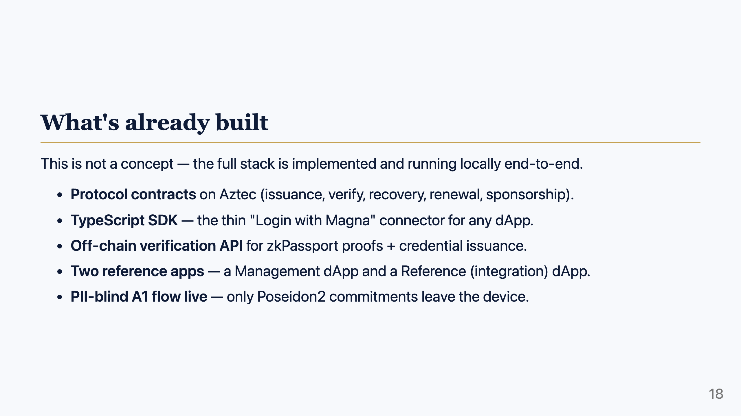
Notes:
Speaker notes:
- Credibility slide. Emphasize: working code, not slideware. Local end-to-end demo is available.
- v1 scope is the rooted, PII-blind passport flow.

Slide 19
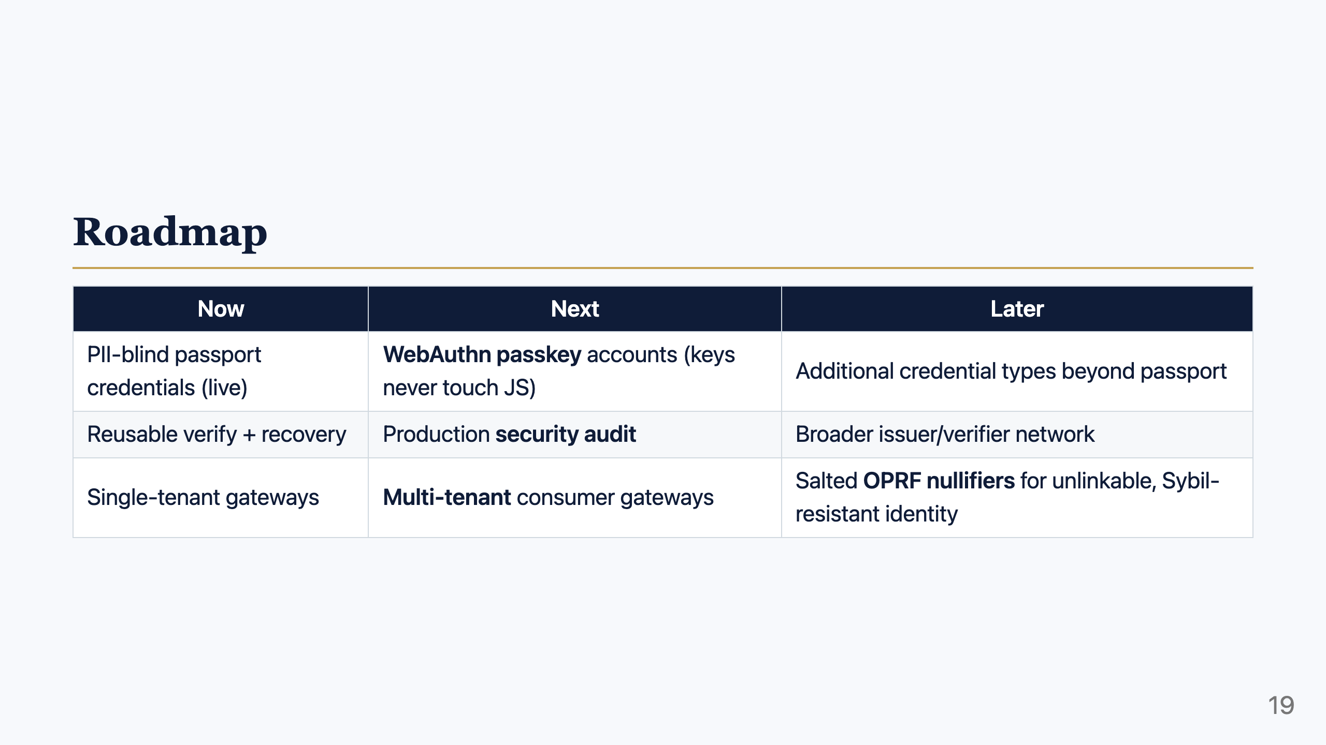
Notes:
Speaker notes:
- Near-term is hardening + distribution (passkeys, audit, multi-tenant).
- The OPRF nullifier upgrade (privacy-preserving, non-recomputable unique IDs) is the forward-looking research item — coordinate with zkPassport on this.

Slide 20
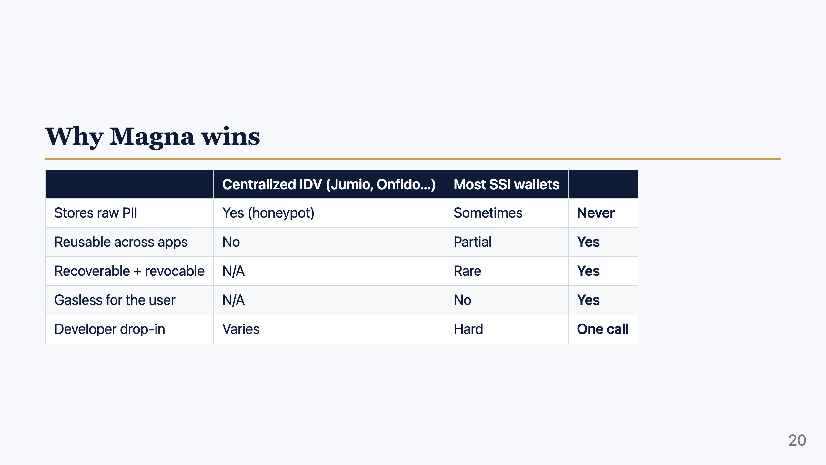
Notes:
Speaker notes:
- The differentiation matrix. Magna's combination — never stores PII + reusable + recoverable/revocable + gasless + drop-in — is the row no competitor fills completely.
- Don't over-claim specific competitor internals in the room; frame as "the category."

Slide 21
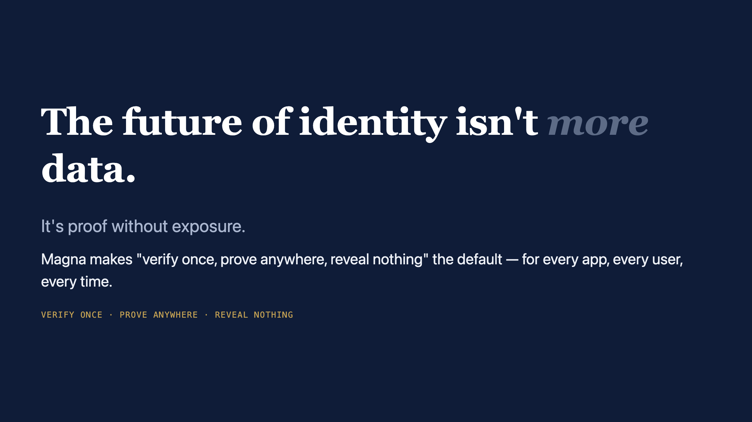
Notes:
Speaker notes:
- Land the vision, then go to your ask (raise / pilot / partnership) — tailor the final ask to the specific audience.

Slide 22
