Slide 1
bestRTC
Oguzhan Yildirim
Alp Tahta

Slide 2
This application incorporates the recording capability provided by the Kurento Media Server in a one to one video communication. In addition, a filter element (FaceOverlayFilter) is placed between the WebRtcEndpoints of the Media Pipeline. The following picture shows an screenshot of this demo running in a web browser:

Slide 3
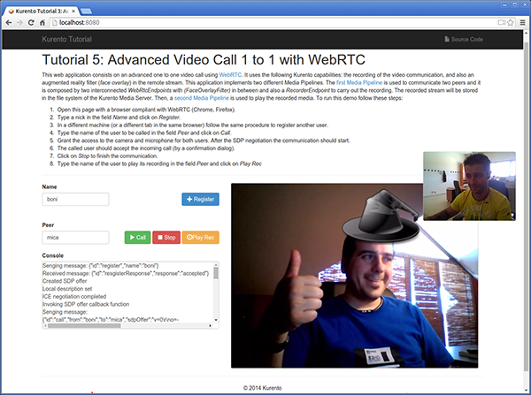

Slide 4
The interface of the application (an HTML web page) is composed by two HTML5 video tags: one for the local video camera stream (the caller stream, the smaller video in the picture) and other for the remote peer in the call (the callee stream, the bigger video in the picture). If two users, A and B, are using the application, the media flow goes this way: The video camera stream of user A is sent to the Kurento Media Server and sent again to the user B. On the other hand, user B sends its video camera stream to Kurento and then it is sent to user A.
This application is implemented by means of two Media Pipeline ‘s. First, the rich real-time WebRTC communication is performed two WebRtcEndpoints interconnected, and with a FaceOverlayFilter in between them. In addition and a RecorderEndpoint is used to store both streams in the file system of the Kurento Media Server. This media pipeline is illustrated in the following picture:

Slide 5
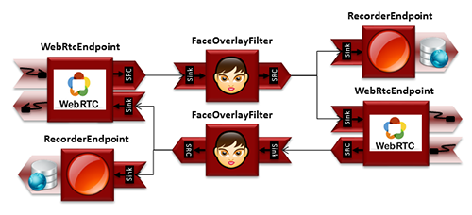

Slide 6
A second media pipeline is needed to play the previously recorded media. This pipeline is composed by a PlayerEndpoint which reads the files stored in the Kurento Media Server. This media element injects the media in a WebRtcEndpoint which is charge to transport the media to the HTML5 video tag in the browser:

Slide 7
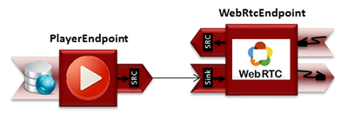

Slide 8
To communicate the client with the server to manage calls we have designed a signaling protocol based on JSON messages over WebSocket ‘s. The normal sequence between client and server would be as follows:
User A is registered in the server with his name
User B is registered in the server with her name
User A wants to call to User B
User B accepts the incoming call
The communication is established and media is flowing between User A and User B
One of the users finishes the video communication
One of the users play the recorded media
This is very simple protocol designed to show a simple one to one call application implemented with Kurento. In a professional application it can be improved, for example implementing seeking user, ordered finish, among other functions.
Assuming that User A is using Client A and User B is using Client B, we can draw the following sequence diagram with detailed messages between clients and server. The following diagram shows the two parts of the signaling protocol: first the enhanced real-time communication is performed, and then the playback of the recorded file is carried out.

Slide 9
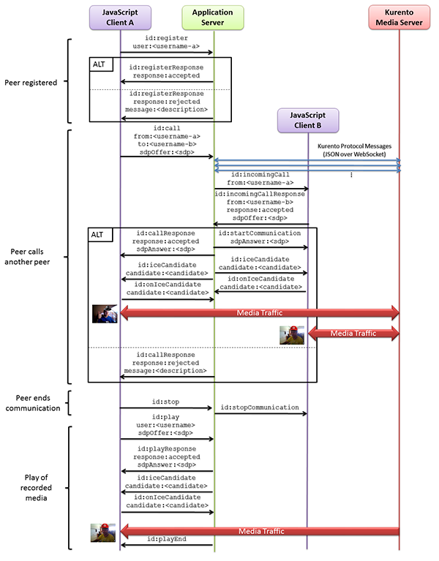

Slide 10
As you can see in the diagram, SDP and ICE candidates need to be interchanged between client and server to establish the WebRTC connection between the Kurento client and server. Specifically, the SDP negotiation connects the WebRtcPeer in the browser with the WebRtcEndpoint in the server.

Slide 11
This work is licensed under a Creative Commons Attribution-ShareAlike 3.0 Unported License.
It makes use of the works of Mateus Machado Luna.

