Slide 1


Git 101
Oleg Volkov

Slide 2
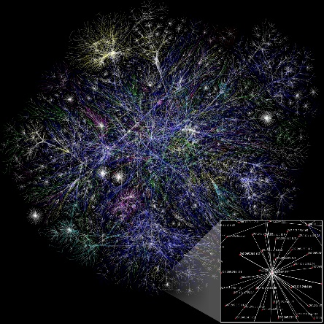


What is Git?
Distributed version control system
no central repository is necessary
Developed by Linus Torvalds
for unconventional needs of Linux Kernel
Loved by everyone
de-facto industry standard

Slide 3
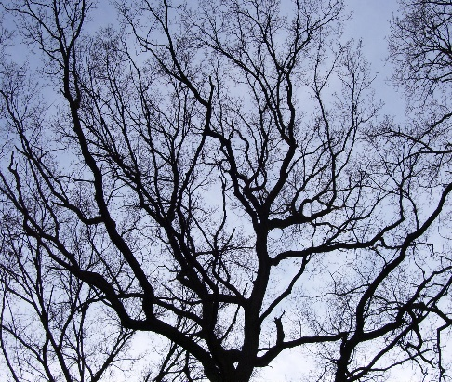
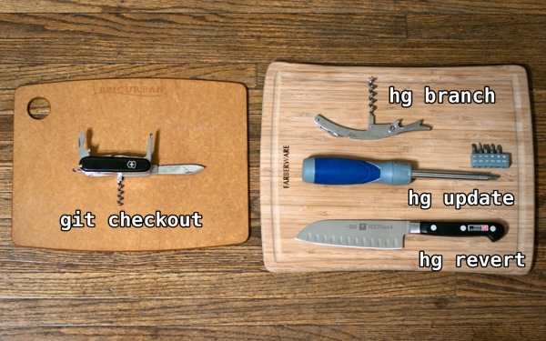

Why Git?
Exemplary branches support
branching was never so easy
Very powerful
can do everything * shoot you in the foot as well
Github
every OSS project alive migrated to github
and github is very sexy anyway
Git swiss knife is taken from http://stevelosh.com/blog/2010/01/the-real-difference-between-mercurial-and-git/

Slide 4

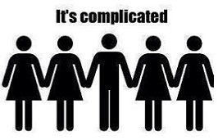
What’s not so good?
Git is complicated
Command names sometimes are weird
checkout -b to create branch? oh well…
But, understanding some basics helps a lot!

Slide 5
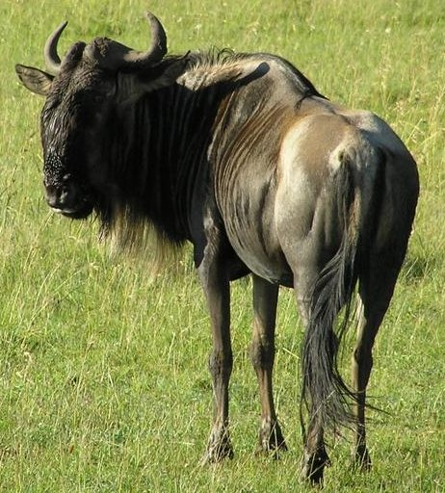
Installing
Git is a Unix child
Git on Windows installs a lot of GNU utilities
…and it’s good!
Learned to love Bash

Slide 6

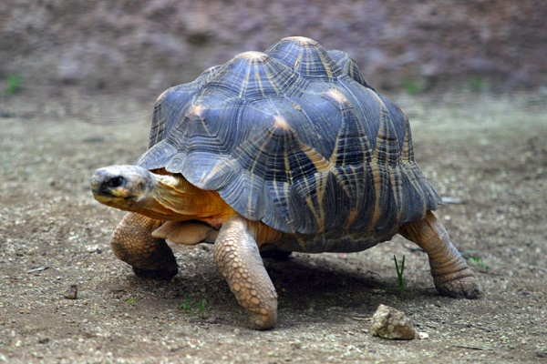
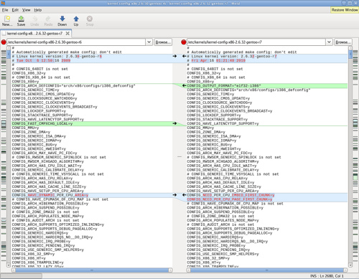
Know the difference
Primary git interface is a command line
git log --oneline --decorate --graph –al
Many other clients are present
TortoiseGit, IDE built-in, GitHub for Windows...
Tasks betters suited to GUI are outsourced to tools
e.g. merge/diff tools: KDiff, P4Merge, Beyond Compare, Meld…

Slide 7
Let’s start
Create empty repository
git init
Clone existing repository to your PC
git clone https://example.com/repo

Slide 8
Let’s start
Repository is local!
All git data is stored in the .git directory
Therefore, you can easily move it around

Slide 9

Everyday churn
What’s up
git status
Add files
git add .
Commit
git commit

Slide 10

Vim first aid
Exit
:q!
Edit
i
Save and exit
:wq

Slide 11
Concept of staging
Local working directory
Staging area / Index
Repository
git add
git commit
git reset
git reset --hard
git checkout

Slide 12
Concept of staging
Simple case
Action | Working directory | Staging/Index | Repository
<initial state> | A | A | A
<edit files> | A’ | A | A
git add | A’ | A’ | A
git commit | A’ | A’ | A’
Beware! Don’t forget to add files after edit if you want them in commit
Action | Working directory | Staging/Index | Repository
<initial state> | A | A | A
<edit files> | A’ | A | A
git add | A’ | A’ | A
<edit files> | A’’ | A’ | A
git commit | A’’ | A’ | A’

Slide 13
Undoing things
Action | Working directory | Staging/Index | Repository
<edit files> | A’ | A | A
git checkout -- <file> | A | A | A
git add | A’ | A’ | A
git reset | A’ | A | A
git add | A’ | A’ | A
git reset --hard | A | A | A
git commit | A’ | A’ | A’
git reset HEAD~1 | A’ | A | A
use git revert to undo commits visible to public (creates new fixup commit)
use git commit --amend to modify the last commit instead of removing

Slide 14
Shortcuts?
Commit with a message
git commit –m “Refactored everything”
Automatically add modified files to index
git commit –a
NOTE: new files are not added!

Slide 15

.gitignore
Files never meant to be in the repository
Commit into repository to be used by all members
# User-specific files
*.suo
*.user
# Build results
[Dd]ebug/
[Dd]ebugPublic/
[Rr]elease/
[Rr]eleases/
x64/
x86/
build/
bld/
[Bb]in/
[Oo]bj/

Slide 16
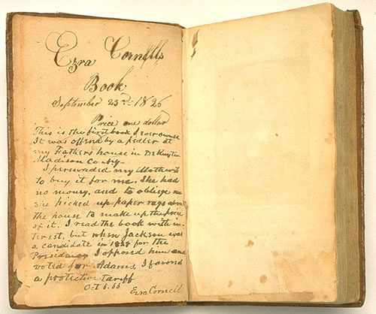
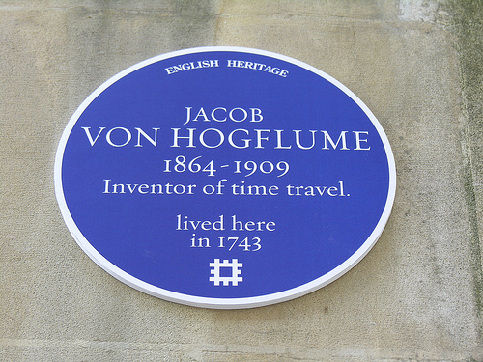
History and time travel
View history
git log
git show
gitk
Go back and forth
git checkout <commit>
Bonus: From any point, you can mess with the code and start a new branch!

Slide 17
Referencing commits
SHA-1 hash
not sequential because of distributed nature
usually several first digits are enough
<branch name>
top commit of the branch
HEAD
where are we currently
HEAD~
parent, the commit before where are we
HEAD~2
two commits before etc.

Slide 18
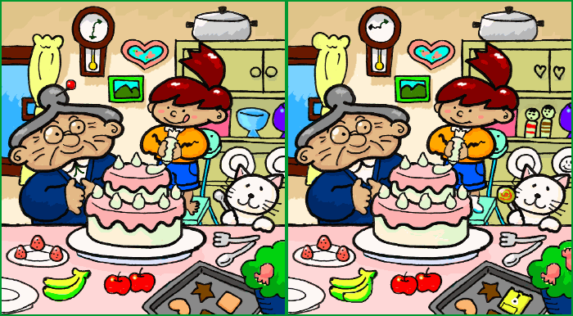
Diffs
Difference to index
git diff
Graphical one
git difftool
How to setup difftool
.gitconfig
Diff to different version
git difftool <commit>

Slide 19


Slide 20

Branches
Create a new branch
git checkout –b <branch name>
Takes all changes from working copy
– e.g. when a change is not as small as expected
Switch to a branch
git checkout <branch name>
In place and super fast!

Slide 21
Branches
List all branches available
git branch
The current branch:
- is visible in Bash
- is shown in git status

Slide 22
Branches
Show branch history and relationships
git log --graph --decorate --oneline
gitk
The same for all branches
git log -all --graph --decorate --oneline
gitk --all

Slide 23

Merge
Merge a branch
git merge <branch name>
Resolve conflicts
git mergetool
git commit
Register merge tool of your choice in .gitconfig

Slide 24

Merge
All commits from the source branch appear on the target!
see git log
BUT…How?

Slide 25
Git internals
Git repository consists of a number of objects
Objects are stored in .git directory
Objects are addressed by SHA-1 hash of their contents
The types of objects are blob, tree, commit and tag

Slide 26
Git internals
Blob objects usually represent the contents of the file
Blob b6b7ca1c….
public static void Main(string args[])
{
…….
……. }

Slide 27
Git internals
Tree objects usually represent contents of the directory
Tree is a collection of items having name, hash and a link
to either blob object or another tree
Blob b6b7ca1c….
public static void Main(string args[])
{
…….
……. }
Blob ae5374…
……..
………….
…………..
…………..
……………..
………………
Tree ab3c616…
type | hash | name
blob | b6b7ca1c… | Program.cs
blob | ae5374… | Repository.cs
tree | 4d03f1…. | Models
Tree ab3c616…
type | hash | name
…. | …. | ….
…. | …. | ….

Slide 28
Git internals
Commit objects represent units of change to the repository
Commit has a hash, author, committer, parent(s), and link to
the tree object representing the snapshot of the working directory
at a time of commit note: snapshot, not a delta
Commit 4fb4bba69b….
author | Oleg Volkov (oleg@example.com)
committer | Oleg Volkov (oleg@example.com)
parent | 1c30354…
tree | ab3c616…
Tree ab3c616…
type | hash | name
blob | b6b7ca1c… | Program.cs
blob | ae5374… | Repository.cs
tree | 4d03f1…. | Models

Slide 29
Git internals
Any subsequent commit lists the previous one as a parent
eedb8fec4…
fixed a bug in a feature
Parent: 3758dcbe…
parent
3758dcbe…
implemented a feature
Parent: 86955ff1…
3758dcbe…
implemented a feature
Parent: 86955ff1…
parent
parent
86955ff1…
created a project
86955ff1…
created a project
86955ff1…
created a project
time

Slide 30
Git internals
The branch is just a named pointer to some commit
master
eedb8fec4…
fixed a bug in a feature
Parent: 3758dcbe…
parent
master
3758dcbe…
implemented a feature
Parent: 86955ff1…
3758dcbe…
implemented a feature
Parent: 86955ff1…
parent
parent
master
86955ff1…
created a project
86955ff1…
created a project
86955ff1…
created a project
time

Slide 31
Git internals
Branch history is just a set of commits reachable from its head
eedb8fec4…
fixed a bug in a feature
Parent: 3758dcbe…
master
3758dcbe…
implemented a feature
Parent: 86955ff1…
86955ff1…
created a project
time

Slide 32
Git internals
Creating new branch is just creating a new pointer,
no data copying is involved, so very fast
eedb8fec4…
fixed a bug in a feature
Parent: 3758dcbe…
feature
master
3758dcbe…
implemented a feature
Parent: 86955ff1…
86955ff1…
created a project
time

Slide 33
Git internals
Branches start to diverge
feature
9cde51b3…
Implemented feature 2
Parent: eedb8fec4 …
master
eedb8fec4…
fixed a bug in a feature
Parent: 3758dcbe…
3758dcbe…
implemented a feature
Parent: 86955ff1…
86955ff1…
created a project
time

Slide 34
Git internals
Branches start to diverge
feature
42621e3…
fix
Parent: eedb8fec4…
master
9cde51b3…
Implemented feature 2
Parent: eedb8fec4…
eedb8fec4…
fixed a bug in a feature
Parent: 3758dcbe…
3758dcbe…
implemented a feature
Parent: 86955ff1…
86955ff1…
created a project
time

Slide 35
master
Git internals
42621e3…
Merged branch ‘feature’
Parent: 42621e3…
Parent: 9cde51b3…
Merge commit
has several parents
Note the set of
reachable commits
from master
42621e3…
fix
Parent: eedb8fec4…
feature
9cde51b3…
Implemented feature 2
Parent: eedb8fec4…
eedb8fec4…
fixed a bug in a feature
Parent: 3758dcbe…
3758dcbe…
implemented a feature
Parent: 86955ff1…
86955ff1…
created a project
time

Slide 36
Merge flavors: the usual
merge commit
master history
master
e
e
feature
feature
master
d
d
d
c
git merge feature
c
c
b
b
b
a
a
a
all the original commits from
the merged branch are retained

Slide 37
Merge flavors: after some merges back and forth
master
feature
master history
git merge master
git merge master

Slide 38
Merge flavors: fast forward
master history
feature
feature
master
master
c
c
c
git merge feature
b
b
b
a
a
a
no merge commit!
can be avoided with --no-ff

Slide 39
Merge flavors: squash
master history
master
b+d
b+d
feature
d
feature
master
d
c
git merge feature
--squash
git commit
c
c
b
b
a
a
a
all the original commits from
the merged branch are combined into one

Slide 40

Rebase
A sneaky merge rewriting target branch commits as if
changes from source branch were always there!
Useful for merging changes from upstream into a private branch
Rebase a branch
git rebase <branch name>
Resolve conflicts
git mergetool
git rebase --continue

Slide 41
Merge flavors: rebase
master history
d’
feature
d’
e
b’
b’
feature
master
d
c
git rebase master
c
master
c
b
a
a
a
Eligible for fast-forward!

Slide 42
Rebase
Rebase rewrites history, proceed with caution
NEVER rebase a branch others are working on!
NOTE: Merge vs rebase is a holy war

Slide 43

Interactive rebase: history cleaning
git rebase –i <after which commit>
Reorder commits
Squash commits
Change commit messages
Modify commits

Slide 44

Delete a branch
E.g. when a feature branch is merged into master and no longer needed
git branch -d <branch name>
If the deleted branch has been merged into another,
commits are retained
Only commits that are not referenced by any branch
will be deleted eventually

Slide 45


Slide 46

Connecting to external repositories
The basic workflow
Clone existing repository
git clone <repo>
Work locally
edit files / git add . / git commit
Take changes from the remote repository
git pull
Submit your changes to the external repository
git push

Slide 47
Connecting to external repositories
Local repository
Remote repository
git clone
(once)
git pull
git push

Slide 48
Connecting to external repositories
Note: git push should always be a fast-forward operation
therefore, always do a git pull before pushing

Slide 49
External repositories: under the hood
Local repository can possibly be connected to multiple
remote repositories (remotes)
By default, git clone creates a remote called origin
Git tracks the state of remote branches; those branches are named
<remote>/<branch name>
e.g. origin/master

Slide 50
External repositories: under the hood
A tracking branch is a branch which is known to be related to
the specific remote branch
git clone creates local tracking branches for origin’s branches
e.g. master -> origin/master
When checking out a branch with the same name as remote’s branch,
tracking is set up automatically

Slide 51
External repositories: under the hood
git fetch updates remote branches pointers,
i.e. retrieves the work done by other people on the remote repo
git merge can merge a local copy of the remote branch
with the local branch
git pull = git fetch + git merge
git push sends your local changes to the remote repo

Slide 52
External repositories: under the hood
Command | Local repository |  | Remote repository
 | Local branch | Remote branch pointer | Remote repository branch
 |  |  | a.b.c.d
git clone | a.b.c.d | a.b.c.d | a.b.c.d
<commits to the remote repo> |  |  | a.b.c.d.e
<commits to the local repo> | a.b.c.d.f | a.b.c.d | a.b.c.d.e
git fetch | a.b.c.d.f | a.b.c.d.e | a.b.c.d.e
git merge | a.b.c.d.e.f.f’ | a.b.c.d.e | a.b.c.d.e
git push | a.b.c.d.e.f.f’ | a.b.c.d.e.f.f’ | a.b.c.d.e.f.f’

Slide 53
Connecting to external repositories
Note: git push should always be a fast-forward operation
therefore, do a git pull before pushing
Create remote branch from a local one
git push -u origin <branch name>
Delete remote branch after local one is deleted
git push origin --delete <branch name>

Slide 54
Pull request concept

Slide 55
Typical workflow
For each feature, a new feature branch is created locally
Commit into a local branch frequently (1-10 times a day)
Local feature branch tracks feature branch on the server
Push into a server feature branch regularly (once a day)
In the end, feature branch is merged into a master
Feature branch is deleted

Slide 56


Slide 57


In Visual Studio

Slide 58
More
Undo working copy changes, but save them
git stash [apply]
Migrate commit(s) to any other branch
git cherry-pick <commit>
Creating a patch
git diff && git apply
Aggregate several commits into
git reset --soft HEAD~n && git commit

Slide 59
More
Find a commit which introduced a regression
git bisect
Find when some string first appeared
git log -S<search term>
Show today’s work
git log --after="yesterday“
--pretty=format:%s --author="Oleg Volkov"

Slide 60
More
Create alias for frequently used commands
git config --global alias.daily
‘log --after="yesterday“ --pretty=format:%s --author="Oleg Volkov“’
Rewrite all commits in a branch
git filter-branch <operation>

