Slide 1


Git 101
Oleg Volkov

Slide 2
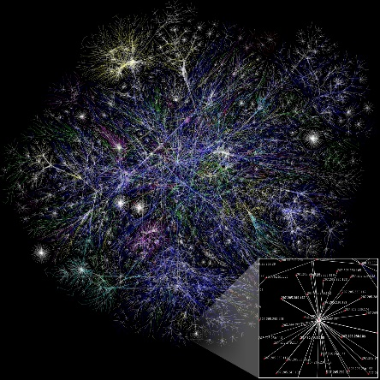


What is Git?
Distributed version control system
no central repository is necessary
Developed by Linus Torvalds
for unconventional needs of Linux Kernel
Loved by everyone
de-facto industry standard

Slide 3

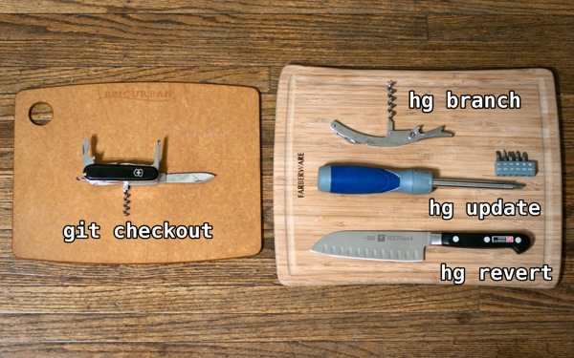

Why Git?
Exemplary branches support
branching was never so easy
Very powerful
can do everything * shoot you in the foot as well
Github
every OSS project alive migrated to github
and github is very sexy anyway
Git swiss knife is taken from http://stevelosh.com/blog/2010/01/the-real-difference-between-mercurial-and-git/

Slide 4

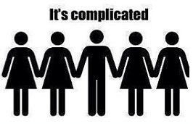
What’s not so good?
Git is complicated
Command names sometimes are weird
checkout -b to create branch? oh well…
But, understanding some basics helps a lot!

Slide 5
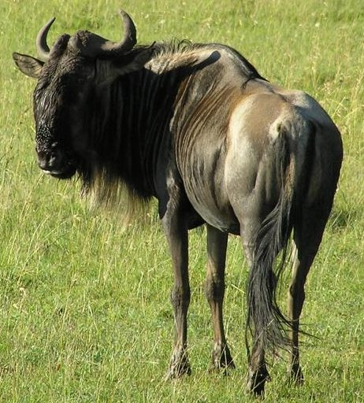
Installing
Git is a Unix child
Git on Windows installs a lot of GNU utilities
…and it’s good!
Learned to love Bash

Slide 6

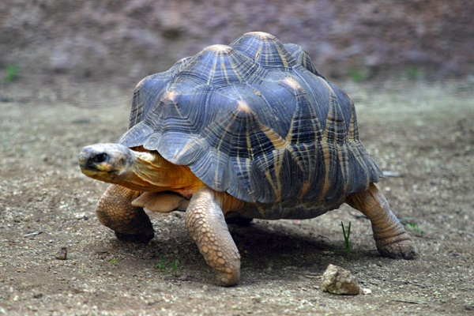
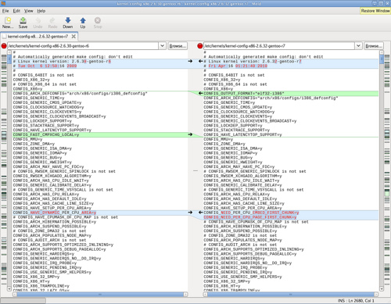
Know the difference
Primary git interface is a command line
git log --oneline --decorate --graph –al
Many other clients are present
TortoiseGit, IDE built-in, GitHub for Windows...
Tasks betters suited to GUI are outsourced to tools
e.g. merge/diff tools: KDiff, P4Merge, Beyond Compare, Meld…

Slide 7
Let’s start
Create empty repository
git init
Clone existing repository to your PC
git clone https://example.com/repo

Slide 8

Everyday churn
What’s up
git status
Add files
git add .
Commit
git commit

Slide 9

Vim first aid
Exit
:q!
Edit
i
Save and exit
:wq

Slide 10
Concept of staging
Local working directory
Staging area / Index
Repository
git add
git commit
git reset
git reset --hard
git checkout

Slide 11
Concept of staging
Simple case
Action | Working directory | Staging/Index | Repository
<initial state> | A | A | A
<edit files> | A’ | A | A
git add | A’ | A’ | A
git commit | A’ | A’ | A’
Beware! Don’t forget to add files after edit if you want them in commit
Action | Working directory | Staging/Index | Repository
<initial state> | A | A | A
<edit files> | A’ | A | A
git add | A’ | A’ | A
<edit files> | A’’ | A’ | A
git commit | A’’ | A’ | A’

Slide 12
Undoing things
Action | Working directory | Staging/Index | Repository
<edit files> | A’ | A | A
git checkout -- <file> | A | A | A
git add | A’ | A’ | A
git reset | A’ | A | A
git add | A’ | A’ | A
git reset --hard | A | A | A
git commit | A’ | A’ | A’
git reset HEAD~1 | A’ | A | A
use git revert to undo commits visible to public (creates new fixup commit)
use git commit --amend to modify the last commit instead of removing

Slide 13
Shortcuts?
Commit with a message
git commit –m “Refactored everything”
Automatically add modified files to index
git commit –a
NOTE: new files are not added!

Slide 14

.gitignore
Files never meant to be in the repository
Commit into repository to be used by all members
# User-specific files
*.suo
*.user
# Build results
[Dd]ebug/
[Dd]ebugPublic/
[Rr]elease/
[Rr]eleases/
x64/
x86/
build/
bld/
[Bb]in/
[Oo]bj/

Slide 15
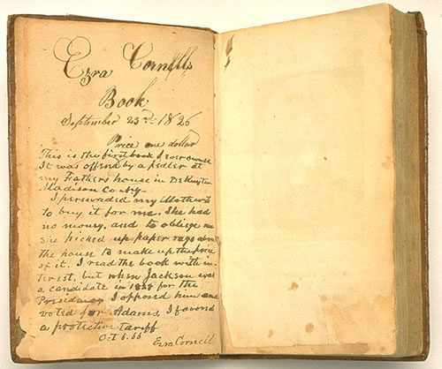
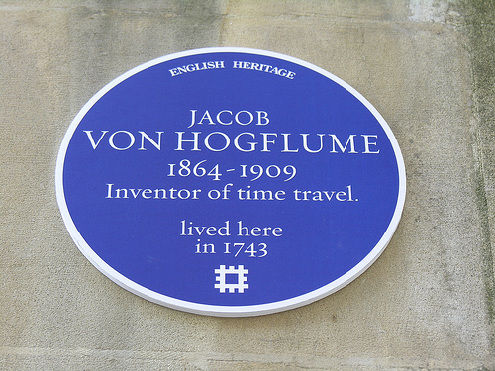
History and time travel
View history
git log
git show
gitk
Go back and forth
git checkout <commit>
Bonus: From any point, you can mess with the code and start a new branch!

Slide 16
Referencing commits
SHA-1 hash
not sequential because of distributed nature
usually several first digits are enough
<branch name>
top commit of the branch
HEAD
where are we currently
HEAD~
parent, the commit before where are we
HEAD~2
two commits before etc.

Slide 17
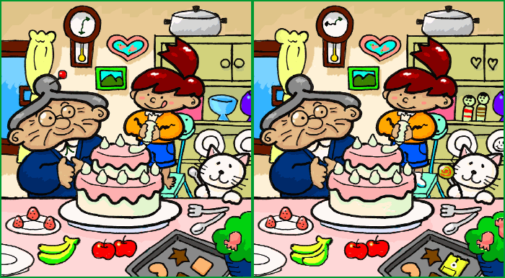
Diffs
Difference to index
git diff
Graphical one
git difftool
How to setup difftool
.gitconfig
Diff to different version
git difftool <commit>

Slide 18

Branches
Create a new branch
git checkout –b <branch name>
Takes all changes from working copy
– e.g. when a change is not as small as expected
Switch to a branch
git checkout <branch name>
In place and super fast!

Slide 19
Branches
List all branches available
git branch
The current branch:
- is visible in Bash
- is shown in git status

Slide 20
Branches
Show branch history and relationships
git log --graph --decorate --oneline
gitk
The same for all branches
git log -all --graph --decorate --oneline
gitk --all

Slide 21

Merge
Merge a branch
git merge <branch name>
Resolve conflicts
git mergetool
git commit
Register merge tool of your choice in .gitconfig

Slide 22
Merge
Usually merge commit is created, having two parents
see gitk –all
(but wait for the fast-forward case in a minute)
All commits from the source branch appear on target
see git log
You can make target branch see only an aggregate commit
git merge --squash <branch>

Slide 23
Merge flavors: the usual
master history
e
feature
master
e
feature
master
d
d
d
c
git merge feature
c
c
b
b
b
a
a
a

Slide 24
Merge flavors: squash
master history
master
b+d
b+d
feature
d
feature
master
d
c
git merge feature
--squash
git commit
c
c
b
b
a
a
a

Slide 25
Merge flavors: fast forward
master history
feature
feature
master
master
c
c
c
git merge feature
b
b
b
a
a
a

Slide 26

Rebase
A sneaky merge rewriting target branch commits as if
changes from source branch were always there!
Useful for merging changes from upstream into a private branch
Rebase a branch
git rebase <branch name>
Resolve conflicts
git mergetool
git rebase --continue

Slide 27
Interactive rebase
TODO

Slide 28

Delete a branch
E.g. when feature branch is merged into master and no longer needed
git branch -d <branch name>

Slide 29

Connecting to external repositories
The basic workflow
Clone existing repository
git clone <repo>
Work locally
edit files / git add . / git commit
Take changes from the remote repository
git pull
Submit your changes to the external repository
git push

Slide 30
Connecting to external repositories
Local repository
Remote repository
git clone
(once)
git pull
git push

Slide 31
Connecting to external repositories
Create remote branch
TODO

Slide 32
External repositories: under the hood
Local repository can possibly be connected to multiple
remote repositories (remotes)
By default, git clone creates a remote called origin
Git tracks the state of remote branches; those branches are named
<remote>/<branch name>
e.g. origin/master

Slide 33
External repositories: under the hood
A tracking branch is a branch which is known to be related to
the specific remote branch
git clone creates local tracking branches for origin’s branches
e.g. master -> origin/master
When checking out a branch with the same name as remote’s branch,
tracking is set up automatically

Slide 34
External repositories: under the hood
git fetch updates remote branches pointers,
i.e. retrieves the work done by other people on the remote repo
git merge can merge a local copy of the remote branch
with the local branch
git pull = git fetch + git merge
git push sends your local changes to the remote repo

Slide 35
External repositories: under the hood
Command | Local repository |  | Remote repository
 | Local branch | Remote branch pointer | Remote repository branch
 |  |  | a.b.c.d
git clone | a.b.c.d | a.b.c.d | a.b.c.d
<commits to the remote repo> |  |  | a.b.c.d.e
<commits to the local repo> | a.b.c.d.f | a.b.c.d | a.b.c.d.e
git fetch | a.b.c.d.f | a.b.c.d.e | a.b.c.d.e
git merge | a.b.c.d.e.f.f’ | a.b.c.d.e | a.b.c.d.e
git push | a.b.c.d.e.f.f’ | a.b.c.d.e.f.f’ | a.b.c.d.e.f.f’

Slide 36
Branching strategies
TODO

Slide 37
Concept of pull requests
TODO

Slide 38


In Visual Studio
TODO

Slide 39
More
Undo working copy changes, but save them
git stash [apply]
Migrate commit(s) to any other branch
git cherry-pick <commit>
Creating a patch
git diff && git apply
Aggregate several commits into
git reset --soft HEAD~n && git commit

Slide 40
More
Find a commit which introduced a regression
git bisect
Find when some string first appeared
git log -S<search term>
Show today’s work
git log --after="yesterday“
--pretty=format:%s --author="Oleg Volkov"

Slide 41
More
Create alias for frequently used commands
git config --global alias.daily
‘log --after="yesterday“ --pretty=format:%s --author="Oleg Volkov“’
Rewrite all commits in a branch
git filter-branch <operation>

