Slide 1


Git 101
Oleg Volkov

Slide 2
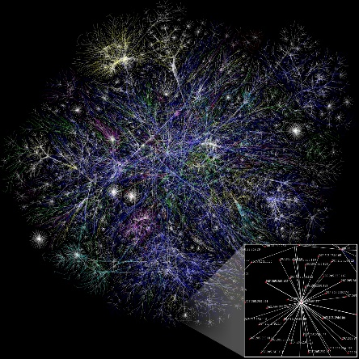
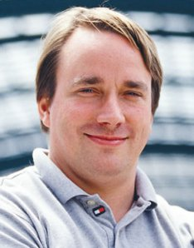

What is Git?
Distributed version control system
no central repository is necessary
Developed by Linus Torvalds
for unconventional needs of Linux Kernel
Loved by everyone
de-facto industry standard

Slide 3
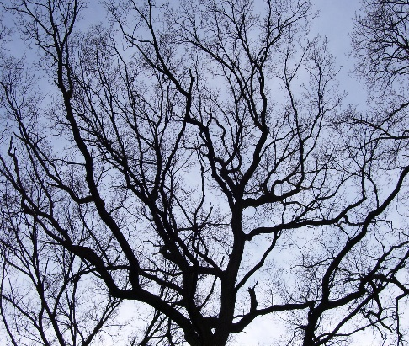
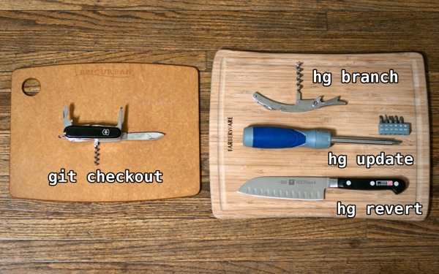

Why Git?
Exemplary branches support
branching was never so easy
Very powerful
can do everything * shoot you in the foot as well
Github
every OSS project alive migrated to github
and github is very sexy anyway
Git swiss knife is take from http://stevelosh.com/blog/2010/01/the-real-difference-between-mercurial-and-git/

Slide 4
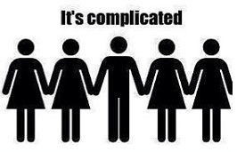
What’s not so good?
Git is complicated
Command names sometimes are weird
checkout -b to create branch? oh well…
But, understanding some basics helps a lot!

Slide 5
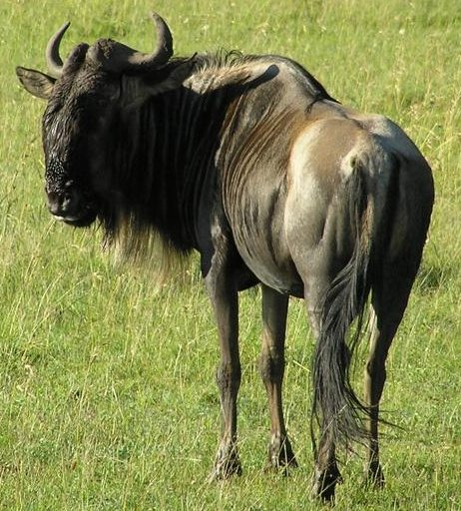
Installing
Git is a Unix child
Git on Windows installs a lot of GNU utilities
…and it’s good!
Learned to love Bash

Slide 6

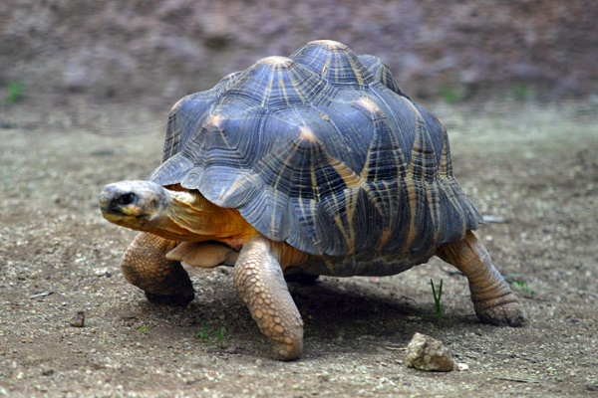
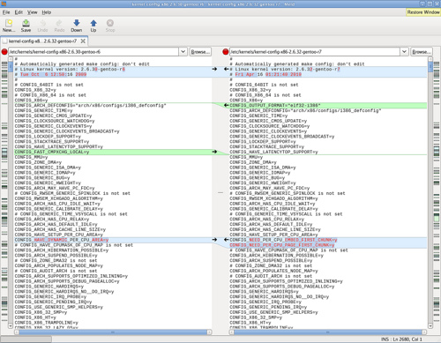
Know the difference
Primary git interface is a command line
git log --oneline --decorate --graph –al
Many other clients are present
TortoiseGit, IDE built-in, GitHub for Windows...
Tasks betters suited to GUI are outsourced to tools
e.g. merge/diff tools: KDiff, P4Merge, Beyond Compare, Meld…

Slide 7
Let’s start
Create empty repository
git init
Clone existing repository to your PC
git clone https://example.com/repo

Slide 8
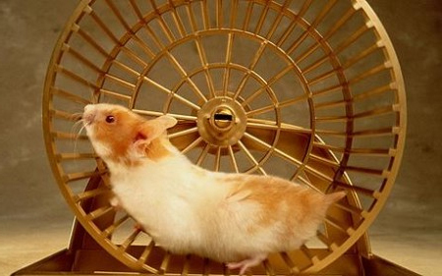
Everyday churn
What’s up
git status
Add files
git add .
Commit
git commit

Slide 9

Vim first aid
Exit
:q!
Edit
i
Save and exit
:wq

Slide 10
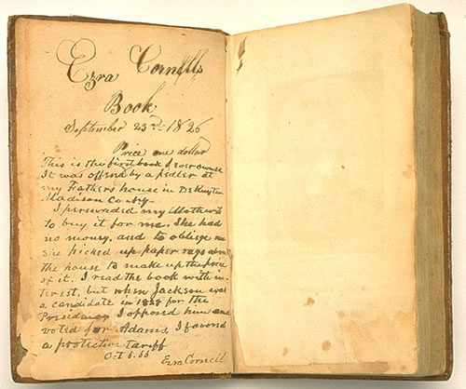
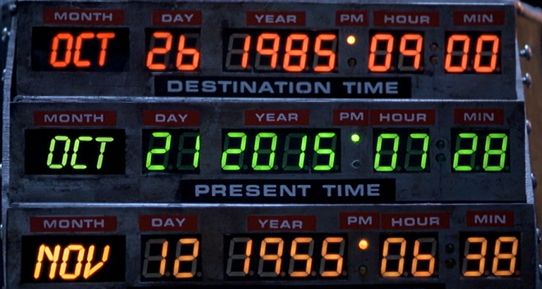
History and time travel
View history
git log
Go back
git checkout <>

Slide 11
Referencing commits
UUID
because of distributed nature
HEAD
where are we currently
HEAD~1
the one before where are we
HEAD~2 etc.

Slide 12
Diffs
Difference to last commit
git diff
Graphical one
git difftool
How to setup difftool
.gitconfig
Diff to different version
git difftool <commit>

