Slide 1
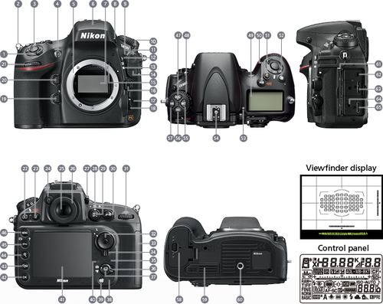
Basics of photography

Slide 2
What are the basics?
Types of camera
Compact
Bridge
Mirrorless
DSLR
Types of lenses
Wide-angle v telephoto
Zoom v prime
Exposure Triangle
Shutter speed/Time value
Aperture
ISO
Focus
Focus points
Single area/One shot v Continuous/AI Servo autofocus
Back button focusing
Other settings

Slide 3
Types of camera
Compact cameras (or ‘point-and-shoot’) are cheap but don’t have good sensors or large zooms
Bridge cameras offer great zoom ranges, but the sensor is not large enough to give high quality images
Mirrorless cameras are lighter than DSLRs but don’t have an optical viewfinder
DSLRs are the ‘gold standard’ and can be either cropped (Nikon’s DX or Canon’s EF-S) or ‘full-frame’

Slide 4
Types of lens (1)
Wide-angle lenses have a short focal length (around 9mm for ‘fish-eye’ lenses all the way up to 35mm)
Good for landscapes
Emphasise the distance between objects
Standard or normal lenses imitate the focal length of the human eye, which is around 50-55mm
Good for general use, street photography
Lighter, ‘faster’ and cheaper than telephoto lenses
Mid-range lenses plug the gap between standard and telephoto lenses
An 85mm lens is the ‘standard’ portrait lens
Long or telephoto lenses have a longer focal length (from 200-800mm)
Good for wildlife or sports photography
Bring objects closer
Flatten perspective

Slide 5
Types of lens (2)
Zoom lenses have a variable focal length, eg 18-35mm
Convenient
Cheaper than having to buy different lenses
Not such high quality as primes
Prime lenses have a fixed focal length, eg 800mm
Higher optical quality
Generally ‘faster’, ie offering a wider maximum aperture in low light
Less flexibility in composition

Slide 6
The Exposure Triangle (1)
The overall brightness of an image is measured in Exposure Values (EV) or ‘stops’
Each doubling of the light increases the EV by one (and vice versa)
You can make your image darker or lighter by changing any of the settings in the Exposure Triangle:
Shutter speed/Time value is the length of time that the shutter is open, exposing the sensor (or film) to light, eg 1/1000 of a second
Aperture is the focal length divided by the size of the ‘entrance pupil’ (ie the size of the hole!), eg a 50mm lens with a 10mm hole in it has an f-number of 50 ÷ 10 = f/5
ISO stands for International Organization for Standardization and measures the sensitivity or ‘speed’ of the sensor (or film), eg ISO 100 or ISO Auto
Cameras think the world is 18% grey, so, if you think the camera is going to be ‘fooled’ by the light conditions, you can add or subtract one or two stops of ‘exposure compensation’, eg +2EV for a polar bear on the ice
If light conditions are changeable or you don’t trust the camera to get the exposure right, you can use ‘bracketing’, which allows you to take multiple shots at different shutter speeds or apertures
If there is a high ‘dynamic range’ (ie both very dark and very light patches), you can turn on Auto D-lighting/Auto Lighting Optimizer to make sure you get visible detail in all areas of the picture

Slide 7
The Exposure Triangle (2)
Exposure or shooting modes
Auto or Scene means the camera automatically sets both the aperture and the shutter speed given the conditions, eg landscape or wildlife
Programmed auto (P) means you can choose different combinations of aperture and shutter speed, eg 1/1000 at f/8 or 1/500 at f/16
Shutter priority (S) means you set the shutter speed, but the camera automatically sets the aperture
Aperture priority (A) means you set the aperture, but the camera automatically sets the shutter speed
Manual (M) means you set the aperture and the shutter speed yourself

Slide 8
The Exposure Triangle (3)
There is only so much light to go round, so choose a good compromise!
If the Shutter speed/Time value is too slow, a moving subject will be blurred or you’ll get camera shake
If the Aperture is too wide, the Depth of Field (DoF) will be too low, and you’ll get blur
If the ISO is too high, you’ll get grain or ‘noise’

Slide 9
Focus
Cameras are now equipped with sensors that make autofocus fast and effective
Focus points can be chosen manually in the viewfinder to tell the camera where to focus
Single area/One shot is a one-off, static adjustment best for stationary subjects
Continuous/AI Servo constantly updates the focus so is best for tracking moving subjects
Back button focusing allows you to keep focusing even while you’re taking pictures and/or to lock the focus and recompose
Just make sure the focus mode switch on the lens is set to M/A or A/M rather than M, or you’ll switch to manual focus!

Slide 10
Other settings
Quality means the format of the image, eg RAW or JPEG
White balance is the colour of the light, eg daylight or flash
Drive mode can be single shot (S) or continuous shooting (C), eg 7 frames per second (fps)
Depth of field preview allows you to check what will be in focus by pressing a button to close the aperture to the chosen setting
Vibration Reduction/Image Stabilisation must be turned on to help keep the camera steady in order to get sharper pictures
Normal is fine for general use
Active is only necessary if you are not standing still, eg on a boat
Lens lock is just a button to lock a zoom lens to the shortest focal length for convenience when carrying it around
Flash and video are available on most cameras but must be turned on manually

