Slide 1
Target Tapping Game
CLIENT:
Glenrose Rehabilitation Hospital,
Alberta Health Services
Notes:
Shawn, Aaron, Patrick, Eddie

Slide 2
Glenrose Rehabilitation Hospital
“The Glenrose Rehabilitation Hospital is a health care facility unique to Alberta, devoted primarily to high-level rehabilitation care of both adults (including the elderly) and children. The Glenrose is also the academic centre for several University of Alberta medical education programs and plays a strong role in the development and advancement of leading edge research and training opportunities in rehabilitation fields.” -
http://www.albertahealthservices.ca/facilities.asp?pid=facility&rid=7822
Notes:
Glenrose specializes in rehabilitation of children and adults. Emphasis on leading edge research.

Slide 3
Users
Patients
Therapists
Effects of Strokes
“Damage to a lower part of the brain, the cerebellum, can affect the body's ability to coordinate movement, a disability called ataxia, leading to problems with body posture, walking, and balance.”
“Physical therapists specialize in treating disabilities related to motor and sensory impairments.” “They are trained in all aspects of anatomy and physiology related to normal function, with an emphasis on movement. They assess the stroke survivor's strength, endurance, range of motion, gait abnormalities, and sensory deficits to design individualized rehabilitation programs aimed at regaining control over motor functions. “
National Institute For Neurological Disorders and Stroke
http://www.ninds.nih.gov/disorders/stroke/poststrokerehab.htm
Notes:
Damage from strokes can affect motor coordination. Therapist trained in all aspects of anatomy with emphasis on movement.

Slide 4
Users
Therapists
Help patients after a stoke achieve use of “stroke-impaired limbs”
Teach patients how to reduce lingering side-effects
Create exercise program
Teach patients how to “retain… newly learned skills”
How to avoid “learned non use”
Guide towards brain plasticity
“Strategies used by physical therapists to encourage the use of impaired limbs include selective sensory stimulation such as tapping or stroking, active and passive range-of-motion exercises, and temporary restraint of healthy limbs while practicing motor tasks.”
http://www.ninds.nih.gov/disorders/stroke/poststrokerehab.htm
Notes:
Movement, range of motion, restraining good limbs practicing motor tasks are all good ways of getting back movement and coordination.

Slide 5
Rehabilitation
THERAPIST GOALS
Help patients regain movement & coordination.
Be as time efficient as possible.
Provide patients with top-quality care and rehabilitation techniques.
PATIENT GOALS
Regain movement & coordination.
Feel good emotionally and physically.
Have a fun and enjoyable experience.

Slide 6
Clients Objectives
Give therapists a tool to be more productive with patients.
Patients to have a more fun and engaging experience.

Slide 7
How To Meet Clients Objectives
Design a game where patients can work on rehabilitation and have fun doing so.
Design a game that therapists have complete control over, that can emulate a current game that is played without any technology.
Design a game that therapists WANT to use, rather then feel OBLIGATED to use, or worse DON’T use.

Slide 8
CURRENT VERSION OF THE TARGET TAPPING GAME
Therapist places objects such as toys, blocks, playing cards, etc. on a table and ask the patient to grab/touch/reach for these objects.
The therapist may place objects on the table individually, in pairs, or all at once.
The patient then must follow the therapists instruction.
Instructions may be something like:
Touch all the blue cards.
Pick up each cube on the table.
FEELS VERY MUCH LIKE REHABILITATION.

Slide 9
OUR VERSION OF THE TARGET TAPPING GAME
Therapist makes “tapping environments” on computer.
Many options for the therapists.
SHAPES: Squares, Circles, Triangles, Stars.
ALPHABETICAL CHARACTERS: A, B, C,….,Z
NUMERICAL CHARACTERS: 0, 1, 2,…,9
COLORS: Red, Green, Blue, Black, Grey, Etc.
SIZES: Tiny, Small, Medium, Large, X-Large.
CONFIGURATIONS:
MULTI: Multiple objects appear at once.
SINGLE: Default, one object at a time.
UP-TIME: Time the target stays on the screen.
HOLD-TIME: Time the patient has to hold the object for.

Slide 10
USAGE
Intentions for this system are as follows:
Therapist makes many tapping environments, all accomplishing different goals and tasks that they feel are important.
Therapist saves all the created environments.
Therapists then can load these environments in game.
A large library of tapping environments becomes available for patients to use.

Slide 11
PROS – compared to traditional game
Design many tapping environments, all playable within seconds.
Easy to switch environments.
Therapist can focus on patient more during sessions, rather then the game.
E.G. Instead of saying now grab the blue cube, or having to place new objects down on the table, the therapist can be at the patients side, physically supporting them if need be, and can watch the patient more closely.
Can fine tune environments to patients needs.

Slide 12
PROS – compared to traditional game
Therapist does not have to remember or keep a log of what kind of environments have been designed for the patient previously. This can be tracked in game.
More games can be played in a session.
Possibility for less downtime between games.
Patient can see a score and timer on screen. Good Feedback.
MORE ACCURACY!

Slide 13
CONS – compared to traditional game
NOT 3D Objects
NO support for grasping or picking up objects

Slide 14
Touch-Screen Windows 7 PC 42-inch LCD TV
Hardware
&
System

Slide 15
SYSEM COMPONENTS
HARDWARE:
42 inch LCD TV
Capacitive Touch Screen Panel
Desktop PC
Custom TV Stand
SOFTWARE:
Windows 7
DEVELOPMENT TOOLS:
XNA Game Library 4.0
C#
Custom Drivers Supplied By Client.
Visual Studio 2010

Slide 16
THE GAME - User Interaction
All interaction is done through a touch screen.
A TV acts as the display, with a touch screen placed on top of the display.
A on-screen-keyboard has been integrated into the application for basic text I/O.
The therapist creates the tapping environments through the touch screen interface, and the patient plays the game by tapping the objects on the touch screen.

Slide 17
System Design
5 MAIN screens
Main Menu
Load Environment Screen
New Environment Screen
Editing Environment Screen
Patient Game Screen
+ Context Specific Menus On Some Screens
+ Context Specific Help For Every MAIN Screen Except Patient Game Screen

Slide 18
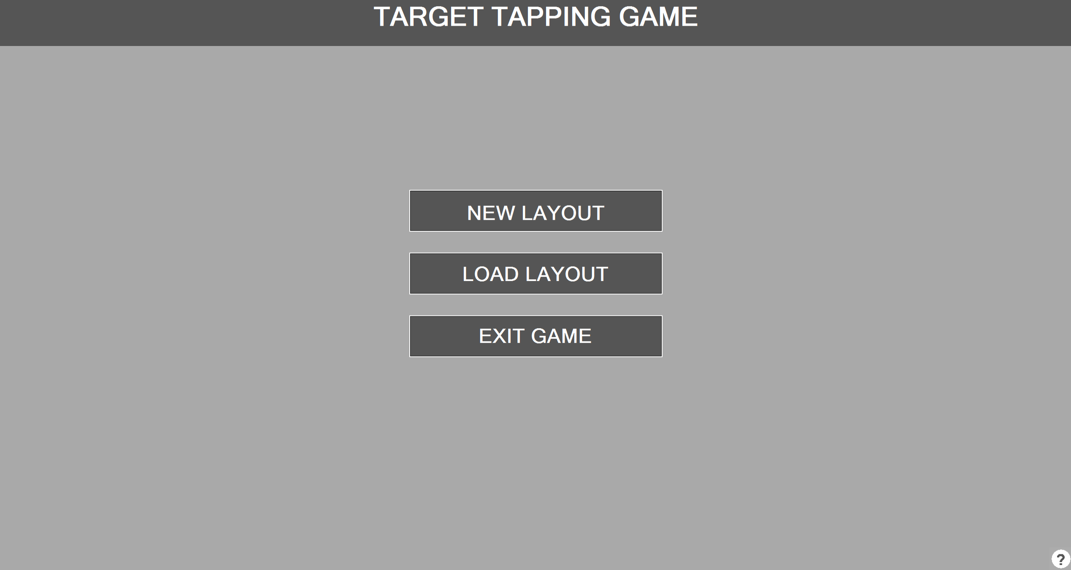
Main Menu
HELP
Create new tapping environment =>
Load tapping environment =>
Exit to windows =>

Slide 19
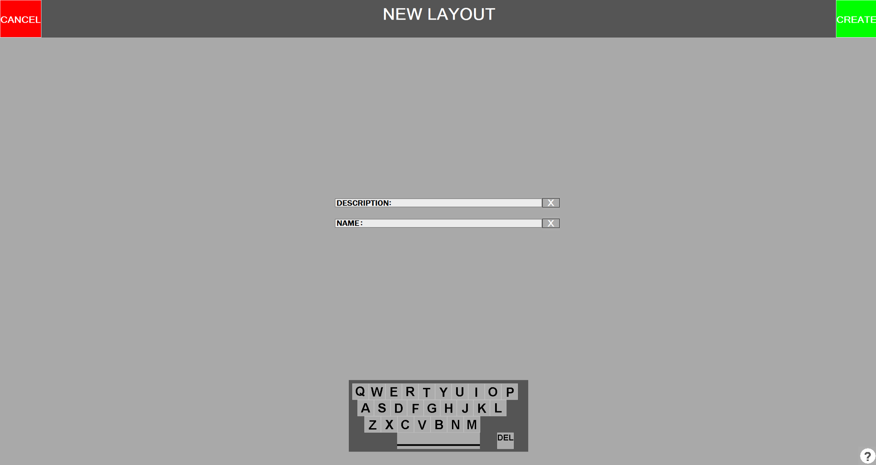
New Layout
HELP
Description & Name are appended to give a level / tapping environment its name.
Fill out Description and Name then press CREATE =>

Slide 20
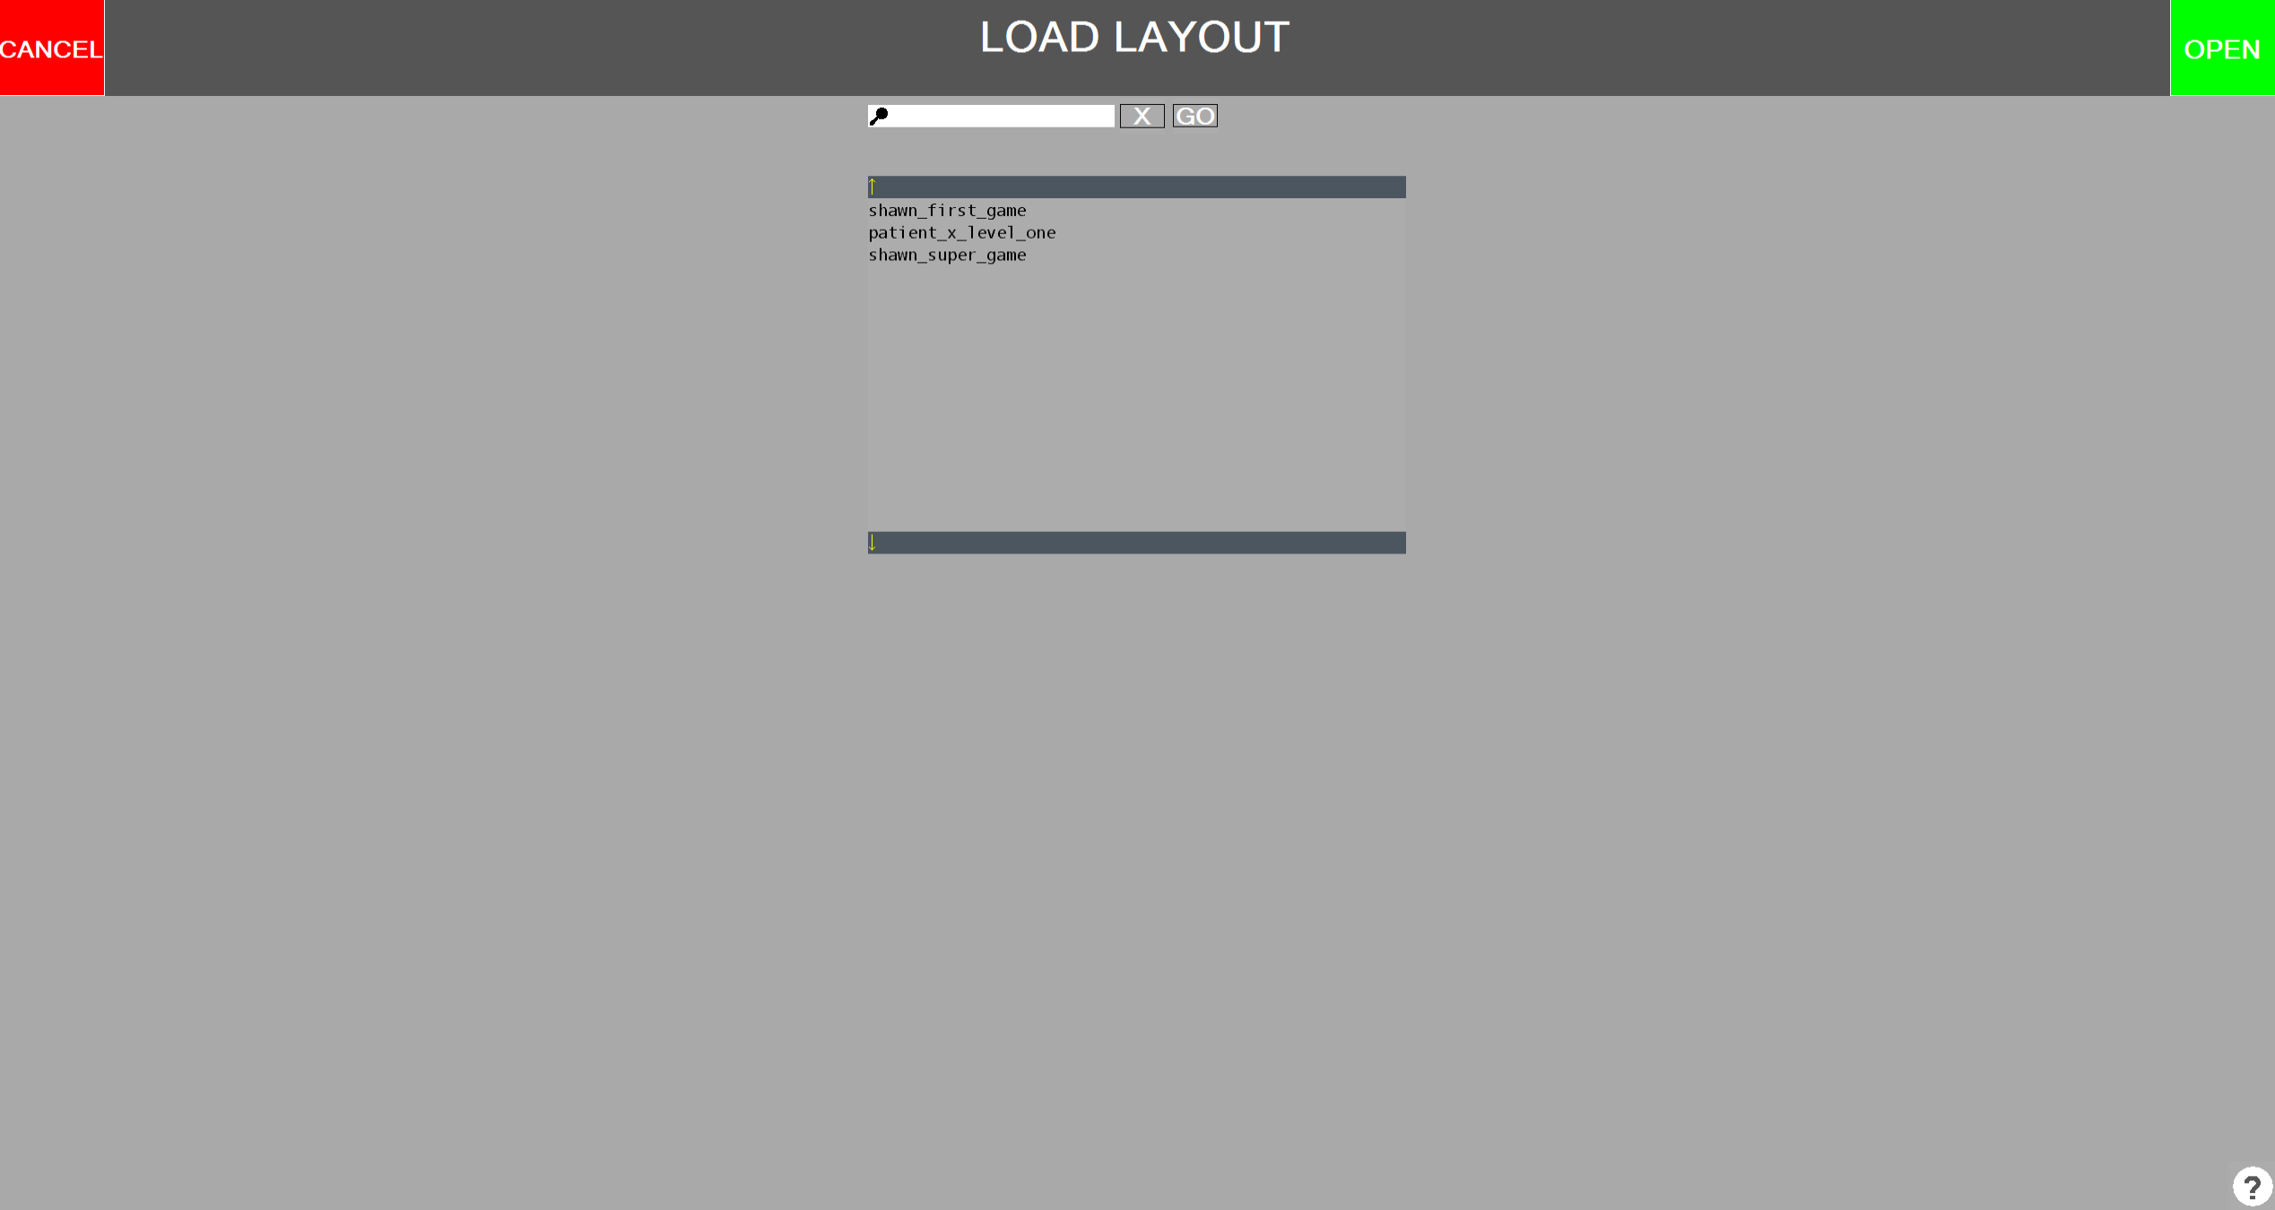
Load Layout
Environment Name
SEARCH
HELP
Description & Name have been appended to give a level / tapping environment its name.
Highlight a tapping environment by tapping on it in the list then press OPEN =>
Searching also available, tap in search box to open OSK.

Slide 21
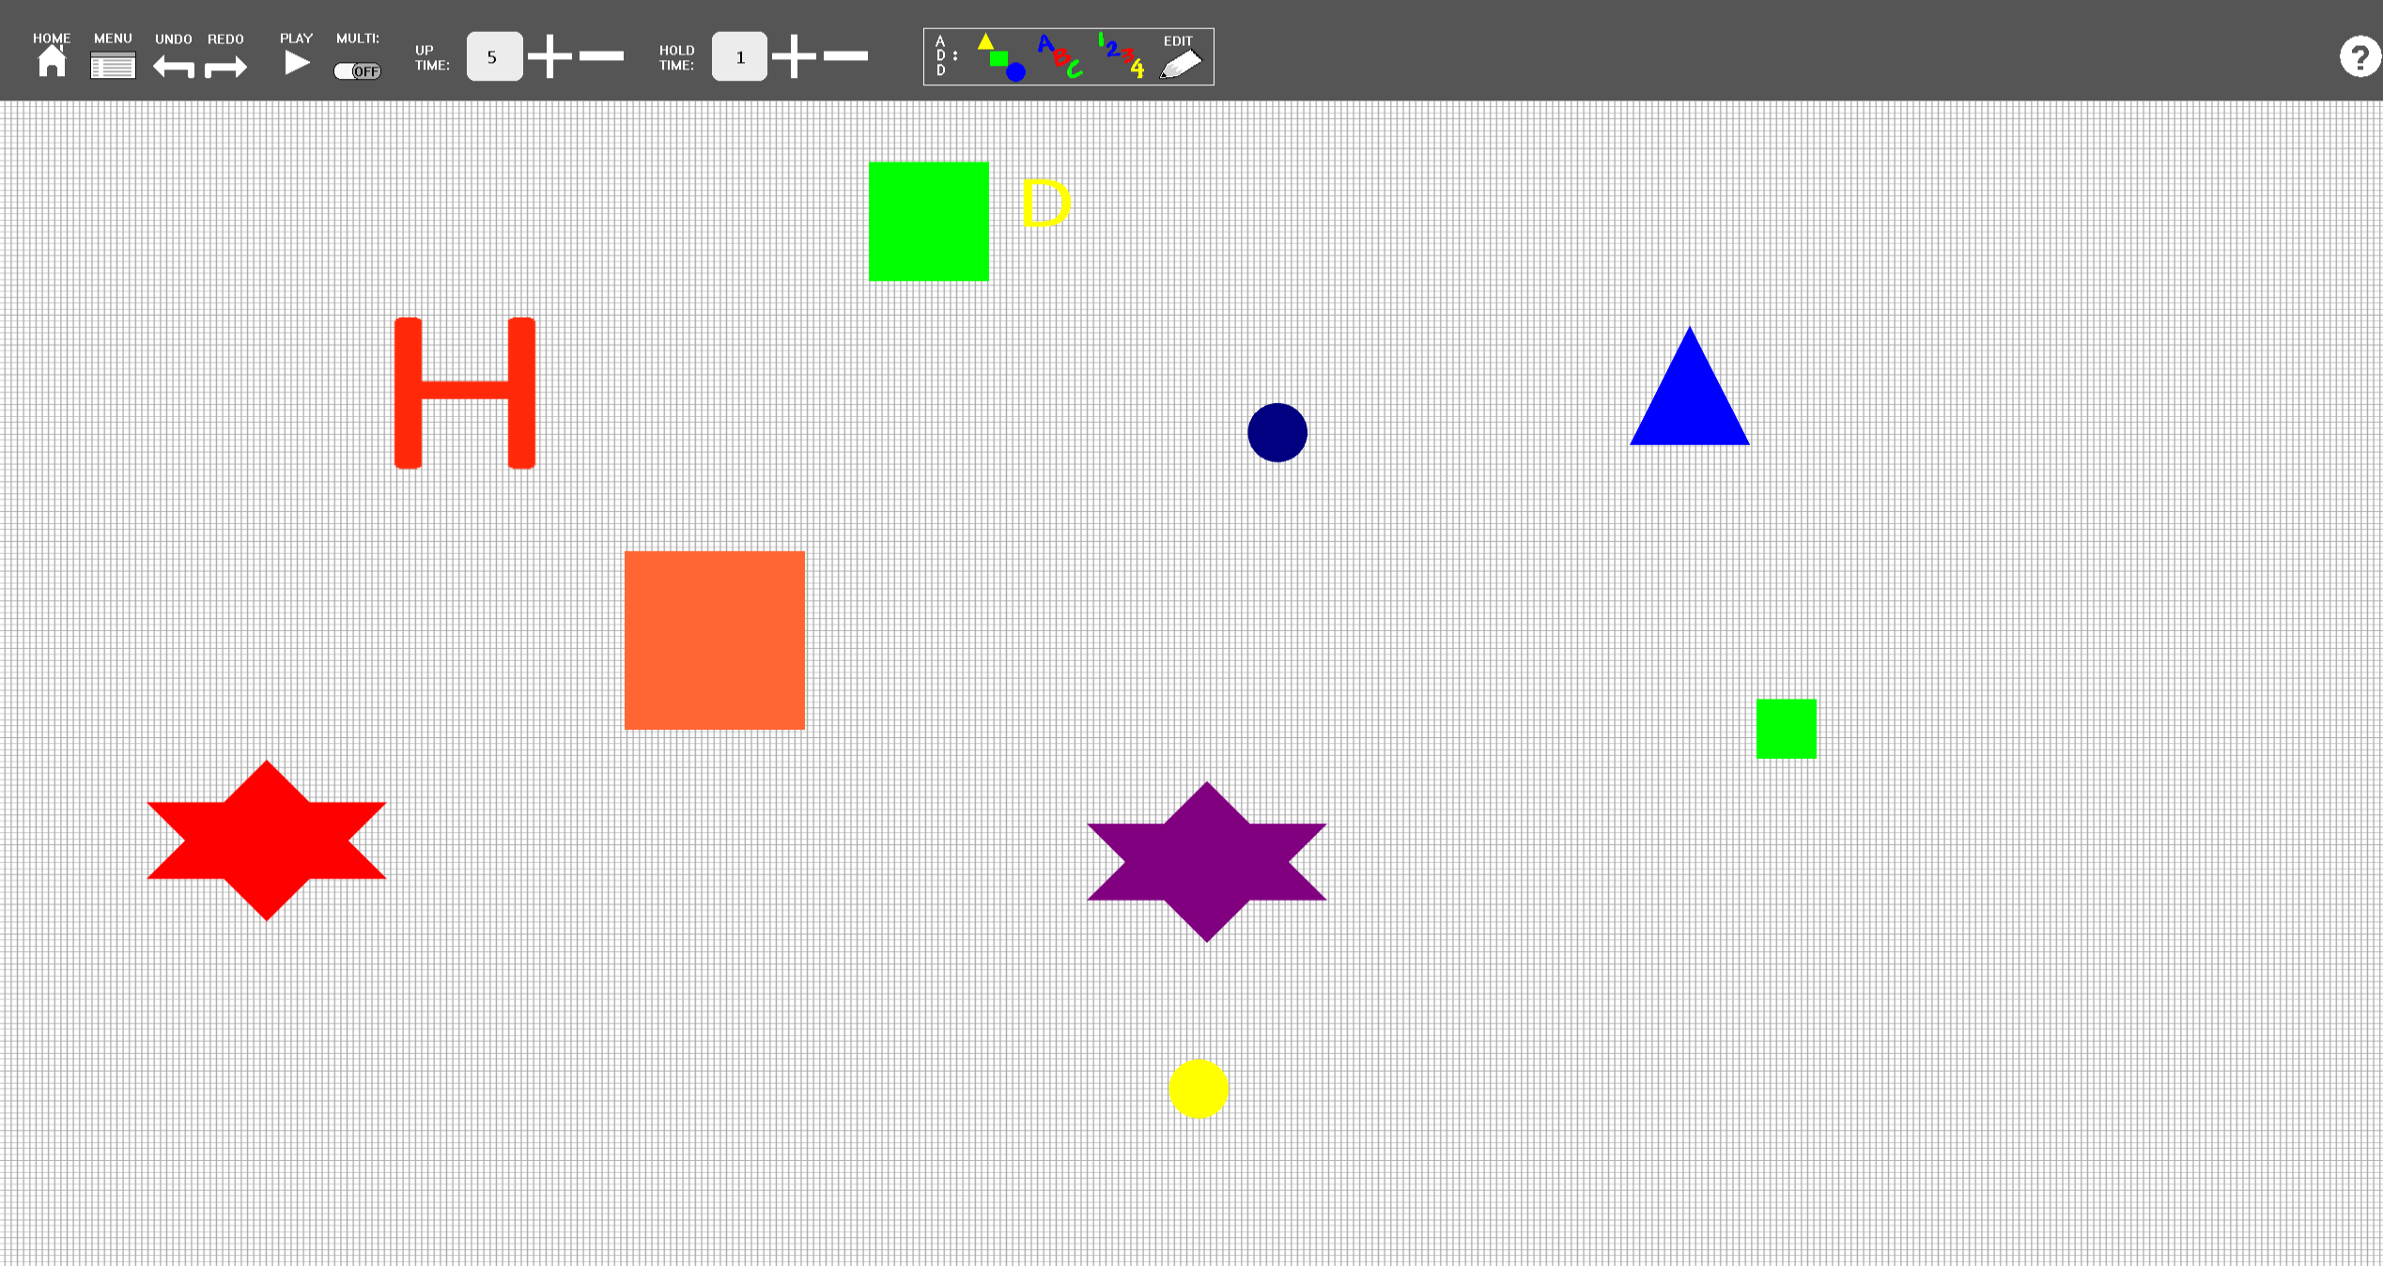
Layout Editor
HELP
Press PLAY to go to Patient Game Screen =>
Available Tools:
Home Button, Menu Button, Undo/Redo, Play, Multi, Up Time, Hold Time, Adding: Shapes & Alphabet Characters & Numbers, Editing Objects

Slide 22
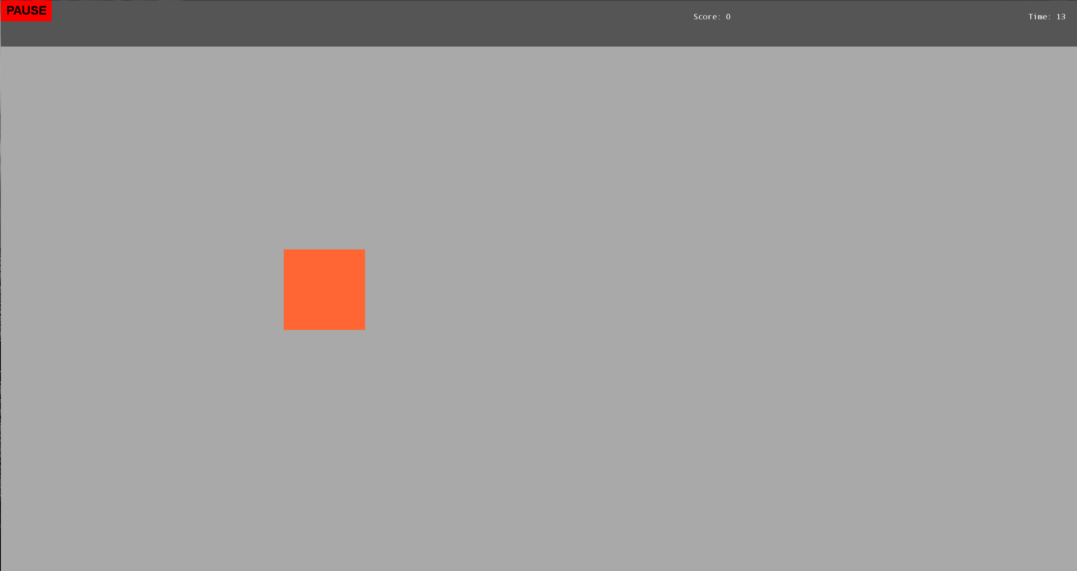
Patient Game
SCORE
Time
Press PLAY to go to Patient Game Screen =>
Available Tools:
Home Button, Menu Button, Undo/Redo, Play, Multi, Up Time, Hold Time, Adding: Shapes & Alphabet Characters & Numbers, Editing Objects

Slide 23
VIDEO DEMO
http://www.youtube.com/watch?v=0tuYilveIWo

Slide 24
USER EVALUATION
The first user evaluation we had taught us one thing; our application is very easy to use, only once the application is understood with what it is supposed to do.
We therefore created context specific help across all therapist screens. With the context specific help the therapist will be able to understand the slight subtleties of the game, if they don’t already understand them.
In other words, we found that if you don’t know the game it can be slightly confusing to operate the program. If you understand the game, understanding the program is much easier.

Slide 25
USER EVALUATION
Our empirical evaluation: Part I
Questionnaire:
Rate your technical ability:
How likely are you to learn a new computer application just for the fun of it:
How many hours a week do you spend on a computer/smart phone:
Do you own a touch-screen device:
You won a prize, you can either claim a cash prize worth $1000 dollars, or a new computer worth $2000; which do you choose (assume you are not in the market for a new computer, and you do not desperately need the cash)?
Think about your daily activities, if you were told you could have software to accomplish some task you currently do manually (without some sort of automation) and that it could eventually save you half the amount of time, but the software was rated moderate-difficult to learn, how likely would you be to take it (you can not ask for it and decide its to hard so you wont use it):

Slide 26
USER EVALUATION
Our empirical evaluation: Part I
Questionnaire:
To me computers are the following: Fun, Easy To Use, Helpful, Life-Saving, Necessity, Confusing, Annoying, Weird, Mystery, Genius, Magical
To me software is often the following: Well Designed, Easy To Use, Helpful, Life-Saving, Poorly Designed, Obvious, Annoying, Weird, Mystery, Genius, Magical, Hard To Learn, Useful Once Learned, Daunting To Learn, Motivating To Learn.

Slide 27
USER EVALUATION
Our empirical evaluation: Part II
Questionnaire:
Was the program flow easy to follow? Explain:
Is there anything about the design you found confusing? Explain:
Is there anything about the design you found helpful? Explain:
Our empirical evaluation: Part III
Questionnaire:
Is there another piece of software this program reminds you of? What is it? Explain:
If you were the therapist to use this software, what part of it might stop you from using it daily? Explain:
If you were the therapist to use this software, what part of it would encourage you to use it daily? Explain:
Time spent on Task:
Participants time was measured twice.

Slide 28
DISCUSSION OF RESULTS
This is what we found:
Technical Ability:
Mean 6.210526316
Std. Deviation 2.615741819
Mode 8
Learn New Application For Fun:
Mean 6.105263158
Std. Deviation 2.826358805
Mode 8
Correlation Between Questions: 0.845984699
Moderate to High Correlation Between: 1,2,3,6 Negative Small Correlation with: 5

Slide 29
DISCUSSION OF RESULTS
How many hours a week do you spend on a computer / smart phone?
Coded The Answers
0 – 10(1) 11-20 (2) 21-30 (3) 31-40 (4) 41+ (5)
Mean: 3.684210526
Std. Deviation: 1.66842013
Median: 5
Mode: 5

Slide 30
DISCUSSION OF RESULTS
To me computers are….
Helpful (every participant)
Necessity
Fun
Easy to use
Annoying, Genius, Magical (tie)
To me software is often.…
Helpful
Useful once learned
Easy to use
Well Designed
Hard to learn, Poorly Designed, Annoying

Slide 31
DISCUSSION OF RESULTS
Written Responses:
COMMON FEEDBACK:
Easy to follow
Help feature was useful
Confused by small features
GO button for search
Conflicting reports on button placement
Load screen confusion
New layout screen confusion
Most confusion from not reading the Help documentation.
Some people found it like Paint, others like Whack-A-Mole, most said Nothing.

Slide 32
DISCUSSION OF RESULTS
What encourages daily use?
Easy to learn, Effectiveness, Efficiency
Discourages daily use?
Tedious, Learning Curve, Small Bugs

Slide 33
MAIN STATISTICAL FINDINGS
Time One:
Mean: 7.01
Std. Deviation: 3.80
T-Test Paired
P-Val = 0.002617914
T-Test Between Tech Prowess & Time 1
P-Val = 0.555574847
T-Test Between Tech Prowess & Time 2
P-Val = 0.526053209
T-Test Between Hours & Time 1
P-Val = 0.077480003
T-Test Between Hours & Time 2
P-Val = 0.002584236
Time Two:
Mean: 3.88
Std. Deviation: 1.71

Slide 34
CONCLUSION
We believe if our participants are representative of the Glenrose Hospital’s therapists:
Therapists will need a 10-15 minute tutorial/training session.
Therapists will need to read complete in game help.
Updates and Fixes may be necessary to lower training required.
The application is capable of being used with patients, and should meet acceptable quality for therapists.

