Slide 1
Target Tapping Game
CLIENT:
Glenrose Rehabilitation Hospital,
Alberta Health Services

Slide 2
Glenrose Rehabilitation Hospital
“The Glenrose Rehabilitation Hospital is a health care facility unique to Alberta, devoted primarily to high-level rehabilitation care of both adults (including the elderly) and children. The Glenrose is also the academic centre for several University of Alberta medical education programs and plays a strong role in the development and advancement of leading edge research and training opportunities in rehabilitation fields.” -
http://www.albertahealthservices.ca/facilities.asp?pid=facility&rid=7822

Slide 3
Users
Patients
Therapists
Effects of Strokes
“Damage to a lower part of the brain, the cerebellum, can affect the body's ability to coordinate movement, a disability called ataxia, leading to problems with body posture, walking, and balance.”
“Physical therapists specialize in treating disabilities related to motor and sensory impairments.” They are trained in all aspects of anatomy and physiology related to normal function, with an emphasis on movement. They assess the stroke survivor's strength, endurance, range of motion, gait abnormalities, and sensory deficits to design individualized rehabilitation programs aimed at regaining control over motor functions. “
http://www.ninds.nih.gov/disorders/stroke/poststrokerehab.htm

Slide 4
Users
Therapists
“Physical therapists help survivors regain the use of stroke-impaired limbs, teach compensatory strategies to reduce the effect of remaining deficits, and establish ongoing exercise programs to help people retain their newly learned skills. Disabled people tend to avoid using impaired limbs, a behavior called learned non-use. However, the repetitive use of impaired limbs encourages brain plasticity and helps reduce disabilities.”
“Strategies used by physical therapists to encourage the use of impaired limbs include selective sensory stimulation such as tapping or stroking, active and passive range-of-motion exercises, and temporary restraint of healthy limbs while practicing motor tasks.”
http://www.ninds.nih.gov/disorders/stroke/poststrokerehab.htm

Slide 5
Rehabilitation
THERAPIST GOALS
Help patients regain movement & coordination.
Be as time efficient as possible.
Provide patients with top-quality care and rehabilitation techniques.
PATIENT GOALS
Regain movement & coordination.
Feel good emotionally and physically.
Have a fun and enjoyable experience.

Slide 6
Clients Objectives
Give therapists a tool to be more productive with patients.
Patients to have a more fun and engaging experience.

Slide 7
How To Meet Clients Objectives
Design a game where patients can both work on rehabilitation and have fun doing so.
Design a game that therapists have complete control over, that can emulate a current game that is played without any technology.
Design a game that therapists WANT to use, rather then feel OBLIGATED to use, or worse DON’T use.

Slide 8
CURRENT VERSION OF THE TARGET TAPPING GAME
Therapist places objects such as toys, blocks, playing cards, etc. on a table and ask the patient to grab/touch/reach for these objects.
The therapist may place objects on the table individually, in pairs, or all at once.
The patient then must follow the therapists instruction.
Instructions may be something like:
Touch all the blue cards.
Pick up each cube on the table.
FEELS VERY MUCH LIKE REHABILITATION.

Slide 9
OUR VERSION OF THE TARGET TAPPING GAME
Therapist makes “tapping environments” on computer.
Many options for the therapists.
SHAPES: Squares, Circles, Triangles, Stars.
ALPHABETICAL CHARACTERS: A, B, C,….,Z
NUMERICAL CHARACTERS: 0, 1, 2,…,9
COLORS: Red, Green, Blue, Black, Grey, Etc.
SIZES: Tiny, Small, Medium, Large, X-Large.
CONFIGURATIONS:
MULTI: Multiple objects appear at once.
SINGLE: Default, one object at a time.
UP-TIME: Time the target stays on the screen.
HOLD-TIME: Time the patient has to hold the object for.

Slide 10
USAGE
Intentions for this system are as follows:
Therapist makes many tapping environments, all accomplishing different goals and tasks that they feel are important.
Therapist saves all the created environments.
Therapists then can load these environments in game.
A large library of tapping environments becomes available for patients to use.

Slide 11
PROS – compared to traditional game
Design many tapping environments, all playable within seconds.
Easy to switch environments.
Therapist can focus on patient more during sessions, rather then the game.
E.G. Instead of saying now grab the blue cube, or having to place new objects down on the table, the therapist can be at the patients side, physically supporting them if need be, and can watch the patient more closely.
Can fine tune environments, to patients needs.

Slide 12
PROS – compared to traditional game
Therapist does not have to remember or keep a log of what kind of environments have been designed for the patient previously. This can be tracked in game.
More games can be played in a session.
Possibility for less downtime between games.
Patient can see a score and timer on screen. Good Feedback.
MORE ACCURACY!

Slide 13
CONS – compared to traditional game
NOT 3D Objects
NO support for grasping or picking up objects

Slide 14
Touch-Screen Windows 7 PC 42-inch LCD TV
Hardware
&
System

Slide 15
SYSEM COMPONENTS
HARDWARE:
42 inch LCD TV
Capacitive Touch Screen Panel
Desktop PC
Custom TV Stand
SOFTWARE:
Windows 7
DEVELOPMENT TOOLS:
XNA Game Library 4.0
C#
Custom Drivers Supplied By Client.
Visual Studio 2010

Slide 16
THE GAME - User Interaction
All interaction is done through a touch screen.
A TV acts as the display, with a touch screen placed on top of the display.
A on-screen-keyboard has been integrated into the application for basic text I/O.
The therapist creates the tapping environments through the touch screen interface, and the patient plays the game by tapping the objects on the touch screen.

Slide 17
System Design
5 MAIN screens
Main Menu
Load Environment Screen
New Environment Screen
Editing Environment Screen
Patient Game Screen
+ Context Specific Menus On Some Screens
+ Context Specific Help For Every MAIN Screen Except Patient Game Screen

Slide 18
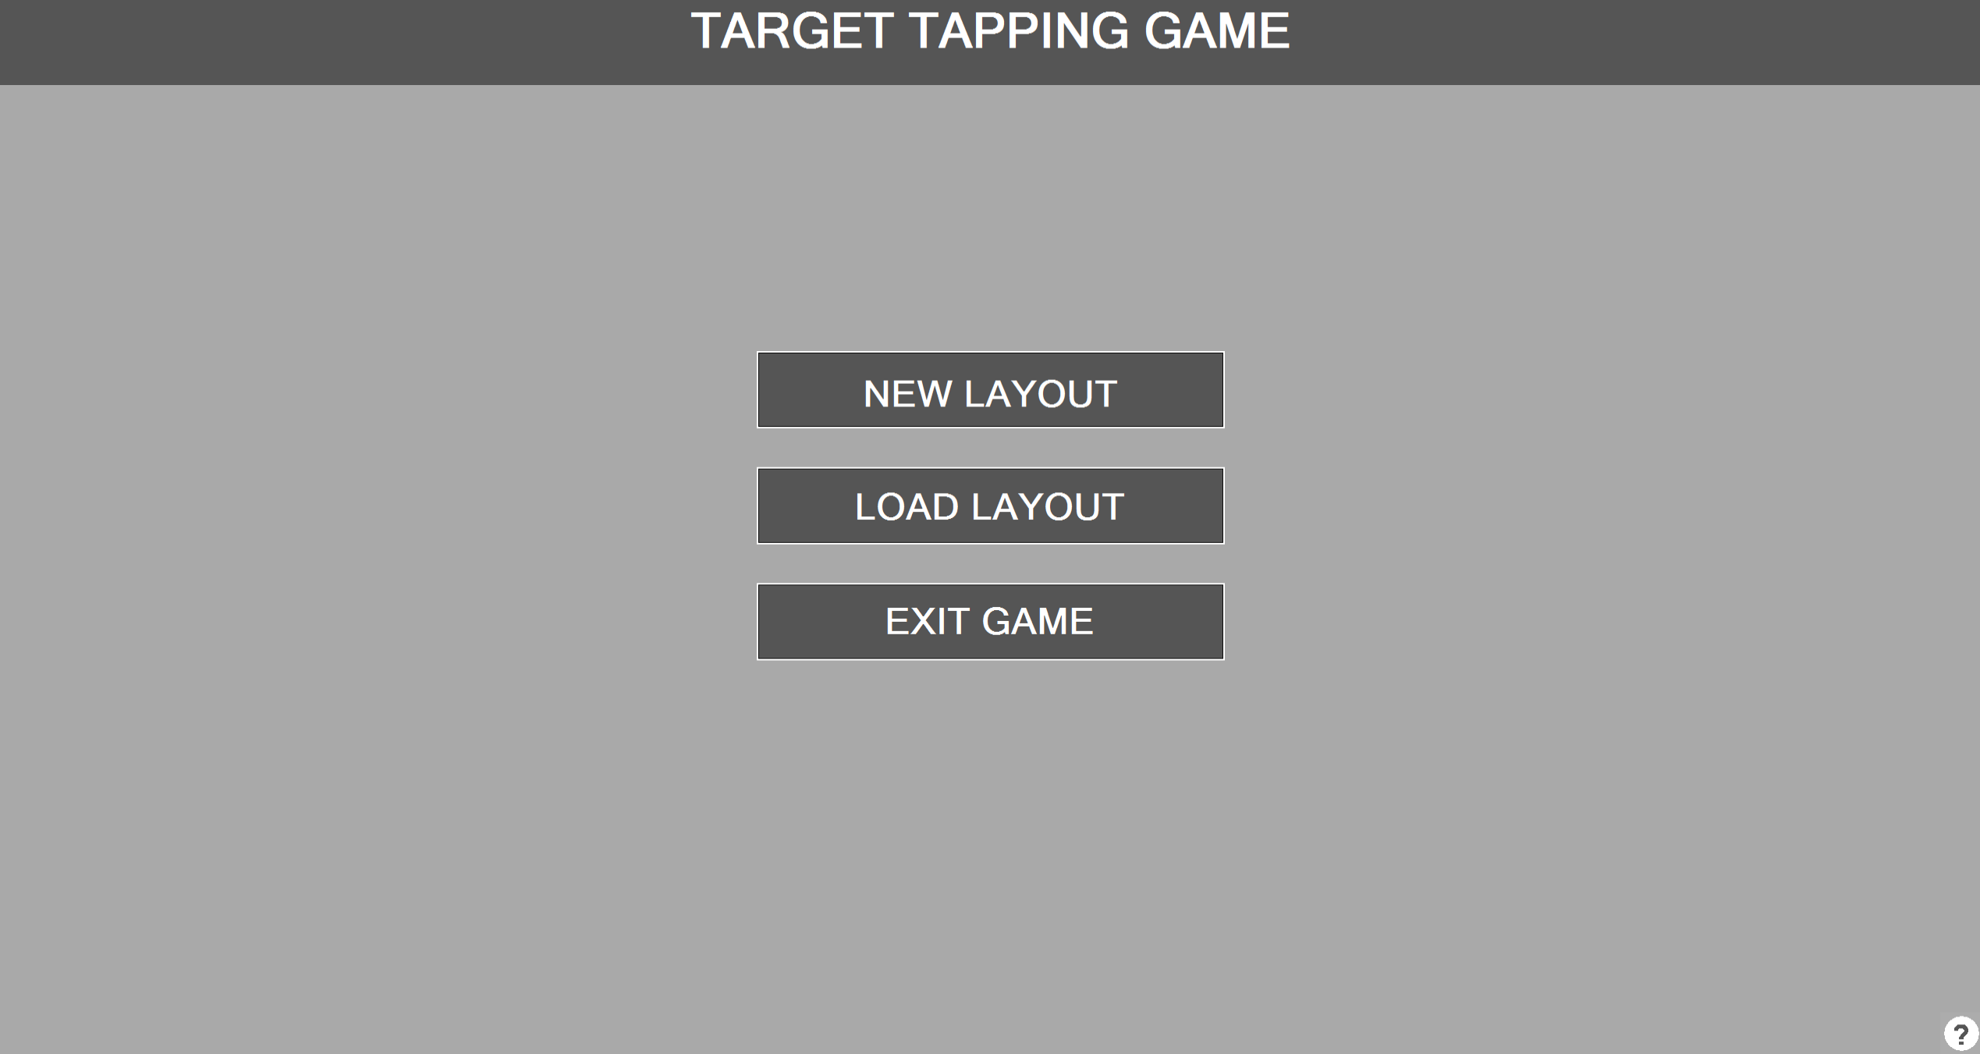
Main Menu
HELP
Create new tapping environment =>
Load tapping environment =>
Exit to windows =>

Slide 19
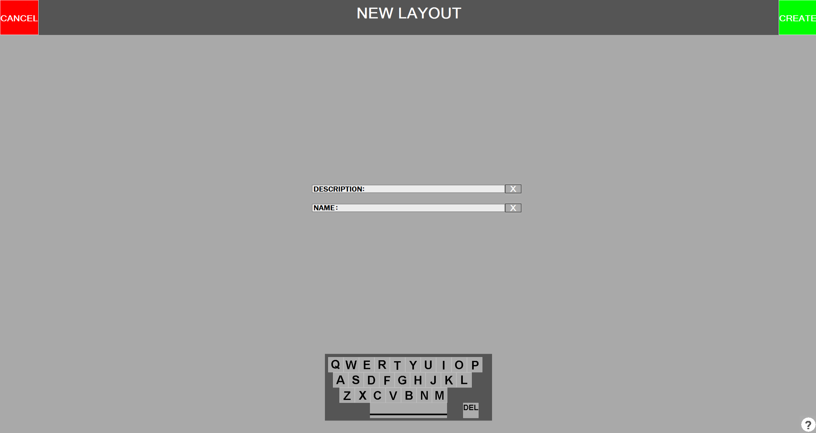
New Layout
HELP
Description & Name are appended to give a level / tapping environment its name.
Fill out Description and Name then press CREATE =>

Slide 20
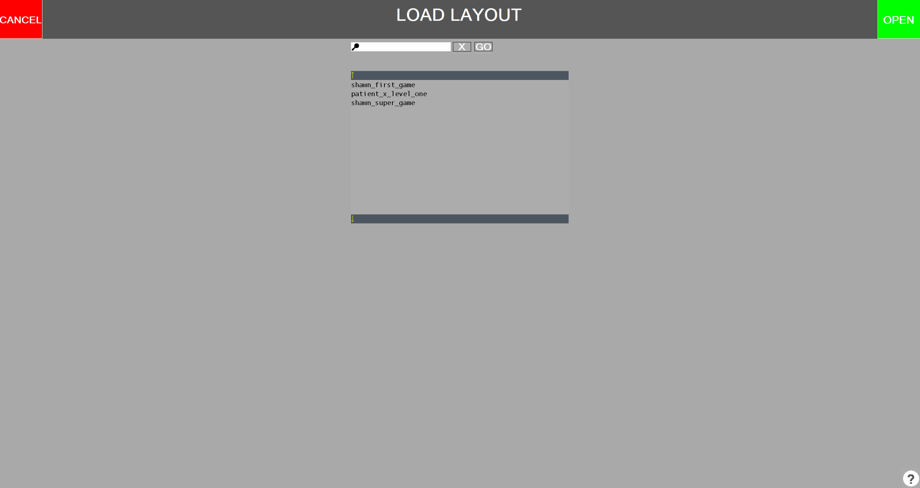
Load Layout
Environment Name
SEARCH
HELP
Description & Name have been appended to give a level / tapping environment its name.
Highlight a tapping environment by tapping on it in the list then press OPEN =>
Searching also available, tap in search box to open OSK.

Slide 21
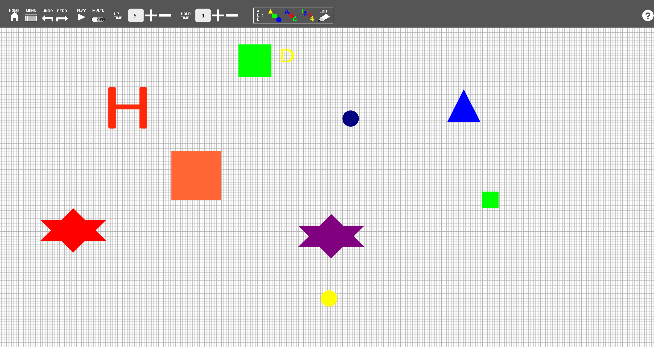
Layout Editor
HELP
Press PLAY to go to Patient Game Screen =>
Available Tools:
Home Button, Menu Button, Undo/Redo, Play, Multi, Up Time, Hold Time, Adding: Shapes & Alphabet Characters & Numbers, Editing Objects

Slide 22
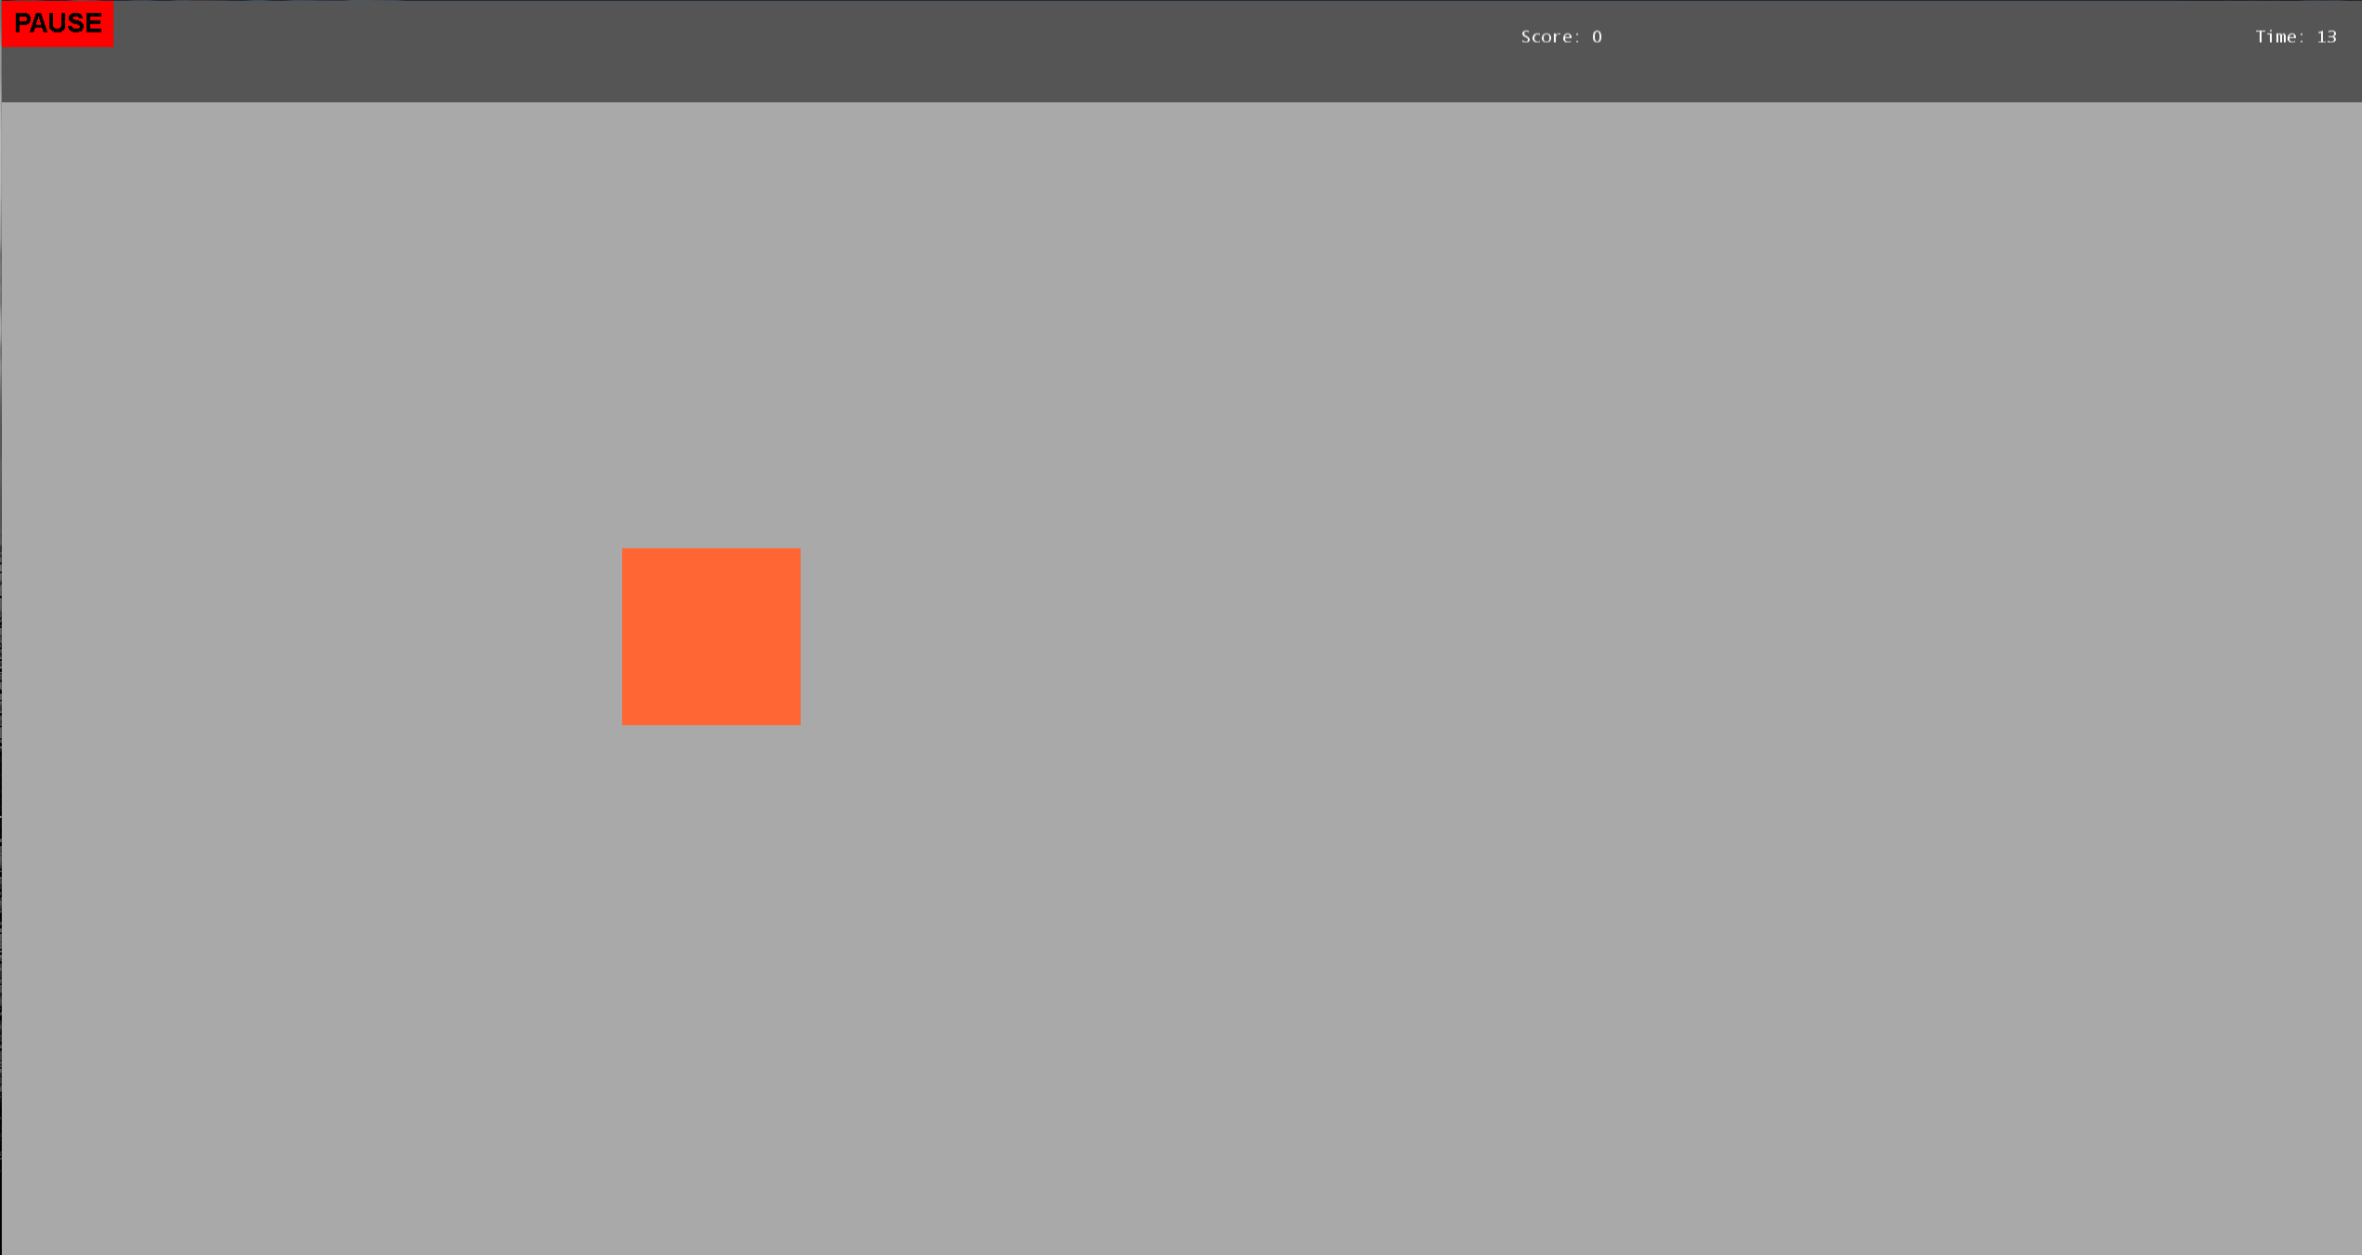
Patient Game
SCORE
Time
Press PLAY to go to Patient Game Screen =>
Available Tools:
Home Button, Menu Button, Undo/Redo, Play, Multi, Up Time, Hold Time, Adding: Shapes & Alphabet Characters & Numbers, Editing Objects

Slide 23
VIDEO DEMO

Slide 24
USER EVALUATION
The first user evaluation we had taught us one thing; our application is very easy to use, only once the application is understood with what it is supposed to do.
We therefore created context specific help across all therapist screens. With the context specific help the therapist will be able to understand the slight subtleties of the game, if they don’t already understand it.
In other words, we found that if you don’t know the game it can be slightly confusing to operate the program. If you understand the game, understanding the program is much easier.

Slide 25
USER EVALUATION

Slide 26
USER EVALUATION

Slide 27
USER EVALUATION

Slide 28
DISCUSSION

Slide 29
DISCUSSION

Slide 30
CONCLUSION

