Slide 1

Cloud Startup Idea: Making Everyday Life Easier for Young People
Discover how cloud technology can revolutionise daily organisation for young people.

Slide 2



Meet Our Team
Salvatore
Yassine
Luca

Slide 3

The Problem We Face Every Day
Modern life for young people is complex, with multiple demands creating daily challenges:
Overwhelm: Managing schoolwork, an active social life, and diverse hobbies often feels overwhelming and chaotic.
Scattered Resources: Important files, essential documents, and critical applications are dispersed across numerous devices and platforms, leading to frustration.
Accessibility Gap: Young individuals desperately need a streamlined, intuitive method to organise and access all their vital information effortlessly, anytime, anywhere.

Slide 4

Our Big Idea: Cloud Buddy
Introducing Cloud Buddy, a revolutionary cloud-based application designed specifically for young people. It's not just storage; it's your personal organisation hub.
A centralised platform to consolidate all your school notes, personal schedules, and favourite apps.
Seamless accessibility from any device—be it phone, tablet, or laptop—ensuring you're always connected to your world, as long as you have internet.
Empowers users to stay impeccably organised, facilitates easy sharing with friends for collaborative projects, and ultimately saves precious time for what truly matters.

Slide 5

Why Cloud Technology is Key
Cost-Effective Accessibility
Robust Data Security
Effortless Scalability
Cloud infrastructure eliminates the necessity for expensive, high-spec local hardware, making powerful tools accessible to everyone.
Your data is inherently secure, constantly backed up, and resilient against device failures, ensuring peace of mind.
The cloud adapts effortlessly, expanding to accommodate an ever-growing volume of files and applications without performance degradation.

Slide 6
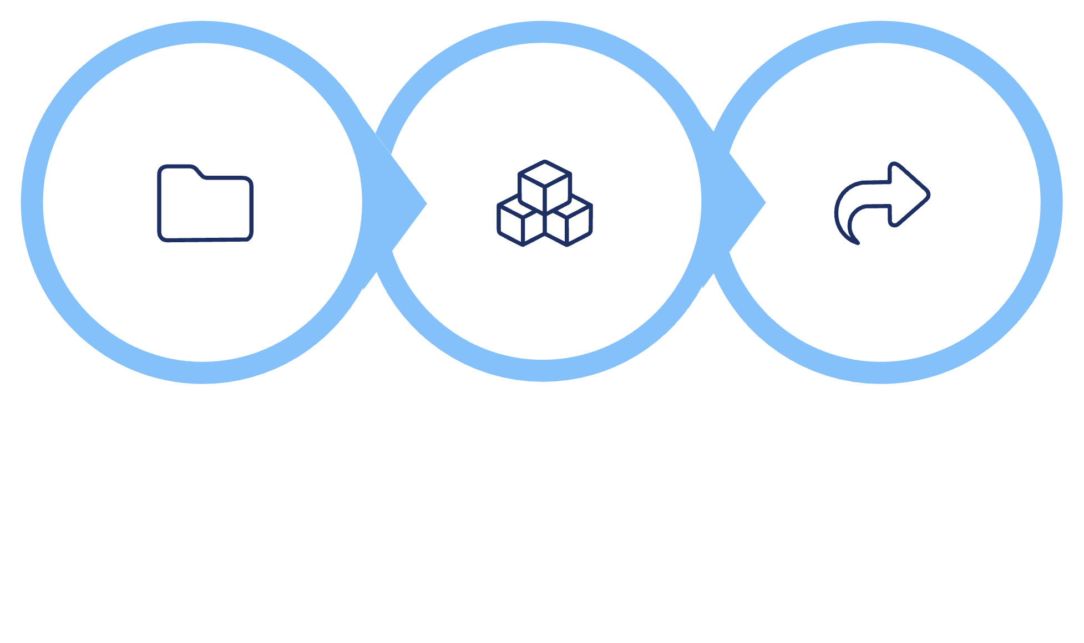



How Cloud Buddy Works
Sync Files
Stay Organised
Share Instantly
Cloud Buddy simplifies your digital life into an intuitive, seamless experience, keeping you on top of your game.
Automatic Syncing: Effortlessly synchronises your crucial files and essential applications to the cloud, ensuring everything is always up-to-date.
Smart Organisation: Integrated smart reminders and calendar features keep you perfectly aligned with your academic and personal commitments.
Instant Collaboration: Share projects, notes, and ideas with friends or study groups instantly, fostering effective teamwork.

Slide 7
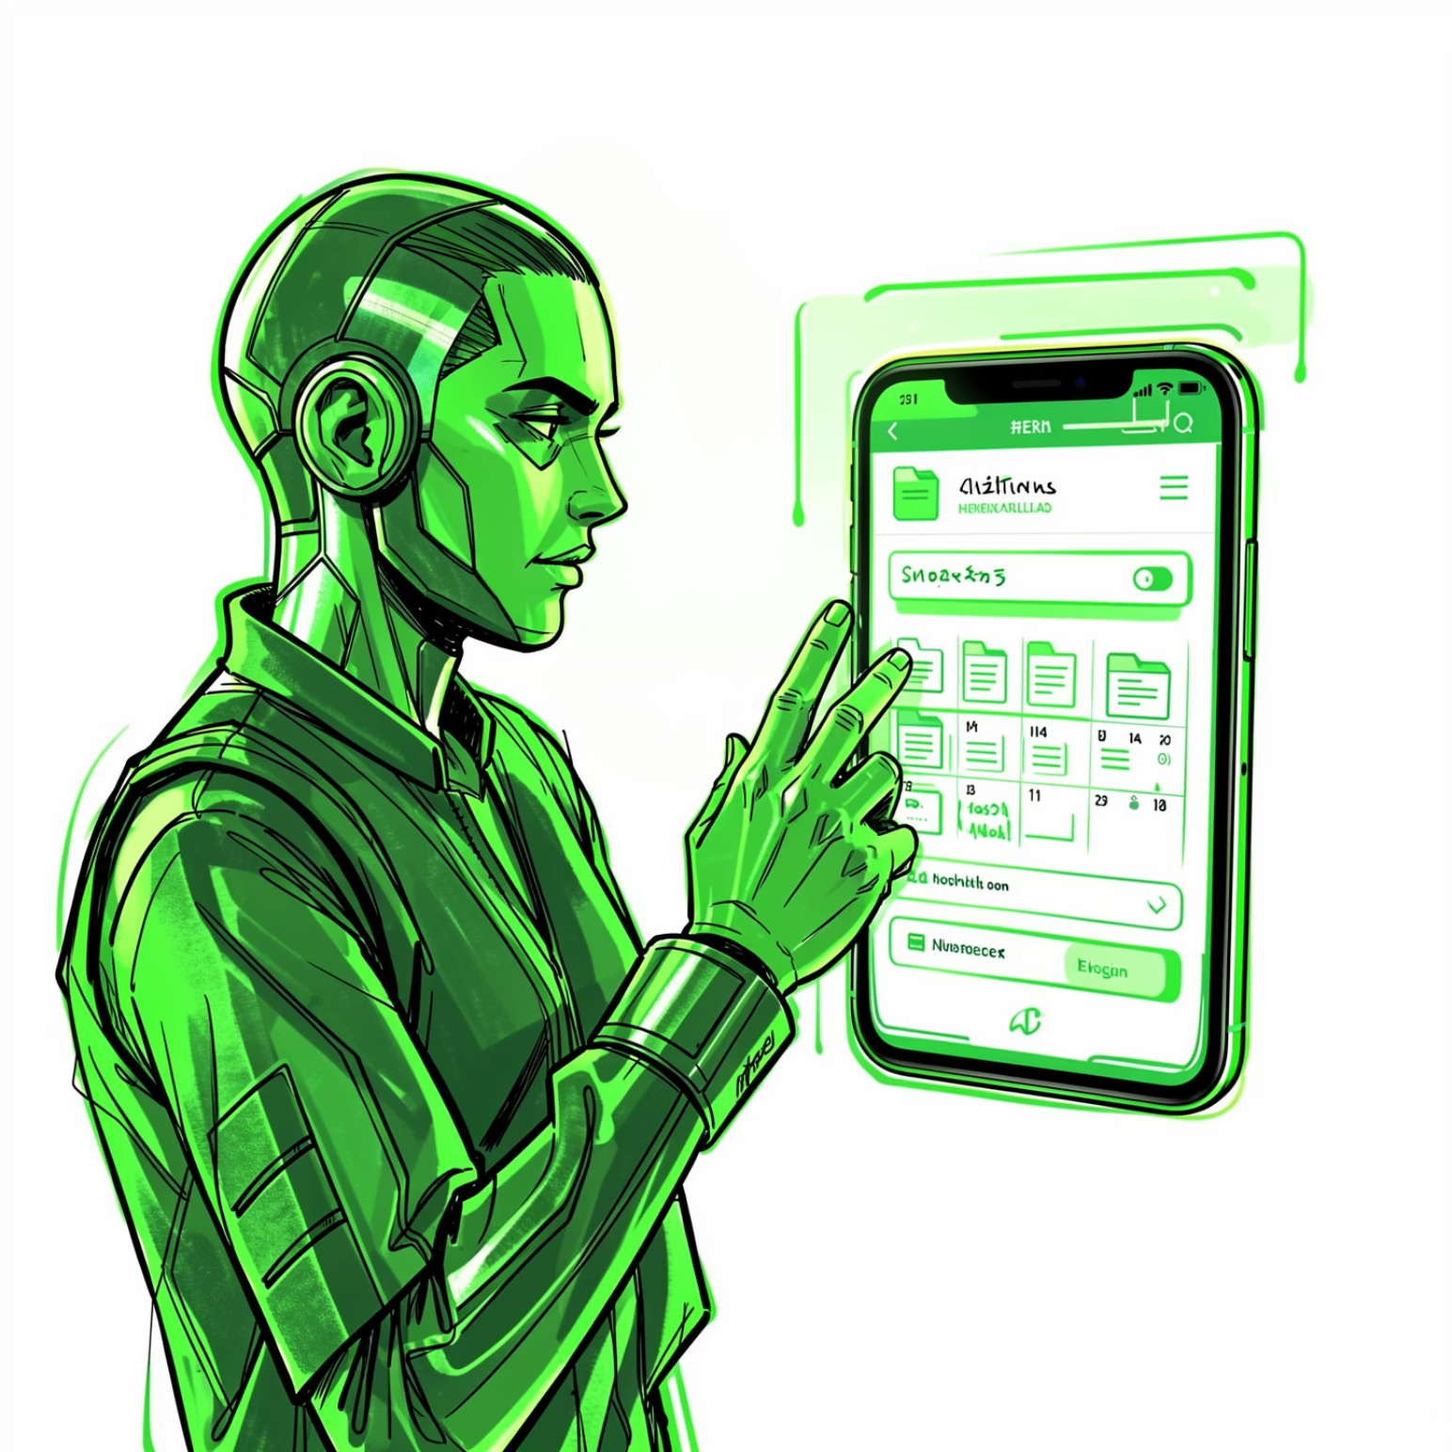
Real-Life Example: Jamie’s Story
"Before Cloud Buddy, I was drowning in papers and digital files. Now, I can access everything, everywhere. It's a game-changer!"
Jamie, a typical student, frequently found it challenging to balance demanding school projects with an active sports schedule.
With Cloud Buddy, Jamie gained the flexibility to access notes, assignments, and study materials on their phone, tablet, or laptop, whether at home, school, or on the go.
This newfound efficiency dramatically reduced time spent searching for documents, saving hours each week.
The result? Improved academic performance, less stress, and more free time to enjoy hobbies and relax.

Slide 8

Our Startup Plan
Prototype Development
1
Build a lean, functional prototype leveraging free cloud credits from Google Cloud or AWS for students.
Community Testing
2
Conduct extensive testing with friends and schoolmates to gather invaluable feedback and refine the user experience.
Phased Launch
3
Initiate with a free basic version to attract a broad user base, progressively introducing premium features for advanced users.
Iterative Improvement
4
Continuously evolve Cloud Buddy based on user analytics and community suggestions to ensure relevance and excellence.

Slide 9
Development Timeline
Project Roadmap
M0
⏱ 9 months · 5 phases
Pre-Dev
M1
1
Pre-Development
1 Month · M0 → M1
Feature definition, UX/UI design and cloud infrastructure setup.
→ Mockups, public roadmap, concept demo
MVP Dev
2
MVP Development
3 Months · M1 → M4
Cloud backend, web/mobile app, file sync, calendar and sharing.
M4
→ MVP (Alpha version)
3
Backer Beta
2 Months · M4 → M6
Beta
Early access for supporters, feedback collection, bug fixing and UX improvements.
→ Stable beta + community engagement
M6
4
Public Launch
Launch
1 Month · M6 → M7
M7
Free version release, digital rewards activation and social launch.
→ Live app + first metrics
5
Post-Launch Growth
Growth
2 Months · M7 → M9
Premium features, cloud cost optimization and sustainability planning.
M9
✅ Total: ~9 Months · 5 Phases · Crowdfunding Ready
→ Sustainable product + growth strategy
Cloud Buddy · Development Roadmap

Slide 10
Crowdfunding Budget
Budget Breakdown
Overview
Target: €15,000
1
Product Development
€9,500
€15,000 total target
63% of total
Product Dev
Software Development
€7,000
€9,500
UX/UI Design
€1,500
63%
Testing & Bug Fixing
€1,000
Cloud Infra
€2,500
17%
2
Cloud Infrastructure
€2,500
Launch
17% of total
€2,500
Cloud Storage & Backend
€1,000
17%
Security & Data Backups
€800
Initial Scalability
€700
3
Crowdfunding & Launch
€2,500
17% of total
Campaign Video & Visuals
€1,200
Platform Fees
€500
Social Media Marketing
€800
💰 Total Target: €14,500 – €15,000 · 100% to product
Cloud Buddy · Crowdfunding Budget Overview

Slide 11

Why We Believe in Cloud Buddy
Youth-Centric Solutions
Future-Proof Technology
Young people crave intuitive, rapid, and dependable tools that seamlessly integrate into their dynamic lives.
Cloud technology is not just a trend; it's the foundational future of digital interaction, making our vision achievable.
Personalised Problem Solving
Our passion stems from addressing real, daily challenges that we, as young individuals, experience firsthand.

Slide 12

Join Us on This Journey!
Be part of a community building the future of digital interaction.

