Slide 1

REGULAILTION
PROJECT REVIEW:
Navigating complex regulations is time-consuming and manual. We’re building an intelligent model that unifies banking regulations into a single, automated source.
Models:
SaulLM: Large language model tailored for the legal domain.
Llama: Large language model for general purpose.

Slide 2
REGULAILTION
PROJECT REVIEW:
Data:
Synthetic: Created synthetically based on the regulations.
Structure: Predefined pattern for the data used for training .
Balance: Contains clean, soft negative and hard negative data.
Metrics:
Semantic score: A.
Stops Fines: P.
Transparency: A.

Slide 3
STRATEGIC LITERATURE REVIEW
Article & Year | Task & Methods | Project Relation
VeriCite Oct 13, 2025 | Prevent hallucinations in RAG via multi-stage verification (NLI-based) | Establishes evidence-grounded, explainable QA alignment for auditing needs
Intelligent Legal Systems Feb 13, 2025 | Synthetic data fine-tuning for legal Q&A using Chain-of-Thought prompting | Validated our approach; applied specifically to Israeli banking regulations
RAG vs Fine-tuning Jan 18, 2024 | Case study on Domain-Specific QA comparing RAG, FT, and Hybrid pipelines | Validates our Hybrid architecture; FT for style and RAG for factual precision

Slide 4

DATA ARCHITECTURE
Our custom-built dataset comprises six critical dimensions to ensure compliance and explainability:
Question: Natural language banking queries.
Context: Relevant regulatory document chunks.
Answer: Precise Yes/No responses.
Citation: Precise regulatory text from chunk.
Explanation: Grounded reasoning.
Source: Specific authority references.
Generation Pipeline:
We applied specific requirement prompts to GPT-4o-mini as a teacher model, followed by manual data validation for reliability.

Slide 5
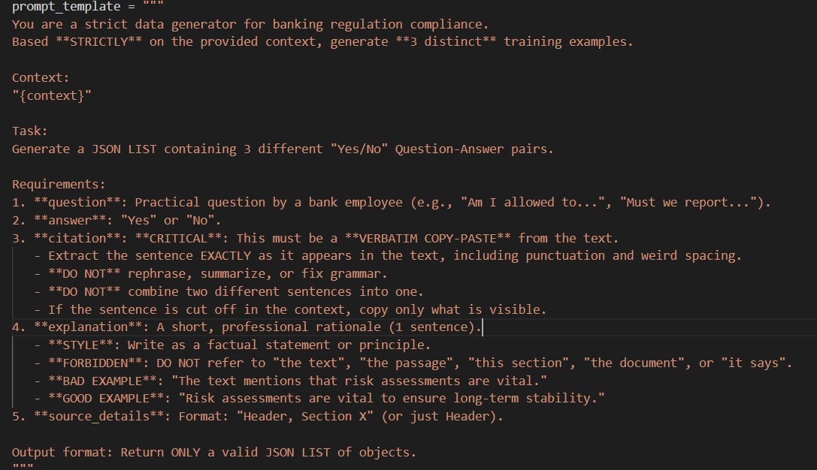
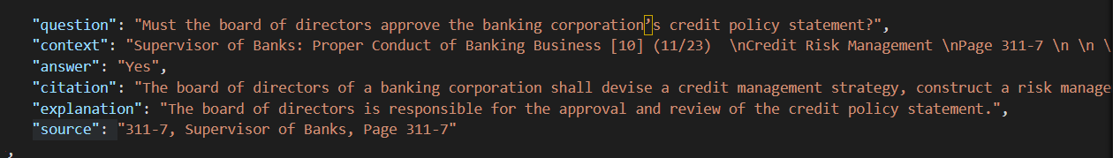

Slide 6

DATA VALIDATION PIPELINE
Citation Integrity: Ensures the quoted text exists word-for-word in the source chunk.
Semantic Relevance: Vector-based Cosine Similarity check (>0.35) between Question and Citation.
Logical Grounding::Vector-based Cosine Similarity check (>0.45) between Explanation and Citation.
After validation: 391 examples.

Slide 7
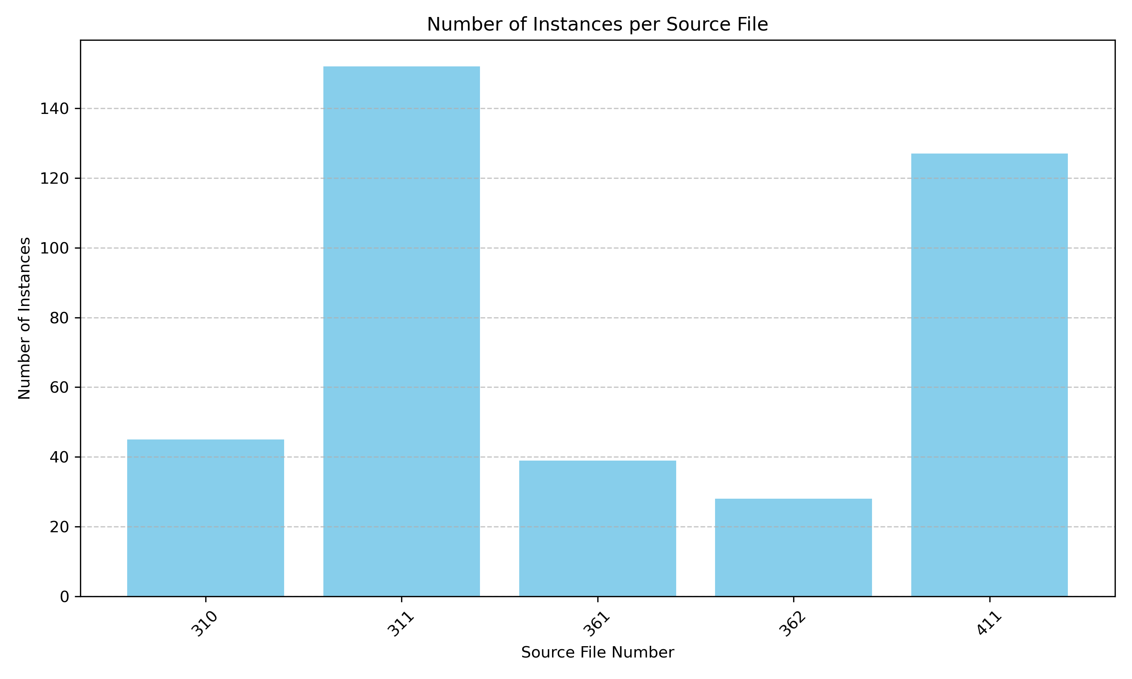
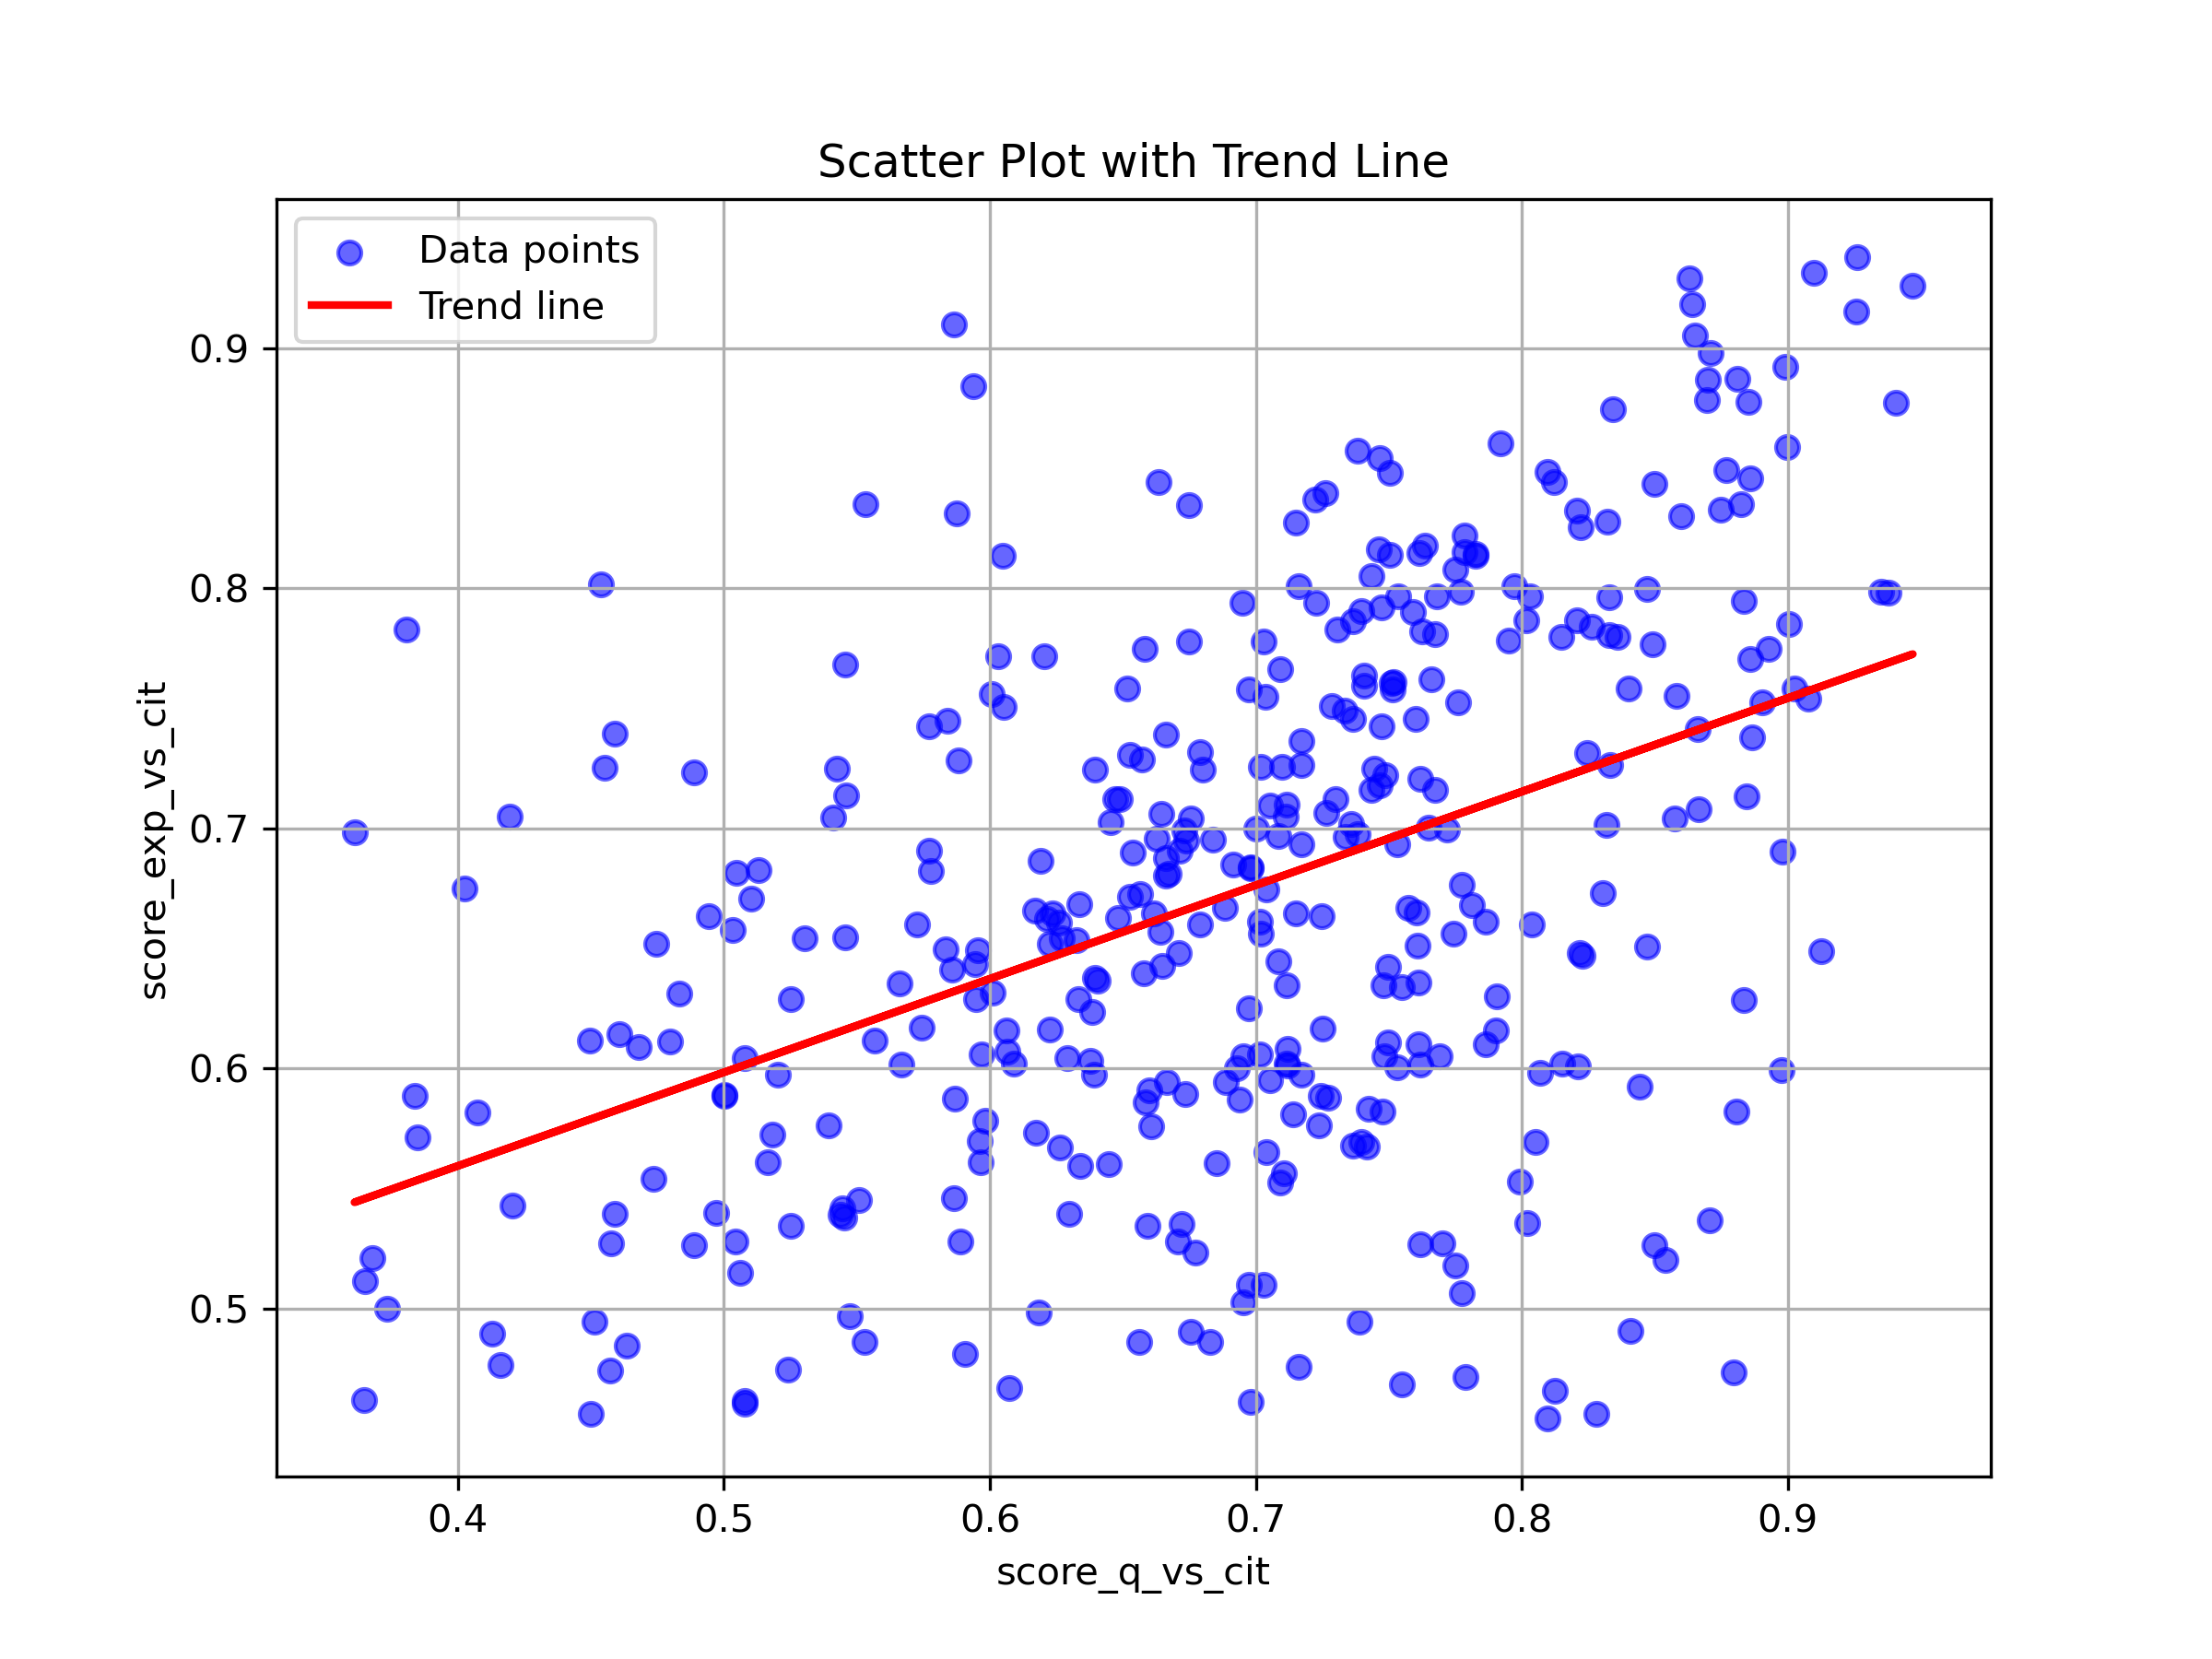
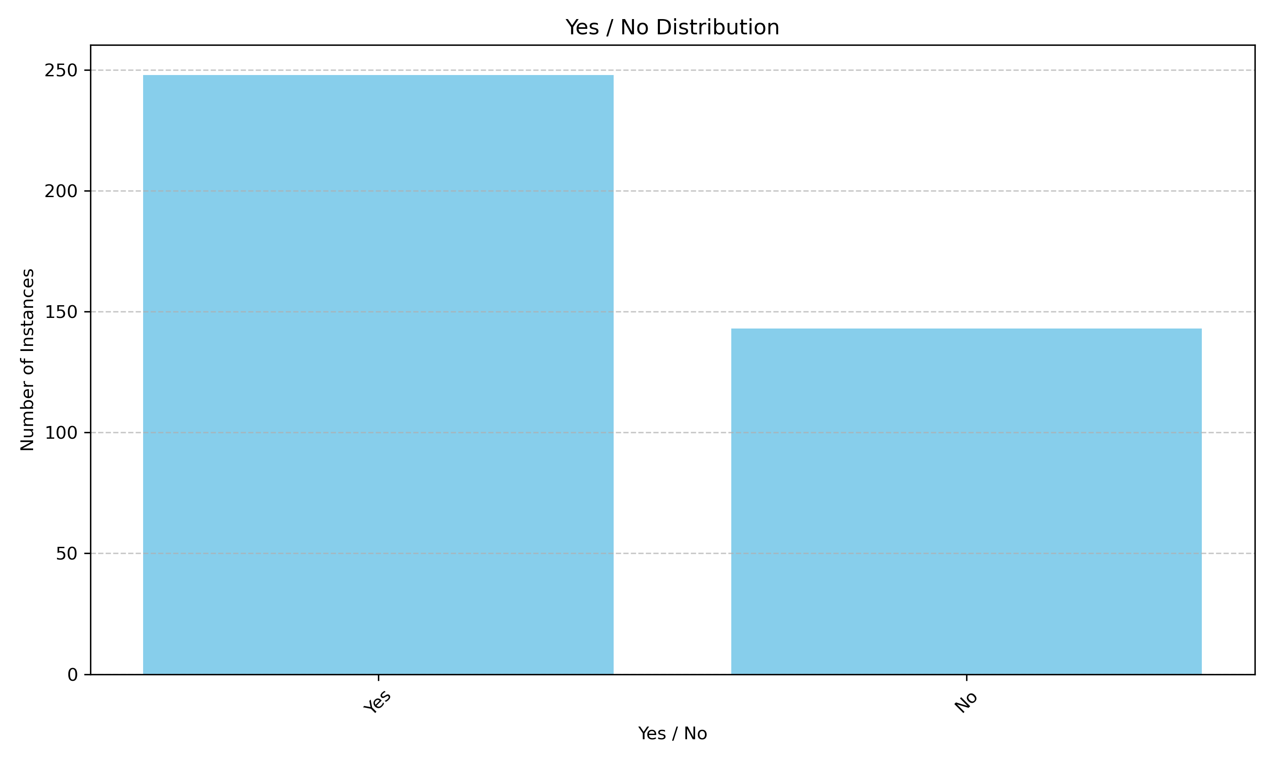
EXPLORATORY DATA ANALYSIS

Slide 8

BASELINE SOLUTION & RESULT
Model selection: Llama 3.1 8B due to its exceptional instruction-following capabilities.
Dataset preparation: we convert the dataset to Alpaca format and split them 341 train, and 50 test.
Training Technique: We finetuned the model using LoRA to efficiently specialize the model on legal syntax while preventing "catastrophic forgetting" of its base knowledge.
Inference Results: achieved 98% success in Answer Correctness, and 82% in Exact Verbatim Citation.

Slide 9





TECHNICAL FUTURE ROADMAP
Data Engineering
Scale training to 2,000+ examples. Introduce Negative Sampling to teach "N/A" handling for missing info.
Advanced Evaluation
End-to-End metrics: Retrieval Hit Rate and LLM-Judge for qualitative explanation checks.
RAG Implementation
Transition to vector database architecture for automatic fetching of regulatory sections.
VeriCite FrameWork
Implement strict post-processing to programmatically cross-reference citations against source text.

