Slide 1

REGULAILTION
PROJECT:
Regulatory texts are lengthy, highly technical, and require strict factual accuracy. General-purpose LLMs often hallucinate and fail to capture legal nuance, making them unreliable for regulatory reasoning.
Goal: accurate, grounded Q&A over banking regulations.
Solution: Domain-aware RAG + FT models.
The Data:
Official Bank of Israel banking & financial regulations.
Synthetic Q&A generation to ensure coverage and consistency.
Questions designed to test precision, grounding, and edge cases.

Slide 2

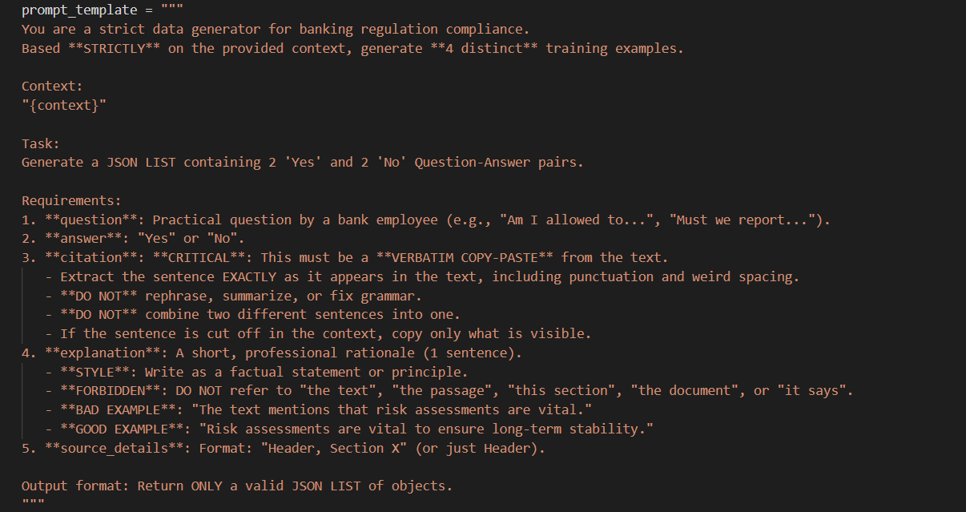
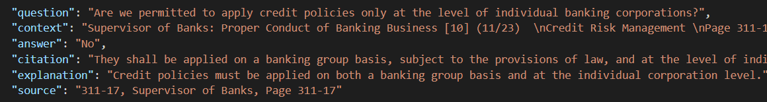
SYNTHETIC DATA GENERATION
THE PROMPT
SAMPLE EXAMPLE

Slide 3
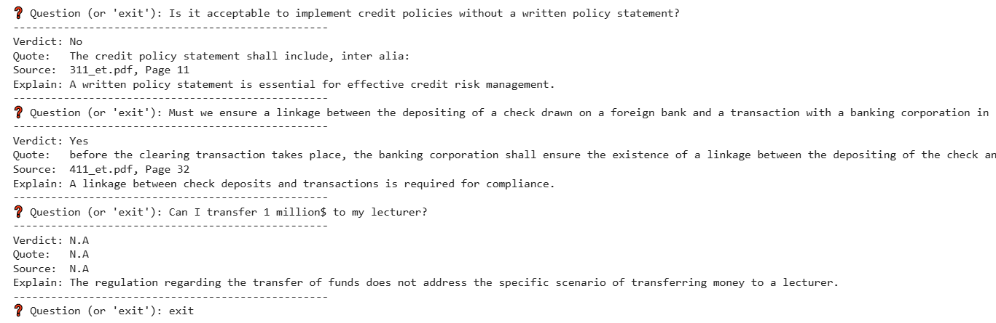
INTERACTIVE INTERFACE

Slide 4



MODELS & METRICS
Models Evaluated:
Metrics Used:
Llama + MiniLM – strong general baseline.
Llama + LegalBERT – domain-aware embeddings.
SaulLM + MiniLM – legal LLM with generic retrieval.
SaulLM + LegalBERT – full legal-domain stack.
Verdict Accuracy – correct regulatory conclusion.
Hit@K – relevant source retrieved in top-K.
Hallucination Rate – percentage of definitive answers provided when the context contains no relevant information.

Slide 5


NOVELTY & ACHIEVEMENTS
Project Novelty:
Project Achievements:
Systematic comparison of legal vs general model stacks in a regulatory RAG setting.
Introduced citation-level evaluation for regulatory correctness.
Combined synthetic legal Q&A generation with real regulatory texts.
Focused on trustworthiness, not just language fluency.
Built a full end-to-end RAG system for regulatory question answering.
Benchmarked general vs legal LLMs and embeddings under identical conditions.
Designed a quantitative evaluation framework beyond generic accuracy.
Improved answer grounding and source alignment in regulatory Q&A.

Slide 6
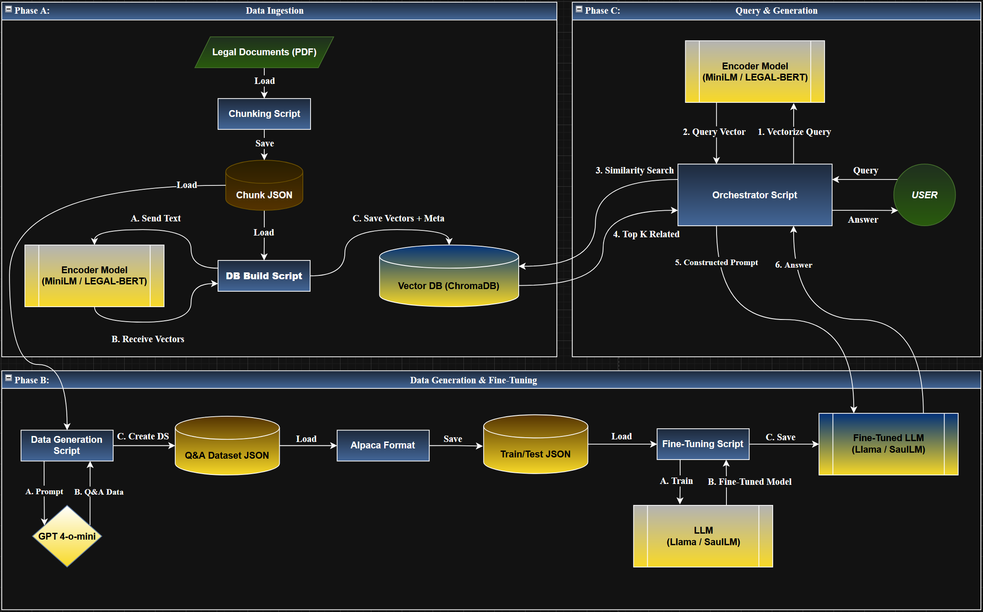
PIPELINE

Slide 7

METHODOLOGY
Part 1
Fine Tuning:
Updating the model itself to optimize it for the task.
Domain Specialization:- Enhanced the model’s regulatory expertise
Robustness to Negatives - Trained the model on hard and soft negative samples to improve its ability to identify irrelevant information and avoid false positives.
Structured Output Optimization: Fine-tuned the model to ensure consistent and valid JSON formatting
Model Selection: Evaluated and compared Llama 3.1 and Saul-7B (pre-trained on the legal domain).
Dataset Construction: Compiled a dataset of 2,000+ examples, including 15-20% negative samples to enhance robustness and prevent hallucinations.
FT KPI’S:

Slide 8
FINE-TUNNING INPUT & OUTPUT
ALPACA FORMAT INPUT (TRAIN)
OUTPUT EXAMPLE (INFERENCE)

Slide 9
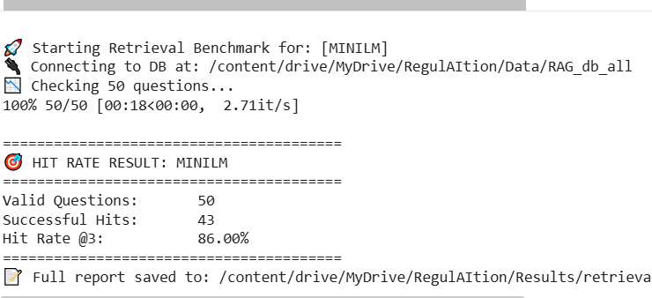
METHODOLOGY
Part 2
RAG:
Vector Database: Engineered a vector database using ChromaDB, consisting of 518 text chunks extracted from official regulations.
Embedding Model: Compared all-MiniLM and LegalBERT to determine the most effective embedding model for banking and legal terminology.
Retrieval Evaluation: Measured Hit@K (HitRate)
Providing the model with external data to ensure
factual accuracy.
Context Injection: Supplies relevant regulatory text for every query.
Evidence-Based: Grounds all answers in official sources (B.O.I) to eliminate hallucinations.
Dynamic Knowledge: Accesses the latest documents without the need for retraining.

Slide 10
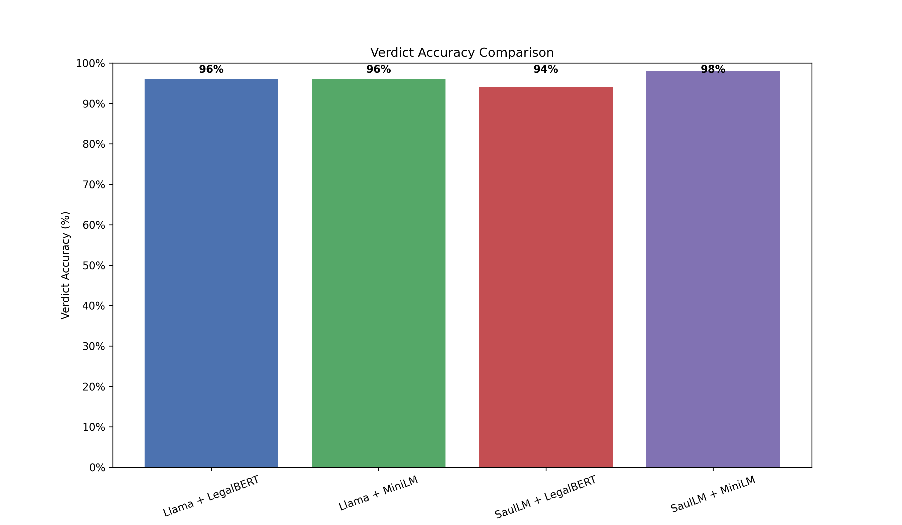
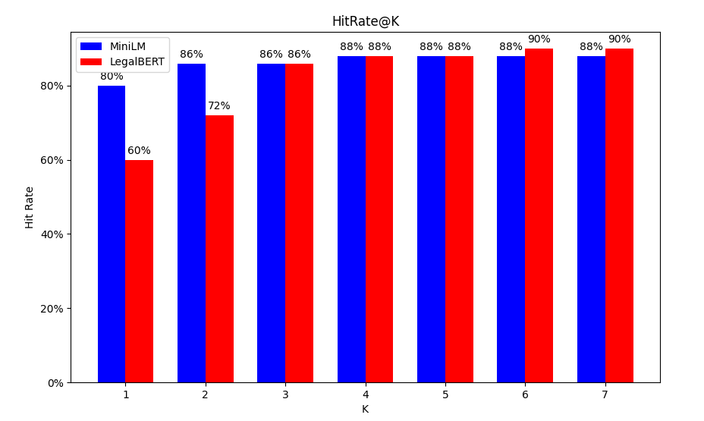
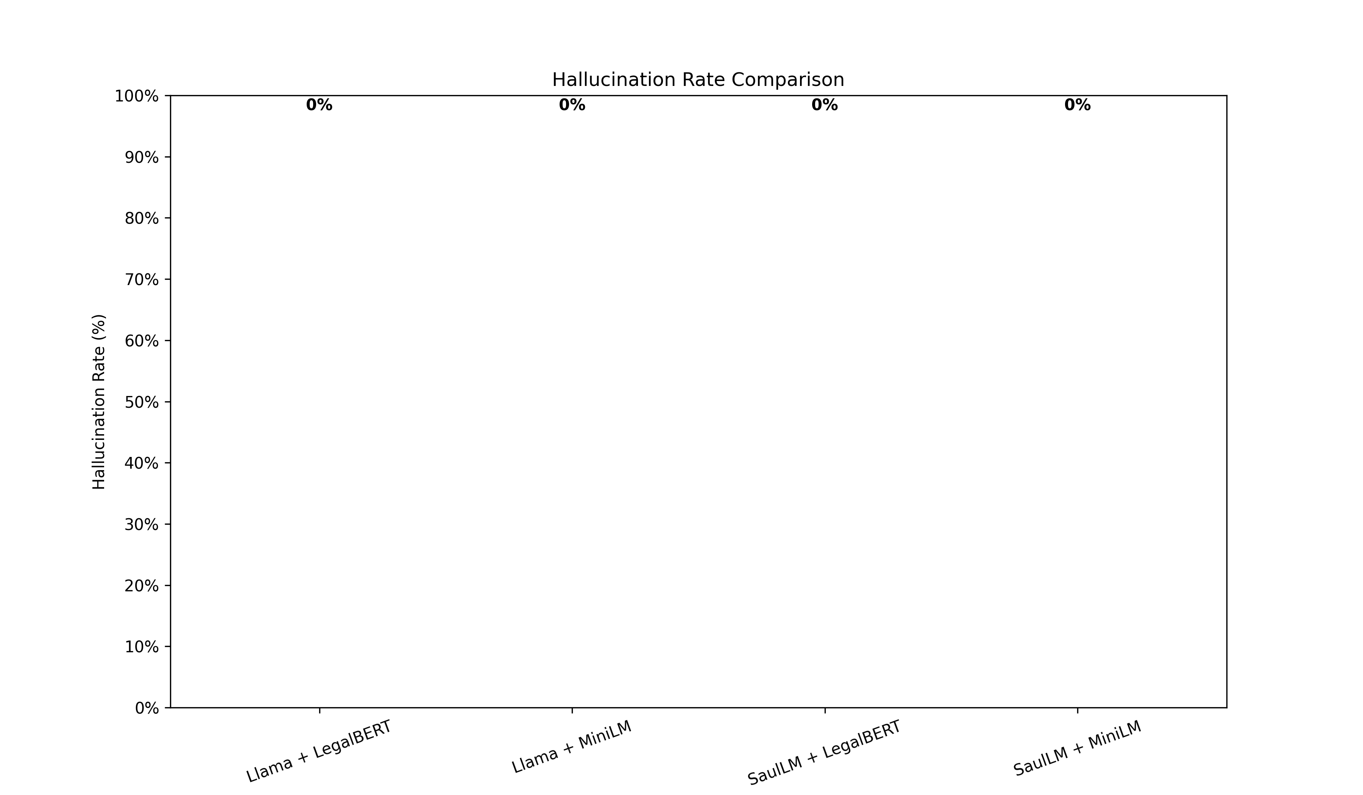
RESULTS

Slide 11
CONCLUSION
Looks Good… But Can Be Better:
Minor hallucinations are still present.
The model identifies the correct chunk in most cases, but consistency is not guaranteed.
In a high-stakes domain like this, even small errors are unacceptable.
Things We (Painfully) Learned:
Each model comes with its own pros and cons.
Hallucination handling needs to be significantly stricter.
A diverse set of KPIs is needed to properly evaluate model quality.
Where Do We Go From Here?
Experiment with additional models and architectures.
Introduce more rigorous validation and consistency checks in the RAG pipeline.
Add a faithfulness metric using an LLM judge to verify citation-explanation alignment.

